Slide 1
KIDNEY disease

Slide 2
From last class
Patient is a 60 years old male who comes to the ER complaining of chest pain. Tests show that he has suffered an MI. The RD is consulted for pt education. patient reports that he has gained 15 kg in the previous year
His work schedule causes him to eat out often. In addition, he is physically inactive. AB also reports that he has a family history of CHD
Diet Recall:
Breakfast : egg, cheese & sausage sandwich
Coffee & 4 creamers 2 sugar
Lunch: turkey& cheese on white bread w mayo
iced tea, sweetened 21 oz
Medium potato chip bag
Dinner : fried chicken breast
Mashed potatoes with gravy
Corn with butter
Cheesecake
2 cans of soda
HT: 175 cm
WT: 86 kg
Waist Circ: 105cm
BP: 140/93
Chol: 259
LDL: 180
HDL: 58
TG: 234

Slide 3
Counsel patient on:
Decreasing saturated fats
Replacing saturated fats with MUFA & PUFA
Overall improvements to his diet:
?
?

Slide 4
2nd question TLC calculations
Carbohydrate (50 – 60%):
2850 x 0.50 = 1425 kcals
1425 kcals/ (4 kcals/g) ≈ 356 grams
2850 x 0.60 = 1710 kcals
1710 kcals/ (4 kcals/g) ≈ 428 grams
Rec intake: 356 – 428 grams
Saturated Fat (<7%):
2850 x 0.07 = 199.5 kcals
199.5 kcals/ (9 kcals/g) = 22 grams
Rec intake: <22 grams
Polyunsaturated Fat (<10%):
2850 x 0.10 = 285 kcals
285 kcals/ (9 kcals/g) = 31.66 ≈ 32 grams

Slide 5
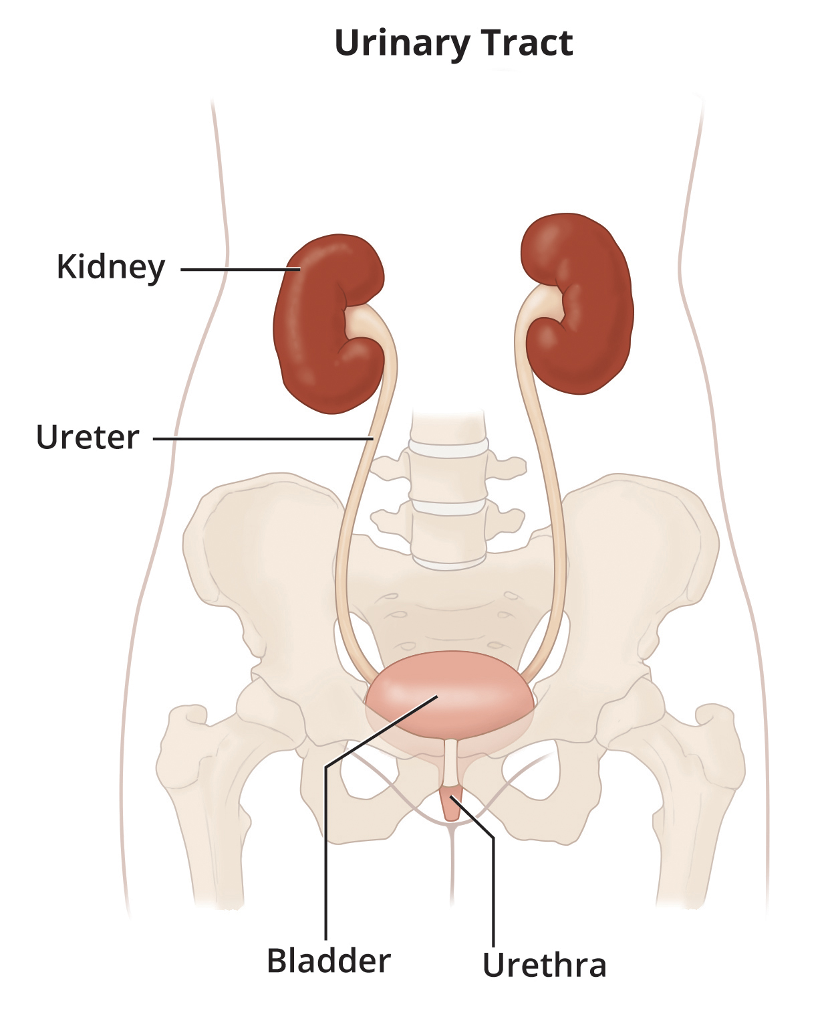
INTRODUCTION
The two kidneys sit just above the waist on each side of the spinal column.
Part of the urinary system
Function: filter blood and remove excess fluid and wastes for elimination in urine
The urinary system consists of
2 kidneys
2 Ureter
Bladder
Urethra
https://www.niddk.nih.gov/health-information/urologic-diseases/urinary-tract-how-it-works

Slide 6
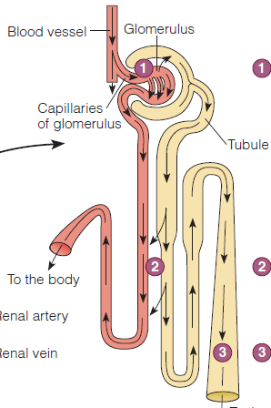
INTRODUCTION
Nephron
Each kidney contains a million nephron
Functions of the Kidneys
functional unit of the kidneys is the nephron
The nephron contains ,the glomerulus(a ball-shaped cluster of capillaries)
blood flows through the glomerulus to allow smaller molecules (wastes, fluid—mostly water)to pass into the tubule
Blood cells and plasma proteins are retained in the blood
filtrate passes through the tubules
Eventually, the remaining filtrate enters a collecting duct shared by several nephrons, and additional water is reabsorbed to form the final urine product

Slide 7
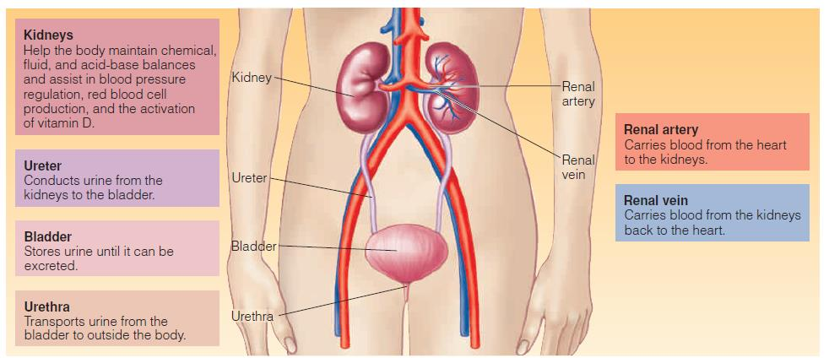
INTRODUCTION

Slide 8
Kidney function
Filtering the blood and forming urine
The kidneys regulate the extracellular fluid
By regulating osmolarity , electrolyte concentrations, and acid-base balance
Excretion of metabolic waste products such as urea and creatinine, as well as various drugs and toxicants.
Regulation blood pressure by secreting the enzyme renin. Renin catalyzes the formation of angiotensin I from the plasma protein angiotensinogen
The kidneys produce the hormone erythropoietin, which stimulates the production of red blood cells in the bone marrow
The kidneys convert vitamin D to its active form

Slide 9
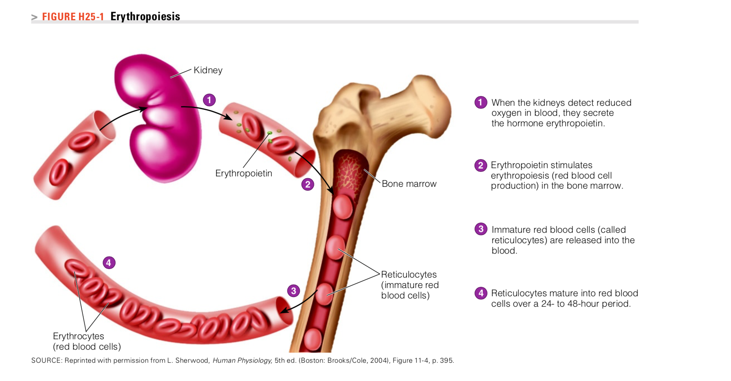
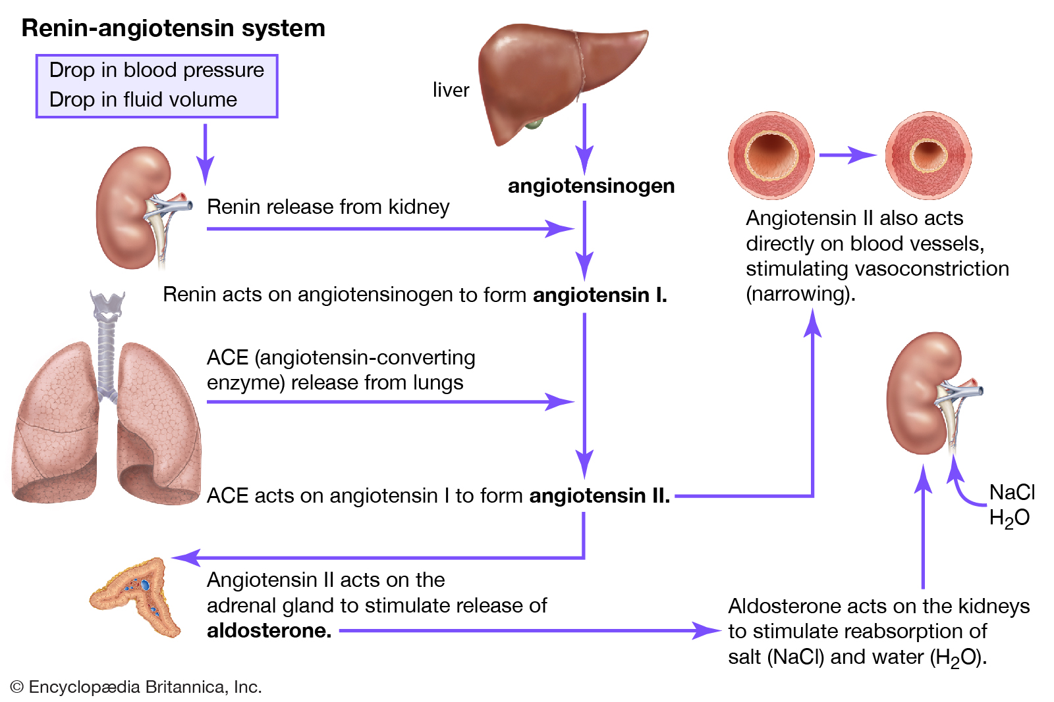
Kidney as a 2º Endocrine gland

Slide 10
The Nephrotic Syndrome
A syndrome caused by significant urinary protein losses (proteinuria)
Occurs because of glomeruli damage
Glomeruli damage increases permeability to plasma proteins, allowing the proteins to escape into the urine
Loss of plasma proteins may cause
Edema
Blood lipid abnormalities
Blood coagulation disorders
Infections
Renal failure

Slide 11
The Nephrotic Syndrome
Causes:
Diabetic nephropathy
Hereditary diseases
Infections
Chemical damage
Some cancers
Large proteins that do not get filtered by the glomerulus and pass into tubule = proteinuria

Slide 12
Consequences of the Nephrotic Syndrome
Albumin is the most abundant plasma protein. In Hypoalbuminemia -> fluid shift from blood plasma to the interstitial space → Edema
Sodium and water retention -> Edema
Blood clotting risk is increased because of urinary losses of proteins that inhibit blood clotting and elevated levels of plasma proteins that favor clotting→ Increased risk of atherosclerosis. Additionally, individuals with nephrotic symptom frequently have high LDL and VLDL
Loss of immunoglobulins (antibodies) in urine→ increase susceptibility to infection
Loss of vitamin D–binding protein results in lower vitamin D and calcium levels → increases the risk of rickets in children
In severe proteinuria, protein-energy malnutrition (PEM) and muscle wasting may develop

Slide 13
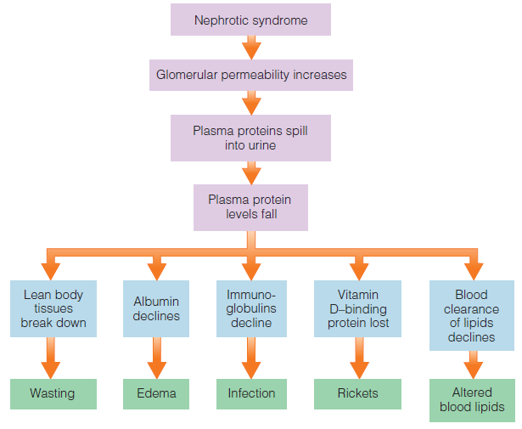

Slide 14
Treatment of the Nephrotic Syndrome
Diagnosis and management of the underlying disorder responsible for the proteinuria
The drugs prescribed will attempt to reduce protein losses, lipid-lowering drugs, anti-inflammatory drugs and immunosuppressants and diuretics ( to alleviate Edema)
Nutrition therapy:
Prevent PEM
Alleviate edema
Correct lipid abnormalities
High protein diets????

Slide 15
mnt
Protein and Energy
Goal: minimize losses of muscle tissue
High protein diets not advised (intraglomerular pressure and glomeruli hyperfiltration, more damage to the glomeruli )
Protein intake should fall between 0.8 and 1.0 gram per kilogram of body weight per day
At least half of the protein should come from high quality sources: milk products, meat, fish, poultry, eggs, and soy products
An adequate energy intake (up to 35 calories per kilogram of body weight daily) sustains weight and spares protein
Sodium and Potassium
Sodium intake may be limited to 1000 to 2000 milligrams (1 to 2 grams) daily + Potassium rich foods

Slide 16
mnt
Lipids
A diet low in saturated fat, trans fats, and refined sugars
lipid-lowering medications sometimes prescribed
Vitamins and Minerals
Avoid/ correct nutrient deficiencies
Iron ( why would iron deficiency occur ?)
Vitamin D
Calcium supplementation (to reduce risk of bone loss)
Multivitamin

Slide 17
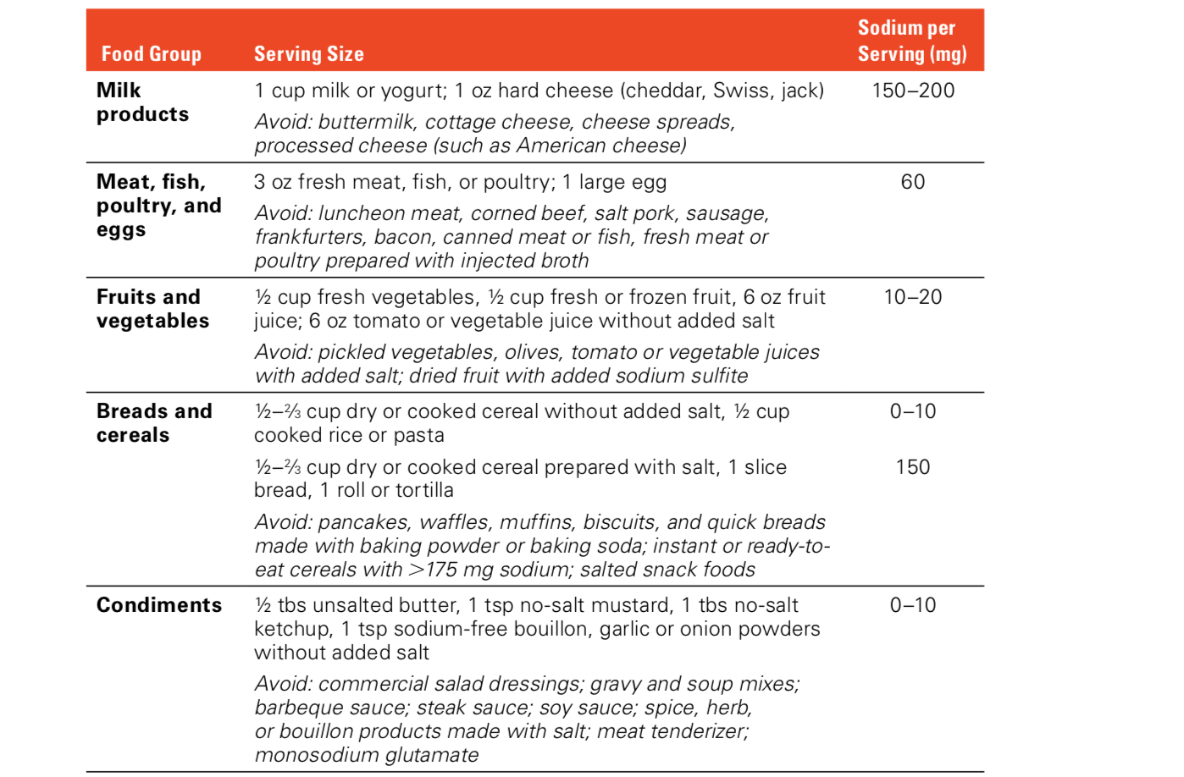
Low-Sodium Diet
Low-Sodium Diet
About 75 percent of the sodium in a typical diet comes from processed foods, about 10 percent from unprocessed natural foods, and about 15 percent from table salt
Sodium in foods

Slide 18
Acute Kidney Injury
A rapid deterioration in kidney function, over hours or days. This leads to
Reduction in urine output
Build up of nitrogenous wastes in the blood
With prompt treatment, acute kidney injury is often reversible, although mortality rates are high, ranging from 36 to 86 percent.
Serum creatinine increases

Slide 19
Causes
Often develops as a consequence of critical illness, sepsis, or major surgery
To aid in diagnosis and treatment
Classified as
Prerenal: conditions that cause a severe reduction in blood flow to the kidneys, such as heart failure, shock, or substantial blood loss, severe dehydration, burns
Intrarenal: Factors that damage kidney tissue, such as infections, toxicants, drugs, chemotherapy, systemic inflammatory conditions such as sepsis
Postrenal: Factors that prevent urine excretion due to urinary tract obstructions/ blockage of the ureter or neck of the bladder
Example: blood clots, tumors, kidney stones

Slide 20
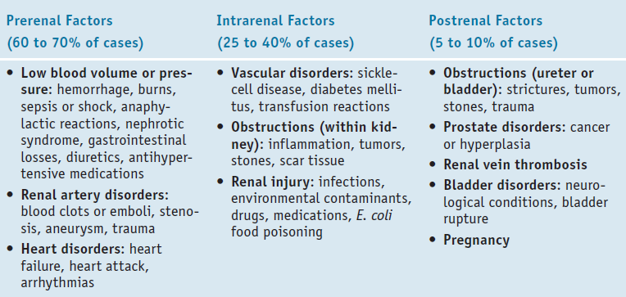

Slide 21
Consequences of Acute Kidney Injury
A decline in renal function
Alteration in composition of blood and urine
The kidneys become unable to regulate the levels of electrolytes, acid, and nitrogenous wastes in the blood
Reduction in urine output→ Oliguria
Rise in serum creatinine levels ( creatinine is waste product of protein metabolism in muscles)
Uremia: nitrogen-containing compounds and various other waste products may accumulate in the blood
Uremic syndrome: a cluster of symptoms caused by impairments in multiple body systems. (hormonal imbalances, electrolyte and acid-base imbalances, disturbed heart and gastrointestinal functioning, neuromuscular disturbances, and depressed immunity, among other conditions)

Slide 22
consequences OF aki
Normal urine output = 1-1.5 Liter per day
In AKI patients, urine production may decrease to less than 500 ml/day
Electrolyte imbalances: The reduced excretion of fluids and electrolytes generally results in
Sodium retention
Elevated levels of potassium (hyperkalemia) potassium imbalances can alter heart rhythm and result in heart failure
Elevated Phosphate levels (hyperphosphatemia) promote excessive secretion of parathyroid hormone, which leads to losses of bone calcium
Magnesium Imbalances in the blood ( reduced levels)
Edema is a common symptom of acute kidney injury and may be apparent as puffiness in the face and hands and swelling of the feet and ankles
Blood urea nitro- gen (BUN) and creatinine are elevated in AKI,
Reduced GFR

Slide 23
Treatment of aki
Goal: restore fluid and electrolyte balances and minimize blood concentrations of toxic waste products
Treatment involves a combination of:
Drug therapy (dosage?(kidney function is required for drug excretion)
Nephrotoxic drugs? (antibiotics and nonsteroidal anti-inflammatory drugs) must be avoided until kidney function improves)
If hyperkalemia→potassium-exchange resins that bind potassium in the GI tract and reduce its ab- sorption
Insulin, bicarbonate ( For acidosis if present)
Diuretics ( Edema)
Phosphate binders may be provided with meals to prevent phosphorus absorption
Dialysis
Nutrition therapy
Individualized treatment
Notes:
Rapid correction of hyperkalemia may require the use of insulin, which drives extracellular potassium into cells

Slide 24
MNT
Energy and Protein
Acute kidney injury is often associated with other critical illnesses, so patients may be hypermetabolic, catabolic, and at high risk of wasting.
Hyperglycemia and hypertriglyceridemia MAY be present
20 -35 cal/kg BW/day
Continuous monitoring of body weight, nitrogen balance, blood glucose levels, and blood triglycerides are monitored
non catabolic w/o dialysis
protein intakes should be limited to 0.8 to 1.0 g/kg BW/day
If improvement in kidney function and patient is undergoing catabolism or dialysis: 1.0-1.7 g/kg BW/day
Additional needs? Dialysis is required to accommodate additional nitrogen load.
Notes:
patients must ingest sufficient protein and energy to preserve muscle mass but should not be overfed.

Slide 25
MNT
Fluids
Fluid balance must be restored in patients who are either overhydrated or de- hydrated
Fluid needs can be estimated by measuring urine output and adding about 400 to 500 milliliters to account for the water lost from skin, lungs, and perspiration.
Fever, vomiting, or diarrhea requires additional f
Patients undergoing dialysis can ingest fluids more freely

Slide 26
mnt
Serum electrolyte levels are monitored closely to determine appropriate electrolyte intakes
Restrictions may be necessary for
Potassium (2000 to 3000 milligrams per day)
phosphorus (8 to 15 milligrams per kilogram body weight per day)
Sodium (2000 to 3000 milligrams per day)
With dialysis , more liberal intakes
W/ and if Diuresis occurs at the beginning of treatment , must give more electrolytes to compensate for urinary losses

Slide 27
mnt
Nutrition Support
Some patients need nutrition support to obtain adequate energy
Enteral support (tube feeding) is preferred over parenteral nutrition
Some formulas designed for patients with acute kidney injury are more calorically dense and have either higher or lower concentrations of proteins and electrolytes than standard formulas

Slide 28
Chronic Kidney Disease
Gradual, irreversible deterioration-progressive loss of kidney function occurs
Progress for many years without causing symptoms
Not reversible but can be slowed or stopped
Progression to CKD stage 5
Renal replacement therapy or transplant
Requires medication and specialized diet
The most common causes of chronic kidney disease are diabetes mellitus and hypertension

Slide 29
Consequences of Chronic Kidney Disease
In the early stages: nephrons enlarge
Overload with work -> damage→ kidney failure
End-stage renal disease requires either
Dialysis
Kidney transplant

Slide 30
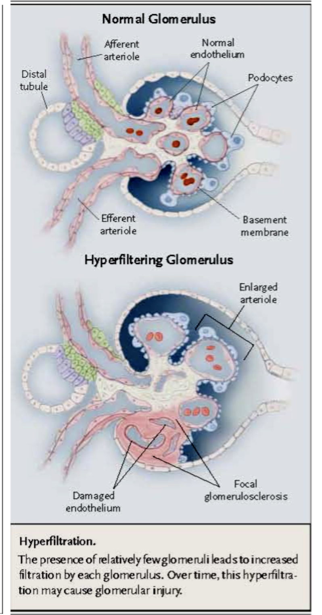
Hyperfiltration damages the glomerulus over time; it’s “working too hard”
Accumulation of AGEs leads to progressive alteration in renal architecture and loss of renal function
Notes:
Advanced glycation end-products,

Slide 31
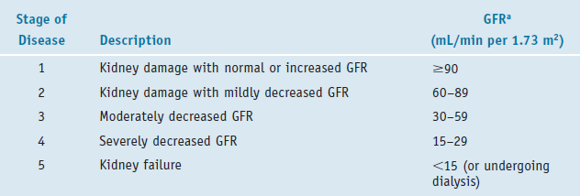
GFR
Glomerular filtration rate (GFR), the rate at which the kidneys form filtrate.
measure the rate at which substances are cleared from the plasma by the glomeruli.
Used to evaluate CKD along with Albuminuria
Albuminuria, the amount of albumin lost in urine daily.
microalbuminuria is common (one of the first signs of renal insufficiency)

Slide 32
Dialysis
Removal of excessive and toxic by- products of metabolism from the blood, replacing the filtering function of the kidney
Fluid and electrolyte balance must be maintained
Passing blood across selective membrane exposed to rinsing fluid (dialysate)
Two types
Hemodialysis (HD), or peritoneal dialysis (PD)
https://www.youtube.com/watch?v=IQKQ4eoKfTg

Slide 33
Hemodialysis
Artificial kidney
the blood is circulated through a dialyzer (artificial kidney/filter), where it is bathed by a dialysate, a solution that selectively removes fluid and wastes.
Typical regimen
3 days/week for 4 hrs./ treatment
Treatments done at a center
High protein requirement (1.2 g/kg/d) ( Amino acids lost in HD)
Risk of Inflammation : contact of blood with foreign surfaces
Hypotension can develop while blood is circulated through the dialyzer. Muscle cramping often occurs during the procedure, especially in the hands, legs, and feet
If patient is anemic, blood loss can worsen anemia

Slide 34
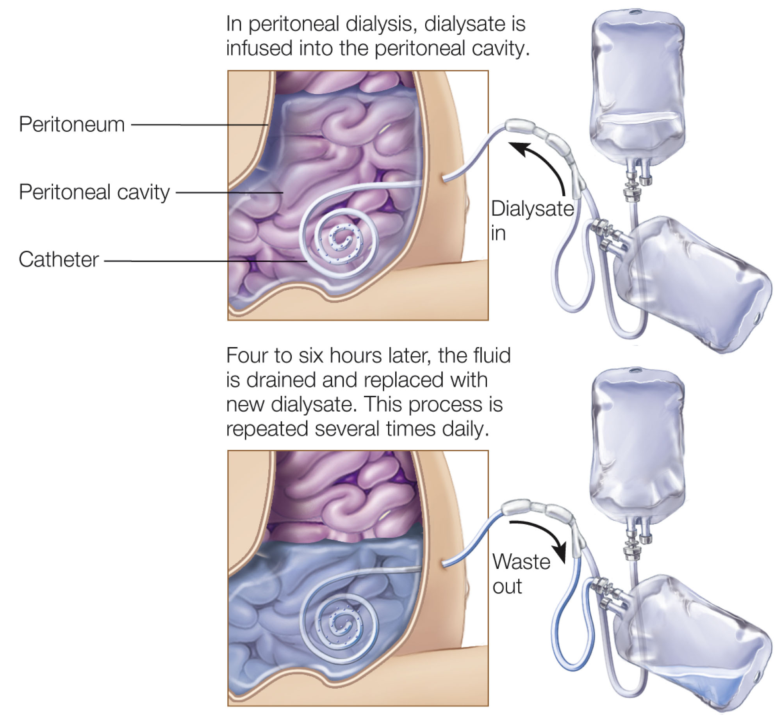
Peritoneal dialysis (PD)
In peritoneal dialysis, the peritoneal membrane surrounding the abdominal organs serves as a semipermeable membrane
Lining of patient’s peritoneal wall is the selective membrane ( pores in peritoneal wall allow passage of certain substances)
The dialysate is infused into a person’s peritoneal cavity, and blood is filtered by the peritoneum (the membrane surrounding the abdominal cavity). After several hours, the dialysate is drained, removing unneeded fluid and wastes
Access via catheter into peritoneal cavity
The dialysate remains in the peritoneal cavity for 4 to 6 hours, after which it is drained and replaced with fresh dialysate (about 2 to 3 liters in adults). Generally, the dialysate solution is exchanged four times daily
The dwell time (i.e., how long the dialysate remains in the peritoneum) and the number of exchanges (i.e., how many bags of dialysate and the total volume of each used in 24 hours)

Slide 35
Dialysis solution: a mixture of dextrose (sugar), salt, and other minerals dissolved in water
In PD, waste products and extra body fluid pass from the blood into the dialysis solution through the peritoneal membrane
Solution is drained from the abdomen.
Range of dextrose concentrations to alter osmolality and assist fluid removal
To estimate Cal needs in PD: have to account for glucose absorbed from dialysate
In CAPD (continuous ambulatory peritoneal dialysis )approximately 60-76% is absorbed
In CCPD(Continuous cycler-assisted peritoneal dialysis) approximately 40-50% is absorbed
Academy of Nutrition & Dietetics, 2013

Slide 36
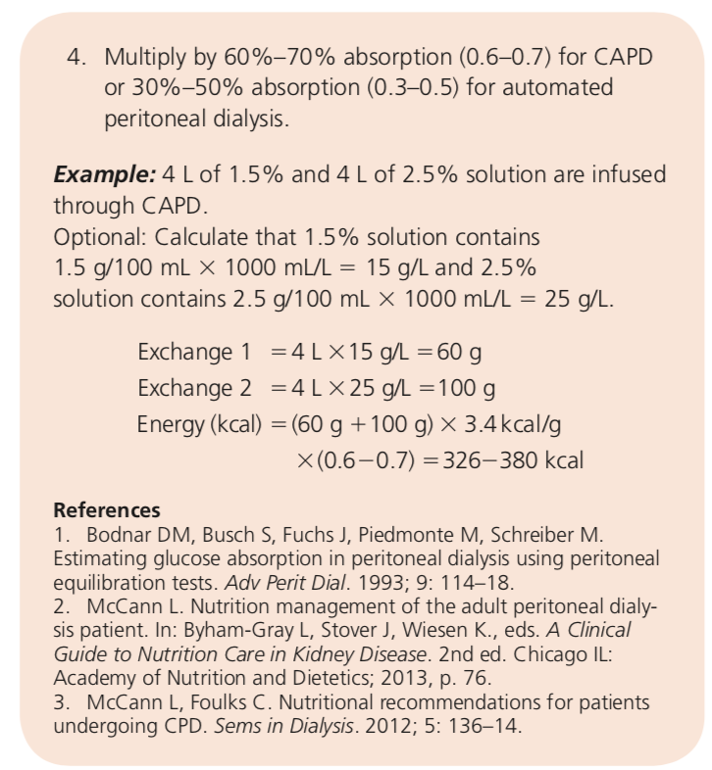
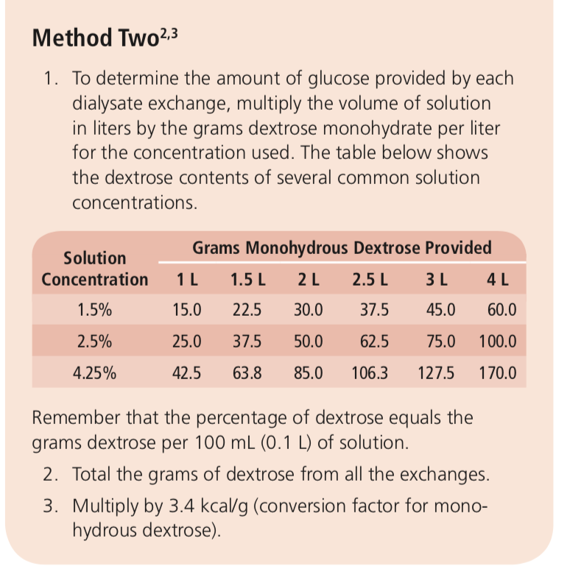
Calculation of Glucose Absorbed
in Peritoneal Dialysis (PD) Patients

Slide 37
Consequences OF ckd
Fluid and electrolyte imbalances may not develop until the third or fourth stage of CKD
Electrolyte imbalances are likely when the GFR is very low ( Hormonal adaptation is inadequate, for example aldosterone and parathyroid help regulate serum potassium levels)
Mild acidosis
Uremic Syndrome ( high levels of urea in the blood)
Hormonal imbalances: Less vit D and EPO
Altered heart function/increased heart disease risk: Fluid and electrolyte imbalances result in hypertension, arrhythmias, and eventual heart muscle enlargement
Neuromuscular disturbances (muscle cramping, tremor, and seizures
Other effects: Defects in platelet function and clotting factors prolong bleeding time and contribute to bruising, GI bleeding, and anemia.

Slide 38
Clinical Effects
Early stages: Anorexia, Exercise intolerance, Fatigue, Headache, Hypertension, Proteinuria, (blood in urine)
Advanced stages:
Anemia, bleeding tendency, Cardiovascular disease, Electrolyte imbalances, Fluid retention, edema, Hormonal abnormalities, Itching, Metabolic acidosis, Nausea and vomiting, Peripheral neuropathy, Protein-energy malnutrition, Reduced immunity, Renal osteodystrophy ( bone and mineral density disorders)
Notes:
CKD leads to a down regulation of lipoprotein lipase and the LDL-receptor, and increased triglycerides in CKD are due to delayed catabolism of triglyceride rich lipoproteins, with no differences in production rate

Slide 39
Laboratory Values
Potassium: 3.5-5.1 mEq/L
Sodium: 135-145 mEq/L
Phosphate: 3.0-4.5 mg/dL (1.0-1.5 mmol/L)
Creatinine (serum): 0.6-1.2 mg/dL
Urea nitrogen (BUN)(End product of protein metabolism converted in the liver to form urea) (plasma or serum): 8-23 mg/dL
TMCE, 2017

Slide 40
CKD Treatment
Treat underlying disease, delay progression
Type 2 diabetes: glucose control
Treat hypertension: ACE inhibitors
Avoid nephrotoxins
Reduce proteinuria
Phosphate binders (taken with food) → reduce serum phosphorus levels
sodium bicarbonate reverse acidosis
Calcitriol → helps regulate serum calcium and reduce parathyroid hormone levels.
Supplements to bypass loss of kidney functions
EPO replacement
vit. D supplementation
Anemia
due to low Hgb from inadequate endogenous erythropoietin (EPO)

Slide 41
MNT
Based on CKD Stages • Complications common:
Malnutrition
CVD
Bone and mineral disorders
Anemia
Many patients have comorbidities
Diabetes
Hypertension
Additionally, CKD increases risk of CVD
Heart failure, atherosclerosis
Vascular calcification

Slide 42
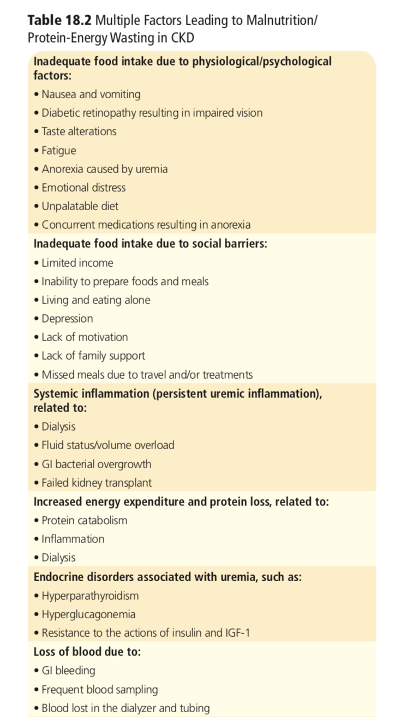
Signs and symptoms of malnutrition present themselves when the GFR declines to 30 mL/minute, and may progress to significant malnutrition at a GFR of 10 mL/minute.

Slide 43
Nutrition Intervention
Stages1&2
Focus on comorbid conditions
diabetes, HTN, hyperlipidemia, progression of CVD
Stages3&4
Adequate protein to maintain muscle mass and serum protein
Adequate kcal to prevent malnutrition
Treat abnormal nutrient status:
Na,K,P,Ca, fluids, vitamins
Normalize blood lipids
Stage 5 (i.e. renal failure, on dialysis):
Protein requirement now HIGHER because of loss of AA in dialysate

Slide 44
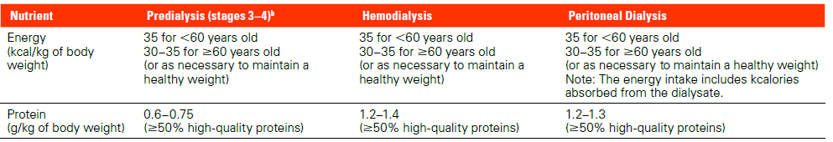
MNT
The patient’s diet strongly influences disease progression, the development of complications, and serum levels of nitrogenous wastes and electrolytes.
Energy & Protein

Slide 45
MNT
Individuals at risk of PEM and wasting should consume foods with high energy density
The calories from glucose from peritoneal dialysis should be included
Weight gain is sometimes a problem when peritoneal dialysis continues for a long period
Protein
A moderate protein restriction may be prescribed to slow disease progression and reduce nitrogenous wastes.
low-protein diets supply less phosphorus than high-protein diets, reducing the risk of hyperphosphatemia.
however, diet must provide enough protein to meet needs and prevent wasting. During the later stages of kidney disease, the recommended protein intake is 0.6 to 0.75 grams per kilogram of body weight per day

Slide 46
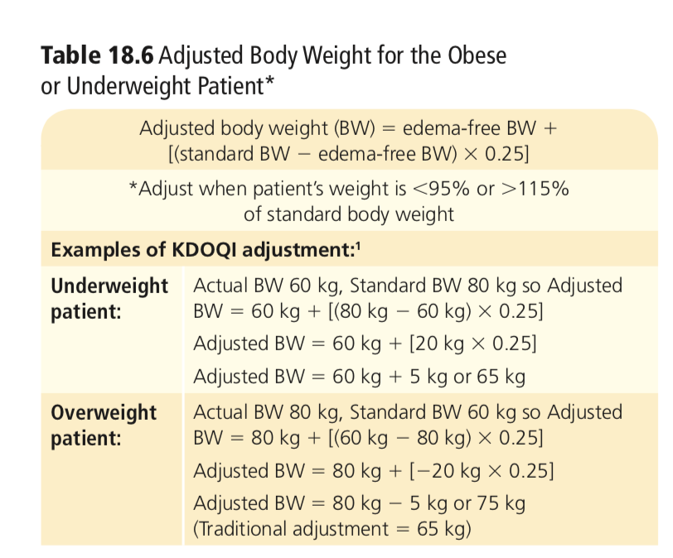
KDOQI Clinical Practice Guidelines for Nutrition in Chronic Renal Failure (Guideline 12)
National Kidney Foundation’s
Kidney Disease Outcome Quality Initiative
“development of clinical practice guidelines to define chronic kidney disease and to classify stages in the progression of chronic kidney disease”

Slide 47
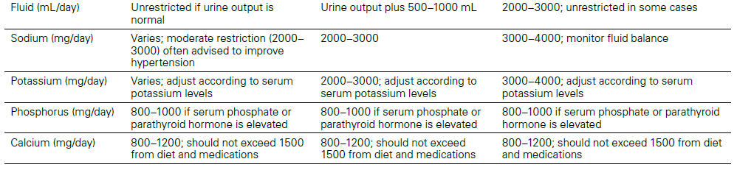
mnt
To control elevated blood lipids and reduce heart disease risk, patients with chronic kidney disease are generally advised to limit their intakes of saturated and trans fats, refined sugars, and alcohol.
Fat, Fluid & Electrolytes

Slide 48
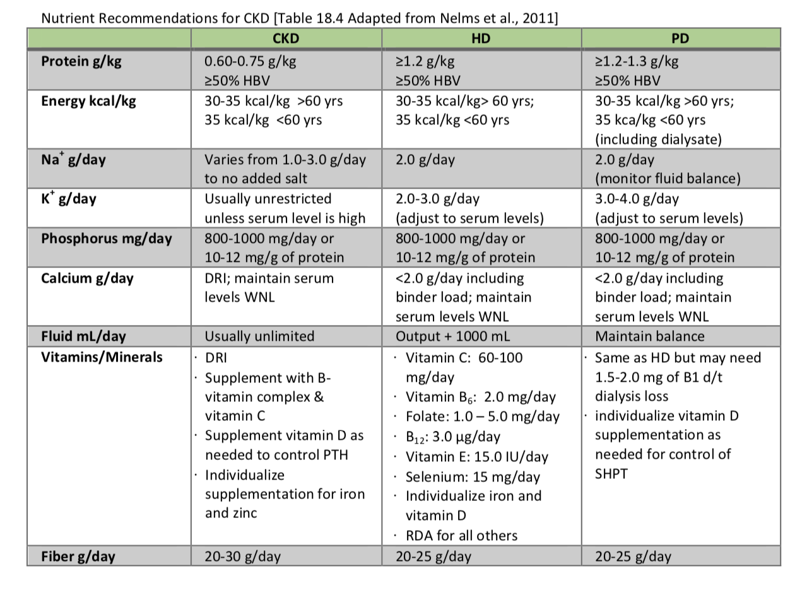

Slide 49
Sodium Restriction in CKD
The goal of nutrition therapy is to keep sodium levels <2 g/d for HD and PD
Average daily sodium intake for Americans is 3.4g/d
Even active people who lose lots of sodium through sweating require no more than 1.5 g/d
Most of of dialysis patients have hypertension
Low-salt diet in HD has been proven to normalize BP
Preparing meals with fresh foods, using spices, avoiding salt when cooking, and drastically limiting salty foods

Slide 50
High sodium intake activates a vicious circle:
Increase in serum osmolarity Greater thirst and greater water intake High inter-dialytic weight gains
More fluid that then needs to be filtered out
Need for large ultrafiltration rates ( higher rates of filtration to remove sodium and fluid during dialysis )
Increased blood pressure
Interdialytic weight gain (IDWG) is the result of salt and water intake between two hemodialysis sessions. IDWG is used as a parameter for fluid intake while taking the daily urine output into account
Higher interdialytic weight gain (IDWG) is associated with higher predialysis blood pressure and increased mortality
Ipema, K., Kuipers, J., Westerhuis, R., Gaillard, C., van der Schans, C., Krijnen, W. and Franssen, C., 2016. Causes and Consequences of Interdialytic weight gain. Kidney and Blood Pressure Research, 41(5), pp.710-720.

Slide 51
Potassium
Recommended potassium intake by age
4,700 mg/d (4.7 g) for 14 years or age and older
Most patients can handle typical intakes of potassium during stages 1 through 4 of illness. Restrictions are generally advised for patients who develop hyperkalemia
If potassium becomes too high, it can cause an irregular heartbeat or a heart attack
Note that salt substitutes and other low-sodium products often contain potassium chloride, which people on a potassium-restricted diet should avoid.

Slide 52
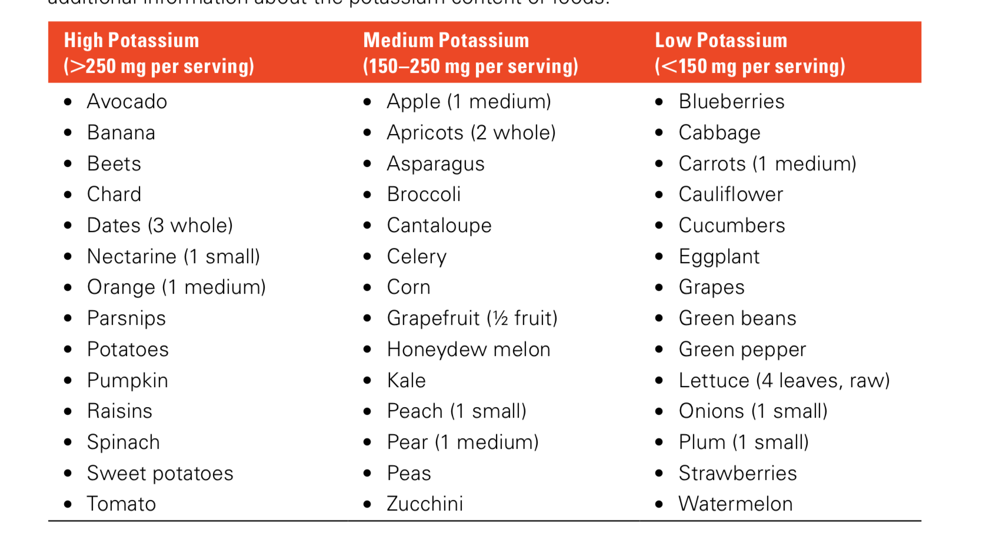

Slide 53
Phosphorus
According to Institute of Medicine, the recommended dietary intakes of phosphorus are as follows:
Adults: 700 mg/day but most people are getting closer to 900-1200 mg/d

Slide 54
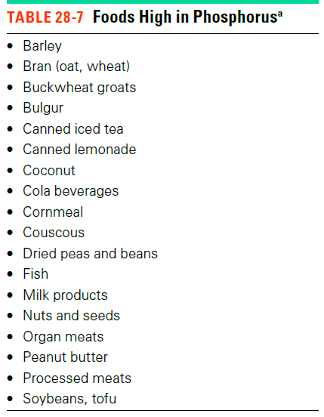
Phosphorus
Elevated serum phosphate levels indicate the need for dietary phosphorus restriction
Intake of phosphate binders (taken with meals)
However, phosphate binders are calcium salts so may increase patients risk of developing hypercalcemia
Vitamin D supplementation is recommended only for patients with suspected deficiency
High-protein foods are also high in phosphorus
The protein-restricted diets consumed by predialysis patients curb phosphorus intakes
After dialysis treatments begin and protein intakes are liberalized, phosphate binders become essential for phosphorus control

Slide 55
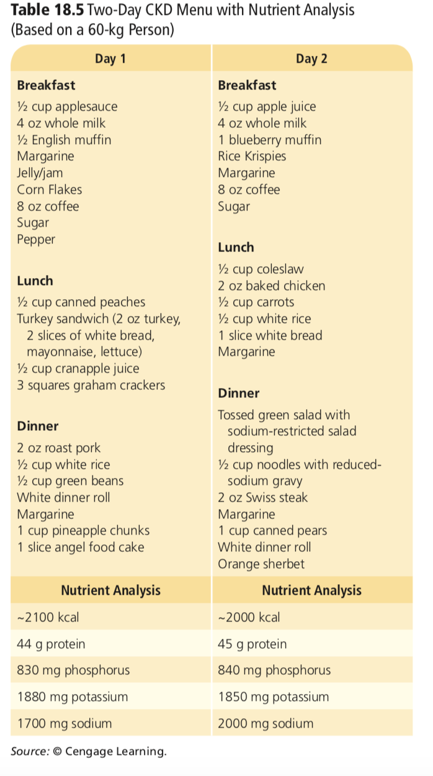

Slide 56
Renal osteodystrophy: Alteration of bone morphology in patients with chronic kidney disease
Occurs due to Increased parathyroid hormone (PTH) levels playing a role in the pathogenesis of high bone turnover states
Secondary hyperparathyroidism(excessive secretion of parathyroid hormone (PTH) by the parathyroid glands in response to hypocalcemia)
Secondary hyperparathyroidism is the predominant cause of osteodystrophy
Renal Osteodystrophy. (2020). Definitions. https://doi.org/10.32388/wsvt9l

Slide 57
In Normal function:
Low [Ca], high [P] –> Parathyroid Gland –> Parathyroid Hormone (PTH)
PTH stimulates the kidney to increase 1) Ca reabsorption, 2) P excretion by kidney 3) vit. D activation
in bone: release of Ca & P via osteoclast activity ( release from bone to blood)
•Active vit. D –> increases intestinal Ca absorption
Overall effect of PTH: increase blood [Ca] and decrease P
Once calcium levels are normalized, this same system can relay negative feedback to the Parathyroid gland and suppress PTH release.
In Chronic Kidney Disease:
1, Decreased P clearance (damaged kidneys may not be able to reabsorb calcium and excrete phosphorus, leading to an imbalance in the blood)
High [P] stimulates PTH
2. Decreased activation of vit.D ( Kidney function GFR decline in CKD)
decreased Ca absorption
Low [Ca] also stimulates PTH Result: Ca mobilization from bone = bone resorption

Slide 58
Dietary Compliance
Adhering to a renal diet is VERY challenging
Keep track of fluid intake: (Use a container filled with water requirements, take into
consideration fluid for medicine)
To help control thirst: Chew gum or suck hard candy, Suck on frozen grapes, Freeze beverages to a semisolid state, Add lemon juice or crumpled mint leaves to water, Gargle with refrigerated mouthwash.
To increase the energy content of meals: Add extra oils and fat, salad dressing or mayonnaise to salads, nondairy whipped toppings
To include more of your favorite vegetables in meals: use the process of leaching ( leaching potassium out of veggies)
To prevent the diet from becoming monotonous: Experiment with new combinations of allowed foods and nondairy products. Add flavor to foods by seasoning with different herbs and spices. Many restricted foods can be used occasionally.

Slide 59
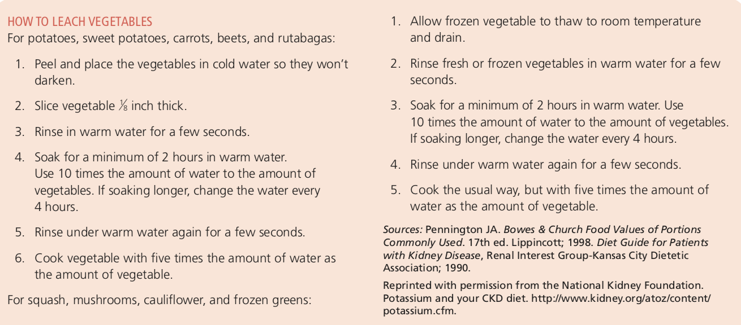

Slide 60
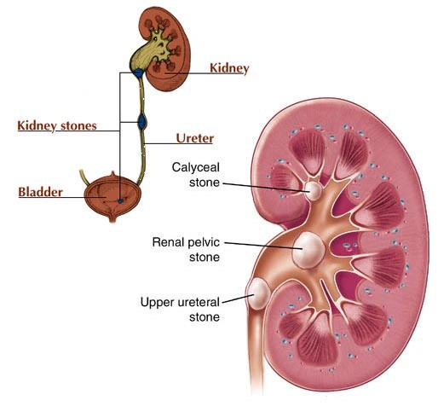
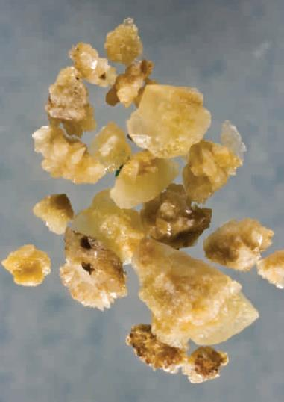
Kidney Stones
Kidney stones (Nephrolithiasis): A crystalline mass that forms within the urinary tract.
Symptoms: Often asymptomatic. However, their passage can cause severe pain or block the urinary tract.
Stones tend to recur but can be prevented with dietary measures and medical treatment

Slide 61
Formation
Kidney stones develop when stone constituents become concentrated in urine, allowing crystals to form and grow.
Factors that predispose an individual to stone formation include the following:
Obstruction: which prevents the flow of urine and encourages salt precipitation.
Dehydration or low urine volume (People who form stones are advised 12-16 cups of fluids/day to maintain urine volumes of least 2 to 2.5 L/day.)
Urine acidity: Some stones form more readily in acidic urine, whereas others in alkaline urine.
Metabolic factors: The presence of compounds that promote or inhibit crystal growth.
Renal disease

Slide 62
Types
Calcium Oxalate Stones
Uric Acid Stones
Cystine Stones
Struvite Stones

Slide 63
Calcium Oxalate Stones
Associated with Hypercalciuria (more common) - (elevated urinary calcium levels). Hypercalciuria can result from excessive calcium absorption, impaired calcium reabsorption in kidney tubules, or elevated serum levels of parathyroid hormone or vitamin D.
Hyperoxaluria (Elevated urinary oxalate levels )- Hyperoxaluria may reflect an increase in the body’s synthesis of oxalate or increased absorption from dietary sources.
Another types of calcium stones is Calcium Phosphate Stones (uncommon), but sometimes formed in people with hypercalciuria who produce alkaline urine.

Slide 64
Calcium Oxalate Stones
Goal: Reduce urinary calcium and oxalate levels.
Adequate consumption of calcium from food sources (about 800 & 1200 mg/day for men and women, respectively). Conversely, low-calcium diets promote oxalate absorption and higher urinary oxalate levels.
Dietary oxalate restriction (see next slide)
High protein and sodium intakes increase urinary calcium excretion. (Protein: 0.8-1.0 g/Kg
BW/day, Sodium: no more than 3450 mg/day)
Vitamin C intakes should not exceed the RDA because vitamin C degrades to oxalate.
Drugs therapy: Thiazide diuretics & potassium citrate

Slide 65
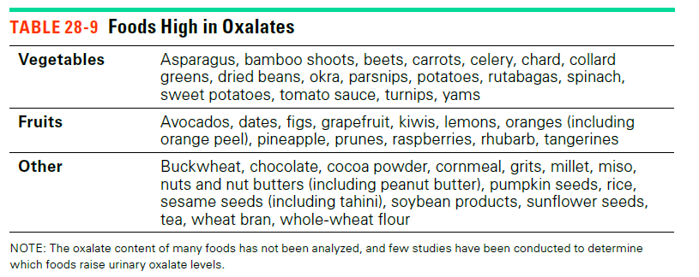
Calcium Oxalate Stones

Slide 66
Uric Acid Stones
Uric acid stones develop when:
Urine is abnormally acidic
Urine contains excessive uric acid
Both.
Frequently associated with gout & a diet rich in purines.
Treatment: Diets restricted in purines?, Drug treatments includes allopurinol and potassium citrate (reduce urine acidity)

Slide 67
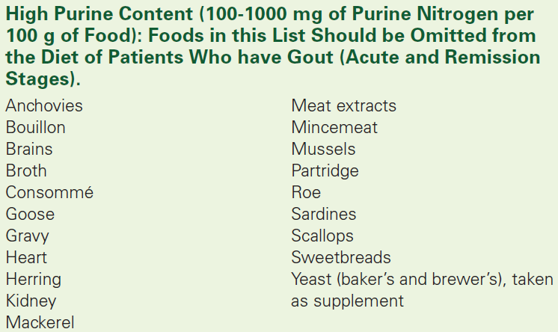

Slide 68
Medical Treatment
Medical treatment may be necessary for a kidney stone that is too large to pass, blocks urine flow, or causes severe pain or bleeding.
Medications that relax the ureter and increase urine volume may be given to facilitate stone passage
Stent (a thin, flexible tube) is placed in the ureter to promote stone passage
Surgical methods that involve physical removal of kidney stones

Slide 69
