Slide 1
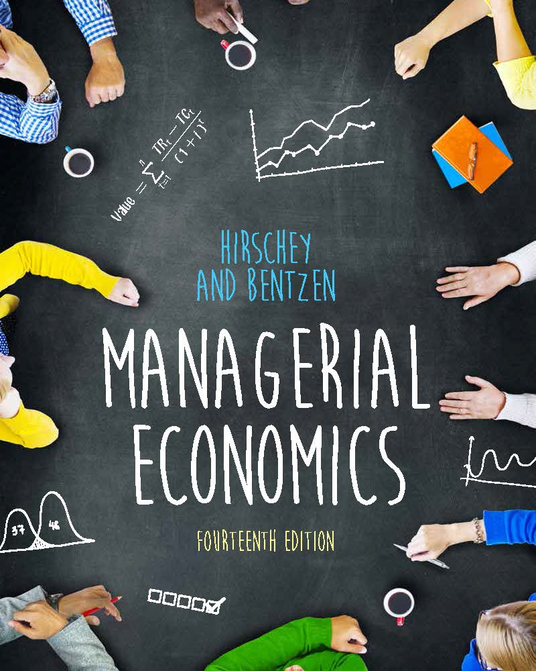
MANAGERIAL ECONOMICS 14th Edition
By
Mark Hirschey and Eric Bentzen

Slide 2
Cost Analysis and Estimation
Chapter 8

Slide 3
Chapter 8 OVERVIEW
Economic and Accounting Costs
Role of Time in Cost Analysis
Short-run Cost Curves
Long-run Cost Curves
Minimum Efficient Scale
Firm Size and Plant Size
Learning Curves
Economies of Scope
Cost-volume-profit Analysis

Slide 4
Chapter 8 KEY CONCEPTS
historical cost
current cost
replacement cost
opportunity cost
explicit cost
implicit cost
incremental cost
profit contribution
sunk cost
cost function
short-run cost functions
long-run cost functions
short run
long run
planning curves
operating curves
fixed cost
variable cost
short-run cost curve
long-run cost curve
economies of scale
cost elasticity
capacity
minimum efficient scale
multiplant economies of scale
multiplant diseconomies of scale
learning curve
economies of scope
cost-volume-profit analysis
breakeven quantity
degree of operating leverage

Slide 5
Economic and Accounting Costs
Historical Versus Current Costs
Historical cost is the actual cash outlay.
Current cost is the present cost of previously acquired items.
Opportunity Costs
Foregone value associated with current rather than next-best use of an asset.
Replacement cost is expense of replacing productive capacity using current technology.
Explicit and Implicit Costs
Explicit costs are cash expenses.
Implicit costs are noncash expenses.

Slide 6
Role of Time in Cost Analysis
Incremental Cost
Incremental cost is the change in cost tied to a managerial decision.
Incremental cost can involve multiple units of output.
Marginal cost involves a single unit of output.
Sunk Cost
Irreversible expenses incurred previously.
Sunk costs are irrelevant to present decisions.

Slide 7
How Is the Operating Period Defined?
Short Run Versus Long Run
At least one input is fixed in the short run.
All inputs are variable in the long run.
Fixed and Variable Costs
Fixed cost is a short-run concept.
All costs are variable in the long run.

Slide 8
Short-run Cost Curves
Short-run Cost Categories
Total Cost = Fixed Cost + Variable Cost
For averages, ATC = AFC + AVC
Marginal Cost, MC = ∂TC/∂Q
Short-run Cost Relations
Short-run cost curves show minimum cost in a given production environment.

Slide 9
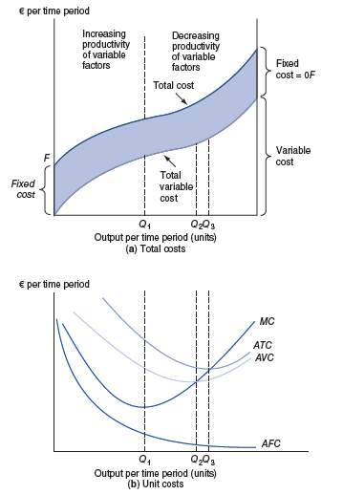

Slide 10
Long-run Cost Curves
Long-run total cost curves show minimum total cost in an ideal environment.
Economies of Scale (EOS)
Increasing returns to scale (IRS) imply falling average costs.
Constant returns to scale CRS) implies constant average costs.
Decreasing returns to scale (DRS) implies rising average costs.

Slide 11
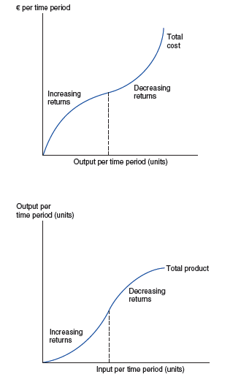

Slide 12
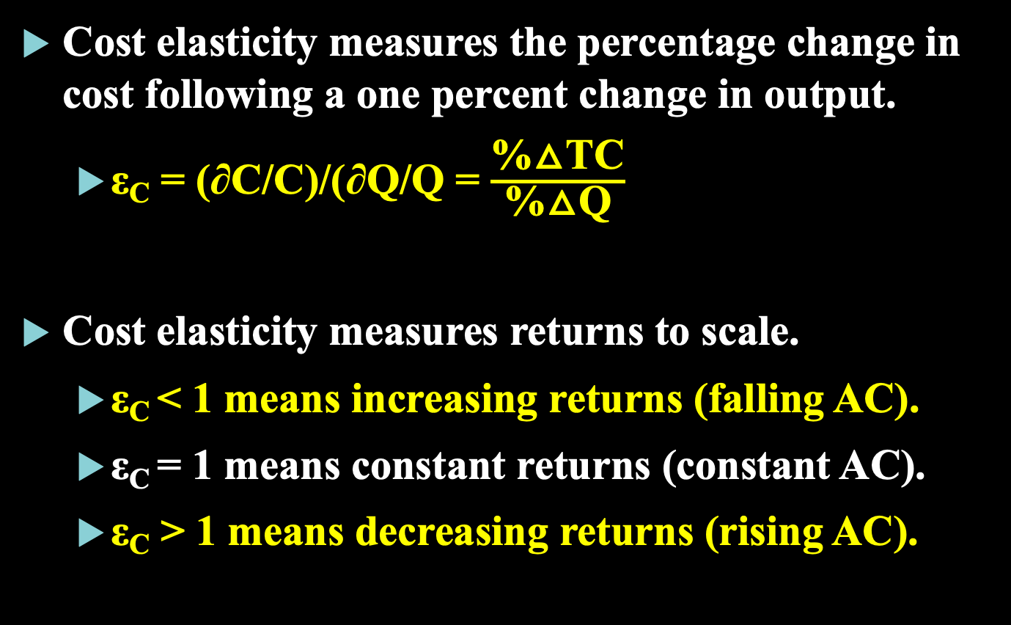
Cost Elasticities and Economies of Scale
Cost elasticity measures the percentage change in cost following a one percent change in output.
ε_{C} = (∂C/C)/(∂Q/Q = $\frac{\text{\%△}\text{TC}}{\text{\%△}\text{Q}}$
Cost elasticity measures returns to scale.
ε_{C} < 1 means increasing returns (falling AC).
ε_{C} = 1 means constant returns (constant AC).
ε_{C} > 1 means decreasing returns (rising AC).

Slide 13
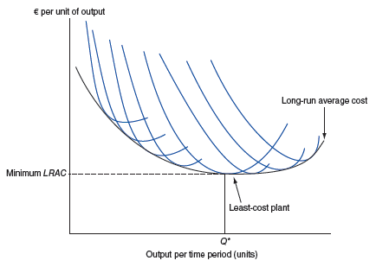




Slide 14
Minimum Efficient Scale (MES)
Minimum Efficient Scale
MES is the “corner point” on an L-shaped LRAC curve.
MES is the minimum point on a U-shaped LRAC curve.
Competition is most vigorous when:
MES is small in absolute terms.
MES is a small share of industry output.
Cost disadvantage to small scale is modest.

Slide 15
Transportation Costs and MES
Transportation Costs
Terminal charges are the cost of loading and unloading freight.
Line-haul costs are expenses of moving goods, e.g., gas.
Inventory costs are shipping costs tied to time in transit.
High transport costs reduce MES impact.
Location near customers can offset scale disadvantages.

Slide 16
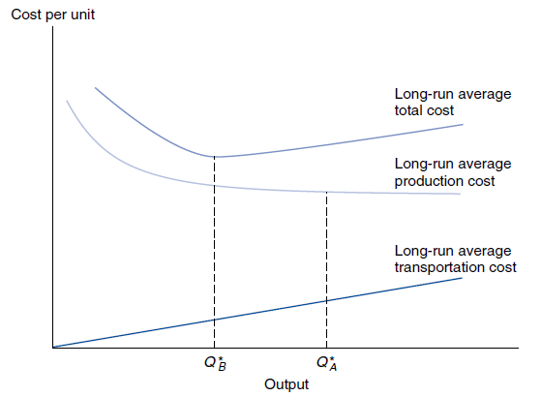


Slide 17
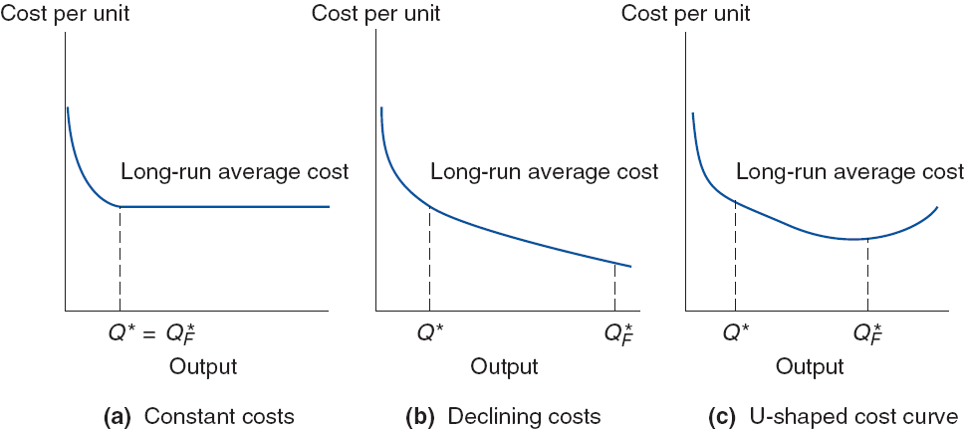




Slide 18
Firm Size and Plant Size
Multi-plant Economies and Diseconomies of Scale
Multi-plant economies are cost advantages from operating several plants.
Multi-plant diseconomies are coordination costs from operating several plants.
Plant Size and Flexibility
Big plants can offer lower AC.
Smaller plants can make it easier to add and /or subtract capacity.

Slide 19
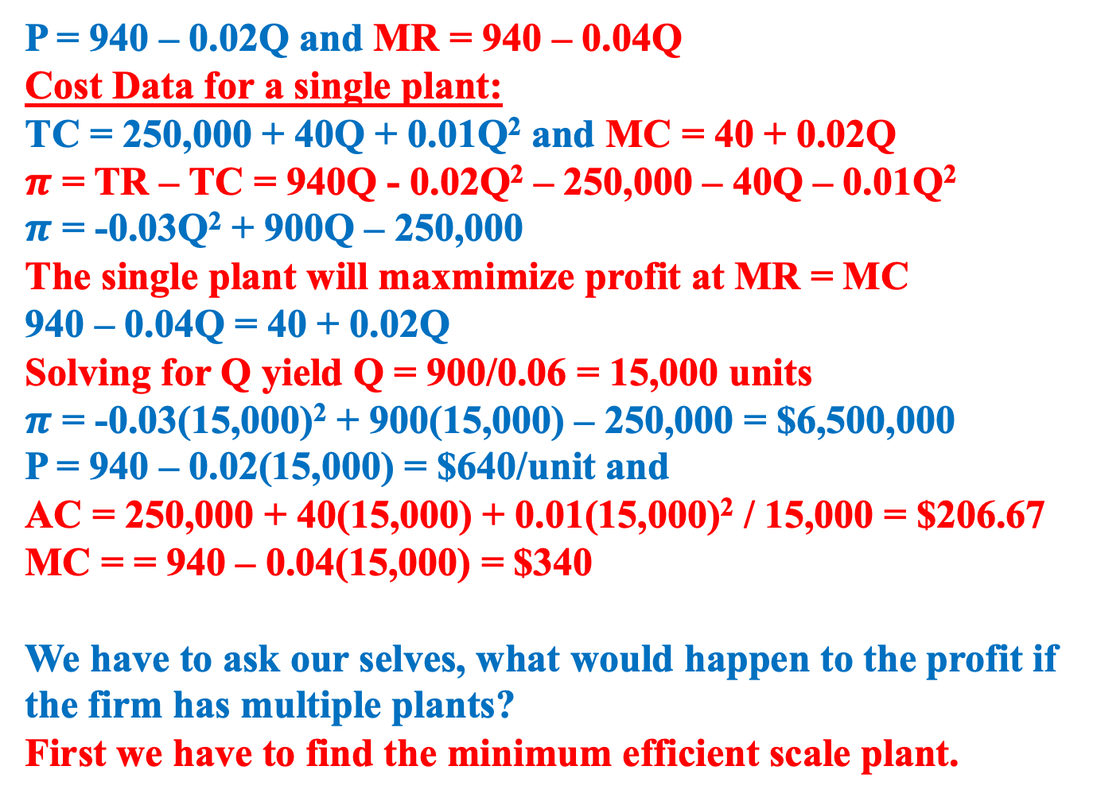
P = 940 – 0.02Q and MR = 940 – 0.04Q
Cost Data for a single plant:
TC = 250,000 + 40Q + 0.01Q² and MC = 40 + 0.02Q
$π$ = TR – TC = 940Q - 0.02Q² – 250,000 – 40Q – 0.01Q²
$π$ = -0.03Q² + 900Q – 250,000
The single plant will maxmimize profit at MR = MC
940 – 0.04Q = 40 + 0.02Q
Solving for Q yield Q = 900/0.06 = 15,000 units
$π$ = -0.03(15,000)² + 900(15,000) – 250,000 = $6,500,000
P = 940 – 0.02(15,000) = $640/unit and
AC = 250,000 + 40(15,000) + 0.01(15,000)² / 15,000 = $206.67
MC = = 940 – 0.04(15,000) = $340
We have to ask our selves, what would happen to the profit if
the firm has multiple plants?
First we have to find the minimum efficient scale plant.

Slide 20
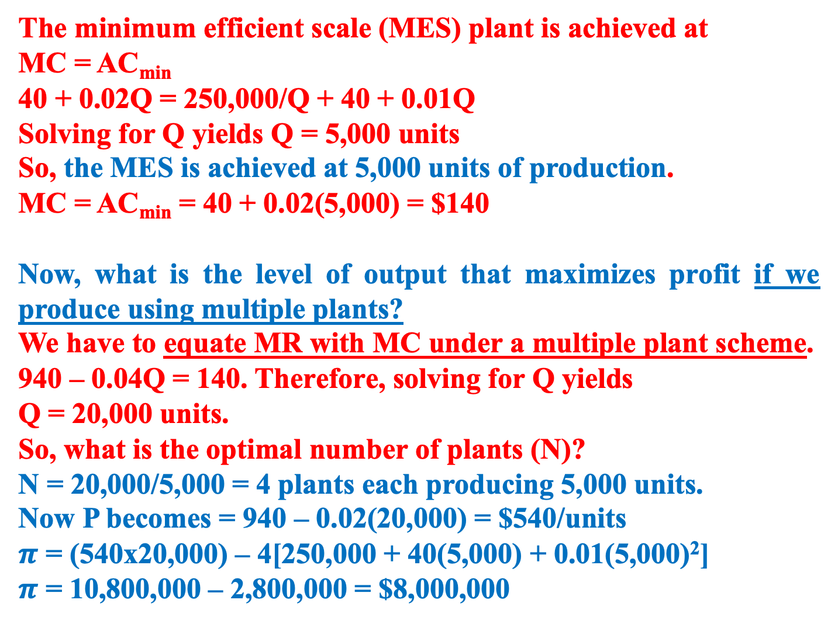
The minimum efficient scale (MES) plant is achieved at
MC = AC_{min}
40 + 0.02Q = 250,000/Q + 40 + 0.01Q
Solving for Q yields Q = 5,000 units
So, the MES is achieved at 5,000 units of production.
MC = AC_{min} = 40 + 0.02(5,000) = $140
Now, what is the level of output that maximizes profit if we produce using multiple plants?
We have to equate MR with MC under a multiple plant scheme.
940 – 0.04Q = 140. Therefore, solving for Q yields
Q = 20,000 units.
So, what is the optimal number of plants (N)?
N = 20,000/5,000 = 4 plants each producing 5,000 units.
Now P becomes = 940 – 0.02(20,000) = $540/units
$π$ = (540x20,000) – 4[250,000 + 40(5,000) + 0.01(5,000)²]
$π$ = 10,800,000 – 2,800,000 = $8,000,000

Slide 21
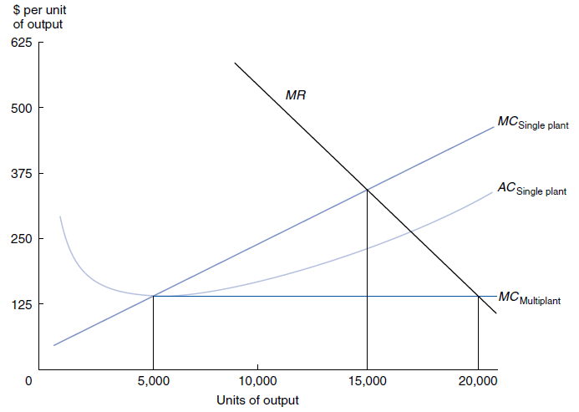





Figure 8.7 Plainfeld Electronics: Single Versus Mltiplant Operation
In this example, profit ia maximized at a production level well beyond that at which average cost is minimized for a single plant. Profits are greater with four plants because output can then be produced at minimum cost.

Slide 22
The Learning Curve
Learning Curve Concept
A learning curve reflects increased efficiency and performance with repetitive production of a good or service.
The concept of the learning curve is that some input resources decrease, on a per-output-unit basis, as the number of units produced increases over time.
Learning causes an inward shift in the LRAC curve due to better production knowledge.
Learning is often mistaken for scale economies.
Strategic Implications of the Learning Curve Concept
If learning results in 20% to 30% cost savings, it becomes a key part of competitive strategy.
Notes:
Slide 2 is list of textbook LO numbers and statements

Slide 23
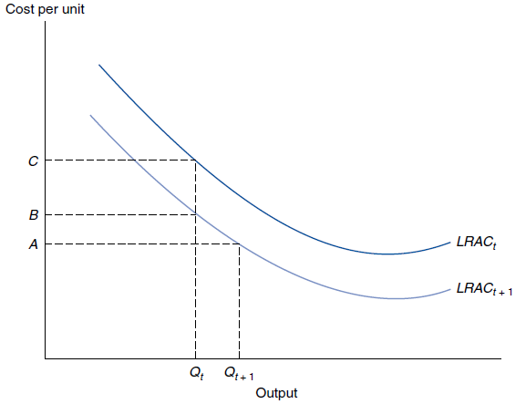


Figure 8.10 Long-Run Average Cost Curves Effects of Learning
Learning will cause a downward shift from LRAC_{t} to LRAC_{t+1}. An average cost decline from C to A reflects the effects of both learning and economies of scale.

Slide 24
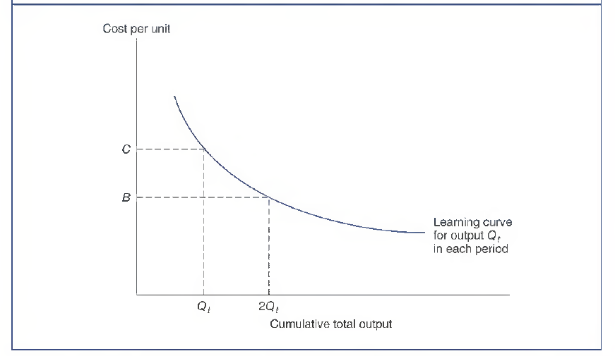
Figure 8.11 Learning Curve on an Arithmatic Scale
The learning curve reflects the percentage decline in average cost as total output doubles from Q_{t} to 2Q_{t}.
1st 100th unit
2nd 100th unit

Slide 25
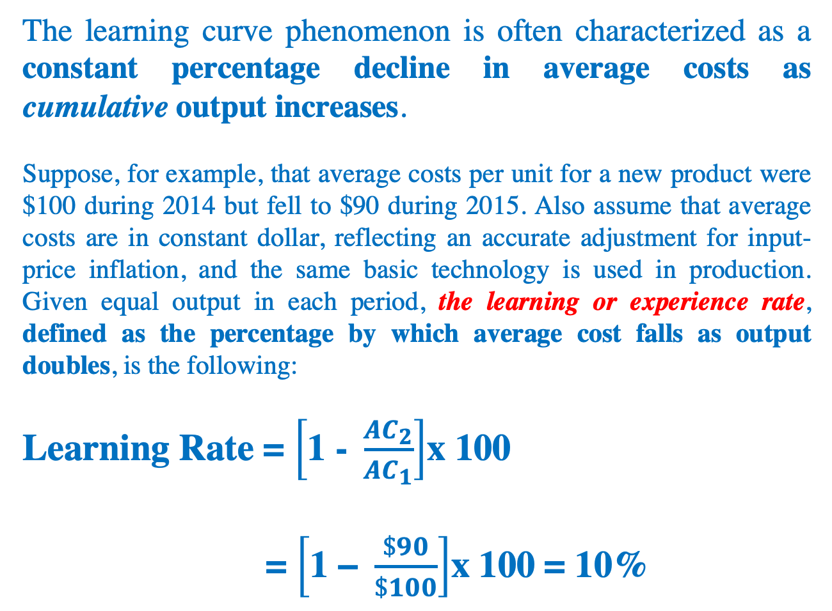
The learning curve phenomenon is often characterized as a constant percentage decline in average costs as cumulative output increases.
Suppose, for example, that average costs per unit for a new product were $100 during 2014 but fell to $90 during 2015. Also assume that average costs are in constant dollar, reflecting an accurate adjustment for input-price inflation, and the same basic technology is used in production. Given equal output in each period, the learning or experience rate, defined as the percentage by which average cost falls as output doubles, is the following:
Learning Rate = $\left[\text{1 − }\frac{{AC}_{2}}{{AC}_{1}}\right]$x 100
= $\left[\text{1 − }\frac{\$90}{\$100}\right]$x 100 = 10%

Slide 26
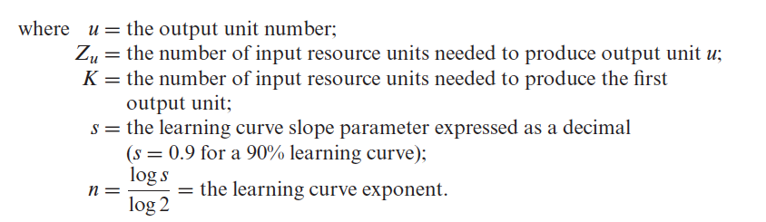
Most Learning Curves Assume a Constant Percentage Reduction Occurs as the Number of Units Produced is Doubled
Z_{u} = K (u^{n})
Notes:
Slide 2 is list of textbook LO numbers and statements

Slide 27
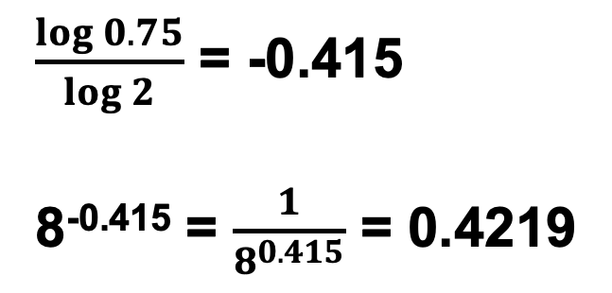

Learning Curve: Example Assume the First Unit of Production Required 3 Hours Time for Assembly. The Learning Rate is 75%. Find (a) the Time to Assemble the 8th Unit, and (b) the Time Needed to Assemble the First 6 Units
Part (a)
$\frac{\log{0.75}}{\log{2}}$ = -0.415
8^{-0.415} = $\frac{1}{8^{0.415}}$ = 0.4219
Notes:
Slide 2 is list of textbook LO numbers and statements

Slide 28




Part (B)
$\frac{1}{1^{0.415}}$ + $\frac{1}{2^{0.415}}$ + $\frac{1}{3^{0.415}}$ + $\frac{1}{4^{0.415}}$ + $\frac{1}{5^{0.415}}$ + $\frac{1}{6^{0.415}}$ = 3.9346

Slide 29
Economies of Scope
Economies of Scope Concept
Scope economies are cost advantages that stem from producing multiple outputs.
Big scope economies explain the popularity of multi-product firms.
Without scope economies, firms specialize.
Exploiting Scope Economies
Scope economics often shape competitive strategy for new products.

Slide 30

Cost-volume-profit Analysis
Cost-volume-profit Charts
Cost-volume-profit analysis shows effects of varying scale.
Breakeven analysis shows zero profit points of cost coverage.
Degree of Operating Leverage
DOL is the elasticity of profit with respect to output.
DOL=Q(P-AVC)/[Q(P-AVC)-TFC].

Slide 31
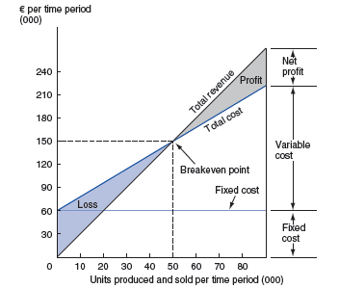




Slide 32
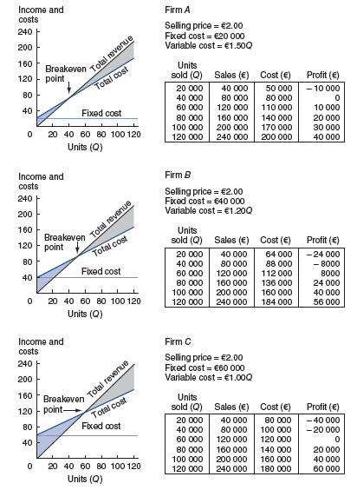


Slide 33
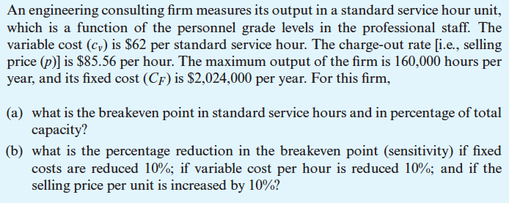
Example

Slide 34

Solution of the Example Part (a)
At the break-even point, TR = TC
PQ$’$ = FC + AVC (Q$’)$
Q$’$ = $\frac{FC}{P − AVC}$
Q$’$ = $\frac{2,024,000}{85.56 −62}$ = 85,908 hours per year
This is equal to = $\frac{85,908}{160,000}$ = 0.537 or 53.7% of capacity.

Slide 35
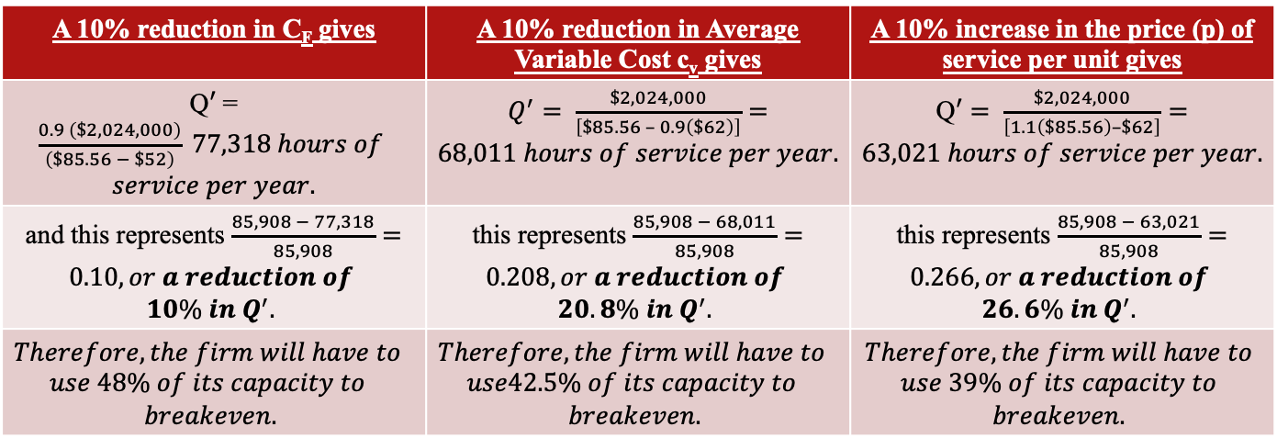
Solution of the Example Part (b)
A 10% reduction in C_{F} gives | A 10% reduction in Average Variable Cost c_{v} gives | A 10% increase in the price (p) of service per unit gives
Q$′$ = $\frac{0.9 \left(\$2,024,000\right)}{\left(\$85.56 − \$52\right)} 77,318 hours of$ $service per year.$ | $Q^{′}= \frac{\$2,024,000}{\left[\$85.56 – 0.9\left(\$62\right)\right]}=68,011 hours of service per year.$ | Q$′= \frac{\$2,024,000}{\left[1.1\left(\$85.56\right)–\$62\right]}=63,021 hours of service per year.$
and this represents $\frac{85,908 − 77,318}{85,908}=0.10, or a reduction of$ $$10\% in Q^{′}.$$ | this represents $\frac{85,908 − 68,011}{85,908}=0.208, or a reduction of$ $$20.8\% in Q^{′}.$$ | this represents $\frac{85,908 − 63,021}{85,908}=0.266, or a reduction of$ $$26.6\% in Q^{′}.$$
$$Therefore, the firm will have to$$ $$use 48\% of its capacity to$$ $$breakeven.$$ | $$Therefore, the firm will have to$$ $$use42.5\% of its capacity to$$ $$breakeven.$$ | $$Therefore, the firm will have to$$ $$use 39\% of its capacity to$$ $$breakeven.$$
Thus, the breakeven point is more sensitive to a reduction in variable cost per hour than to the same percentage reduction in the fixed cost.
Furthermore, notice that the breakeven point in this example is highly sensitive to the selling price per unit, P.

Slide 36


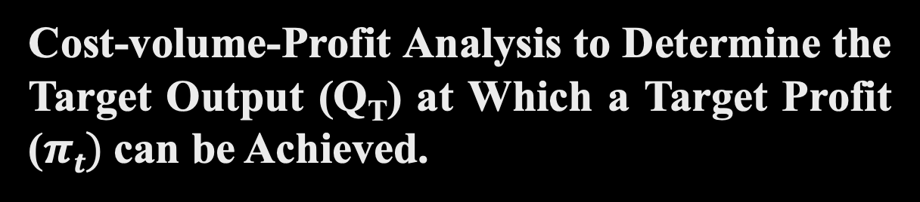
Cost-volume-Profit Analysis to Determine the Target Output (Q_{T}) at Which a Target Profit ($πt)$can be Achieved.
To do this we simply add the target profit ($πt)$to the numerator of the breakeven output equation:
Q_{T} = $\frac{FC+πt}{P − AVC}$
Example: FC = $200, P = $10, AVC = $ 5 and $πt$= $100
Q_{T} = $\frac{FC+πt}{P − AVC}$ = $\frac{200+100}{10 −5}=60 units.$
Check: TR = 10x60 = $600, TC = 200 + 5(60) = $500
$πt$= $600 - $500 = $100

