Slide 1
Mental Health

Slide 2
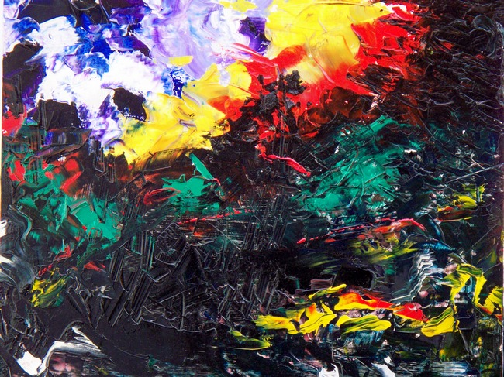
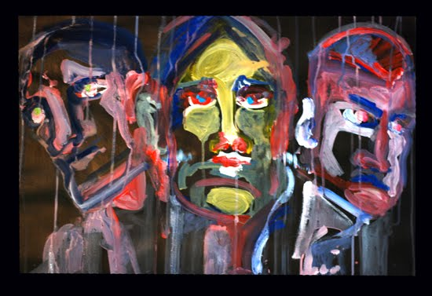
Mental Health
“Same world, different view”

Slide 3
Characteristics of Good Mental Health
Feels good about themselves
Feels comfortable with other people
Able to meet the demands of life
Expresses emotions in healthy ways
Is optimistic (positive)
Uses health skills
Stress management
Decision making
Conflict resolution
Uses “I messages”
Copes/adapts with change
Assertive
Active listener
Can be part of a team/group

Slide 4
Characteristics of Poor Mental Health
Does NOT share feelings
Emotions control behaviors
Is pessimistic (negative)
Ignores/denies problems
Can not accept change
Lets stress control life
“You” messages (blame and escalate)
Aggressive and passive
Depressed
Runs from conflict
Close minded
Needs to “run” the group

Slide 5
Mental Illness
Patterns of thinking or behavior, that cause a person significant emotional pain or prevents normal functioning.

Slide 6
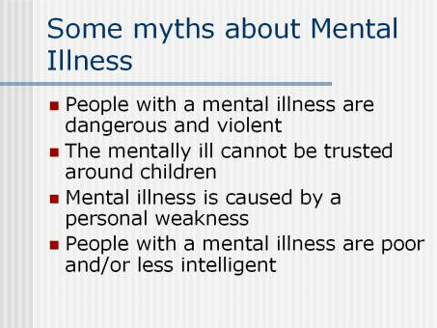

Slide 7
General Causes of Mental Illnesses
Inherited traits.
Negative life experiences (traumatic).
Environmental exposures before birth.
Viruses, toxins, alcohol or drugs.
Brain chemistry: Hormonal imbalances.

Slide 8
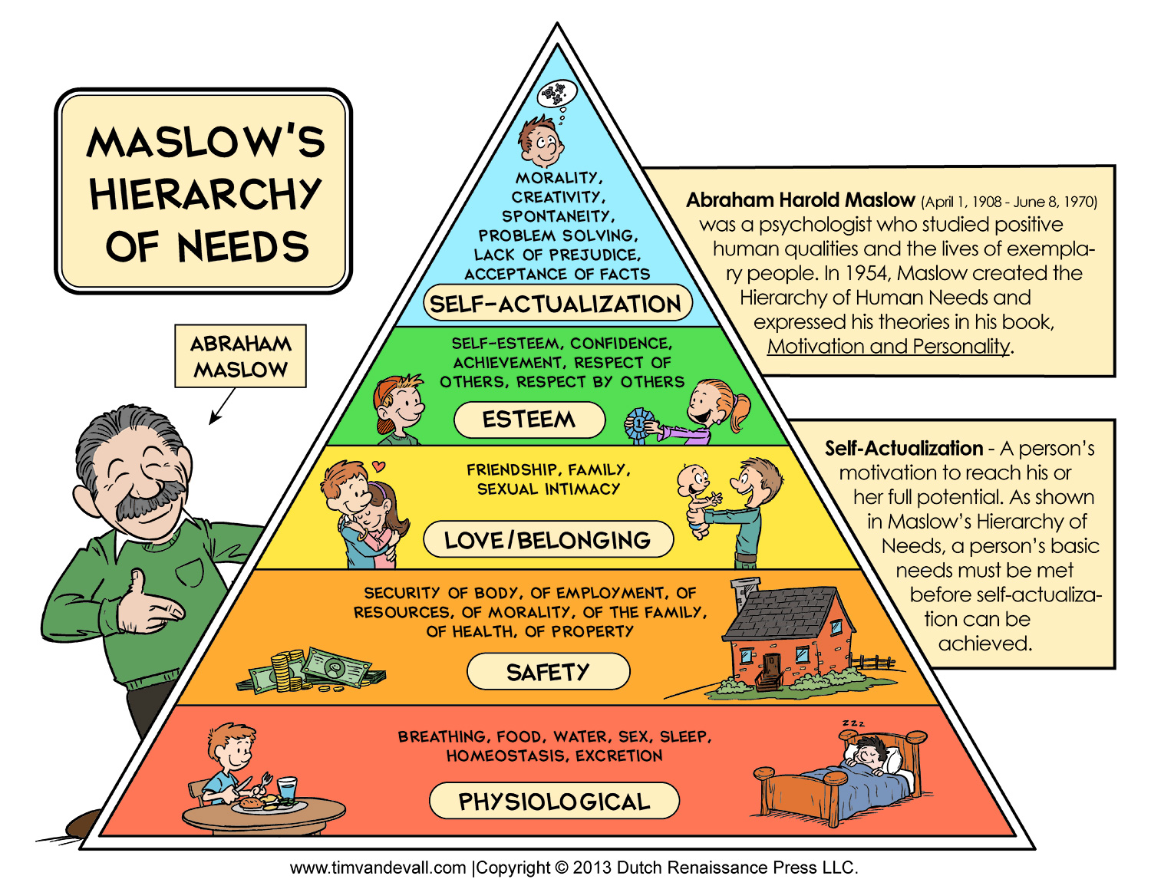

Slide 9
Mental Health Quiz Please reply saying: “true or false”
Mental illness is more common than diabetes.
Mental illness occurs in 1 out of every 4 families in the U.S.
Mental illnesses are treatable.
Being mentally impaired/challenged is very different from having a mental illness.
It takes medication, years of intense therapy, and counseling to treat a mental illness.

Slide 10
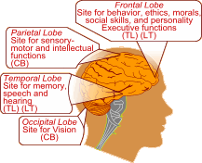
There is a chemical imbalance in the brain of a person with a mental illness

Slide 11

Optical Illusions
“Same picture, different view”

Slide 12


Slide 13
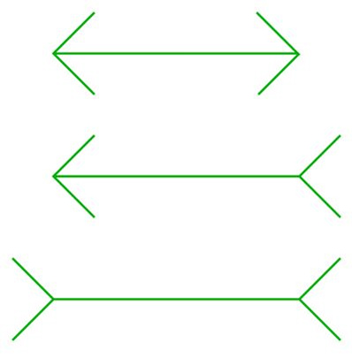
Which middle line is the longest?

Slide 14
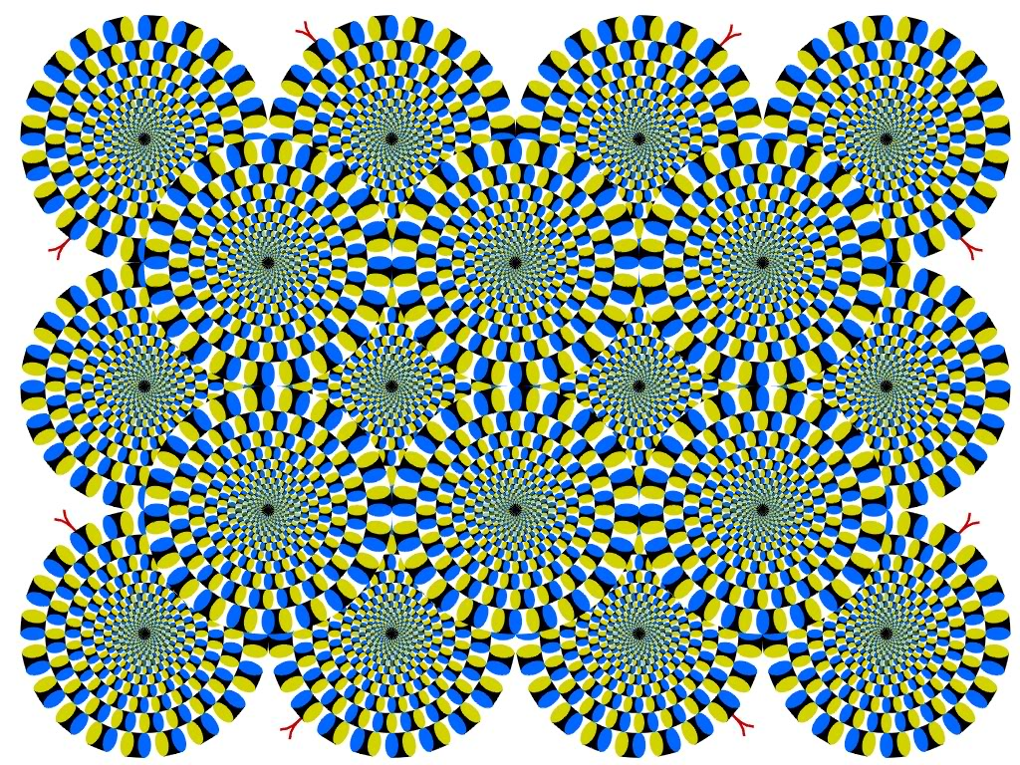
Notes:
Is it moving?

Slide 15
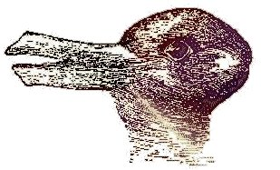
Do you see a duck facing the left or a rabbit facing right?

Slide 16
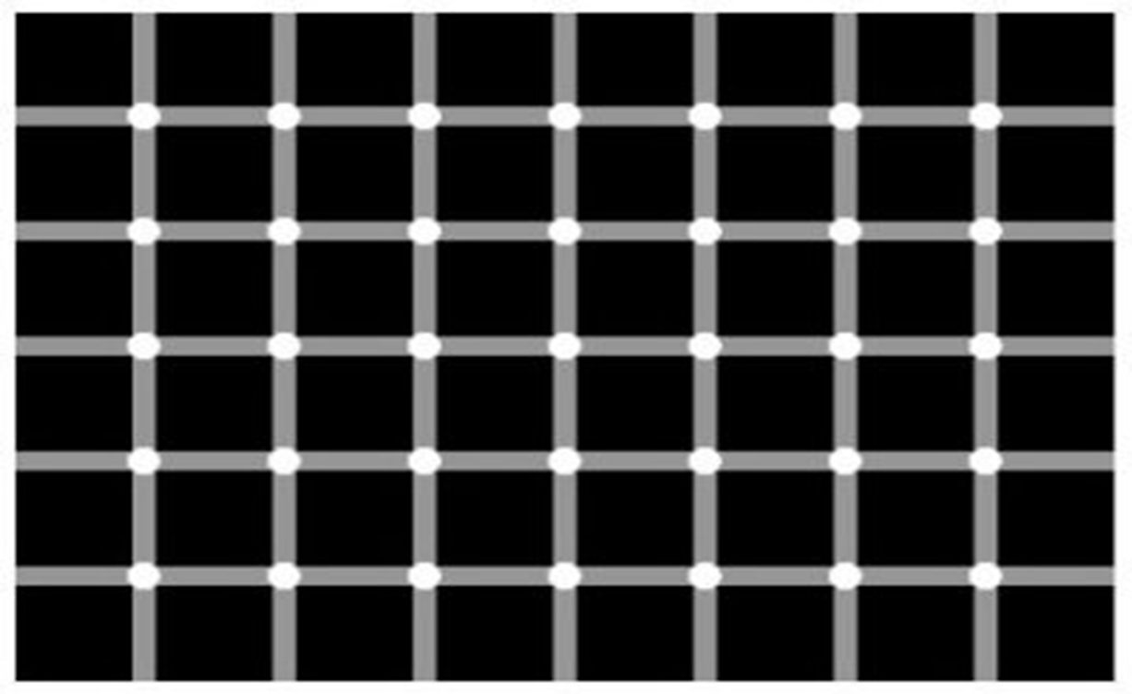
How many gray dots do you see?

Slide 17
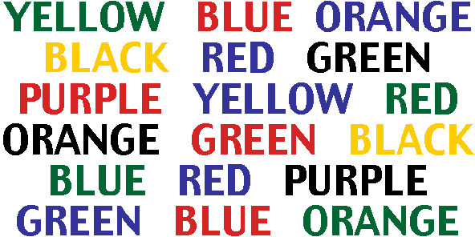
Say the color of each word

Slide 18

Are the horizontal lines straight or diagonal?

Slide 19

Do you see a face or a word?

Slide 20

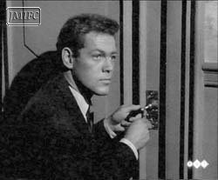
Obsessive/Compulsive Disorder (OCD)
An uncontrollable need to perform repetitive acts; compulsions are urgent, repeated rituals.
The person may not lead a normal life because compulsions become so repetitive.

Slide 21
Schizophrenia
A condition of losing touch with reality accompanied by reduced ability to function.
Split Mind:
-loses ability to distinguish fantasy from reality.
-signs of tissue shrinkage in brain.
-Some individuals inherit a potential of developing schizophrenia.
-Early psychological trauma: Violence, sexual abuse, death, divorce, separation, or other stressors of childhood.

Slide 22

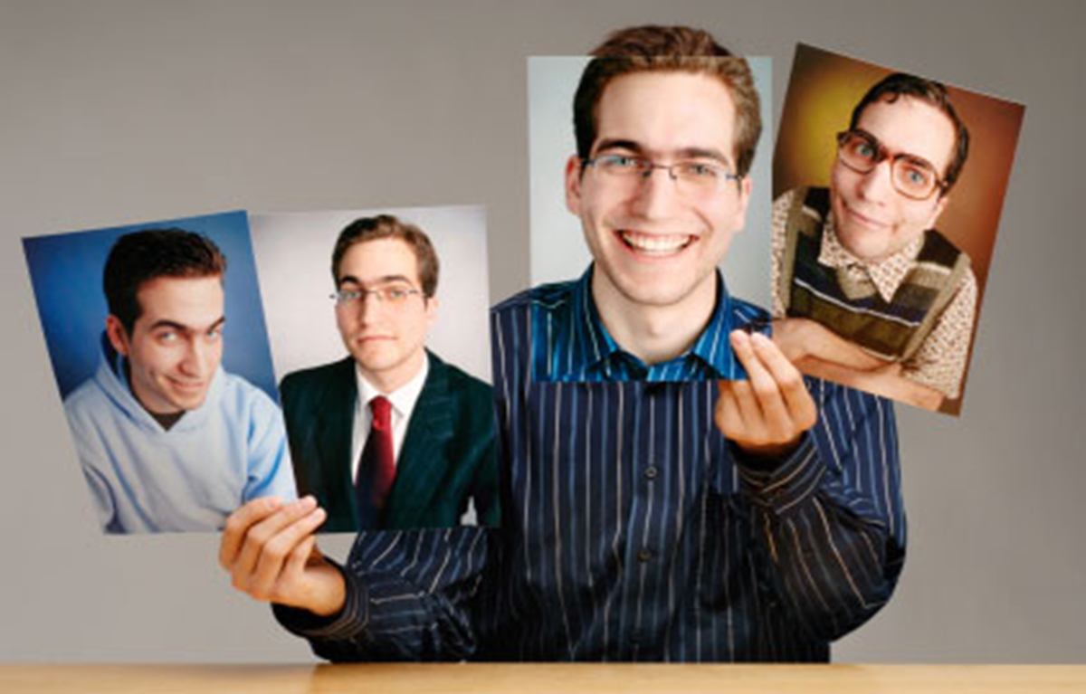
Multiple Personality Disorder (Dissociative Identity Disorder)
Two or more separate identities or personality traits:
Ability to control individual’s behavior and thinking.
Create alters to distance themselves from pain and trauma.

Slide 23
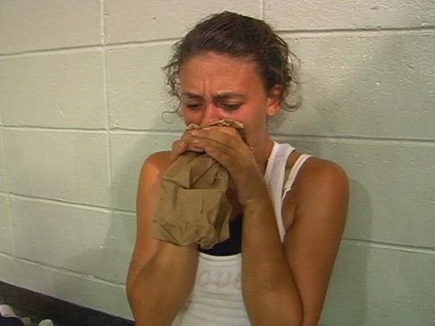
Anxiety
Someone experiencing anxiety suffers from severe panic attacks and fear in high stress events.

Slide 24
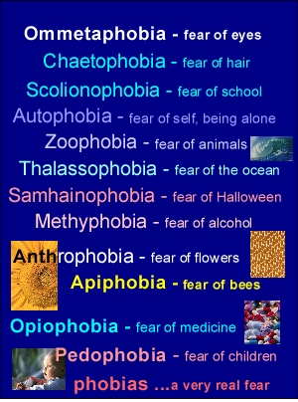
Phobia
An extreme, irrational fear of an object or situation.

Slide 25
Attention-Deficit Hyperactivity Disorder (ADHD)
Combination of problems, such as difficulty sustaining attention, hyperactivity and impulsive behavior.
Often diagnosed before the age of 7.
As early as 2 or 3 years old.
Chronic interference in more than 1 setting.
Home life, school work, sports/activities.

Slide 26
Signs & Symptoms
Inattentive
Fails to pay close attention to details. Make careless mistakes. Trouble keeping attention. Difficulty following through on instructions. Problems organizing tasks or activities.
Hyperactive/Impulsive
Fidgets or squirms frequently Often leaves seat. Always seems on the go Talks excessively. Difficulty waiting turn. Interrupts conversations.

Slide 27

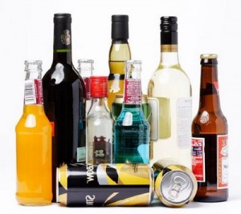

Addiction
A physical or psychological craving need for higher and higher doses of a substance that leads to bodily harm, social maladjustment, or economic hardship; dependence on a substance, habit, or behavior.

Slide 28
Facts & Statistics From: Methodist Hospital Eating Disorder Institute
90% of women in America are unhappy with their bodies & think they need to lose weight.
75% of men are unhappy with their body & feel they need to trim fat & increase muscle.
Average women in U.S.: 65 kg.
Average women in media: 50 kg.
Between 98-99% of reducing diets fail to produce permanent weight loss.
7 million women and 1 million men and children suffer with an eating disorder. Up to 22% will die!

Slide 29
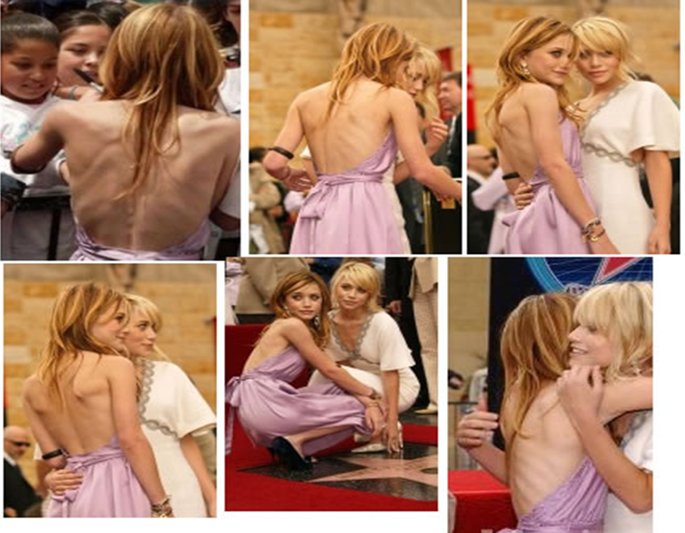
Anorexia Nervosa
A disorder in which the irrational fear of becoming obese results in severe weight loss from self-imposed starvation.

Slide 30
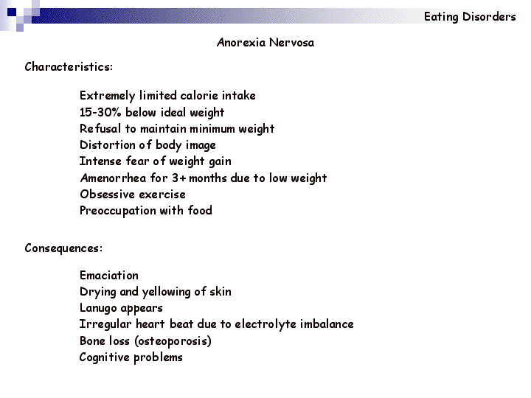
Anorexia Nervosa

Slide 31
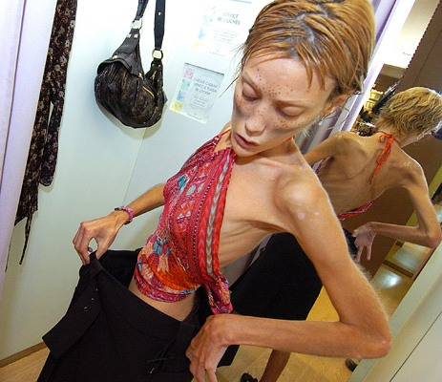
Warning Signs
Dramatic weight loss.
Anxiety about gaining weight.
Denial of hunger.
Food rituals.
Excessive exercise.
Isolation.
Frequent comments about being “fat”.
Avoids food situations.

Slide 32
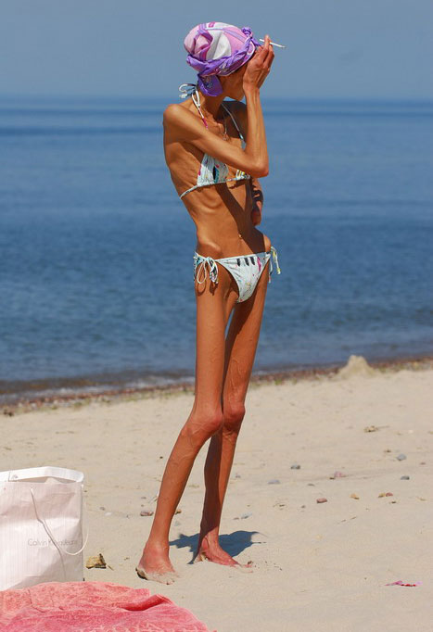
Health Risks
Muscle loss and weakness.
Reduction in bone density.
Fainting, fatigue, overall weakness.
Dry skin and hair, hair loss.
Growth of lanugo.
Slow heart rate/blood pressure.
Amenorrhea.
Cold intolerance.
Heart failure (death).

Slide 33
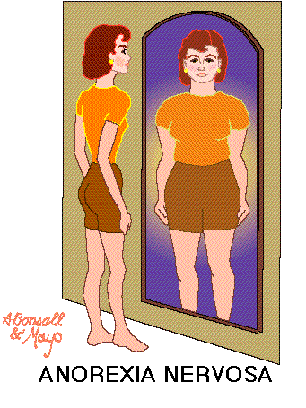

Slide 34
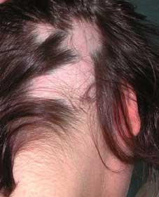
Common Signs:
Alopecia: Hair loss

Slide 35
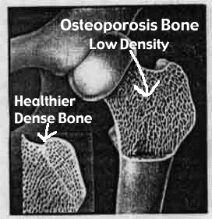
Osteoporosis is common! (lack of calcium)

Slide 36
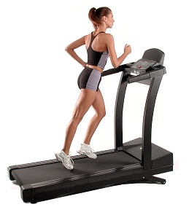
Compulsive Exercise

Slide 37
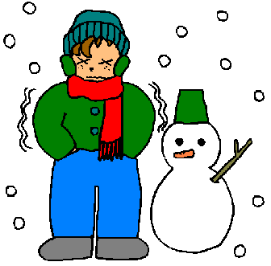
Cold Intolerance

Slide 38
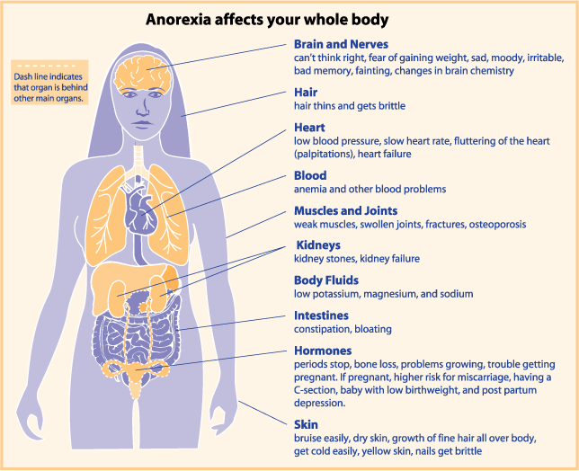

Slide 39



Bulimia Nervosa
Binging and purging, or consuming a large amount of food in a short amount of time followed by an attempt to rid oneself of the food consumed (purging), typically by vomiting, taking a laxative, diuretic, or stimulant, and/or excessive exercise, because of an extensive concern for body weight.

Slide 40
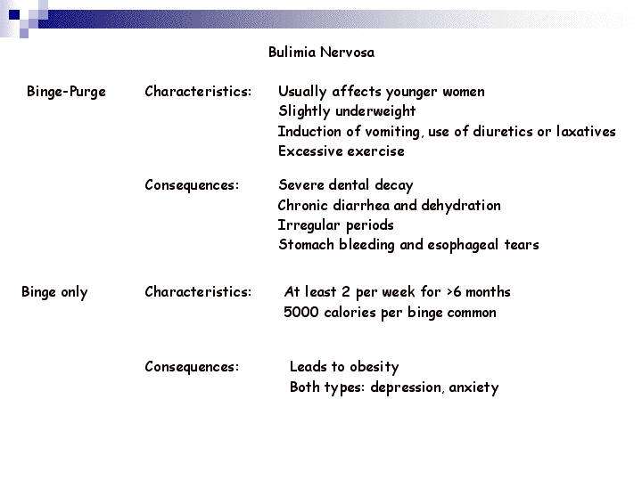
Bulimia Nervosa

Slide 41
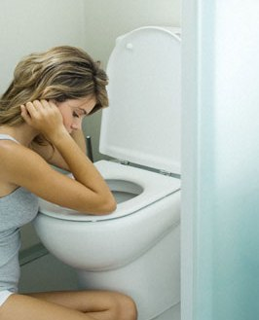
Warning Signs
Buys large amounts of food.
Eats secretly, missing food, and skips meals.
Weight fluctuation.
Excessive use of laxative, diet pills and exercise.
Uncontrolled binging.
Low impulse to control.

Slide 42
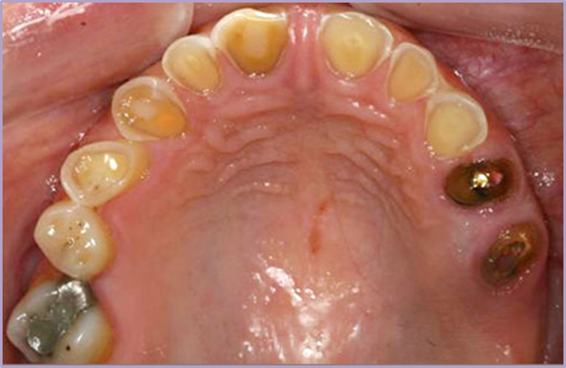
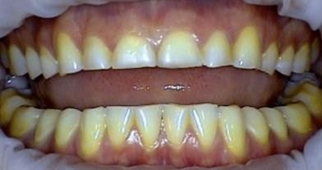
Health Risks
Stomach Rupture.
Tooth decay/erosion.
Loss of fluids.
Risks of seizures.
Esophageal inflammation.
Irregular bowel movements.
Chronic sore throats.

Slide 43
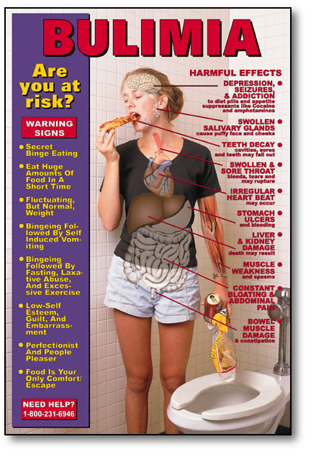
Bulimia Nervosa

Slide 44
Post Traumatic Stress Disorder (PTSD)
Mental health condition that's triggered by a terrifying event — either experiencing it or witnessing it. Symptoms may include flashbacks, nightmares and severe anxiety, as well as uncontrollable thoughts about the event.

Slide 45
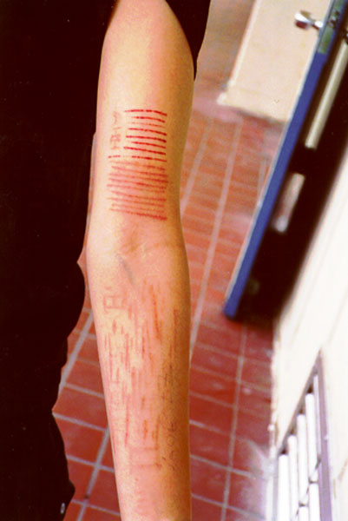
Self-Harm
The act of attempting to alter a mood state by inflicting physical harm that is serious enough to cause tissue damage to one’s body.

Slide 46
Common Behaviors
Cutting Burning Head-banging Carving Scratching
Bruising or hitting Biting Picking of skin Pulling of hair Bone-breaking

Slide 47
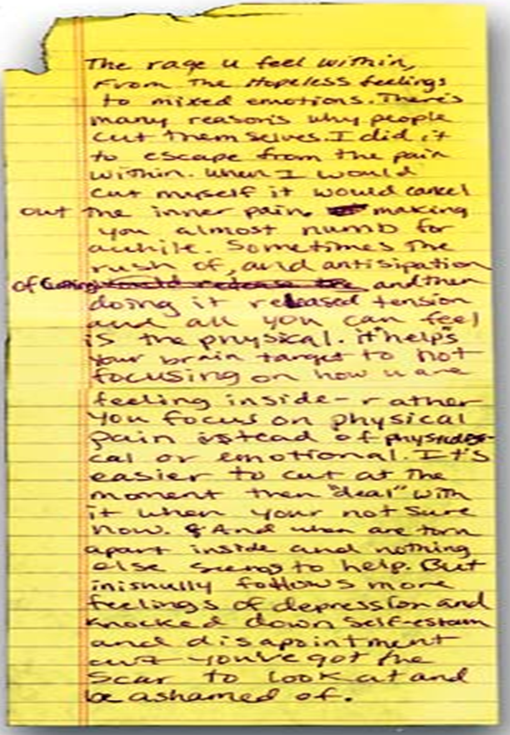
Escape from emptiness and depression.
Provides relief.
Relieves anger.
Escapes numbness.
Reality.

Slide 48
Depression
Emotional disorders primarily involving sadness, dependency and depression.
Dejection, hopelessness, inability to feel pleasure or to take interest.
Needs medical attention.

Slide 49
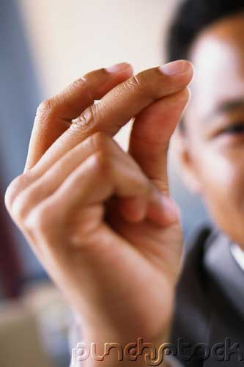
Depression
“JUST SNAP OUT OF IT!”

Slide 50
Depression
Snapping out of depression is as likely as talking yourself out of a heart attack.
Depression is a serious illness that needs medical attention.
If someone is experiencing mild depression for 2 weeks, they should seek help.
Left untreated, depression can lead to suicide.
Fortunately, depression can be treated and lives.
Saved when symptoms are recognized.

Slide 51
Depression Symptoms
Withdrawal from family and friends.
Drop in grades.
Change in eating & sleeping patterns.
Large weight gain or loss.
Unresolved grief over a loss.
Substance use.
Difficulty concentrating, remembering or making decision irritability or angry outburst.

Slide 52

Seasonal Affective Disorder (SAD)
Depression that only occurs during the fall and winter months:
Oversleeping/difficulty staying awake.
Fatigue.
Social withdrawal.
Inability to cope.

Slide 53
Bipolar Disorder
Depressive Symptoms:
Loss of energy. Feelings of worthlessness. Difficulty concentrating. Insomnia. Loss of interest. Recurrent thoughts of death or suicide.
Manic Symptoms:
Severe changes in mood. Increased energy. Decreased need for sleep. Increased talking (too fast or too much). Disregard of risk. Overly-inflated self-esteem.

Slide 54
Suicide
#1 cause is: Untreated depression.
3rd leading cause of death (15-24 yr. olds)
Most suicidal teens DO NOT WANT TO DIE, rather they feel it is the only way to end their pain.
9 out of 10 adolescents who commit suicide give clues to others before the suicide attempt! (only 10% show no warning signs).

Slide 55
Suicide: Warning Signs
Giving away prized possessions.
Feelings of despair, hopelessness.
Threats to hurt oneself.
Preoccupation with death.

Slide 56
You are part of the PROBLEM if you:
Attempt to punish, or threaten.
Cover up or make excuses for their behavior.
Take responsibility for the person.
Keep the problem to yourself and chose not to tell someone.

Slide 57
You are part of the SOLUTION if you:
Remain calm, unemotional and factually honest in speaking to the person about your concerns.
Attend support groups.
Encourage your friend to seek help.
Do not cover up or avoid the situation and confront the person with your concerns.

Slide 58
STEPS to help someone with a mental illness:
1. Share Concern Skill:
I care/love…
I see…
I feel…
Listen – I want/would like, I will…
2. Ask the tough questions:
“Are you depressed? Are you starving yourself?”
3. Tell a trusted adult.

Slide 59
Can you recover?
Mental disorders are treatable.
Multidisciplinary approach is required:
Physicians.
Therapists/Counselors.
Dieticians.
Medications.

Slide 60
Prevention Strategies
Share your feelings and emotions with someone you trust.
Use positive self talk.
Manage stress with stress management skills.
Use healthy decision making skills.
Use effective communication skills.
“I Messages”.
KNOW the signs and symptoms.

Slide 61
Five Stages of Grief (Kubler-Ross Model)
This model describes the process by which people deal with grief and tragedy.
They apply to any form of catastrophic loss (job, income, divorce, freedom, death, etc.).
These steps do not necessarily come in order, although a person will experience at least two.

Slide 62
D.A.B.D.A
Denial
Initial reaction to a loss.
Anger
Victim can no longer deny feelings.
Bargaining
May involve praying, alternative treatments, or promising better behavior.
Depression
Period of grieving for the loss.
Acceptance
Coming to terms with situation.

