Slide 1

Mechatronics System Design
Chapter 6: Control Algorithms and Physical Controllers Design.
Instructor: Dr. Ahmad Al-Balasie
First Semester - 2021/2022

Slide 2
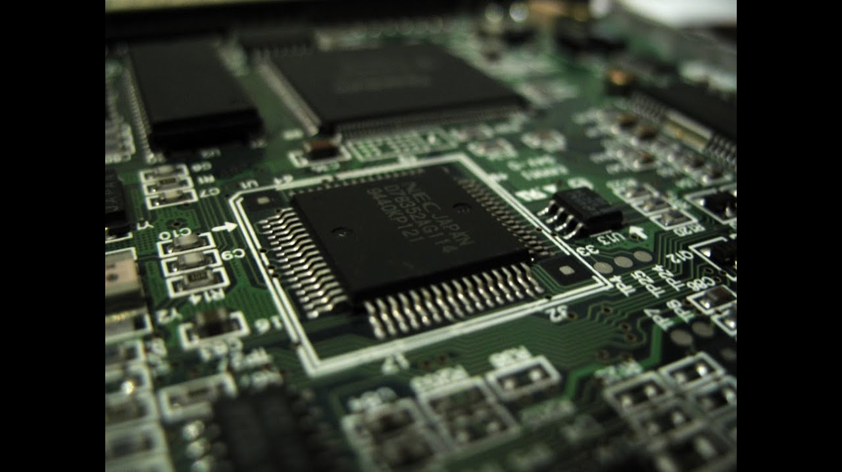
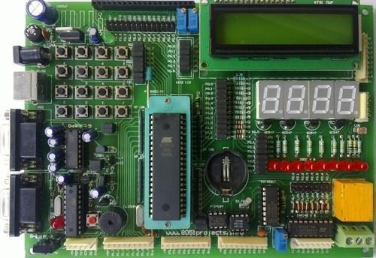
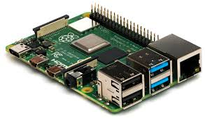
  Controller Realization
When designing a mechatronic system, one of the most important and critical decisions the designer has to make is the type of controller (physical controller) to use in order to control the system. There are a number of possible options as follows:
    Microcontroller/Microprocessor (e.g., Arduino microcontroller):
The microprocessor or a microcontroller is an integrated circuit that can be programmed to carry out set of instructions in response to hardwired inputs and that can send outputs. It can carry out a large number of instructions per seconds.

Slide 3
  Controller Realization
The microcontroller is usually used in applications that have a large number of products to be manufactured (e.g., washing machines, air-conditioners, automotive applications). The cost of the device is low. It is very compact and small size and thus does not take up much space. It has low power consumption.
It has the capability to perform some signal processing processes, but it is very limited in principle (e.g., cannot perform Fourier transform).
The number of inputs and outputs is limited and these need designing and developing. It also requires a number of additions in terms of hardware to make it fully functional.

Slide 4
  Controller Realization
It needs interfacing the inputs and the outputs to the real world. It is also susceptible to electrical noise (i.e., electromagnetic interference).
Generally, the microcontrollers and microprocessor require effort in programming, although it has now become possible to program them in high level languages (such as Micro-basic and Micro-C).
To summarize, these devices are suitable for applications that will be produced in large numbers in order to keep the cost down, require restricted space. But they need more effort in designing and programming.

Slide 5
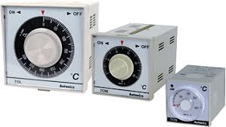
  Controller Realization
    2. Analog Controllers
  The analog controllers can be design by using root locus
  plot or bode plots in the s-domain.
  The objective of control system design is to construct a system that has a desirable response to standard inputs. A desirable transient response is one that is sufficiently fast without excessive oscillations. A desirable steady-state response is one that follows the desired output with sufficient accuracy.
This class of controllers depend in a classical control and they are design in the s-domain.
Analog controllers can be implemented using analog components e.g. operational amplifiers (it is called active circuit realization) or by using resistance and capacitive (RC) elements (it is called passive circuit realization).

Slide 6
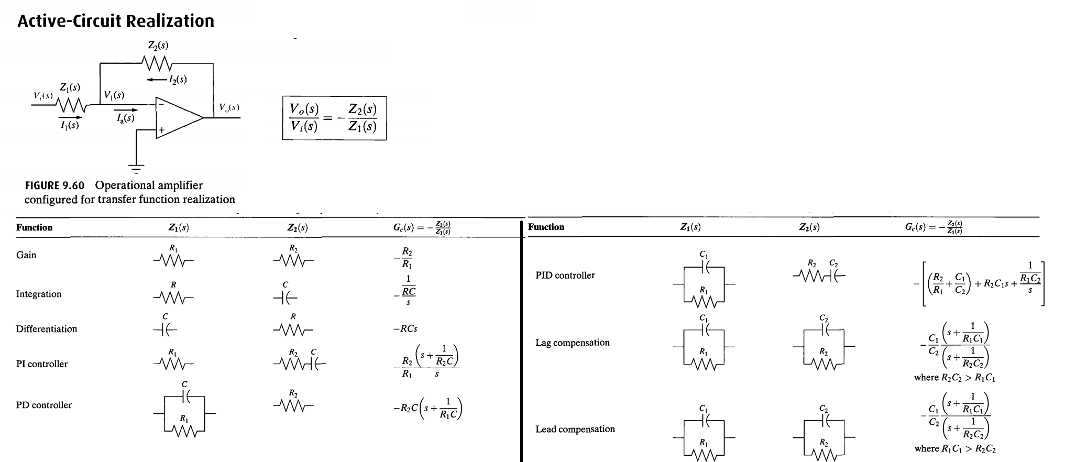
  Controller Realization

Slide 7
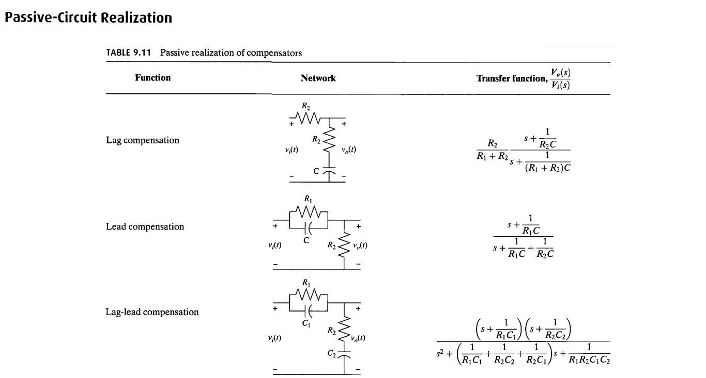

Slide 8
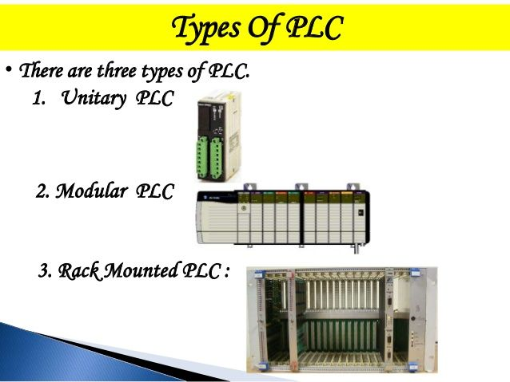
  Controller Realization
    3.Programmable logic controller (PLC):
  PLC is an electronic device that can be programmed using ladder diagram, function block or a sequential programming. PLC has a set of inputs and outputs (both analogue and/or digital). It continuously runs the program that has been stored within it and scans for the status of inputs. It then sends out outputs to control external devices.

Slide 9
  Controller Realization
The PLC has a large size and thus it requires more space. It cost higher than the Microcontrollers and the Microprocessors and it could range from $300 to thousands of US dollars.
The PLC has good interfacing for inputs and outputs. It has a high level of reliability.
The PLC is widely used in many industrial controllers. PLC are used in the water industries, oil and gas as well as factories. It is easy to program using ladder diagrams, block diagrams or even high level languages. The PLC is generally considered too slow to be used for high speed real time systems. The ladder language used in PLCs is easy to understand and program.

Slide 10
  Controller Realization
Modern PLCs are very modular in design and thus allow future expansion and also allow the designer to select additional features. Modern PLC have digital as well as analogue inputs and outputs that are very well developed and advanced. Cards can be added that include high speed counters, PID controllers and various means of communication (e.g., Ethernet, serial i/o). Inputs and outputs can also be protected against short circuit and can also be opto-isolated. PLCs in general are very suitable for tough industrial environments.
The PLC is not suitable for any signal processing, and thus the PLC is usually only used for simple logic processing that replace old relay systems.

Slide 11
  Controller Realization
As opposed to microprocessors and microcontrollers, PLCs have ready designed input and output interfaces. Their inputs and outputs are more resilient to electromagnetic interference (and in many cases protected against misuse or human error). PLCs are also more robust than microcontrollers and microprocessors and much easier to program.
The disadvantages of PLCs are that they are relatively slow (compared to Microcontrollers/Microprocessors, they take up more space and have a relatively high cost.

Slide 12
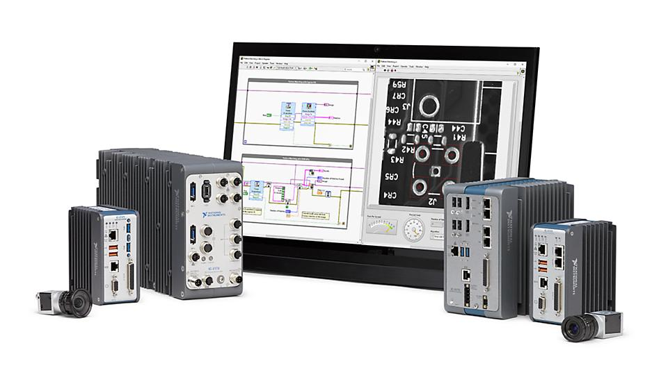
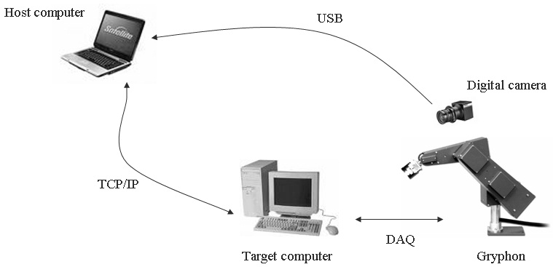
  Controller Realization
4. PC desktop/laptop:
In certain situations, a desktop or a laptop is used as a controller. This is usually done in situations where extensive signal processing and analysis are required. Special interfacing is usually carried out by the use of interface I/O cards. The cost is usually higher than the PLC.

Slide 13
  Controller Realization
The advantage of using of a desktop or a laptop is that it offers an excellent user interface, but it is not suitable for industrial environments that have dust, grease and liquids.
It is also not suitable for applications that have a large number of units due to the high cost and hence this is only used for one off systems. It is good for prototyping and developing new systems, is fast and has an excellent user interface.
The operating systems for desktop/PC is unsuitable for real time control and suffer from the risk of crashing and bugs. They also require additional I/O boards for interfacing to the real world.

Slide 14
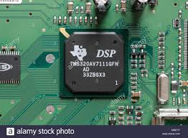
  Controller Realization
5. Digital Signal Processing (DSP) integrated circuits:
DSP are powerful microprocessors that possess advanced signal processing capabilities and are used where space is restricted. Texas instruments (TI) produces a large range of these devices some of which even include video processors. Texas Instruments is one of the leaders in this field.

Slide 15
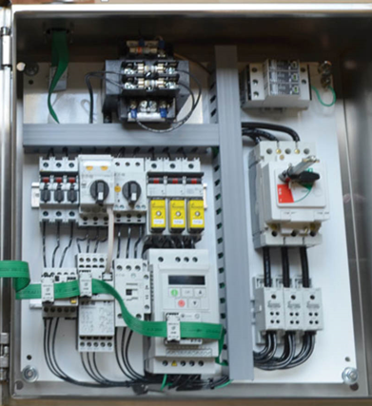
  Controller Realization
6. Relay controllers:
This method uses relays and their contacts (normally closed and normally open contacts that are denoted as NC and NO respectively) to implement logic functions. They are rarely used nowadays as they are bulky and consume a lot of energy and take up a lot of space.
The disadvantages of relay controllers are:
  They take up too much space.
  They consume a lot of power.
  They are unreliable due to the failure of electromechanical components.
  They are slow in processing.

Slide 16
  Controller Realization
7. Logic gates:
Logic gates could be used to implement logic decisions. These could be implemented in electronic format, such gates (CMOS, TTL), programmable logic devices (PLD) and programmable logic arrays (PLA), field programmable gate arrays (FPGA). FPGAs offer very high speeds and high levels of reliability and are very compact. However, one of their disadvantages is that they require a special programming language (VHDL).
The most widely used options of these are the first four. The table below shows a general comparison of the three options:

Slide 17
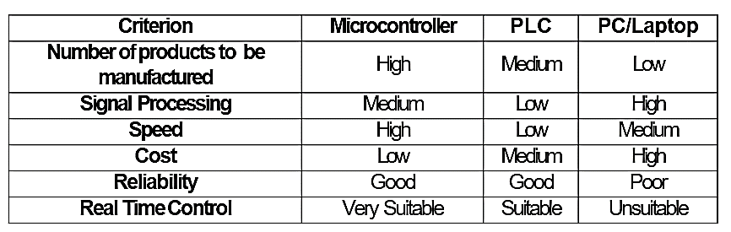
  Controller Realization

Slide 18
  Controller Algorithms
The other critical decision that the designer has to make is the type of control algorithm which can be used. The decision requires a thorough understanding of the process to be controlled and the required performance. There are a number of options:
    On/off control (also known as Bang-bang control):
This is the simplest method of control. The control element that is controlling the process under control can only have one of two states: on or off.
The control system switches on the final control element if the actual value is less than the desired value and switches it off if the actual value is more than the desired value. This method is very simple and reliable. But it might cause imprecise control of the variable, but this is sometimes acceptable in certain situations (e.g., hot water tank in a house).

Slide 19
  Controller Algorithms
Proportional control:
In this mode of control the actual value of the variable to be controlled is subtracted from the desired value. The result is multiplied by the proportional constant (some- times called the gain) and sent to the output of the controller. This method ensures that the response of the controller is increased when the error increases. Also note that this method does not have any memory (i.e., there is no need to re- member the last output of the controller in the last update).
The main disadvantage of the proportional control is that it cannot eliminate the steady state error (it can only reduce it). Increasing the value of the proportional constant will improve the speed of response and reduce the steady state error (but cannot eliminate it). However, this could lead to overshooting of the system or even oscillation in certain cases.

Slide 20
  Controller Algorithms
PI, PID, PD control:
Integral control can be added to the proportional control. This is referred to as PI control. The advantage of this method is that it can eliminate the steady state error. However, integral control can lead to the instability of some system.
The derivative control is also sometimes used in a PID controller to prevent the system becoming unstable. PD controllers are used in position control systems to ensure good speed of response.

Slide 21
  Controller Algorithms
Advanced control methods:
Many other types of controllers can also be used to deal with difficult systems. Using artificial intelligence such as neural networks, fuzzy logic and genetic algorithms better control solutions can be devised.
Adaptive control can be used in controllers that can monitor the system and adapt the control algorithm to suit the system. These systems are used in special systems that are difficult to control with conventional PID methods.
Another new method of open loop control is called command shaping (input shaping) which depends on reshaping the input signal to obtain a desired output

Slide 22
  Examples
Choose a suitable physical controller for the following applications:
    Face Recognition in an office: PC.
    A washing machine of which we want to manufacture a large number and space is restricted: A Microcontroller.
    Air conditioner large numbers to be manufactured, space is restricted: A Microcontroller.
    Water pumping system in a local water substation: PLC assuming that the number of systems to be manufactured is small; there is no need for signal processing; and it is to be installed in an industrial tough environment.
    Internal combustion engine controller: Space is restricted and fast operation is required:
a microcontroller/microprocessor.

Slide 23
  Examples
In each of the following problems, explain the type of physical controller you would use, the most suitable control algorithm and the most suitable type of actuator. Explain your choices:
1. A voice recognition system that opens a door lock.
The voice recognition system requires a lot of digital signal processing.
Physical Controller: PC (desktop or laptop) as it has good processing power for DSP.
Control Algorithm: an On/Off Controller.
Actuator: A simple electromagnetic solenoid, to open the lock

Slide 24
  Examples
An Electric Vehicle.
As the supply for the electric vehicle is most likely a battery, then the most suitable type of actuator is a permanent magnet DC motor.
The physical controller is usually a microcontroller, as it takes little space, and it is expected to be manufactured in large numbers.
The control algorithm can be a PID controller that can control the speed of the vehicle.
A robotic manipulator arm. As the accuracy of positioning is important, the servo motor is the most suitable actuator. A stepper motor can also be used.
As for the control algorithm, the most suitable algorithm is a PD controller since there will be no steady-state error with those actuators.
A microcontroller is the best choice here as it is suitable for real time control and it takes up little space.

Slide 25
  Examples
A factory shutter gate:
The most suitable actuator is an induction motor, there is no need to change the speed. The direction of rotation is reversed in a 3-phase induction motor by interchanging any two phases.
The control algorithm can be an on/off controller.
The physical controller can be a PLC as space is not a problem, and it is very robust for the industrial environment.

