Slide 1
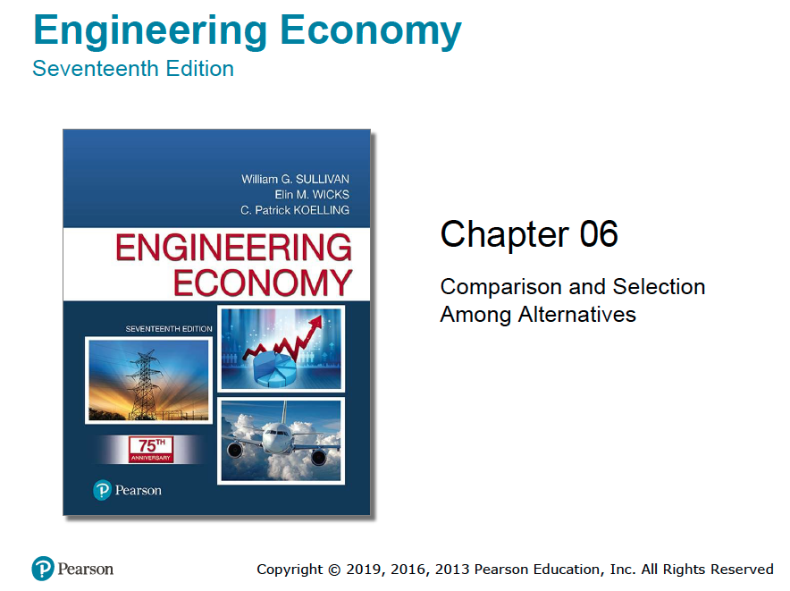

Slide 2
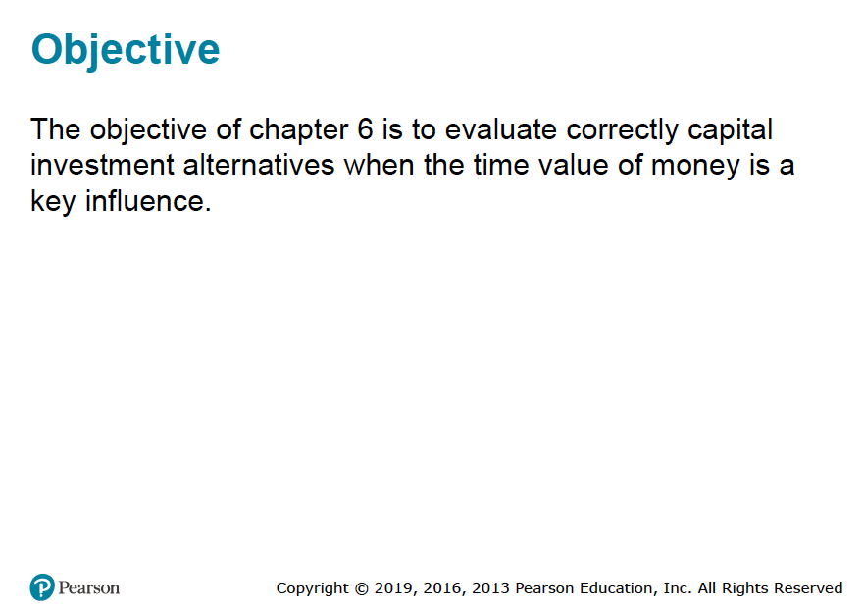

Slide 3
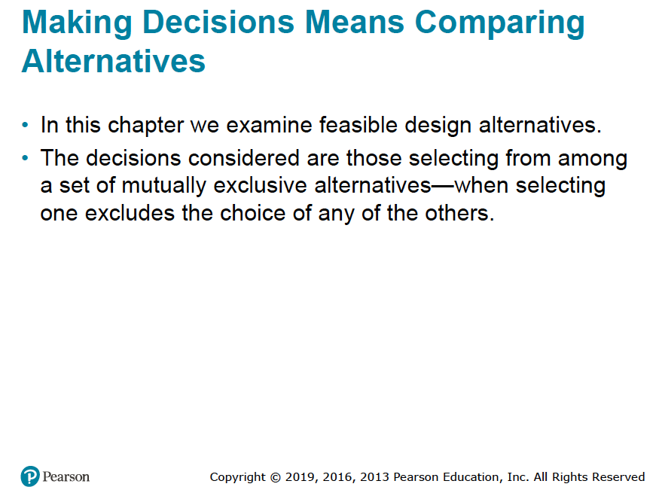

Slide 4
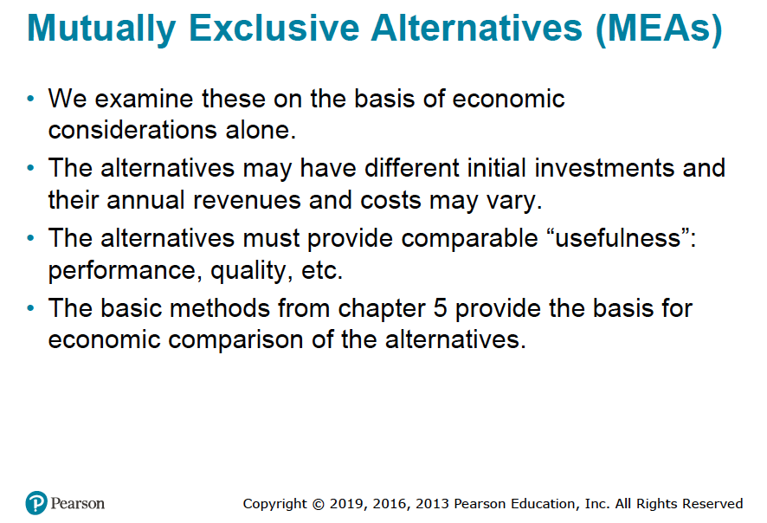

Slide 5
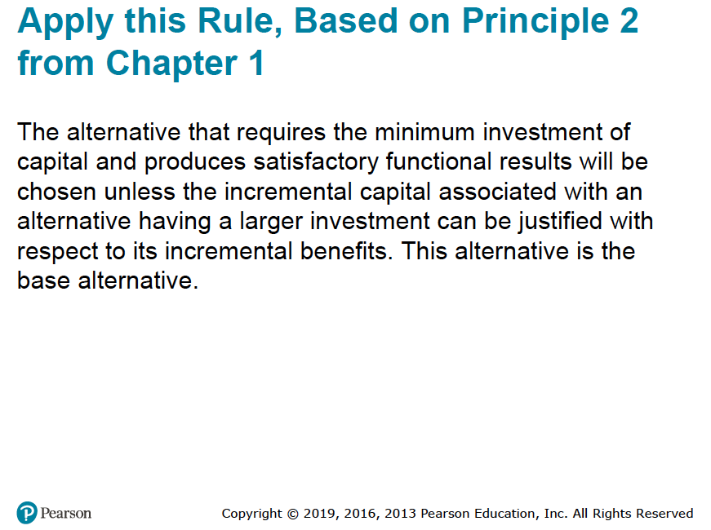

Slide 6
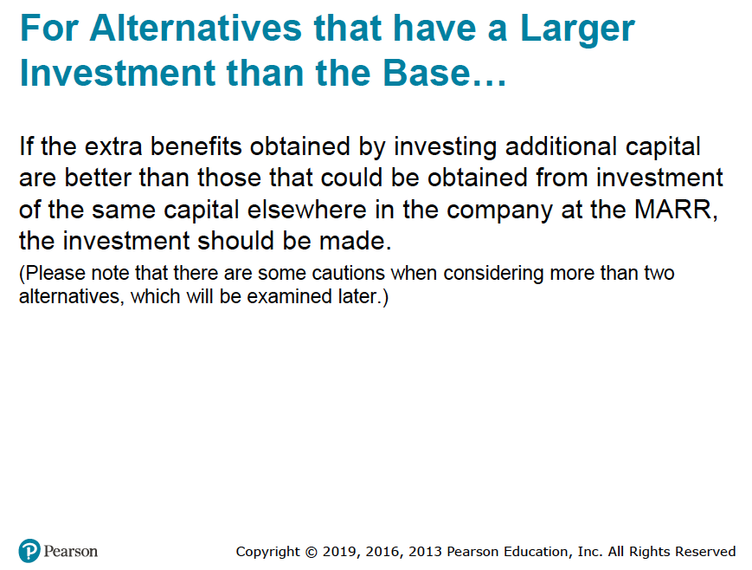

Slide 7
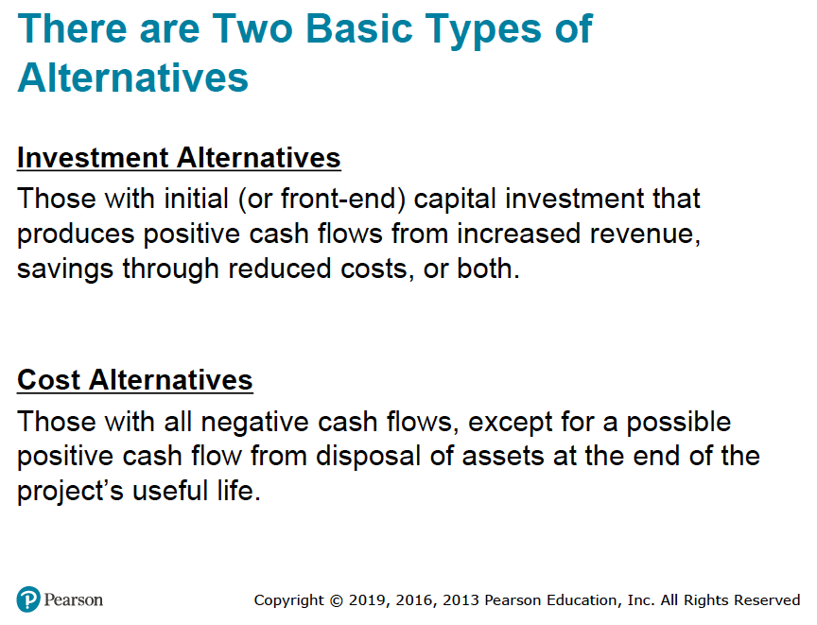

Slide 8
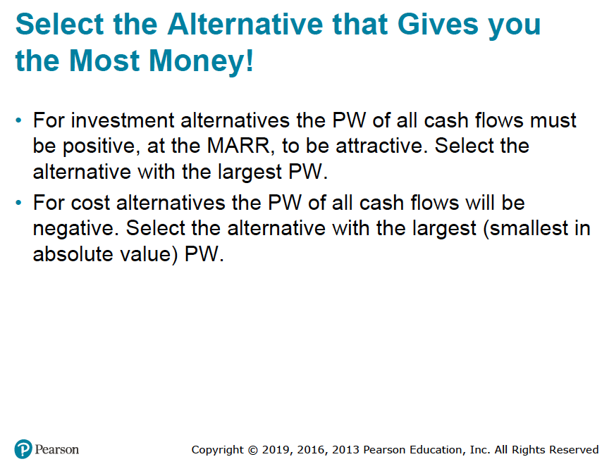

Slide 9
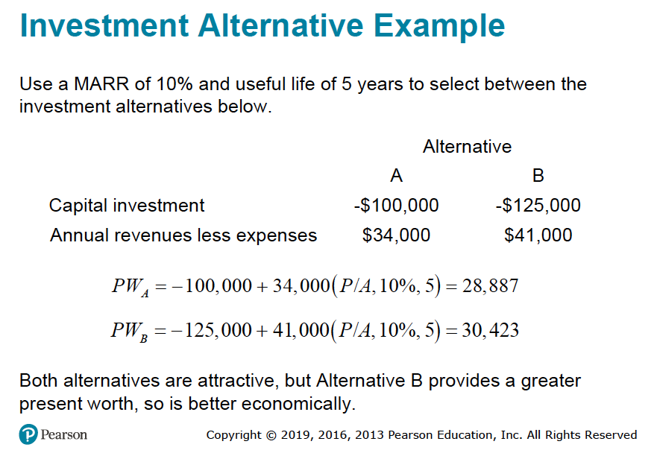

Slide 10
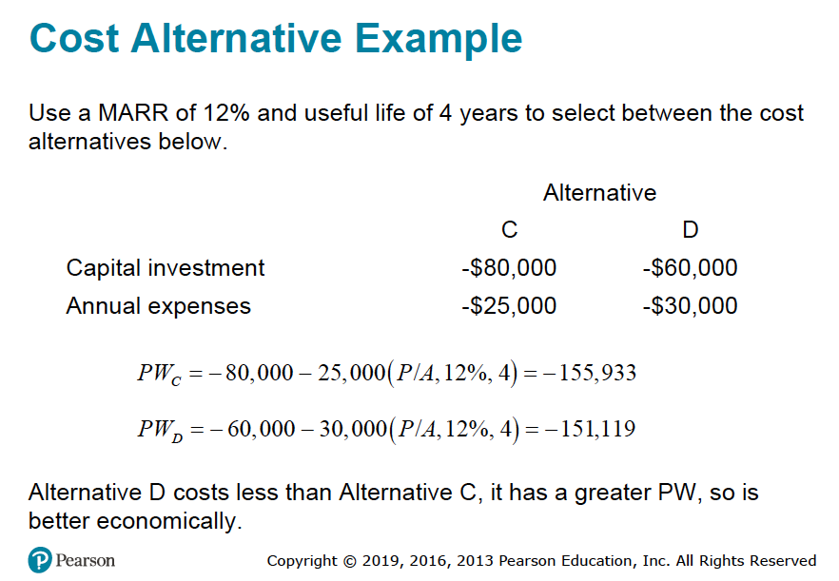

Slide 11
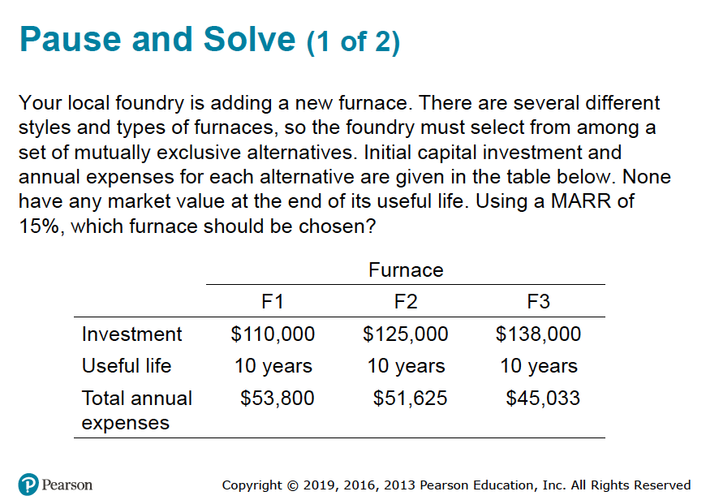

Slide 12
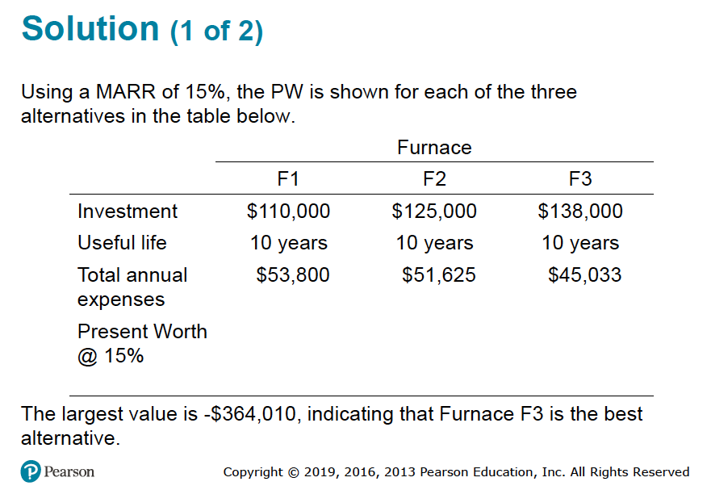

Slide 13
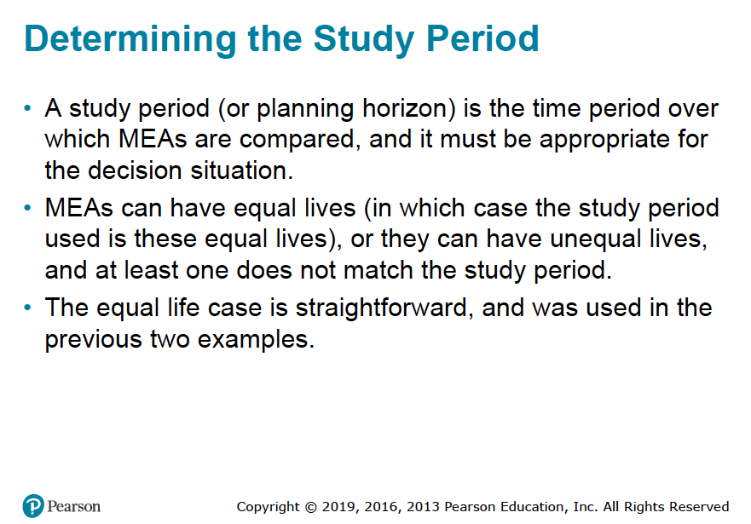

NB: MEAs are mutually exclusive alternatives.

Slide 14
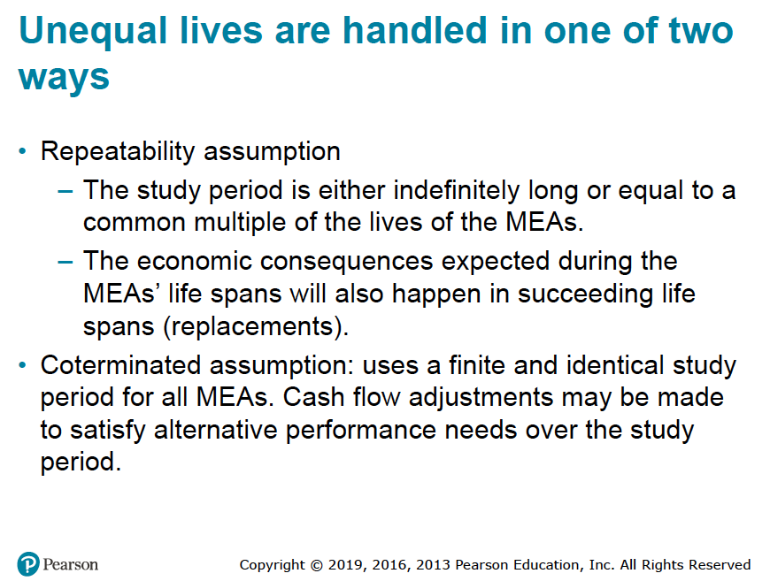

Slide 15
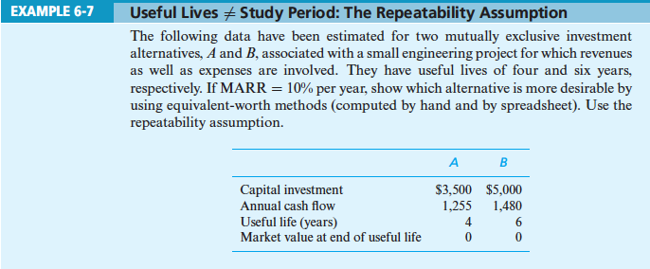

Slide 16
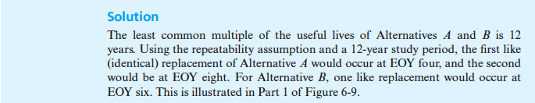
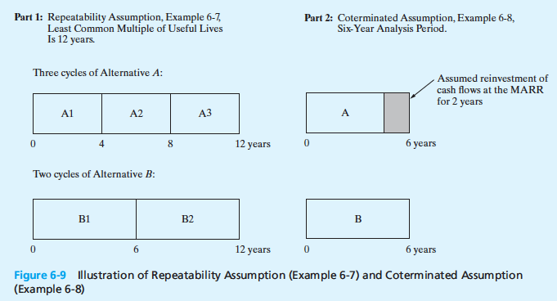

Slide 17
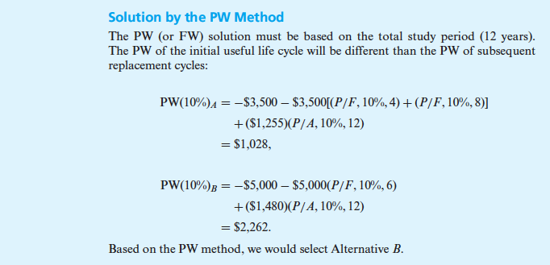

Slide 18
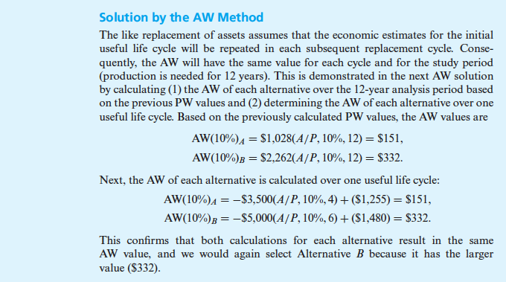

Slide 19
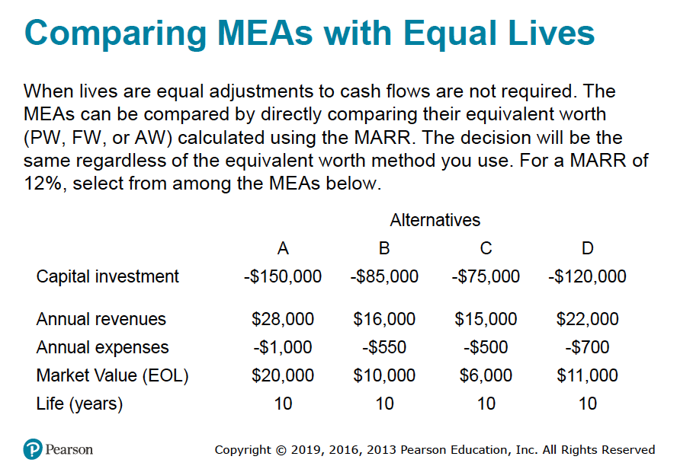

Slide 20
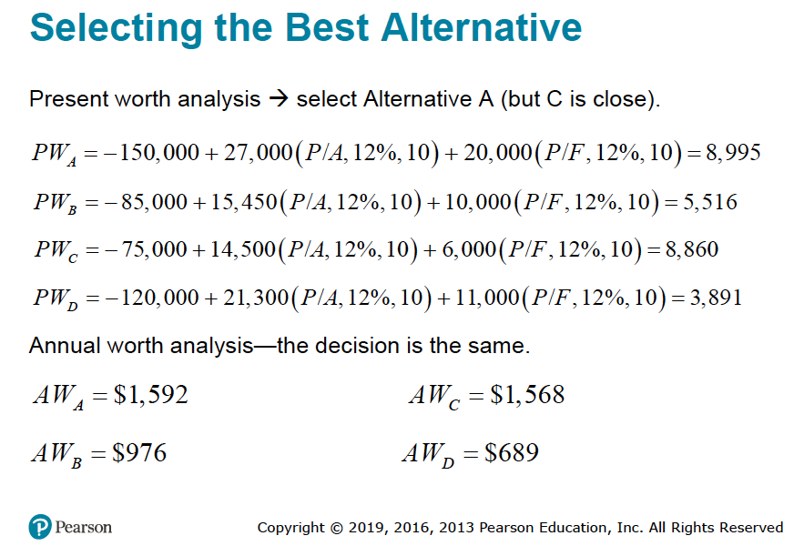

Slide 21
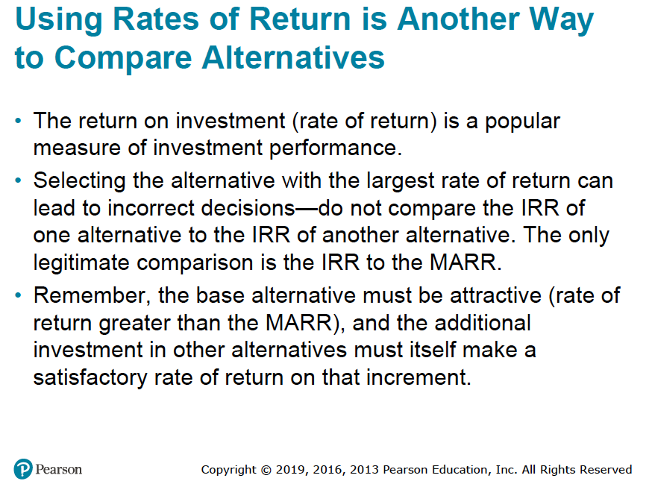

Slide 22
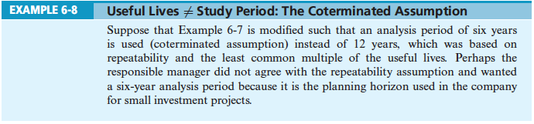

Slide 23
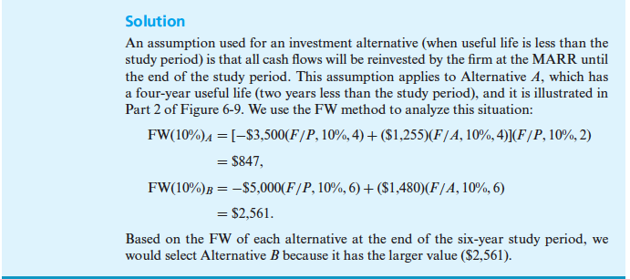

Slide 24
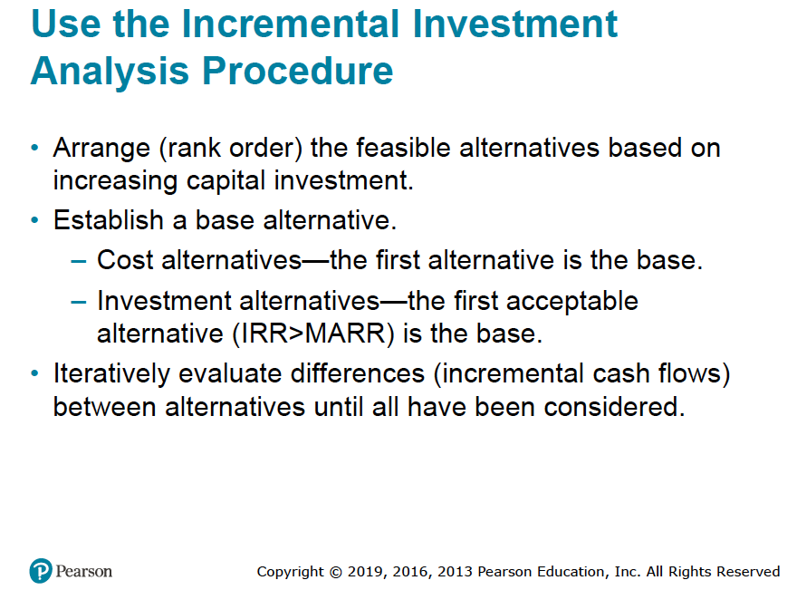

Slide 25
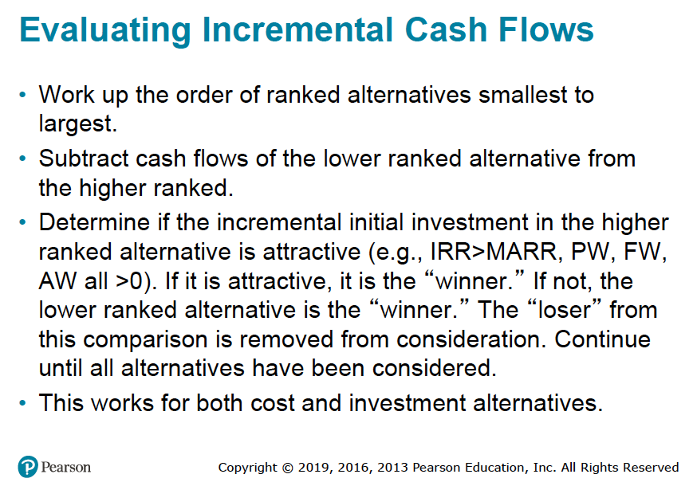

Slide 26
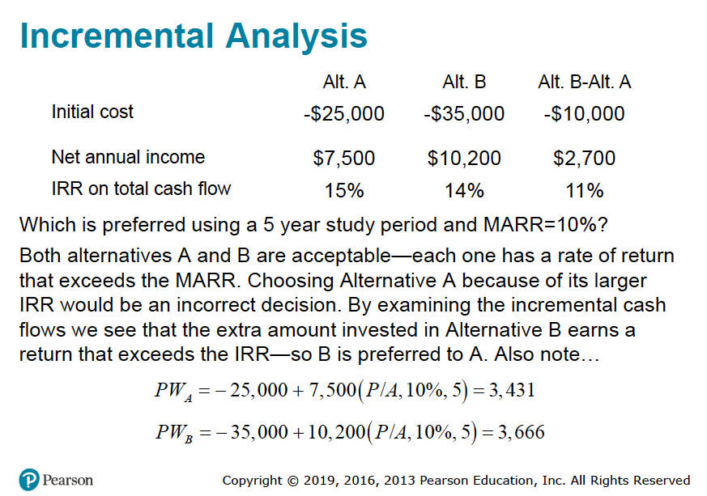


Slide 27
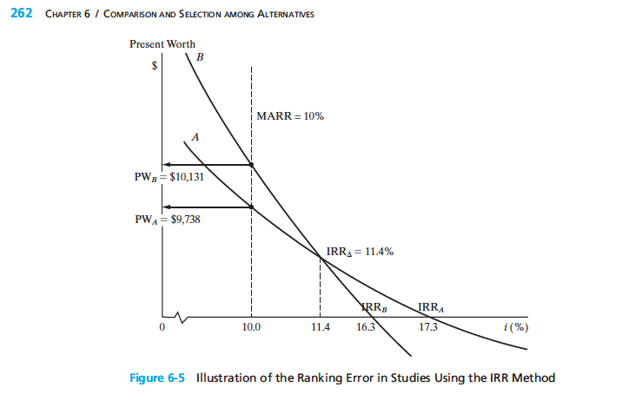

Ranking Reversal of Projects
At MARR = 10% project B
must be selected.
At MARR = 15% project A
must be selected.
If MARR = 15%
Cross-over discount rate
= 11.4%
At MARR = 11.4% the
management will be indifferent
between projects A and project B.

Slide 28
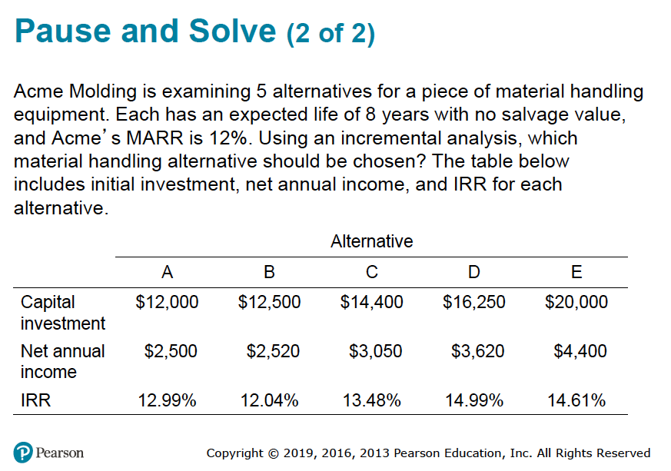

Slide 29
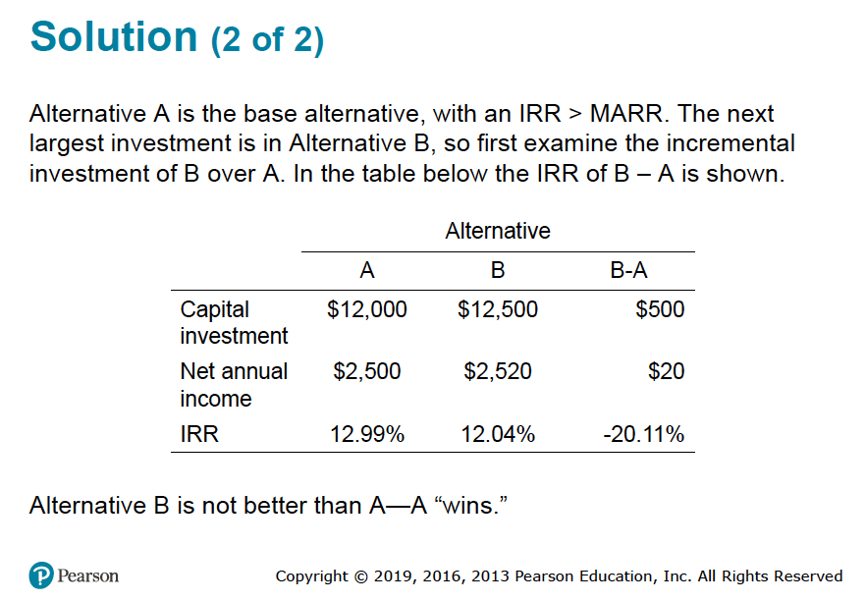



Slide 30
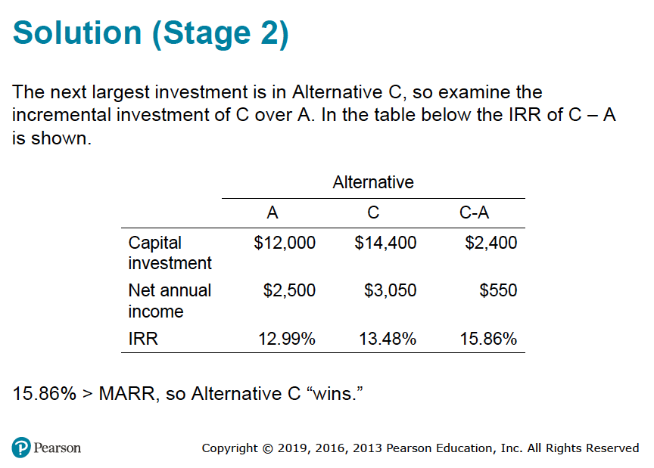


Slide 31
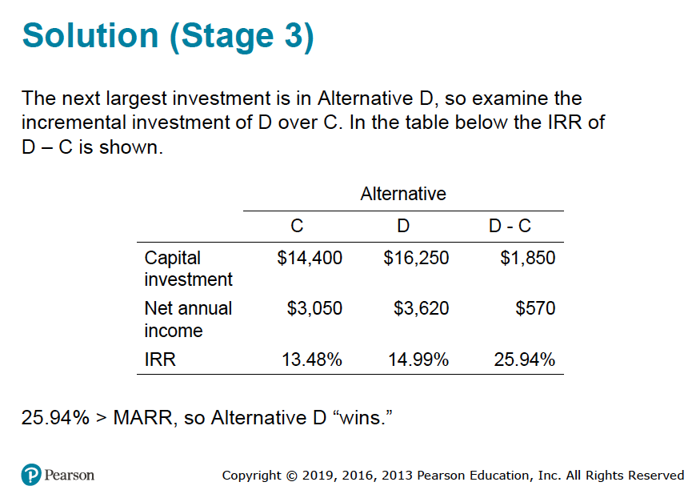


Slide 32
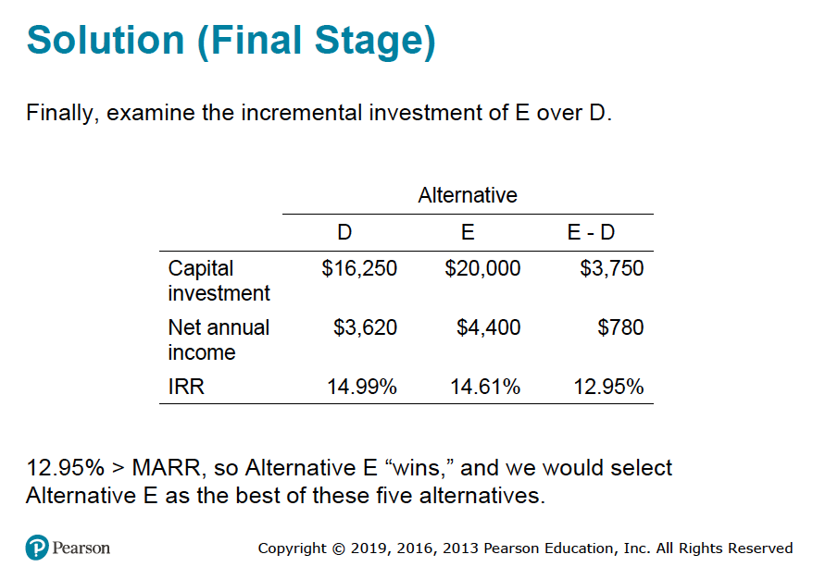



Slide 33
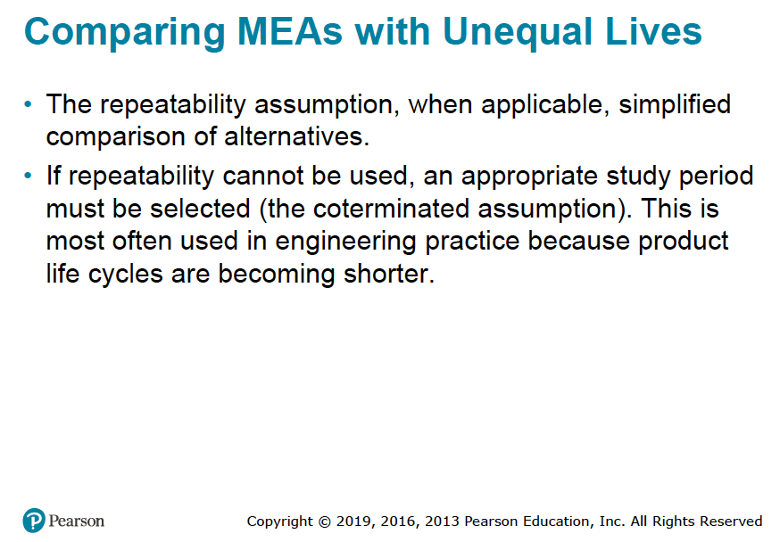

Slide 34
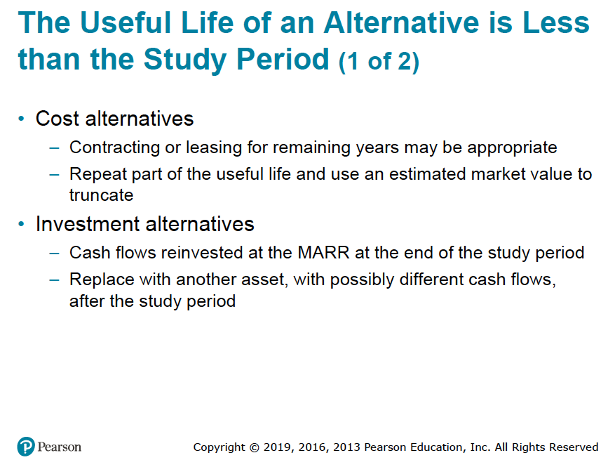

Slide 35
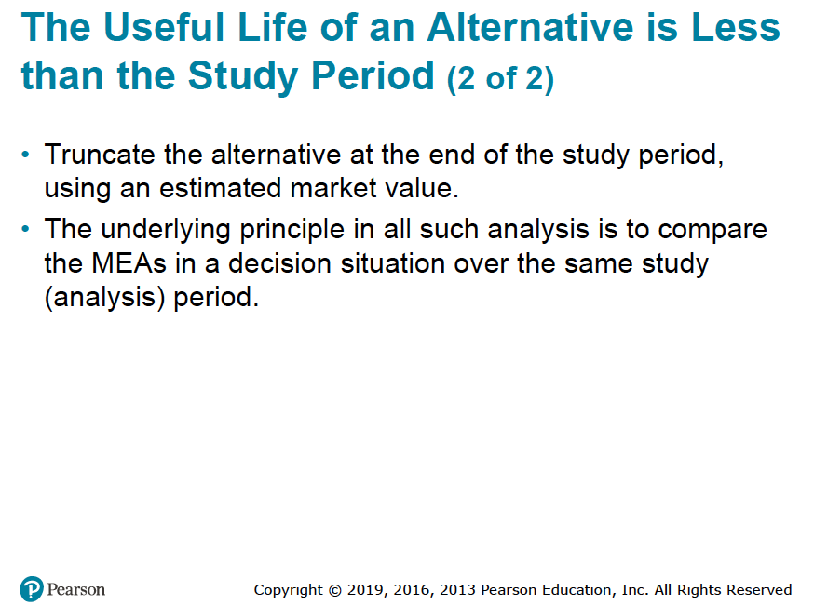

Slide 36
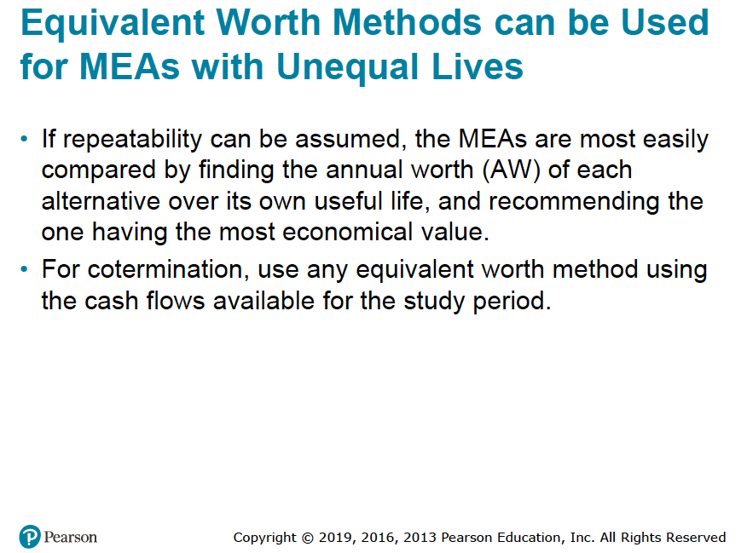

Slide 37
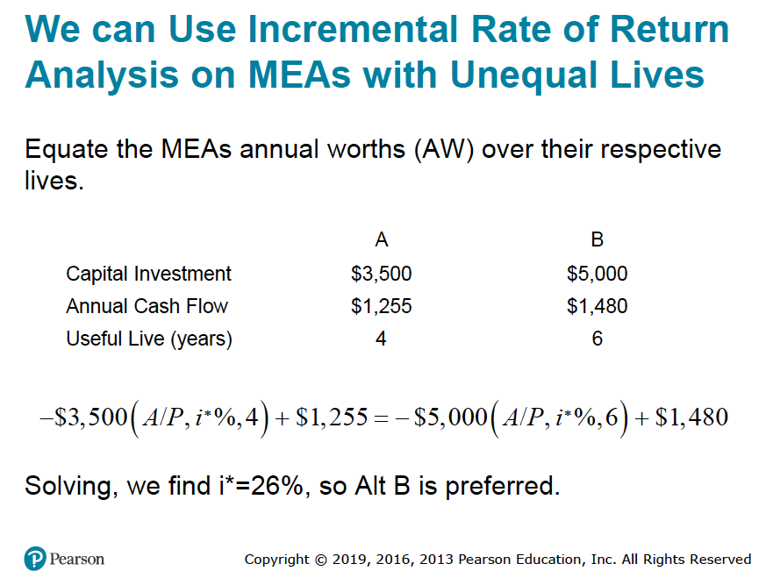

Slide 38
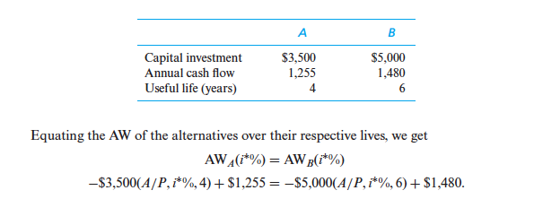
The decision rule using this approach is that, if i∗ ≥ MARR, the increment is justified and the alternative with the higher capital investment cost is preferred. So, when repeatability applies, we simply need to develop the AW equation for each alternative over its own useful life and find the interest rate that makes them equal. To demonstrate, consider the alternatives that were analyzed in Example 6-8 by using a MARR of 10% per year and a study period of 12 years (repeatability assumption).
By trial and error, the IRR of the extra capital needed to repeatedly invest in Alternative B (instead of Alternative A) over the study period is i∗ = 26%. Since this value is greater than the MARR, the increment is justified, and Alternative B is preferred.

Slide 39
