Slide 1
Assessment and Management of Patients With Hepatic Disorders

Slide 2
Review of Anatomy and Physiology
Largest gland of the body
Located in the upper right abdomen
A very vascular organ that receives blood from GI tract via the portal vein and from the hepatic artery

Slide 3
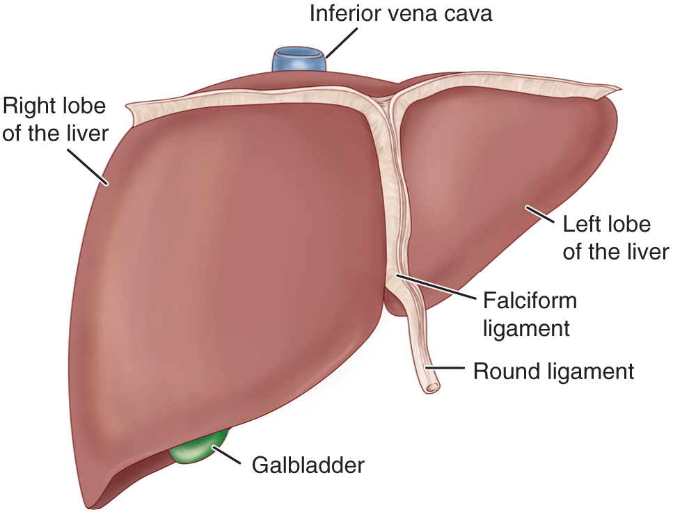
Liver and Biliary System

Slide 4
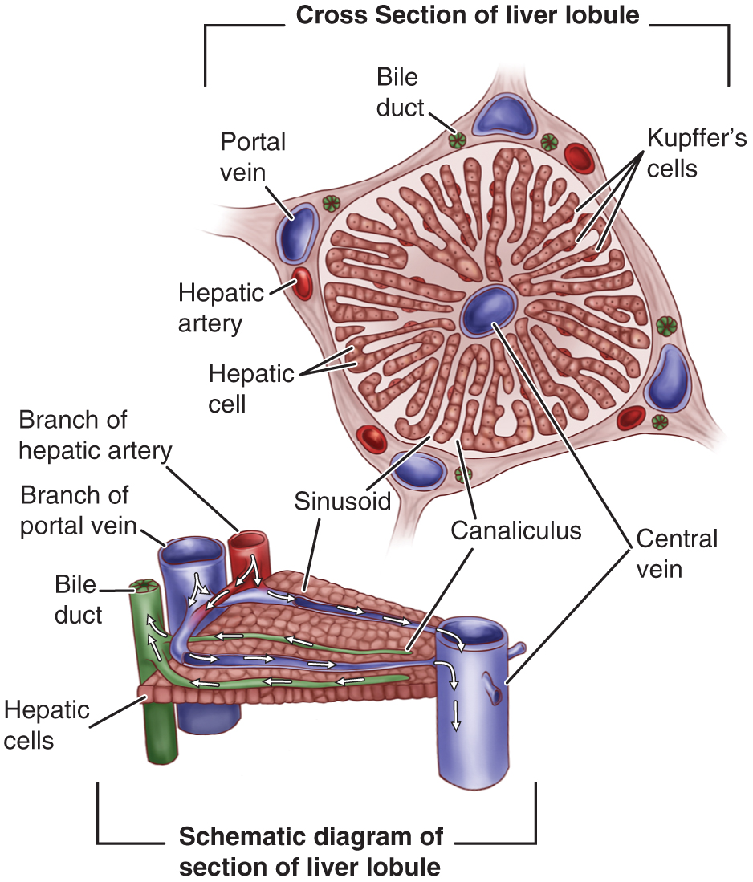
Section of a Liver Lobule

Slide 5
Assessment and Metabolic Function Studies
Health history, gerontologic changes,
OTC medications
Pallor, jaundice
Petechiae, erythema, angiomas
Gynecomastia
Neurologic status
Glucose metabolism
Ammonia conversion
Protein metabolism
Fat metabolism
Vitamin and iron storage
Bile formation, Bilirubin excretion
Drug metabolism

Slide 6
Question
Is the following statement true or false?
The majority of blood supply to the liver, which is poor in nutrients, comes from the portal vein.

Slide 7
Answer
False
The majority of blood supply to the liver, which is rich in nutrients from the gastrointestinal tract, comes from the portal vein.

Slide 8
Liver Function Studies
Serum aminotransferase: AST, ALT, GGT, GGTP, LDH
Serum protein studies
Direct and indirect serum bilirubin, urine bilirubin, and urine bilirubin and urobilinogen
Prothrombin time
Serum alkaline phosphatase
Serum ammonia
Cholesterol

Slide 9
Additional Diagnostic Studies
Liver biopsy
Ultrasonography
CT
MRI

Slide 10
Hepatic Dysfunction
Acute or chronic, cirrhosis of the liver
Most common cause is malnutrition related to alcoholism
Infection
Anoxia
Metabolic disorders
Nutritional deficiencies
Hypersensitivity states

Slide 11
Manifestations
Jaundice
Portal hypertension, ascites, and varices
Hepatic encephalopathy or coma
Nutritional deficiencies

Slide 12
Jaundice
Yellow- or green-tinged sclera and skin caused by increased serum bilirubin levels
Hemolytic, hepatocellular, obstructive
  Hereditary hyperbilirubinemia
Hepatocellular and obstructive jaundice are most associated with liver disease

Slide 13
Signs and Symptoms Associated With Hepatocellular and Obstructive Jaundice
Hepatocellular
  Mild or severely ill
  Lack of appetite, nausea or vomiting, weight loss
  Malaise, fatigue, weakness
  Headache, chills, fever, infection
Obstructive
  Dark orange-brown urine, clay-colored stools
  Dyspepsia and intolerance of fats, impaired digestion
  Pruritus

Slide 14
Portal Hypertension
Obstructed blood flow through the liver results in increased pressure throughout the portal venous system
Results in
  Ascites
  Esophageal varices

Slide 15
Ascites: Fluid in Peritoneal Cavity—Causes
Portal hypertension resulting in increased capillary pressure and obstruction of venous blood flow
Vasodilatation of splanchnic circulation (blood flow to the major abdominal organs)
Changes in the ability to metabolize aldosterone, increasing fluid retention
Decreased synthesis of albumin, decreasing serum osmotic pressure
Movement of albumin into the peritoneal cavity

Slide 16
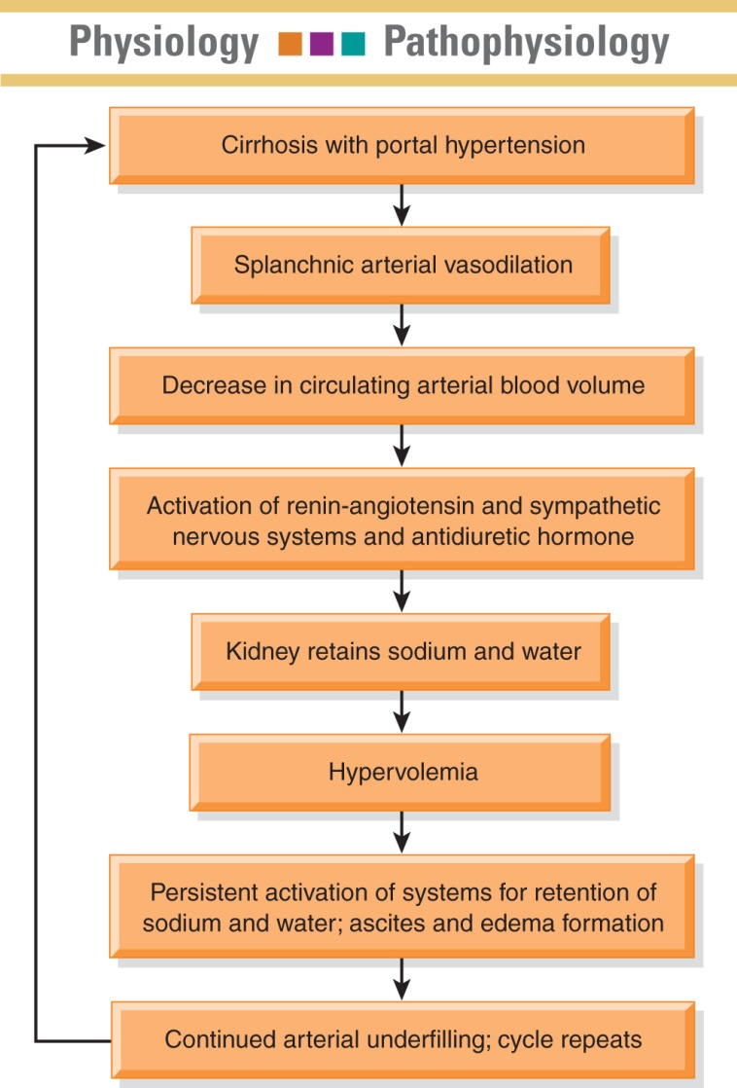
Ascites

Slide 17
Assessment of Ascites
Record abdominal girth and weight daily
Patient may have striae, distended veins, and umbilical hernia
Assess for fluid in abdominal cavity by percussion for shifting dullness or by fluid wave
Monitor for potential fluid and electrolyte imbalances

Slide 18

Assessing for Abdominal Fluid Wave

Slide 19
Treatment of Ascites
Low-sodium diet
Diuretics
Bed rest
Paracentesis
Administration of salt-poor albumin
Transjugular intrahepatic portosystemic shunt (TIPS)

Slide 20
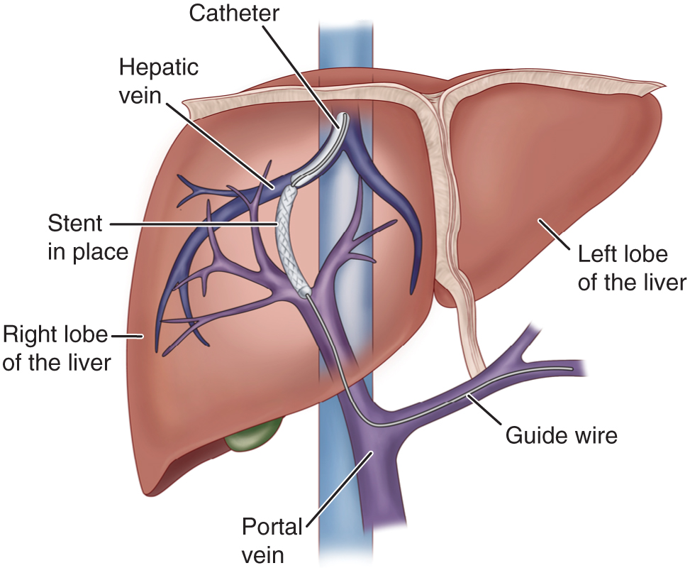
TIPS

Slide 21
Question
Which diuretic medication would most often be used for a patient with ascites?
Actazolamide (Diamox)
Ammonium chloride
Furosemide (Lasix)
Spironolactone (Aldactone)

Slide 22
Answer
Spironolactone (Aldactone)
Spironolactone (Aldactone) is most often the first-line therapy in patients with ascites from cirrhosis. Oral diuretics such as furosemide (Lasix) may be added but should be used cautiously. Ammonium chloride and acetazolamide (Diamox) are contraindicated because of the possibility of precipitating hepatic coma.

Slide 23
Hepatic Encephalopathy and Coma
Assessment
  EEG
  Changes in LOC
  Potential seizures
  Fetor hepaticus
  Monitor fluid, electrolyte, and ammonia levels
Life-threatening complications: accumulation of ammonia and other toxic metabolites in the blood

Slide 24
Medical Management
Eliminate precipitating cause
Lactulose to reduce serum ammonia levels
IV glucose to minimize protein catabolism
Protein restriction
Reduction of ammonia from GI tract by gastric suction, enemas, oral antibiotics
Discontinue sedatives analgesics and tranquilizers
Monitor or treat complications and infections

Slide 25
Bleeding of Esophageal Varices
Occurs in about one third of patients with cirrhosis and varices
First bleeding episode has a mortality rate of 30% to 50%
Manifestations include hematemesis, melena, general deterioration, and shock
Patients with cirrhosis should undergo screening endoscopy every 2 years

Slide 26
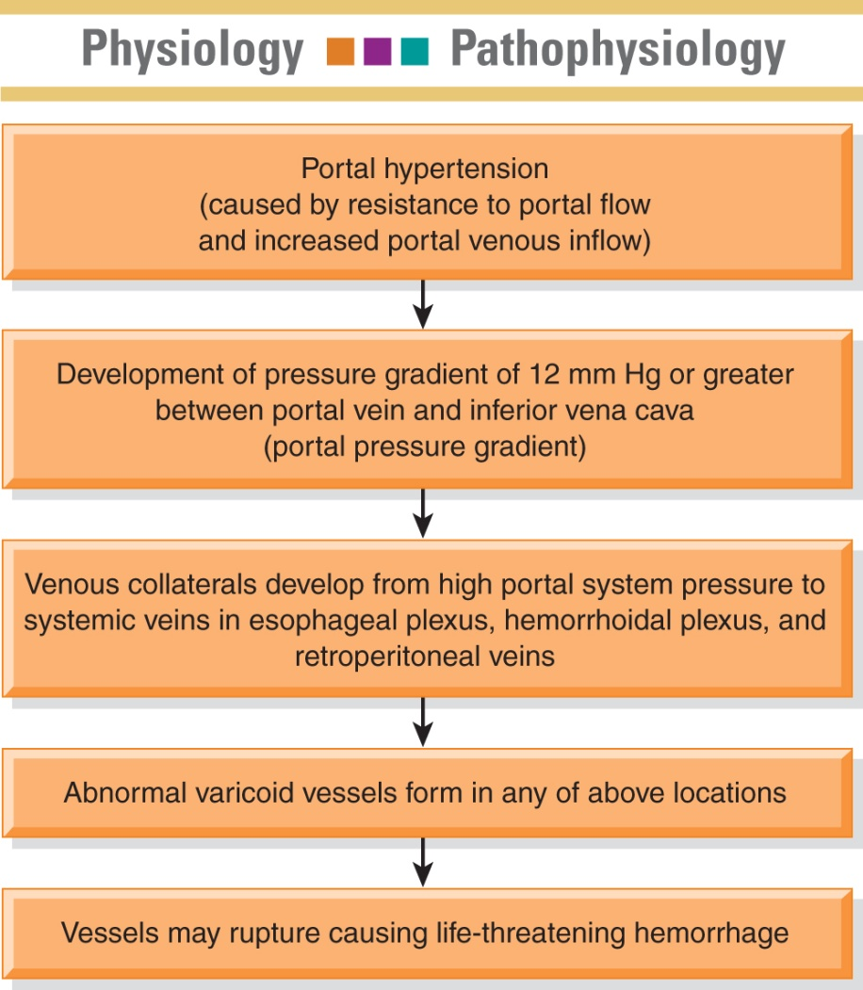
Bleeding Esophageal Varices

Slide 27
Treatment of Bleeding Varices
Treat for shock; administer oxygen
IV fluids, electrolytes, volume expanders, blood and blood products
Vasopressin, somatostatin, octreotide to decease bleeding
Nitroglycerin in combination with vasopressin to reduce coronary vasoconstriction
Propranolol and nadolol to decrease portal pressure; used in combination with other treatment

Slide 28
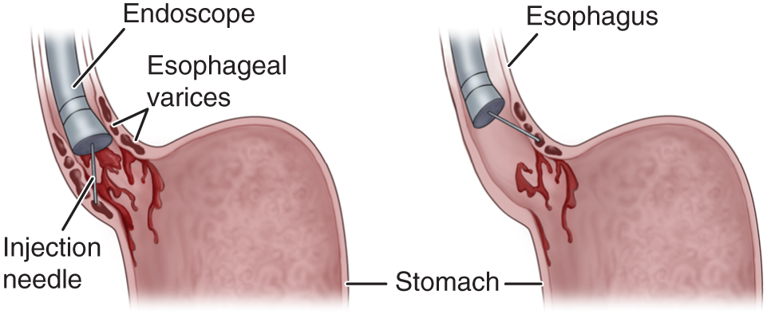
Endoscopic Sclerotherapy

Slide 29
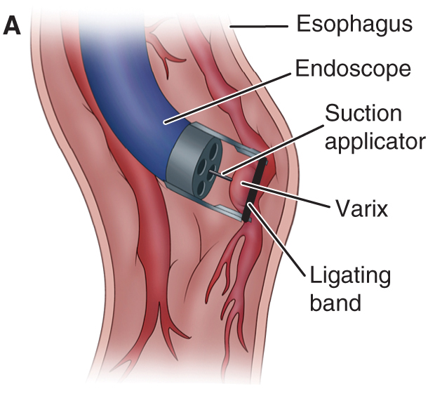
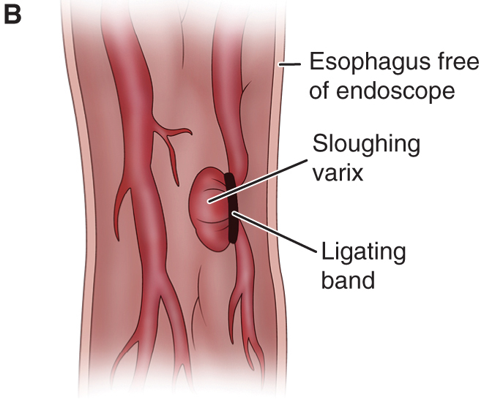
Esophageal Banding

Slide 30
Nursing Management
Monitor frequently for aspiration, changes in vital signs, emotional responses, and cognitive status
Monitor for associated complications: hepatic encephalopathy resulting from blood breakdown in the GI tract and delirium related to alcohol withdrawal
Oral care, tube care, and GI suctioning
Implement measures to reduce anxiety and agitation
Education and support of patient and family

Slide 31
Hepatitis
Viral hepatitis: a systemic viral infection that causes necrosis and inflammation of liver cells with characteristic symptoms and cellular and biochemical changes.
  A and E: fecal–oral route
  B and C: bloodborne
  D: only people with hepatitis B are at risk
  Hepatitis G and GB virus-C
Nonviral hepatitis: toxic and drug induced

Slide 32
Hepatitis A
Spread by poor hand hygiene; fecal–oral
Incubation: 15 to 50 days
Illness may last 4 to 8 weeks
Mortality rate is 0.5% for those younger than age 40 years and 1% to 2% for those older than age 40 years
Manifestations: mild flulike symptoms, low-grade fever, anorexia, later jaundice and dark urine, indigestion and epigastric distress, enlargement of liver and spleen

Slide 33
Management of Hepatitis A
Prevention
  Good handwashing, safe water, and proper sewage disposal
  Vaccine
  Refer to Chart 49-7
  Immunoglobulin for contacts to provide passive immunity
Bed rest during acute stage
Nutritional support

Slide 34
Hepatitis B
Transmitted through blood, saliva, semen, and vaginal secretions; sexually transmitted; transmitted to infant at the time of birth
A major worldwide cause of cirrhosis and liver cancer
Risk factors: refer to Chart 49-9
Long incubation period: 1 to 6 months
Manifestations: insidious and variable; similar to hepatitis A

Slide 35
Management of Hepatitis B
Medications for chronic hepatitis type B include alpha interferon and antiviral agents: lamivudine (Epivir), adefovir (Hepsera)
Bed rest and nutritional support
Vaccine: for persons at high risk, routine vaccination of infants
  Passive immunization for those exposed
  Standard precautions and infection control measures
  Screening of blood and blood products

Slide 36
Hepatitis C
Transmitted by blood and sexual contract, including needle sticks and sharing of needles
The most common bloodborne infection
A cause of one third of cases of liver cancer and the most common reason for liver transplant
Risk factors: refer to Chart 49-10
Incubation period is variable
Symptoms are usually mild
Chronic carrier state frequently occurs

Slide 37
Management of Hepatitis C
Antiviral medications: interferon, ribavirin (Rebetol)
Measures to reduce spread of infection as with hepatitis B
Alcohol potentiates disease; medications that effect the liver should be avoided
Prevention: public health programs to decrease needle sharing among drug users
Screening of blood supply
Safety needles for health care workers

Slide 38
Other Liver Disorders
Nonviral hepatitis
  Toxic hepatitis
  Drug-induced hepatitis
Fulminant hepatic failure

Slide 39
Hepatic Cirrhosis
Types
  Alcoholic
  Postnecrotic
  Biliary
Pathophysiology:
Manifestations: liver enlargement, portal obstruction, ascites, GI varices, edema, vitamin deficiency, anemia, mental deterioration; refer to Chart 49-11

Slide 40
Nursing Process: The Care of the Patient With Cirrhosis of the Liver—Assessment
Focus: onset of symptoms, history of precipitating factors
Alcohol use or abuse
Dietary intake and nutritional status
Exposure to toxic agents and drugs
Assess changes in mental status, ADL and IADLs, job and social relationships
Monitor signs and symptoms related to bleeding; changes in fluid volume and laboratory data

Slide 41
Nursing Process: The Care of the Patient With Cirrhosis of the Liver—Diagnosis
Activity intolerance
Imbalanced nutrition
Impaired skin integrity
Risk for injury and bleeding

Slide 42
Collaborative Problems and Complications of Cirrhosis of the Liver
Bleeding and hemorrhage
Hepatic encephalopathy
Fluid volume excess

Slide 43
Nursing Process: The Care of the Patient With Cirrhosis of the Liver—Planning
Goals may include increased participation in activities, improvement of nutritional status, improvement of skin integrity, decreased potential for injury, improvement of mental status, and absence of complications

Slide 44
Activity Intolerance
Rest and supportive measures
Positioning for respiratory efficiency
Oxygen
Planned mild exercise and rest periods
Address nutritional status to improve strength
Measures to prevent hazards of immobility

Slide 45
Imbalanced Nutrition
I&O
Encourage small frequent meals
High-calorie diet, sodium restriction
Protein modified or restricted if patient is at risk for encephalopathy
Supplemental vitamins, minerals, B complex, provide water-soluble forms of fat-soluble vitamins if patient has steatorrhea
Consider patient preferences

Slide 46
Other Interventions
Impaired skin integrity
  Frequent position changes
  Gentle skin care
  Reduce scratching related to pruritus
Risk for injury
  Prevent falls, trauma related to risk for bleeding

Slide 47
Cancer of the Liver
Primary liver tumors
  Associated with hepatitis B and C
  Hepatocellular carcinoma (HCC)
Liver metastasis
  Few cancers originate in the liver
  Frequent site of metastatic cancer
Manifestations
  Dull persistent pain, RUQ, back or epigastrium
  Weight loss, anemia, anorexia, weakness
  Jaundice, bile ducts occluded, ascites or obstructed portal veins

Slide 48
Nonsurgical Management of Liver Cancer
Underlying cirrhosis, which is prevalent in patients with liver cancer, increases risks of surgery
Major effect of nonsurgical therapy may be palliative
Radiation therapy
Chemotherapy
Percutaneous biliary drainage
Other nonsurgical treatments

Slide 49
Surgical Management of Liver Cancer
Treatment of choice for HCC if confined to one lobe and liver function is adequate
Liver has regenerative capacity
Types of surgery
  Lobectomy
  Cryosurgery
  Liver transplant

Slide 50
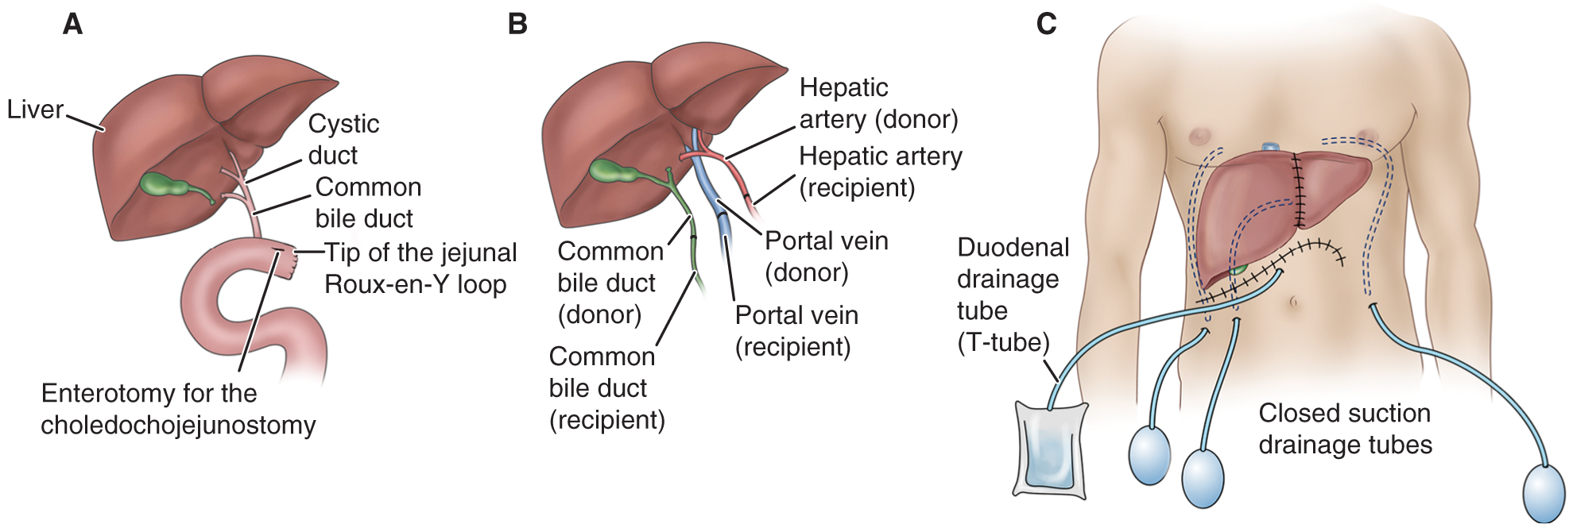
Liver Transplant

Slide 51
Nursing Care of the Patient Undergoing a Liver Transplantation
Preoperative nursing interventions
Postoperative nursing interventions
Patient teaching
Ethical dilemma:
Caregiver stress:

