Slide 1
Chapter 9 Objects and Classes

Slide 2
OO Programming Concepts
Object-oriented programming (OOP) involves programming using objects. An object represents an entity in the real world that can be distinctly identified. For example, a student, a desk, a circle, a button, and even a loan can all be viewed as objects. An object has a unique identity, state, and behaviors. The state of an object consists of a set of data fields (also known as properties) with their current values. The behavior of an object is defined by a set of methods.

Slide 3
Problems with Procedural Languages
Data does not have an owner.
Difficult to maintain data integrity.
Functions are building blocks.
Many functions can modify a given block of data.
Difficult to trace bug sources when data is corrupted.

Slide 4

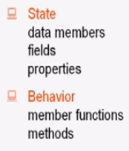
What is Object?
An object has state, exhibits some well defined behaviour, and has a unique identity.

Slide 5
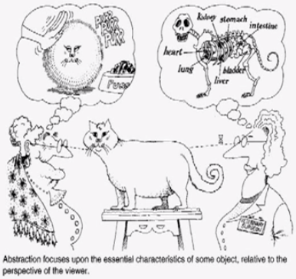
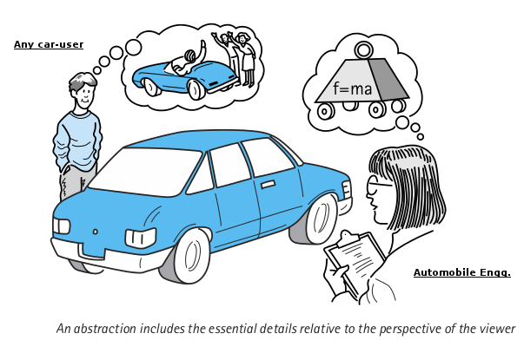
Abstraction - Modeling
Abstraction focuses upon the essential characteristics of some object, relative to the perspective of the viewer.
Notes:
You can see it is the same cat, but from the view point of the owner on the left, she sees it as a cute little fur ball that eats food and makes cute sounds.
But from the view point of the vet surgeon the cat has parts like lungs, liver, kidneys etc.
Two people have different abstract models of the same object.
Procedural programming does not have the ability to create abstraction.

Slide 6
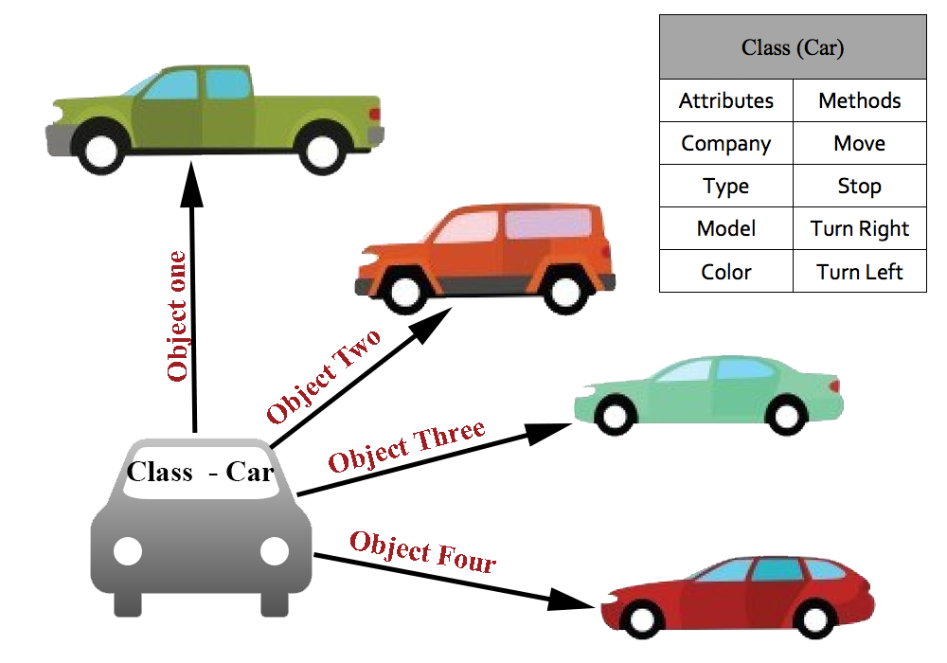
What is Class?
A class represents a set of objects that share common structure and a common behavior.
A class is a blueprint or prototype that defines the variables and methods common to all objects of a certain kind.

Slide 7
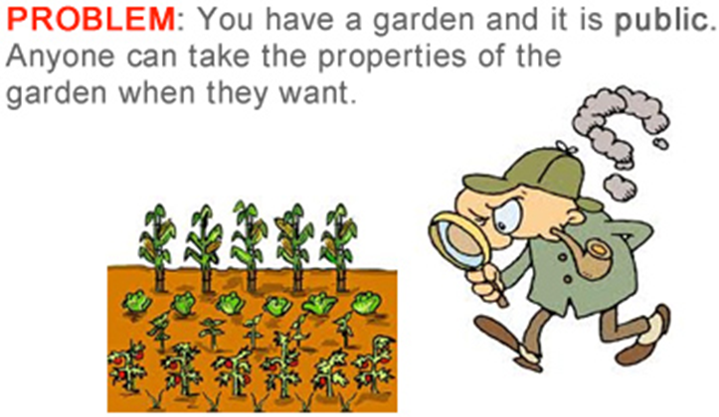
Class Access
Notes:
Any operation by the outside requester to a private property has no effect.
It must go through the setter of the property.
For example if you want to only allow int to be assigned to property $number his can be accomplished by validating the type from the setter method.
You can also only allow number between a certain range to be set.
This allows data rules to be enforced at all times by way of the setters.

Slide 8

Class Access cont.

Slide 9
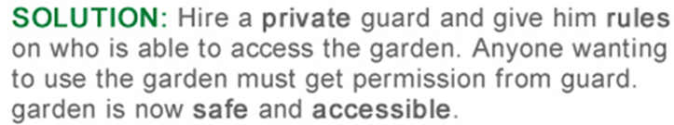
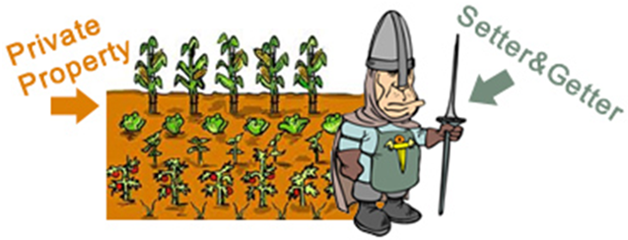
Class Access cont.
Notes:
Again, setters and getters act as guards of internal private properties.
They are interfaced by the external request from the outside world.

Slide 10
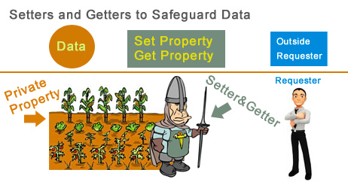
Class Access cont.

Slide 11
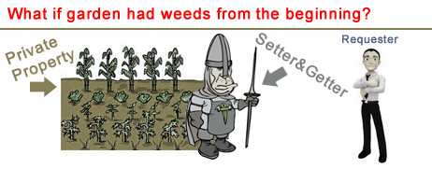
Initialization of Objects
Constructors ensure correct initialization of all data. They are automatically called at the time of object creation.
Destructors on the other hand ensure the de allocation of resources before an object dies or goes out of scope.
Notes:
In other words using contructors to initialize data form the start allows your object to be set or ready for operations.

Slide 12
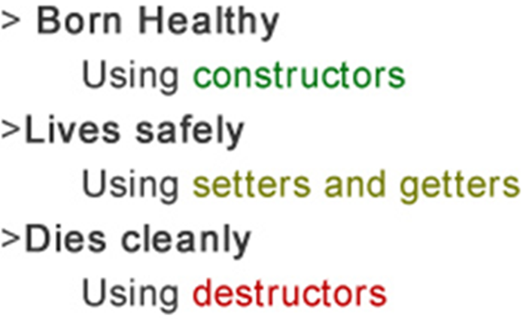
Lifecycle of an Object

Slide 13
Objects
An object has both a state and behavior. The state defines the object, and the behavior defines what the object does.

Slide 14
Classes
Classes are constructs that define objects of the same type. A Java class uses variables to define data fields and methods to define behaviors. Additionally, a class provides a special type of methods, known as constructors, which are invoked to construct objects from the class.

Slide 15
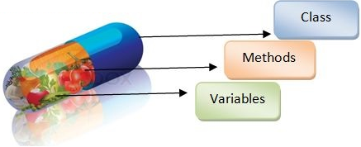
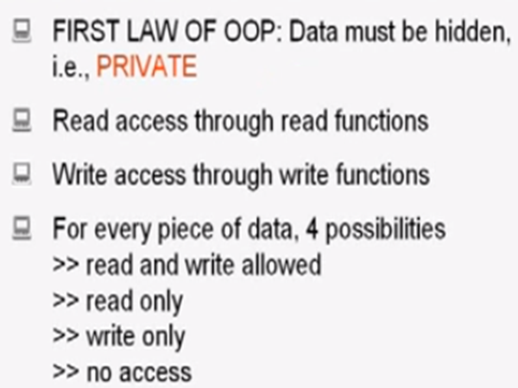

Encapsulation
Notes:
Encapsulation hides the details of the implementation of an object.

Slide 16

Encapsulation
Encapsulation is used to hide unimportant implementation details from other objects.
In real world
  When you want to change gears on your car:
    You don’t need to know how the gear mechanism works.
    You just need to know which lever to move.

Slide 17
Encapsulation cont.
In software programs:
  You don’t need to know how a class is implemented.
  You just need to know which methods to invoke.
  Thus, the implementation details can change at any time without affecting other parts of the program.

Slide 18

Inheritance
Extending the functionality of a class or
Specializing the functionality of the class.

Slide 19
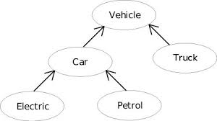
Inheritance cont.
Subclasses: a subclass may inherit the structure and behaviour of it’s superclass.

Slide 20
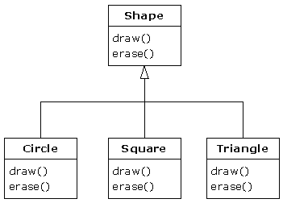
Polymorphism
Polymorphism refers to the ability of an object to provide different behaviours (use different implementations) depending on its own nature. Specifically, depending on its position in the class hierarchy.
drawShape (class Shape)

Slide 21
Classes

Slide 22
UML Class Diagram

Slide 23
Example: Defining Classes and Creating Objects
Objective: Demonstrate creating objects, accessing data, and using methods.
TestSimpleCircle
Run

Slide 24
Example: Defining Classes and Creating Objects
TV
TestTV
Run

Slide 25
Constructors
Constructors are a special kind of methods that are invoked to construct objects.
Circle() {
}
Circle(double newRadius) {
radius = newRadius;
}

Slide 26
Constructors, cont.
A constructor with no parameters is referred to as a no-arg constructor.
· Constructors must have the same name as the class itself.
· Constructors do not have a return type—not even void.
· Constructors are invoked using the new operator when an object is created. Constructors play the role of initializing objects.

Slide 27
Creating Objects Using Constructors
new ClassName();
Example:
new Circle();
new Circle(5.0);

Slide 28
Default Constructor
A class may be defined without constructors. In this case, a no-arg constructor with an empty body is implicitly defined in the class. This constructor, called a default constructor, is provided automatically only if no constructors are explicitly defined in the class.

Slide 29
Declaring Object Reference Variables
To reference an object, assign the object to a reference variable.
To declare a reference variable, use the syntax:
ClassName objectRefVar;
Example:
Circle myCircle;

Slide 30
Declaring/Creating Objects in a Single Step
ClassName objectRefVar = new ClassName();
Example:
Circle myCircle = new Circle();
Assign object reference
Create an object

Slide 31
Accessing Object’s Members
Referencing the object’s data:
objectRefVar.data
e.g., myCircle.radius
Invoking the object’s method:
objectRefVar.methodName(arguments)
e.g., myCircle.getArea()

Slide 32
Trace Code, cont.
animation
Circle myCircle = new Circle(5.0);
Circle yourCircle = new Circle();
yourCircle.radius = 100;
myCircle
reference value
Assign object reference to myCircle

Slide 33
Trace Code, cont.
animation
Circle myCircle = new Circle(5.0);
Circle yourCircle = new Circle();
yourCircle.radius = 100;
myCircle
reference value
yourCircle
reference value
Assign object reference to yourCircle

Slide 34
Trace Code, cont.
animation
Circle myCircle = new Circle(5.0);
Circle yourCircle = new Circle();
yourCircle.radius = 100;
myCircle
reference value
yourCircle
reference value
Change radius in yourCircle

Slide 35
Caution
Recall that you use
  Math.methodName(arguments) (e.g., Math.pow(3, 2.5))
to invoke a method in the Math class. Can you invoke getArea() using SimpleCircle.getArea()? The answer is no. All the methods used before this chapter are static methods, which are defined using the static keyword. However, getArea() is non-static. It must be invoked from an object using
  objectRefVar.methodName(arguments) (e.g., myCircle.getArea()).
More explanations will be given in the section on “Static Variables, Constants, and Methods.”

Slide 36
Reference Data Fields
The data fields can be of reference types. For example, the following Student class contains a data field name of the String type.
public class Student {
String name; // name has default value null
int age; // age has default value 0
boolean isScienceMajor; // isScienceMajor has default value false
char gender; // c has default value '\u0000'
}

Slide 37
The null Value
If a data field of a reference type does not reference any object, the data field holds a special literal value, null.

Slide 38
Default Value for a Data Field
The default value of a data field is null for a reference type, 0 for a numeric type, false for a boolean type, and '\u0000' for a char type. However, Java assigns no default value to a local variable inside a method.
public class Test {
public static void main(String[] args) {
Student student = new Student();
System.out.println("name? " + student.name);
System.out.println("age? " + student.age);
System.out.println("isScienceMajor? " + student.isScienceMajor);
System.out.println("gender? " + student.gender);
}
}

Slide 39
Example
Java assigns no default value to a local variable inside a method.
public class Test {
public static void main(String[] args) {
int x; // x has no default value
String y; // y has no default value
System.out.println("x is " + x);
System.out.println("y is " + y);
}
}
Compile error: variable not initialized

Slide 40
Differences between Variables of
Primitive Data Types and Object Types

Slide 41
Copying Variables of Primitive Data Types and Object Types

Slide 42
Garbage Collection
As shown in the previous figure, after the assignment statement c1 = c2, c1 points to the same object referenced by c2. The object previously referenced by c1 is no longer referenced. This object is known as garbage. Garbage is automatically collected by JVM.

Slide 43
Garbage Collection, cont
TIP: If you know that an object is no longer needed, you can explicitly assign null to a reference variable for the object. The JVM will automatically collect the space if the object is not referenced by any variable.

Slide 44
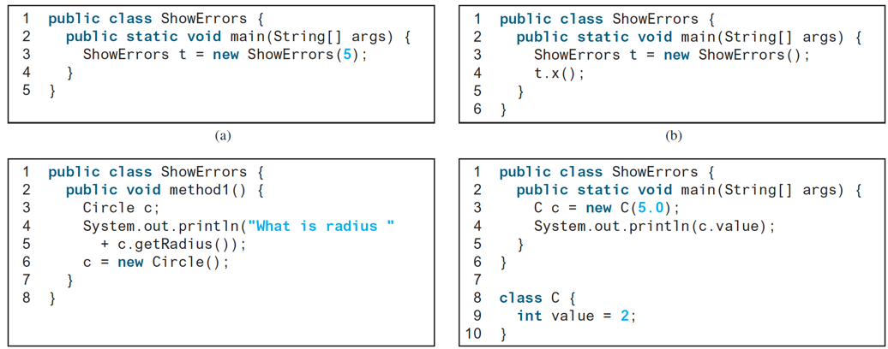
What's wrong?!

Slide 45
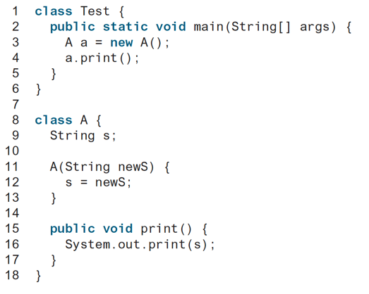
What's Wrong?!

Slide 46
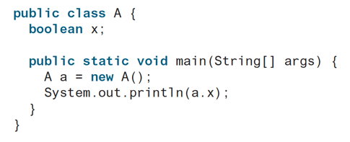
What’s the output?!

Slide 47
The Date Class
Java provides a system-independent encapsulation of date and time in the java.util.Date class. You can use the Date class to create an instance for the current date and time and use its toString method to return the date and time as a string.

Slide 48
The Date Class Example
For example, the following code
  java.util.Date date = new java.util.Date();
  System.out.println(date.toString());
displays a string like Sun Mar 09 13:50:19 EST 2003.

Slide 49
The Random Class
You have used Math.random() to obtain a random double value between 0.0 and 1.0 (excluding 1.0). A more useful random number generator is provided in the java.util.Random class.

Slide 50
The Random Class Example
If two Random objects have the same seed, they will generate identical sequences of numbers. For example, the following code creates two Random objects with the same seed 3.
Random random1 = new Random(3);
System.out.print("From random1: ");
for (int i = 0; i < 10; i++)
System.out.print(random1.nextInt(1000) + " ");
Random random2 = new Random(3);
System.out.print("\nFrom random2: ");
for (int i = 0; i < 10; i++)
System.out.print(random2.nextInt(1000) + " ");
From random1: 734 660 210 581 128 202 549 564 459 961
From random2: 734 660 210 581 128 202 549 564 459 961

Slide 51
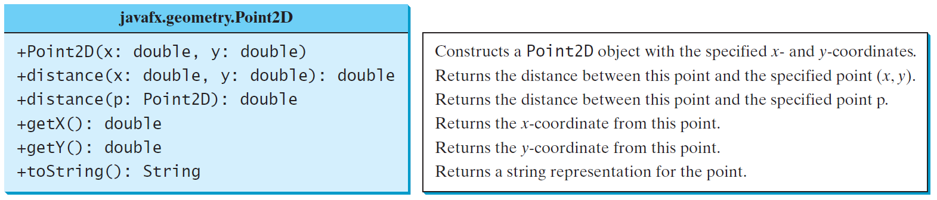
The Point2D Class
Java API has a conveninent Point2D class in the javafx.geometry package for representing a point in a two-dimensional plane.
TestPoint2D
Run

Slide 52
Instance
Variables, and Methods
Instance variables belong to a specific instance.
Instance methods are invoked by an instance of the class.

Slide 53
Static Variables, Constants, and Methods
Static variables are shared by all the instances of the class.
Static methods are not tied to a specific object.
Static constants are final variables shared by all the instances of the class.

Slide 54
Static Variables, Constants, and Methods, cont.
To declare static variables, constants, and methods, use the static modifier.

Slide 55
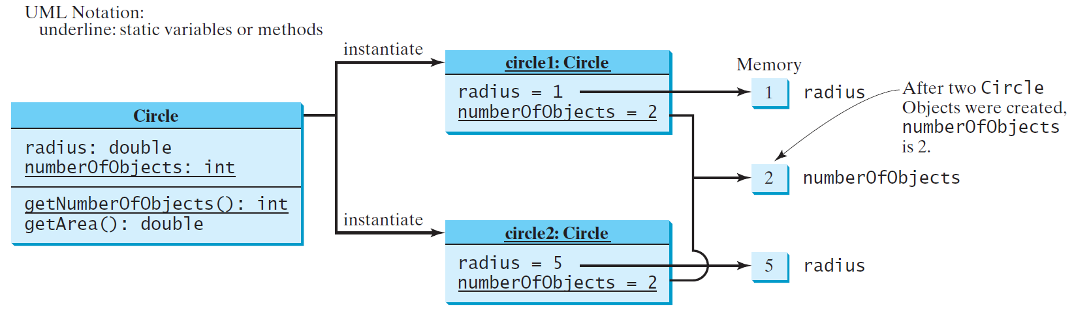
Static Variables, Constants, and Methods, cont.

Slide 56
Example of
Using Instance and Class Variables and Method
Objective: Demonstrate the roles of instance and class variables and their uses. This example adds a class variable numberOfObjects to track the number of Circle objects created.
CircleWithStaticMembers
TestCircleWithStaticMembers
Run

Slide 57
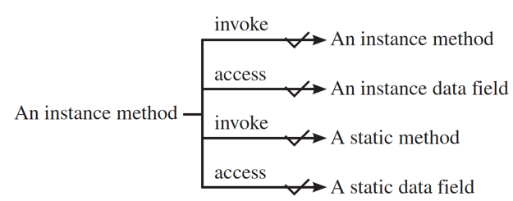
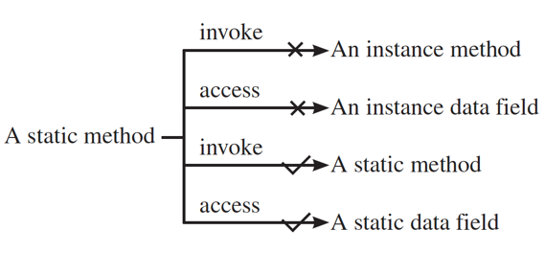

Slide 58
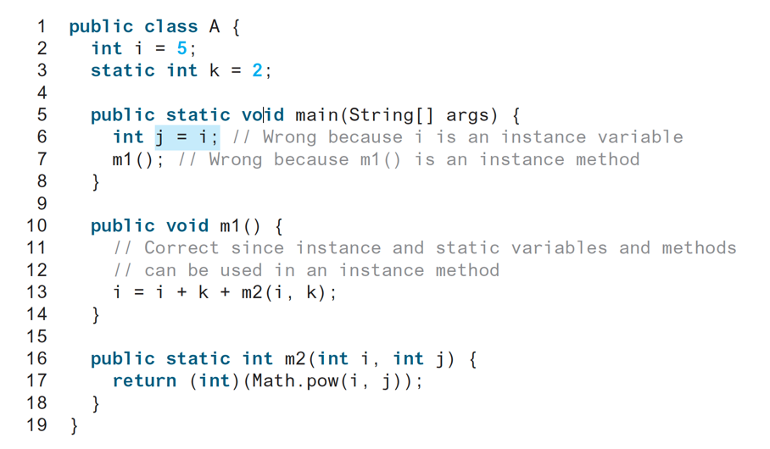
Is this Correct?!

Slide 59
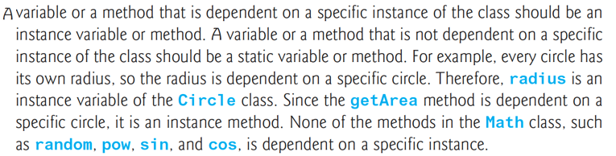

Slide 60
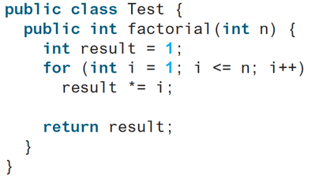
What do you think?

Slide 61
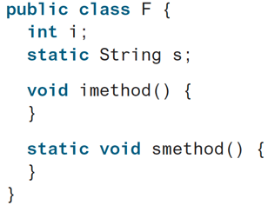
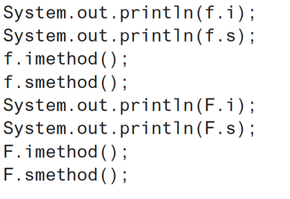
Which is correct?!
Let f be an instance of F

Slide 62
Visibility Modifiers and
Accessor/Mutator Methods
package-private or package-access
By default, the class, variable, or method can be
accessed by any class in the same package.
public
The class, data, or method is visible to any class in any package.
private
The data or methods can be accessed only by the declaring class.
The get and set methods are used to read and modify private properties.

Slide 63
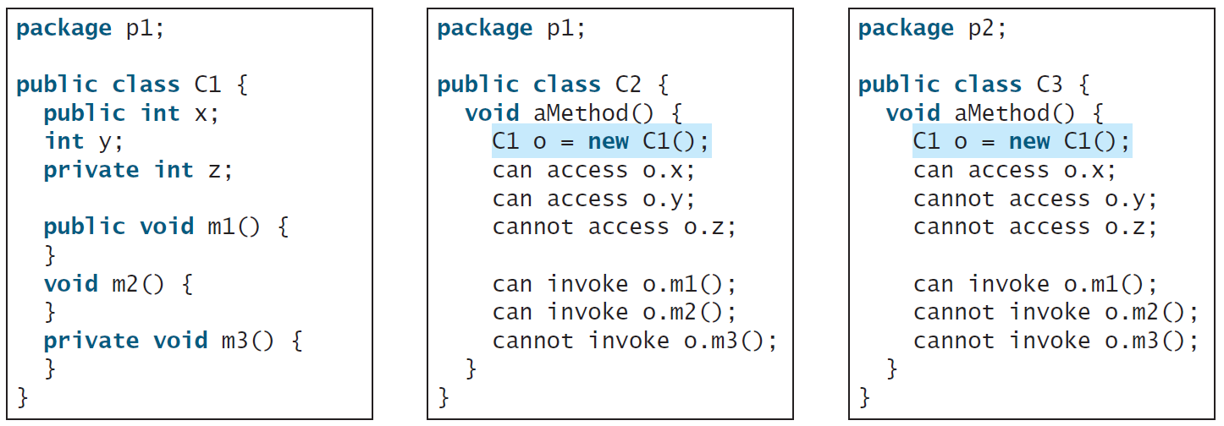
The private modifier restricts access to within a class, the default modifier restricts access to within a package, and the public modifier enables unrestricted access.

Slide 64
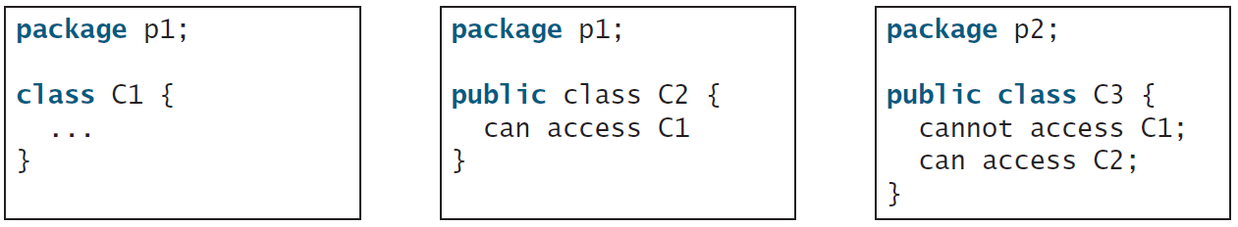
The default modifier on a class restricts access to within a package, and the public modifier enables unrestricted access.

Slide 65
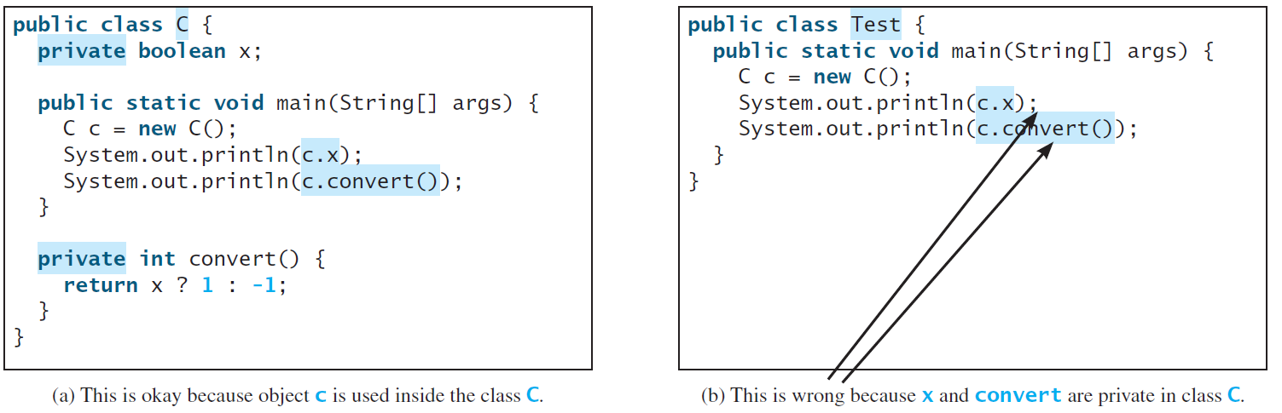
NOTE
An object cannot access its private members, as shown in (b). It is OK, however, if the object is declared in its own class, as shown in (a).

Slide 66
Why Data Fields Should Be private?
To protect data.
To make code easy to maintain.

Slide 67
Example of
Data Field Encapsulation
CircleWithPrivateDataFields
TestCircleWithPrivateDataFields
Run

Slide 68
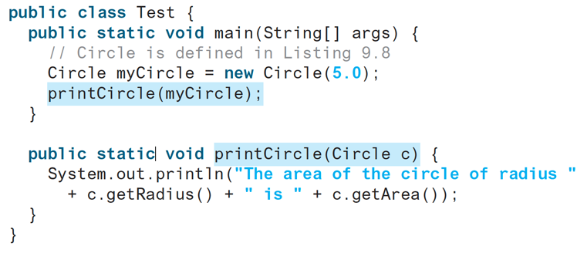
Passing Objects to Methods
Passing by value for primitive type value (the value is passed to the parameter)
Passing by value for reference type value (the value is the reference to the object)
TestPassObject
Run

Slide 69
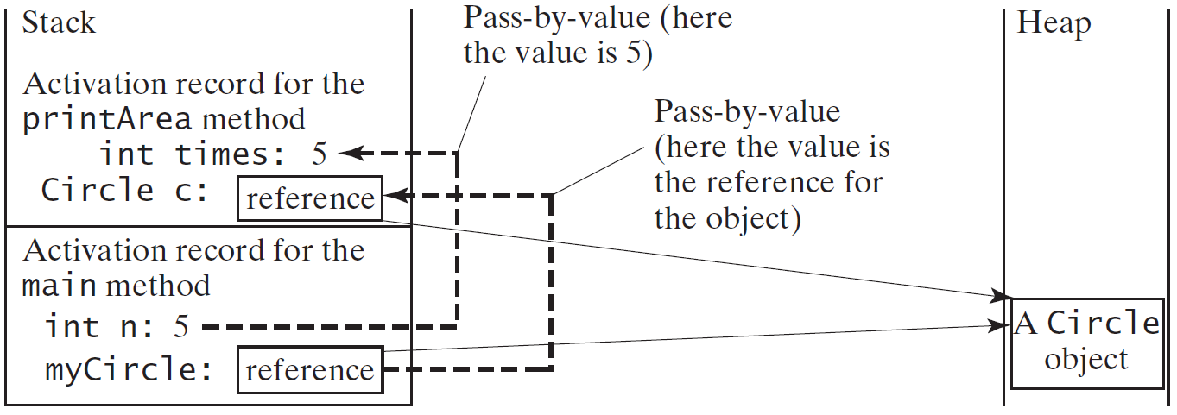
Passing Objects to Methods, cont.

Slide 70
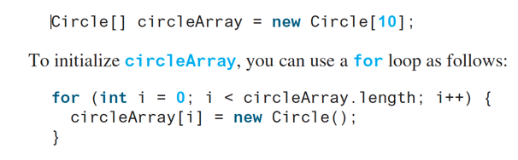
Array of Objects
An array of objects is actually an array of reference variables. So invoking circleArray[1].getArea() involves two levels of referencing as shown in the next figure. circleArray references to the entire array. circleArray[1] references to a Circle object.

Slide 71
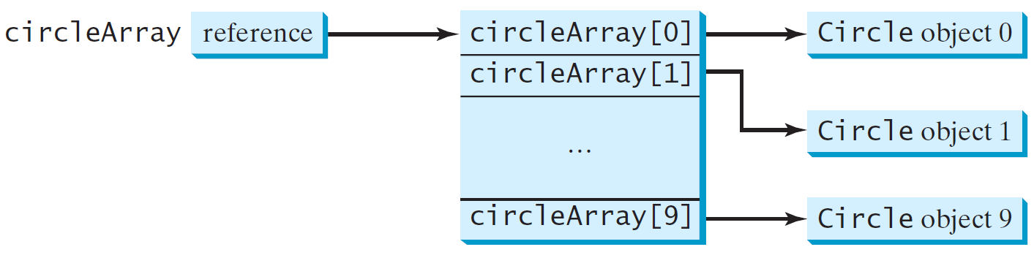
Array of Objects, cont.
Circle[] circleArray = new Circle[10];

Slide 72
Array of Objects, cont.
Summarizing the areas of the circles
TotalArea
Run

Slide 73
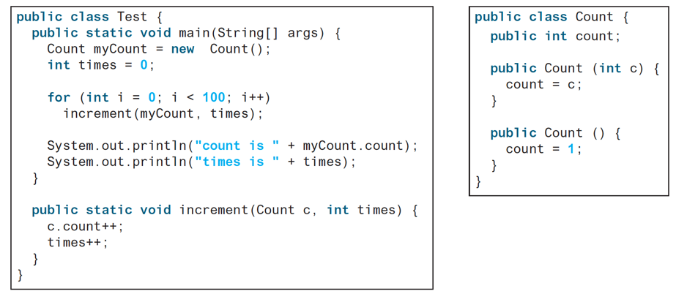

Slide 74
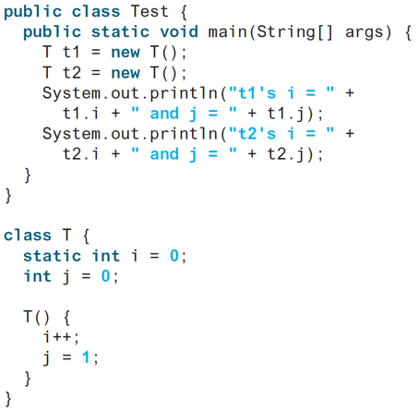
What is the output?

Slide 75
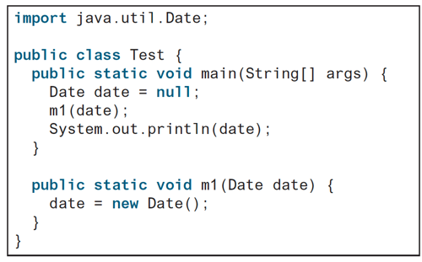
What is the output?

Slide 76
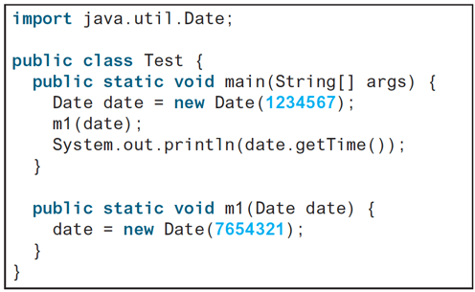
What is the output?

Slide 77
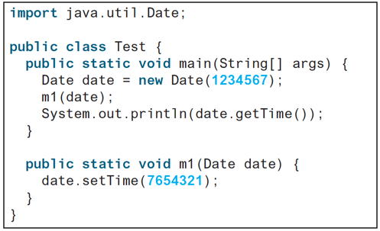
What is the output?

Slide 78
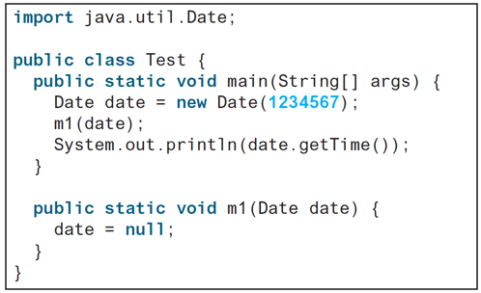
What is the output?

Slide 79
Immutable Objects and Classes
If the contents of an object cannot be changed once the object is created, the object is called an immutable object and its class is called an immutable class. If you delete the set method in the Circle class in Listing 8.10, the class would be immutable because radius is private and cannot be changed without a set method.
A class with all private data fields and without mutators is not necessarily immutable. For example, the following class Student has all private data fields and no mutators, but it is mutable.

Slide 80
Example
public class BirthDate {
private int year;
private int month;
private int day;
public BirthDate(int newYear,
int newMonth, int newDay) {
year = newYear;
month = newMonth;
day = newDay;
}
public void setYear(int newYear) {
year = newYear;
}
}
public class Student {
private int id;
private BirthDate birthDate;
public Student(int ssn,
int year, int month, int day) {
id = ssn;
birthDate = new BirthDate(year, month, day);
}
public int getId() {
return id;
}
public BirthDate getBirthDate() {
return birthDate;
}
}
public class Test {
public static void main(String[] args) {
Student student = new Student(111223333, 1970, 5, 3);
BirthDate date = student.getBirthDate();
date.setYear(2010); // Now the student birth year is changed!
}
}

Slide 81
What Class is Immutable?
For a class to be immutable,
it must mark all data fields private and,
provide no mutator methods and,
no accessor methods that would return a reference to a mutable data field object.

Slide 82
Scope of Variables
The scope of instance and static variables is the entire class. They can be declared anywhere inside a class.
The scope of a local variable starts from its declaration and continues to the end of the block that contains the variable. A local variable must be initialized explicitly before it can be used.

Slide 83
The this Keyword
The this keyword is the name of a reference that refers to an object itself. One common use of the this keyword is reference a class’s hidden data fields.
Another common use of the this keyword to enable a constructor to invoke another constructor of the same class.

Slide 84
Reference the Hidden Data Fields

Slide 85
Calling Overloaded Constructor

