Slide 1
PTA
Amal Abu Kteish
aabukteish@birzeit.edu

Slide 2
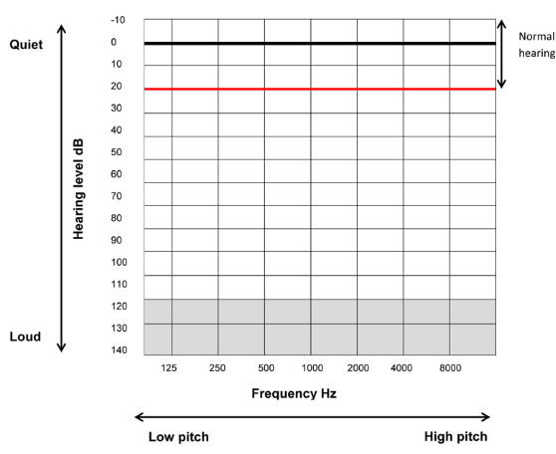
Revision

Slide 3
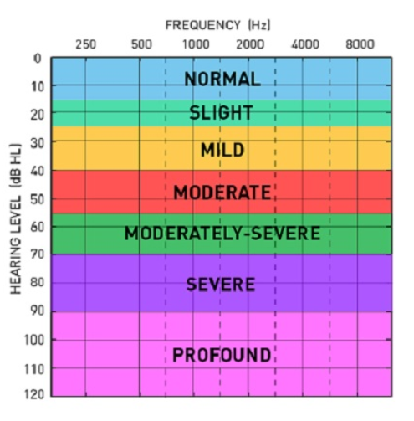
Revision

Slide 4
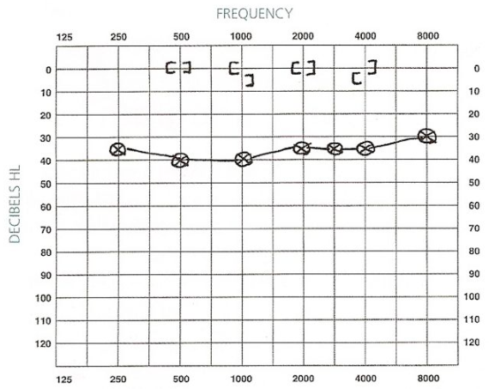
Bilateral CHL

Slide 5
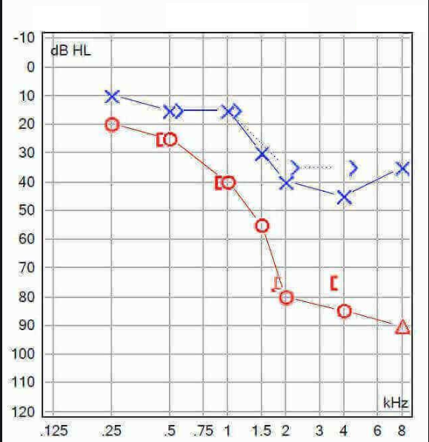
Assymetric SNHL

Slide 6
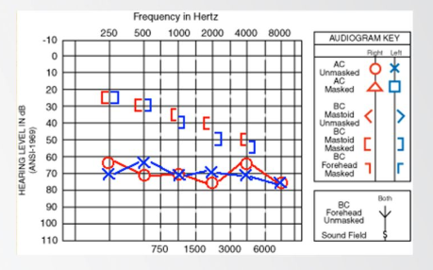
Mixed HL

Slide 7
Special considerations
Initial familiarization at 40 dB HL, and never exceed 80 dB HL. Increase in 5 dB Steps.
In the not masked BC testing, it is impossible to determine which ear is responding to bone conduction hearing.
Place the bone vibrator over the mastoid of the worse ear (judged as the pure tone average between 500-4000 Hz.(
In instructions for BC, emphasis should be given to patient to respond to the tone regardless of the side.
Block ear canal in BC testing at 4 kHz (Air-borne radiation).

Slide 8
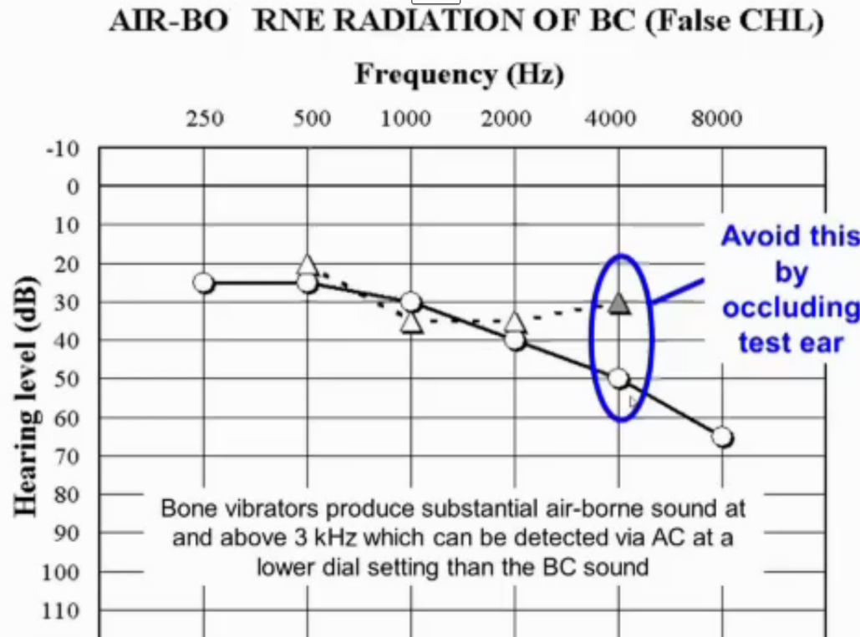




False ABG at 4 kHz due to Air-borne radiation of sound from bone conductor

Slide 9
Assignment?
Why Air-brone radiation happens at 4 kHz?

Slide 10
Vibrotactile Thresholds
BC vibrotactile thresholds can be as low as:
- 55 dB at 500 Hz
- 70 dB at 1000 Hz.
For AC vibrotactile thresholds (using circumaural headphones) can be as low as:
- 80 dB at 250 Hz
- 90-100 dB at 500 Hz.

Slide 11
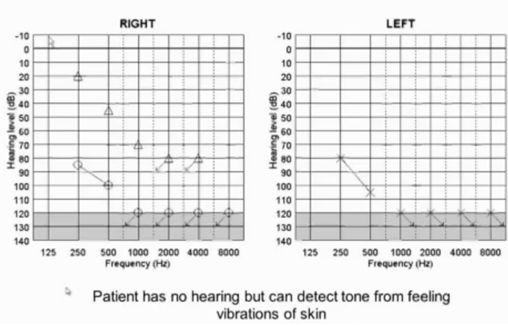
Vibrotactile thresholds

Slide 12
Clinical Factors affecting the uncertainty in PTA result
Background noise
Cognitive abilities (concentration/ attention ..)
Motor response (e.g. elderly)
Tinnitus

Slide 13
Test retest variability of PTA
Typically (+/-) 5-10 dB for PTA (can be worse)
Patients with tinnitus

Slide 14
Carhart effect
The fixation of the stapes with other middle ear disorders (otosclerosis or congenital fixation) can impair route 3 hence leading to reduction in BC threshold.
Classically associated with otosclerosis:
- Does not necessarily ALWAYS occur with otosclerosis
- May be associated with other middle ear disorders (e.g. congenital fixation)

Slide 15
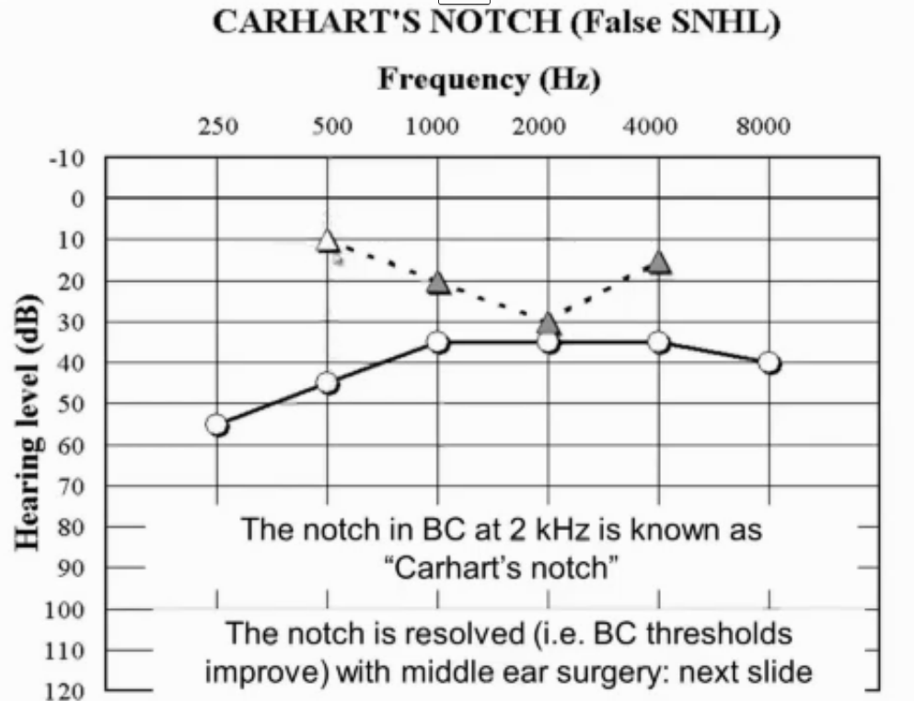
Carhart effect

Slide 16
Ear Canal Collapse
Occurs in the elderly (mainly) due to weaker ear cartilage when using supra-aural headphones
Leads to occlusion effect
Occlusion effect can be as much as 20 dB at 500 Hz

Slide 17
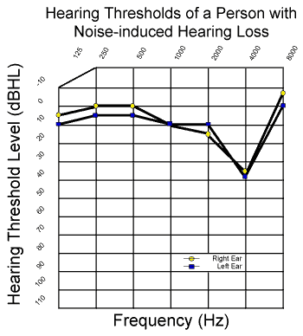
Typical Audiogram of Noise Induced Hearing Loss

Slide 18
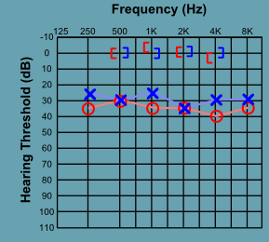
Typical audiogram of Otitis Media with Effusions

