Slide 1
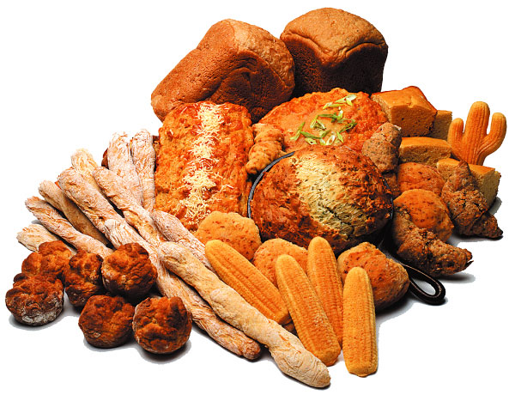
Carbohydrates

Slide 2
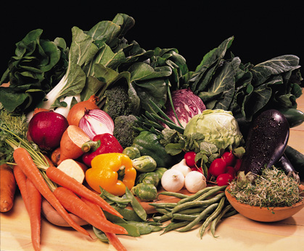
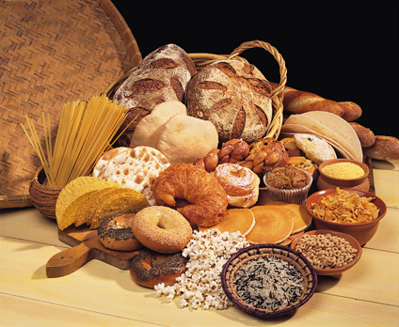
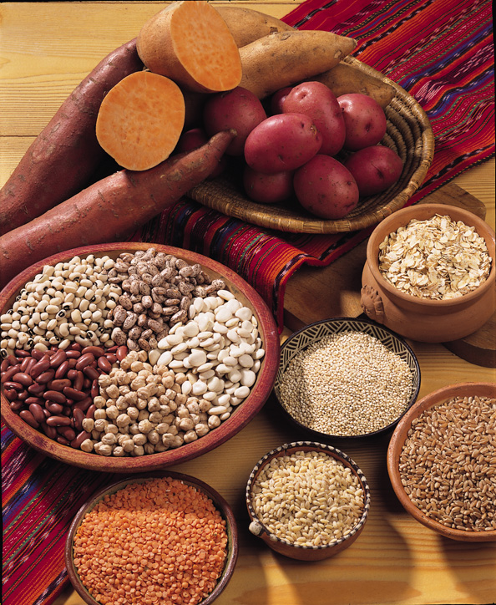
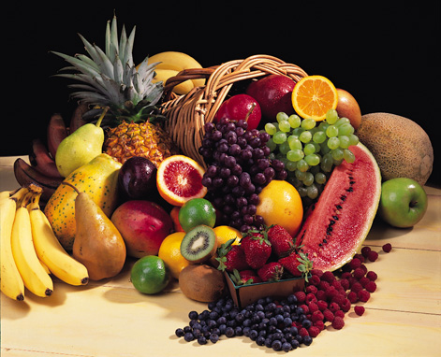
What are Carbohydrates?

Slide 3
Carbohydrates Contain the Elements:
Carbon
Hydrogen
Oxygen
They Are Split Into Three Groups Known As:
Monosaccharides(Monomers)
Disaccharides (Dimers)
Polsaccharides(Polymers)

Slide 4
Most , but not all carbohydrate have a formula (CH₂O)_{n} (hence the name hydrate of carbon)
The n represents the number of times the CH2O unite is repeated.

Slide 5
Types of Carbohydrates
Simple Carbohydrates
monosaccharides
disaccharides
Complex Carbohydrates
polysaccharides
glycogen
starches
Cellulose

Slide 6
Monosaccharides
(mono: one, saccharide: sugar)
simple sugars with multiple OH groups.
They can be classify according to :
1- the number of carbons (3, 4, 5, 6,7), a monosaccharide is a triose, tetrose, pentose or hexose , heptoses

Slide 7
Monosaccharides
2- based on their carbonyl carbon (>C=O)
According to the location of the carbonyl functional group, monosaccharides can be either aldoses (terminal carbonyl group; aldehyde) or ketoses (internal carbonyl group; ketone).
Aldoses (e.g., glucose) have an aldehyde group at one end.
Ketoses (e.g., fructose) have a keto group, usually at C2.

Slide 8

Monosaccharides
Glucose
carbohydrate form used by the body, referred to as “blood sugar”
basic sub-unit of other larger carbohydrate molecules
found in fruits, vegetables, honey
The chemical formula for glucose is C₆H₁₂O₆

Slide 9
Monosaccharides
Fructose
sweetest of the sugars
occurs naturally in fruits & honey, “fruit sugar”
combines with glucose to form sucrose
Galactose
combines with glucose to form lactose, “milk sugar”

Slide 10
dehydration reaction
This is when two monosaccharides join to form a Disaccharide
The two monosacharides are joined by a covalent bond called glycosidic linkage By take water out

Slide 11
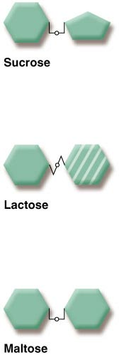
Disaccharides
Sucrose (“table sugar”)
glucose + fructose
Lactose (“milk sugar”)
glucose + galactose
Maltose (“malt sugar”)
glucose + glucose

Slide 12
Hydrolysis
This is the breaking down of a glycosidic bond.
Instead of water been taken away water is added.
Lysis means splitting.

Slide 13
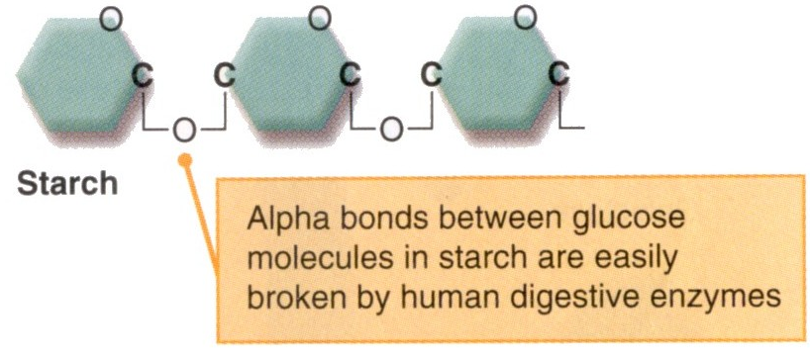
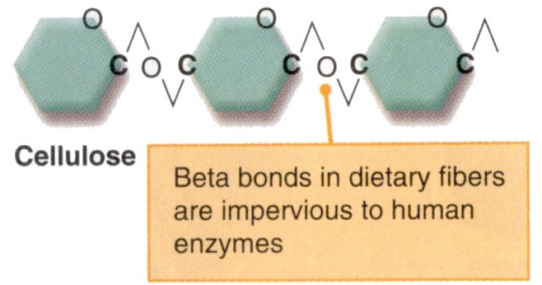
Polysaccharides
Polysaccharides are polymers with hundreds to thousands of monosaccharides joined by a glycosidic bondlong

Slide 14
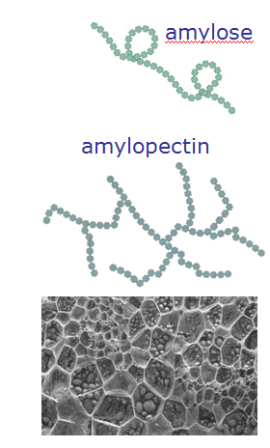
Polysaccharides
Starch
Consists of glucose subunits
plant storage form of carbohydrate
long branched or unbranched chains of glucose
amylose
amylopectin

Slide 15
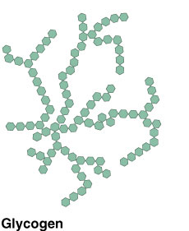
Polysaccharides
Glycogen
highly branched chains of glucose units
animal storage form of carbohydrate
found in LIVER and MUSCLE

Slide 16
Polysaccharides
Cellulose
Composed of glucose subunits
Different bond formed than starch (a straight and never branched structural )
Structural component in plants (in the cell wall )
Cellulose molecules are arranged in

Slide 17
Qualitative tests of Carbohydrate

Slide 18
Molisch test
It is a sensitive test for the identification of carbohydrates or carbohydrate moieties in other macromolecules
This test is specific for all carbohydrates.
Monosaccharide gives a rapid positive test, Disaccharides and polysaccharides react slower.
Objective: To identify the carbohydrate from other macromolecules lipids and proteins.

Slide 19
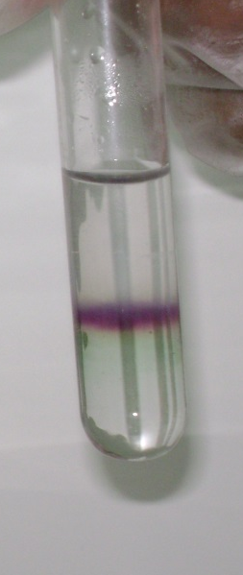
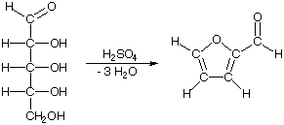
Principle:
A concentrated sulfuric acid (H2SO4) solution dehydrates the carbohydrate to form an aldehyde that condenses with α-naphthol in the Molisch reagent to produce a purple compound.
α-naphthol
Purpel color

Slide 20
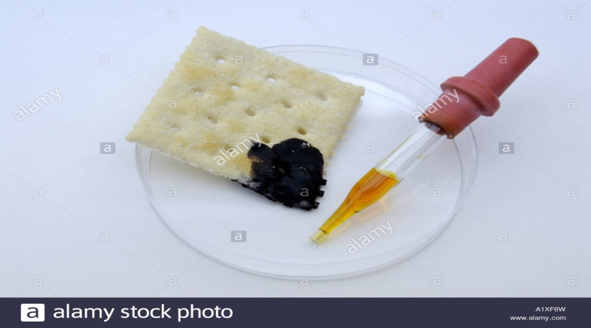
I2/KI test
Many polysaccharides can be identified by their reaction with IKI reagent [Iodine (I2) dissolved in potassium iodide (KI)].
IKI reagent interacts with the helices of amylose and glycogen, and the chains of cellulose forming colored complexes.

Slide 21
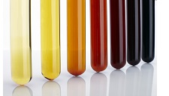
A deep blue-black color is obtained with starch;
A red-brown color is given by glycogen;
A violet-brown to red-brown color with cellulose.
The colors fade away by heating and return by cooling.

Slide 22
Barfoed’s Test
This test is performed to distinguish between reducing monosaccharides, reducing disaccharides.
Objective: To distinguish between mono- , di- and poly saccharides.

Slide 23
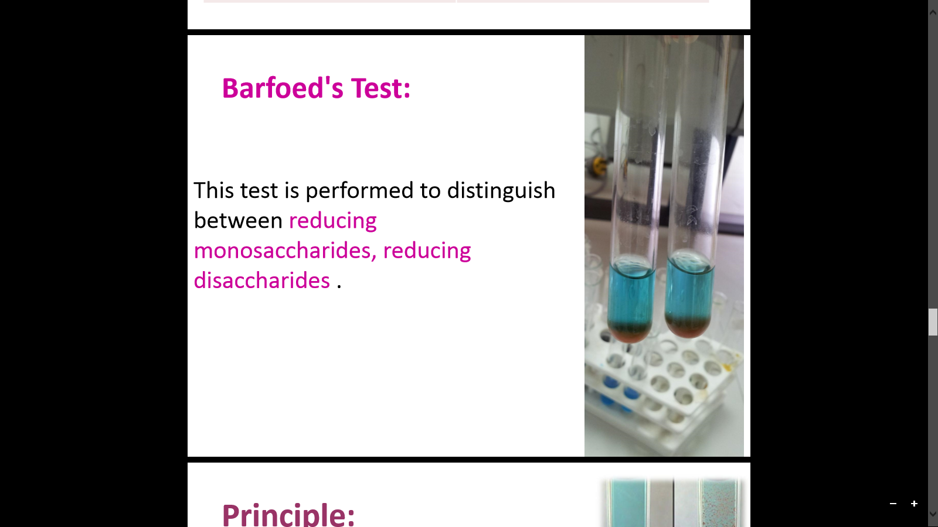
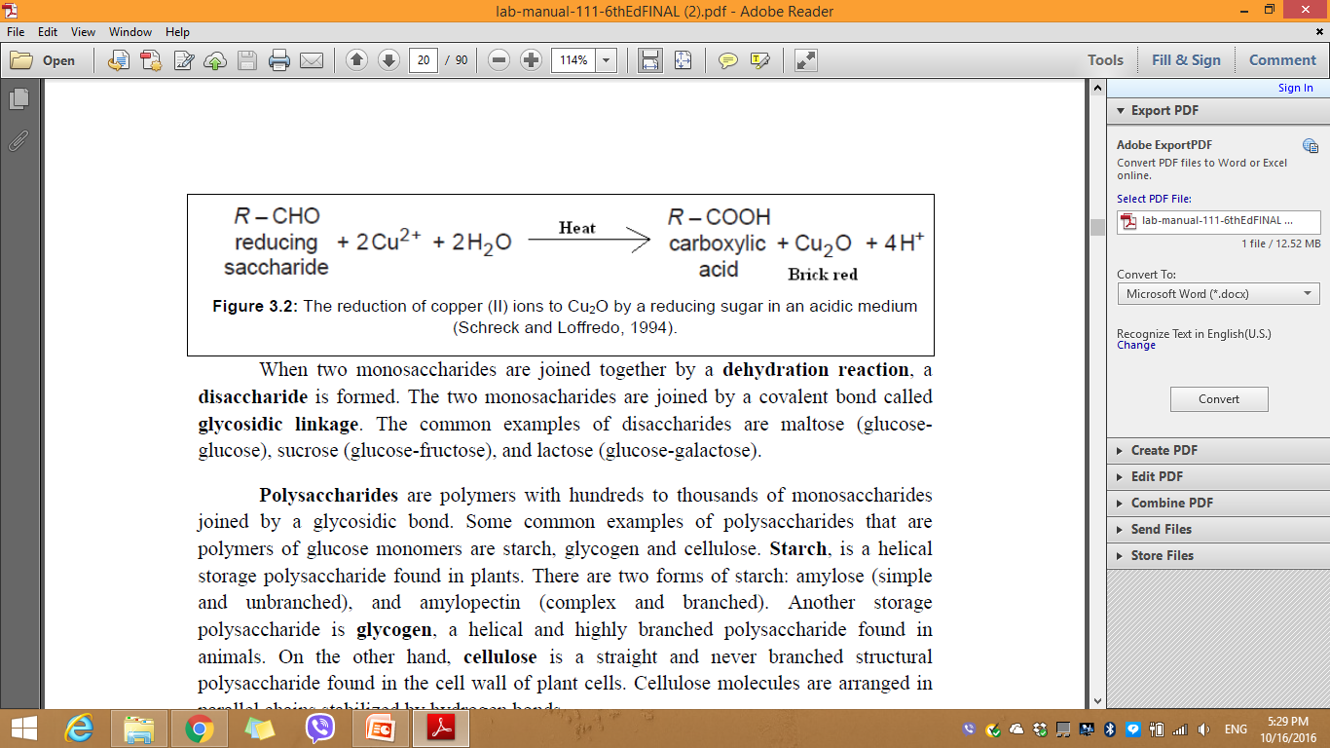
Principle: Barfoed’s test used copper (II) ions in a slightly acidic medium
Reducing monosaccharides are oxidized by the copper ion in solution to form a carboxylic acid and a reddish precipitate of copper (I) oxide within three minutes.
Reducing disaccharides undergo the same reaction, but do so at a slower rate.

Slide 24
Benedict's test
Benedict's reagent is used as a test for the presence of reducing sugars. All monosaccharides are reducing sugars; they all have a free reactive aldehyde group .
However, ketoses can also be reducing sugars due to the conversion of ketoses to aldoses by tautomerization
Objective: To distinguish between the reducing and non-reducing sugars.

Slide 25
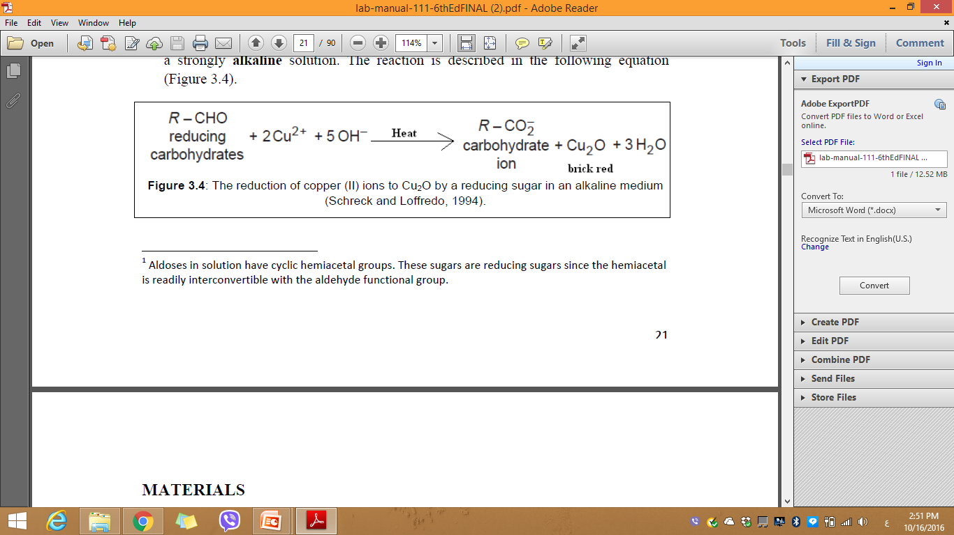
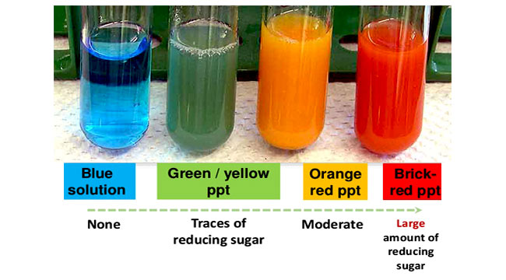
Principle :Benedict’s reagent test used copper (II) ions in an alkaline solution
Reducing sugars are oxidized by the copper ion in solution to form a carboxylic acid and a reddish precipitate of copper oxide.

Slide 26
