Slide 1
Chapter 6
Quantum Mechanics in One Dimension

Slide 2
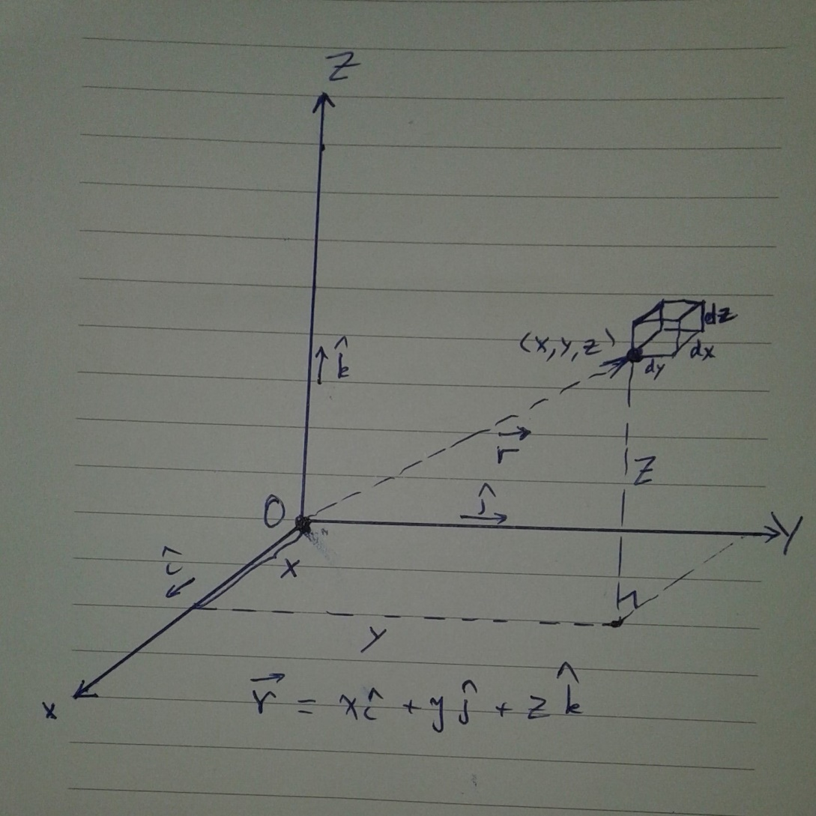
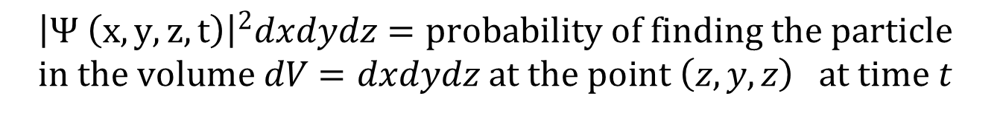
$${\left|Ψ \left(x, y, z, t\right)\right|}^{2}dxdydz=probability of finding the particle \\ in the volume dV=dxdydz at the point \left(z, y, z\right) at time t$$

Slide 3
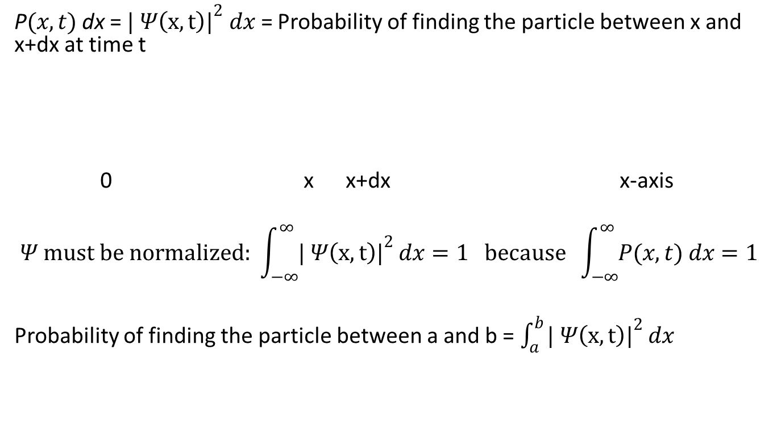

In one dimention: $Ψ(x,t)$
P$(x,t)$ dx = ${| Ψ\left(x,t\right)|}^{2} dx$ = Probability of finding the particle between x and x+dx at time t
0 x x+dx x-axis
$$Ψ must be normalized: \int_{−∞}^{∞}{{| Ψ\left(x,t\right)|}^{2}}dx=1 because \int_{−∞}^{∞}{P(x,t) dx}=1$$
Probability of finding the particle between a and b = $\int_{a}^{b}{{| Ψ\left(x,t\right)|}^{2}}dx$

Slide 4
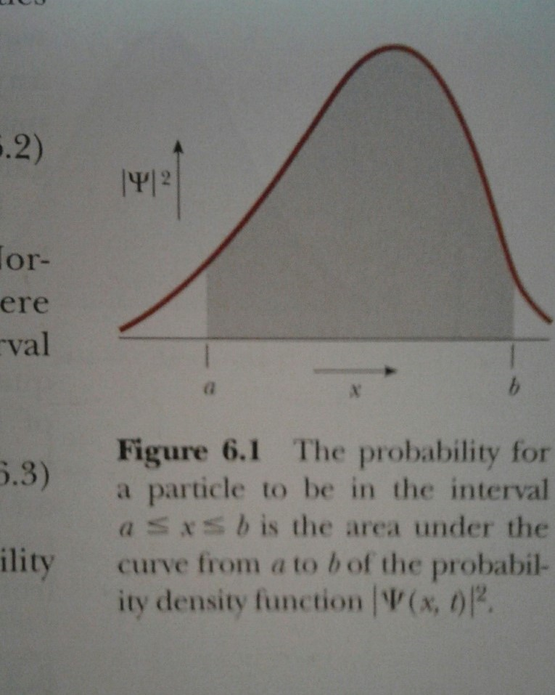
Probability of finding the particle between a and b = $\int_{a}^{b}{{| Ψ\left(x,t\right)|}^{2}}dx$

Slide 5
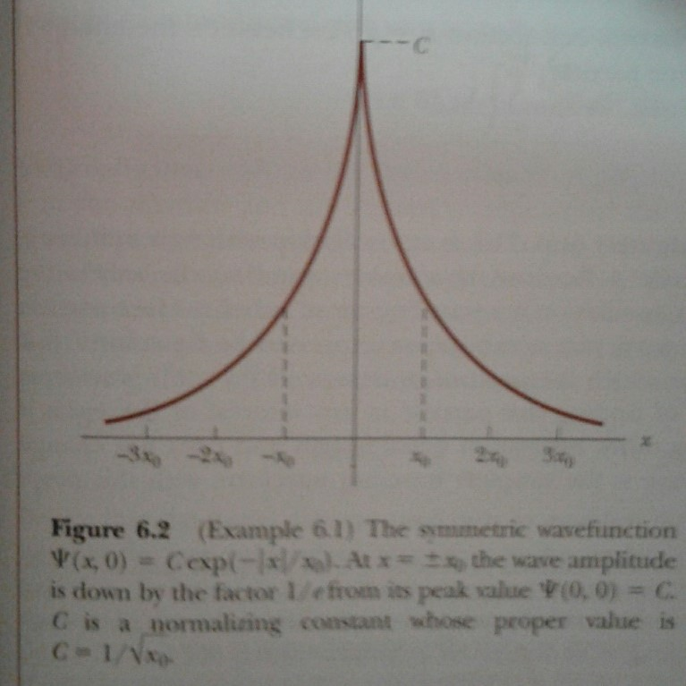

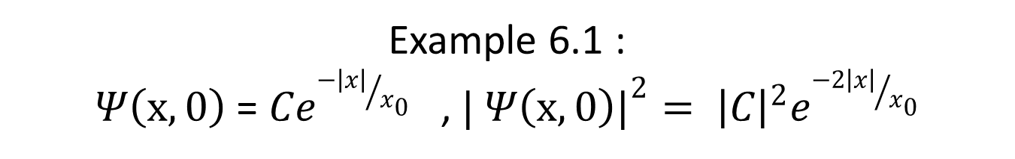
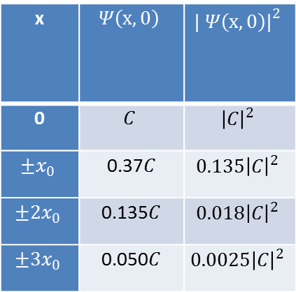
Example 6.1 :
$Ψ\left(x,0\right)$ = $Ce^{{−\left|x\right|}/{x_{0}}}$ , ${| Ψ\left(x,0\right)|}^{2}= {\left|C\right|}^{2}e^{{−2\left|x\right|}/{x_{0}}}$
a) Plot $Ψ\left(x,0\right)$
a)
x | $$Ψ\left(x,0\right)$$ | $${| Ψ\left(x,0\right)|}^{2}$$
0 | $$C$$ | $${\left|C\right|}^{2}$$
$$±x_{0}$$ | 0.37$C$ | $${0.135\left|C\right|}^{2}$$
$$±2x_{0}$$ | 0.135$C$ | $${0.018\left|C\right|}^{2}$$
$$±3x_{0}$$ | 0.050$C$ | $${0.0025\left|C\right|}^{2}$$

Slide 6
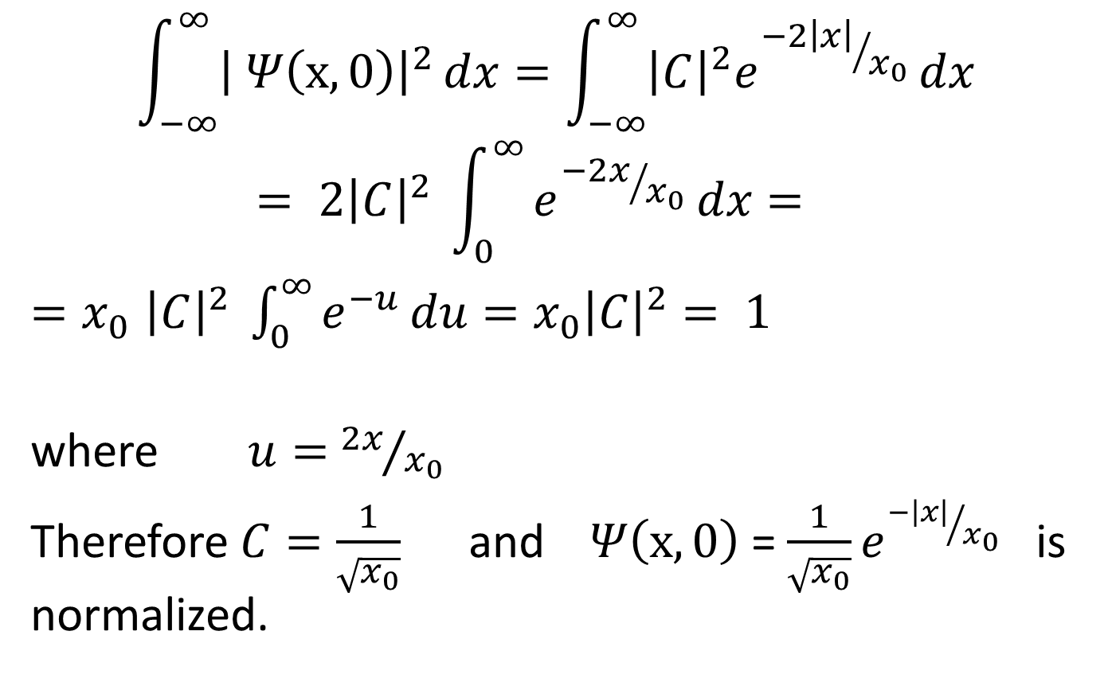
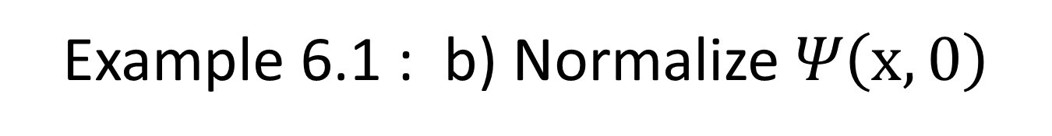
Example 6.1 : b) Normalize $Ψ\left(x,0\right)$
$$\int_{−∞}^{∞}{{\left| Ψ\left(x,0\right)\right|}^{2}}dx=\int_{−∞}^{∞}{{\left|C\right|}^{2}e^{{−2\left|x\right|}/{x_{0}}}}dx= 2{\left|C\right|}^{2} \int_{0}^{∞}{e^{{−2x}/{x_{0}}}}dx=$$
${=x}_{0}{\left|C\right|}^{2} \int_{0}^{∞}{e^{−u}}du=x_{0}{\left|C\right|}^{2}= 1$
where $u=$ ${2x}/{x_{0}}$
Therefore $C=\frac{1}{\sqrt{x_{0}}}$ and $Ψ\left(x,0\right)$ = $\frac{1}{\sqrt{x_{0}}}e^{{−\left|x\right|}/{x_{0}}}$ is normalized.

Slide 7
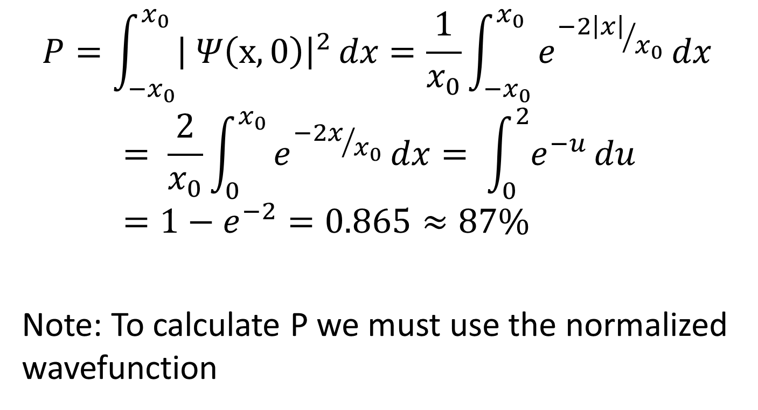

Example 6.1 : c) Probability of finding the particle between $− x_{0}$ and $x_{0}$
$$P=\int_{−x_{0}}^{x_{0}}{{\left| Ψ\left(x,0\right)\right|}^{2}}dx=\frac{1}{x_{0}}\int_{−x_{0}}^{x_{0}}{e^{{−2\left|x\right|}/{x_{0}}}}dx= \frac{2}{x_{0}}\int_{0}^{x_{0}}{e^{{−2x}/{x_{0}}}}dx= \int_{0}^{2}{e^{−u}}du=1−e^{−2}=0.865≈87\%$$
Note: To calculate P we must use the normalized wavefunction

Slide 8
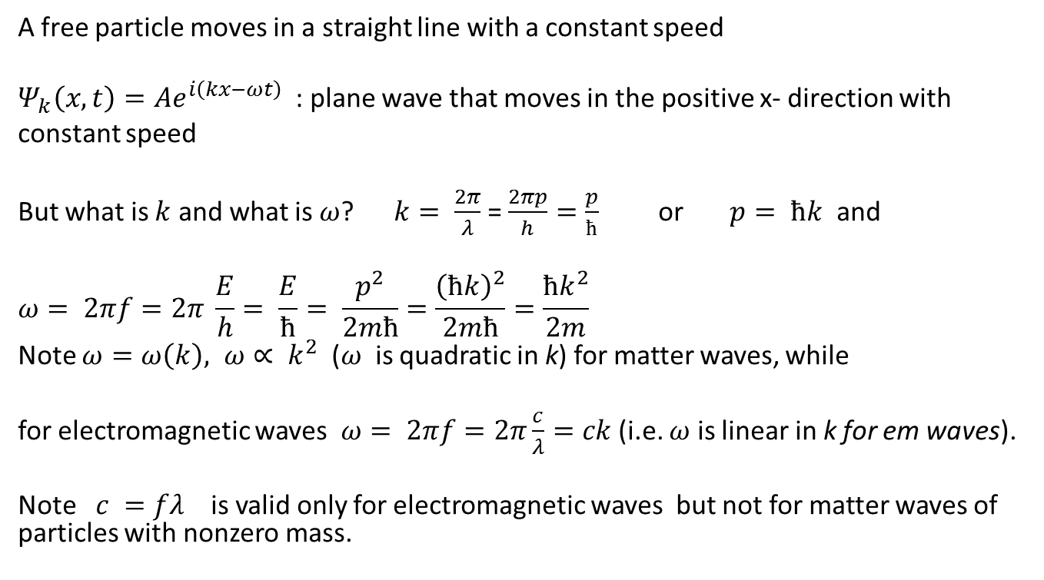
Section 6.2: Wavefunction for a free particle (free= no external forces)
A free particle moves in a straight line with a constant speed
$Ψ_{k}\left(x,t\right)=Ae^{i\left(kx−ωt\right)}$ : plane wave that moves in the positive x- direction with
constant speed
But what is $k$ and what is $ω$? $k= \frac{2π}{λ}$ = $\frac{2πp}{h}=\frac{p}{ħ}$ or $p= ħk$ and
$$ω= 2πf=2π \frac{E}{h}= \frac{E}{ħ}= \frac{p^{2}}{2mħ}=\frac{{\left(ħk\right)}^{2}}{2mħ}=\frac{ħk^{2}}{2m}$$
Note $ω=ω\left(k\right), ω∝ k^{2}$ ($ω$ is quadratic in k) for matter waves, while
for electromagnetic waves $ω= 2πf=2π\frac{c}{λ}=ck$ (i.e. $ω$ is linear in k for em waves).
Note $c =fλ$ is valid only for electromagnetic waves but not for matter waves of particles with nonzero mass.

Slide 9
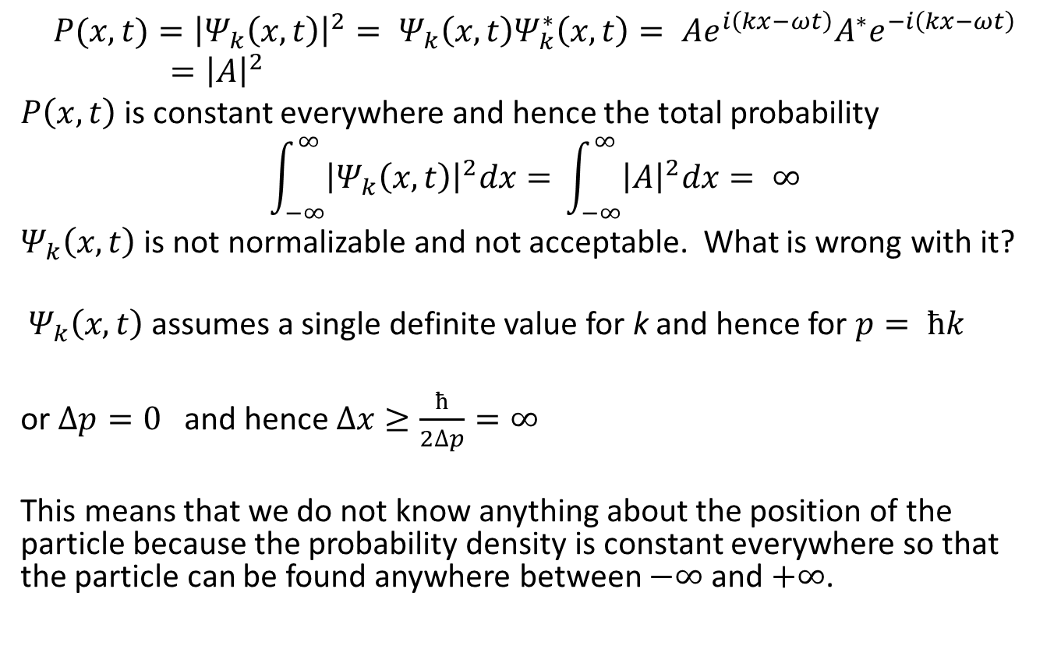
Calculate the probability density ${P(x,t)=\left|Ψ_{k}\left(x,t\right)\right|}^{2}$
$${P(x,t)=\left|Ψ_{k}\left(x,t\right)\right|}^{2}= Ψ_{k}\left(x,t\right)Ψ_{k}^{∗}\left(x,t\right)= Ae^{i\left(kx−ωt\right)}A^{∗}e^{−i\left(kx−ωt\right)}={\left|A\right|}^{2}$$
$P\left(x,t\right)$ is constant everywhere and hence the total probability
$$\int_{−∞}^{∞}{{\left|Ψ_{k}\left(x,t\right)\right|}^{2}dx=} \int_{−∞}^{∞}{{\left|A\right|}^{2}dx= ∞}$$
$Ψ_{k}\left(x,t\right)$ is not normalizable and not acceptable. What is wrong with it?
$Ψ_{k}\left(x,t\right)$ assumes a single definite value for k and hence for $p= ħk$
or $∆p=0$ and hence $∆x≥\frac{ħ}{2∆p}=∞$
This means that we do not know anything about the position of the particle because the probability density is constant everywhere so that the particle can be found anywhere between $−∞$ and $+∞$.

Slide 10
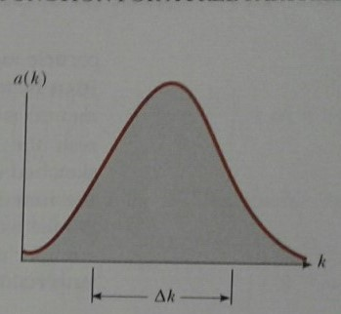
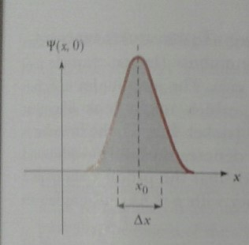
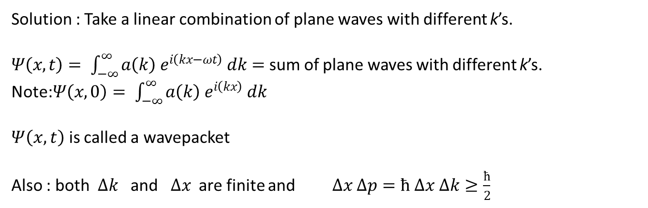
Solution : Take a linear combination of plane waves with different k’s.
$Ψ\left(x,t\right)= \int_{−∞}^{∞}{a\left(k\right) e^{i\left(kx−ωt\right)} dk=}$ sum of plane waves with different k’s.
Note:$Ψ\left(x,0\right)= \int_{−∞}^{∞}{a\left(k\right) e^{i\left(kx\right)} dk }$
$Ψ\left(x,t\right)$ is called a wavepacket
Also : both $∆k$ and $∆x$ are finite and $∆x ∆p=ħ ∆x ∆k≥\frac{ħ}{2}$

Slide 11
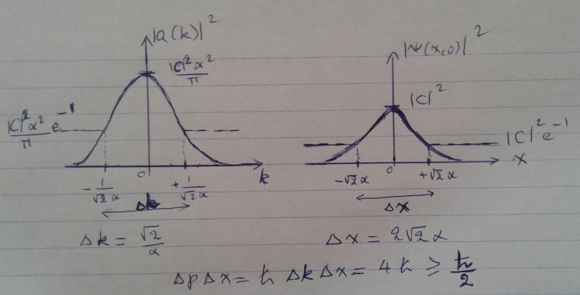
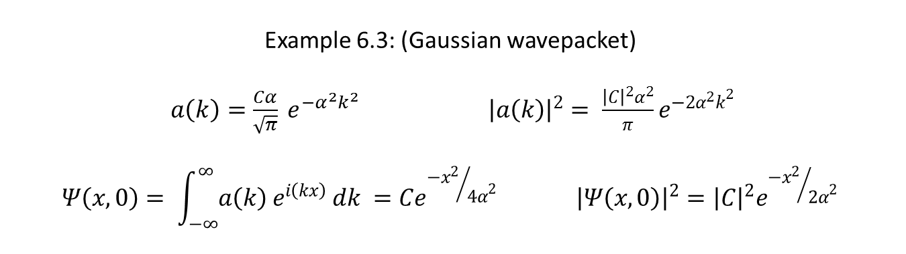
Example 6.3: (Gaussian wavepacket)
$a\left(k\right)=\frac{Cα}{\sqrt{π}} e^{−α^{2}k^{2}}$ ${\left|a\left(k\right)\right|}^{2}= \frac{{\left|C\right|}^{2}α^{2}}{π}e^{−2α^{2}k^{2}}$
$$Ψ\left(x,0\right)= \int_{−∞}^{∞}{a\left(k\right) e^{i\left(kx\right)} dk }=Ce^{{{−x}^{2}}/{{4α}^{2}}} {\left|Ψ\left(x,0\right)\right|}^{2}={\left|C\right|}^{2}e^{{{−x}^{2}}/{{2α}^{2}}}$$

Slide 12
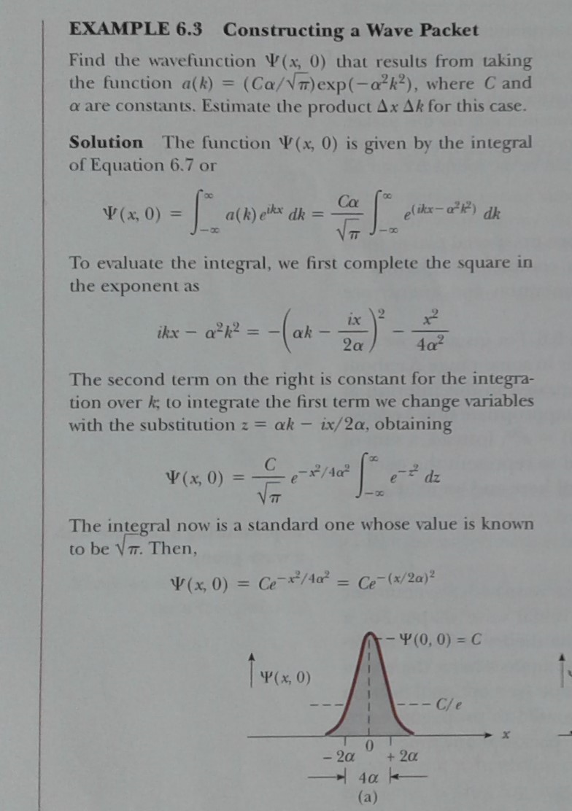

Slide 13
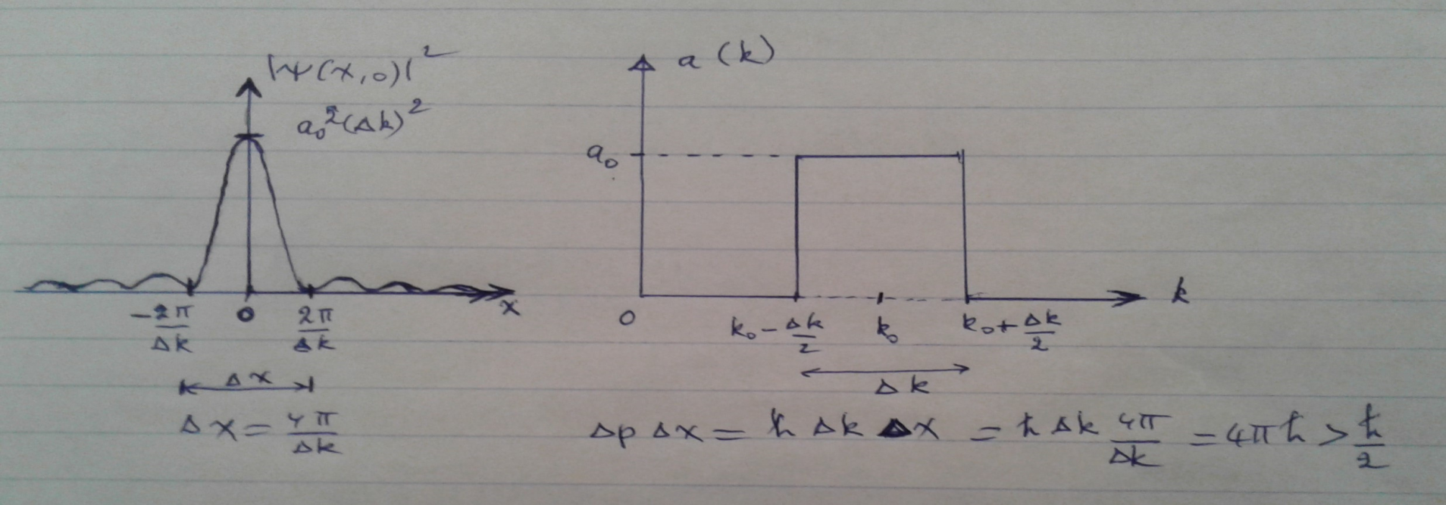
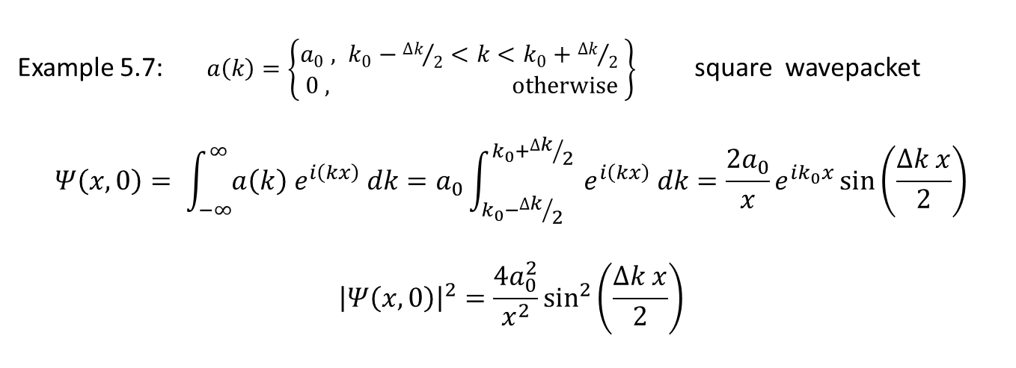
Example 5.7:$a\left(k\right)=\left\{\begin{matrix}a_{0} , k_{0}−{∆k}/2<k<k_{0}+{∆k}/2 \\ 0 , otherwise\end{matrix}\right\}$ square wavepacket
$$Ψ\left(x,0\right)= \int_{−∞}^{∞}{a\left(k\right) e^{i\left(kx\right)} dk}=a_{0}\int_{k_{0}−{∆k}/2}^{k_{0}+{∆k}/2}{ e^{i\left(kx\right)} dk=\frac{{2a}_{0}}{x}e^{ik_{0}x}\sin\left(\frac{∆k x}{2}\right)}$$
$${\left|Ψ\left(x,0\right)\right|}^{2}=\frac{{4a}_{0}^{2}}{x^{2}}\sin^{2}\left(\frac{∆k x}{2}\right)$$

Slide 14
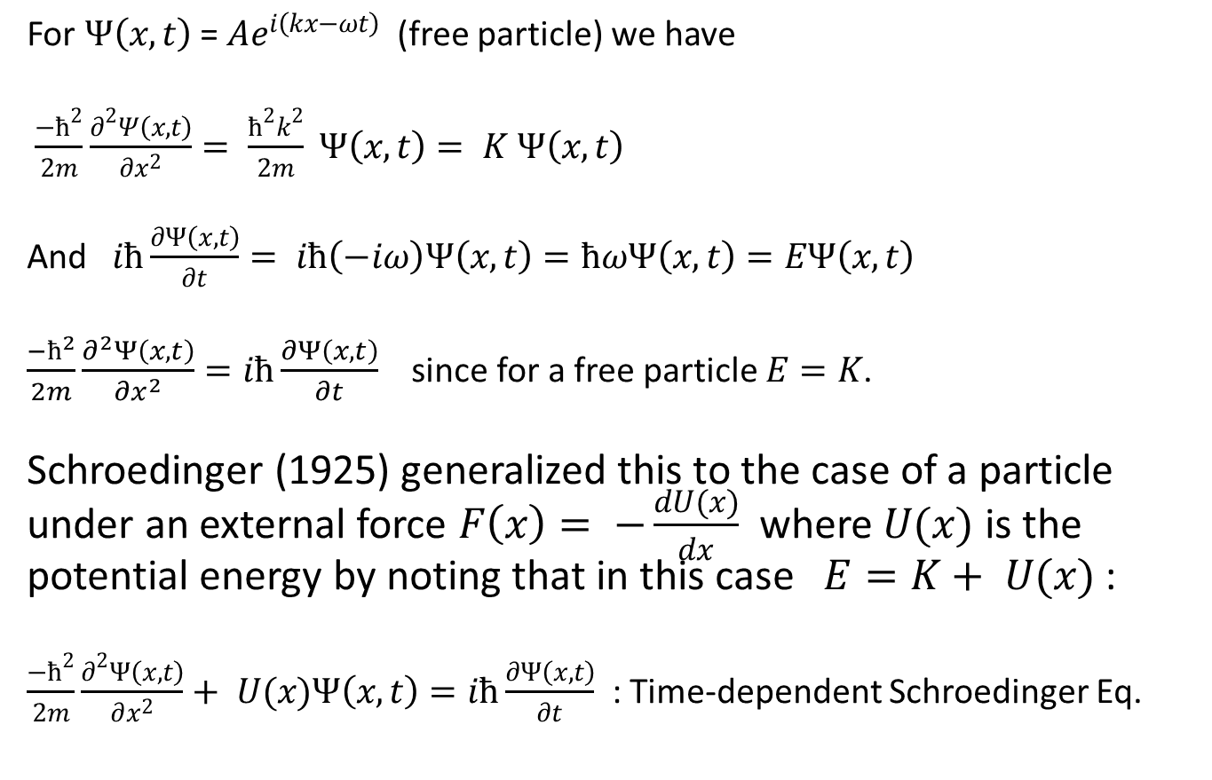
Section 6.3: Wavefunctions in the presence of forces
For $Ψ\left(x,t\right)$ = $Ae^{i\left(kx−ωt\right)}$ (free particle) we have
$\frac{−ħ^{2}}{2m}\frac{∂^{2}Ψ\left(x,t\right)}{∂x^{2}}= \frac{ħ^{2}k^{2}}{2m} Ψ\left(x,t\right)= K Ψ\left(x,t\right)$
And $iħ\frac{∂Ψ\left(x,t\right)}{∂t}= iħ\left(−iω\right)Ψ\left(x,t\right)=ħωΨ\left(x,t\right)=EΨ\left(x,t\right)$
$\frac{−ħ^{2}}{2m}\frac{∂^{2}Ψ\left(x,t\right)}{∂x^{2}}=iħ\frac{∂Ψ\left(x,t\right)}{∂t}$ since for a free particle $E=K$.
Schroedinger (1925) generalized this to the case of a particle under an external force $F\left(x\right)= −\frac{dU(x)}{dx}$ where $U(x)$ is the potential energy by noting that in this case $E=K+ U(x)$ :
$\frac{−ħ^{2}}{2m}\frac{∂^{2}Ψ\left(x,t\right)}{∂x^{2}}+ U(x)Ψ\left(x,t\right)=iħ\frac{∂Ψ\left(x,t\right)}{∂t}$ : Time-dependent Schroedinger Eq.

Slide 15
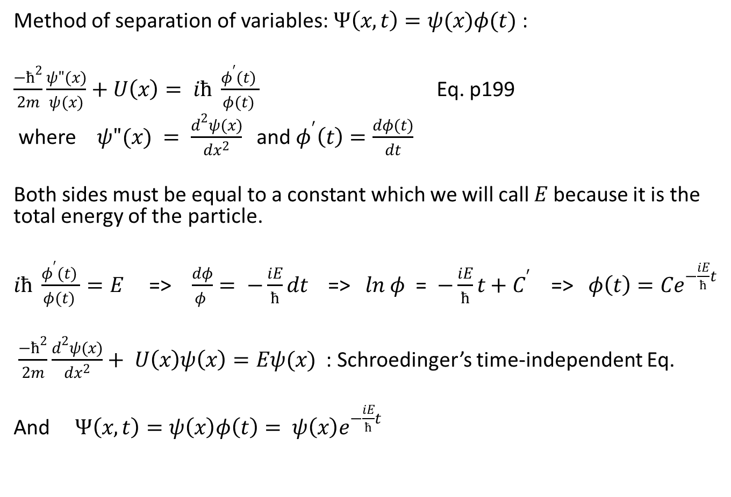
$$\frac{−ħ^{2}}{2m}\frac{∂^{2}Ψ\left(x,t\right)}{∂x^{2}}+ U(x)Ψ\left(x,t\right)=iħ\frac{∂Ψ\left(x,t\right)}{∂t}$$
Method of separation of variables: $Ψ\left(x,t\right)=ψ(x)φ(t)$ :
$\frac{−ħ^{2}}{2m}\frac{ψ"(x)}{ψ(x)}+$ $U\left(x\right)= iħ \frac{φ^{′}(t) }{φ(t) }$ Eq. p199
where $ψ"(x) = \frac{d^{2}ψ(x)}{dx^{2}}$ and $φ^{′}\left(t\right)=\frac{dφ(t)}{dt}$
Both sides must be equal to a constant which we will call $E$ because it is the total energy of the particle.
$iħ \frac{φ^{′}(t) }{φ(t) }=E$ => $\frac{dφ}{φ }= −\frac{iE}{ħ}dt$ => $ln φ$ = $−\frac{iE}{ħ}t+C^{′}$ => $φ\left(t\right)=Ce^{−\frac{iE}{ħ}t}$
$\frac{−ħ^{2}}{2m}\frac{d^{2}ψ(x)}{dx^{2}}+ U\left(x\right)ψ\left(x\right)=Eψ(x)$ : Schroedinger’s time-independent Eq.
And $Ψ\left(x,t\right)=ψ\left(x\right)φ\left(t\right)= ψ\left(x\right)e^{−\frac{iE}{ħ}t}$

Slide 16
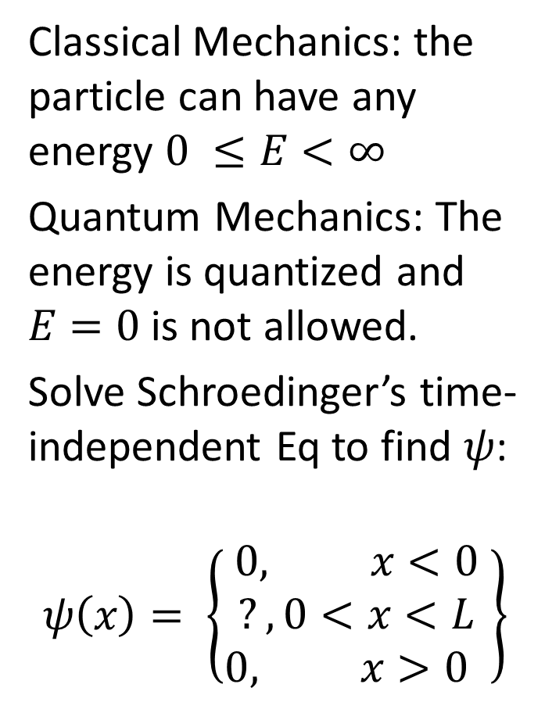
Section 6.4: The particle in a box:
Classical Mechanics: the particle can have any energy $0 ≤E<∞$
Quantum Mechanics: The energy is quantized and $E=0$is not allowed.
Solve Schroedinger’s time-independent Eq to find $ψ$:
$$ψ\left(x\right)= \left\{\begin{matrix}0, x<0 \\ ?, 0<x<L \\ 0, x>0 \end{matrix}\right\}$$

Slide 17
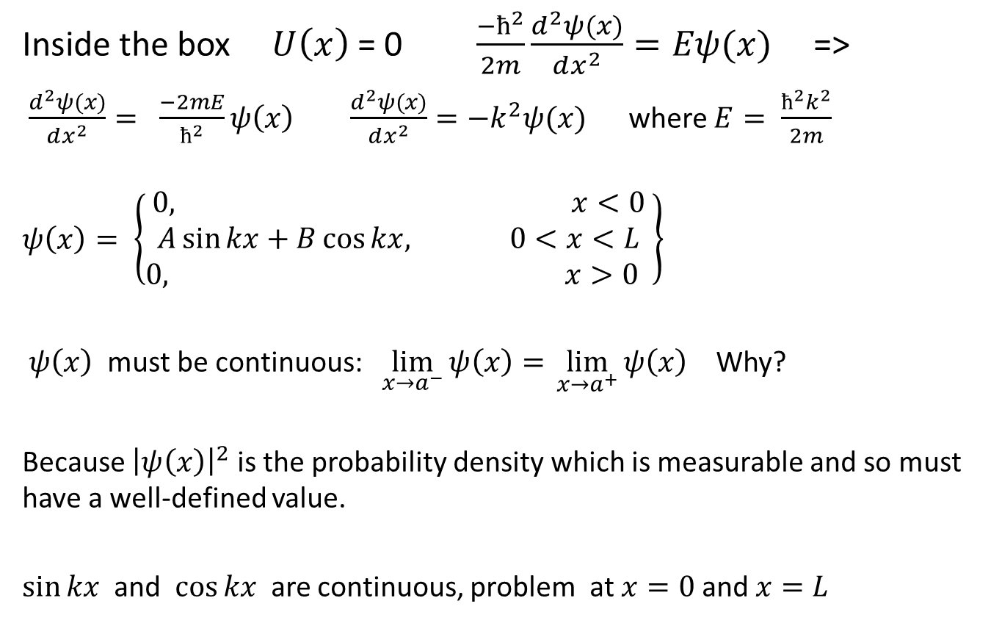

$$\frac{−ħ^{2}}{2m}\frac{d^{2}ψ(x)}{dx^{2}}+ U\left(x\right)ψ\left(x\right)=Eψ(x)$$
Inside the box $U\left(x\right)$ = 0 $\frac{−ħ^{2}}{2m}\frac{d^{2}ψ(x)}{dx^{2}}=Eψ(x)$ =>
$\frac{d^{2}ψ(x)}{dx^{2}}= \frac{−2mE}{ħ^{2}}ψ\left(x\right)$ $\frac{d^{2}ψ(x)}{dx^{2}}=−k^{2}ψ(x)$ where $E= \frac{ħ^{2}k^{2}}{2m}$
$$ψ\left(x\right)= \left\{\begin{matrix}0, x<0 \\ A\sin{kx}+B\cos{kx,} 0<x<L \\ 0, x>0 \end{matrix}\right\}$$
$ψ\left(x\right)$ must be continuous: $\lim_{x→a^{−}}{ψ\left(x\right)= }\lim_{x→a^{+}}{ψ\left(x\right) }$ Why?
Because ${\left|ψ\left(x\right)\right|}^{2}$ is the probability density which is measurable and so must have a well-defined value.
$\sin{kx}$ and $\cos{kx}$ are continuous, problem at $x=0$and $x=L$

Slide 18
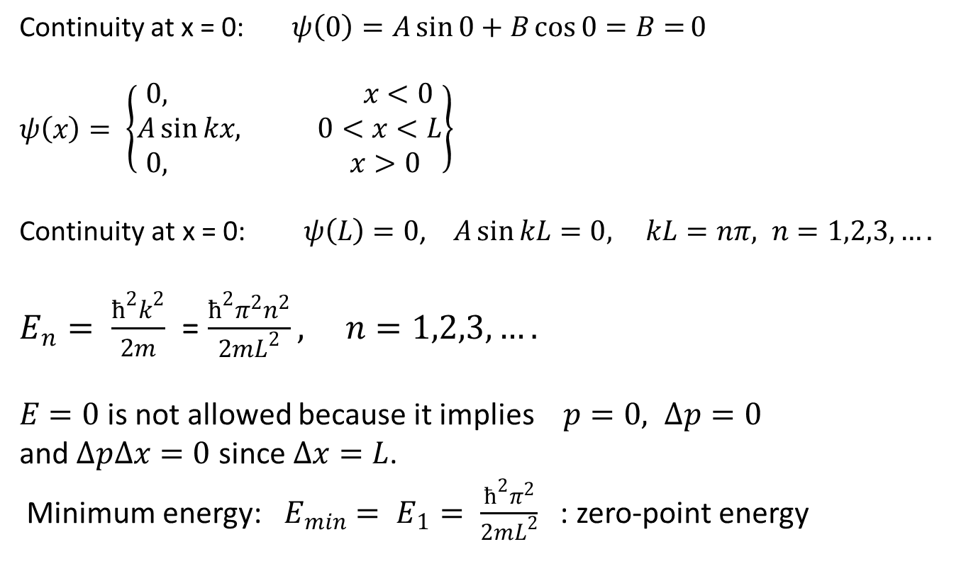

$$ψ\left(x\right)= \left\{\begin{matrix}0, x<0 \\ A\sin{kx}+B\cos{kx,} 0<x<L \\ 0, x>0 \end{matrix}\right\}$$
Continuity at x = 0: $ψ\left(0\right)=A\sin{0}+B\cos{0=B=}0$
$$ψ\left(x\right)= \left\{\begin{matrix}0, x<0 \\ A\sin{kx, } 0<x<L \\ 0, x>0 \end{matrix}\right\}$$
$\text{Continuity} \text{at} \text{x}\text{ = 0:} ψ\left(L\right)=0$, $A\sin{kL=0, }$ $kL=nπ, n=1,2,3,….$
$E_{n}= \frac{ħ^{2}k^{2}}{2m}$ = $\frac{ħ^{2}π^{2}n^{2}}{2mL^{2}}, n=1,2,3,….$
$E=0$is not allowed because it implies $p=0, ∆p=0$
and $∆p∆x=0$ since $∆x=L$.
Minimum energy: $E_{min}= E_{1}= \frac{ħ^{2}π^{2}}{2mL^{2}}$ : zero-point energy

Slide 19
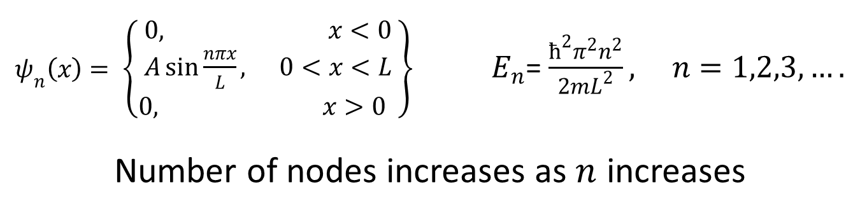
$ψ_{n}\left(x\right)= \left\{\begin{matrix}0, x<0 \\ A\sin{\frac{nπx}{L}, } 0<x<L \\ 0, x>0 \end{matrix}\right\}$ $E_{n}$= $\frac{ħ^{2}π^{2}n^{2}}{2mL^{2}}, n=1,2,3,….$
Number of nodes increases as $n$ increases

