Slide 1
Disorders of Renal Function

Slide 2
Disorders of Glomerular Function
Glomerular disorders are one of the most common forms of kidney disease.
The glomeruli may be the major site of disease (primary glomerular disease) or part of a disease affecting other organs (secondary glomerular disease).

Slide 3
Glomerulonephritis
Glomerulonephritis represents a group of kidney diseases that result from inflammation and injury of the glomerulus.
It may occur as a primary condition in which the glomerular abnormality is the only disease present, or as a secondary condition in which the glomerular abnormality results from another disease, such as diabetes mellitus or SLE.
Most cases of primary and many cases of secondary glomerular disease probably have an immune origin.

Slide 4
Glomerulonephritis
Glomerular disorders alter the permeability of the glomerular capillary membrane to plasma proteins and blood cells to produce either a nephritic or nephrotic syndrome.
The nephritic syndromes, which evoke an inflammatory response in the glomeruli and a decrease in glomerular permeability, are characterized by hematuria with red cell casts in the urine, diminished GFR, azotemia, oliguria, and hypertension.
The nephrotic syndromes, which increase glomerular capillary membrane permeability, are characterized by massive proteinuria, hypoalbuminemia, generalized edema and hyperlipidemia.

Slide 5
Types of Glomerular Disease
The clinical manifestations of glomerular disorders generally fall into several categories: acute nephritic syndromes and chronic glomerulonephritis.
The nephritic syndromes produce a proliferative inflammatory response, whereas the nephrotic syndrome produces increased permeability of the glomerulus.
Because most glomerular disorders can produce mixed nephritic and nephrotic syndromes, a definitive diagnosis often requires renal biopsy.

Slide 6
Acute Nephritic Syndrome
Acute nephritic syndrome is an acute inflammatory process that occludes the glomerular capillary lumen and damages the capillary wall. It may occur as a renal limited primary disorder, such as acute postinfectious glomerulonephritis, or as a secondary complicating disorder in systemic diseases, such as SLE.
In its most dramatic form, acute nephritic syndrome is characterized by sudden onset of hematuria (either microscopic or grossly visible, with red cell casts), variable degrees of proteinuria, diminished glomerular filtration rate (GFR), oliguria, and signs of impaired renal function. Extracellular fluid accumulation, edema, and hypertension develop because of the decreased GFR and enhanced tubular reabsorption of salt and water.

Slide 8
Nephrotic Syndrome
The nephrotic syndrome is characterized by massive proteinuria (≥3.5 g/day in adults), along with an associated hypoalbuminemia (<3 g/dL), generalized edema.
The nephrotic syndrome is not a specific glomerular disease, but a constellation of clinical findings that result from an increase in glomerular permeability and loss of plasma proteins in the urine.

Slide 9
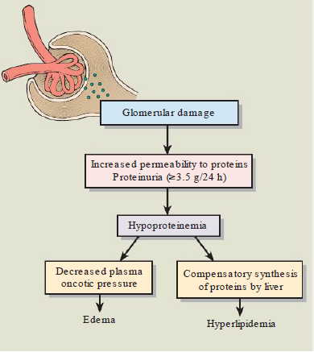
Pathophysiology of the nephrotic syndrome.

Slide 10
Chronic Glomerulonephritis
Chronic glomerulonephritis represents the chronic phase of a number of specific types of glomerulonephritis. Some forms of acute glomerulonephritis (e.g., poststreptococcal glomerulonephritis) undergo complete resolution, whereas others progress at variable rates to chronic glomerulonephritis.
Some persons who present with chronic glomerulonephritis have no history of glomerular disease. These cases may represent the end result of relatively asymptomatic forms of glomerulonephritis.
Histologically, the condition is characterized by small kidneys with sclerosed glomeruli. In most cases, chronic glomerulonephritis develops insidiously and slowly progresses to chronic kidney disease over a period of years.

Slide 11
Acute Pyelonephritis
Acute pyelonephritis is an acute suppurative inflammation of the kidney caused by bacterial infection.
Escherichia coli is the causative agent in about 80% of cases. Factors that contribute to the development of acute pyelonephritis are outflow obstruction, catheterization and urinary instrumentation, vesicoureteral reflux, pregnancy, and neurogenic bladder.

Slide 12
Acute Pyelonephritis
There are two routes by which bacteria can gain access to the kidney: ascending infection from the lower urinary tract and through the bloodstream (hematogenous spread). Ascending infection from the lower urinary tract is the most important and common route by which bacteria reach the kidney.
The hematogenous route results from seeding of the kidneys by bacteria from distant loci in the course of septicemia or infective endocarditis. It is more likely to occur in debilitated, chronically ill persons and those receiving immunosuppressive therapy, and with nonenteric bacteria such as staphylococci and certain fungi.

Slide 13
Chronic Pyelonephritis and Reflux
Nephropathy
Chronic pyelonephritis represents a progressive process. There is scarring and deformation of the renal calyces and pelvis, along with atrophy and thinning of the overlying cortex. The disorder involves a recurrent or persistent bacterial infection superimposed on urinary tract obstruction, urine reflux, or both.
The symptoms of chronic pyelonephritis may be similar to those of acute pyelonephritis, or its onset may be insidious. Often there is a history of recurrent episodes of UTI or acute pyelonephritis. Loss of tubular function and the ability to concentrate urine give rise to polyuria and nocturia, and mild proteinuria is common.
Severe hypertension often is a contributing factor in the progress of the disease. Chronic pyelonephritis is a significant cause of chronic kidney disease and renal failure.

Slide 14
Drug-Related Nephropathies
Drug-related nephropathies involve functional or structural changes in the kidneys that occur after exposure to a drug.
Because of their large blood flow and high filtration pressure, the kidneys are exposed to any substance that is in the blood.
The kidneys also are active in the metabolic transformation of drugs and therefore are exposed to a number of toxic metabolites.
Renal tubular cells, particularly proximal tubule cells, are vulnerable to the toxic effects of drugs because their role in concentrating and reabsorbing glomerular filtrate exposes them to high levels of circulating toxins.

Slide 15
Drug-Related Nephropathies
The tolerance to drugs varies with age and depends on renal function, state of hydration, blood pressure, and the pH of the urine.
Elderly persons are particularly susceptible to kidney damage caused by drugs and toxins.
The dangers of nephrotoxicity are increased when two or more drugs capable of producing kidney damage are given at the same time.

Slide 16
Drug-Related Nephropathies
Drugs and other toxic substances can damage the kidneys by causing a decrease in renal blood flow, directly damaging tubulointerstitial structures, producing hypersensitivity reactions, or obstructing urine flow.
Some drugs, such as diuretics, high–molecular-weight radiocontrast media, the immunosuppressive drugs cyclosporine and tacrolimus, and the nonsteroidal anti- inflammatory drugs (NSAIDs), can cause acute kidney injury by decreasing renal blood flow.
Other drugs such as sulfonamides and vitamin C supplements can form crystals that cause kidney damage by obstructing urinary flow in the tubules.

Slide 17
Obstructive Disorders
Urinary obstruction can occur in persons of any age and can involve any level of the urinary tract, from the urethra to the renal pelvis.
Obstruction may be sudden or insidious, partial or complete, and unilateral or bilateral.
The conditions that cause urinary tract obstruction include congenital anomalies, urinary calculi (i.e., stones), pregnancy, benign prostatic hyperplasia, scar tissue resulting from infection and inflammation, tumors, and neurologic disorders such as spinal cord injury.

Slide 18
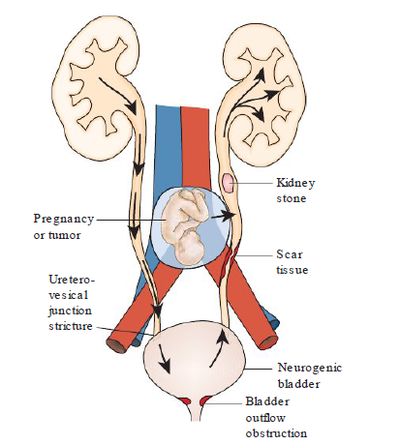
Locations and causes of urinary tract obstruction.

Slide 19
Hydronephrosis
Hydronephrosis refers to urine- filled dilation of the renal pelvis and calyces associated with progressive atrophy of the kidney due to obstruction of urine outflow.
The degree of hydronephrosis depends on the duration, degree, and level of obstruction. In far-advanced cases, the kidney may be transformed into a thin-walled cystic structure with parenchymal atrophy, total obliteration of the pyramids, and thinning of the cortex.
The condition is usually unilateral; bilateral hydronephrosis occurs only when the obstruction is below the level of the ureterovesical junction.

Slide 20
Clinical Features
The manifestations of urinary obstruction depend on the site of obstruction, the cause, and the rapidity with which the condition developed.
Most of the early symptoms are produced by the underlying pathologic process. Urinary tract obstruction encourages the growth of microorganisms and should be suspected in persons with recurrent urinary tract infections.

Slide 21
Kidney Stones
The most common cause of upper urinary tract obstruction is urinary calculi. Although stones can form in any part of the urinary tract, most develop in the kidneys.
Kidney stones, also known as nephrolithiasis or renal calculi, are the third most common disorder of the urinary tract, exceeded only by urinary tract infections and prostate disorders.

Slide 22
Clinical Features
One of the major manifestations of kidney stones is pain. Depending on location, there are two types of pain associated with kidney stones: renal colic and noncolicky renal pain.
Renal colic is the term used to describe the colicky pain that accompanies stretching of the collecting system or ureter. The symptoms of renal colic are caused by stones 1 to 5 mm in diameter that can move into the ureter and obstruct flow. Classic ureteral colic is manifested by acute, intermittent, and excruciating pain in the flank and upper outer quadrant of the abdomen on the affected side. The pain may radiate to the lower abdominal quadrant, bladder area, perineum, or scrotum in the man. The skin may be cool and clammy, and nausea and vomiting are common.
Noncolicky pain is caused by stones that produce distention of the renal calyces or renal pelvis. The pain usually is a dull, deep ache in the flank or back that can vary in intensity from mild to severe. The pain is often exaggerated by drinking large amounts of fluid.

