Slide 1
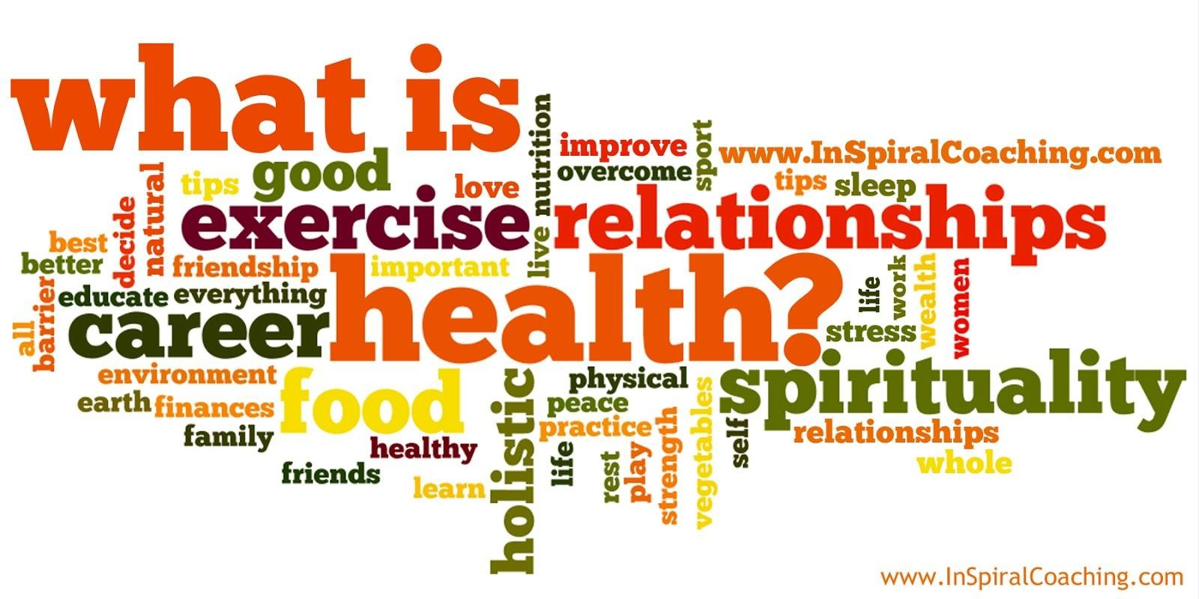
What is Health?
Dr. Sahar Hassan

Slide 2

Definition of health
“Absence of disease”
Cornerstone of the biomedical model
Negative term: considered healthy only if you
don’t suffer disease

Slide 3

Definition of health
”A state of complete physical, mental and social well-being, not merely the absence of disease or infirmity” (WHO, 1946)
Positive term
Idealistic approach to health

Slide 4
Definition of health
WHO recent definition:
To reach a state of complete physical, mental & social wellbeing, an individual or group must be able to:
hope
identify and to realize aspirations,
to satisfy needs,
and to change or cope with the environment.
Health is a positive concept emphasizing social & personal resources, as well as physical capacities.

Slide 5

Lay definition of health
We use the term “lay” to mean people who are neither health care professionals nor health services researchers, but who may have specialized knowledge related to health. This includes patients, the general public, and consumer advocates

Slide 6

Lay definition of health
health is a relative situation and related to personal expectations
Health is a positive concept
Depend on factors like: age, gender, culture, ethnicity, disability..etc
E.g. Evil eye

Slide 7
Lay definition of health
Health as not ill: you are healthy when you don’t
have any symptoms of disease
Health as absence of disease/health despite disease: focusing on disease (medical model). Used by people who feel healthy despite disease

Slide 8
Lay definition of health
Health as behavior: based on healthy behavior
Health as physical fitness: mostly used by men of all ages. Focus on playing sports & being slim
Health as energy: vitality & enthusiasm used by women & older men

Slide 9
Lay definition of health
Health as a social relationship: used by women. Focus on having good relationship with others & ability to help other people
Health as function: being able to carry everyday tasks. Used by men especially older people
Health as psychosocial well-being: energy, having social relationships and viewed as a state of mind

Slide 10
Wellness
A term used to mean healthy balance of the mind, body & spirit that results in an overall feeling of well-being
The dimensions of wellness may include
Mental
physical,
spiritual,
social,
occupational
environmental health conditions

Slide 11
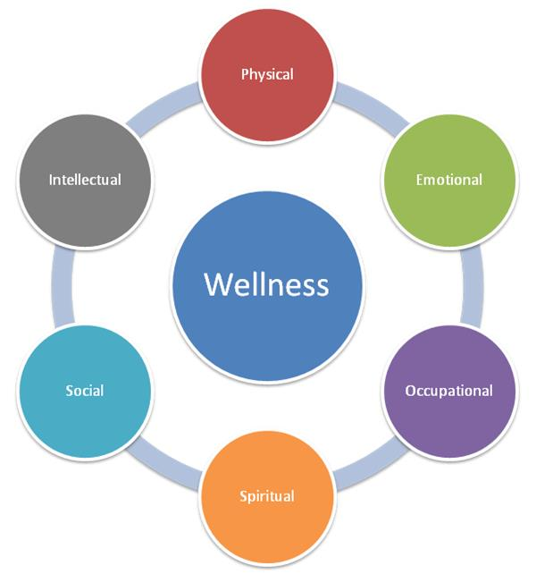
Wellness

Slide 12
Models of health

Slide 13
Models of health
Biomedical model
Social model of health

Slide 14
Biomedical model

Slide 15
Components of the Palestinian Health Care Delivery System
Do we have a health care or an illness treatment System?
Hospitals
Physicians
The Doctor-Patient Relationship
Nurses
Medical & Nursing Schools
Primary health care clinics at various levels
Nursing Homes
Pharmaceutical / Drug Companies
Medical supplements & device makers
Insurance Companies

Slide 16
Medical Providers Primary Roles
Physicians
Have the authority to diagnose, prescribe treatment
Certify death or competency
Most are specialists today
Nurses
Assist in medical settings under the supervision of a physician
Have less education than physician
Most are women
Men nurses are increasing..

Slide 17
The biomedical model
Health is the absence of disease & disease is the absence of health
Illness can be reduced to disordered bodily function within the individual
Health services treat sick & disabled people largely within specialisms
Health services are remedial and curative

Slide 18
The biomedical model
Each disease is thought to be caused by a specific pathogen, often leading to over-reliance on pharmacological intervention
The production of medical knowledge via the use of scientific research methods is valued over the use of qualitative research methods
Health professionals are the “experts” with the power to diagnose disease & decide on treatment

Slide 19
Surveillance
Surveillance: observation of individuals/ populations
It is normal part of everyday life & is another example of how people’s lives have become medicalized
For example: asking women to do cervical smear, mammogram & men to do tests for prostate cancer
Evidence suggests that Surveillance serves to create tension & anxiety

Slide 20
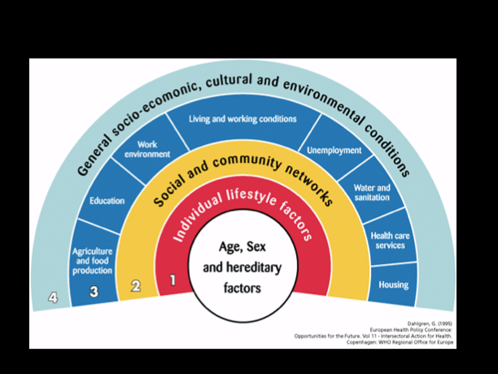
The social model of health

Slide 21
What are social determinants of health?
The social determinants of health are the conditions in which people are born, grow, live, work & age
These circumstances are shaped by the distribution of money, power & resources at global, national and local levels. (WHO)

Slide 22
The social model of health
3 characteristics:
Health & disease are socially produced: biomedicine is reductionist because it assumes that disease is natural & located in the individual
While biomedical model assumes a direct relationship between pathology & disease, the social model recognizes other factors that play role in determining who become sick & why
Medicine is neutral & scientific. Social model emphasizes the way in which health care is influenced by a range of social factors

Slide 23
Experience of illness, sickness & disease

Slide 24
Illness & Social Order
Illness is a threat to social order
If too many people are sick at one time, it affects our ability to perform tasks necessary for continued operation of society
Ill health is a form of abnormal & disruptive to the normal functioning of society

Slide 25
Sick Role
Sick role:
societal expectations about attitudes & behavior of a person labeled as ill
the sanctioning of illness within society
Illness behavior: actions of people when they feel unwell

Slide 26
Illness behavior
Factors influencing help-seeking behavior:
The extent to which symptoms are visible & recognizable
Their perceived seriousness & consequent levels of anxiety
The extent to which they impact on the sufferer’s life
Their perceived frequency & persistence
The degree to which an individual can tolerate them
Knowledge about what symptoms may mean
Competing explanations for the symptoms
Availability of treatment & assistance

Slide 27
On being sick: roles & responsibilities
The patient:
Is exempted from normal social role & responsibilities i.e. going to work
Is not responsible for his/her illness & cannot get well on his/her own, cannot “just pull himself together”
Must want to get better
Must seek technically competent help & comply with treatment

Slide 28
On being sick: roles & responsibilities
The doctor:
Must act in a professional & objective manner
Must do everything possible to help the patient recover
Must be well trained & competent
Must be able to examine the patient

Slide 29
Stigma & disease
Stigma: social disgrace attached to any condition
Is a powerful discrediting label that can change & spoil the way in which the person viewed.

Slide 30
Stigma & disease
Stigma can occur in 2 types:
Discrediting conditions that are visible to others: such as eczema, psoriasis, physical impairment
Discrediting conditions that are not visible to others or can be easily concealed: such as epilepsy, HIV, depression or diabetes.

Slide 31
Stigma & disease
In the case of Down’s syndrome, it is discrediting condition as the facial features of the individual are distinct from those of other people, thus immediately stigmatizing the person.
Some conditions lead to stigma because of the moral attributes related to particular condition i.e. HIV/AIDS are associated with sexual promiscuity, drug use & homosexuality
So, person with HIV/AIDS experience “enacted stigma” a type of stigma leads to actual discrimination.

Slide 32
Health, holism & nursing
Holistic approach: acceptance that health is determined & defined by inter-related social, psychological and biological factors.
Holism:
an approach which seeks to move away from a biological model
A theory that considers the parts of a whole as interconnected & interdependent

Slide 33
Health, holism & nursing
Ideally, nursing care is known to be provided within a holistic framework
In reality, nursing work is messy & contingent
Lack of resources can limit the amount of time that nurses devote to each individual patient, which interferes with provision of holistic care

Slide 34
Any question ?

