Slide 1
IPv6: motivation
initial motivation: 32-bit IPv4 address space would be completely allocated
additional motivation:
  speed processing/forwarding: 40-byte fixed length header
  enable different network-layer treatment of “flows”

Slide 2
IPv6 datagram format
flow label: identify datagrams in same "flow.” (concept of “flow” not well defined).
32 bits
priority: identify priority among datagrams in flow
ver
pri
flow label
payload len
next hdr
hop limit
source address
(128 bits)
128-bit
IPv6 addresses
destination address
(128 bits)
payload (data)
What’s missing (compared with IPv4):
no checksum (to speed processing at routers)
no fragmentation/reassembly
no options (available as upper-layer, next-header protocol at router)

Slide 3
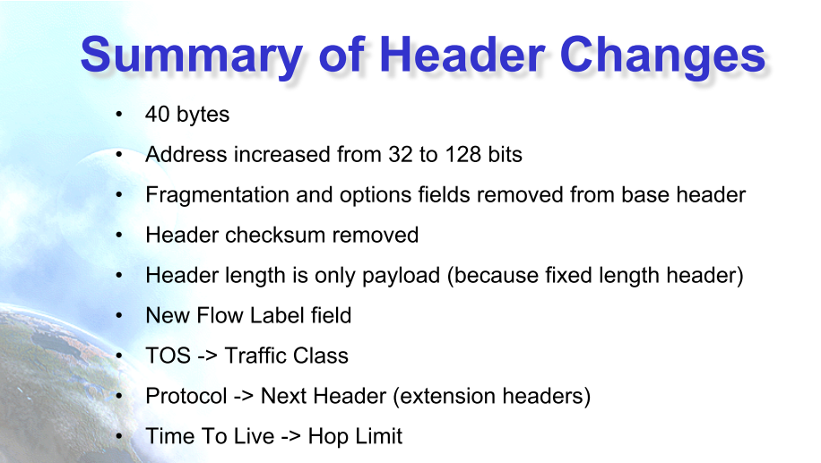

Slide 4
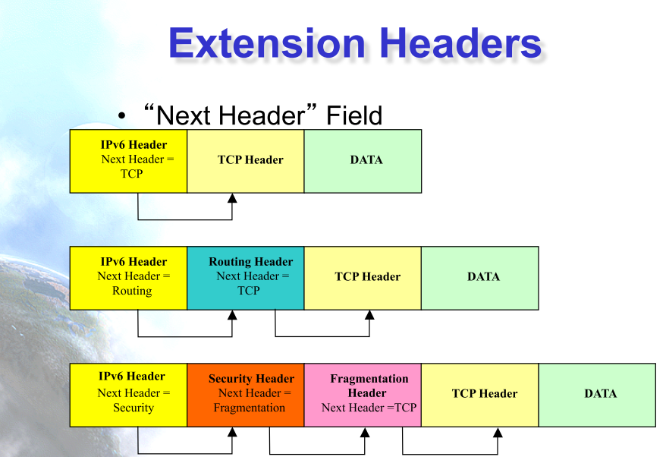

Slide 5
128-bit IPv6 Address
3FFE:085B:1F1F:0000:0000:0000:00A9:1234
8 groups of 16-bit hexadecimal numbers separated by “:”
Leading zeros can be removed
3FFE:85B:1F1F::A9:1234
:: = all zeros in one or more group of 16-bit hexadecimal numbers

Slide 6
Transition from IPv4 to IPv6
not all routers can be upgraded simultaneously
  no “flag days”
  how will network operate with mixed IPv4 and IPv6 routers?
tunneling: IPv6 datagram carried as payload in IPv4 datagram among IPv4 routers (“packet within a packet”)
  tunneling used extensively in other contexts (4G/5G)
IPv4 header fields
IPv6 header fields
IPv4 payload
IPv4 source, dest addr
IPv6 source dest addr
UDP/TCP payload
IPv6 datagram
IPv4 datagram

Slide 7
Tunneling and encapsulation
Ethernet connecting two IPv6 routers:
A
B
Ethernet connects two IPv6 routers
E
F
IPv6
IPv6
IPv6
IPv6
IPv6 datagram
Link-layer frame
The usual: datagram as payload in link-layer frame
IPv4 network connecting two IPv6 routers
A
B
E
F
IPv6
IPv6/v4
IPv6/v4
IPv6
IPv4 network

Slide 8
Tunneling and encapsulation
Ethernet connecting two IPv6 routers:
A
B
Ethernet connects two IPv6 routers
E
F
IPv6
IPv6
IPv6
IPv6
IPv6 datagram
Link-layer frame
The usual: datagram as payload in link-layer frame
IPv4 tunnel connecting two IPv6 routers
A
B
IPv4 tunnel
connecting IPv6 routers
E
F
IPv6
IPv6/v4
IPv6/v4
IPv6
IPv6 datagram
IPv4 datagram
tunneling: IPv6 datagram as payload in a IPv4 datagram

Slide 9
Tunneling
A
B
IPv4 tunnel
connecting IPv6 routers
E
F
logical view:
IPv6
IPv6/v4
IPv6/v4
IPv6
A
B
C
D
E
F
physical view:
IPv6
IPv6/v4
IPv4
IPv4
IPv6/v4
IPv6
flow: X
src: A
dest: F
data
src:B
dest: E
src:B
dest: E
src:B
dest: E
flow: X
src: A
dest: F
data
Flow: X
Src: A
Dest: F
data
Flow: X
Src: A
Dest: F
data
Flow: X
Src: A
Dest: F
data
Note source and destination addresses!
A-to-B:
IPv6
B-to-C:
IPv6 inside
IPv4
B-to-C:
IPv6 inside
IPv4
B-to-C:
IPv6 inside
IPv4
E-to-F:
IPv6

Slide 10
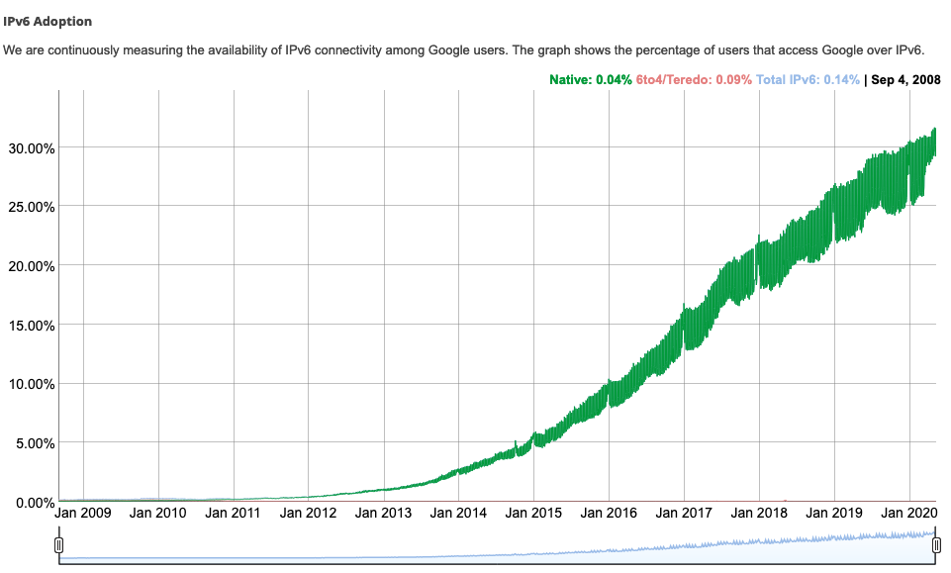
IPv6: adoption
Google¹: ~ 30% of clients access services via IPv6
NIST: 1/3 of all US government domains are IPv6 capable
¹ https://www.google.com/intl/en/ipv6/statistics.html

Slide 11
IPv6: adoption
Google¹: ~ 30% of clients access services via IPv6
NIST: 1/3 of all US government domains are IPv6 capable
Long (long!) time for deployment, use
  25 years and counting!
  think of application-level changes in last 25 years: WWW, social media, streaming media, gaming, telepresence, …
  Why?
¹ https://www.google.com/intl/en/ipv6/statistics.html

