Slide 1
Types of assessment

Slide 2
Two general types pf assessment
Standardized assessment
Non-standardized assessment

Slide 3
Standardized Assessment
Systematic
- Say and Do controlled (by manual)
- Specific stimuli are used
- Explicit rules for scoring the test
- Not influenced by the examiner’s biases
- measurement process will be uniform across examiners

Slide 4
Assessment methods
Norm-referenced tests
Criterion-Referenced Tests
Authentic assessment

Slide 5
Norm-referenced tests
Norm-referenced tests are always standardized. They allow a comparison of an individual’s performance to the performance of a larger group, called a normative group.
The results of the normative group are used to create normal distribution curve

Slide 6
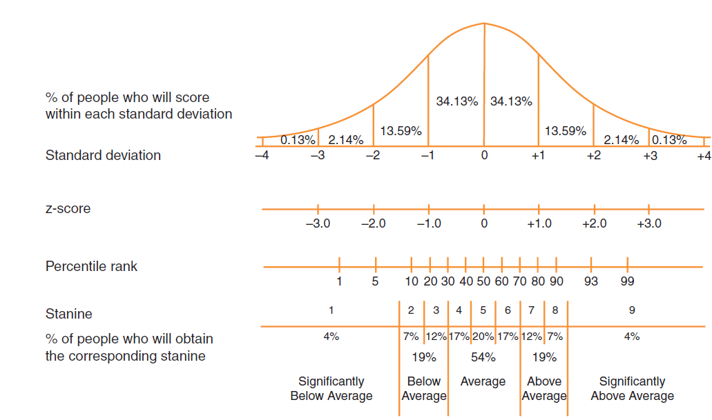

Slide 7
Norm-referenced tests | advantages
The tests are objective.
The skills of an individual can be compared to those of a large group of similar individuals.
Test administration is usually efficient.
They are widely recognized, allowing for a common ground of discussion when other professionals are involved .
Do not require a high level of clinical experience and skill

Slide 8
Norm-referenced tests | disadvantages
Norm-referenced tests do not allow for individualization.
The testing situation may be unnatural and not representative of real life.
The approach evaluates isolated skills without considering other contributing factors.
Norm-referenced tests must be administered exactly as instructed for the results to be
considered valid and reliable.
Test materials may not be appropriate for certain populations, such as culturally and
linguistically diverse clients.

Slide 9
Criterion-Referenced Tests (CRT)
CRTs identify what a client can and cannot do compared to a predefined criterion.
CRTs assume that there is a level of performance that must be met for a behavior to be acceptable.
Examples?

Slide 10
Criterion-Referenced Tests| advantages
The tests are usually objective.
Test administration is usually efficient.
widely recognized
With non-standardized criterion-referenced tests, there is some opportunity for
individualization.

Slide 11
Criterion-Referenced Tests| disadvantages
The testing situation may be unnatural and not representative of real life.
•The approach evaluates isolated skills without considering other contributing factors.
•Standardized criterion-referenced tests do not allow for individualization.
•Standardized criterion-referenced tests must be administered exactly as instructed for the results to be considered valid and reliable.

Slide 12
Scoring of standardized tests
Standardized testing —> scores (quantitative measures)
A test administration —> raw score
Raw score is the actual scores earned on a test
Raw score —> converted to be viewed on a distribution
Two statistical measures of a distribution:
- mean (the arithmetic average of the scores of the norming samples)
- standard deviation (the extent to which scores deviate from the mean)

Slide 13
The client’s score(s) can be expressed in two ways:
- standard deviation from the mean
- percentile rank (use percentile points to express a child’s score relative to the norming sample)
i.e., if a child scores is at the 25th percentile? This means…..?
The median is …….

Slide 14
Authentic assessments
authentic assessment identifies what a client can and cannot do with an emphasis on
contextualized test stimuli. The test environment is more realistic and natural.
it is ongoing. The authentic assessment approach evaluates the client’s performance during diagnostic and treatment phases.
requires more clinical skill. How do we do it?

Slide 15
Authentic assessments| advantages
The approach is natural and similar to the real world.
Clients participate in self-evaluation and self-monitoring.
•The approach allows for individualization. This is particularly beneficial with culturally diverse clients or special needs clients, such as those who use(AAC) systems.
•The approach offers flexibility.

Slide 16
Authentic assessments| disadvantages
The approach may lack objectivity.
•Procedures are not usually standardized, thus reliability and validity are less
assured.
•requires a high level of clinical experience
•The approach is not efficient, requiring a lot of planning time.

Slide 17
Dynamic assessment
test- teach-retest

Slide 18
Types of Scores in non-Standardized Assessment
Measurement Scales:
- nominal scale: a category is present or absent (e.g., hoarseness,...).
ordinal scale: a numerical scale that can be arranged according to rank orders or levels.

Slide 19
Psychometric principles
Validity
Reliability
Standardization

Slide 20
Validity
Face validity
Content validity
Construct validity
Criterion validity : concurrent validity / predictive validity

