Slide 1
Chapter 11 Inheritance and Polymorphism
Creating classes from other classes!

Slide 2
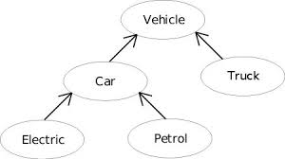
Inheritance cont.
Subclasses: a subclass may inherit the structure and behaviour of it’s superclass.

Slide 3
Inheritance
You use a class to model objects of the same type.
Different classes may have some common properties and behaviors, which can be generalized in a class that can be shared by other classes.
You can define a specialized class that extends the generalized class.
The specialized classes inherit the properties and methods from the general class.

Slide 4
Superclasses and Subclasses
GeometricObject
Circle
Rectangle
TestCircleRectangle
Run

Slide 5
A subclass inherits accessible data fields and methods from its superclass
Does it inherit class constructors?!!
A constructor is used to construct an instance of a class. Unlike properties and methods, a superclass's constructors are not inherited in the subclass. They can only be invoked from the subclasses' constructors, using the keyword super. If the keyword super is not explicitly used, the superclass's no-arg constructor is automatically invoked.
What if there is no-arg constructor defined in the super class?!!!

Slide 6
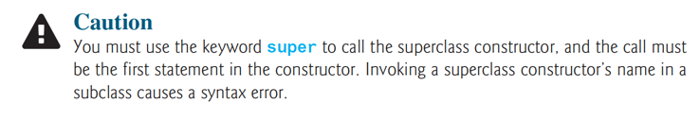
Superclass’s Constructor Is Always Invoked
A constructor may invoke an overloaded constructor or its superclass’s constructor. If none of them is invoked explicitly, the compiler puts super() as the first statement in the constructor. For example,

Slide 7
Using the Keyword super
The keyword super refers to the superclass of the class in which super appears. This keyword can be used in two ways:
To call a superclass constructor
To call a superclass method

Slide 8
CAUTION
You must use the keyword super to call the superclass constructor. Invoking a superclass constructor’s name in a subclass causes a syntax error. Java requires that the statement that uses the keyword super appear first in the constructor.

Slide 9
Constructor Chaining
Constructing an instance of a class invokes all the superclasses’ constructors along the inheritance chain. This is known as constructor chaining.
public class Faculty extends Employee {
public static void main(String[] args) {
new Faculty();
}
public Faculty() {
System.out.println("(4) Faculty's no-arg constructor is invoked");
}
}
class Employee extends Person {
public Employee() {
this("(2) Invoke Employee’s overloaded constructor");
System.out.println("(3) Employee's no-arg constructor is invoked");
}
public Employee(String s) {
System.out.println(s);
}
}
class Person {
public Person() {
System.out.println("(1) Person's no-arg constructor is invoked");
}
}

Slide 10
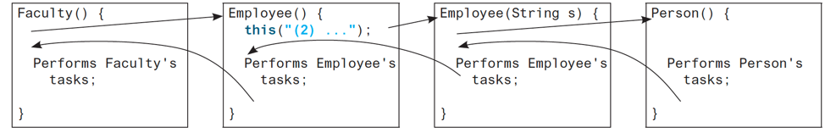
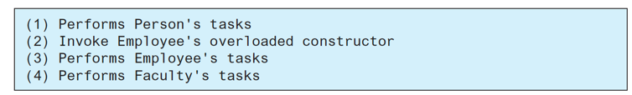
Output

Slide 11
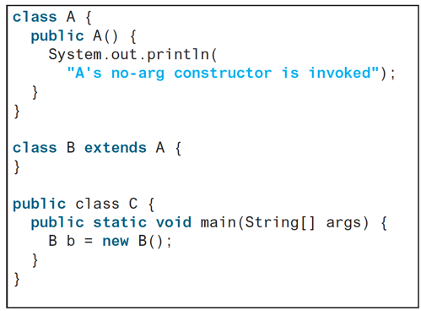
What is the output?

Slide 12
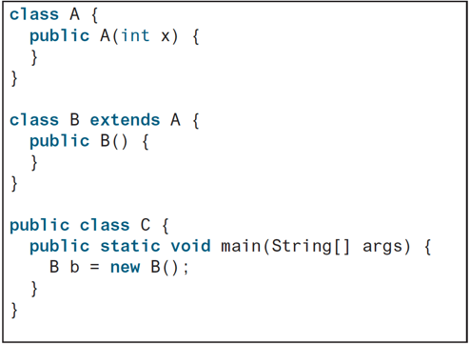
What is the Output?

Slide 13

Example on the Impact of a Superclass without no-arg Constructor
Find out the errors in the program:
public class Apple extends Fruit {
}
class Fruit {
public Fruit(String name) {
System.out.println("Fruit's constructor is invoked");
}
}

Slide 14
Defining a Subclass
A subclass inherits from a superclass. You can also:
  Add new properties
  Add new methods
  Override the methods of the superclass

Slide 15
Calling Superclass Methods
You could rewrite the printCircle() method in the Circle class as follows:
public void printCircle() {
System.out.println("The circle is created " +
super.getDateCreated() + " and the radius is " + radius);
}

Slide 16
Overriding Methods in the Superclass
A subclass inherits methods from a superclass. Sometimes it is necessary for the subclass to modify the implementation of a method defined in the superclass. This is referred to as method overriding.
public class Circle extends GeometricObject {
// Other methods are omitted
/** Override the toString method defined in GeometricObject */
public String toString() {
return super.toString() + "\nradius is " + radius;
}
}
To override a method, the method must be defined in the subclass using the same signature as in its superclass.

Slide 17
NOTE
An instance method can be overridden only if it is accessible. Thus a private method cannot be overridden, because it is not accessible outside its own class. If a method defined in a subclass is private in its superclass, the two methods are completely unrelated.

Slide 18
NOTE
Like an instance method, a static method can be inherited. However, a static method cannot be overridden. If a static method defined in the superclass is redefined in a subclass, the method defined in the superclass is hidden.
The hidden static methods can be invoked using the syntax SuperClassName.staticMethodName.

Slide 19
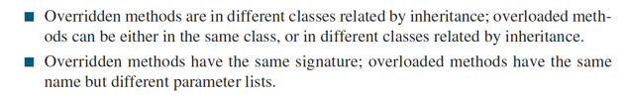
Overriding vs. Overloading

Slide 20
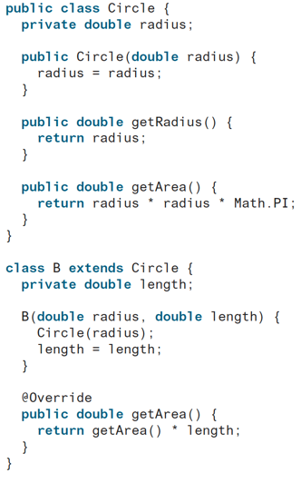
Problems?!
This annotation denotes that the annotated method is required to override a method in its
superclass. If a method with this annotation does not override its superclass’s method, the
compiler will report an error

Slide 21
The Object Class and Its Methods
Every class in Java is descended from the java.lang.Object class. If no inheritance is specified when a class is defined, the superclass of the class is Object.

Slide 22
The toString() method in Object
The toString() method returns a string representation of the object. The default implementation returns a string consisting of a class name of which the object is an instance, the at sign (@), and a number representing this object (memory add.).
Loan loan = new Loan();
System.out.println(loan.toString());
The code displays something like Loan@15037e5 . This message is not very helpful or informative. Usually you should override the toString method so that it returns a digestible string representation of the object.

Slide 23
Polymorphism
Three pillars of object-oriented programming are encapsulation, inheritance, and polymorphism
Polymorphism means that a variable of a supertype can refer to a subtype object.
A class defines a type. A type defined by a subclass is called a subtype, and a type defined by its superclass is called a supertype. Therefore, you can say that Circle is a subtype of GeometricObject and GeometricObject is a supertype for Circle.
PolymorphismDemo
Run

Slide 24
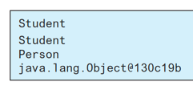
public class PolymorphismDemo {
public static void main(String[] args) {
m(new GraduateStudent());
m(new Student());
m(new Person());
m(new Object());
}
public static void m(Object x) {
System.out.println(x.toString());
}
}
class GraduateStudent extends Student {
}
class Student extends Person {
public String toString() {
return "Student";
}
}
class Person extends Object {
public String toString() {
return "Person";
}
}
Method m takes a parameter of the Object type. You can invoke it with any object.
An object of a subtype can be used wherever its supertype value is required. This feature is known as polymorphism.
When the method m(Object x) is executed, the argument x’s toString method is invoked. x may be an instance of GraduateStudent, Student, Person, or Object. Classes GraduateStudent, Student, Person, and Object have their own implementation of the toString method. Which implementation is used will be determined dynamically by the Java Virtual Machine at runtime. This capability is known as dynamic binding.
DynamicBindingDemo
Run

Slide 25
Dynamic Binding
Dynamic binding works as follows: Suppose an object o is an instance of classes C₁, C₂, ..., C_{n-1}, and C_{n}, where C₁ is a subclass of C₂, C₂ is a subclass of C₃, ..., and C_{n-1} is a subclass of C_{n}. That is, C_{n} is the most general class, and C₁ is the most specific class. In Java, C_{n} is the Object class. If o invokes a method p, the JVM searches the implementation for the method p in C₁, C₂, ..., C_{n-1} and C_{n}, in this order, until it is found. Once an implementation is found, the search stops and the first-found implementation is invoked.

Slide 26
Method Matching vs. Binding
Matching a method signature and binding a method implementation are two issues. The compiler finds a matching method according to parameter type, number of parameters, and order of the parameters at compilation time. A method may be implemented in several subclasses. The Java Virtual Machine dynamically binds the implementation of the method at runtime.

Slide 27
Generic Programming
public class PolymorphismDemo {
public static void main(String[] args) {
m(new GraduateStudent());
m(new Student());
m(new Person());
m(new Object());
}
public static void m(Object x) {
System.out.println(x.toString());
}
}
class GraduateStudent extends Student {
}
class Student extends Person {
public String toString() {
return "Student";
}
}
class Person extends Object {
public String toString() {
return "Person";
}
}
Polymorphism allows methods to be used generically for a wide range of object arguments. This is known as generic programming. If a method’s parameter type is a superclass (e.g., Object), you may pass an object to this method of any of the parameter’s subclasses (e.g., Student or String). When an object (e.g., a Student object or a String object) is used in the method, the particular implementation of the method of the object that is invoked (e.g., toString) is determined dynamically.

Slide 28
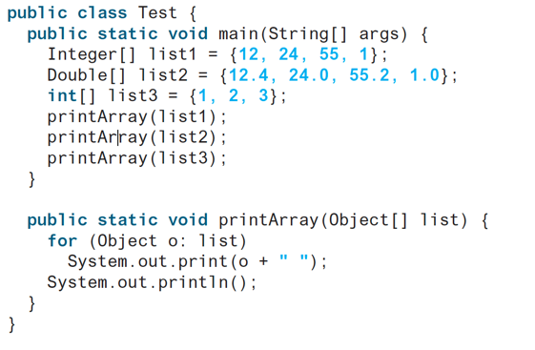
What's wrong?
Notes:
int obj

Slide 29
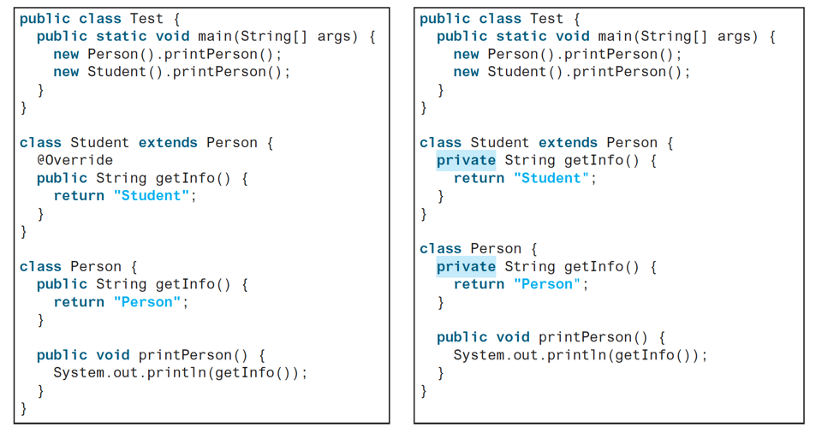
What's the output?!
Notes:
Per St, Per Per

Slide 30
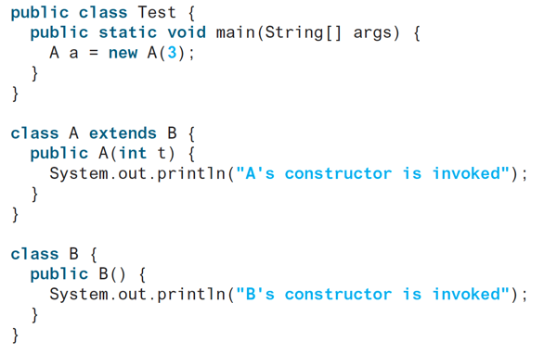
What's the Output?
Notes:
B, A

Slide 31
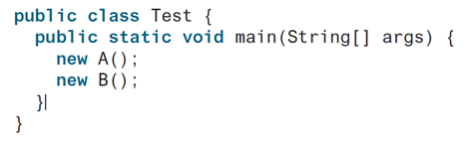
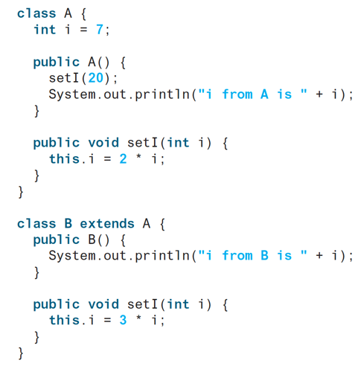
What's the Output
Notes:
40 , 60 , 60

Slide 32
Casting Objects
Casting can also be used to convert an object of one class type to another within an inheritance hierarchy.
  m( new Student() );
assigns the object new Student() to a parameter of the Object type. This statement is equivalent to:
  Object o = new Student(); // Implicit casting
  m( o );
The statement Object o = new Student(), known as implicit casting, is legal because an instance of Student is automatically an instance of Object.
Notes:
You have already used the casting operator to convert variables of one primitive type to another.

Slide 33
Why Casting is Necessary?
Suppose you want to assign the object reference o to a variable of the Student type using the following statement:
  Student b = o ; // A compile error would occur.
Why does the statement Object o = new Student() work and the statement Student b = o doesn’t?
  This is because a Student object is always an instance of Object, but an Object is not necessarily an instance of Student.
  Even though you can see that o is really a Student object, the compiler is not so clever to know it.

Slide 34
Why Casting Is Necessary?
To tell the compiler that o is a Student object, use an explicit casting.
The syntax is similar to the one used for casting among primitive data types.
Enclose the target object type in parentheses and place it before the object to be cast, as follows:
  Student b = (Student) o ; // Explicit casting

Slide 35
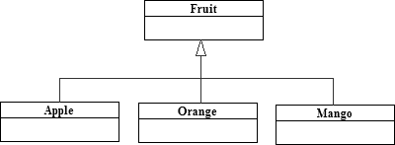
Casting from Superclass to Subclass
Explicit casting must be used when casting an object from a superclass to a subclass.
  Fruit fruit = new Apple();
  Apple a = (Apple) fruit;
  Orange o = (Orange) fruit;
This type of casting may not always succeed.

Slide 36
The instanceof Operator
Use the instanceof operator to test whether an object is an instance of a class:
  Object myObject = new Circle();
  ... // Some lines of code
  /** Perform casting if myObject is an instance of Circle */
  if (myObject instanceof Circle) {
  System.out.println("The circle diameter is " +
  ((Circle)myObject).getDiameter());
  ...
  }

Slide 37
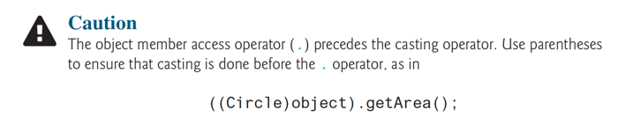
Parentheses

Slide 38
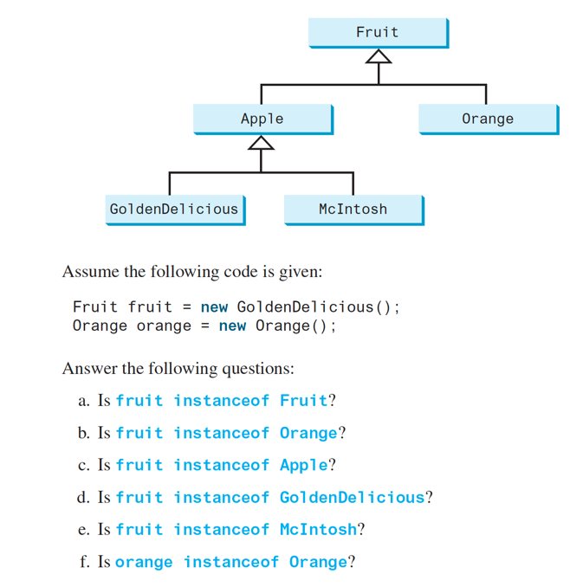
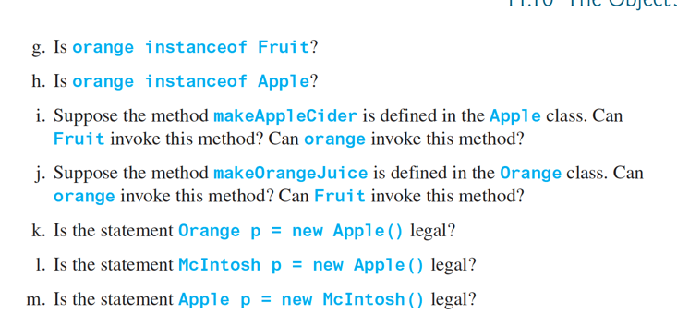
Notes:
TFTTF TTFNN NNY

Slide 39
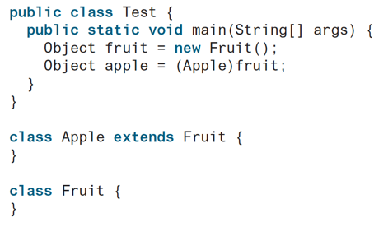
What's Wrong?
Notes:
Class Cast Exception

Slide 40
The equals Method
The equals() method compares the
contents of two objects. The default implementation of the equals method in the Object class is as follows:
public boolean equals(Object obj) {
return this == obj;
}
For example, the equals method is overridden in the Circle class.
public boolean equals(Object o) {
if (o instanceof Circle) {
return radius == ((Circle)o).radius;
}
else
return false;
}

Slide 41
NOTE
The == comparison operator is used for comparing two primitive data type values
or
For determining whether two objects have the same references.
The equals method is intended to test whether two objects have the same contents, provided that the method is modified in the defining class of the objects.

Slide 42
The ArrayList Class
You can create an array to store objects. But the array’s size is fixed once the array is created. Java provides the ArrayList class that can be used to store an unlimited number of objects.

Slide 43
Generic Type
ArrayList is known as a generic class with a generic type E. You can specify a concrete type to replace E when creating an ArrayList. For example, the following statement creates an ArrayList and assigns its reference to variable cities. This ArrayList object can be used to store strings.
ArrayList<String> cities = new ArrayList<String>();
ArrayList<String> cities = new ArrayList<>();
TestArrayList
Run

Slide 44
Differences and Similarities between Arrays and ArrayList
DistinctNumbers
Run

Slide 45
Array Lists from/to Arrays
Creating an ArrayList from an array of objects:
String[] array = {"red", "green", "blue"};
ArrayList<String> list = new ArrayList<>(Arrays.asList(array));
Creating an array of objects from an ArrayList:
String[] array1 = new String[list.size()];
list.toArray(array1);

Slide 46
Sort, max and min in an Array List
String[] array = {"red", "green", "blue"};
System.out.pritnln(java.util.Collections.max(
new ArrayList<String>(Arrays.asList(array)));
java.util.Collections.sort(new ArrayList<String>(Arrays.asList(array)));
String[] array = {"red", "green", "blue"};
System.out.pritnln(java.util.Collections.min(
new ArrayList<String>(Arrays.asList(array)));

Slide 47
Shuffling an Array List
Integer[] array = {3, 5, 95, 4, 15, 34, 3, 6, 5};
ArrayList<Integer> list = new
ArrayList<>(Arrays.asList(array));
java.util.Collections.shuffle(list);
System.out.println(list);

Slide 48
The MyStack Classes
A stack to hold objects.
MyStack

Slide 49
The protected Modifier
The protected modifier can be applied on data and methods in a class. A protected data or a protected method in a public class can be accessed by any class in the same package or its subclasses, even if the subclasses are in a different package.
private, default, protected, public

Slide 50
Accessibility Summary

Slide 51
Visibility Modifiers

Slide 52
A Subclass Cannot Reduce the Accessibility
A subclass may override a protected method in its superclass and change its visibility to public. However, a subclass cannot Reduce the accessibility of a method defined in the superclass. For example, if a method is defined as public in the superclass, it must be defined as public in the subclass.

Slide 53
NOTE
The modifiers are used on classes and class members (data and methods), except that the final modifier can also be used on local variables in a method. A final local variable is a constant inside a method.

Slide 54
The final Modifier
The final class cannot be extended:
final class Math {
...
}
The final variable is a constant:
final static double PI = 3.14159;
The final method cannot be
overridden by its subclasses.

