Slide 1
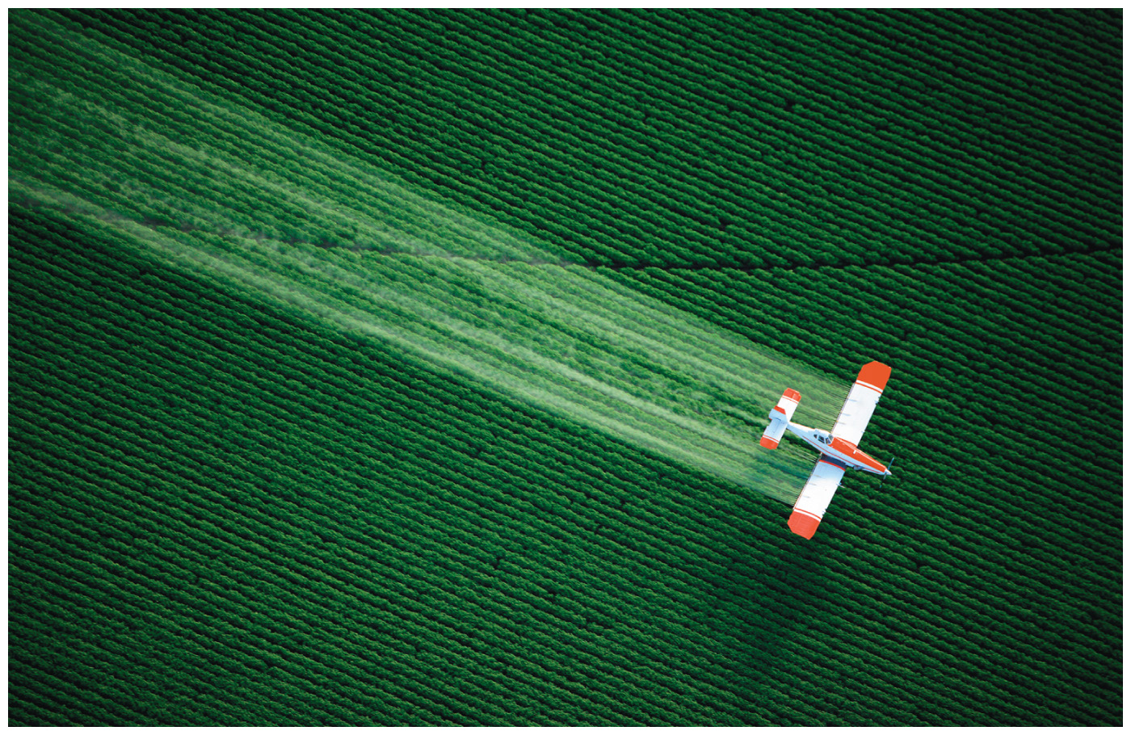
Chapter 6
The Reactions of Alkenes and Alkynes
The Stereochemistry of Addition Reactions
Paula Yurkanis Bruice
University of California,
Santa Barbara

Slide 2
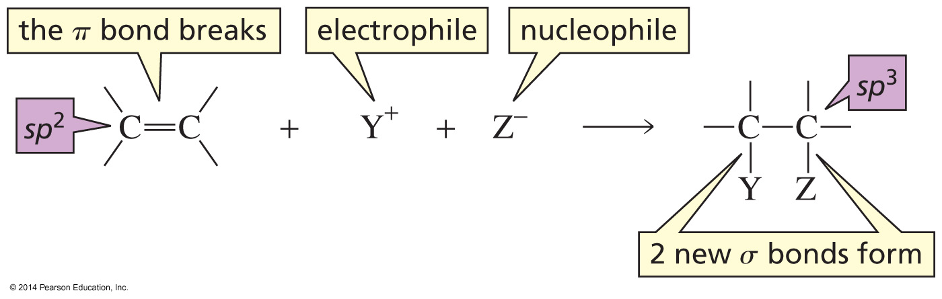
An Electrophilic Addition Reaction

Slide 3
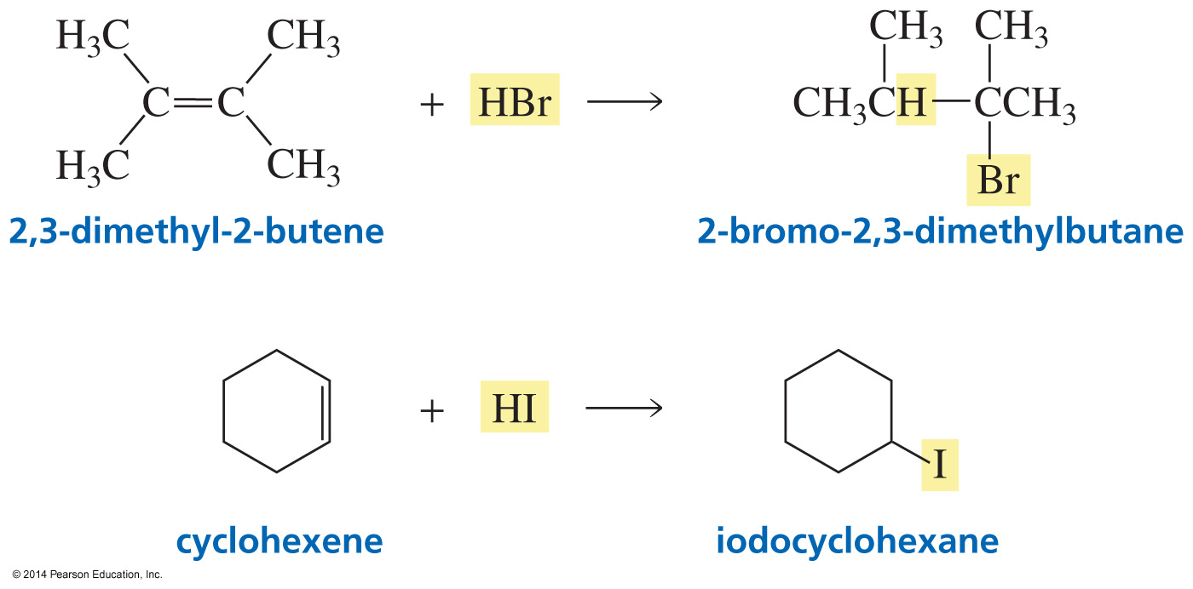
Addition of Hydrogen Halides

Slide 4
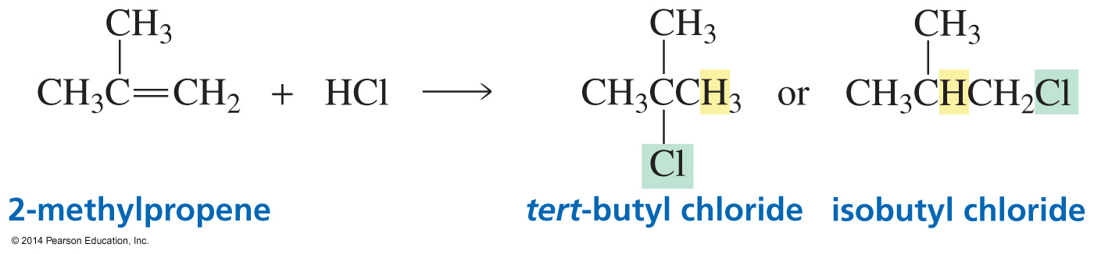
Which sp² Carbon gets the H⁺?

Slide 5
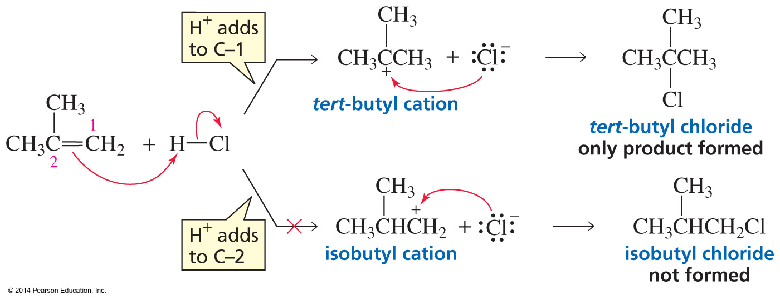
The Mechanism
Carbocation formation is the rate-limiting step.

Slide 6
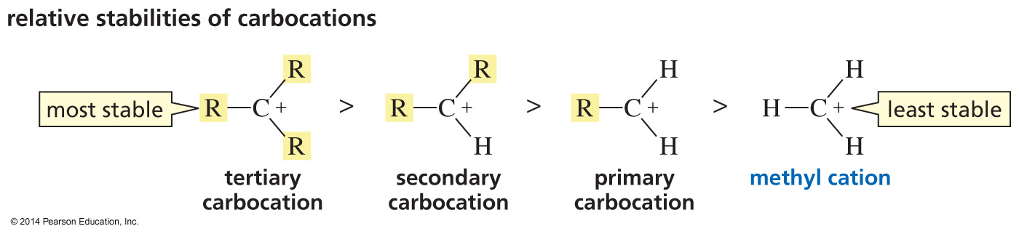
Relative Stabilities of Carbocations

Slide 7
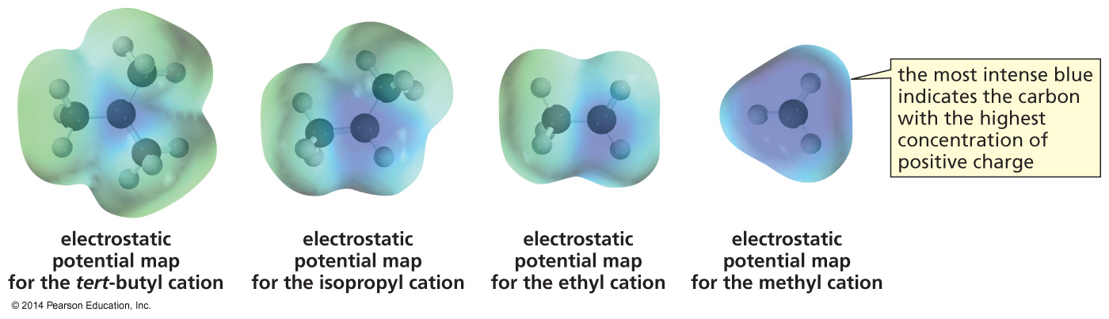
Carbocation Stability
Alkyl groups decrease the concentration of positive charge on the carbon.

Slide 8
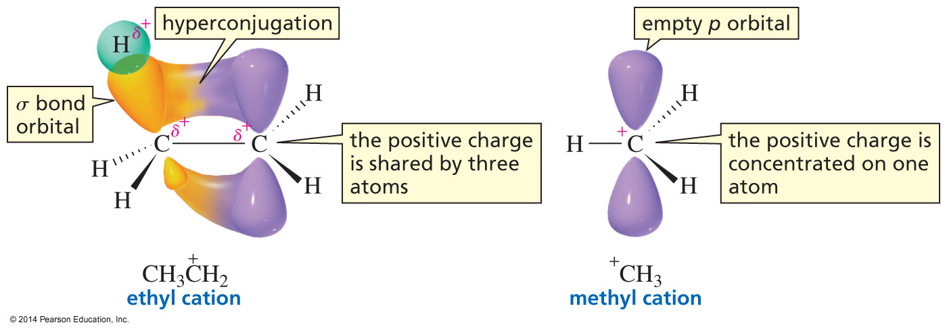
Hyperconjugation Stabilizes
a Carbocation

Slide 9
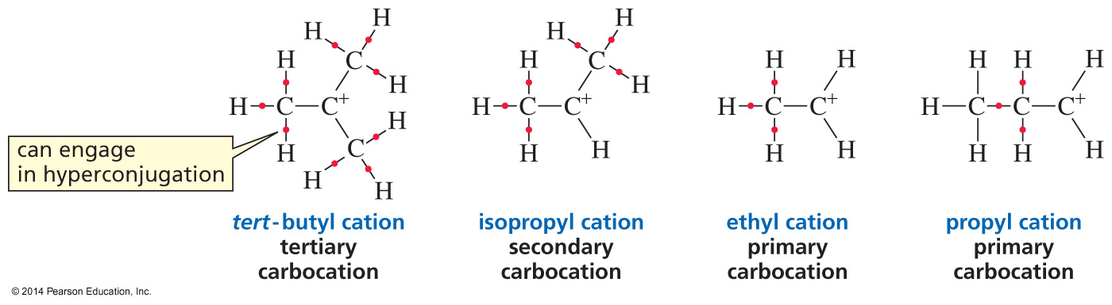
Hyperconjugation

Slide 10
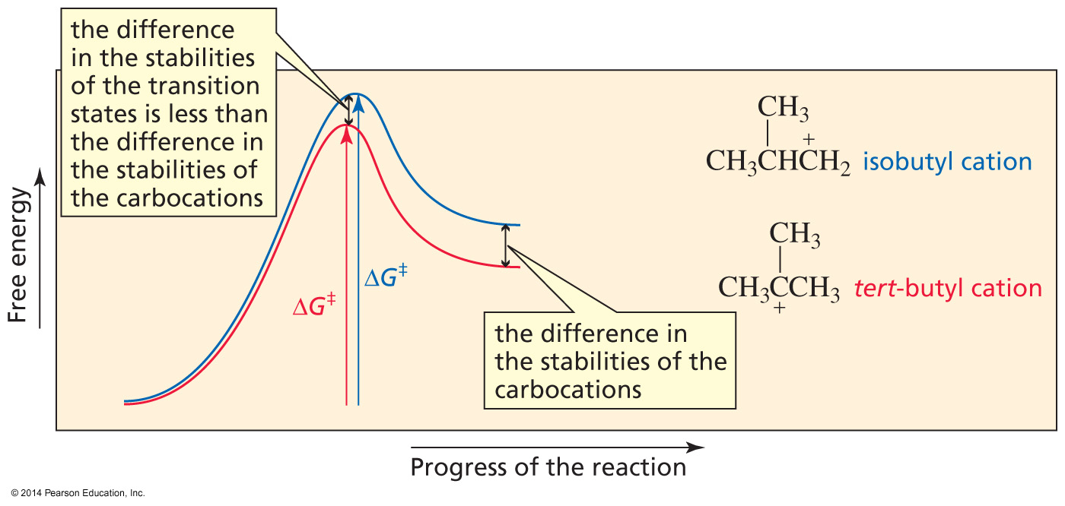
Why the difference in Rate?
The more stable carbocation is formed more rapidly.

Slide 11
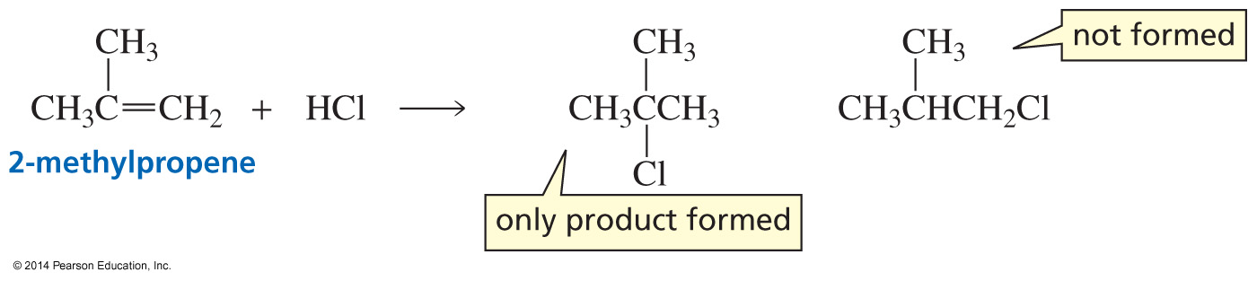
The difference in Carbocation Stability determines the Products

Slide 12
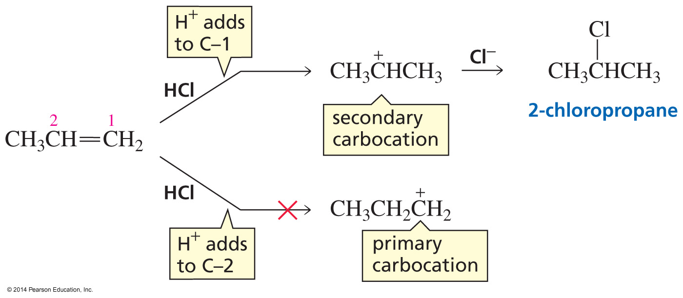
Electrophilic Addition Reactions are Regioselective

Slide 13
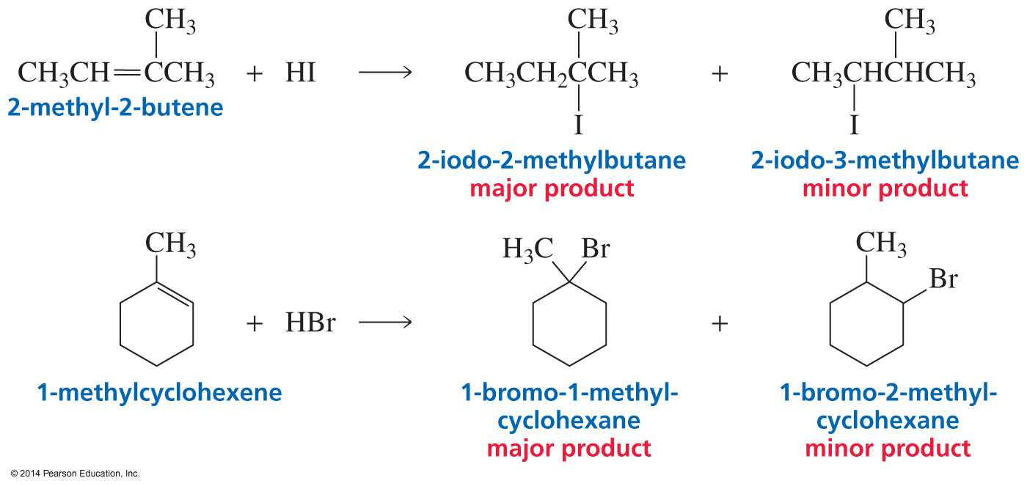
The Electrophile adds to the sp² Carbon bonded to the most Hydrogens
A regioselective reaction forms more of one constitutional isomer than another.
• Completely regioselective
• Highly regioselective
• Moderately regioselective

Slide 14
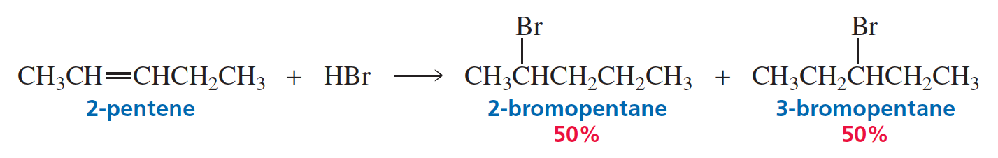
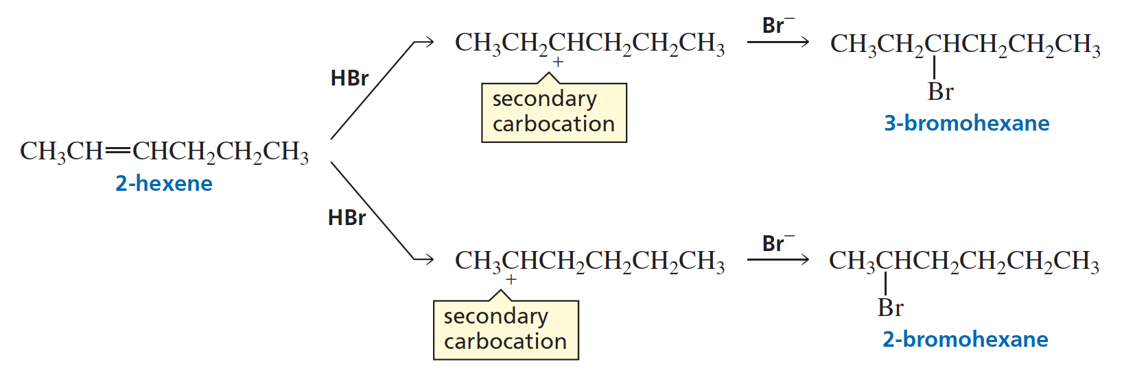
Not Regioselective

Slide 15
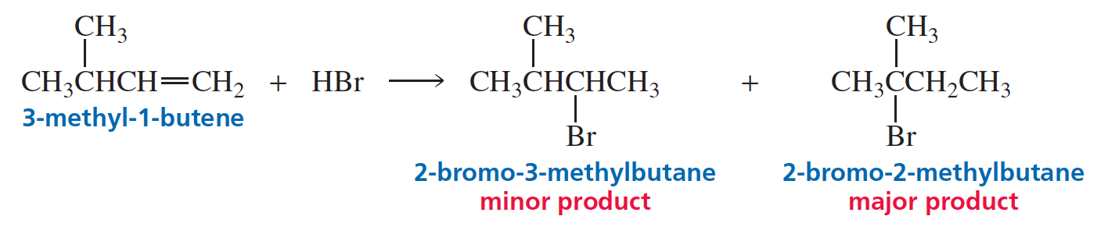
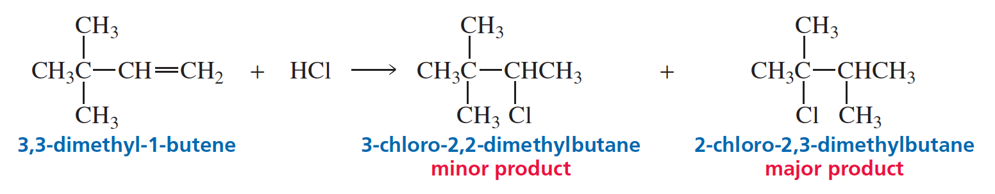
The major product is a Surprise

Slide 16
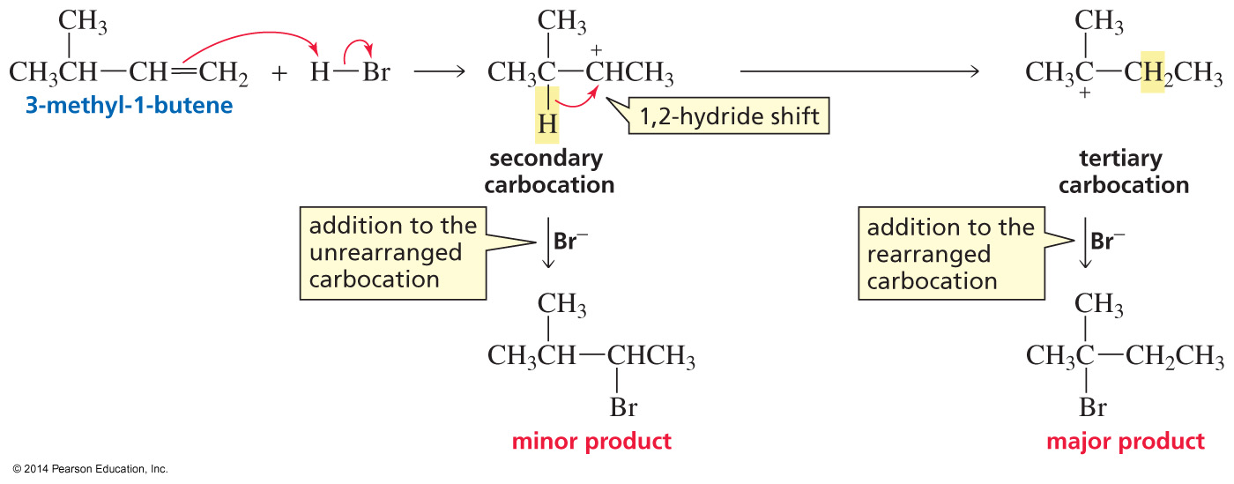
Carbocation Rearrangement
(a 1,2-hydride shift)

Slide 17
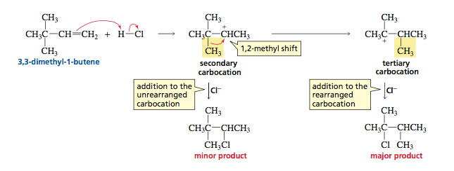
Carbocation Rearrangement
(a 1,2-methyl shift)

Slide 18
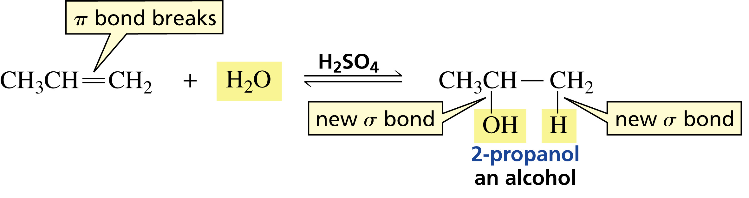
Acid-Catalyzed Addition of Water

Slide 19
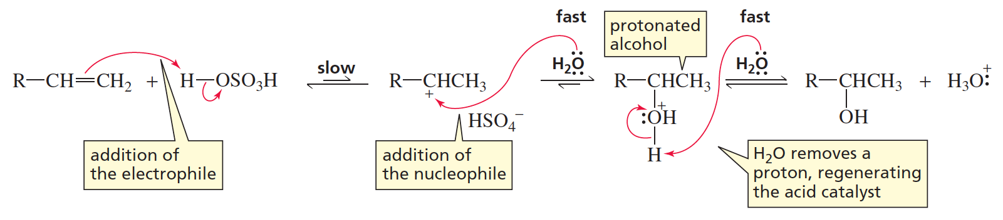
Mechanism for the Acid-Catalyzed Addition of Water

Slide 20
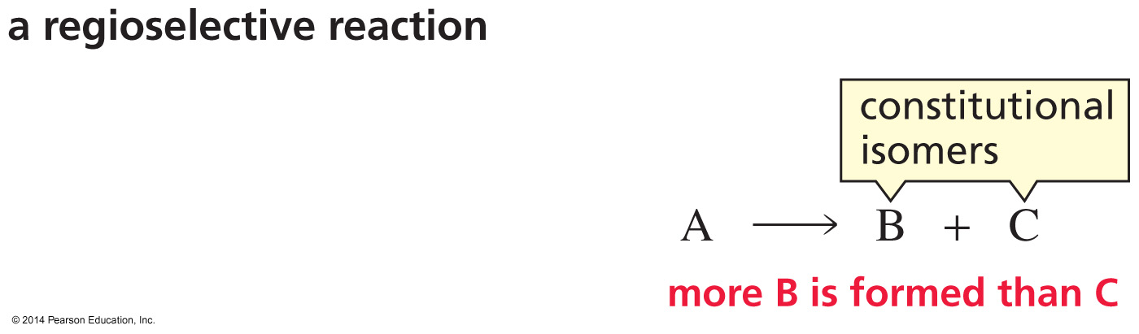
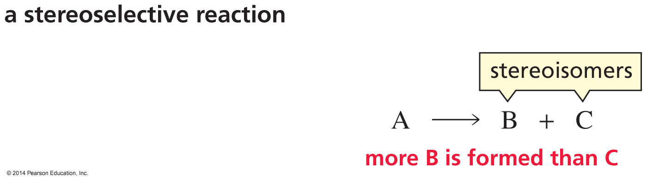
Regioselective vs. Stereoselective Reactions

Slide 21
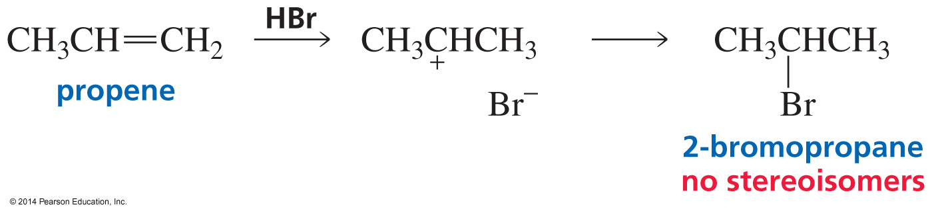
The Product does not
have Stereoisomers

Slide 22
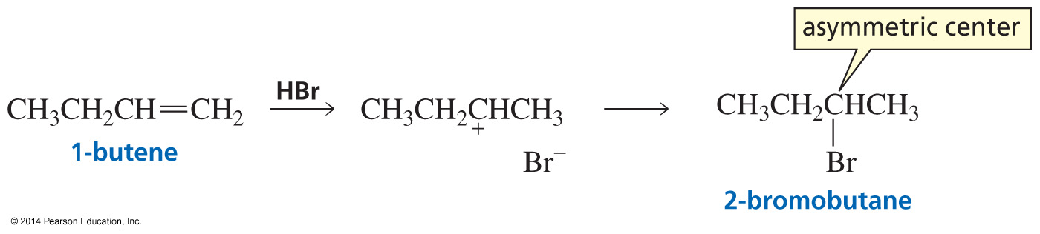
The Product is a Racemic Mixture
When a reactant that does not have an asymmetric center forms a product that has one asymmetric center, the product is a racemic mixture. Why?

Slide 23
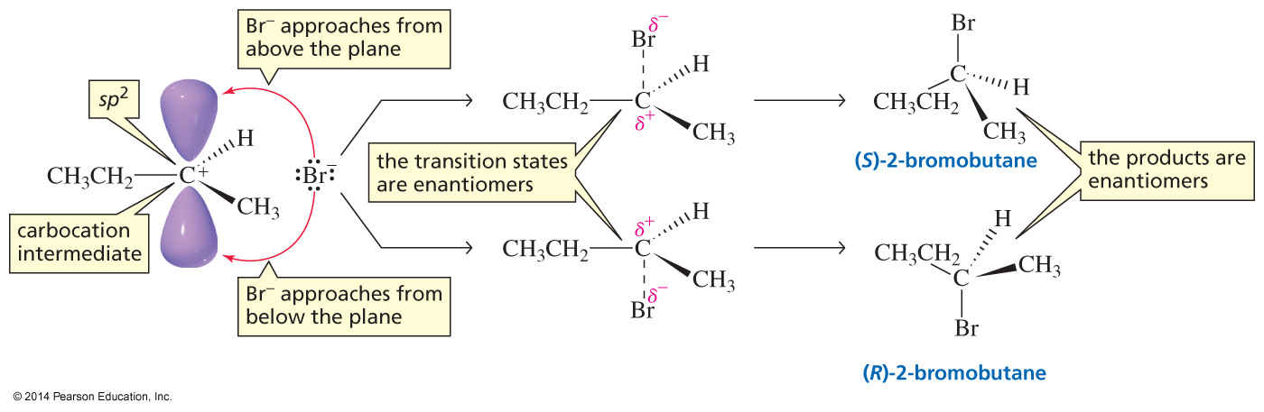
Formation of a Racemic Mixture

Slide 24
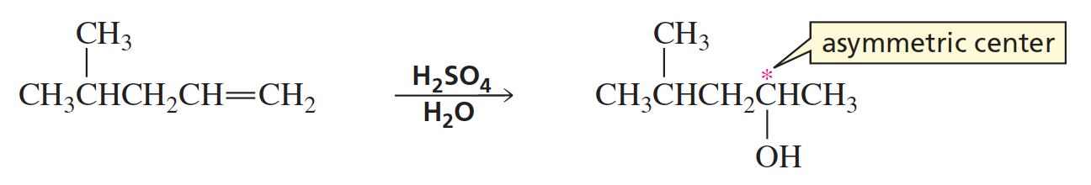
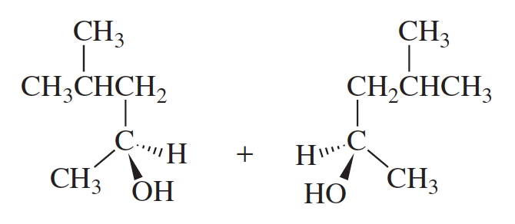
The Product is a Racemic Mixture

Slide 25
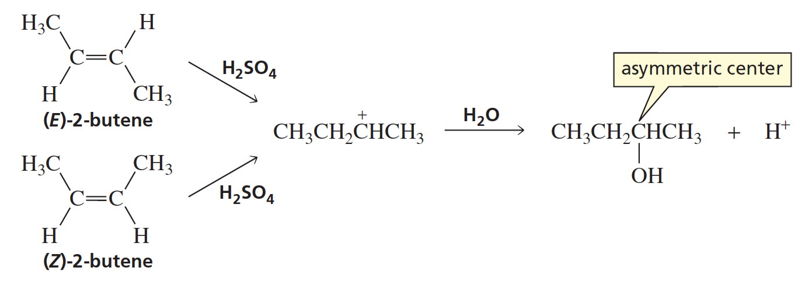
The Product is a Racemic Mixture
(racemic)

Slide 26
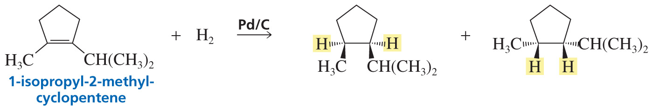
Addition of H₂ to a Cis Isomer
forms only the Cis Stereoisomers
Cis Stereoisomers

Slide 27
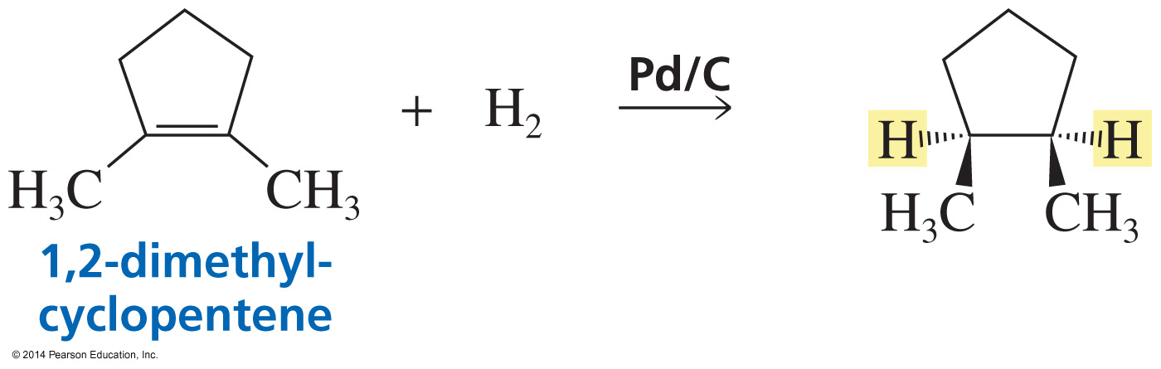
If the Substituents are the same, the Cis Stereoisomer is a Meso Compound

Slide 28
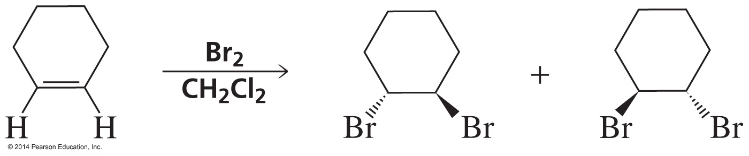
Anti Addition to a Cis Isomer forms only the Trans Stereoisomers

Slide 29
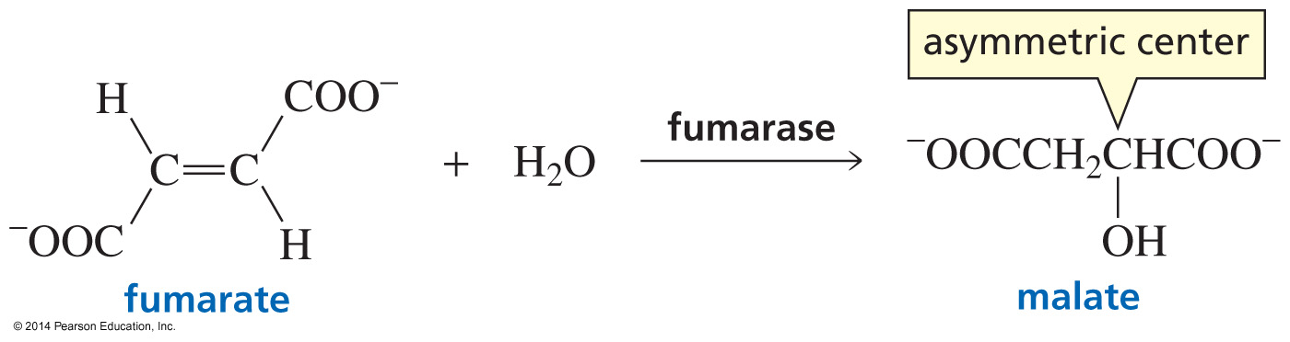
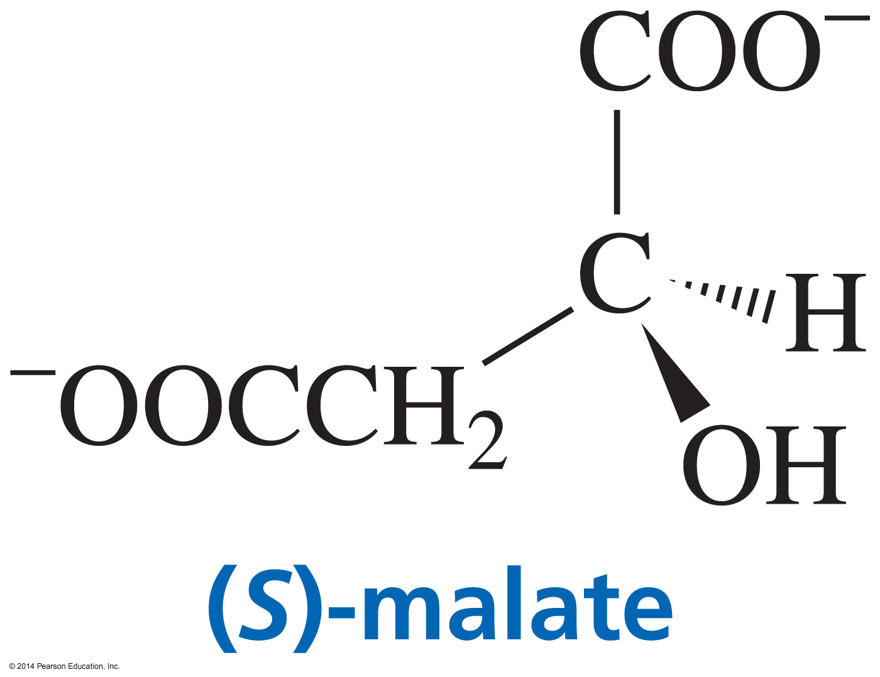
An Enzyme forms only one Stereoisomer; the Reaction is Completely Stereoselective
Enzyme
one Stereoisomer
(Stereoselective)

Slide 30
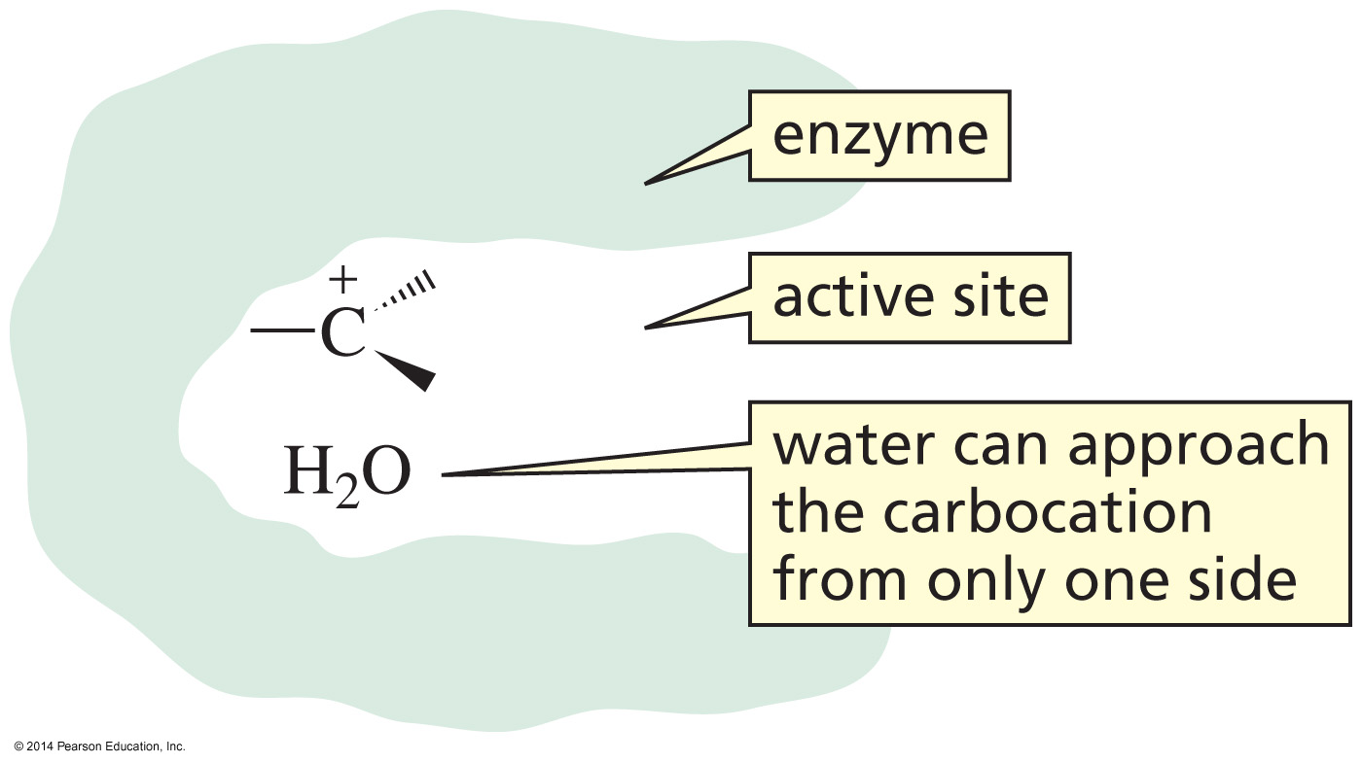
An Enzyme can block
one side of the Reactant

Slide 31
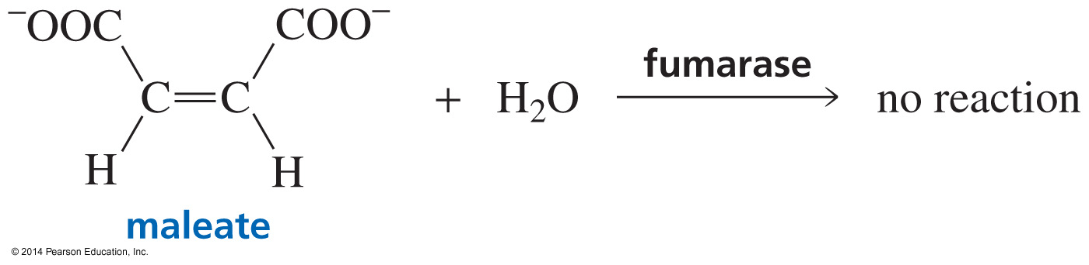
An Enzyme reacts with
only one Stereoisomer

Slide 32
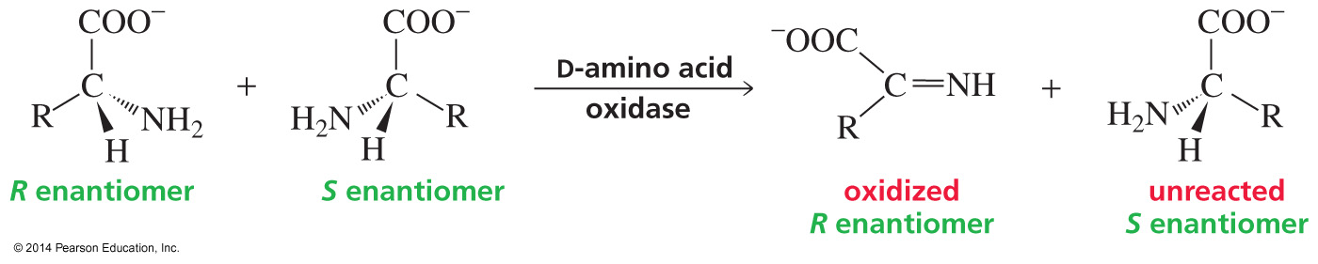
Therefore, Enantiomers can be separated
using an Enzyme-Catalyzed Reaction

Slide 33
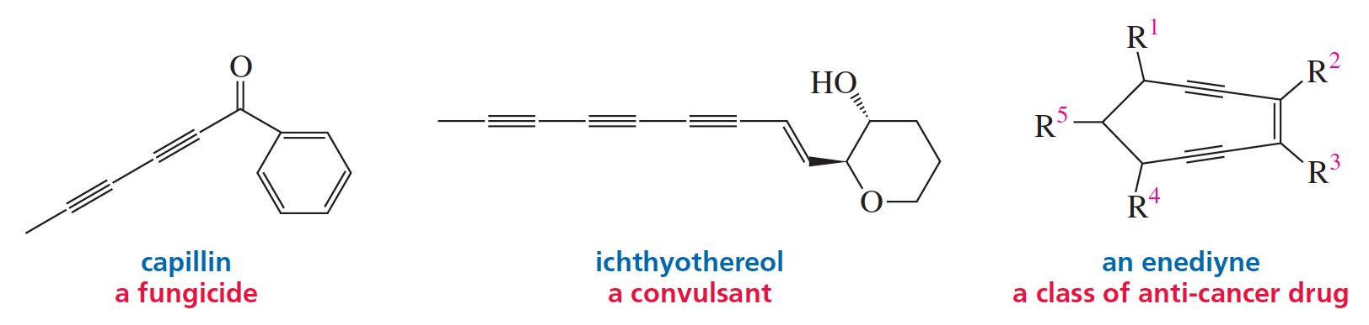
An Introduction to Alkynes
An alkyne is a hydrocarbon that contains a carbon–carbon triple bond.
General formula: C_{n}H_{2n–2} (acyclic)
C_{n}H_{2n–4} (cyclic)

Slide 34
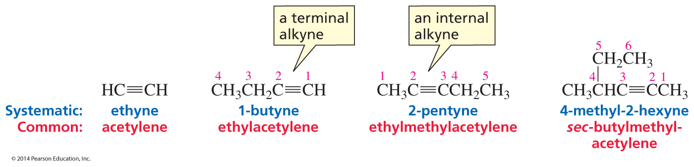
Nomenclature of Alkynes

Slide 35
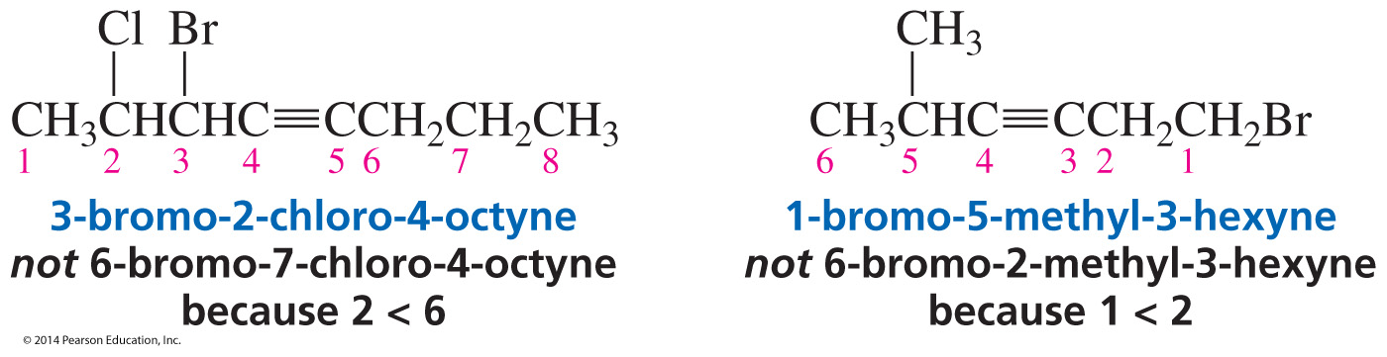
Nomenclature of Alkynes
The “yne” suffix is assigned the lowest number.
The substituents are assigned so the lowest number is in the name.

Slide 36
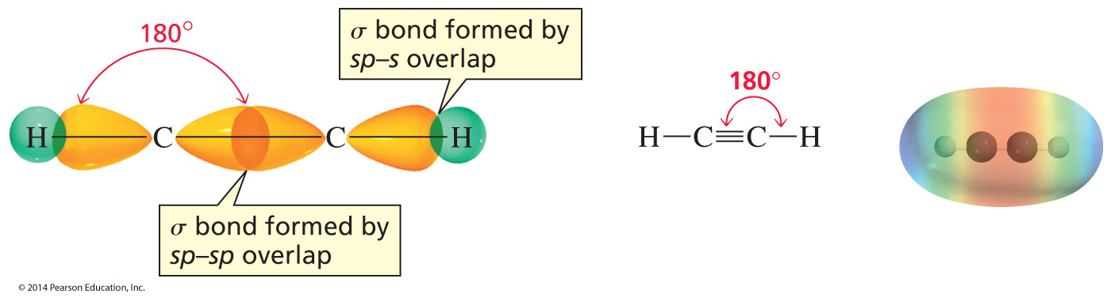
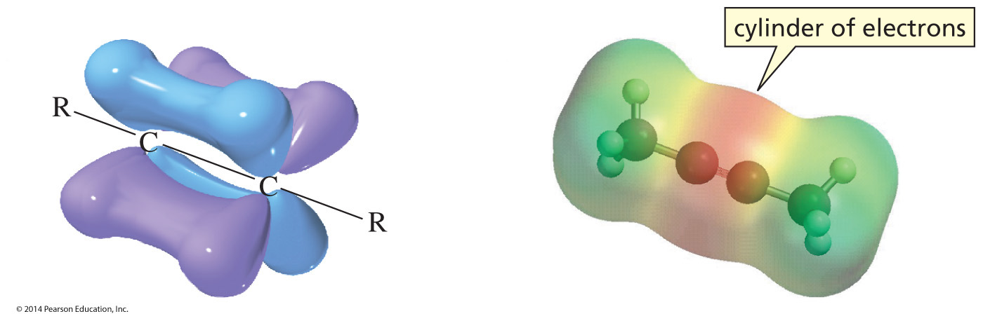
The Structure of Alkynes
The triple bond is composed of a sigma bond and two π bonds.

Slide 37
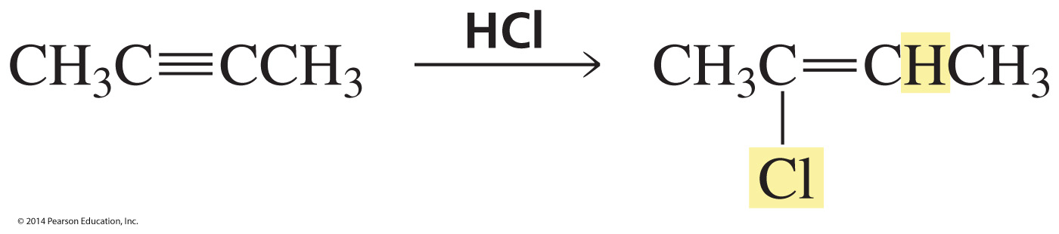
Alkynes (Like Alkenes) undergo
Electrophilic Addition Reactions

Slide 38
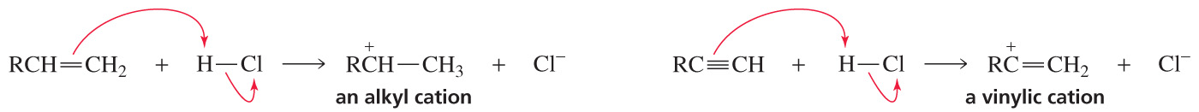
The first step is
addition of an Electrophile
Addition of an electrophile
to an alkene
Addition of an electrophile
to an alkyne

Slide 39
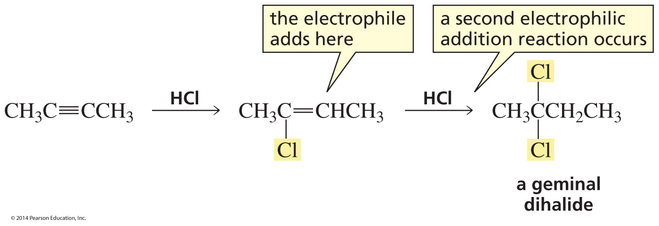
A second Addition Reaction can Occur

Slide 40
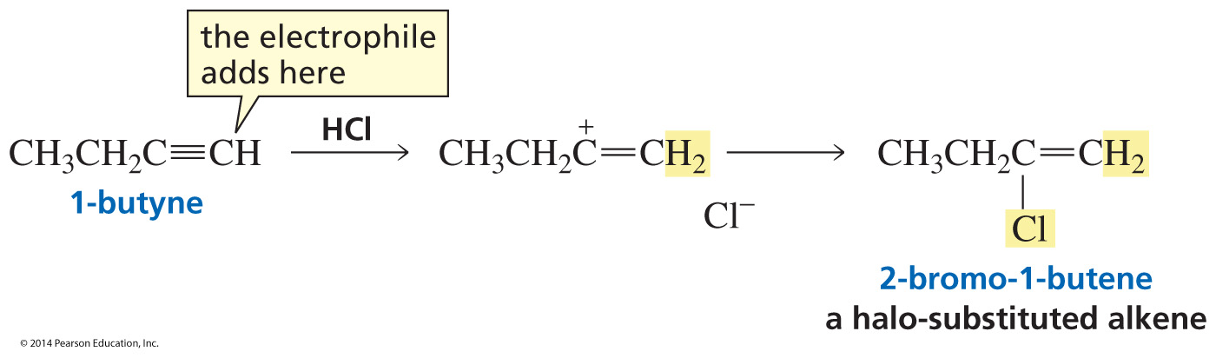
Addition to a Terminal Alkyne is Regioselective

Slide 41
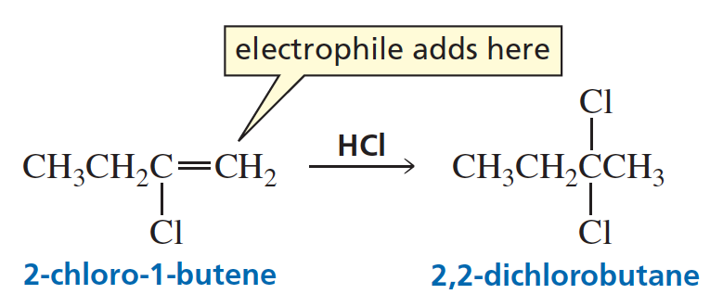
The second Electrophilic Addition
reaction is also Regioselective

Slide 42
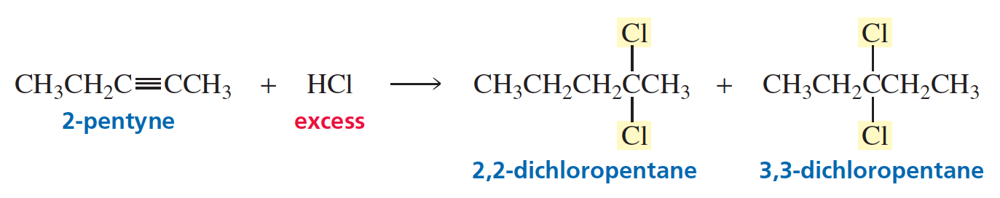
An Asymmetrical Internal Alkyne forms two Products

Slide 43
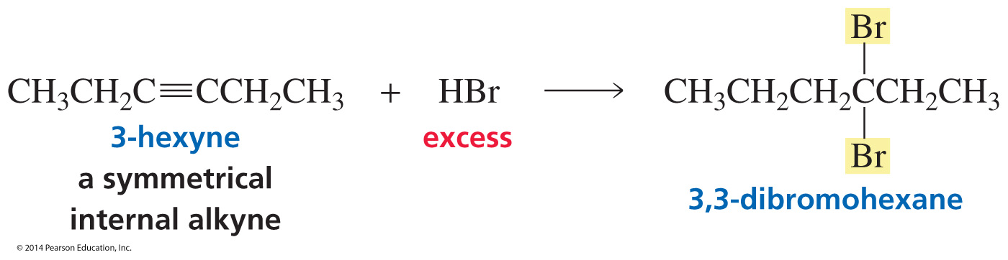
A Symmetrical Internal Alkyne forms one Product

Slide 44
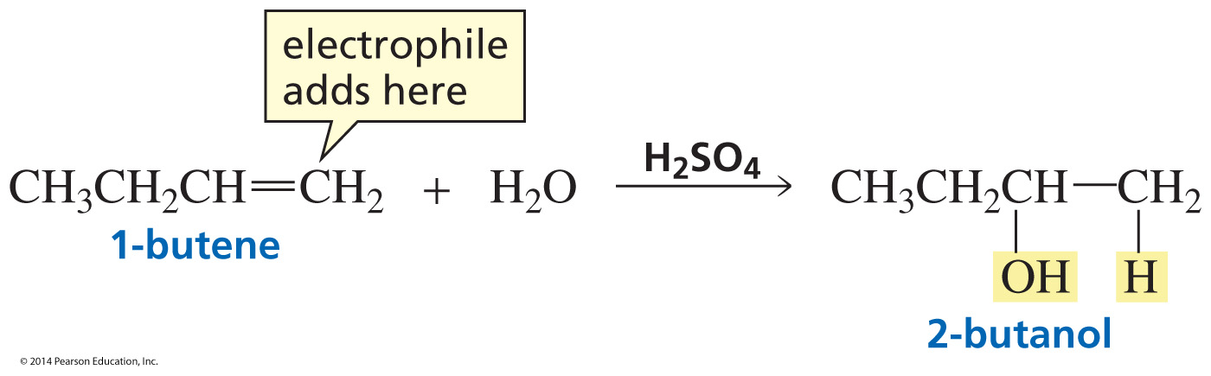
Acid-Catalyzed Addition of water to an Alkene

Slide 45

Acid-Catalyzed Addition of water to an Alkyne

Slide 46

Keto–Enol Interconversion

Slide 47

Mechanism for Acid-Catalyzed Keto–Enol Interconversion

Slide 48

Acid-Catalyzed Addition of Water

Slide 49

A Terminal Alkyne is less reactive than an Internal Alkyne
Because terminal alkynes are less reactive, the rate of the reaction is increased with a mercuric ion catalyst.

Slide 50

Addition of Hydrogen forms an Alkane

Slide 51

Stopping at the Alkene

Slide 52

Lindlar Catalyst
Lindlar catalyst: ( Herbert Lindlar) is a heterogeneous catalyst that consists of palladium deposited on calcium carbonate 5% Pd-CaCO₃
reduce its activity

Slide 53

Syn Addition

Slide 54

Why Cis?
The catalyst delivers the hydrogens to one side of the triple bond.

