Slide 1

.
Fundamentals Of Nursing & health promotion(Nurs1100)
Pulmonary Embolism(PE)
The Name: Aya Manassrah
Academic No. :1202109
Course Teacher: Maram Jaghama

Slide 2

The Goals
During this presentation I will talk about each of the following:-
Definition of disease
Causes
Signs & Symptoms
Diagnosis
Treatment
The Nursing Care plan(Risks&Interventions)

Slide 3

Pulmonary Embolism(PE):
Refers to the obstruction of the pulmonary artery or one of its branches by a thrombus(blood clot) that originates somewhere in the venous system or in the right side of the heart.
This disorder is usually r/t DVT which means: thrombus formation in the deep veins, usually in the calf or thigh.
Causes:
Pulomnary embolism is a common disorder and often is associated with:
Trauma.
Surgery.
Hypercoagulable states.
Prolonged immobility.

Slide 4
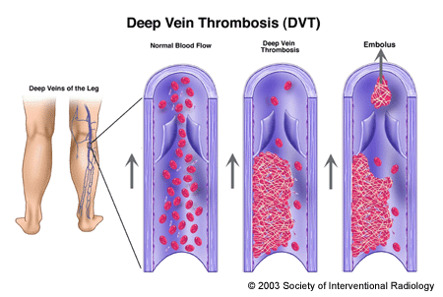
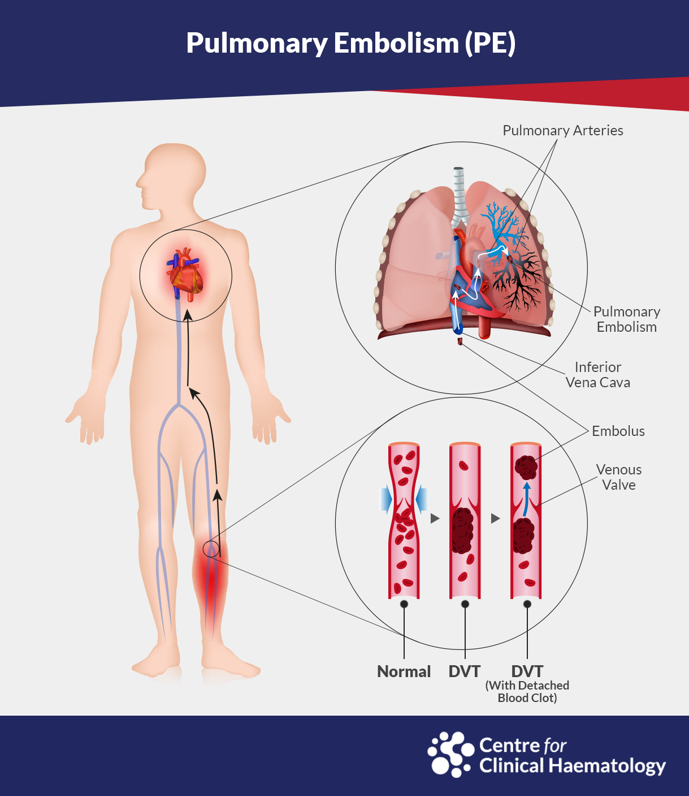
What causes a DVT to split into a small, ambulant blood clot?

Slide 5
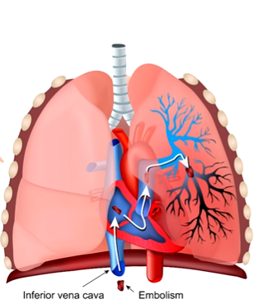

Slide 6

Signs & Symptoms:
Symptoms of pulmonary embolism depend on the size of the thrombus and the area of the pulmonary artery occluded by the thrombus:
Dyspnea
Chest pain
Tachycardia
Tachypnea
fever
Diaphoresis(sweating)
Apprehension (anxiety)
Hemoptysis (coughing up blood)
Syncope(faint)
cyanosis

Slide 7

Medical Diagnosis
Chest x-ray.
ECG.
ABG analysis (arterial blood gas).
Pulmonary angiogram.
V/Q scan (ventilation/perfusion lung scan).

Slide 8

Treatment
Medication
1. Anticoagulation therapy: Heparin, and warfarin sodium.
2. Thrombolytic therapy: Urokinase, streptokinase, alteplase.
Surgical
1. Surgical embolectomy.
2. Transvenous catheter embolectomy.

Slide 9
Care Plan As a Nurse

Slide 10
Potential Nsg.Dx
(Potential health problems)
problem does not exist
presence of risk factors

Slide 11
Risk for bleeding r/t anticoagulant therapy to prevent more clots.
Interventions | Rationales
Monitor vital signs for indicators of bleeding | Tachypnea, hypotension,and Tachycardia maybe associated with bleeding. This can occur with anticoagulant therapy and will need prompt intervention.
At the minimum of every 8 hours, inspect for any wounds that may have resulted from invasive procedures. | This assessment will determine if there is any bleeding from anticoagulant therapy.

Slide 12
Risk for Impaired Gas exchange r/t decreased pulmonary perfusion.
Interventions | Rationales
Monitor pulse oximetry and report O2 Saturation <95% | An O2 saturation of less than 95% may detect hypoxia.
Encourage deep breathing exercises and administer oxygen if indicated. | Increases oxygen delivery to the body by mobilizing secretions and improving ventilation.
Auscultate lung sounds, noting areas of decreased ventilation and the presence of adventitious sounds. | Crackles are common clinical findings with pulmonary embolism.

Slide 13
Risk for Deficient knowledge r/t patient who is not familiar with anticoagulant.
Interventions | Rationals
Assess the patients level of comprehension and language. | This will ensure that the information given is at a level of comprehension that is tailored to the patient and their health education.
Determine the patients knowledge of medication regimen . | Patient who are more knowledgeable and educated on their medications are more likely to continue to take their medications as perscribed.

Slide 14

Actual Nsg.Dx
(Actual health problems)
problem presents at the time of assessment
presence of associated signs and symptoms

Slide 15
Ineffective Breathing Pattern r/t Anxiety, chest pain, hyoxia a.m.b ABGs, desaturation, dyspnea,tachypnea, tachycardia.
Interventions | Rationals
Assess the client’s anxiety level | Pulmonary embolism is a sudden acute condition that can produce anxiety. Anxiety can result in rapid, shallow respirations and increase dyspnea.
Assess the characteristics of pain. | Pain is usually sharp or stabbing and gets worse with deep breathing and coughing. It can result in shallow respirations, further impairing effective gas exchange.
Position the client in a sitting position, and change the position every 2 hours | the sitting position allows good lung excursion and chest expansion, Repositioning facilitates movement and the drainage of secretions.
Anticipate the need for intubation and mechanical ventilation | Intubation and positive-pressure ventilation are a means to stabilize breathing and ventilation.

Slide 16
References
1. Hinkle&cheever, Textbook of Medical-Surgical Nursing Book , 13th Edition, Page{600,601,602}.
2. https://nurseslabs.com/pulmonary-embolism/
3. https://nursestudy.net/pulmonary-embolism-pe-nursing-care-plan/

Slide 17


Slide 18


