Slide 1
Brand & Product Decision in Global Marketing
Chapter 10

Slide 2
Learning Objectives
Review the basic product concepts that underline a successful global marketing product strategy.
Compare and contrast local products and brands, international products and brands, and global products and brands.
Explain how Maslow’s hierarchy helps global marketers understand the benefits sought by buyers in different part of the world.
Outline the importance of “country of origin” as a brand element
List the five strategic alternatives that marketers can utilize during the global product planning process
Explain the new-product continuum and compare and contrast the different types of innovation.

Slide 3
Basic Product Concepts
A product is a good, service, or idea with both tangible and intangible attributes that collectively create value for a buyer or a user.
Tangible attributes can be assessed in physical terms: weight, dimensions, material used, etc.
Intangible product attributes include status of ownership, manufacturer service commitment, brand’s overall reputation.
Product P is at the heart of Marking Mix.
Product strategy must be sensitive to market needs, competition and the company’s resources.

Slide 4
Product Types
Consumer products
Industrial products
Buyer orientation is a composite measure of the amount of effort a customer expends, the level of risk associated with a purchase, and buyer involvement.
Life span – durable, nondurable, and disposable.

Slide 5
Product Warranties
Warranties are important element of a product’s value proposition.
Warranty is a written guarantee that assures the buyer that s/he is getting what is paid for, or that provides recourse in case a product’s performance falls short of expectations.
Competitive tool in global marketing.
  The case of Hyundai
  Sales Jumped from 90k in 1998 to 500k in 2011.
  Overtook Toyota as Europe’s best selling Asian brand.
Warranties are usually associated with expensive and high value brand products.

Slide 6
Packaging
Packaging is oftentimes integral element of product-related decisions.
Shipment to other parts of the world.
Consumer packaged goods applies to a wide variety of products- to protect/ contain.
Packaging serves as a communication function.
Packaging must engage the senses, make emotional connection and enhance the overall customer and brand experience. Corona & Coke.
Eco-packaging and creative packaging is picking up importance today (recycling, biodegradability, sustainable forestry)

Slide 7
Labeling
Multilanguage labeling is abundant today.
In today’s self-service retail industry, labels:
  Attract customers’ attention
  Support a product’s positioning
  Help persuade consumers to buy
Provide various types of information – ingredients, use and storage, expiry, etc.
Content may be dictated by country regulations
  Regulations differ: EU- GMO
  Pork meat, HALAL, KOSHER, etc.

Slide 8
Labeling
Examples of labeling in global marketing:
  Mandatory health warnings on tobacco.
  American Automobile Labeling Act clarifies the country of origin, final assembly point, percentage of major source of foreign content.
  Nutrition information on all food packages – McDonald’s.
  Language is becoming major issue.
  “COOL” law for meat, poultry, etc.

Slide 9
Aesthetics
Visual aesthetics- Perception of colors is embedded in cultures- (shape, color, package).
Aesthetic styles- degree of complexity.
Sometimes standardized color can be used in all countries- caterpillar yellow, Marlboro red, in other instances, color choice should be adapted to meet local taste and perception.

Slide 10
Basic Branding Concepts
A brand is a complex bundle of images and experiences in the customer’s mind.
Brands perform important functions:
  A promise- quality or certification
  Enables customers to better organize their shopping experience.
Brand functions as a distinctive tool between one company’s offering and competitors.

Slide 11
Basic Branding Concepts
Customers integrate their experiences of observing, using, or consuming a product with everything they hear and read about it.
Information and perceptions about products and brands has the following sources and cues:
  Advertising
  Publicity
  Word of mouth
  Sales personnel
  Packaging
  After sale service
  Price

Slide 12
Basic Branding Concepts
Brand image is those perceptions and impressions about a brand as reflected by brand associations that consumers hold in their memories. It is the sum of impressions and experiences towards a particular product.
Brand image is a way companies use to differentiate themselves among competitors.
Brand equity represents the total value that accrues to a product as a result of a company’s cumulative investment in marketing of the brand.

Slide 13
Benefits of strong brand equity
Greater loyalty.
Less vulnerability to marketing actions.
Less vulnerability to marketing crisis.
Larger margins.
More inelastic consumer response to price increase.
More elastic consumer response to price decrease.
Increased marketing communication effectiveness.
More protection to companies.

Slide 14



Slide 15
Brands Value
Rank | Value ($ millions) | Rank | Value ($ millions)
1. Apple | 184,154 | 11. General Electric | 44,208
2. Google | 141,703 | 12. McDonald’s | 41,533
3. Microsoft | 79,999 | 13. BMW | 41,521
4. Coca Cola | 69,733 | 14. Disney | 40,772
5. Amazon | 64,796 | 15. Intel | 39,459
6. Samsung | 56,249 | 16. Sisco | 31,930
7. Toyota | 50,291 | 17. Oracle | 27,446
8. Facebook | 48,188 | 18. Nike | 27,021
9. Mercedes Benz | 47,829 | 19. Louis Vuitton | 22,919
10. IBM | 46,829 | 20. Honda | 22,696

Slide 16
Basic Branding Concepts
Companies develop logos, distinctive packaging and other communication devices to promote visual representations of their brands.
Logo can take many forms.
Brand name itself.
  Example coke and the wave- word mark and non-word mark, or brand symbol.
Have the advantage to transcend language. (Nike swoosh, Mercedes star, McDonald’s arches).
Protection and IPR

Slide 17
Local Products and Brands
Local product or local brand is one that has achieved success in a single national market.
Global companies sometimes create local products and brands to cater the needs and preferences of a particular country.
  Coca Cola- Kinely in India and Arwa in Palestine.
Local products and brands represent significant competitive hurdles to global companies entering new markets.
  LI-NING Shoes in China, Rukab ice cream in Palestine
Growing national or patriotic pride.

Slide 18
International Products and Brands
International products and international brands are offered in several markets in a particular region.
Sometimes such products and brands have a different name in various parts of the world.
  Daimler’s tow-seat car in Europe.
  Islamic banking services.
  Local/ regional soccer matches advertising.
  Palestinian dates.
  Palestinian olive oil.

Slide 19
Global Products and Brands
Global product meets the wants and needs of a global market. It is offered in all world regions –at every stage of country development.
Global brand has the same name and positioning throughout the world.
  Visa International: Life takes Visa
  Gillette: The best a man can get
  BMW: the ultimate driving machine
  Nestle: Makes the very best

Slide 20
Global Products and Brands
Global products are slightly adapted. A global company views the world as one country.
While countries are different, global companies treat them the same. Same products, same production methods, and same advertising in different languages. Product affects such orientation.
This creates competitive advantage by reaping economies of scale associated with creating a single ad campaign, and same production methods. However, in food it is a bit different.

Slide 21
Global Products and Brands
Global products are not global brands
  Stereos and Sony
Combination/ Tiered branding where a corporate name is combined with a product brand name of the same company.
  Sony Walkman
  Apple MacBook
  WV Polo
The company leverages its brand name to introduce new product or line.

Slide 22
Global Products and Brands
Co-branding happens when tow or more different companies’ product brands are featured on product packaging/ advertising.
  Credit Cards
  Intel Inside
Co-branding can generate customer loyalty and achieve synergies, but at the same time confuse consumers.
Brand extension entails using an established brand name as an umbrella when entering new businesses or developing new products.
  Virgin- airline, railroad, retail store, mega store, movie theatres, financial services, health clubs, and Galactic.

Slide 23
Global Brand Development
Guidelines for establishing a global brand:
  Create a compelling value proposition.
  Think about elements of the brand that have global potential (names, marks, symbols).
  Develop a company-wide communication system to share knowledge and info.
  Develop consistent planning process across markets and products.
  Ensure that local brand managers accept global best practices.
  Execute brand-building strategies that leverage global strength and respond to relevant local difference.
By doing so, companies can create global brand leadership.

Slide 24
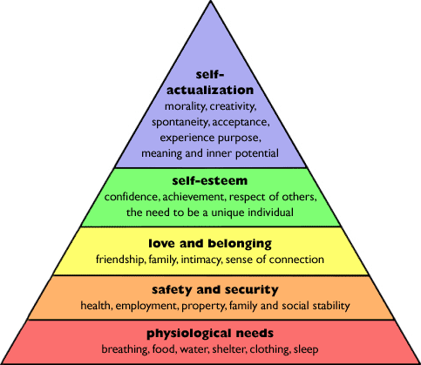
A Needs-Based Approach to Product Planning

Slide 25
A Needs-Based Approach to Product Planning
The essence of marketing is finding needs and fulfilling them. Value! Example refrigerator.
Products meeting basic needs have potential for globalization.
Mid-level needs (social needs) including self-respect, self-esteem, and the esteem for others, create internal motivation for status oriented products. Parker Pen.
Consumers buy luxury products to satisfy esteem needs. Conspicuous consumption or Luxury badging.
Products can fulfill different needs in different countries. Refrigerator example.

Slide 26
A Needs-Based Approach to Product Planning
In the Asian consumer culture, the need approach can be modified into social needs which include affiliation, admiration, and status.
Affiliation: satisfied by acceptance by a group. Conformity with group norms becomes a key force driving consumer behavior- Teens.
Admiration: satisfied by receiving respect- acts.
Status: the esteem of society as a whole.
  $200+ billion global luxury goods market- geographical breakdown 20% Japan, 22% in Asia Pacific. Italy’s Gucci Sales revenue 50% in Asia.

Slide 27
“Country of Origin” as Brand Element
Made in China
Made in Turkey
Made in Sweden
Made in Italy
Made in France
Made in Germany
Made in Japan
Made in USA
Made in EU

Slide 28
“Country of Origin” as Brand Element
Perceptions about and attitudes towards particular countries often extend to products and brands originating from that country.
Country-of-origin-effect- contribute to brand image and brand equity.
Perceptions and attitudes about product’s origin can be positive or negative. The manufacturing reputation of a particular country can change over time.
  German- quality & engineering
  Italy- style
  French- chic
  Mexican- picking up
  Japan- quality
  China and India- ???
  Country brand can start fresh in unknown countries.
In some product categories, foreign products have advantage over domestic because of their foreignness, allowing premium prices. Beer test example.

Slide 29
Extend, Adapt, Create: Strategic Alternatives in Global Marketing
Depending on organizational objectives and market needs, marketing programs and strategies are implemented.
Extension strategy calls for offering a product unchanged in markets outside the home country.
Adaptation strategy involves changing elements of design, function, packaging in response to needs or conditions in particular country.
Customer preference and laws and regulations in different countries frequently lead to obligatory product design and adaptation.
Product invention strategy entails developing new products “from the ground up” with the world market in mind.

Slide 30
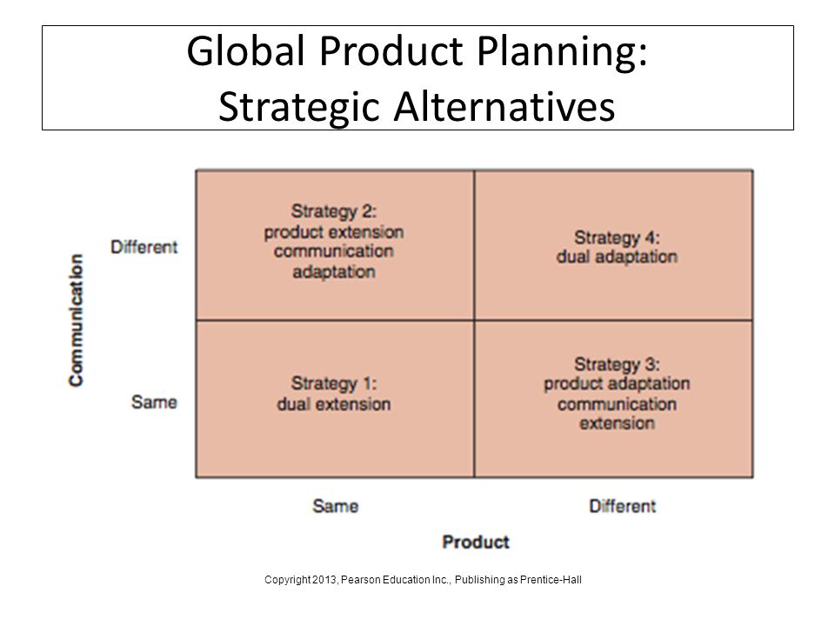

Slide 31
Strategy 1: Product-Communication Extension (Dual Extension)
Companies perusing this strategy sell the same product with no adaptation, using the same advertising and promotional appeals used domestically, in two or more country markets.
Messages must be understood across different cultures.
Generally extension/standardized strategies are utilized more frequently with industrial products, as they are less rooted in culture.
  Apple Phone example- Apple GCCP
Technology companies and industrial goods manufacturers should be specially alert to dual-extension possibilities.

Slide 32
Strategy 2: Product Extension-Communication Adaptation
A product or brand can be successfully extended to multiple country markets with some modification of the communication strategy.
Consumer perceptions about value proposition aspects are different from country to country.
Products fill different needs, appeals to different segment or serves as a different function in a particular country.
Product transformation occurs when the same physical product ends up serving a different function or use than that for which it was originally designed or created.
Low cost of implementation.
  Changes in product design are avoided.
  New/ adapted manufacturing setup is avoided.

Slide 33
Strategy 3: Product Adaptation-Communication Extension
Adaptation to product to local taste with minimal change to the communication strategy adopted at home.
New BLS Cadillac model- EU
Oreo cookies example
More expensive to the company as product needs change- associated cost to manufacturing setup, R&D and inventory.

Slide 34
Strategy 4: Product-Communication Adaptation (Dual Adaptation)
Both the product and communication are changed and adapted to a particular market.
Environmental conditions, regulatory conditions and customer preference may differ from one country to another.
Unilever’s Rexona deodorant had 30 different packages and 48 different formulations. Advertising and branding were also executed on local basis.

Slide 35
Strategy 5: Innovation
Innovation is the process of providing resources with a new capacity to create value. It is very demanding but potentially rewarding strategy for reaching mass markets in less developed markets, or important market segments in industrialized countries.
  HP solar laptop.
  Hand-cranked radios.
  Adjusted lenses eyeglasses
Creating the greatest value is the key. Customer perception defines real value of product. Not only product performance, but rather customer perception.
It is necessary to support the product quality with imaginative, value-creating advertising and marketing communication.

Slide 36
How to Choose a Strategy
Managers run the risk of committing two types or error regarding product and communication decisions.
  “not invented here” syndrome: ignore decisions made by subsidiaries.
  Impose policies upon all subsidiaries “what is right for customers in the home market must also be right for customers everywhere”.
The choice of product-communication strategy is a function of three factors:
  The product itself- function or need it serves.
  The market- conditions under which the product is used, customers’ preference, and customer’ ability and willingness to buy.
  The adaptation and manufacturing cost.

