Slide 1
What Is Strategic Management? Page 268
management – what managers do to develop the organization’s strategies.
Strategies – the plans for
1.how the organization will do what it’s in business to do,
2. how it will compete successfully, and
3. how it will attract and satisfy its customers in order to achieve its goals.
Strategic
Notes:
Strategic management is what managers do to develop the organization’s strategies. It’s an important task involving all the basic management functions—planning, organizing, leading, and controlling. What are an organization’s strategies? They’re the plans for how the organization will do whatever it’s in business to do, how it will compete successfully, and how it will attract and satisfy its customers in order to achieve its goals.
One term often used in strategic management is business model, which simply is how a company is going to make money. It focuses on two things: (1) whether customers will value what the company is providing, and (2) whether the company can make any money doing that.

Slide 2
Business model
Business model نموذج الاعمال –
It focuses on two things: (1) whether customers will value what the company is providing and (2) whether the company can make any money doing that.

Slide 3
Why Is Strategic Management Important? P.269
It results in higher organizational performance.
It requires that managers examine and adapt to business environment changes.
It coordinates diverse organizational units, helping them focus on organizational goals.
Strategic management is involved in many of the decisions that managers make.
Notes:
Why is strategic management so important? There are three reasons. The most significant one is that it can make a difference in how well an organization performs. In other words, it appears that organizations that use strategic management do have higher levels of performance. And that fact makes it pretty important for managers.
Another reason it’s important has to do with the fact that managers in organizations of all types and sizes face continually changing situations. They cope with this uncertainty by using the strategic management process to examine relevant factors and decide what actions to take.
Finally, strategic management is important because organizations are complex and diverse. Each part needs to work together toward achieving the organization’s goals; strategic management helps do this.

Slide 4
The Strategic Management Process
management process – a six-step process that encompasses strategic planning, implementation, and evaluation.
Strategic
Notes:
The strategic management process (see Exhibit 9-1) is a six-step process that encompasses strategy planning, implementation, and evaluation. Although the first four steps describe the planning that must take place, implementation and evaluation are just as important! Even the best strategies can fail if management doesn’t implement or evaluate them properly.

Slide 5
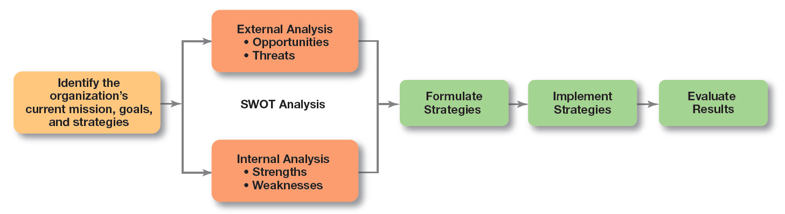
Exhibit 9-1 Strategic Management Process

Slide 6
The Strategic Management Process (cont.)
Identifying the organization’s current mission, goals, and strategies:
Mission الرسالة \المهمة : a statement of the purpose of an organization.
The scope of its products and services
Vision الرؤيا (Dream)
Goals: the foundation for further planning.
Measurable performance targets
Step 1:
Notes:
Every organization needs a mission—a statement of its purpose. Defining the mission forces managers to identify what it’s in business to do. But sometimes that mission statement can be too limiting. For example, the co-founder of the leading Internet search engine Google says that while the company’s purpose of “organizing the world’s information and making it universally accessible and useful” has served them well, they failed to see the whole social side of the Internet and have been playing catch-up.

Slide 7
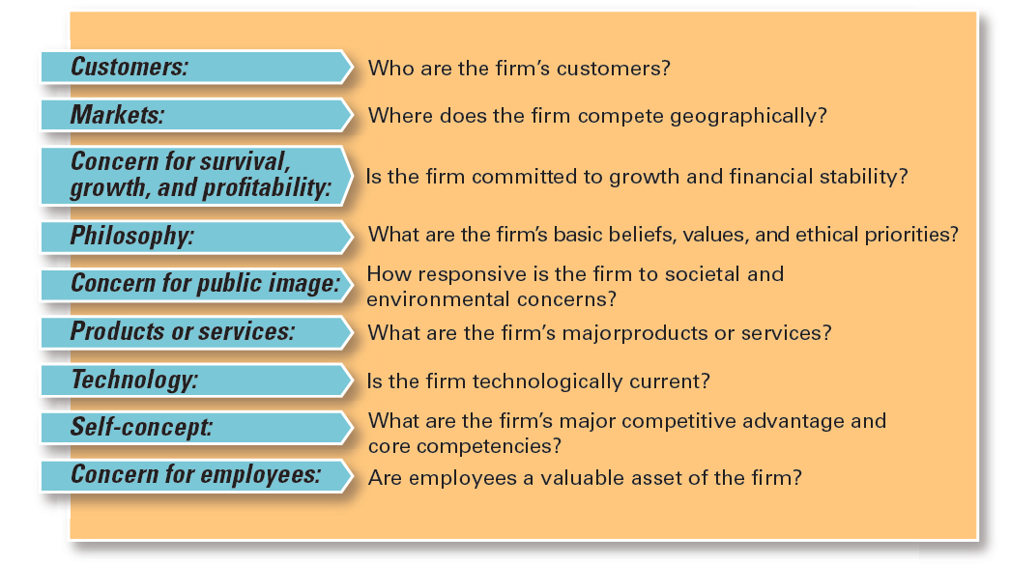
Exhibit 9-2: Components of a Mission Statement
Notes:
What should a mission statement include? Exhibit 9-2 describes some typical components.

Slide 8
جامعة بيرزيت
رسالة الجامعة
رؤيتنا
مؤسسة ريادية بكافة مكوناتها تساهم في الإنتاج المعرفي في بعديه الوطني والعالمي.
رسالتنا
توفير بيئة مستنيرة ذات استقلالية تتيح حرية الفكر والتعبير، وتحرص على الممارسات الديمقراطية والحوار، وتحفز التميز والإبداع والابتكار والريادية في التعليم والتعلم والبحث، لرفد المجتمع بالكفاءات والمعارف التي من شأنها قيادة التغيير والمساهمة في رقيه وتقدمه.
قيمنا
تتبنى الجامعة ضمن قانونها وأنظمتها وإجراءاتها ونشاطاتها المبادئ والقيم التي تكفل توجيه أداء المؤسسة بكافة مكوناتها لتحقيق رسالة الجامعة ورؤيتها على أكمل وجه:

Slide 9
التميز: توفير بيئة جامعية محفزة على التعلم والبحث والريادة والإبداع والإسهام في التنمية المجتمعية.
العدالة والمساواة: إتاحة الفرصة لجميع شرائح المجتمع على قدم المساواة ودون تمييز، وتعزيز دور المرأة مع إيلاء الأولوية لذوي الاحتياجات الخاصة والفئات المهمشة.
حرية التعبير: صون الحرية الأكاديمية والقدرة على البحث والنشر وتشجيع التبادل المعرفي والحوار في ظل اختلاف الآراء وتعدد وجهات النظر.
النزاهة والمهنية: تعزيز أخلاقيات العمل الحميدة والممارسات الفضلى وأسس الجودة والتأكيد على المسؤولية الشخصية والمصداقية والنزاهة والعدل والمثابرة.
التنوع: تنوع مجتمع الجامعة من طلبة وعاملين من أجل تعزيز الانتماء والتكامل والمشاركة.
التنمية المستدامة: المشاركة الفاعلة في تنمية المجتمع من خلال بناء القدرات وتطوير السياسات والإستراتيجيات ونشر الوعي البيئي والمحافظة على الموارد المحدودة لضمان ديمومة المؤسسة وتطور مخرجاتها.
التعلم مدى الحياة: الالتزام بتطوير الذات بشكل مستمر وصقل المهارات والكفاءات وتبادل المعارف والفكر كنَهج حياة.

Slide 10
The Strategic Management Process (cont.)
: Doing an external analysis
The environmental scanning of specific and general environments.
Focuses on identifying opportunities and threats
Step 2
Notes:
Analyzing that environment is a critical step in the strategic management process. Managers do an external analysis so they know, for instance, what the competition is doing, what pending legislation might affect the organization, or what the labor supply is like in locations where it operates. In an external analysis, managers should examine the economic, demographic, political/legal, sociocultural, technological, and global components to see the trends and changes.
Once they’ve analyzed the environment, managers need to pinpoint opportunities that the organization can exploit and threats that it must counteract or buffer against. Opportunities are positive trends in the external environment; threats are negative trends.

Slide 11
The Strategic Management Process (cont.)
Doing an internal analysis
Assessing organizational resources, capabilities, and activities:
Strengths create value for the customer and strengthen the competitive position of the firm.
Weaknesses can place the firm at a competitive disadvantage.
Steps 2 and 3 combined are called a SWOT analysis. (Strengths, Weaknesses, Opportunities, and Threats)
Step 3:
Notes:
The internal analysis provides important information about an organization’s specific resources and capabilities. An organization’s resources are its assets—financial, physical, human, and intangible—that it uses to develop, manufacture, and deliver products to its customers. They’re “what” the organization has. On the other hand, its capabilities are its skills and abilities in doing the work activities needed in its business—“how” it does its work. The major value-creating capabilities of the organization are known as its core competencies.
After completing an internal analysis, managers should be able to identify organizational strengths and weaknesses. Any activities the organization does well or any unique resources that it has are called strengths. Weaknesses are activities the organization doesn’t do well or resources it needs but doesn’t possess.

Slide 12
SWOT Analysis
analysis – an analysis of the organization’s strengths, weaknesses, opportunities, and threats.
Resources – an organization’s assetsالاصول \الموجودات that are used to develop, manufacture, and deliver a product to its customers.
Capabilities – an organization’s skills and abilities in doing the work activities needed in its business.
SWOT
Notes:
The combined external and internal analyses are called the SWOT analysis, an analysis of the organization’s strengths, weaknesses, opportunities, and threats. After completing the SWOT analysis, managers are ready to formulate appropriate strategies—that is, strategies that (1) exploit an organization’s strengths and external opportunities, (2) buffer or protect the organization from external threats, or (3) correct critical weaknesses.

Slide 13
Strengths and Weaknesses
- any activities the organization does well or any unique resources that it has.
Weaknesses – activities the organization does not execute well or needed resources it does not possess.
Core competencies – the organization’s major value-creating capabilities that determine its competitive weapons.
Strengths

Slide 14
Core competencies competitive advantage
Value and difficult to duplicates
Quality ,flexibility ,team ,service …

Slide 15
Swot analysis Matrix- BZU
 | Strength (S) | Weakness (W)
Internal | Brand High quality of education | Cash shortages Lack of specialization
External | Opportunities (O) | Threat (T)
 | E- learning Partnership (exchange program) | Competition Economic

Slide 16
The Strategic Management Process (cont.)
: Formulating strategies
Develop and evaluate strategic alternatives.
Select appropriate strategies for all levels in the organization that provide relative advantage over competitors.
Match organizational strengths to environmental opportunities.
Correct weaknesses and guard against threats.
Step 4
Notes:
As managers formulate strategies, they should consider the realities of the external environment and their available resources and capabilities in order to design strategies that will help an organization achieve its goals. The three main types of strategies managers will formulate include corporate, competitive, and functional.

Slide 17
The Strategic Management Process (cont.)
Step 5: Implementing strategies (put strategy into action )
Implementation – effectively fitting organizational structure and activities to the environment.
The environment dictates the chosen strategy; effective strategy implementation requires an organizational structure matched to its requirements.
Step 6: Evaluating results
How effective have strategies been?
What adjustments, if any, are necessary?
Notes:
Once strategies are formulated, they must be implemented. No matter how effectively an organization has planned its strategies, performance will suffer if the strategies aren’t implemented properly.
The final step in the strategic management process is evaluating results. How effective have the strategies been at helping the organization reach its goals? What adjustments are necessary?

Slide 18
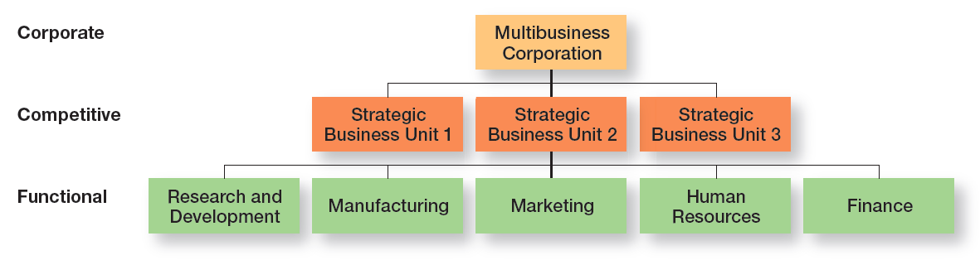
Exhibit 9-3 Types of Organizational Strategies

Slide 19
Types of organizational strategies
Corporate
Top –level of Manager
Competitive
Middle –level managers
Functional
Lower level managers

Slide 20
What Is Corporate Strategy?
Corporate strategy – an organizational strategy that determines what businesses a company is in or wants to be in, and what it wants to do with those businesses.
Notes:
A corporate strategy is one that determines what businesses a company is in or wants to be in and what it wants to do with those businesses. It’s based on the mission and goals of the organization and the roles that each business unit of the organization will play.
When an organization is in several different businesses, those single businesses that are independent and that have their own competitive strategies are referred to as strategic business units (SBUs).

Slide 21
Types of Corporate Strategies
Growth
expansion into new products and markets.
Stability
maintenance of the status quo.
Renewal
examination of organizational weaknesses that are leading to performance declines.

Slide 22
Growth Strategies
Growth Strategy – a corporate strategy that’s used when an organization wants to expand the number of markets served or products offered, through either its current business(es) or new business(es).
Benefits: 1. increase Revenue الإيرادات (sales)
2. Number of employees
3.Market share
Notes:
A growth strategy is when an organization expands the number of markets served or products offered, either through its current business(es) or through new business(es). Because of its growth strategy, an organization may increase revenues, number of employees, or market share. Organizations grow by using concentration, vertical integration, horizontal integration, or diversification.

Slide 23
Types of Growth Strategies
Concentration – focuses on its primary line of business and increases the number of products offered or markets served in this primary business.
Vertical integration
Backward vertical integration – the organization becomes its own supplier.(control its input: resource )
Forward vertical integration – the organization becomes its own distributor.(control its output)
Notes:
An organization that grows using concentration focuses on its primary line of business and increases the number of products offered or markets served in this primary business.
A company also might choose to grow by vertical integration, either backward, forward, or both. In backward vertical integration, the organization becomes its own supplier so it can control its inputs. In forward vertical integration, the organization becomes its own distributor and is able to control its outputs.

Slide 24
Types of Growth Strategies (cont.)
Horizontal integration – a company grows by combining with competitors.
Diversification
Related diversification – when a company combines with other companies in different, but related industries.
Unrelated diversification – when a company combines with firms in different and unrelated industries.
Notes:
In horizontal integration, a company grows by combining with competitors. Finally, an organization can grow through diversification, either related or unrelated. Related diversification happens when a company combines with other companies in different, but related industries. Unrelated diversification is when a company combines with firms in different and unrelated industries.

Slide 25
Corporate Strategies (cont.)
– a corporate strategy in which an organization continues to do what it is currently doing.
Doesn’t grow but doesn’t fall
Stability Strategy
Notes:
A stability strategy is a corporate strategy in which an organization continues to do what it is currently doing. Examples of this strategy include continuing to serve the same clients by offering the same product or service, maintaining market share, and sustaining the organization’s current business operations. The organization doesn’t grow, but doesn’t fall behind, either.

Slide 26
Corporate Strategies (cont.)
– a corporate strategy designed to address declining performance.
Retrenchment strategy – a short-run renewal strategy used for minor performance problems.(helps an organization stabilize operations ,revitalize organizational resources and capabilities and prepare to compete again)
Renewal Strategy
Notes:
When an organization is in trouble, something needs to be done. Managers need to develop strategies, called renewal strategies, that address declining performance. The two main types of renewal strategies are retrenchment and turnaround strategies. A retrenchment strategy is a short-run renewal strategy used for minor performance problems. This strategy helps an organization stabilize operations, revitalize organizational resources and capabilities, and prepare to compete once again. When an organization’s problems are more serious, more drastic action—the turnaround strategy—is needed. Managers do two things for both renewal strategies: cut costs and restructure organizational operations. However, in a turnaround strategy, these measures are more extensive than in a retrenchment strategy.

Slide 27
Turnaround strategy – when an organization’s problems are more serious, more drastic action is needed.
Cut costs
Restructure organizational operation

Slide 28
How Are Corporate Strategies Managed?
Corporate Portfolio Analysis is used when an organization’s corporate strategy involves a number of businesses.
Managers can manage this portfolio of businesses using a corporate portfolio matrix, such as the BCG matrix .(developed by the Boston consulting Group)
BCG matrix – a strategy tool that guides resource allocation decisions on the basis of market share and growth rate of SBUs.(2*2 matrix).business unit is evaluated using a SWOT analysis.
Notes:
The BCG matrix— was developed by the Boston Consulting Group and introduced the idea that an organization’s various businesses could be evaluated and plotted using a 2 × 2 matrix to identify which ones offered high potential and which were a drain on organizational resources. The horizontal axis represents market share (low or high), and the vertical axis indicates anticipated market growth (low or high). A business unit is evaluated using a SWOT analysis and placed in one of the four categories, which are as follows:
• Stars: High market share/High anticipated growth rate
• Cash Cows: High market share/Low anticipated growth rate
• Question Marks: Low market share/High anticipated growth rate
• Dogs: Low market share/Low anticipated growth rate

Slide 29
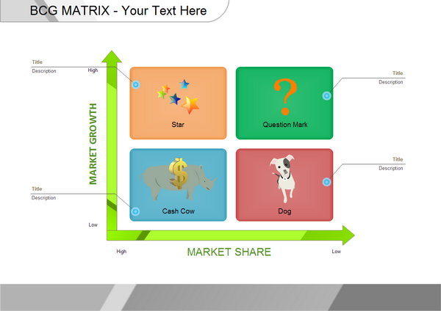
BCG MATRIX

Slide 30
Bcg
Four Categories
Dogs: should be sold off or liquidated
Cash Cows:
mangers should “milk” cash cows for as much as they can ,
limit any new investment in them and
use the large amounts of cash to invest in stars and questions marks with a strong potential to improve market share

Slide 31
Bcg
Stars: will develop into cash cows as markets mature and sales growth slow
Question Marks: some will be sold off and others strategically encouraged into stars

Slide 32
BCG Matrix of Apple-EXAMPLE
iPhones
Apple iPad and Apple Smartwatch are also regarded as the Stars for the company and are currently in the transition to become the Cash Cows for the company.
Apple TV makes a bit of money, but it’s not reaching its true potential.
Apple iTunes and the second being Apple MacBook and iMac’s.
Apple iPods big thing when they were introduced in the market but eventually failed to create a significant impact due to high competition and low customer demand.

Slide 33
Competitive Strategies
Competitive strategy – an organizational strategy for how an organization will compete in its business(es).
Strategic Business Unit (SBU) – the single independent businesses of an organization that formulate their own competitive strategies.

Slide 34
Page 276
Competitive advantage – what sets an organization apart; its distinctive edge.
Quality as a Competitive Advantage
Design Thinking as a Competitive Advantage
Social media
Sustaining Competitive Advantage
Notes:
Developing an effective competitive strategy requires an understanding of competitive advantage, which is what sets an organization apart—that is, its distinctive edge

Slide 35
step 1 Core competencies
Step 2 gain sustainable competitive advantage page 278
Step 3 value

Slide 36
Five Forces Model- Michael porter-p.278
Porters five forces model determine industry attractiveness and profitability:
Threat of new entrants. How likely is it that new competitors will come into the industry?
Such as capital requirement , no brand loyalty ,low government regulation .
2. Threat of substitutes. How likely is it that other industries’ products can be substituted for our industry’s products?
Notes:
In any industry, five competitive forces dictate the rules of competition. Together, these five forces determine industry attractiveness and profitability, which managers assess using these five factors.
Threat of new entrants. How likely is it that new competitors will come into the industry?
Threat of substitutes. How likely is it that other industries’ products can be substituted for our industry’s products?

Slide 37
Five Forces Model (cont.)
Bargaining power of buyers. How much bargaining power do buyers (customers) have?
Bargaining power of suppliersالموردين . How much bargaining power do suppliers have?
Current rivalry المنافسين . How intense is the rivalry among current industry competitors?
Notes:
3. Bargaining power of buyers. How much bargaining power do buyers (customers) have?
4. Bargaining power of suppliers. How much bargaining power do suppliers have?
5. Current rivalry. How intense is the rivalry among current industry competitors?

Slide 38
Choosing a Competitive Strategy
Cost leadership strategy – when an organization competes on the basis of having the lowest costs (costs or expenses, not prices) in its industry. (customer are sensitive price change )
Differentiation strategy – a company that competes by offering unique products that are widely valued by customers. (customer loyalty ) such as high quality ,superior services , innovative design …(customer are not sensitive )
Notes:
When an organization competes on the basis of having the lowest costs (costs or expenses, not prices) in its industry, it’s following a cost leadership strategy. A low-cost leader is highly efficient. Overhead is kept to a minimum, and the firm does everything it can to cut costs.
A company that competes by offering unique products that are widely valued by customers is following a differentiation strategy. Product differences might come from exceptionally high quality, extraordinary service, innovative design, technological capability, or an unusually positive brand image. Practically any successful consumer product or service can be identified as an example of the differentiation strategy.

Slide 39
Choosing a Competitive Strategy (cont.)
Focus strategy – involves a cost advantage (cost focus) or a differentiation advantage (differentiation focus) in a narrow segment or niche.
Stuck in the middle – when costs are too high to compete with the low-cost leader or when its products and services aren’t differentiated enough to compete with the differentiator.
Notes:
Although these two competitive strategies are aimed at the broad market, the final type of competitive strategy—the focus strategy—involves a cost advantage (cost focus) or a differentiation advantage (differentiation focus) in a narrow segment or niche. Segments can be based on product variety, customer type, distribution channel, or geographical location.
What happens if an organization can’t develop a cost or a differentiation advantage? Porter called that being stuck in the middle and warned that’s not a good place to be. An organization becomes stuck in the middle when its costs are too high to compete with the low-cost leader or when its products and services aren’t differentiated enough to compete with the differentiator. Getting unstuck means choosing which competitive advantage to pursue and then doing so by aligning resource, capabilities, and core competencies.

Slide 40
Functional Strategy
– the strategies used by an organization’s various functional departments to support the competitive strategy.
For example: marketing dept. new sales plan
Or HR Training
End page 279
Functional strategy
Notes:
Functional strategies are the strategies used by an organization’s various functional departments to support the competitive strategy.

