Slide 1
Epidemiology-an introduction
Lecture 1

Slide 2
Epidemiology
EPI: UPON, AMONG
DEMOS: PEOPLE
LOGOS: WORD, REASON, DOCTRINE

Slide 3
What is epidemiology?
Epidemiology is the study of how often diseases occur in different groups of people and why.
In medicine
Why has this person got this disease?
What is the best way of treating them?
In epidemiology
What kind of people get this disaese? Why do they get it when others don’t?
How can we find out what is generally the best way of treating people with this disease???

Slide 4

Individual
Molecular
Society
Family

Slide 5
Differences between basic, clinical and public health science
Public Health | Clinical | Basic
Populations or communities | Ill patients who seek care or tx | Cells, tissues, animals in labs | What/who is studied
Prevent disease, promote health | Improve diagnosis and treatment of disease | Understand disease mechanisms, effects of toxic substances | Research goals

Slide 6
In the lab…
Mostly experimental
Variables controlled by the investigator
Highly equipment intensive
All (or most) variables known
Valid results (usually)
Replication relatively easy
Results sometimes uncertain for humans
Little need for statistical manipulation of data

Slide 7
In the community…
Mostly observational
Variables controlled by “nature”
Highly labor intensive
Some variables unknown
Validity of data often questionable
Replication difficult/impossible
Meaning of results for humans clear
Statistical control often very important

Slide 8
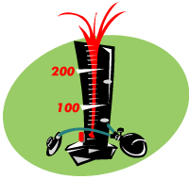
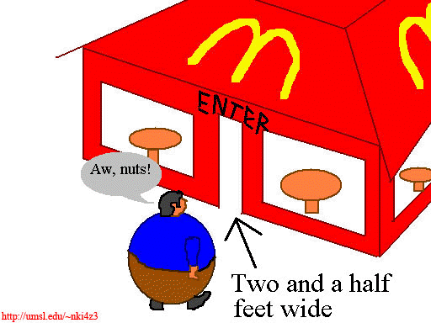
A physiologist may study blood pressure, the epidemiologist will probably study hypertension
The nutritionist studies adult weight, the epidemiologist studies obesity

Slide 9
What is epidemiology?
Epidemiology is based on 2 main assumptions
1. Human disease does not occur at random.
2. Human disease has causal and preventive factors that can be identified through systematic investigation of different populations or subgroups of individuals within a population in different places or at different times.

Slide 10
Definitions
The study of the distribution and determinants of disease frequency in man. (MacMahon and Pugh, 1970)

Slide 11
EPIDEMIOLOGY
FREQUENCY PREVALENCE INCIDENCE
DISTRIBUTION WHO? WHERE? WHEN?
DETERMINANTS WHY?? CAUSES OF DISEASE
HOW MANY?
WHERE?
WHAT NOW?
WHY?
HOW?

Slide 12
Frequency
Amount of disease- risk, incidence rate and prevalence.
These measurements give an idea about the burden of disease in a population

Slide 13
“When we measure,
we know better”
- Center for Disease Control (CDC), Atlanta, Georgia,USA

Slide 14
“Not everything that can be counted counts, and not everything that counts can be counted”
Albert Einstein
هناك شك انها ليست لآلبيرت، اما لِ وليام بروس كاميرون حسب بعض الاثباتات
محمد مصلح 2019-9-9

Slide 15

Distribution
By time
Studying time trends for certain diseases.
Three basic types of time trend are described-
Epidemic: a temporary increase in the incidence of a disease in a population.
Periodic: referes to the pattern of more or less regular changes in incidence (e.g whooping cough tends to peak every 3 years or so.
Secular trends: secular or long –term trends, refer to non-periodic changes in disease statistics over a number of years.

Slide 16

Distribution
By person
Characteristics of person which affect the likelihood of occurrence of
particular Diseases include age, sex, ethnicity, occupation,
socio-economic status, marital status
Disease rates can be calculated for subsets of the population , therefore helping to identify priorities for preventive action.

Slide 17
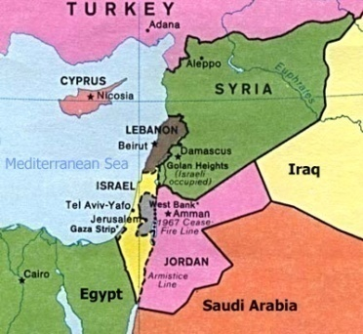
Distribution
By place
International, regional, and small area comparisons of disease distribution may be made.
Standardization is required to allow for important differences in population structure!

Slide 18
Epidemiology
ILLNESS CENTERED
- Cardiovascular epidemiology
- Cancer epidemiology
- Respiratory disease epidemiology
- Infectious disease epidemiology
DETERMINANT CENTERED
- Nutritional epidemiology
- Occupational epidemiology
- Behavioural epidemiology

Slide 19
Epidemiology
CLINICAL EPIDEMIOLOGY
Study of disease outcome
Clinical trials

Slide 20
History of epidemiology
Epidemiology is as old as medicine itself-
Hippocrates first suggested in the fifth century B.C. that
environmental factors influence disease occurence.
William Farr- a physician-set up a system for routine compilation of the numbers and causes of deaths in England.
- compared mortality patterns of
married and single persons.
workers in different occupations

Slide 21
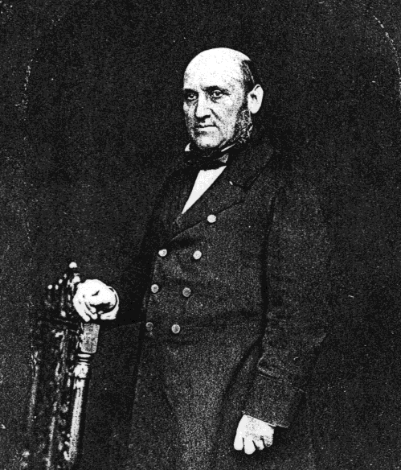
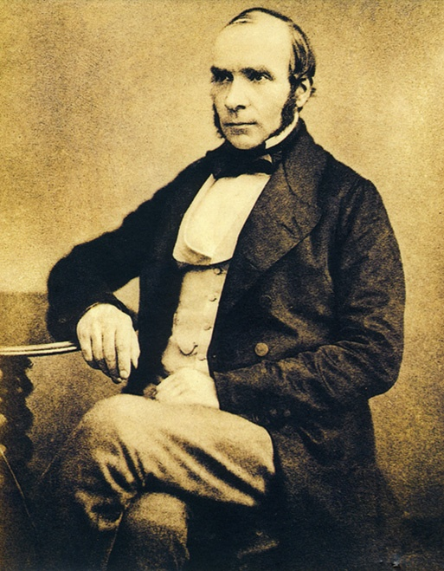
The Founding Father of Modern Epidemiology
?
William Farr
1807-1883
John Snow
1813-1858

Slide 22
Farr was the official “Compiler of Statistics” in the UK General Register Office and is known as the “Father of Vital Statistics”
He was aware of deficiencies in the birth and death registries, but was determined to make the best use of the available data while fully considering the possible implications of the deficiencies; worked to promote accuracy and completeness

Slide 23
Farr used solid quantitative methods (not merely impressions) to study how disease and mortality were influenced by characteristics such as social position, occupation, and physical environment
Was first to produce estimates of annual rates of death from specific causes by analyzing England’s birth and death registries
Among the first to estimate death rates from suicide in different population groups

Slide 24
History of epidemiology
Cholera epidemic- John Snow -1854
Death rates from cholera, 1853-1854, according to water company supplying subdistrict of London
Water company | Population in 1851 | Cholera deaths | Deaths per 100,000 living
Southwake Both companies Lambeth | 167,654 301,149 14,632 | 192 182 0 | 114 60 0

Slide 25
History of epidemiology
Cholera epidemic- John Snow -1854
Death rates from cholera in London, 1853-1854, according to water company supplying actual house
Water company | Number of houses | Cholera deaths | Deaths per 100,000 houses
Southwake Lambeth | 40,046 26,107 | 1263 98 | 315 37

Slide 26
History of epidemiology
JOHN SNOW (1813-1858)
Snow the first investigator to draw together all 3 components of the definition of
Epidemiology!!
Frequency of cholera
2. Distribution of cholera
3. A cause or determinant of the outbreak
Diseases can be prevented without complete knowledge of specific causal factors!
(the bacteria Vibrio cholerae was discovered in 1883 by Robert Koch)

Slide 27
Epidemiologic transition
Epidemiologic transition
Past
Present
Chronic diseases
Cancer, CVD,diabetes
Deficiency diseases
Infectious diseases
long latent period,
multiple causes
Short latent period,single cause

Slide 28
Noncommunicable diseases
Global mortality
Chronic obstructive pulmonary disease
4.2%
Communicable diseases
41%
Non communicable diseases
58.8%
Diabetes1.1%
Cancer
13.4%
CVD
30.9%
World Health Report 1999

Slide 29
What are the objectives of epidemiology?
1. To determine the extent/frequency of disease (states of health) and/or behaviors in a community.
2. To identify the etiology or the cause/s of a disease and the factors that impact upon a person’s risk for a disease.
3. To study the natural history and prognosis of disease.

Slide 30
What are the objectives of epidemiology?
4. To evaluate new preventive and therapeutic measures and new modes of health care delivery.
5. To provide the foundation for developing public policy and regulatory decisions relating to public health problems.

Slide 31
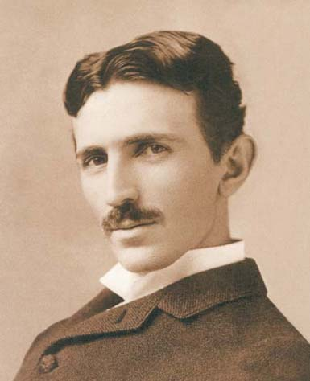
“Science is but a perversion of itself unless it has as its ultimate goal the betterment of humanity”
- Nikola Tesla, Inventor, 1856-1943
“The Father of Physics"
"The man who invented the 20th century“
"the patron saint of modern electricity"

Slide 32
“A MAJOR CHALLENGE FOR EPIDEMIOLOGY today is to become an effective instrument in the SHAPING AND EVALUATION OF HEALTH POLICIES AND PRACTICES… Epidemiologists must OBTAIN AND ANALYSE THE INFORMATION NEEDED and PRESENT IT to health planners IN SUCH A WAY THAT THIS INFORMATION CAN BE USED in policy, planning and evaluation.
Michel Thuriaux, Epidemiology and Statistics Unit, WHO Regional Office for Europe, 1992

Slide 33

However, as epidemiologist/public health practitioners we most often need to act/intervene under conditions of uncertainty based on the available evidence

Slide 34
CAUSATION
Uses of Epidemiology
Epidemiology is a good tool to study association between disease and different factors.
A cause in epidemiology –is a factor –when its intensity or fequency increases the incidence of disease increases (the probability of disease increases)
A cause does not have to be necessary or sufficient. ..........
e.g if you smoke have a higher probability of developing lung cancer. (interaction between smoking and genetic polymorphism)
Most causes act in interactive ways

Slide 35
Causation
unless we define a disease according to exposure.
HIV- AIDS
Virus-measles
Lead- lead poisoning

Slide 36
Examples from the literature
SMOKING AND LUNG CANCER
AIDS

Slide 37
EPIDEMIOLOGY
FREQUENCY PREVALENCE INCIDENCE
DISTRIBUTION WHO? WHERE? WHEN?
DETERMINANTS CAUSES OF DISEASE
RISK FACTOR
DISEASE
STUDY DESIGN
CHANCE?-statistical testing
BIAS AND CONFOUNDING?
IS IT A CAUSE??

Slide 38
Disease frequency measures
Measures used as health indicators

Slide 39
“It is not because countries are poor that they cannot afford good health information; it is because they are poor that they cannot afford to be without it”
- Health Metrics Network, WHO, 2005

Slide 40
Mortality as Indicator of Health Status of a Population
Death is a unique and universal event, and as a final event, clearly defined
Age at death and cause of death provide a picture of health status
In high mortality settings, information on trends of death by causes substantiate the progress of health programs

Slide 41
As survival improves with modernization, and populations age, mortality measures do not give an adequate picture of a population’s health status
Indicators of morbidity such as the prevalence of chronic diseases and disabilities become more important

Slide 42
The concept of using mortality data as a basis for public health action arose in Europe some 500 years ago… Graunt’s analyses of Bills of Mortality in the 1600s…
Sadly, we know more about epidemiology and public health in certain 18th century European populations than we do about the current situation of some/many developing countries

Slide 43
Measures of Mortality
Crude Death Rates
Age-Specific Death Rates
Cause-Specific Death Rates
Life Table Estimates
– Life Expectancy
– Survivorship (by age)
Special Indicators
– Infant and Maternal Mortality Rates
Case Fatality

Slide 44
Crude Death Rate
Total number of deaths in a defined period (usually one year) out of the average population for that time period (per /1000 persons)

Slide 45
Risk of death changes by age, so CDR is affected by population age structure
Aging populations can have rising CDRs even as health conditions are improving
Countries with very young populations will often have lower CDRs, but not necessarily age-specific death rates, than those with older populations
Therefore, mortality comparisons across population groups must always account for differences in age composition

Slide 46
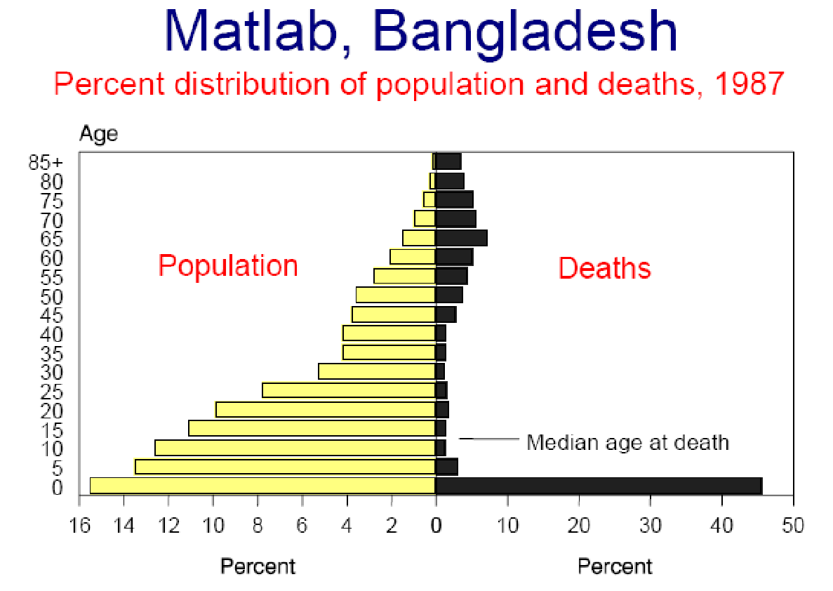

Slide 47
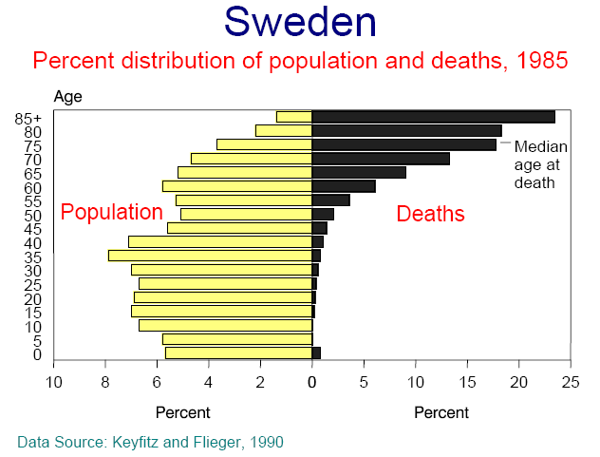

Slide 48
Age-specific Death Rates
Total number of deaths in a specific age-group within a defined period out of the average population for that age-group (per /1000 persons)

Slide 49
Why age-specific death rates?
Can compare mortality at different ages or in the same age group over time
Can compare across population groups with different age compositions
Can be used to calculate life-tables for life-expectancy estimations

Slide 50
Life Expectancy
LE_{age X} = average number of years a person aged x will live, if subject to the mortality rates contained in the life table (i.e. if the age-specific death rates for a given year prevailed for the rest of that person’s life)

Slide 51
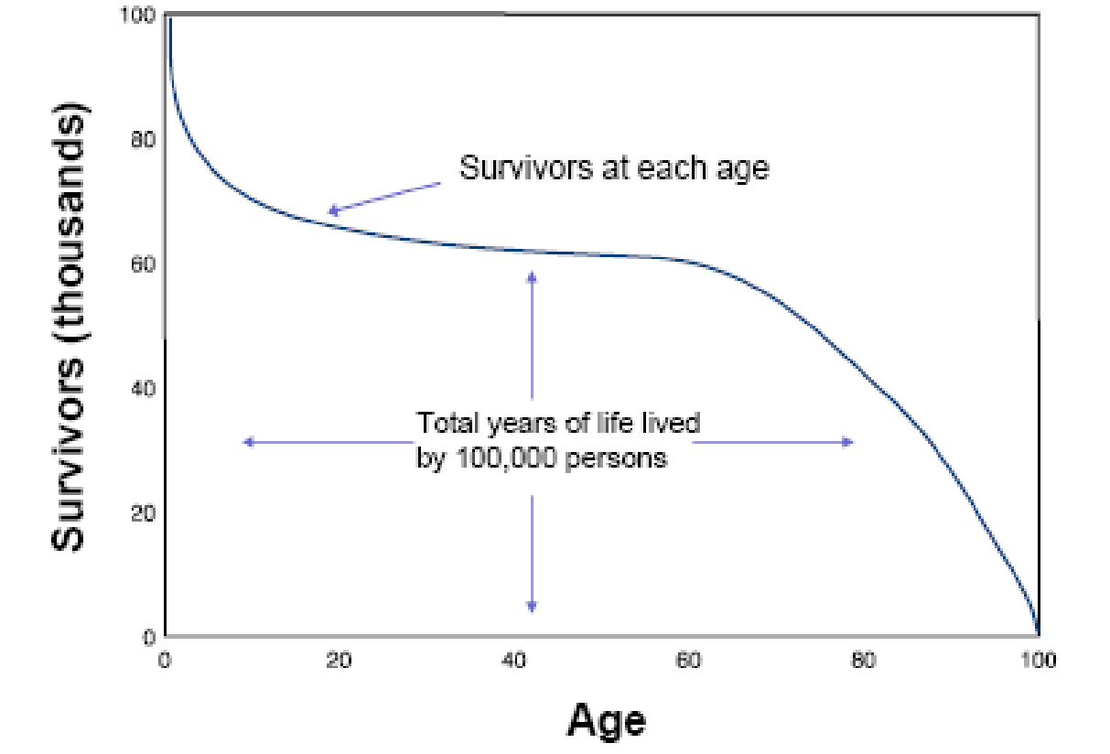
“In the long run, we are all dead”
- John Maynard Keynes

Slide 52
Is there an upper limit to life expectancy?
Compression of mortality: An increasing of concentration of deaths at older ages
Compression of morbidity: An increasing of illness and disability in the latter years of life with fewer years of disabled life before death among the elderly
Are health gains matching or exceeding gains in survival?

Slide 53
If there is no compression of mortality and no postponement of morbidity, then increasing life expectancy will result in growing numbers of ill and disabled elderly, creating increasing burdens on the health care system and society

Slide 54
Highest – Japan: 82.6 years
Lowest – Swaziland: 39.6 years*
* 40% below world average!

Slide 55
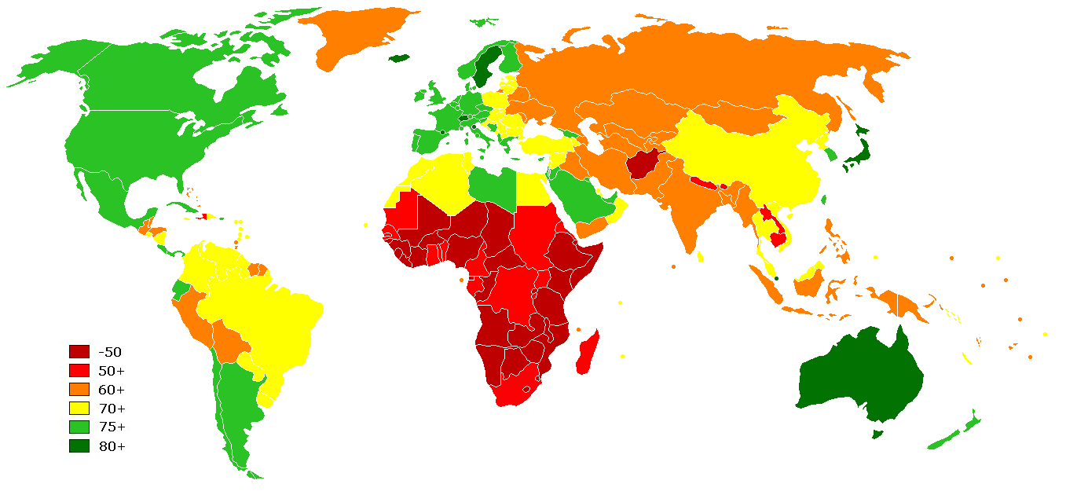

Slide 56
79.1 | Netherlands | 52.9 | Cameroon
47.4 | Nigeria | 80.3 | Canada
73.4 | Palest. Terr. | 72.9 | China
71.7 | Philippines | 72.9 | Colombia
65.5 | Russia | 52.9 | Ethiopia
64.6 | Tajikistan | 76.3 | Georgia
51.8 | Uganda | 59.5 | Ghana
67.9 | Ukraine | 68.6 | India
78.1 | USA | 55.3 | Kenya
65.0 | Uzbekistan | 65.9 | Kyrgyzstan
CIA World Factbook (2008 estimates)

Slide 57
Cause-Specific Death Rates
Number of deaths attributable to a particular cause divided by the population at risk (usually in deaths per 100,000)

Slide 58
Multiple causes of death are an important issue when dealing with cause-specific mortality data
At times, the cause with the greatest public health significance may be lost

Slide 59
Infant Mortality
Number of deaths before one year of age (from a specific cause or all causes) divided by total number of live births (/100,000 live births)

Slide 60
Why IMR?
Good indicator of overall health status (and healthcare) of a population
Major determinant of LE at birth
Sensitive to changes in socio-economic conditions

Slide 61
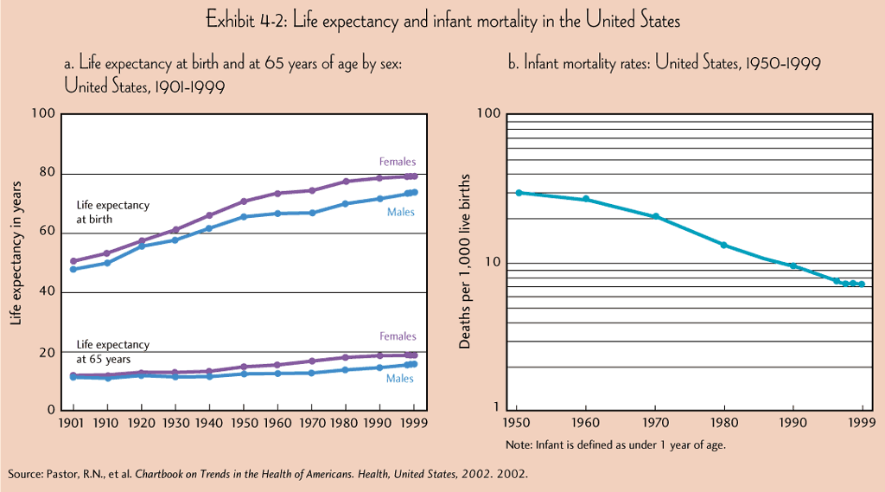

Slide 63
Maternal Mortality
“Death of a woman while pregnant or within 42 days of termination of pregnancy irrespective of the duration and site of pregnancy, from any cause related to or aggravated by the pregnancy or its management, but not from accidental or incidental causes”
- ICD-10

Slide 64
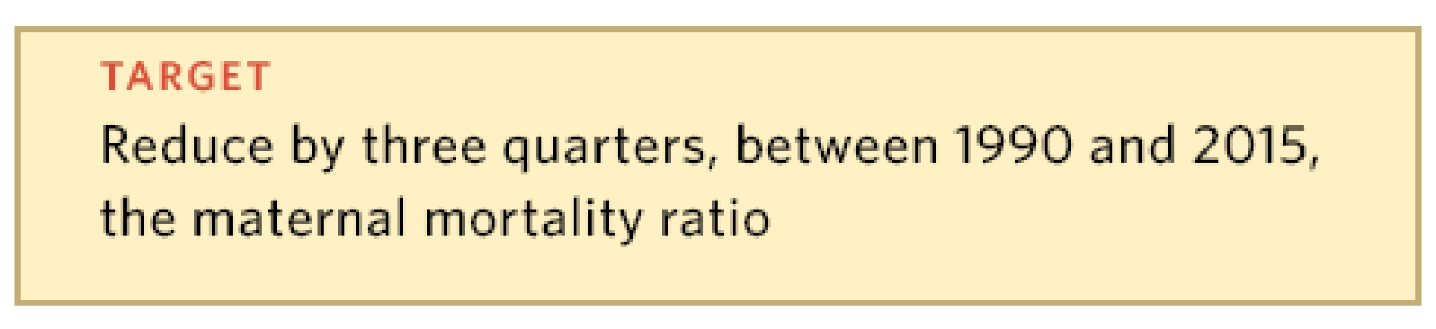
UN Millennium Development Goal #5
Improve Maternal Health
Maternal Mortality Ratio:
The number of recorded (or estimated) maternal deaths divided by the total recorded (or estimated) live births in the same period

Slide 65
The maternal mortality ratio should not be confused with the maternal mortality rate (whose denominator is the number of women of reproductive age), which measures the likelihood of both becoming pregnant and dying during pregnancy or within six weeks after delivery. The maternal mortality ratio (whose denominator is the number of live birth), takes fertility levels (likelihood of becoming pregnant) into consideration.

Slide 66
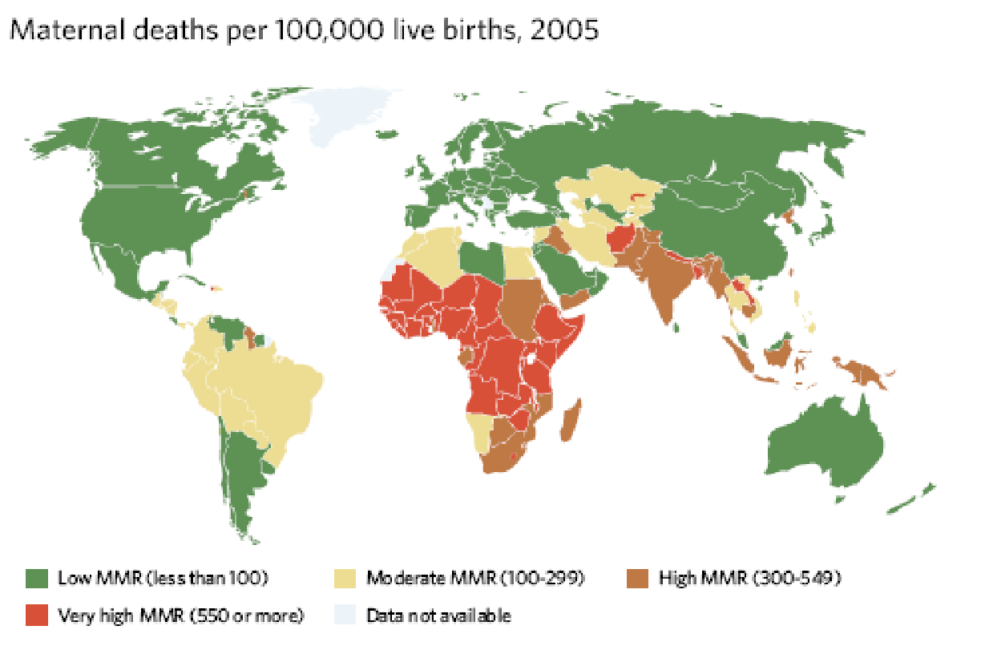
The Millennium Development Goals Report 2008

Slide 67
Maternal mortality remains unacceptably high across much of the developing world.
In 2005, more than 500,000 women died during pregnancy, childbirth or in the six weeks after delivery.
99% of these deaths occurred in the developing regions, with sub-Saharan Africa and Southern Asia accounting for 86% of them.
In sub-Saharan Africa, a woman’s risk of dying from treatable or preventable complications of pregnancy and childbirth over the course of her lifetime is 1 in 22, compared to 1 in 7,300 in the developed regions.

Slide 68
Proportional Mortality
The proportional mortality is the contribution of a specific cause of death to the total mortality experience of a population
Number of deaths attributed to a specific cause out of the total number of deaths, expressed as a percentage

Slide 69
Measures of disease frequency
Lecture- 2

Slide 70
Measures of disease frequency
Risk = incidence proportion = cumulative incidence
Incidence rate= incidence density
Prevalence

Slide 71
Measures of disease frequency
Risk- the probability of a person developing a certain disease or condition.
Number of subjects developing disease during a time period
Risk=
Number of subjects followed for the time period
Measuring an event- onset of disease, death from a given disease, or any event that marks a health outcome!
Have to specify a period of time- otherwise risk values are meaningless!!!

Slide 72
Measures of disease frequency
Risk
e.g- oral contraceptive use and bacteriuria
Total population 2390 women
482 were OC users in 1973 of which 27 developed bacteruria in 1976
Risk of bacteruria among OC users=27/482=5.6% during this 3 –year period.

Slide 73
Measures of disease frequency
Risk
Attack rate- the risk of being infected with a condition during an epidemic period
Used with infectious outbreaks!!!!
e.g influenza epidemic- attack rate of 10%- 10% of the population developed the disease during the epidemic period!!!!

Slide 74
Measures of disease frequency
Risk
Case fatality rate- proportion of people, among those who develop the disease, who proceed to die from the disease.
Used with infectious outbreaks!!!!
Case fatality rate is a function of the severity of a disease

Slide 75
Measures of disease frequency
Risk
Risk= A/N
Drawbacks of risk as a measurement of disease occurrence-
Competing risks
Loss to follow-up
A/N is always an underestimation of the true risk

Slide 76
Measures of disease frequency
Incidence rate
Incidince rate- measures the rapidity with which newly diagnosed cases of the disease of interest develop.
Incidence rate- number of new cases of the disease
Sum for each individual in the population of the length of time at risk of getting the disease

Slide 77
Measures of disease frequency
Incidence rate
2
A
D
IR= A/PT= 2/22= 0.09 cases/person-year
2
B
3
C
D
Patient
7
D
2
E
6
F
0
2
4
6
8
Observation (years)

Slide 78
Measures of disease frequency
Incidence rate
Person time (PT)= average number of people in the population x time
Incidence rate is not a probability. Ranges (0,∞ )
Incidence rate is an instantaneous concept
Mortality (incidence rate)
- Crude (unadjusted)
- Age specific or gender specific.. etc..

Slide 79
Measures of disease frequency
Incidence rate
Under steady-state conditions , a situation in which rates do not change with time , the reciprocal of the incidence rate equals the average time until an event occurs this time is referred to as the ”waiting time”
e.g mortality rate of 11 deaths per 1000 person-years- average time until death- expectation of life- expected survival time- 1000/11= 90.9 years
”unfortunatly mortality rates typically change with time”

Slide 80
Measures of disease frequency
Incidence rate
Example- according to the swedish cancer Registery, in the years 1971,1972 and 1973 there were 97 , 121 and 112 cases of pancreatic cancer, respectively, among men age 70-74 years. At the beginning of 1971 there were 309,949 men in this age group and at the end of 1973 , 332,400 men. Calcualte the Incidence rate of pancreatic cancer in this population.
IR= new cases of disease/ person time
New cases of disease= 97+121+112= 330
Person time???

Slide 81
Measures of disease frequency
Incidence rate
Example- according to the swedish cancer Registery, in the years 1971,1972 and 1973 there were 97 , 121 and 112 cases of pancreatic cancer, respectively, among men age 70-74 years. At the beginning of 1971 there were 309,949 men in this age group and at the end of 1973 , 332,400 men. Calcualte the Incidence rate of pancreatic cancer in this population.
Persontime= average population size x time
Average poulation size= 309,949+332,400/2= 321,174.5
Time- observation period- 3 years
321,174.5 x 3 = 963,523.5

Slide 82
Measures of disease frequency
Incidence rate
Example- according to the swedish cancer Registery, in the years 1971,1972 and 1973 there were 97 , 121 and 112 cases of pancreatic cancer, respectively, among men age 70-74 years. At the beginning of 1971 there were 309,949 men in this age group and at the end of 1973 , 332,400 men. Calcualte the Incidence rate of pancreatic cancer in this population.
IR= 330/963,523.5=0.00034 per year

Slide 83
Measures of disease frequency
Relation between Risk and Incidence rate
Risk = Incidence rate x Time
An approx.- works only with low risks!!!!

Slide 84
Measures of disease frequency prevalence
Prevalence – is a measure of disease status- the proportion of people in a population that has the disease!!!!
Number of individuals having the disease at a specific time
Prevalence=
Number of individuals in the population at that point in time

Slide 85
Point Prevalence
Proportion of individuals in a specified population at-risk who have a disease/condition of interest at a given point in time

Slide 86
Point Prevalence
Calendar time (ex. Oct 10, 2007)
Infants who enter a study when they show up at the clinic and are examined only once

Slide 87
Period Prevalence
Proportion of individuals in a specified population at-risk who have a disease/condition of interest over a specified period of time
Examples: annual prevalence rate, lifetime prevalence rate

Slide 88
Point Prevalence rate =
# persons with the condition
total number of persons
Period Prevalence rate =
# persons with condition
total number of persons
at a point in time
in a specified period of time

Slide 89
Asthma question
Type of measure:
Point prevalence?
Period prevalence?
Lifetime prevalence?
Interview question:
Do you currently have asthma?
✔

Slide 90
Asthma question
Type of measure:
Point prevalence?
Period prevalence?
Lifetime prevalence?
Interview question:
Have you had asthma in the last 10 years?
✔

Slide 91
Asthma question
Type of measure:
Point prevalence?
Period prevalence?
Lifetime prevalence?
Interview question:
Have you ever had asthma?
✔

Slide 92
Measures of disease frequency prevalence
What factors affect prevalence??
1. Incidence
2. Duration of disease
So prevalence is not useful as incidence to study the causes of disease!!!
Prevalence is useful for studying the disease burden on a population!!!

Slide 93
Measures of disease frequency prevalence and incidence rate
In a steady state........
Incidence rate and duration are stable over time........
P
= IR x D
1-P
For small prevalences.......
P = IR x D

Slide 94
Measures of disease frequency prevalence and incidence rate
Example- in 1973-1977, the average annual incidence rate of lung cancer in Connecticut was 45.9 per 100,000 and the average annual prevalence was 23.0 per 100.000. so the average duration of lung cancer is--
D=P/I = 23.0/10⁵
= 0.5 year
45.9/10⁵/year
Individuals diagnosed with lung cancer during this period survived an average of 6 months from diagnosis to death!!!

Slide 95
Factors influencing observed prevalence rate
Longer duration of the disease
Prolongation of life without cure
Increase in new cases (incidence / risk)
Out-migration of non-diseased people
In-migration of susceptible/diseased people
Improved diagnostics &/or reporting

Slide 96
Factors influencing observed prevalence rate
Shorter duration of the disease
Increased case-fatality rate
Decrease in new cases (incidence / risk)
In-migration of “healthy” people
Out-migration of diseased people
Improved cure rate

Slide 97
True or False?
Incidence will decrease if a new drug is effective in reducing deaths from the disease
T F√

Slide 98
True or False?
Incidence measures the absolute risk of developing the disease
T ? F

Slide 99
True or False?
Incidence measures the absolute risk of developing the disease
T√ F

Slide 100
True or False?
Incidence (risk) is the probability that a healthy individual will develop the disease during a specified period of time
T ? F

Slide 101
True or False?
True or False?
Incidence (risk) is the probability that a healthy individual will develop the disease during a specified period of time
T√ F

Slide 102
True or False?
Incidence (risk) will decrease if a particular prevention program is effective
T ? F

Slide 103
True or False?
Incidence (risk) will decrease if a particular prevention program is effective
T√ F

Slide 104
Characteristics of risk, prevalence and incidence rate
Characteristic
Risk
Prevalence
IR
What is measured?
Prob. Of disease
% of population with disease
Rapidity of disease occurrence
Units
None
none
/ time
Time of disease diagnosis
Newly diagnosed
Existing
Newly diagnosed

Slide 105
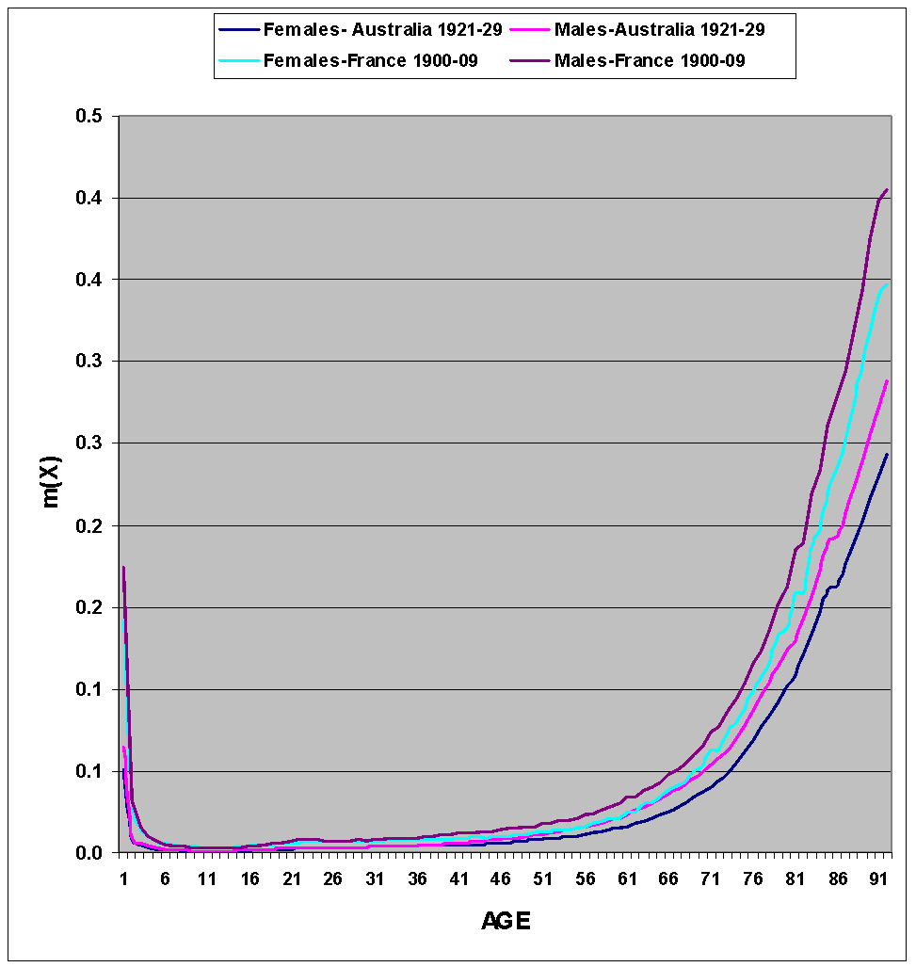
Mortality curves

Slide 106
Age-sex Pyramids
A simple graphic tool describing the age-sex structure of a given population at a specific point in time
It is in practice a kind of (double) histogram (one for each sex) representing the population size for each age (and sex) group shifted 90⁰ in a way that the lowest age groups are at the basis of the graph and each sex looks into the opposite direction (usually females right and males left)
The X axes represents the size of the age group and the Y axes its age (or year of birth)

Slide 107
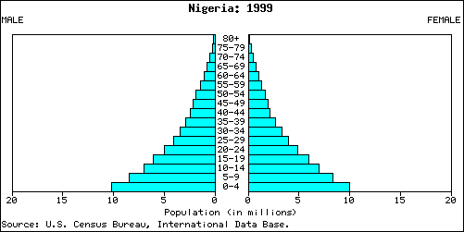
Nigeria 1999

Slide 108
The pyramid shape
Age structure is the result of the fertility, mortality and at times also migration patterns the specific population went through during the last decades
Since these patterns many times leave a unique stamp on the pyramid shape, the age-pyramid may serve as a “story teller” of the demographic history of the specific population
Age structure indicators: Proportions at different ages and specifically children (0-14), old people (65+) and those at working ages (15-64)

Slide 109
Other age structure indicators
Besides the proportions at different ages two additional common indicators are:
  Sex ratio by age
  The age dependency ratio
Sex ratio: usually men to women (x100) – beginning with a slight advantage for men (106) diminishes continuously arriving at high ages to very low levels (50 men to 100 women)
Dependency ratio: a simple indicator connecting between age structure and economic issues

Slide 110
Life Expectancy
LE_{age X} = average number of years a person aged x will live, if subject to the mortality rates contained in the life table (i.e. if the age-specific death rates for a given year prevailed for the rest of that person’s life)

Slide 111
“In the long run, we are all dead”
- John Maynard Keynes

Slide 112
Is there an upper limit to life expectancy?
Compression of mortality: An increasing of concentration of deaths at older ages
Compression of morbidity: An increasing of illness and disability in the latter years of life with fewer years of disabled life before death among the elderly
Are health gains matching or exceeding gains in survival?

Slide 113
If there is no compression of mortality and no postponement of morbidity, then increasing life expectancy will result in growing numbers of ill and disabled elderly, creating increasing burdens on the health care system and society

Slide 114
Highest – Japan: 82.6 years
Lowest – Swaziland: 39.6 years*
* 40% below world average!

Slide 116
79.1 | Netherlands | 52.9 | Cameroon
47.4 | Nigeria | 80.3 | Canada
73.4 | Palest. Terr. | 72.9 | China
71.7 | Philippines | 72.9 | Colombia
65.5 | Russia | 52.9 | Ethiopia
64.6 | Tajikistan | 76.3 | Georgia
51.8 | Uganda | 59.5 | Ghana
67.9 | Ukraine | 68.6 | India
78.1 | USA | 55.3 | Kenya
65.0 | Uzbekistan | 65.9 | Kyrgyzstan
CIA World Factbook (2008 estimates)

Slide 117
Infant Mortality
Number of deaths before one year of age (from a specific cause or all causes) divided by total number of live births (/100,000 live births)

Slide 118
Why IMR?
Good indicator of overall health status (and healthcare) of a population
Major determinant of LE at birth
Sensitive to changes in socio-economic conditions

Slide 119
Crude, Category-specific, and Adjusted (Standardized) rates

Slide 120
Crude risk / rates
Crude rates: rates presented for an entire population.
A summary measure, calculated by dividing the total number of cases of the outcome in the population by the total number of individuals in that population in a specified time period.

Slide 121
Category specific rates
Category-specific rates: defined on the basis of particular characteristics such as age, sex, or race.

Slide 122
What do do?
There are two ways to account for differing distributions of a characteristic between populations being compared.
To present and compare only the category-specific rates.( but large number of comparisons).
Standardized rates: single summary rate for each population that takes into account any differences in the structure of the populations.

Slide 123
Standardization
When comparing rates standardized or adjusted for a particular factor, any remaining observed differences between the groups cannot be attributed to confounding by that variable.
2 main techniques : direct and indirect methods.

Slide 124
Direct standardization-(example: age adjustment)

Slide 125
Direct standardization
Age specific rates for different populations are applied to a standard population with certain age distribution.
 |  | Sweden |  |  |  | Panama
 | population | deaths | Mortality per 1000 |  | population | deaths | Mortality per 1000
Total | 7,496,000 | 73,555 | 9.8 |  | 1,075,000 | 7,871 | 7.3
0-29 y | 3,145,000 | 3,523 | 1.1 |  | 741,000 | 3,904 | 5.3
30-59 y | 3,057,000 | 10,928 | 3.6 |  | 275,000 | 1,421 | 5.2
≥ 60 y | 1,294,000 | 59,104 | 45.7 |  | 59,000 | 2.456 | 41.6

Slide 126
Direct standardization
The age distribution of the Swedish population can be used as the standard age distribution. We can then calculate the expected number of deaths by applying the age specific mortality rates of panama to the standard population.
0-29 y: 3,145,000 x 5.3/1000 = 16,668.5
30-59 y: 3,057,000 x 5.2 /1000 = 15,896.4
≥ 60 y: 1,294,000 x 41.6 /1000 = 53,830.4
Total 86,395.3
Standardized mortality rate: 86,395.3 x 1000 /7,496,000 =11.5

Slide 127
Direct standardization
So mortality rate in Panama is higher than Sweden!!!!

Slide 128
Indirect standardization
Standardized mortality ratios
Here rates from a standard population are used to calculate the number of cases that would have been expected in this group had they developed the disease at the same rate as the general population.
SMR = observed deaths (O) x 100%
expected deaths (E)

Slide 129
Conclusions
The decision to use crude, adjusted, or category-specific rates depends on the information that we are trying to obtain.
Crude rates represent the actual experience of the population and provide data for the allocation of health resources and public health planning. But are difficult to interpret because they maybe confounded by differences between underlying population structures.
Category –specific rates provide the best detailed information, but too many comparisons.
Adjusted rates provide a summary value that removes the effect of the differences in population structure so that populations can be compared. But actual value of the adjusted rate is meaningless!

Slide 130
Measures of association
Lecture 3

Slide 131
Measures of association
The central objective of epidemiology is to study the cause of disease----
exposure disease
What do you compare???
Risk in exposed with the risk of nonexposed----- in a single summary parameter!!!
RR RD OR AR PAR

Slide 132
Absolute and relative effects
The 2 most commonly compared measures are the risk and IR
1. Absolute effect-Risk difference or Incidence rate difference.
RD= R_{e}-R_{o}
2. Relative effect- relative risk
RR= RD/R_{o}

Slide 133
Relative risk
Relative effect= risk difference/ risk in unexposed
RD
R_{e}-R_{o}
R_{e}
R_{o}
=
-
= RR - 1 ~RR
=
R_{o}
R_{o}
R_{o}
R_{o}
How much more likely one group is to develop a disease than another!!!

Slide 134
Relative risk 2x2 table
Disease
Yes
No
a
b
Yes
exposure
c
d
No
Risk in exposed / risk in non exposed = a / (a+b)
c / (c+d)

Slide 135
Relative risk-example
bacteruria
Yes
No
Yes
27
455
OC use
77
1831
No
104
2286
RR= 27/482 / 77/1908 = 1.4 40% increase in risk!!!
RR= 1 no risk
RR > 1 increased risk
RR < 1 decreased risk

Slide 136
Case-control study-OR
Exposure Disease Investigator

?
?
In a case-control study, participants are selected on the basis of disease status- not possible to calculate risk of disease- but RR can be estimated by calculating the ratio of the odds of exposure among cases to that among controls.
Odds of exposure among cases
OR =
OR~RR
Odds of exposure among controls

Slide 137
2 x 2 table OR
Disease
Yes
No
a
b
Yes
exposure
c
d
No
OR= a/c
= ad/cb
b/d

Slide 138
OR- Example
Myocardial infarction
Yes
No
23
304
Yes
OC users
133
2816
No
156
3120
OR= a/c
= ad/cb =23x2816/ 133x 304 = 1.6
b/d

Slide 139
OR VS. RR
Lung cancer
cases
controls
70
30
Yes
Smoking
30
70
No
TOTAL
100
100
OR= 70 x 70/ 30 x 30 = 5.4
RR= 70/100 / 30/100 = 2.3

Slide 140
OR VS. RR
Lung cancer
cases
controls
70
300
Yes
Smoking
30
700
No
TOTAL
100
1000
OR= 70 x 700/ 30 x 300 = 5.4
RR= 70/370 / 30/730 = 4.6

Slide 141
OR ~ RR
Disease
Yes
No
a
b
Yes
exposure
c
d
No
When disease is rare total exposed = a + b ~ b
total unexposed= c+d ~ d
RR= a /a+b = a/b = ad = OR
c/ c+d
c/d
bc

Slide 142
Absolute effects- Attributable risk
RR- represents the likelihood of disease in exposed individuals relative to those who are nonexposed.
Risk Difference = AR= EAR = R_{e} – R_{o}
Is the disease risk among exposed individuals that maybe attributed to the exposure under study
AR% - EAF – exposed attributable fraction = R_{e} – R_{o} x 100
R_{e}
Is the fraction of risk among exposed individuals that may be attributed to the exposure.

Slide 143
Attributable risk
AR_{exp} = R_{e} – R_{o}
Measures the excess risk for a given exposure category associated with the exposure.
AR_{exp}
RISK
Unexposed
exposed

Slide 144
Absolute effects- Attributable risk
In case control studies- AR%= RR-1/RR
e.g. RR of lung cancer and passive smoking = 1.5
AR%???
1.5-1/1.5= 0.33 = 33% can be attributed to passive smoking

Slide 145
Comparison between RR and AR example
Annual mortality rate per 100,000
Lung cancer
Coronary heart disease
Cigarette smokers 140 669
Nonsmokers 10 413
RR 14.0 1.6
AR 130/10⁵/year 256/10⁵/year

Slide 146
RR and EAR provide very different
types information
RR measures the strength of association between exposure
and disease (causality)
AR% - a measure of the public health impact of a particular exposure, assuming that the association is one of cause and effect!

Slide 147
PAR and PAF
Population attributable risk-estimates the excess rate of disease in the total study population of exposed and nonexposed individuals that is attributable to the exposure.
PAR= R_{T} – R_{o}
R_{T}= Risk of disease in the population
R_{o} = Risk of disease in the unexposed
Is the fraction of risk in the total population that maybe attributed to the exposure under study!
PAF = R_{T} - R_{o}
R_{T}

Slide 148
population attributable risk
PAR depends on the prevalence of exposure in the population. Population is composed of both exposed and non exposed.
When exposure is rare the risk in population is similar to the risk in the unexposed.
AR _{exp}
PAR
Risk
Unexposed
Population
Exposed

Slide 149
population attributable risk
risk in population is similar to that in the exposed when the exposure is common
AR _{exp}
PAR
Risk
Unexposed
Population
Exposed

Slide 150
PAF
PAF= P_{e} x (RR-1)
P_{e} (RR-1) + 1
PAF- depends on RR and the proportion of exposed persons in the population
EAF- depends on RR only!!!

Slide 151
PAF- example
Myocardial infarction
Yes
No
Yes
23
304
OC users
No
133
2816
156
3120
OR = 1.6
PAF??
Prevelance of OC use in the population- prevalence in the controls
P_{e}= 304/3120=0.0974
PAF= 0.0974 x (1.6-1) /0.0974x (1.6-1)+1= 5.5%
If OC causes MI , 5.5% of MI in the study population could be prevented
if OC use was discontinued

Slide 152
Measures of association
Relative effects- strength of association
RR- relative risk – R_{e}/R_{o} –measures the strength of association between exposure and disease
In case- control studies- OR~RR = odds of exposure among cases/ odds of exposure among controls
Absolute effects- assuming a cause- effect relationship
how much of the risk is attributable to exposure
AR- Risk in exposed that is attributed to the exposure
PAR- Risk in the the whole population ( exposed and
nonexposed) that is due to the exposure

