Slide 1
Organizational structure
Maram Jaghama

Slide 2
Fayol (1949) suggested that an organization is formed when the number of workers is large enough to require a supervisor.
Organizations are necessary because they accomplish more work than can be done by individual effort.
Because people spend most of their lives in social, personal, and professional organizations, they need to understand how organizations are structured—their formation, methods of communication, channels of authority, and decision-making processes.

Slide 3
Organizational Structure
Definition
Refers to the way in which a group is formed, methods of communication, its means for channeling authority, and decision making process.
Each organization has: - Formal organization structure - Informal organization structure

Slide 4
Formal Structure:
Highly planned and visible, the emphasis is on organizational positions and formal power.
Formal structure, through departmentalization and work division, provides a framework for defining managerial authority, responsibility, and accountability.
In a well-defined formal structure, roles and functions are defined and systematically arranged, different people have differing roles, and rank and hierarchy are evident.

Slide 5
Informal organization structure:
Is unplanned and often hidden, the focus is on the employees, their relationships, and the informal power that is inherent within those relationships.
Informal structure is generally a naturally forming social network of employees.
the informal structure that fills in the gaps with connections and relationships that illustrate how employees network with one another to get work done
informal structures are typically based on camaraderie, they often result in a more immediate response from individuals, saving people’s time and effort.
“Camaraderie: mutual trust and friendship among people who spend a lot of time together’’

Slide 6
The informal structure also has its own leaders. In addition, it also has its own communication channels, often referred to as the grapevine.
grapevine communication is at the heart of the informal organization; it is the conversations that occur in the break room, down the halls, during the carpool, and in between work that allows the relationships of informal groups to develop. In addition, social media sites and electronic communication such as e-mail and text messages are also used to facilitate communication among informal group members.
While grapevine communication is fast and can facilitate information upward, downward, and horizontally, it is difficult to control or to stop. With little accountability for the message, grapevine communication often becomes a source for rumor or gossip.

Slide 7
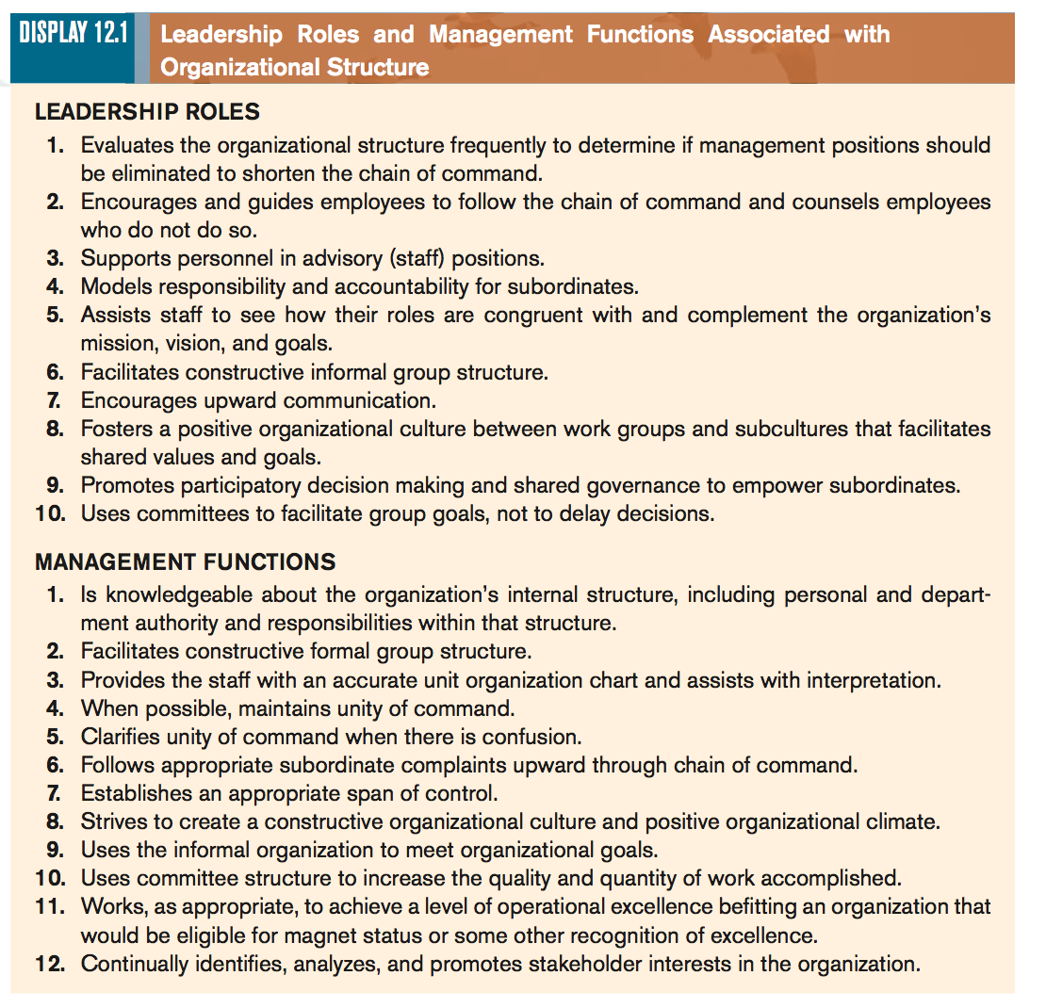

Slide 8
Component OF Organizational Structure
Relationships and Chain of Command: The organization chart defines formal relationships within the institution. - Unbroken (solid) lines represent formal relationships, lines of communication, and authority. These line positions can be shown by solid horizontal or vertical lines. Solid horizontal lines represent communication between people with similar spheres of responsibility and power but different functions. Solid vertical lines between positions denote the official chain of command, the formal paths of communication and authority. Those having the greatest decision-making authority are located at the top; those with the least are at the bottom. The level of position on the chart also signifies status and power.

Slide 9
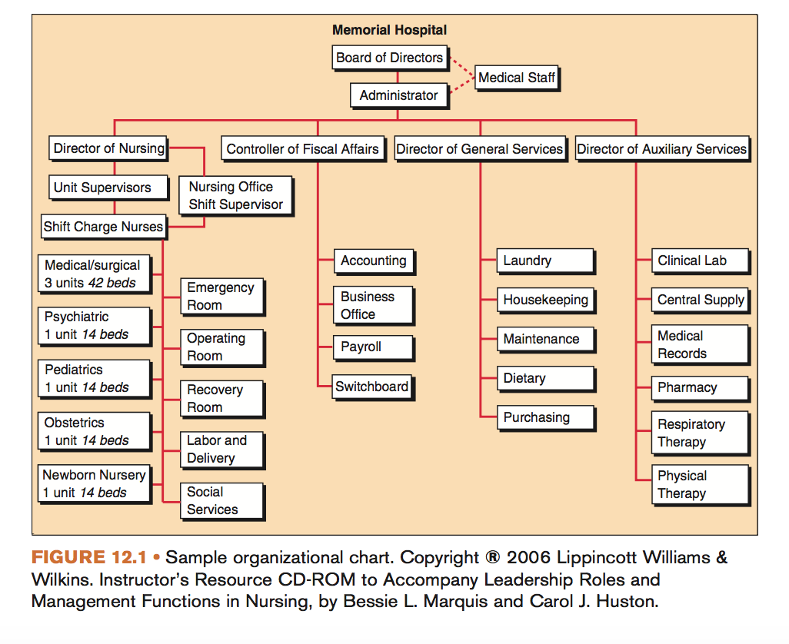

Slide 10
Dotted or broken lines on the organization chart represent staff positions. Because these positions are advisory, a staff member provides information and assistance to the manager but has limited organizational authority.
Advisory (staff) positions do not have inherent legitimate authority.
Unity of command is indicated by the vertical solid line between positions on the organizational chart. This concept is best described as ‘one person/one boss’ in which employees have one manager to whom they report and to whom they are responsible.
Unity of command is difficult to maintain in some large health-care organizations because the nature of health care requires an interprofessional approach.

Slide 12
Component OF Organizational Structure.. cont’..
2. Span of Control: can be determined from the organization chart. The number of people directly reporting to any one manager represents that manager’s span of control and determines the number of interactions expected of him or her.

Slide 13
The key difference between chain of command and span of control is that the chain of command refers to the levels of authority in a company whereas the span of control is the number of subordinates a manager is responsible for controlling

Slide 14
Component OF Organizational Structure.. cont’..
3. Managerial Levels: in large organizations, several levels of managers often exist
Top-level managers look at the organization as a whole, coordinating internal and external influences, and generally make decisions with few guidelines or structures. Examples of top-level managers include the organization’s chief operating officer or CEO and the highest level nursing administrator.
Middle-level managers coordinate the efforts of lower levels of the hierarchy and are the conduit between lower and top-level managers. Middle-level managers carry out day-to-day operations but are still involved in some long-term planning and in establishing unit policies. Examples of middle-level managers include nursing supervisors, nurse-managers, and unit managers.
First-level managers are concerned with their specific unit’s work flow. They deal with immediate problems in the unit’s daily operations, with organizational needs, and with personal needs of employees. First-level managers need good management skills. Because they work so closely with patients and health-care teams. Examples of first-level managers include, team leaders, case managers, and charge nurses.

Slide 15
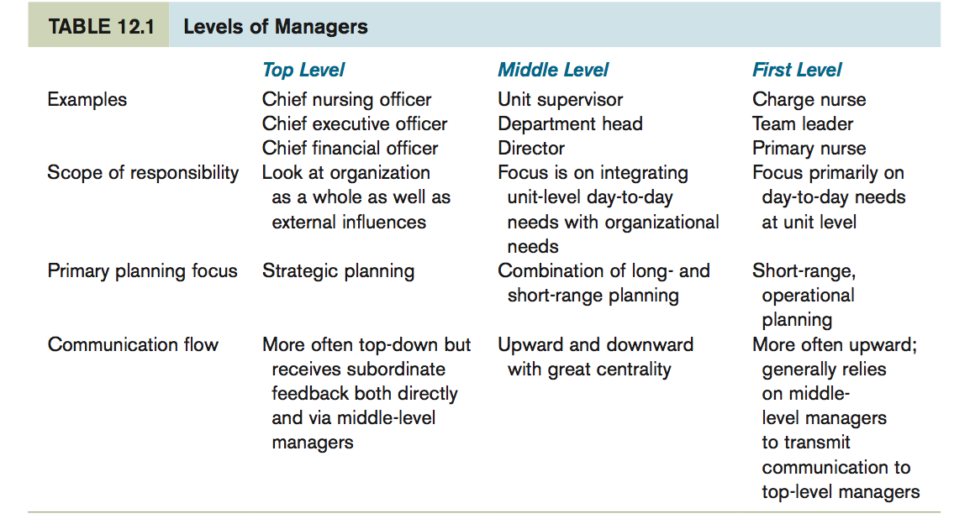

Slide 16
Component OF Organizational Structure.. cont’..
4. Centrality: refers to the location of a position on an organization chart where frequent and various types of communication occur.
Question: in your opinion, which level of management has large degree of centrality ?

Slide 17
A middle manager has a large degree of centrality because this manager receives information upward, downward, and horizontally.

Slide 18
The manager should understand the interrelationships and differences among these three items:
Authority: is defined as the official power to act. It is power given by the organization to direct the work of others. A manager may have the authority to hire, fire, or discipline others.
Responsibility: is a duty or an assignment. It is the implementation of a job.
Accountability: is similar to responsibility, but it is internalized. Thus, to be accountable means that individuals agree to be morally responsible for the consequences of their actions.

Slide 19
DECISION MAKING WITHIN THE ORGANIZATIONAL HIERARCHY
In organizations with centralized decision making, a few managers at the top of the hierarchy make the decisions and the emphasis is on top-down control.
In other words, the vision or thinking of one or a few individuals in the organization guides the organization’s goals and how those goals are accomplished.

Slide 20
Decentralized decision making diffuses decision making throughout the organization and allows problems to be solved by the lowest practical managerial level.
Often, this means that problems can be solved at the level at which they occur.
although some delays may occur in decision making if the problem must be transmitted through several levels to reach the appropriate individual to solve the problem

Slide 21
In general, the larger the organization, the greater the need to decentralize decision making.

Slide 22
ORGANIZATIONAL CULTURE
Organization culture is the total of an organization’s values, language, traditions, customs, and those few things present in an institution that are not open to discussion or change.
For example, the hospital logo that had been designed by the original board of trustees is an item that may not be considered for updating or change.
Organizational culture is a system of symbols and interactions unique to each organization. It is the ways of thinking, behaving, and believing that members of a unit have in common.

Slide 23
Organizational culture should not, however, be confused with organizational climate— how employees perceive an organization.
For example, an employee might perceive an organization as fair, friendly, and informal or as formal and very structured. The perception may be accurate or inaccurate, and people in the same organization may have different perceptions about the same organization.
Therefore, since the organizational climate is the view of the organization by individuals, the organization’s climate and its culture may differ.

Slide 24
Stakeholders
Stakeholders are those entities in an organization’s environment that play a role in the organization’s health and performance or that are affected by the organization. Stakeholders may be both internal and external, they may include individuals and large groups, and they may have shared goals or diverse goals.

Slide 25
Types of organizational structure
Line Structures
Ad Hoc Design
Matrix Structure
Service Line Organization
Flat Designs
Assignment

Slide 26
