Slide 1
CHAPTER 4
Further Compound Interest Functions

Slide 2
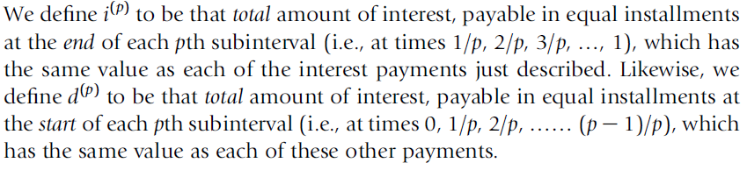
4.1 INTEREST PAYABLE pTHLY

Slide 3
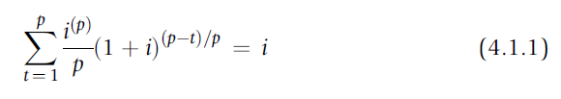
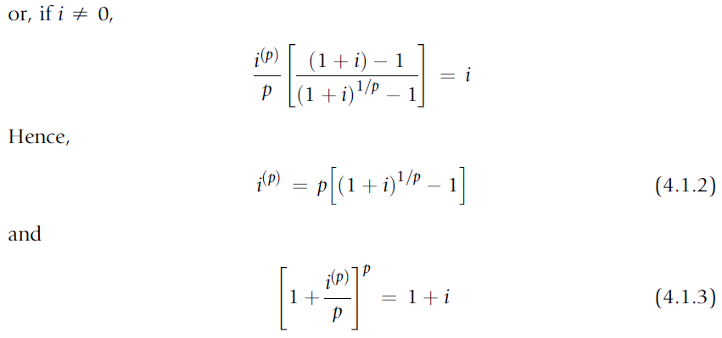
4.1 INTEREST PAYABLE pTHLY

Slide 4
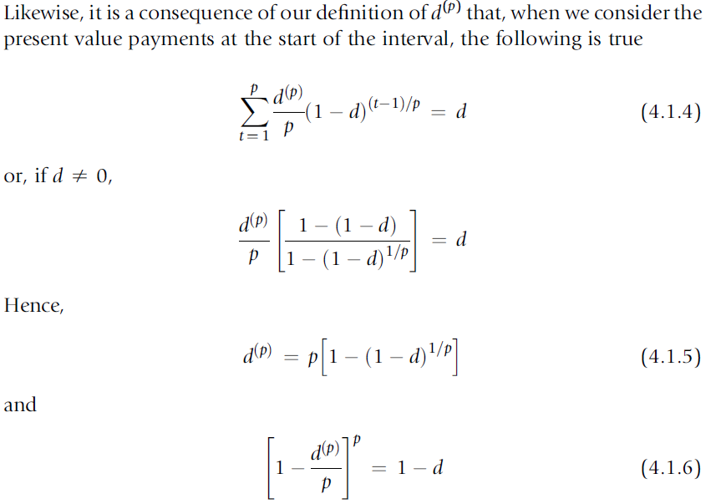
4.1 INTEREST PAYABLE pTHLY

Slide 5

4.1 INTEREST PAYABLE pTHLY
If the nominal rate of interest convertible quarterly is $i^{(4)}$ = 12% per annum, the effective rate per annum is $i^{}$= 12:5509%:

Slide 6
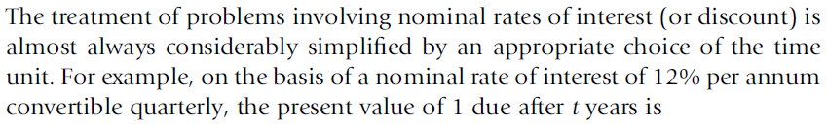
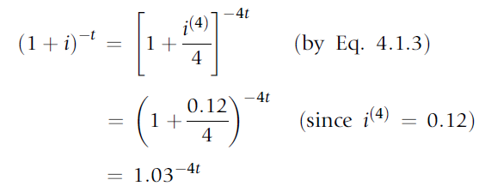
4.1 INTEREST PAYABLE pTHLY

Slide 7
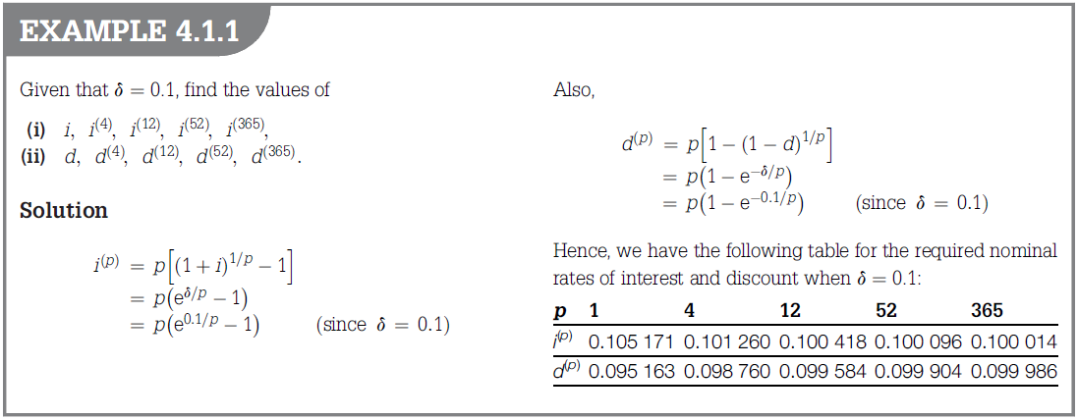

Slide 8
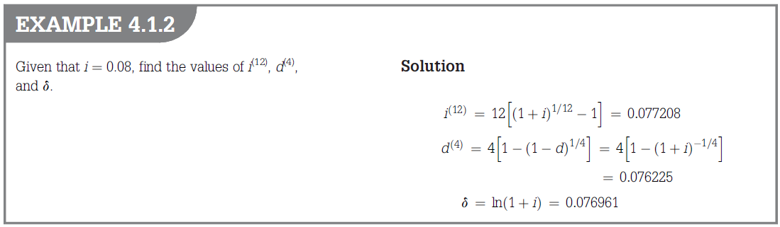

Slide 9
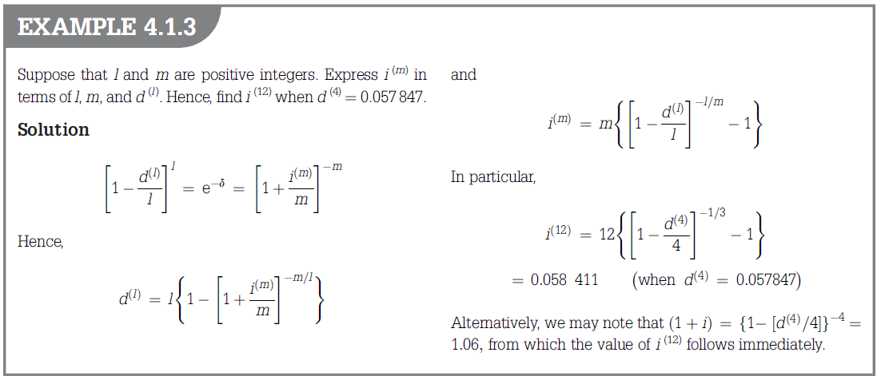

Slide 10
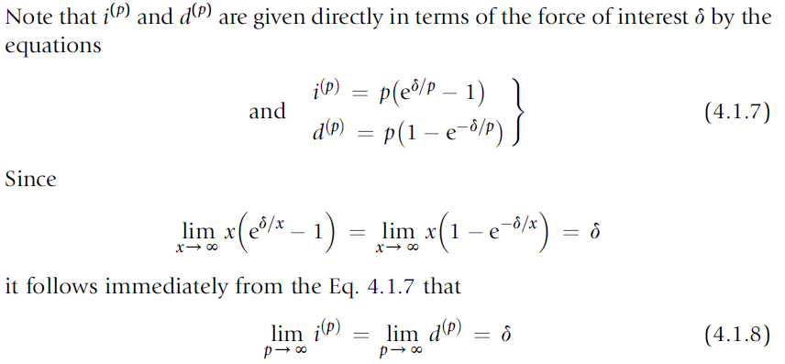
4.1 INTEREST PAYABLE pTHLY

Slide 11
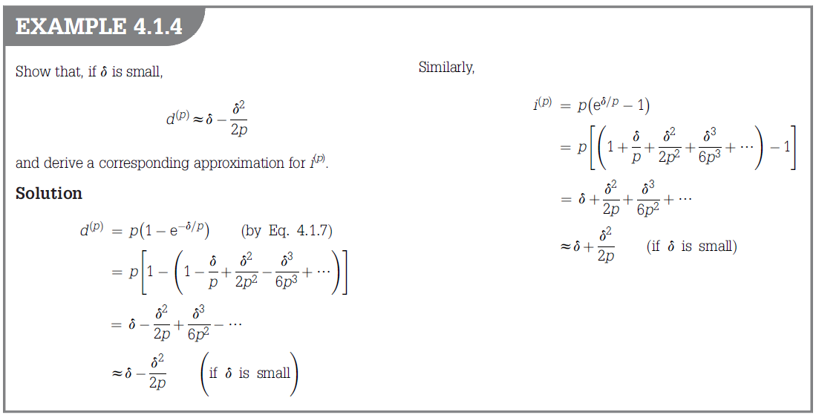
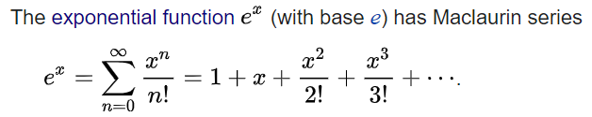

Slide 12
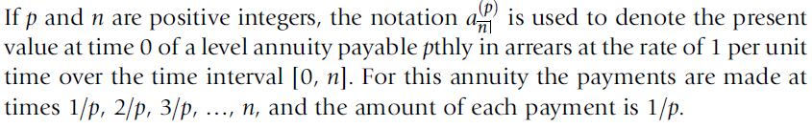

4.2 ANNUITIES PAYABLE pTHLY: PRESENT VALUES AND ACCUMULATIONS

Slide 13
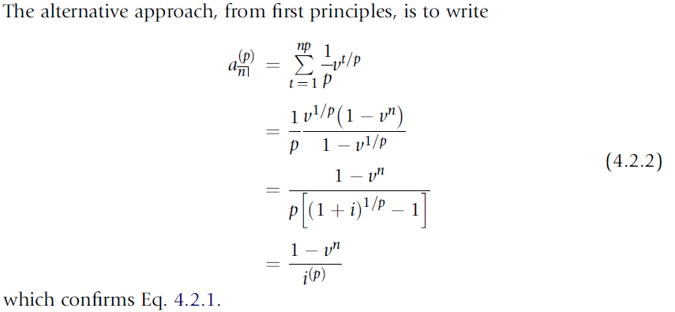
4.2 ANNUITIES PAYABLE pTHLY: PRESENT VALUES AND ACCUMULATIONS

Slide 14
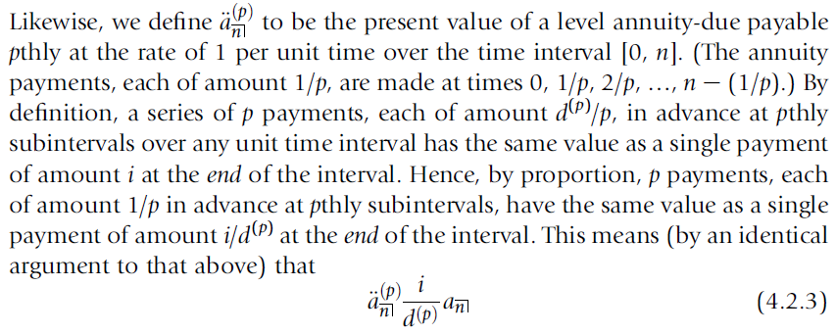

4.2 ANNUITIES PAYABLE pTHLY: PRESENT VALUES AND ACCUMULATIONS
=

Slide 15
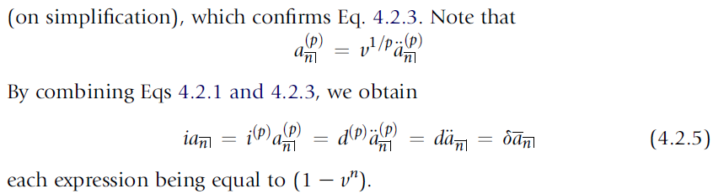
4.2 ANNUITIES PAYABLE pTHLY: PRESENT VALUES AND ACCUMULATIONS

Slide 16
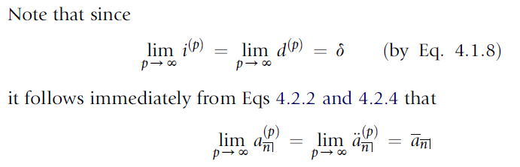
4.2 ANNUITIES PAYABLE pTHLY: PRESENT VALUES AND ACCUMULATIONS

Slide 17
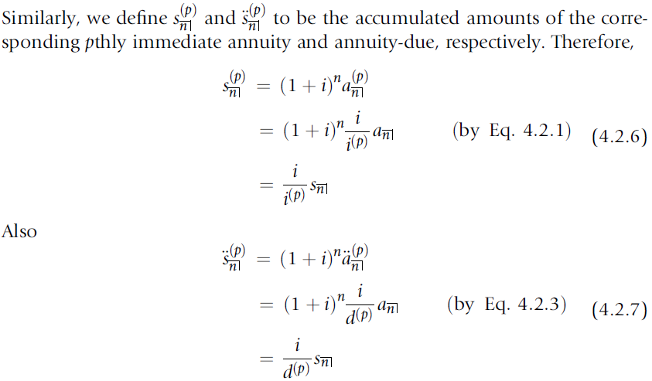
4.2 ANNUITIES PAYABLE pTHLY: PRESENT VALUES AND ACCUMULATIONS

Slide 18
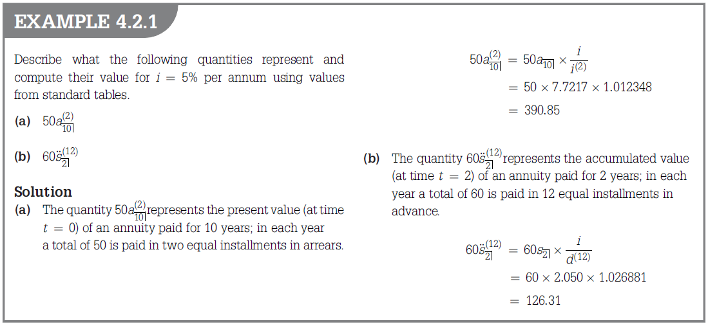

Slide 19
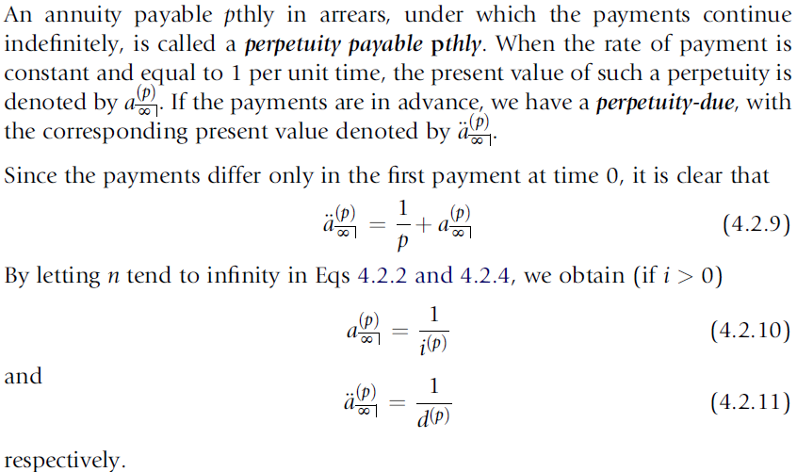
4.2 ANNUITIES PAYABLE pTHLY: PRESENT VALUES AND ACCUMULATIONS

Slide 20
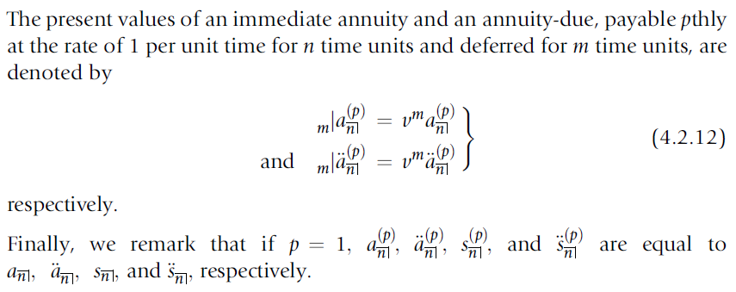
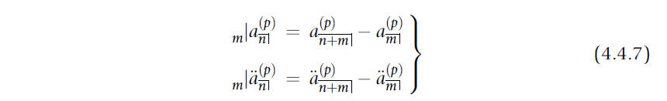
4.2 ANNUITIES PAYABLE pTHLY: PRESENT VALUES AND ACCUMULATIONS

Slide 21

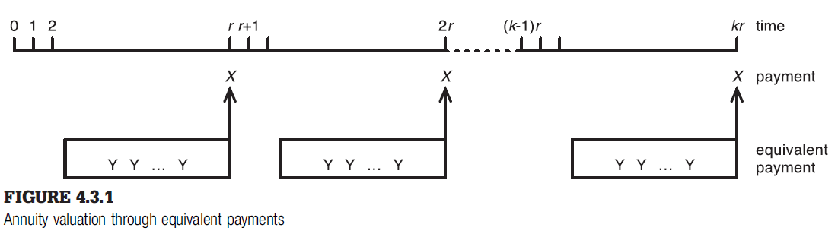
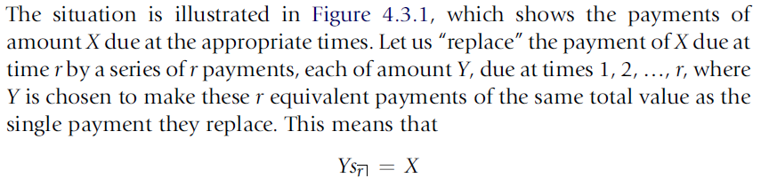
4.3 ANNUITIES PAYABLE AT INTERVALS OF TIME r, WHERE r > 1

Slide 22
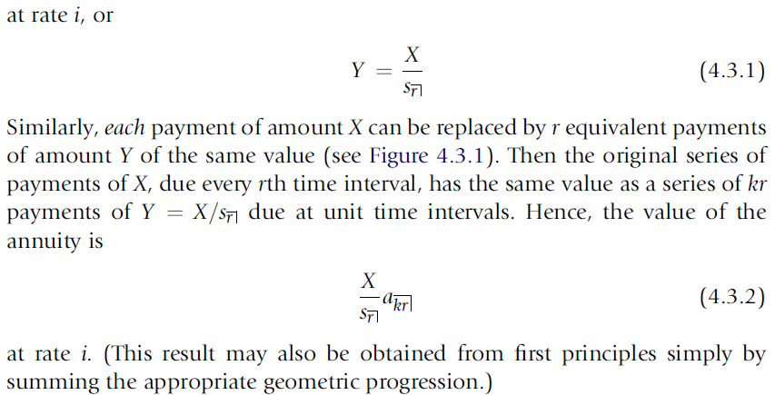
4.3 ANNUITIES PAYABLE AT INTERVALS OF TIME r, WHERE r > 1

Slide 23
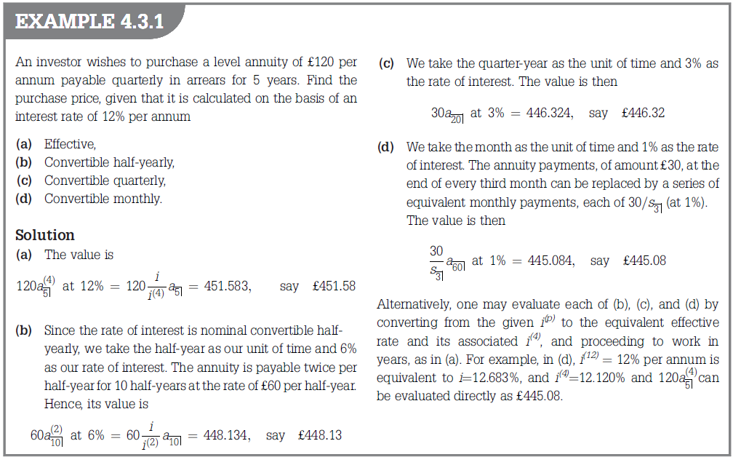

*C

Slide 24
