Slide 1
Physical Pharmacy
States Of Matter

Slide 2
Inrtoduction
Definition
Physical pharmacy uses the knowledge of mathematics, physics and chemistry and applies them to the pharmaceutical dosage form development
Aim:
Enable the pharmacist to make rational decisions on scientific basis concerning the art and technology of tablets, solutions, suspensions, emulsions, etc. formulation and stabilization

Slide 3
Examples
Tablet compaction and hardness/ friability depends on attraction forces
Tablet formulation (How)
Emulsion stabilization
Suspension (wetting/viscosity and rheology)
Drug release and mechanisms (how to study)
Solubility how?

Slide 4
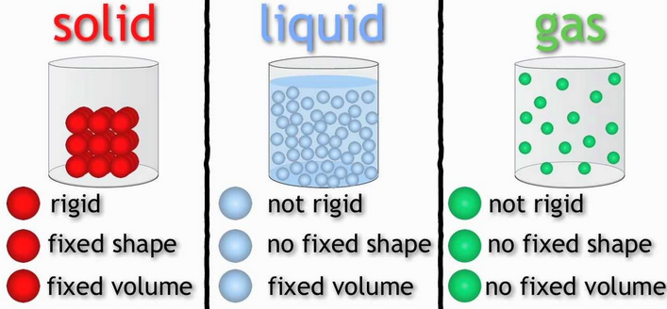
Binding Forces Between Molecules
Binding forces can be divided into
Intermolecular forces (betweenmolecules) and intramolecular forces (ex: covalent)
For a molecule to occur in any state of matter (Solid, Gas, Liquid) Intermolecular forces must exist
intermolecular (between molecules) bonding is largely governed by electron orbital interactions.and can be divided to:
1- Cohesion: the attraction of like molecules
2- Adhesion The attraction of unlike like molecules or the attraction of unlike molecules.

Slide 5
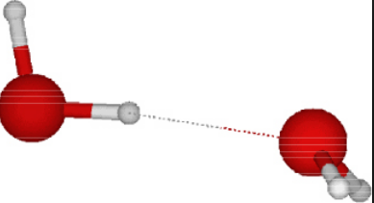
Repulsion Forces Between Molecules
Repulsion is a reaction between two molecules that forces them apart.
For molecules to interact, these forces must be balanced in an energetically favored arrangement.
Energetically favored a term used to describe the intermolecular distances and intermolecular conformations on the basis of the balancing of attractive and repulsive forces
Notes:
Not attraction nor repulsion prevail

Slide 6
Binding Forces Between
Molecules
If the molecules are moved slightly in any direction, the stability of the interaction will change by either
a decrease in attraction (when moving the molecules away from one another)
or an increase in repulsion (when moving the molecules toward one another).

Slide 7
Importance of intermolecular Forces:
Knowledge of these forces and their balance (equilibrium) is important for understanding not only the
properties of gases, liquids, and solids,
but also interfacial phenomena,
flocculation in suspensions,
stabilization of emulsions,
compaction of powders in capsules, dispersion of powders or liquid droplets in aerosols, and the compression of granules to form tablets

Slide 8
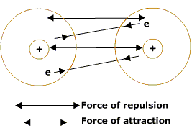
Intermolecular Repulsive and Attractive Forces
Were they do come from?
Repulsion is due to the electronic clouds of molecules and increases rapidly with a decrease in distance between the molecules.
Attraction
between opposite charges
Thus, attractive forces are necessary for molecules to cohere, whereas repulsive forces act to prevent the molecules from interpenetrating and annihilating each other

Slide 9
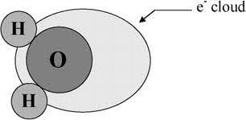
Repulsion is due to the interpenetration of the electronic clouds of molecules and increases exponentially with a decrease in distance between the molecules.
At a certain equilibrium distance, about (3-4) × 10⁻⁸ cm (3–4 Å), the repulsive and attractive forces are equal At this position, the potential energy of the two molecules is a minimum and the system is most stable

Slide 10
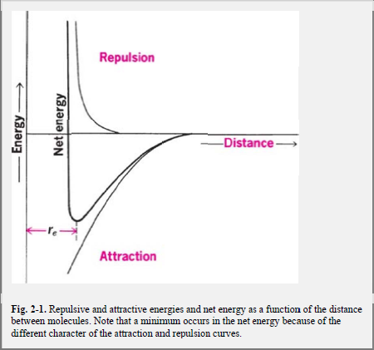
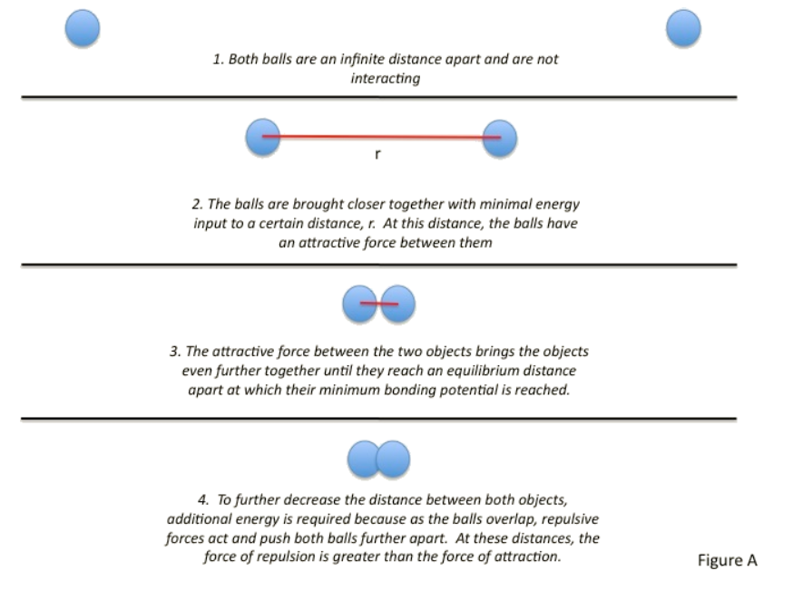
Lennard-Jones potential

Slide 11
Attractive Intermolecular forces
1- Van der Waals Forces
Van der Waal interactions are weak forces that involve the dispersion of charge across a molecule called a dipole
It involves charge-charge inter action of molecules (No Ionic bonding)
1- Keesom forces
2- Debye forces
3- London forces

Slide 12
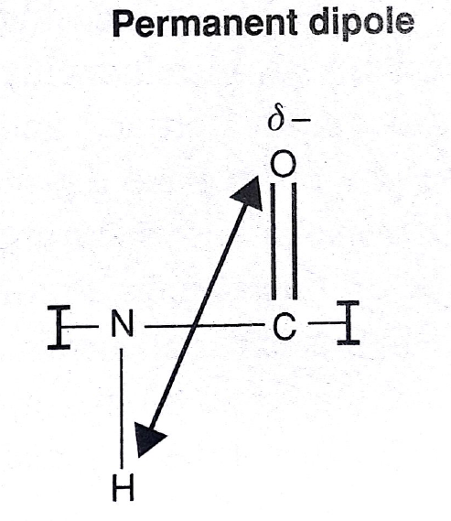

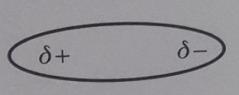
Permanent Dipole
Peptide bond
Electro negative oxygen attracts pair of electron in carbon double bond , C-N and N-H and nitrogen towards itself
Resulting in partial positive charge on the Hydrogen

Slide 13
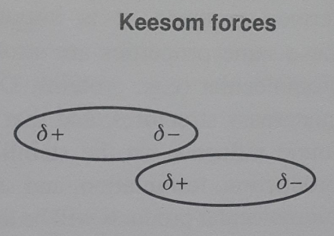
Keesom Forces
(Dipole-Dipole)
Due to partial charges
Atoms Interact with each
Other in a weak ionic way
The positive pole of one atom attract the negative pole of the other one resulting in a weak attraction
(
Notes:
orientaion forces= keesom force

Slide 14
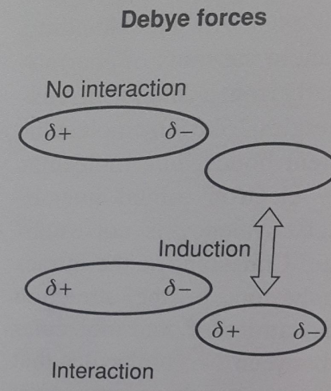
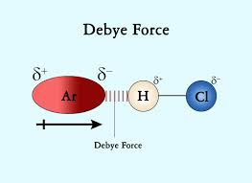
Debye Forces
(Dipole-Induced dipole)
A perminant dipole is capable of inducing a charge (polarizing) in a nearby molecules resulting in an induced dipole

Slide 15
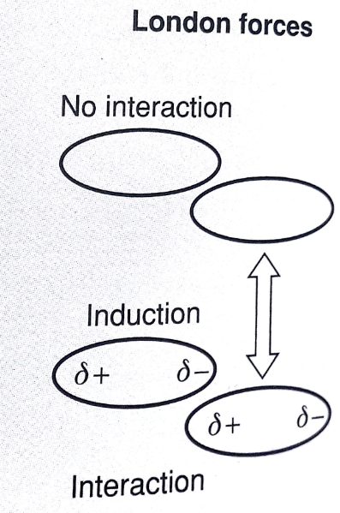
London Forces (induced dipole-induced dipoles interaction)”dispersion forces”
Two neutral neighboring molecules can induce partial charge distribution
a temporary attractive force that results when the electrons in two adjacent atoms occupy positions that make the atoms form temporary dipoles.
London forces are the attractive forces that cause nonpolar substances to condense to liquids and to freeze into solids when the temperature is lowered sufficiently.

Slide 16
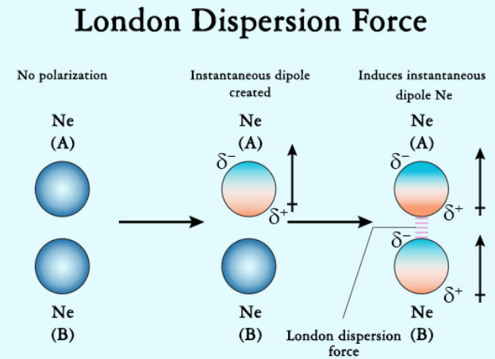
electron density in a molecule becomes redistributed in proximity to another molecule

Slide 17
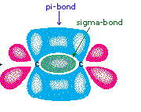
Orbital Overlap
Important Dipole-Dipole Interaction between pi (π) orbitals in an aromatic system
For a c=c double bond
1st bond is called sigma bond (Orbitals overlaps horizontally with plane to form first covalent bond
2nd bond will be Pi bond (Orbitals are projecting vertically out of plane to form a 2nd weaker covalent bond) involves p-orbitals only

Slide 18
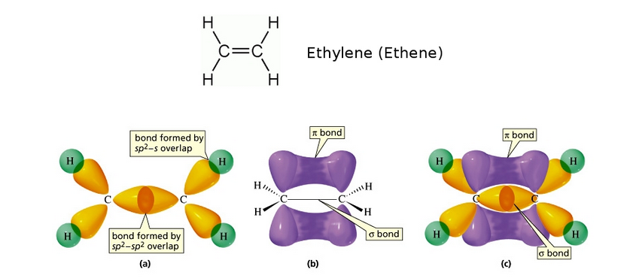

Slide 19



Carbon atom Sp³ hybridizatio)
Carbon electeron configuration
(atomic number 6)
To make 4 bonds hybridization occur
+> CH4 not CH2

Slide 20

Carbon atom Sp² hybridization)
Example Ethene (C2H4)
Always one π (pi) bond is required for the double bond
Pi- bond occurs between P- orbitals
In SP³ hybridization no P orbitals only SP³
hybridized orbital can give rise to sigma
bonding
For C=C to occur a SP² (hybrid. Occur)
SP³ Hybrid

Slide 21
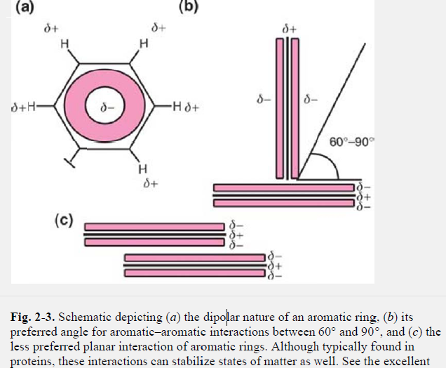
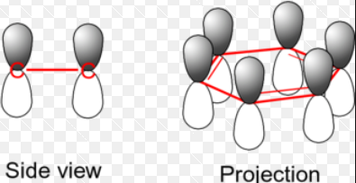
Orbital overlap (aromatic compounds)
Dipole –Dipole interaction
Between pi- electrons
Aromatic rings are dipolar
Having a partial –ve charge on the pi- electrons projecting out of plane and a +ve partial charge on hydrogen

Slide 22
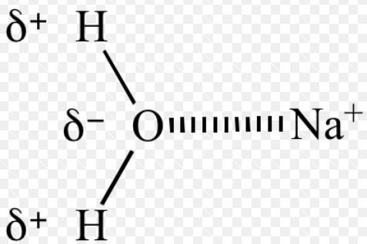
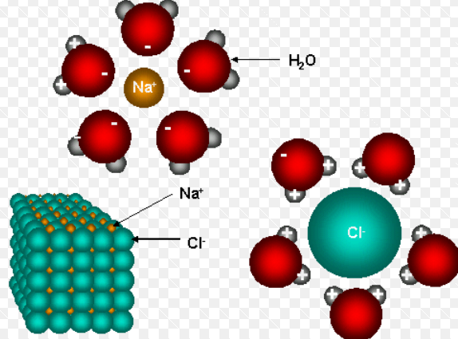
Ion Dipole and Ion-induced dipole forces
Ion Dipole Interaction
In addition to the dipolar interactions known as van der Waals forces, other attractions occur between polar or nonpolar molecules and ions
Account for solubility of ionic crystalline substance in water
Ex: the cation, attracts the relatively negative oxygen
Notes:
Na= 11

Slide 23
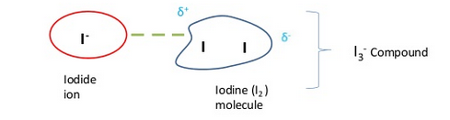

Ion Dipole and Ion-induced dipole forces
ion-induced dipole attraction is a weak attraction that results when the approach of an ion creates a dipole in a non-polar atom
Ion induced dipole responsible for solubility of I2 in a solution of KI(Potassium iodide)
Non Polar I2 is polarized(dipole Induced) when approaching the iodide electron cloud=> Weak attraction
Soluble Complex

Slide 24
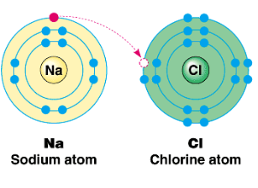
Ion-Ion Interaction(Not Ionic bonding)
Ionic bond between counter ions is the strongest bond
Ion-ion interaction exist in salt system were a cataion from one compound will interact with anion from another compound and causes attraction
Also repulsive forces from same charged ions exists (Balance between repulsive and attractive forces determines the bond’s Strength)
crystal habit, solubility, polymorph
Ionic bond not (ion-ion interaction
Due to different number of electrons and protons Na+ will have a +ve charge

Slide 25
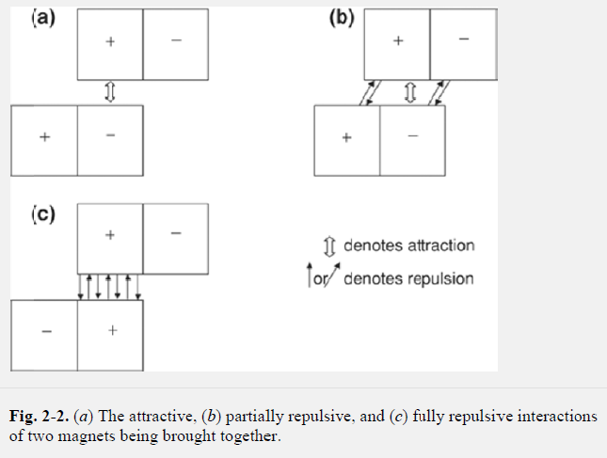
Ion-Ion Interaction (like magnets)

Slide 26
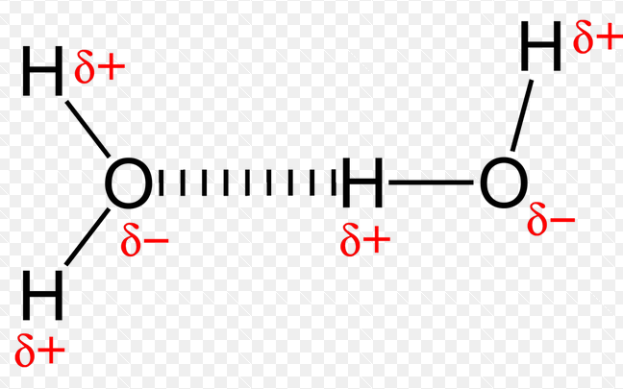
Hydrogen bonding
Interaction between a molecule containing a hydrogen and a strong electronegative atom like Flourine, Oxygen, Nitrogen
Example in water and ice:
Hydrogen bond
Accounts for some water properties
Low vapor pressure , high boiling point

Slide 27
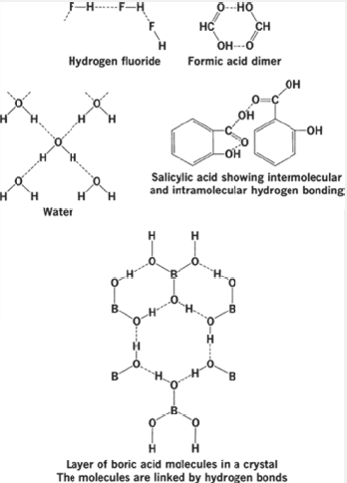
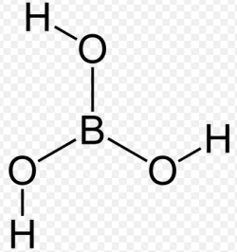
Hydrogen bonding
Found also in alcohols
Carboxylic acids
Esters, Polypeptides
Boric Acid
Notes:
RO-C=O
R

Slide 28
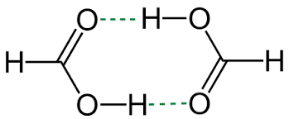
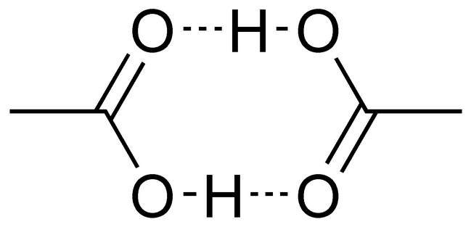
Hydrogen bonding
Formic acid and acetc acid can form dimers because the hydrogen bond is so strong (can exist even in vapor state)
Formic Acid Dimer
Acetic acid dimer
Notes:
Dimers are a molecule or molecular complex consisting of two identical molecules linked together. (cyclic)

Slide 29
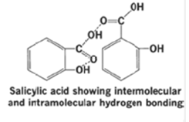
Hydrogen bonding
The hydrogen fluoride exist in vapor state as Hydrogen flouride polymer. (F----H)n
n can have a value up to 6
For Salicylic acid inter and inra molecular bonding occur

Slide 30
Bond energies
Measure of the strength of bond (energy needed to break the bond)
Hydrogen bond (2-8 Kcal/mole)
Covalent 50-100 Kcal/mole
Ionic bond > 100 kcal/mole
London forces is the weakest

Slide 31
