Slide 1
Multithreading and Parallel Programming In Java
By Samer Zein, PhD

Slide 2
introduction
Multithreading enables multiple tasks in a program to be executed concurrently
One of the powerful features of Java is its built-in support for multithreading—the concurrent running of multiple tasks within a program.
A program may consist of many tasks that can run concurrently.
A thread is the flow of execution.
A thread provides the mechanism for running a task. With Java, you can launch multiple threads from a program concurrently.
These threads can be executed simultaneously in multiprocessor system, from beginning to end, of a task.

Slide 3
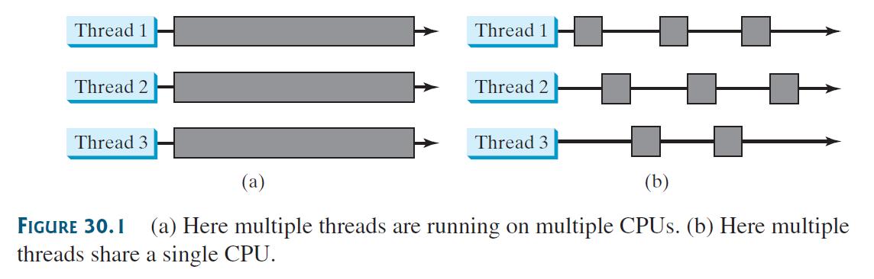
Example Execution of threads
Multithreading can make your program more responsive and interactive, as well as enhance performance.
For example, a good word processor lets you print or save a file while you are
typing.
In some cases, multithreaded programs run faster than single-threaded programs even on single-processor systems

Slide 4
Creating tasks and threads
A task class must implement the Runnable interface. A task must be run from a thread.
Tasks are objects. To create tasks, you have to first define a class for tasks, which implements the Runnable interface.
The Runnable interface is rather simple, All it contains is the run method

Slide 5
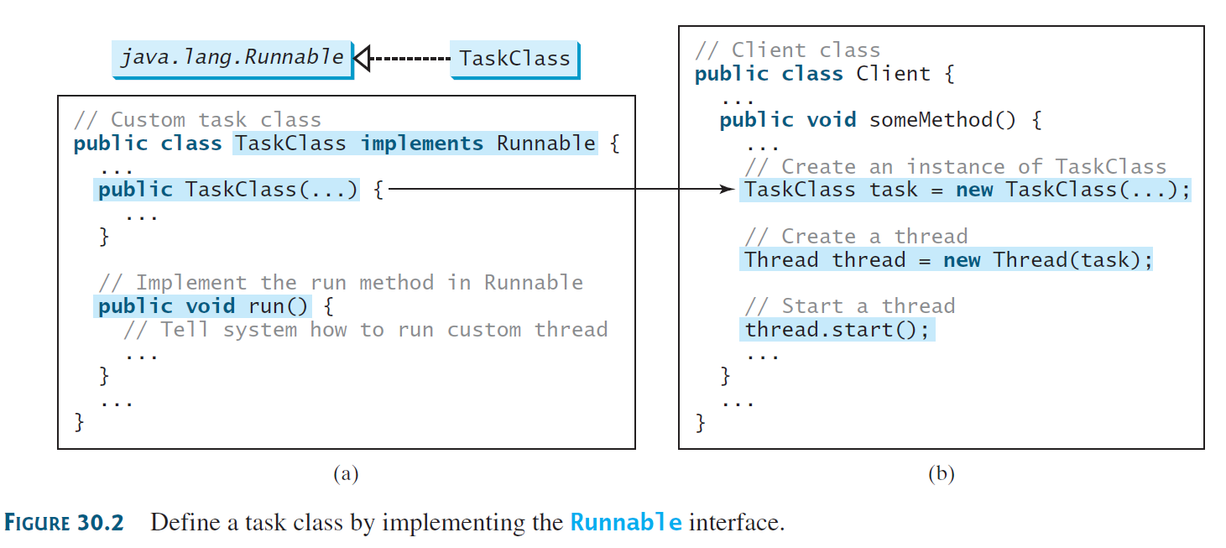
Example for task and thread

Slide 6
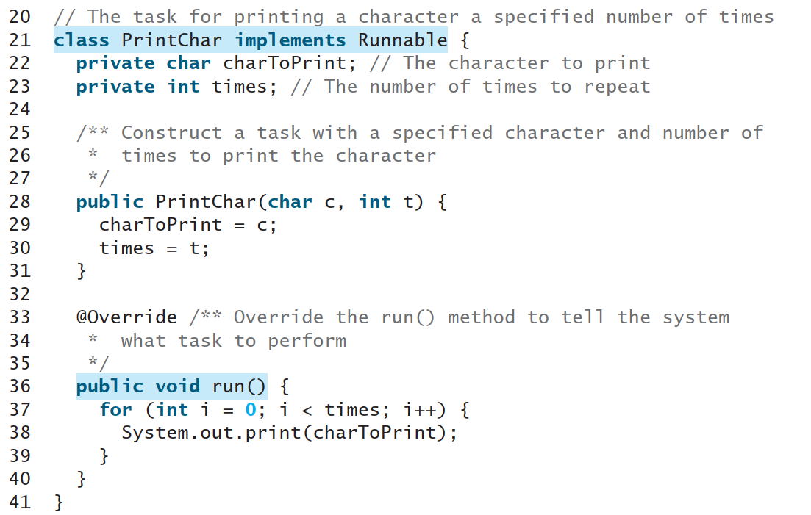

Slide 7
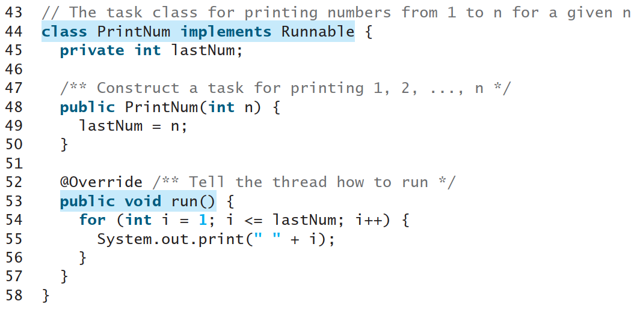

Slide 8
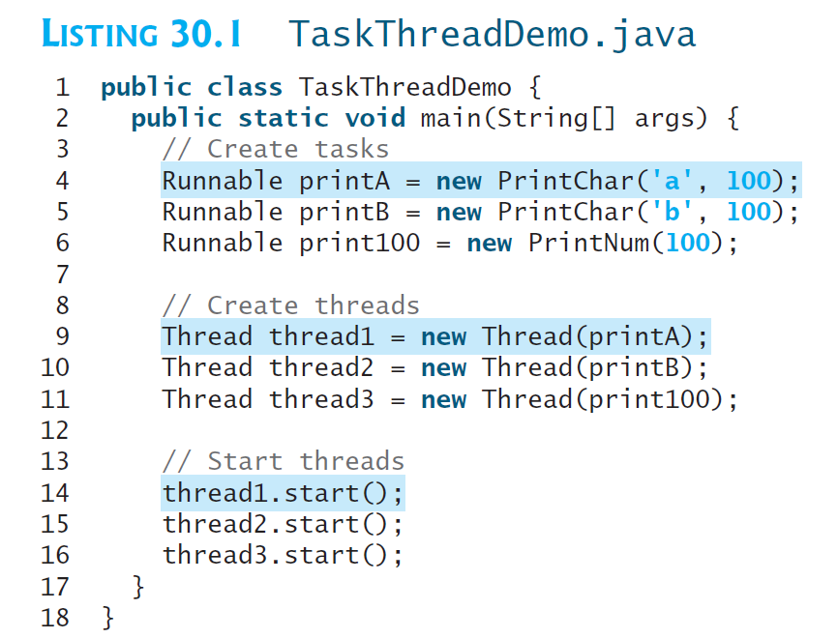

Slide 9
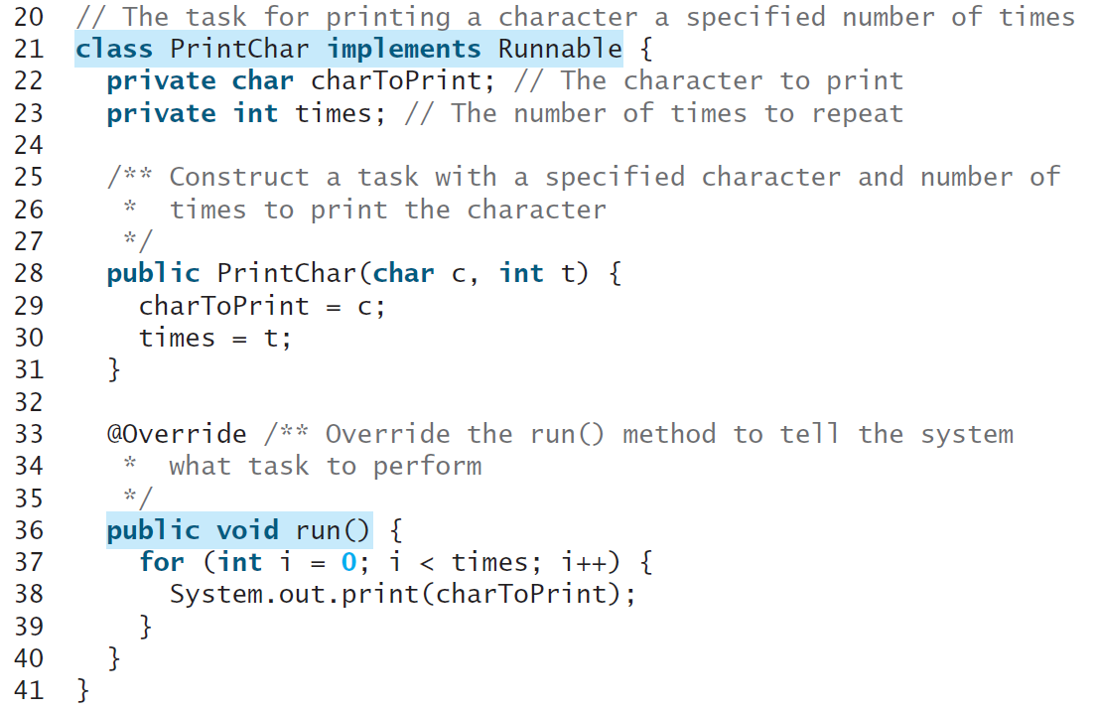
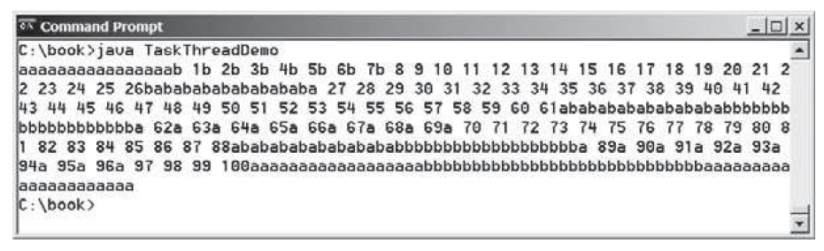
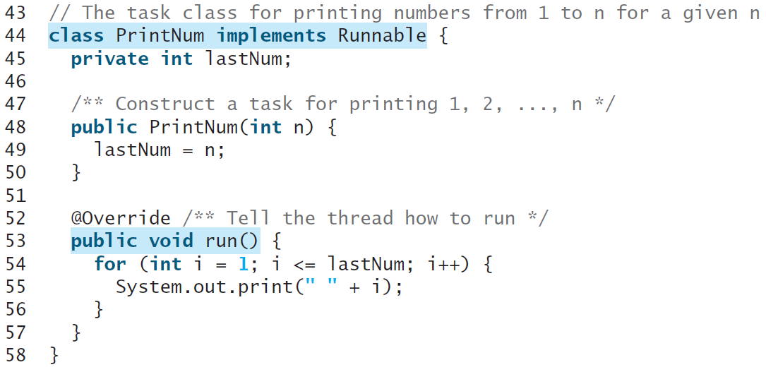

Slide 10
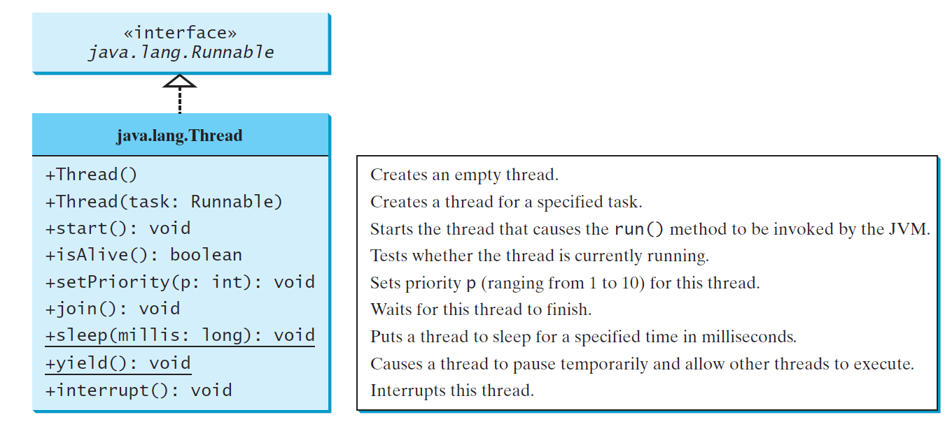
The thread class

