Slide 1
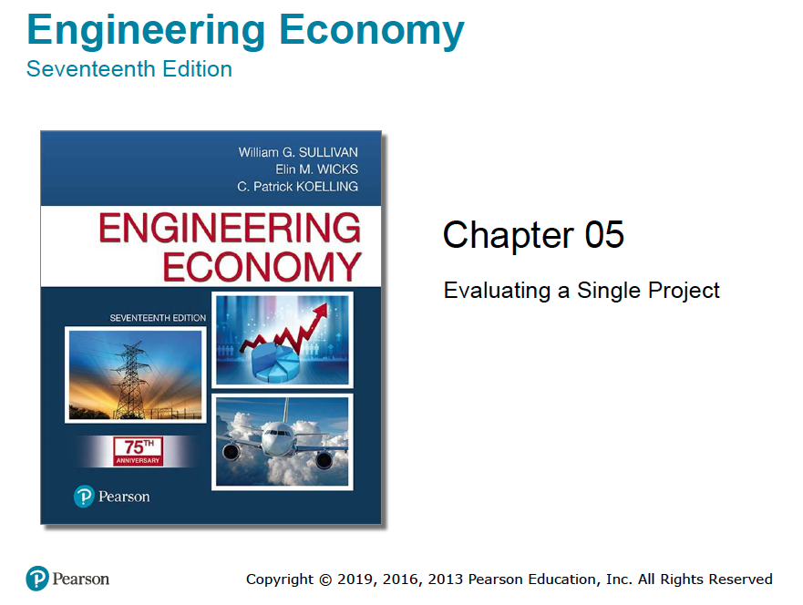

Slide 2
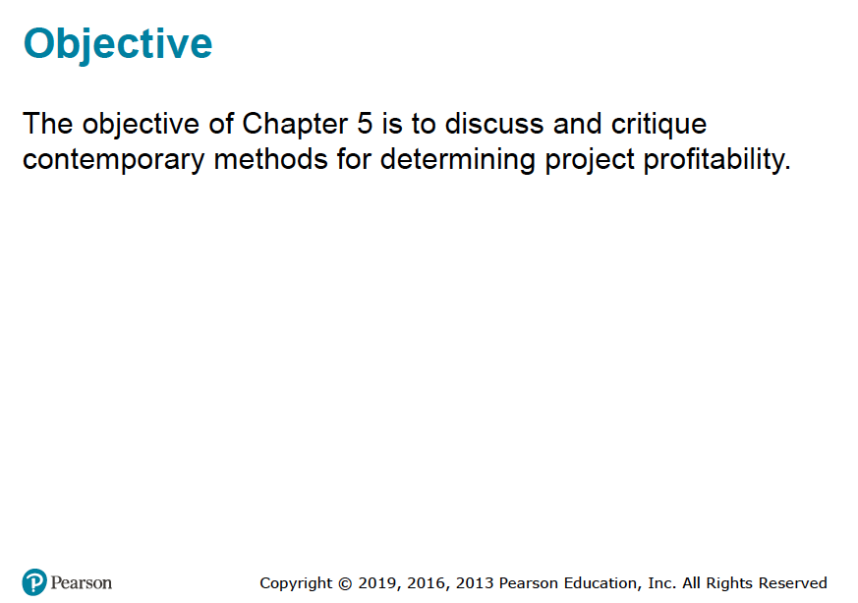

Slide 3
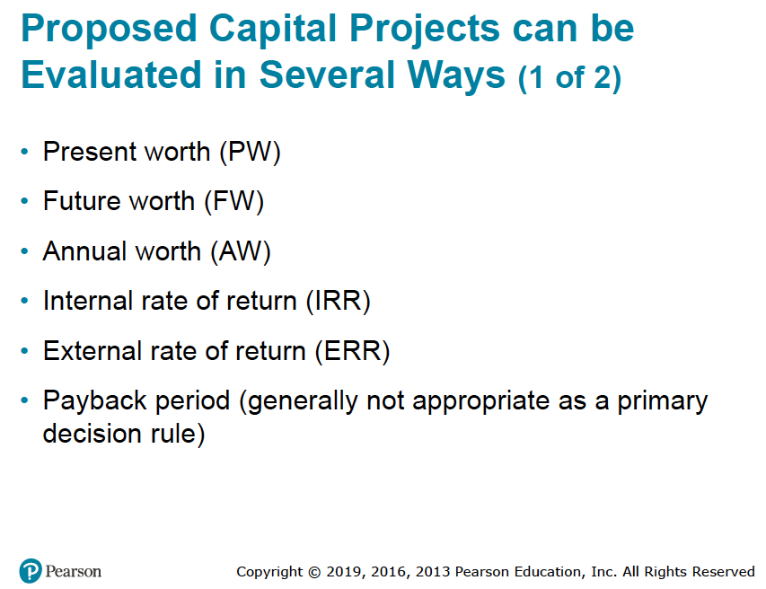

Slide 4
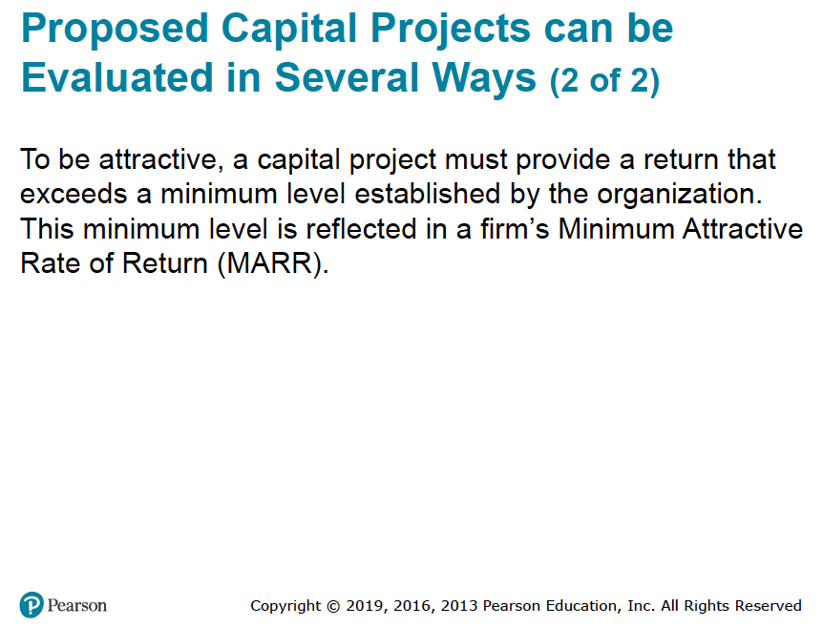

Slide 5
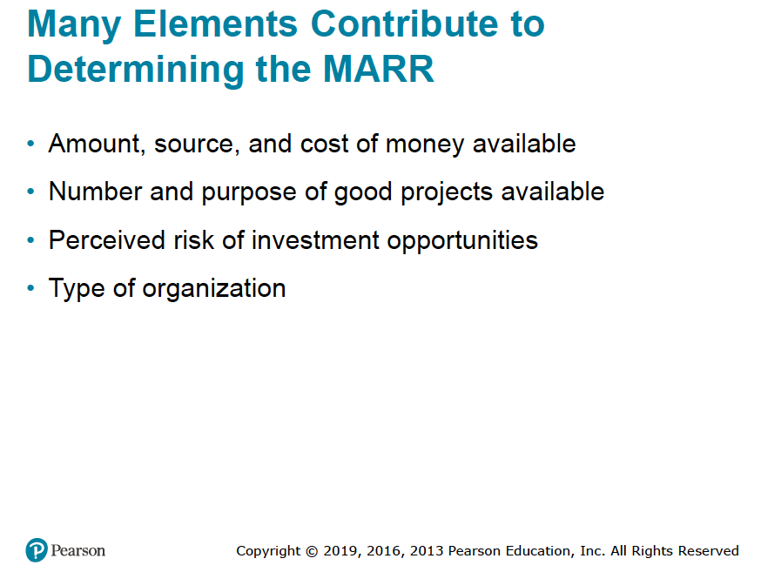

Slide 6
MARR
In theory, the MARR, which is sometimes called the hurdle rate, should be chosen to maximize the economic well-being of an organization, subject to the types of considerations just listed above.
How an individual firm accomplishes this in practice is far from clear-cut and is frequently the subject of discussion.
One popular approach to establishing a MARR involves the opportunity cost viewpoint described in Chapter 2, and it results from the phenomenon of capital rationing.
This situation may arise when the amount of available capital is insufficient to sponsor all worthy investment opportunities.
The subject of capital rationing is covered in Chapter 13.

Slide 7
MARR
A simple example of capital rationing is given in Figure 5-1, where the cumulative investment requirements of seven acceptable projects are plotted against the prospective annual rate of profit of each.
Figure 5-1 shows a limit of $600 million on available capital.
In view of this limitation, the last funded project would be E, with a prospective rate of profit of 19% per year, and the rest rejected project is F (G is also rejected). In the case of project F, the MARR by the opportunity cost principle would be 16% per year.
By not being able to invest in project F, the firm would presumably be forfeiting the chance to realize a 16% annual return.
As the amount of investment capital and opportunities available change over time, the firm’s MARR will also change.

Slide 8
MARR
This means that the final project accepted for investment is a breakeven project, i.e. its PW = 0 and that it provides an IRR that is just equal to the discount rate or the MARR, and a profitability index of 1.
The optimal capital budget B* is determined whereby the IRR always equals the MCC for the last project undertaken.
The condition that must be met for any budget to be optimal is that IRR or the MARR = MCC.

Slide 9
MARR
Superimposed on Figure 5-1 is the approximate cost of obtaining the $600 million, illustrating that project E is acceptable only as long as its annual rate of profit exceeds the cost of raising the last $100 million.
As shown in Figure 5-1, the cost of capital will tend to increase gradually as larger sums of money are acquired through increased borrowing (debt) or new issuances of common stock (equity) due to the increase in the level of risk attached to extra projects.
Determining the MARR is discussed further in Chapter 13.

Slide 10
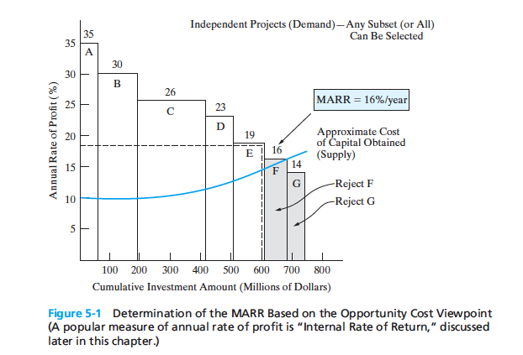



(WACC = MCC)
The optimal capital budget =$680 m
Where MARR = WACC

Slide 11
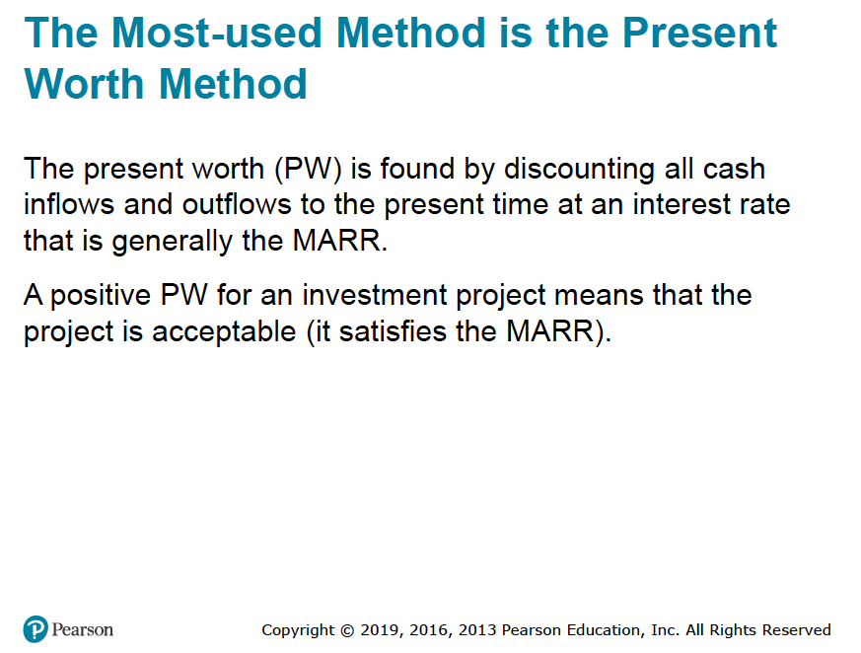

Slide 12
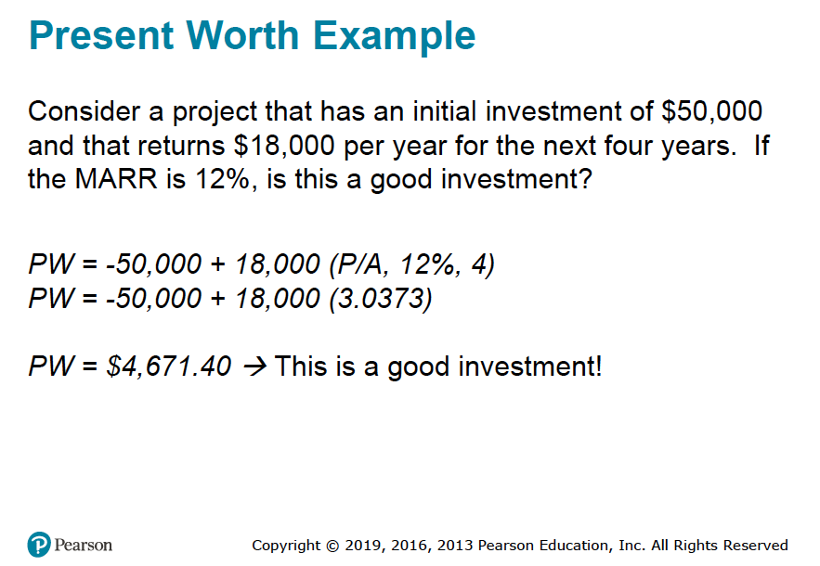



Slide 13

Assumptions and Critique of the PW Method
There are several noteworthy assumptions that we make when using PW to model the wealth-creating promise of a capital investment opportunity.
First, it is assumed that we know the future with certainty.
Regrettably, we don’t live in a certain world!.
For example, we presume to know with certainty future interest rates and other factors.
Second, it is assumed we can borrow and lend money at the same interest rate (i.e., capital markets are perfect).
Regrettably, the real world has neither certainty nor perfect (frictionless, e.g., no taxes and/or commissions) capital markets.

Slide 14

However …
The PW (and FW and AW, to follow) model is built on these seemingly restrictive assumptions.
But it is cost-beneficial in the sense that the cost of using the PW model is less than the benefits of improved decisions resulting from PW analysis.
More sophisticated models exist, but they usually do not reverse decisions made with the PW model.
Therefore, our goal is to cost-beneficially recommend capital investments that maximize the wealth of a firm to its owners (i.e., stockholders).
A positive-valued PW (and FW and AW) means that accepting a project will increase the worth, or value, of the firm.

Slide 15
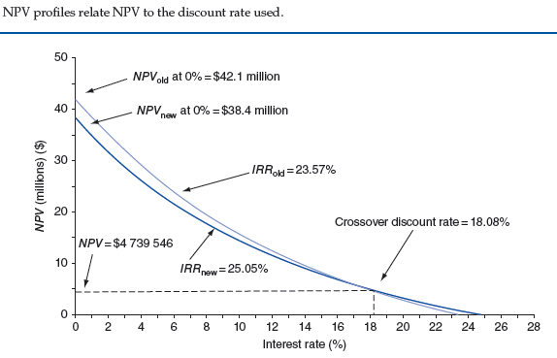
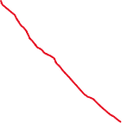




Slide 16
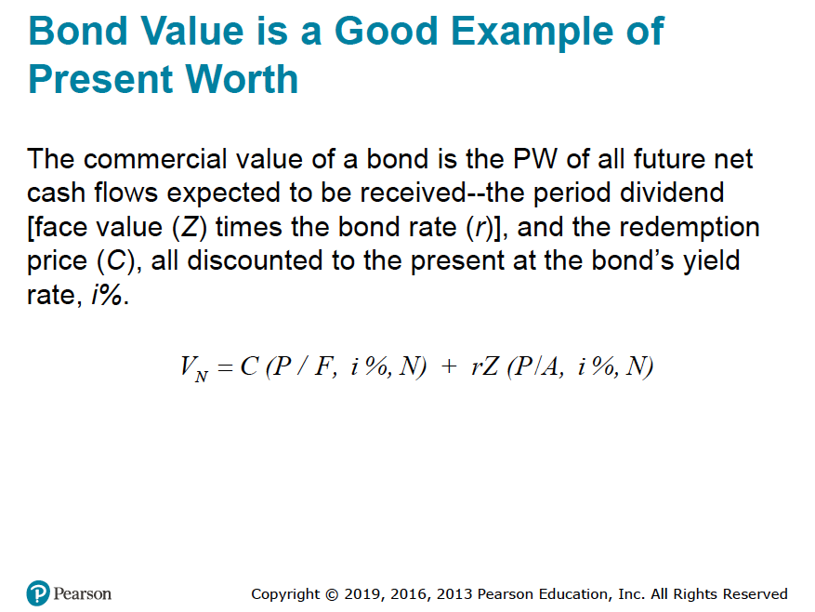



Slide 17
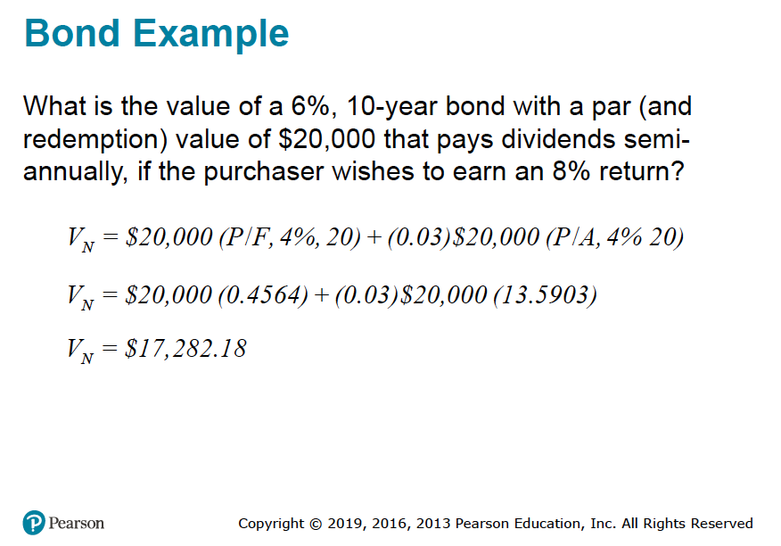





Slide 18
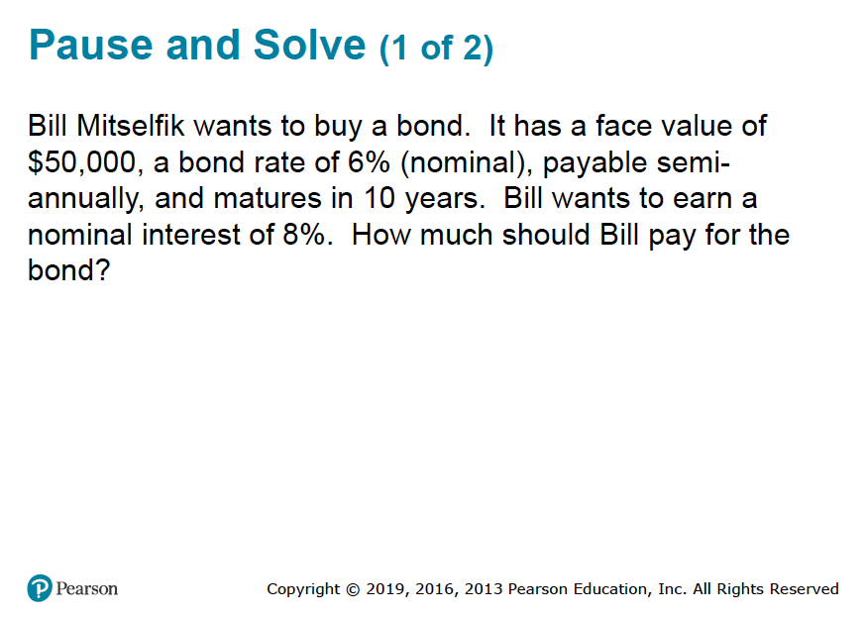

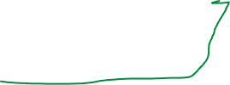

Slide 19
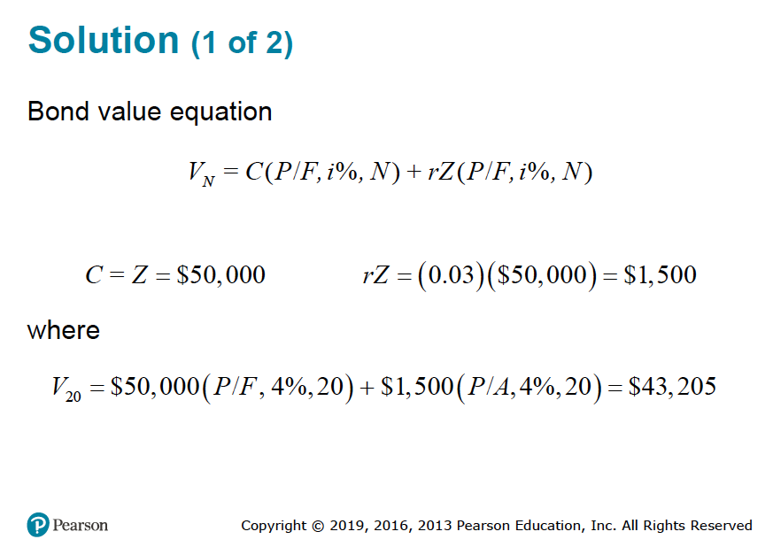



Slide 20
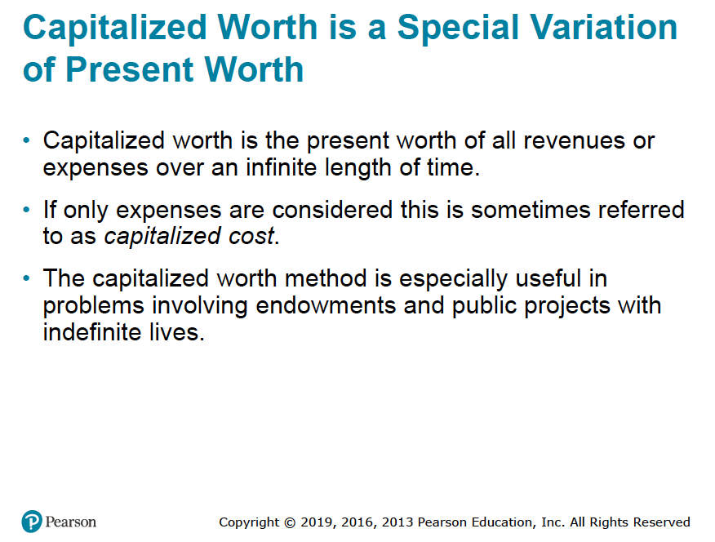

Slide 21
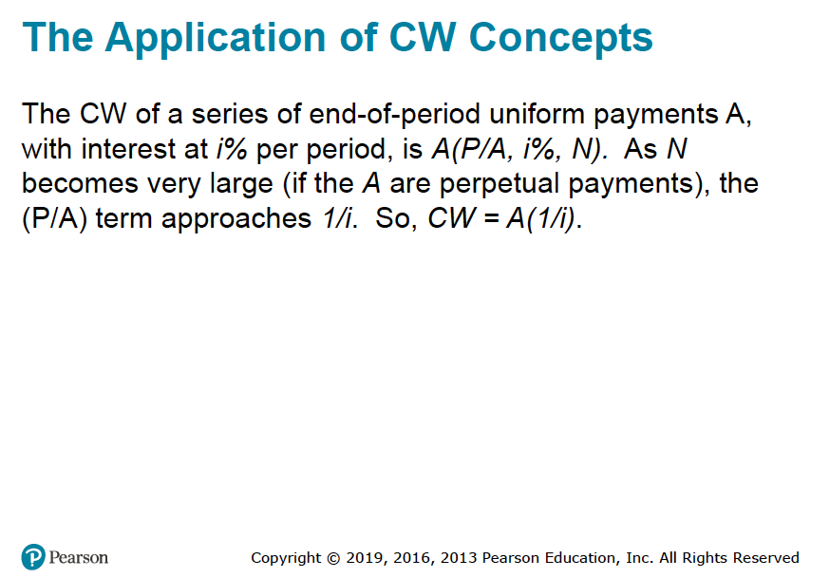


Slide 22
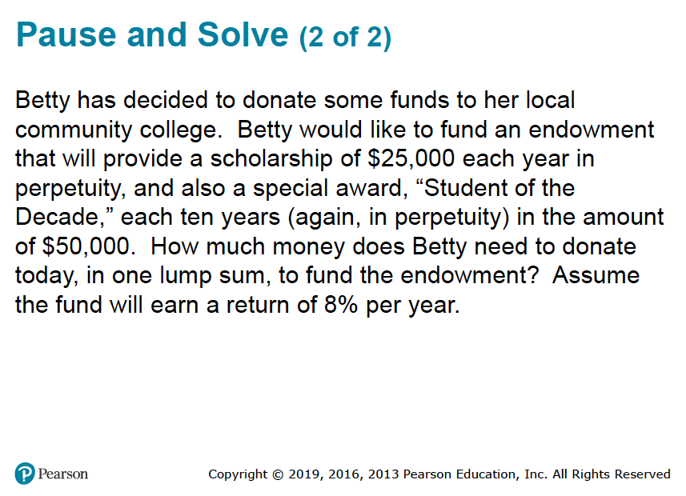

Slide 23
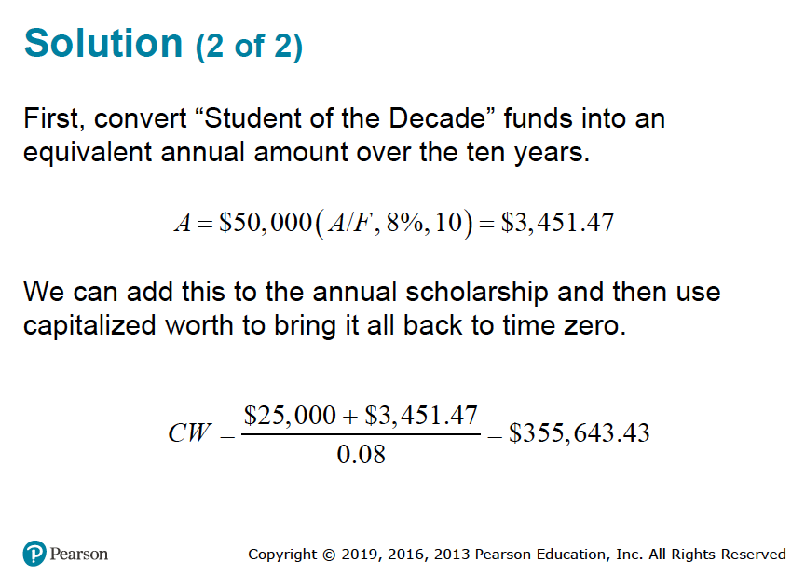




Slide 24
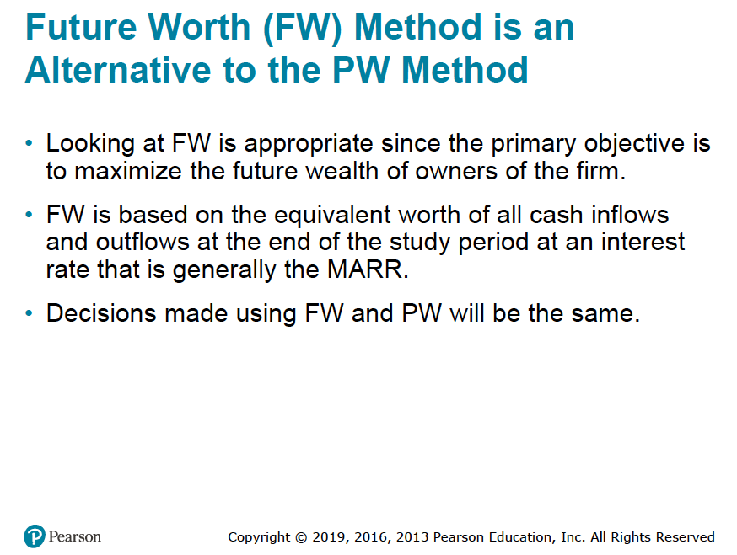

Slide 25
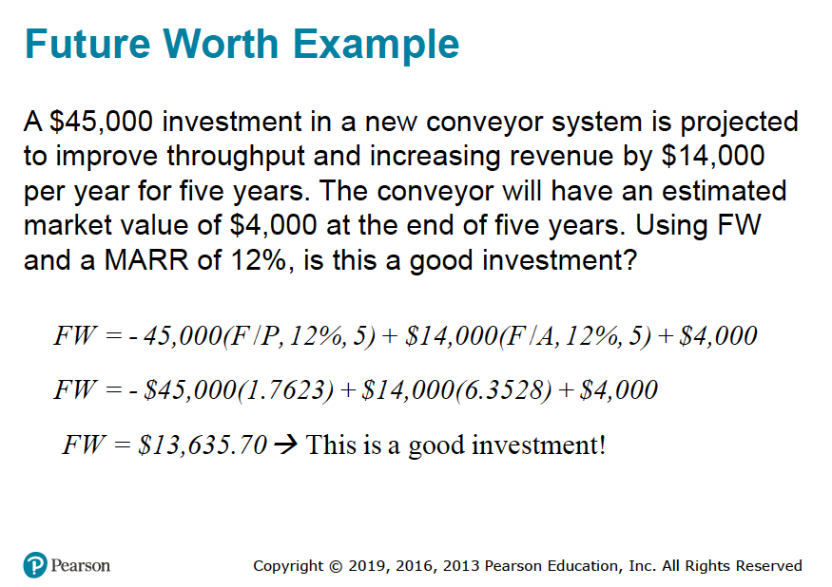



Slide 26
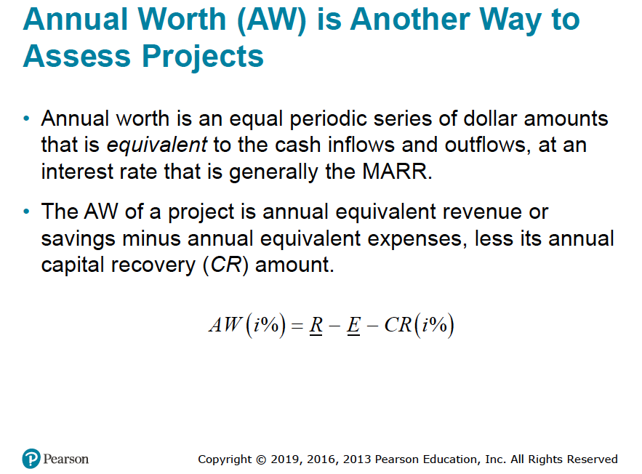


Slide 27
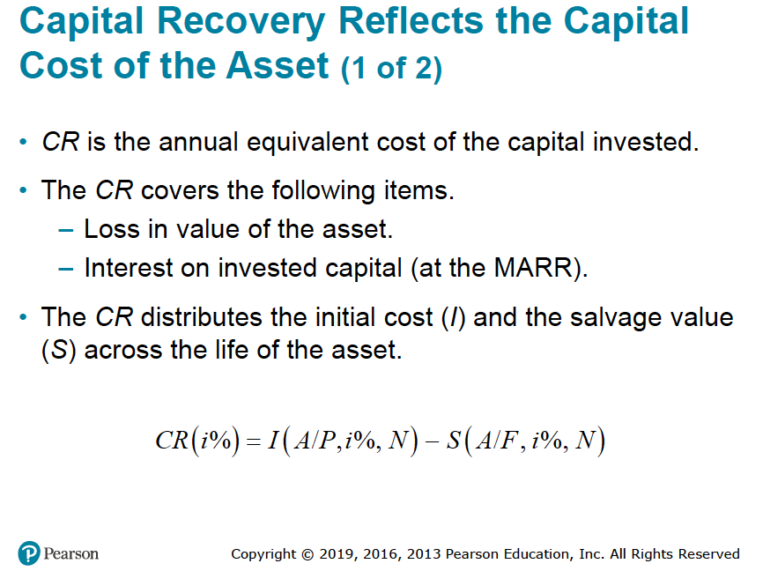

Slide 28
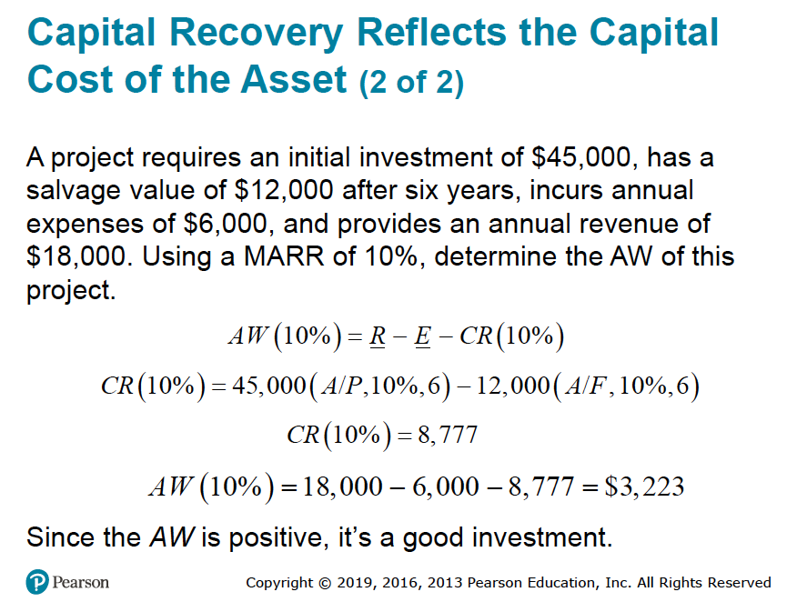




Slide 29
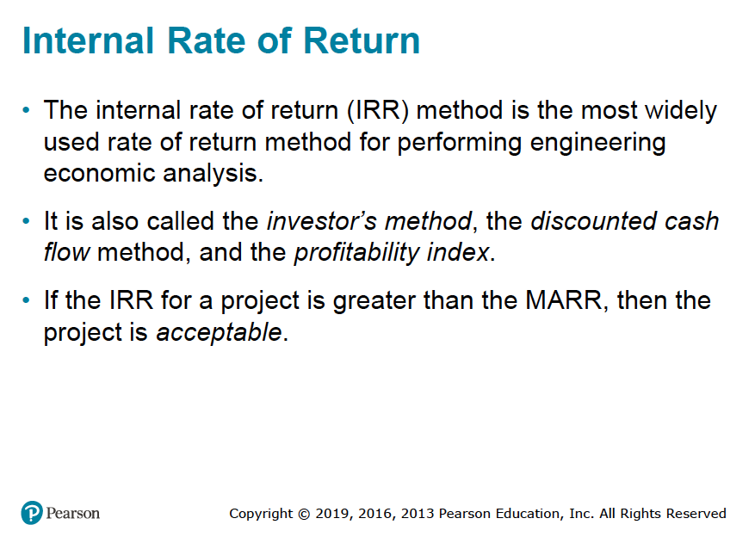



Slide 30
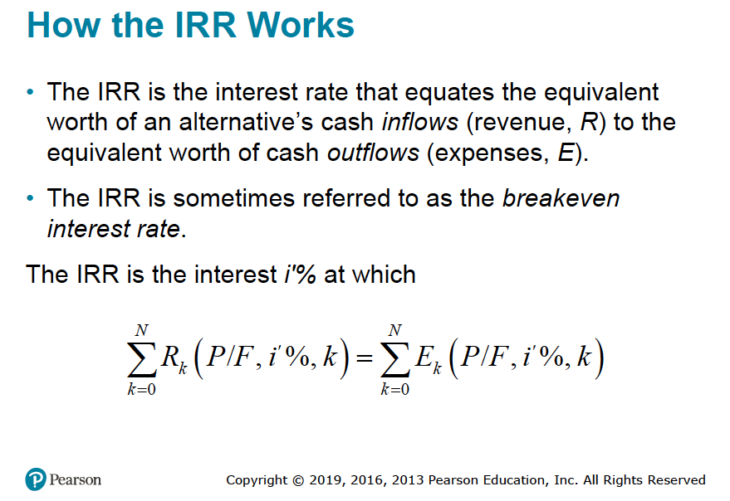







Slide 31
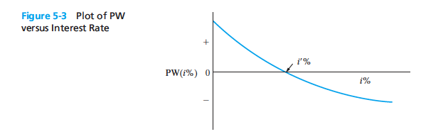



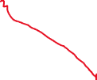

Slide 32
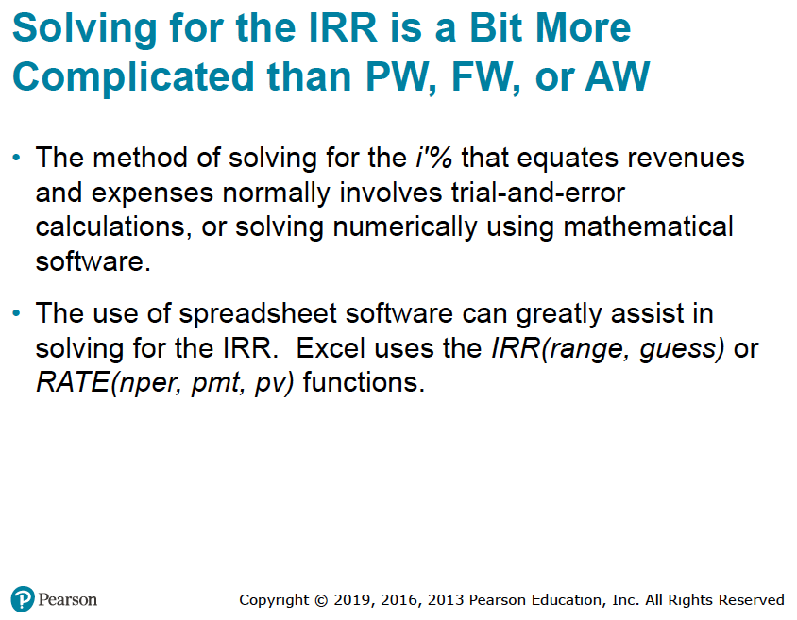

Slide 33
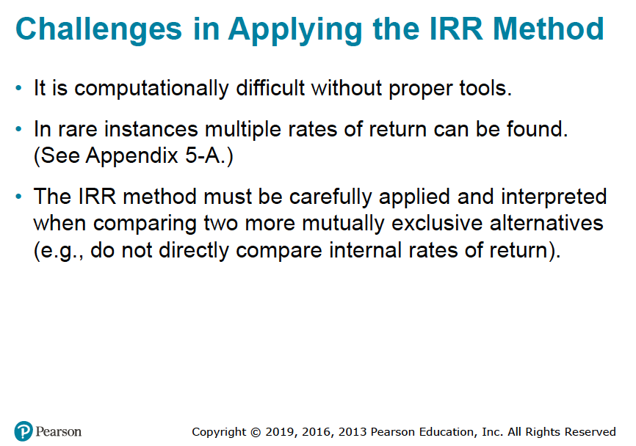




Slide 34
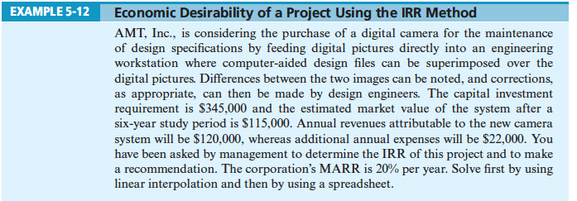


Slide 35
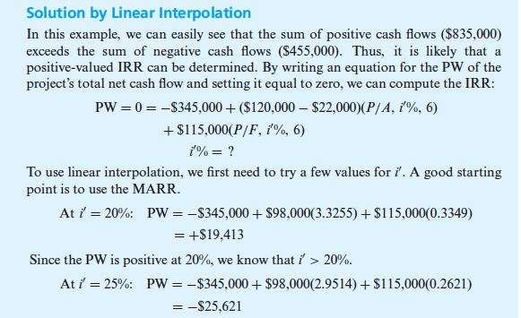


Slide 36
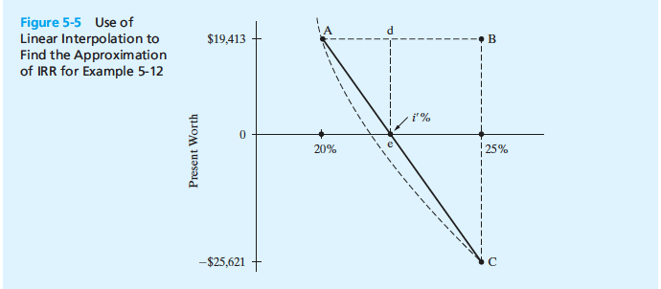




Slide 37
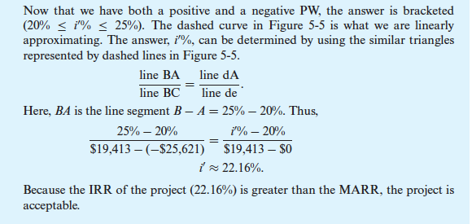


Slide 38
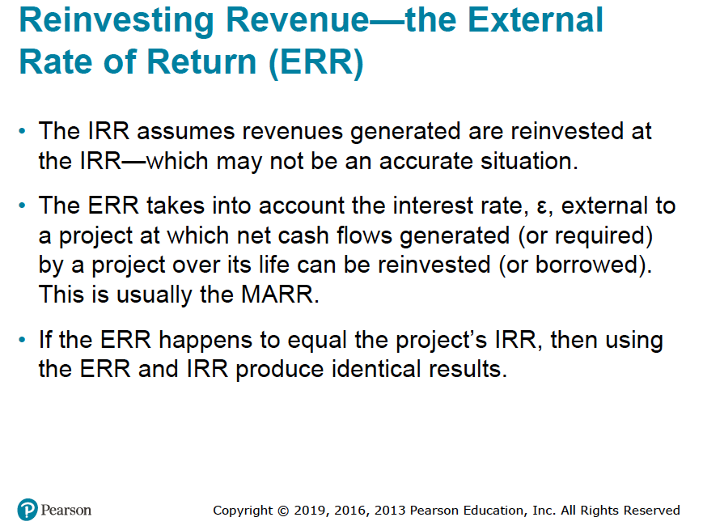




Slide 39
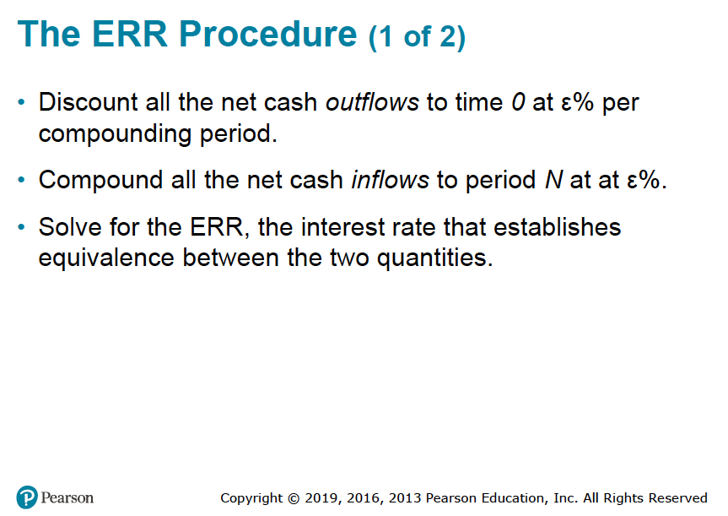

Slide 40
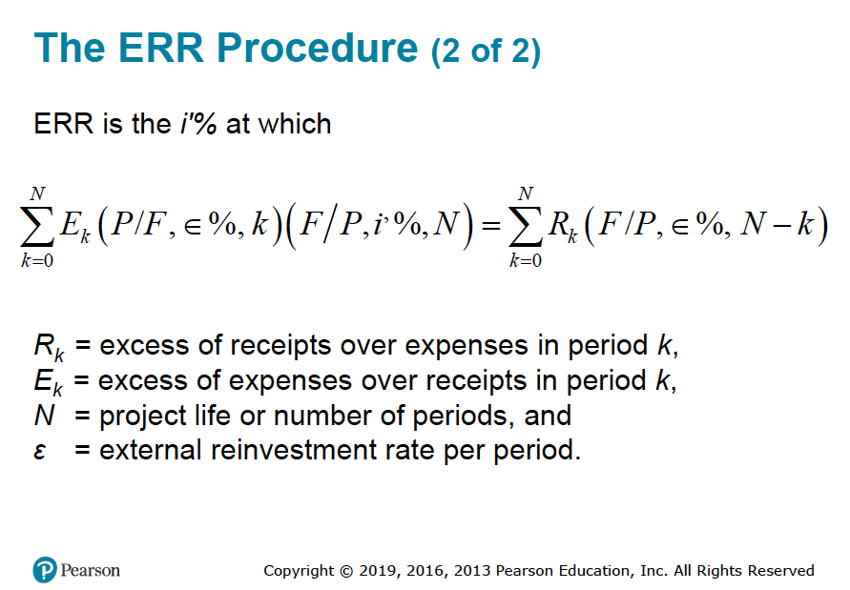





Slide 41
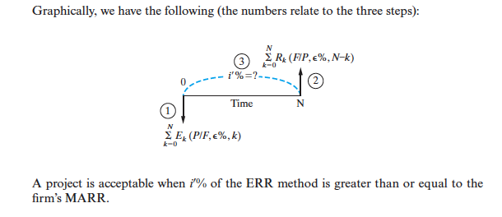

Slide 42

Example: Evaluation of New Equipment Purchase, Using the External Rate of Return (ERR) Method
A piece of new equipment has been proposed by engineers to increase the productivity of a certain manual welding operation.
The investment cost is $25,000, and the equipment will have a market (salvage) value of $5,000 at the end of its expected life of five years.
Increased productivity attributable to the equipment will amount to $8,000 per year after extra operating costs have been subtracted from the value of the additional production.
Use the ERR method to evaluate the proposed equipment assuming that the MARR is 20% per year.
Is the investment a good one?

Slide 43



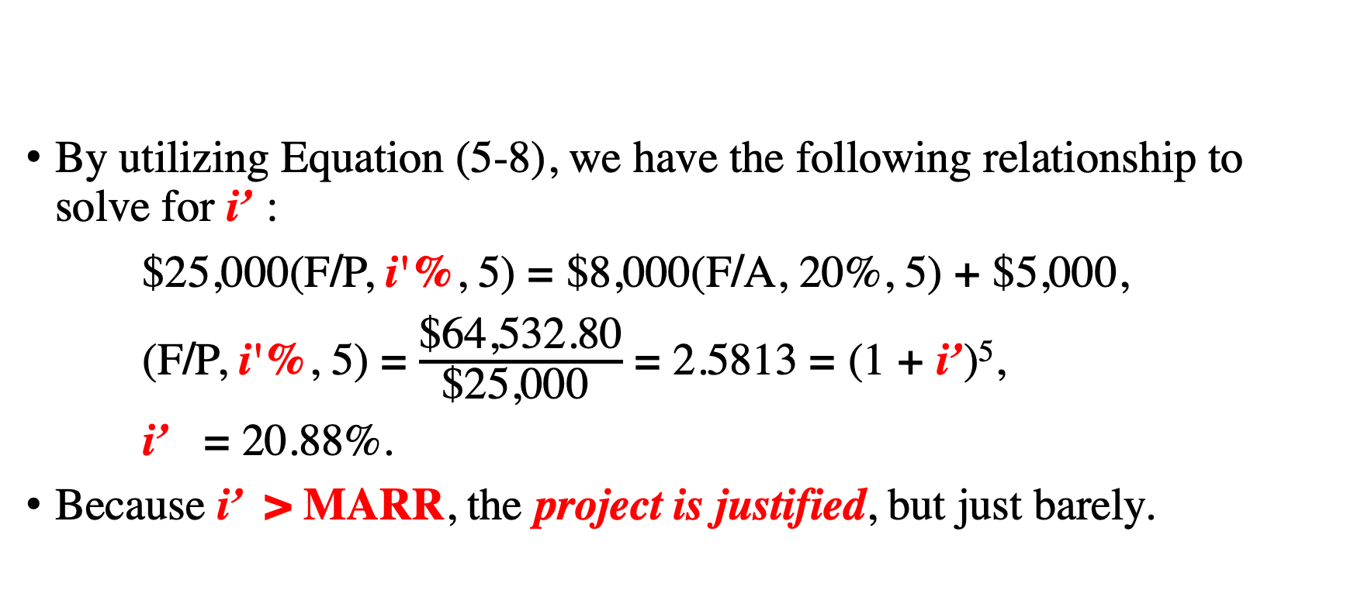



Solution
By utilizing Equation (5-8), we have the following relationship to solve for i’ :
$25,000(F/P, i'%, 5) = $8,000(F/A, 20%, 5) + $5,000,
(F/P, i'%, 5) = $\frac{\text{\$64,532.80}}{\text{\$25,000 }}$ = 2.5813 = (1 + i’)⁵,
i’ = 20.88%.
Because i’ > MARR, the project is justified, but just barely.

Slide 44
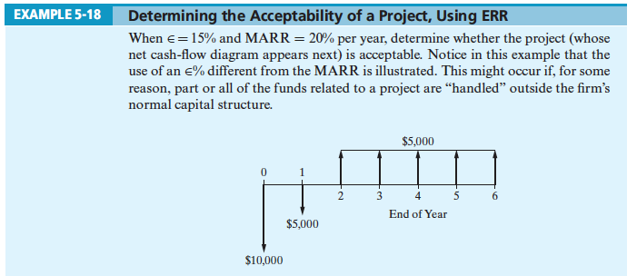



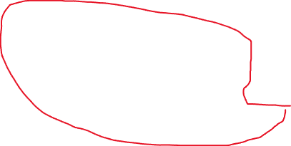



Slide 45
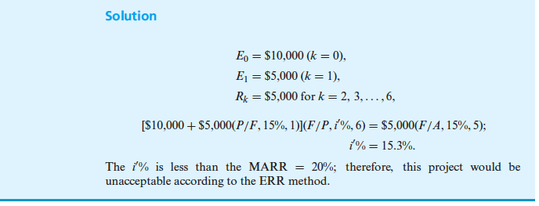

Slide 46
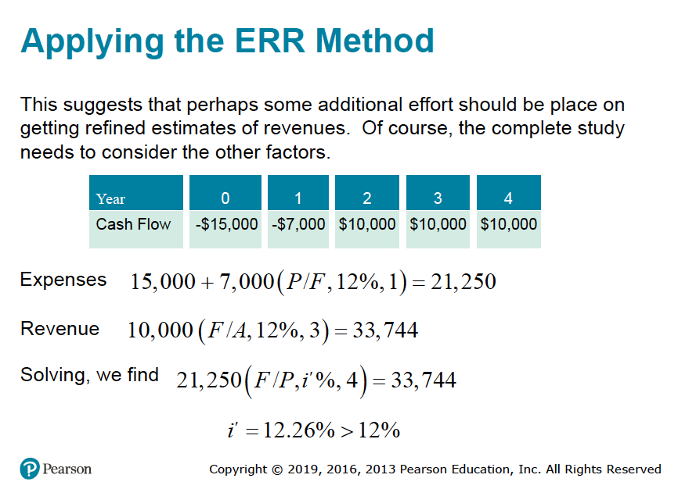



placed
(F/P, I’%, 4) = 33,744/21,250 = 1.5879
This gives an indication that i’% is a little bit larger than 12%.
21,250 (1+i’%)⁴ = 33,744
21,250 (1.1226)⁴ = 33,749

Slide 47
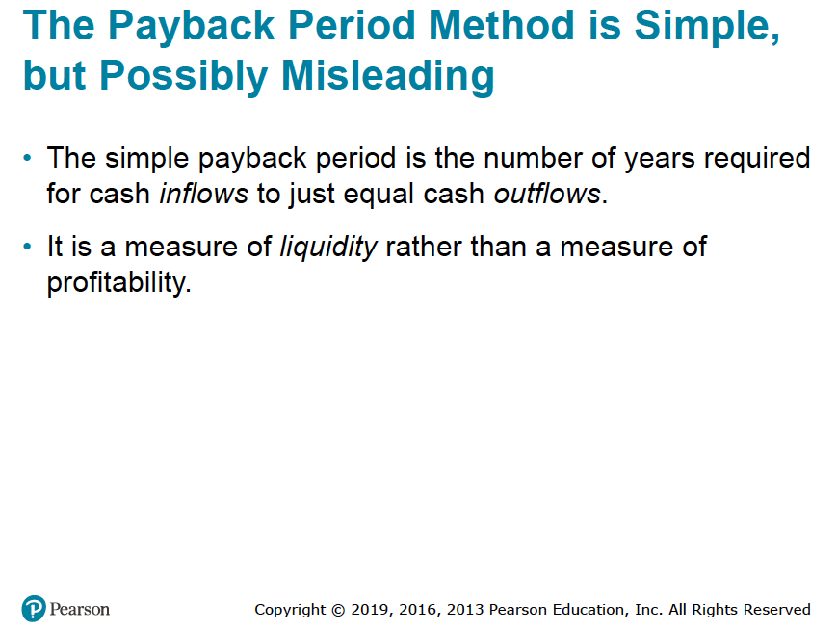

Slide 48
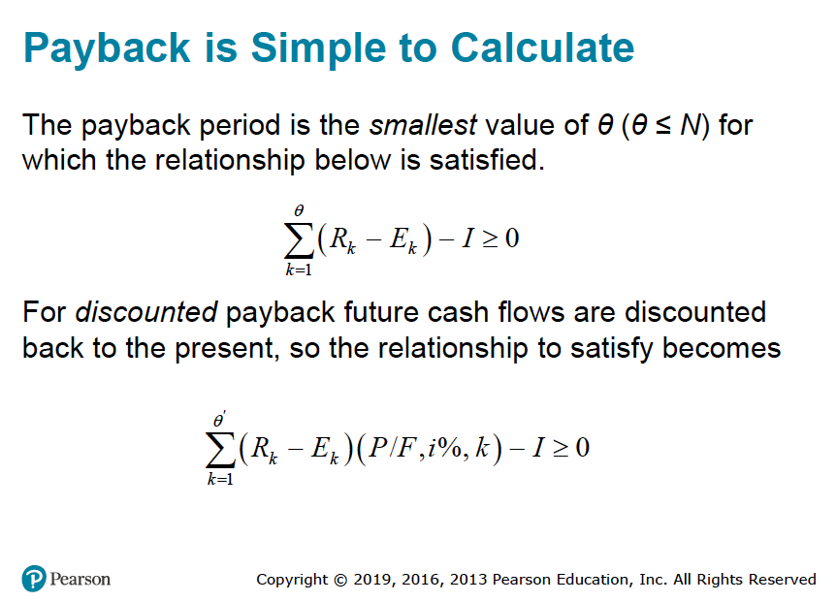

$$\acute{θ}$$

Slide 49
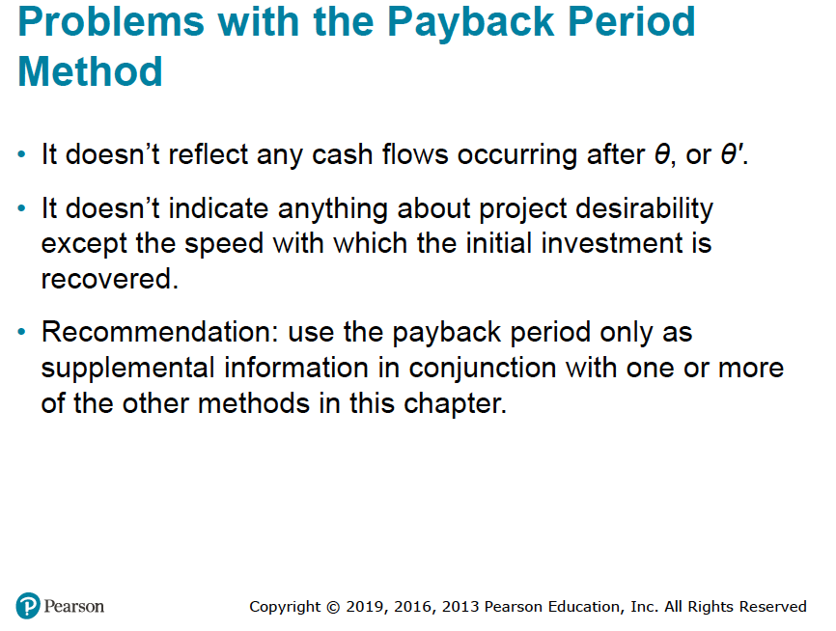

Slide 50
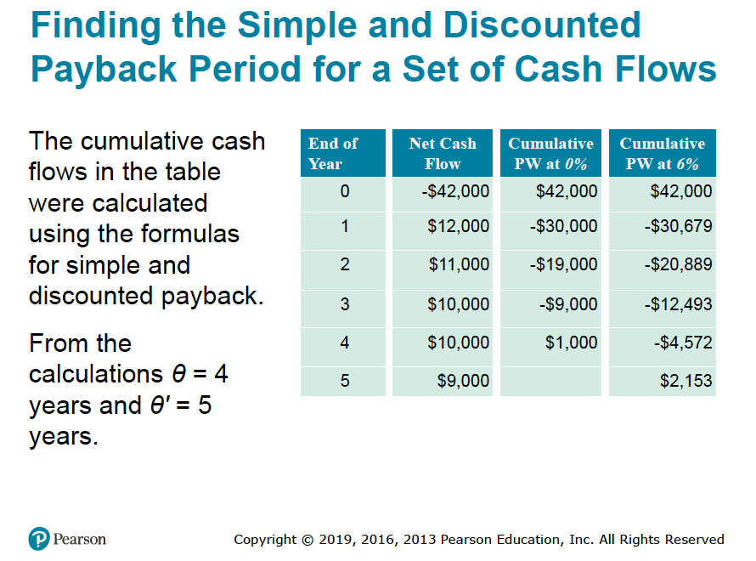





Slide 51
For nominal payback period
12000 - 42,000 = -30,000
11,000 – 30,000 = -19,000
10,000 -19,000 = -9,000
10,000 – 9,000 = 1,000
Therefore, nominal payback period is 4 years.
For the discounted payback period
12,000 (P/F, 6%, 1) – 42,000 = (12,000 X 0.9434) - 42,000 = -30,679
11,000 (P/F, 6%, 2) – 30,697 = (11,000 X 0.89) – 30,697 = -20,889
10,000 (P/F, 6%, 3) – 20,889 = (10,000 X 0.8396) – 20,889 = -12,493
10,000 (P/F, 6%, 4) – 12,493 = (10,000 X 0.7921) – 12,493 = -4,572
9,000 (P/F, 6%, 5) – 4,572 = (9,000 X 0.7473) – 4,572 = 2,153
Therefore, the discounted payback period is 5 years.

Slide 52
