Slide 1
Chapter 6:
System Design
System Decomposition
2013/2014

Slide 2
Design is Difficult
Analysis: Focuses on the application domain.
Design: Focuses on the solution domain.
  The solution domain is changing very rapidly
    Halftime knowledge in software engineering: About 3-5 years.
    Cost of hardware rapidly sinking.
  Design knowledge is a moving target.
Design window: Time in which design decisions have to be made.
Notes:
Compared with Requirements Analysis System design is messy.
One of the reasons is that the analysis depends on the application domain. When entering design, we add the implementation domain. We worry about how to map the application domain expressed in the system model (object model, dynamic model, functional model) into the existing hardware.
Unfortunately this is not a well known science. Again only heuristics are known. Unfortunately even these heuristics have a half-life of 2-5 years. One of the problems is that we are still making incredible progress in computer science which is driven by technology
20 years ago we every analysis was mapped on a main frame. It was too expensive to waste cycles.
With the advence of minis and LAN networks, people started talking about client/server architectures and mapped their analysis onto distributed networks of computers
One of the questions a designer faces is performance vs reliability. If a certain design needs to be optimized because the response time is too slow, what should the designer do? Pick a Cray or a network of Sun workstations
What I teach today will be out of date in 3 years

Slide 3
The Scope of System Design
Bridge the gap between a problem and an existing system in a manageable way
Problem
System
Design
How?
Use Divide & Conquer:
  1) Identify design goals
  2) Model the new system design as a set of subsystems
  3-8) Address the major design goals.
Existing System

Slide 4
System Design: Eight Issues
System Design
8. Boundary
Conditions
1. Identify Design Goals
Additional NFRs
Trade-offs
Initialization
Termination
Failure.
2. Subsystem Decomposition
7. Software
Control
Layers vs Partitions
Architectural Style
Coherence & Coupling
Monolithic
Event-Driven
Conc. Processes
3. Identify Concurrency
Identification of
Parallelism
(Processes,
Threads)
4. Hardware/
Software Mapping
5. Persistent Data
Management
6. Global Resource
Handlung
Identification of Nodes
Special Purpose Systems
Buy vs Build
Network Connectivity
Storing Persistent Objects
Filesystem vs Database
Access Control
ACL vs Capabilities
Security
Notes:
1. Design goals
2. System decomposition
Breaking the system into subsystems, Layers and partitions, System information flow (topology)
3. Identification of concurrency
Threads of control
4. Hardware/software allocation
Estimate hardware requirements, Hardware/software trade-offs, Describe processor allocation, Physical connectivity (existing hardware)
5. Data management
Data structures implemented in memory or secondary storage
6. Global resource handling
Choose access control
7. Software control implementation
Procedure-based, event-based, concurrent systems
8. Boundary conditions
Describe behavior at initialization, termination and failure
9. Feasibility
Discuss design alternatives, Technological constraints that drive the design, What if the constraints change?

Slide 5
Overview
System Design I (This Lecture)
  0. Overview of System Design
  1. Design Goals
  2. Subsystem Decomposition, Architectural Styles
System Design II (Next Lecture)
  3. Concurrency: Identification of parallelism
  4. Hardware/Software Mapping:
  Mapping subsystems to processors
  5. Persistent Data Management: Storage for entity objects
  6. Global Resource Handling & Access Control:
  Who can access what?)
  7. Software Control: Who is in control?
  8. Boundary Conditions: Administrative use cases.
Notes:
Rumbaugh distinguishes two kinds of design: System design and Object design. System design, the topic of this and the next lecture is concerned with the overall aspects of the system. What are the goals it tries to achieve. The main goals are: Low cost, good response time, high reliability. Types (Often listed under Global requirements in Problem Statement). Trade-off priorities
System design is also concerned about the overall structure of the system. How is it broken into pieces? How do these pieces fit together? Must they know about each other? The best system design is one where the interaction between the subsystems is minimal.
Concurrency is another important design issue. The more concurrency we can identify in a system, the better it can perform.
Mapping the subsystem to processors is the moment of truth, and the hardest. While decomposition and concurrency identification are still independent of technology, subsystem allocation is not. Shall we map them to hardware or can we get by with software (Example: Floating point package).
The management of data is also a design issue. The FRIEN database group is an example: Most of its problems are design specific.
Access methods specify the security of the design. Can a random user or a program gone hay-wire create havoc to the rest of the system?
Control is another important design issue. Who is in control? A main program or a set of harmoniously cooperating processes?
Boundary conditions specify the non-steady state behavior of the system. Usually the designer worries about the steady state (average number of transactions/sec). However, initialization and termination behavior, in particular failure conditions are important design issues. How does the system behave when an error occurs? Does it simply type "Illegal address at PC 0. Abort!" (Famous last words on a screen cockpit filmed by a video camera before the plane, an F-15 fighter, crashed).
For the FRIEND system, database design issues are very important. We will discuss several design goals that are very important for the design of distributed databases

Slide 6
Analysis Sources: Requirements and System Model
Functional Model
8. Boundary
Conditions
1. Design Goals
Nonfunctional
Requirements
Definition
Trade-offs
Initialization
Termination
Failure
Functional Model
2. System Decomposition
Dynamic
Model
7. Software
Control
Layers vs Partitions
Coherence/Coupling
Monolithic
Event-Driven
Conc. Processes
Dynamic
Model
3. Concurrency
Object Model
Identification of
Threads
4. Hardware/
Software Mapping
5. Data
Management
6. Global Resource
Handlung
Special Purpose Systems
Buy vs Build
Allocation of Resources
Connectivity
Persistent Objects
Filesystem vs Database
Access Control List
vs Capabilities
Security
Notes:
1. Design goals
2. System decomposition
Breaking the system into subsystems, Layers and partitions, System information flow (topology)
3. Identification of concurrency
Threads of control
4. Hardware/software allocation
Estimate hardware requirements, Hardware/software trade-offs, Describe processor allocation, Physical connectivity (existing hardware)
5. Data management
Data structures implemented in memory or secondary storage
6. Global resource handling
Choose access control
7. Software control implementation
Procedure-based, event-based, concurrent systems
8. Boundary conditions
Describe behavior at initialization, termination and failure
9. Feasibility
Discuss design alternatives, Technological constraints that drive the design, What if the constraints change?

Slide 7
How the Analysis Models influence System Design
Nonfunctional Requirements
  => Definition of Design Goals
Functional model
  => Subsystem Decomposition
Object model
  => Hardware/Software Mapping, Persistent Data Management
Dynamic model
  => Identification of Concurrency, Global Resource Handling, Software Control
Finally: Hardware/Software Mapping
  => Boundary conditions
Notes:
In Requirements analysis we have beautifully built 3 descriptions of the problem, the models.
Where do the models go in system design? The above list of system design issues looks a little bit random.
But there is a reason behind it:
Nonfunctional Requirements
=> Definition of Design Goals
Functional model
=> Subsystem Decomposition (Subsystems based on functional requirements, coherence & coupling)
Object model
=> Hardware/software Mapping and Data Management (Persistent objects)
Dynamic model
=> Identification of Concurrency, Global Resource Handling, Software Control
Finally: From the Subsystem Decomposition
=> Boundary conditions

Slide 8
From Analysis to System Design
Nonfunctional
Requirements
Functional Model
8. Boundary
Conditions
1. Design Goals
Definition
Trade-offs
Initialization
Termination
Failure
Functional Model
2. System Decomposition
Dynamic
Model
Layers vs Partitions
Coherence/Coupling
Architectural Style
7. Software
Control
Dynamic
Model
Object Model
Monolithic
Event-Driven
Conc. Processes
4. Hardware/
Software Mapping
5. Data
Management
6. Global Resource
Handlung
3. Concurrency
Identification of
Threads
Special Purpose Systems
Buy vs Build
Allocation of Resources
Connectivity
Persistent Objects
Filesystem vs Database
Access Control List
vs Capabilities
Security
Notes:
1. Design goals
2. System decomposition
Breaking the system into subsystems, Layers and partitions, System information flow (topology)
3. Identification of concurrency
Threads of control
4. Hardware/software allocation
Estimate hardware requirements, Hardware/software trade-offs, Describe processor allocation, Physical connectivity (existing hardware)
5. Data management
Data structures implemented in memory or secondary storage
6. Global resource handling
Choose access control
7. Software control implementation
Procedure-based, event-based, concurrent systems
8. Boundary conditions
Describe behavior at initialization, termination and failure
9. Feasibility
Discuss design alternatives, Technological constraints that drive the design, What if the constraints change?

Slide 9
Stakeholders have different Design Goals
Low cost
Increased productivity
Backward compatibility
Traceability of requirements
Rapid development
Flexibility
Functionality
User-friendliness
Usability
Ease of learning
Fault tolerant
Robustness
Runtime
Efficiency
Reliability
Portability
Good documentation
Client
(Customer)
End
User
Minimum # of errors
Modifiability, Readability
Reusability, Adaptability
Well-defined interfaces
Developer/
Maintainer
Notes:
Nielson
Usability Engineering
Rubin
Task Analysis

Slide 10
Typical Design Trade-offs
Functionality v. Usability
Cost v. Robustness
Efficiency v. Portability
Rapid development v. Functionality
Cost v. Reusability
Backward Compatibility v. Readability
Notes:
Example: Functionality vs usability. Is a system with 100 functions usable? How about a large scale menu?
Low Cost vs Robustness: A low cost system does not check for errors when the user is entering wrong data
(ebay Entry 5.00 vs 5,00). Let‘s say you bid for 5, 00 Euro
In Germany 5,00 is 5 Euros, if the entry routine expects a „.“, then the „,“ might be overlooked,
and you have bidden. for 500 Dollars!
Efficiency vs Portability: Can you build a portable real-time game? How do you get high framerates. Special graphics routines that access the display buffer! That is usually not portable. If you write portable graphics code, say with the OpenGL, then you sometimes might not get the response times you are looking for. All special graphics code is still hand-tailored for a specific machine or graphics processor.
Rapid development vs. functionality: Let’s say your development time is 5 weeks, you have 5 programmers, your design window is 2 weeks, after design 3 programmers are leaving your company, and your delivery deadline cannot be moved. You are going to reduce the functionality. Not all the use cases in your model can be implemented nor delivered.
Cost vs. Reusability: This is an interesting trade-off, whose validity is changing right now. In the past, if you tried to make your design reusable you had to add extra effort. Recode your data structures (move from array of int to array of Generic). Moving from a 1-1 association to a many-many association involved more coding and more testing. Nowadays, with design patterns, this trade-off is changing a little bit. You can get reusability pretty cheap if you use design patterns!
Backward Compatibility vs Readability.
The same applies to this trade-off. In the past you would guarantee backward compatibility by introducing special switches.
#Ifdef OldSystem then WriteToPaperTapeWriter
#Ifdef Newsystems then WritetoCD-R
Nowadays, again with the use of design patterns, for example, the bridge pattern, you can keep a system backward compatibile and still keep it readable!

Slide 11
Subsystems and Services
Subsystem
  Collection of classes, associations, operations, events that are closely interrelated with each other
  The classes in the object model are the “seeds” for subsystems
Service
  A group of externally visible operations provided by a subsystem (also called subsystem interface)
  The use cases in the functional model provide the “seeds” for services
Notes:
Relation of subsystems to each other is similar to object model
System topology is similar functional model!
A service is a group of operations provided by the subsystem
Services are defined during system design and refined as subsystem interfaces during object design.
Good design: The subsystem interface object describes all the services of the subsystem interface
Architectural style: layered, hierarchical, peer-to-peer, client-server, 3-tier, repository, etc)

Slide 12
Example: Services provided by the ARENA Subsystems
User Interface
Manages advertisement banners & sponsorships
Administers user accounts
Manages tournaments,promotions, applications
Tournament
Advertisement
User Management
Adds games, styles, and expert rating formulas
Services
are described
by subsystem interfaces
Component Management
User Directory
Tournament Statistics
Session Management
Stores user profiles (contact info & subscriptions)
Maintains state during matches
Stores results of archived tournaments

Slide 13
Subsystem Interface
Subsystem interface: Set of fully typed UML operations
  Specifies the interaction and information flow from and to subsystem boundaries, but not inside the subsystem
  Refinement of service, should be well-defined and small
  Subsystem interfaces are defined during object design
Application programmer’s interface (API)
  The API is the specification of the subsystem interface in a specific programming language
  APIs are defined during implementation
The terms subsystem interface and API are often confused with each other
  The term API should not be used during system design and object design, but only during implementation.

Slide 14
Example: Notification subsystem
Service provided by Notification Subsystem
  LookupChannel()
  SubscribeToChannel()
  SendNotice()
  UnscubscribeFromChannel()
Subsystem Interface of Notification Subsystem
  Set of fully typed UML operations
    Left as an Exercise
API of Notification Subsystem
  Implementation in Java
    Left as an Exercise.

Slide 15
Subsystem Interface Object
Subsystem Interface Object
  The set of public operations provided by a subsystem
Good system design
  The subsystem interface object describes all the services of the subsystem interface
  Subsystem interface objects can be realized with the Façade pattern (=> lecture on design patterns).
Notes:
We will use the Facade design pattern to model the subsystem interface object

Slide 16
Coupling and Coherence of Subsystems
Goal: Reduce system complexity while allowing change
Coherence measures dependency among classes
  High coherence: The classes in the subsystem perform similar tasks and are related to each other via many associations
  Low coherence: Lots of miscellaneous and auxiliary classes, almost no associations
Coupling measures dependency among subsystems
  High coupling: Changes to one subsystem will have high impact on the other subsystem
  Low coupling: A change in one subsystem does not affect any other subsystem.
Notes:
The goal is a reduction of complexity while change occurs.
A good subsystem decomposition has maximum coherence and minimum coupling:
How can we achieve high coherence?
How can we achieve low coupling?
Coherence measures dependency among classes
High coherence: The classes in the subsystem perform similar tasks and are related to each other via associations
Low coherence: Lots of miscellaneous and auxiliary classes, no associations
Coupling measures dependency among subsystems
High coupling: Changes to one subsystem will have high impact on the other subsystem (model change, massive recompilation,…)
Low coupling: A change in one subsystem does not affect any other subsystem

Slide 17
Coupling and Coherence of Subsystems
Good System Design
Goal: Reduce system complexity while allowing change
Coherence measures dependency among classes
  High coherence: The classes in the subsystem perform similar tasks and are related to each other via many associations
  Low coherence: Lots of miscellaneous and auxiliary classes, almost no associations
Coupling measures dependency among subsystems
  High coupling: Changes to one subsystem will have high impact on the other subsystem
  Low coupling: A change in one subsystem does not affect any other subsystem
Notes:
The goal is a reduction of complexity while change occurs.
A good subsystem decomposition has maximum coherence and minimum coupling:
How can we achieve high coherence?
How can we achieve low coupling?
Coherence measures dependency among classes
High coherence: The classes in the subsystem perform similar tasks and are related to each other via associations
Low coherence: Lots of miscellaneous and auxiliary classes, no associations
Coupling measures dependency among subsystems
High coupling: Changes to one subsystem will have high impact on the other subsystem (model change, massive recompilation,…)
Low coupling: A change in one subsystem does not affect any other subsystem

Slide 18
How to achieve high Coherence
High coherence can be achieved if most of the interaction is within subsystems, rather than across subsystem boundaries
Questions to ask:
  Does one subsystem always call another one for a specific service?
    Yes: Consider moving them together into the same subystem.
  Which of the subsystems call each other for services?
    Can this be avoided by restructuring the subsystems or changing the subsystem interface?
  Can the subsystems even be hierarchically ordered (in layers)?
Notes:
What kind of model is good for describing layers and partitions? UML Class diagrams!

Slide 19

How to achieve Low Coupling
Low coupling can be achieved if a calling class does not need to know anything about the internals of the called class (Principle of information hiding, Parnas)
Questions to ask:
  Does the calling class really have to know any attributes of classes in the lower layers?
  Is it possible that the calling class calls only operations of the lower level classes?
David Parnas, *1941,
Developed the concept of
modularity in design.
Notes:
What kind of model is good for describing layers and partitions? UML Class diagrams!

Slide 20
Is this a Good Design?
User Interface
Component Management
Advertisement
Tournament
Tournament Statistics
No, it has too
much coupling
(“Spaghetti” Design)
Session Management
User Management
Notes:
Why is this decomposition bad? It has high coupling, almost every subsystem relies on every other subsystem.
Too much “ravioli”…..!

Slide 21

Dijkstra’s answer to “Spaghetti Design”
Dijkstra revolutionary idea in 1968
  An system should be designed and built as a hierarchy of layers: Each layer uses only the services offered by the lower layers
The T.H.E. system
  T.H.E. = Technische Hochschule Eindhoven
An operating system for single user operation
  Supporting batch-mode
  Multitasking with a fixed set of processes sharing the CPU
Edser W. Dijkstra, 1930-2002
Formal verification: Proofs for programs
Dijkstra Algorithm, Banker’s Algorithm, Gotos considered harmful, T.H.E.,
1972 Turing Award

Slide 22
The Layers of the T.H.E. System
“An operating system is a hierarchy of layers, each layers using services offered by the lower layers”
Retrospectively,
T.H.E was the first
system that used an
architectural style!
Layer 4: User Programs
Layer 3: I/O Device Manager
Layer 2: Communication with Console
Layer 1: Pager
Layer 0: Scheduler
Notes:
Appeared first in 1965, proposed by Dijkstra, 1965, in the design of the T.H.E. system.

Slide 23
Architectural Style vs Architecture
Subsystem decomposition: Identification of subsystems, services, and their relationship to each other
Architectural Style: A pattern for a subsystem decomposition
Software Architecture: Instance of an architectural style.
Notes:
Specification of the system decomposition is critical
An architectural style is a pattern or template for subsystem decomposition

Slide 24
Examples of Architectural Styles
  Layered Architectural style
    Service-Oriented Architecture (SOA)
  Client/Server
  Peer-To-Peer
  Three-tier, Four-tier Architecture
  Repository
  Model-View-Controller
  Pipes and Filters
Notes:
Styles are listed in Chapter 6, p. 237
We will talk about Client-Server, Peer-To-Peer, Repository and MVC,
Only in the book: Three-tier, Four-tier , Pipes and Filters

Slide 25
Layers and Partitions
A layer is a subsystem that provides a service to another subsystem with the following restrictions:
  A layer only depends on services from lower layers
  A layer has no knowledge of higher layers
A layer can be divided horizontally into several independent subsystems called partitions
  Partitions provide services to other partitions on the same layer
  Partitions are also called “weakly coupled” subsystems.
Notes:
A large system should be decomposed into subsystems using both, layers and partitions
Layering and partitioning are techniques to achieve low coupling!!!
In an object-oriented design, each subsystem makes its layer a subclass of the generic layer class provided by the UI subsystem.
In JEWEL, each individual subsystem provides its own zoom and refresh methods.
Ideally the refresh method will be called for every draw operation. The UI subsystem is responsible for knowing when to call for a refresh (but the UI group will not have to implement it itself: it is a callback method implemented by the visualization and GIS group). All the interfaces with UI (such as how UI will provide the other groups with selection information) should be well documented and agreed on by all groups.

Slide 26
The Layered Architectural Style
uses
Hierarchical
Relationship
Client
Layer N
calls
Layer N-1
calls
Layer N-2
...
calls
Layer 1
calls
Layer 0

Slide 27
Hierarchical Relationships between Subsystems
There are two major types of hierarchical relationships
  Layer A “depends on” layer B (compile time dependency)
    Example: Build dependencies (make, ant, maven)
  Layer A “calls” layer B (runtime dependency)
    Example: A web browser calls a web server
    Can the client and server layers run on the same machine?
      Yes, they are layers, not processor nodes
      Mapping of layers to processors is decided during the Software/hardware mapping!
UML convention:
  Runtime relationships are associations with dashed lines
  Compile time relationships are associations with solid lines.
Notes:
Example: Peer-to-Peer systems

Slide 28
Example of a System with more than one Hierarchical Relationship
Layer
Relationship
„depends on“
Layer 1
A:Subsystem
Layer
Relationship
„calls“
Layer 2
B:Subsystem
C:Subsystem
D:Subsystem
Layer 3
E:Subsystem
F:Subsystem
G:Subsystem
Layer
Relationship
„calls“
Notes:
Subsystem Decomposition Heuristics
- No more than 7+/-2 subsystems
More subsystems increase coherence but also complexity (more services)
- No more than 4+/-2 layers
Good design: Try to find 3 layers!!!! In many cases this is possible. 3-tier-architectures are an example

Slide 29
Example of a Layered Design (ARENA)
User Interface
Layer 1
Advertisement
User Management
Layer 2
Tournament
Component Management
User Directory
Layer 3
?
Session Management
Tournament Statistics
Layer 4
Notes:
New type of association: The dashed line means “depends on at runtime”. The solid line means “depends on at compile time”.

Slide 30
Virtual Machine
A virtual machine is a subsystem connected to higher and lower level virtual machines by "provides services for" associations
A virtual machine is an abstraction that provides a set of attributes and operations
The terms layer and virtual machine can be used interchangeably
  Also sometimes called “level of abstraction”.
Notes:
A virtual machine can be seen a collection of classes instead of a single class.
This module uses services provided by lower level virtual machines and provides a service to higher level machines
Key concept in structuring and providing abstraction, but slightly out of out of date, cannot deal with distributed architectures.
Works still well for single processor architectures (tasks)

Slide 31








Building Systems as a Set of Virtual Machines
A system is a hierarchy of virtual machines, each using language primitives offered by the lower machines.
Virtual Machine 4 .
Virtual Machine 3
The language offered by Virtual Machine 2
The language offered by Virtual Machine 1
Virtual Machine 2
Virtual Machine 1
Operating System, Libraries
Existing System
Notes:
Appeared first in 1965, proposed by Dijkstra, 1965, in the design of the T.H.E. system.

Slide 32
Closed Architecture (Opaque Layering)
Each layer can only call operations from the layer below (called “direct addressing” by Buschmann et al)
C1ass1
C1ass2
C1ass3
L4
attr
attr
attr
op
op
op
C1assE
C1assF
L3
attr
attr
op
op
Design goals: Maintainability, flexibility.
C1assC
C1assD
attr
attr
L2
op
op
Class A
C1ass B
L1
attr
attr
op
op

Slide 33
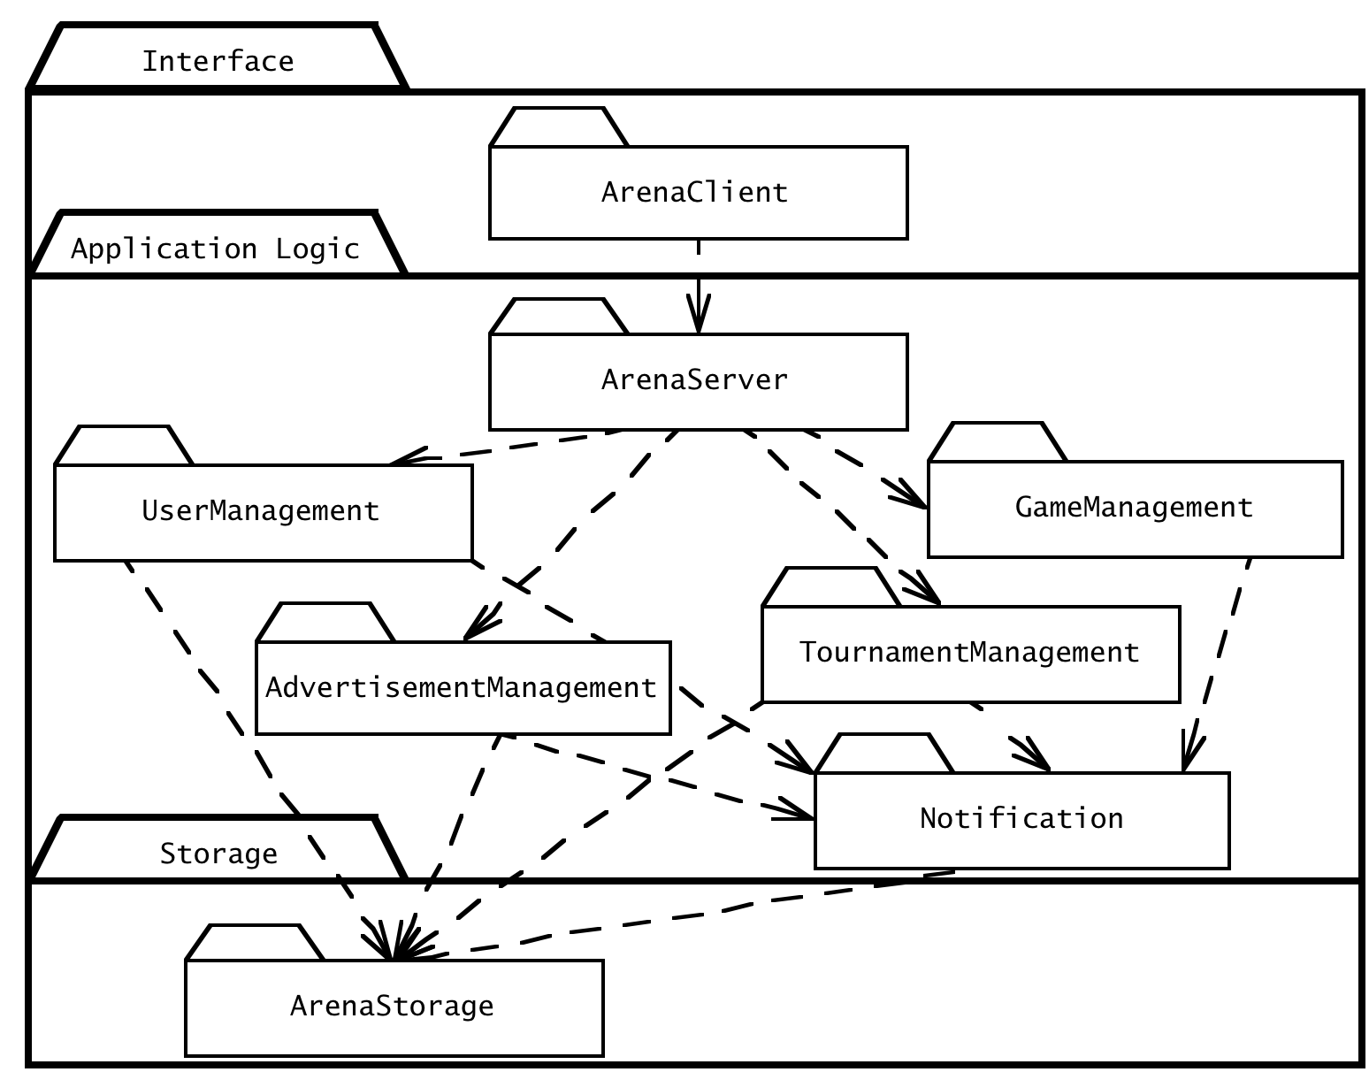
Opaque Layering in ARENA
Layer 3
Layer 2
Layer 1

Slide 34
Open Architecture (Transparent Layering)
Each layer can call operations from any layer below (“indirect addressing”)
C1ass1
C1ass2
C1ass3
L4
attr
attr
attr
op
op
op
C1assE
C1assF
L3
attr
attr
Design goal:
Runtime efficiency.
op
op
C1assC
C1assD
L2
attr
attr
op
op
Class A
C1ass B
L1
attr
attr
op
op

Slide 35
SOA is a Layered Architectural Style
Service Oriented Architecture (SOA)
Basic idea: A service provider (“ business”) offers business services (“business processes”) to a service consumer (application, “customer”)
  The business services are dynamically discoverable, usually offered in web-based applications
The business services are created by composing (choreographing) them from lower-level services (basic services)
The basic services are usually based on legacy systems
Adapters are used to provide the “glue” between basic services and the legacy systems.
(Web-)Application
Business Services
Business Services (Composite Services)
Basic Services
Adapters to Legacy Systems
Legacy Systems
Notes:
Definition Legacy System : The system works satisfactorily, and the owner sees no reason for changing it or it can actually not be changed because the compiler or the source code is gone!
The costs of redesigning or replacing the system are prohibitive....
The system requires close to 100 percent availability, so it cannot be taken out of service, and the cost of designing a new system with a similar availability level is high.
Examples include systems to handle CRM systems, customers' accounts in banks, computer reservation systems, air traffic control, energy distribution (power grids), nuclear power plants, military defense installations. A legacy system is usually not well understood.
Reasons: The designers of the system have left the organization, and the system has either not been fully documented or documentation has been lost, or the source code is gone and it cannot be compiled anymore☺
A portal can be thought of as a Web-based application that is customizable by the end-user both in the look and feel of the portal and in the available content and applications which the portal contains. A portal, furthermore, can be thought of as an aggregator of content and applications or a single point of entry to a user's set of tools and applications.
A portlet can be thought of as a miniature Web application that is running inside of a portal page along side any number of similar entities. A portlet is a Web component which is managed by a container and can process requests and generate dynamic content. Portlets come in many flavors -- some are standards-based, while others are proprietary to the portal which hosts them. The Java Portlet Specification (JSR-168), approved in October of 2003, defines a standard API for J2EE-based portal platforms. The goal of JSR-168 is to provide a set of standards so that any compliant portlet can be deployed on any portal which supports the specification. Figure 2 shows a traditional portal model where the portal has a portlet container which hosts any number of discrete portlets. Each of these portlets generates fragments of mark-up which the portal ultimately pieces together to create a complete page that is presented to the user.

Slide 36
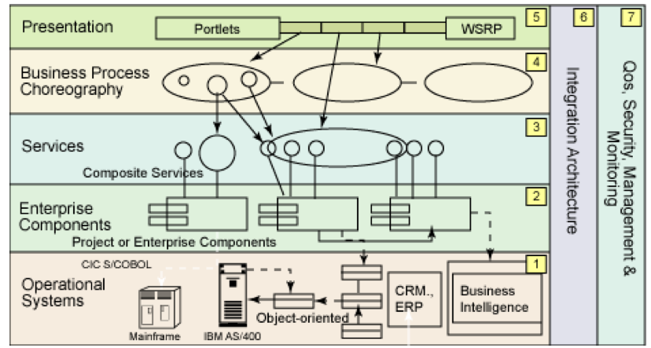
IBM’s View of a Service Oriented Architecture
Source http://www.ibm.com/developerworks/webservices/library/ws-soa-design1/
User Interface
(Web Portal)
Business
Services
Basic
Services
Adapters
Legacy Systems
Notes:
WSRP = Web Services for Remote Portlets. Specification for accessing remotely running portals, that is, SOAP-based Web services
Layer 5: Access/Presentation layer
Application layer. Not part of SOA, but increasingly important because technologies such as Web Services for Remote Portlets provide services at this level
Level 4: Business process choreography layer
This layer provides compositions of services defined in layer 3. The composition acts as a single service offered to applications
Layer 3: Services layer
All the services offered by the business. A service is a discoverable software component with an externalized service description. This service description is available for searching, binding, and invocation by a SOA higher layer
Layer 2: Enterprise components layer
Provides the functionality of the legacy systems via adapters is responsible for maintaining workload management, high-availability and load balancing
Layer 1: Operational systems layer
Existing custom built or old applications that are still of business value, (called legacy systems). Examples: existing CRM and ERP applications. CRM=Customer Relationship Management System, ERP = Enterprise Resource Planning System (Example: SAP)
Layer 6: Integration Architecture
This layer enables the integration of services through intelligent routing, protocol mediation, and other transformation mechanisms, often described as the ESB (see Resources)
Layer 7: QoS Layer
This layer provides the capabilities required to monitor, manage, and maintain QoS such as security, performance, and availability.

Slide 37
Properties of Layered Systems
Layered systems are hierarchical. This is a desirable design
  Hierarchy reduces complexity
Closed architectures are more portable
  Provide very low coupling
Open architectures are more efficient
Layered systems often have a chicken-and egg problem
Symbol Table
A: Symbolic Debugger
How do you open the
symbol table when you are
debugging the File
System?
D: File System
G: Operating System
Notes:
Example: Debugger trying to open the symbol table when the file system is being debugged

Slide 38
Another Example of a Layered Architectural Style
ISO’s OSI Reference Model
  ISO = International Standard Organization
  OSI = Open System Interconnection
Reference model which defines 7 layers and communication protocols between the layers
Application
Presentation
Level of abstraction
Session
Transport
Network
DataLink
Physical

Slide 39
OSI Model Layers and their Services
The Application layer is the system you are building (unless you build a protocol stack)
  The application layer is usually layered itself
The Presentation layer performs data transformation services, such as byte swapping and encryption
The Session layer is responsible for initializing a connection, including authentication
Application
!
Presentation
Session
Transport
Network
DataLink
Physical
Notes:
Layers 1 to 6 are often called the protocol stack.

Slide 40
OSI Model Layers and their Services
The Transport layer is responsible for reliably transmitting messages
  Used by Unix programmers who transmit messages over TCP/IP sockets
The Network layer ensures transmission and routing
  Service: Transmit and route data within the network
The Datalink layer models frames
  Service: Transmit frames without error
The Physical layer represents the hardware interface to the network
  Service: sendBit() and receiveBit()
Application
Presentation
Session
Transport
Network
DataLink
Physical
Notes:
The Transport layer is responsible for reliably transmitting messages
This is the service seen by Unix programmers when want to transmit messages over TCP/IP sockets
The Network layer ensures data transmission
It provides the service to transmit and route date within the network
The Datalink layer models frames
It provides the service to send and receive frames without error
The Physical layer represents the hardware interface to the network.
It provides the service consisting of the operations send() and receive bits over a channel

Slide 41
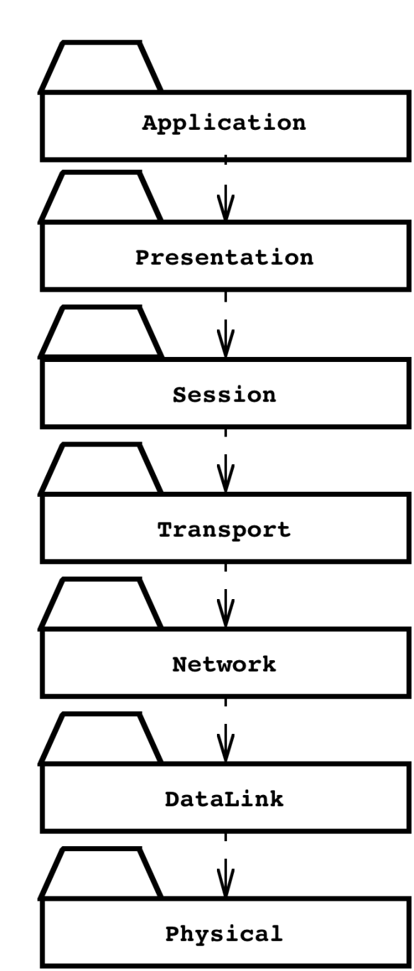
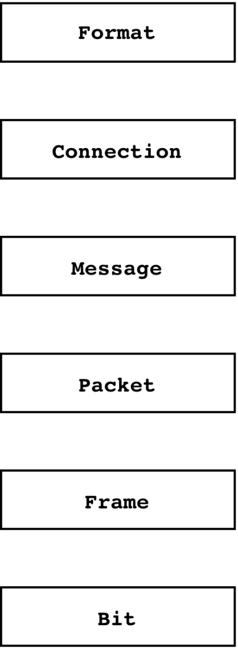
An Object-Oriented View of the OSI Model
The OSI Model is a closed software architecture (i.e., it uses opaque layering)
Each layer can be modeled as a UML package containing a set of classes available for the layer above
Notes:
An example of a closed architecture is the Reference Model of Open Systems Interconnection (in short, the OSI model) is composed of seven layers [Tanenbaum, 1996]. Each layer is responsible for performing a well defined function. In addition, each layer provides its services by using services by the layer below. The Physical layer represents the hardware interface to the network. It is responsible for transmitting bits over a communication channels. The DataLink layer is responsible for transmitting data frames without error using the services of the Physical layer. The Network layer is responsible for transmitting and routing packets within a network. The Transport layer is responsible for ensuring that the data is reliably transmitted from end to end. The Transport layer is the interface Unix programmers see when transmitting information over TCP/IP sockets between two processes. The Session layer is responsible for the initialization of a connection, including authentication. The Presentation layer performs data transformation services, such as byte swapping or encryption. The Application layer is the system you are designing (unless you are building an operating system or protocol stack). The application layer can and should, of course, also consist of layered subsystems.
An example of closed architecture: the OSI model (UML class diagram). The OSI model decomposes network services into seven layers, each responsible for a different level of abstraction.

Slide 42
Middleware Allows Focus On Higher Layers
Middleware
Abstraction provided
By Middleware
Application
Presentation
Object
CORBA or RMI
Session
Transport
Socket
Network
TCP/IP
DataLink
Physical
Ethernet
Wire

Slide 43
The Application Layer provides the Abstractions of the “New System”. It is usually layered itself
RMI,
CORBA
Application
Application
Presentation
Presentation
Session
Session
Bidirectional associa- tions for each layer
Transport
Transport
Protocol
Stack
Network
Network
Data Link
Data Link
Physical
Physical
Processor 1
Processor 2
Notes:
The application layer itself can be layered! This is shown on the next slide

Slide 44
Layer 1
Layer 1
Layer 2
Layer 3
Layer 2
Layer 4
Layer 3
Application Layer
Application Layer
Presentation Layer
Presentation Layer
Session Layer
Session Layer
Bidirectional associa- tions for each layer
Transport Layer
Transport Layer
Network Layer
Network Layer
Data Link Layer
Data Link Layer
Physical
Physical
Processor 1
Processor 2

Slide 45
Examples of Architectural Styles
  Layered Architectural Style
    Service-Oriented Architecture (SOA)
  Client/Server
  Peer-to-Peer
  Three-tier, Four-tier Architecture
  Repository
    Blackboard
  Model-View-Controller
  Pipes and Filters
Notes:
Styles are listed in Chapter 6, p. 237
We will talk about Client-Server, Peer-To-Peer, Repository and MVC,
Only in the book: Three-tier, Four-tier , Pipes and Filters

Slide 46
Client/Server Architectures
Often used in the design of database systems
  Front-end: User application (client)
  Back end: Database access and manipulation (server)
Functions performed by client:
  Input from the user (Customized user interface)
  Front-end processing of input data
Functions performed by the database server:
  Centralized data management
  Data integrity and database consistency
  Database security
Notes:
Often used in the design of database systems
Front-end: User application (client)
Back end: Database access and manipulation (server)
Functions performed by client:
Customized user interface, Front-end processing of data
Initiation of server remote procedure calls, Access to database server across the network
Functions performed by the database server:
Centralized data management, Data integrity and database consistency
Database security, Concurrent operations (multiple user access)
Centralized processing (for example archiving)

Slide 47
Client/Server Architectural Style
Special case of the Layered Architectural style
  One or many servers provide services to instances of subsystems, called clients
Each client calls on the server, which performs
some service and returns the result
  The clients know the interface of the server
  The server does not need to know the interface of the client
The response in general is immediate
End users interact only with the client.
Server
Client
*
*
+service1()
requester
provider
+service2()
+serviceN()

Slide 48
Design Goals for Client/Server Architectures
Service Portability
Server runs on many operating systems and many networking environments
Location-
Transparency
Server might itself be distributed, but provides a single "logical" service to the user
High Performance
Client optimized for interactive display-intensive tasks; Server optimized for CPU-intensive operations
Scalability
Server can handle large # of clients
Flexibility
User interface of client supports a variety of end devices (PDA, Handy, laptop, wearable computer)
A measure of success with which the
observed behavior of a system confirms to the
specification of its behavior (Chapter 11: Testing)
Reliability
Server should be able to survive client and communication problems.
Notes:
The server might itself be distributed (why?),
Service Portability
Server should run on a variety of operating systems and work in a variety of networking environments
Location-Transparency
The server might itself be distributed, but should provide a single "logical" service to the user
Performance
Client should be optimized for interactive display-intensive tasks
Server should provide CPU-intensive operations
Scalability
Server should have spare capacity to handle large number of clients
Flexibility
The system should be usable for a variety of user interfaces and end devices (eg. PDA, Handy, laptop, wearable computer)
Reliability
System should survive individual client and communication link problems

Slide 49
Problems with Client/Server Architectures
Client/Server systems do not provide peer-to-peer communication
Peer-to-peer communication is often needed
Example:
  Database must process queries from application and should be able to send notifications to the application when data have changed
application1:DBUser
1. updateData
database:DBMS
application2:DBUser
2. changeNotification

Slide 50
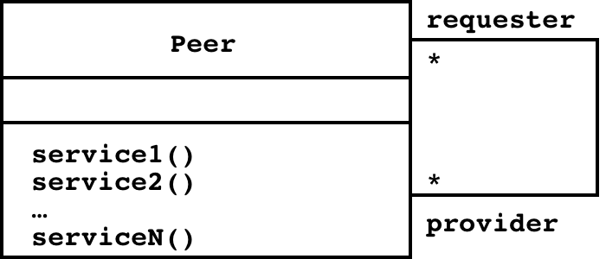
Peer-to-Peer Architectural Style
Generalization of Client/Server Architectural Style
“Clients can be servers and servers can be clients”
Introduction a new abstraction: Peer
“Clients and servers can be both peers”
How do we model this statement? With Inheritance?
Proposal 1: “A peer can be either a client or a server”
Proposal 2: “A peer can be a client as well as a server”.
Notes:
More difficult because of possibility of deadlocks
“A Peer is either a Client or a Server”What is the corresponding UML model?
Make a hint that leads to the answer, that Peer is a superclass for client and server! Use the phrase “either or” and refer to Abbott’s technique!

Slide 51
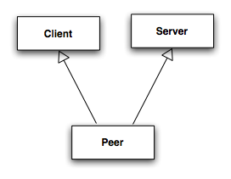
Relationship Client/Server & Peer-to-Peer
Problem statement “Clients can be servers and servers can be clients”
Which model is correct?
Model 1: “A peer can be either a client or a server”
Model 2: “A peer can be a client as well as a server”
?
Model 1
✔
Model 2
Client
Server
Notes:
More difficult because of possibility of deadlocks
“A Peer is either a Client or a Server”What is the corresponding UML model?
Make a hint that leads to the answer, that Peer is a superclass for client and server! Use the phrase “either or” and refer to Abbott’s technique!

Slide 52
3-Layer-Architectural Style
3-Tier Architecture
Definition: 3-Layered Architectural Style
  An architectural style, where an application consists of 3 hierarchically ordered subsystems
    A user interface, middleware and a database system
    The middleware subsystem services data requests between the user interface and the database subsystem
Definition: 3-Tier Architecture
  A software architecture where the 3 layers are allocated on 3 separate hardware nodes
Note: Layer is a type (e.g. class, subsystem) and Tier is an instance (e.g. object, hardware node)
Layer and Tier are often used interchangeably.

Slide 53
Virtual Machines in 3-Layered Architectural Style
A 3-Layered Architectural Style is a hierarchy of 3 virtual machines usually called presentation, application and data layer
Presentation Layer
(Client Layer)
Application Layer
(Middleware,
Business Logic)
Data Layer
Operating System, Libraries
Existing System
Notes:
Appeared first in 1965, proposed by Dijkstra, 1965, in the design of the T.H.E. system.

Slide 54
Example of a 3-Layered Architectural Style
Three-Layered Architectural style are often used for the development of Websites:
  1. The Web Browser implements the user interface
  2. The Web Server serves requests from the web browser
  3. The Database manages and provides access to the persistent data.

Slide 55
Example of a 4-Layered Architectural Style
4-Layer-architectural styles are usually used for the development of electronic commerce sites. The layers are
  The Web Browser, providing the user interface
  A Web Server, serving static HTML requests
  An Application Server, providing session management (for example the contents of an electronic shopping cart) and processing of dynamic HTML requests
  A back end Database, that manages and provides access to the persistent data
    In commercially available 4-tier architectures, this is usually a relational database management system (RDBMS).

Slide 56
Repository Architectural Style
The basic idea behind this architectural style is to support a collection of independent programs that work cooperatively on a common data structure called the repository
Subsystems access and modify data from the repository. The subsystems are loosely coupled (they interact only through the repository).
Repository
*
Subsystem
createData()
setData()
getData()
searchData()

Slide 57
Repository Architecture Example: Incremental Development Environment (IDE)
Compiler
SemanticAnalyzer
SyntacticAnalyzer
Optimizer
Parse
Tree
Symbol
Table
LexicalAnalyzer
CodeGenerator
Repository
ParseTree
SymbolTable
SyntacticEditor
SymbolicDebugger
Notes:
This is the architecture of modern interactive programming environments such as Eclipse: The compiler consists of several subsystems, such as syntactic analysis, semantic analsys, each of these subsystems read and write into the repository subsystems Parsetree and symboltable.
The symbol table can then be accessed by a symbolic debugger at runtime.
Hearsay II speech understanding system (“Blackboard architecture”)
Database Management Systems
Modern Development Environments (Eclipse, …)

Slide 58
From Repository to Blackboard
The repository architectural style does not specify any control
  The control flow is dictated by the repository
  through triggers or by the subsystems
  through locks and synchronization primitives
In the blackboard architectural style, we can model the controller more explicitly
  This style is used for solving problems for which an algorithmic solution does not (yet) exist
  => Buschmann et al 1995
  => WS 2009-10: Patterns in Software Engineering

Slide 59
Model-View-Controller Architectural Style
Problem: In systems with high coupling changes to the user interface (boundary objects) often force changes to the entity objects (data)
  The user interface cannot be reimplemented without changing the representation of the entity objects
  The entity objects cannot be reorganized without changing the user interface
Solution: Decoupling! The model-view-controller (MVC) style decouples data access (entity objects) and data presentation (boundary objects)
    Views: Subsystems containing boundary objects
    Model: Subsystem with entity objects
    Controller: Subsystem mediating between Views (data presentation) and Models (data access).

Slide 60
Model-View-Controller Architectural Style
Subsystems are classified into 3 different types
  Model subsystem: Responsible for application domain knowledge
  View subsystem: Responsible for displaying information to the user
  Controller subsystem: Responsible for interacting with the user and notifying views of changes in the model
Class Diagram
initiator
Controller
1
repository
*
Model
1
notifier
subscriber
View
*
Notes:
The MVC style is a special case of the repository architectural style:
Model subsystem implements the Repository, the Controller subsystem explicitly dictates the control flow
Example: Filesystem based on MVC

Slide 61
Example: Modeling the
Sequence of Events in MVC
UML Class Diagram
Controller
initiator
*
1
repository
Model
1
notifier
View
subscriber
*
4.0 User types new filename
:Controller
5.0 Request name change in model
1.0 Subscribe
:Model
7.0 Show updated views
6.0 Notify subscribers
:InfoView
3.0Subscribe
:FolderView
2.0Subscribe
:PowerpointView
UML Communication Diagram

Slide 62
Review: UML Communication Diagram
A Communication Diagram visualizes the interactions between objects as a flow of messages. Messages can be events or calls to operations
Communication diagrams describe the static struc-ture as well as the dynamic behavior of a system:
  The static structure is obtained from the UML class diagram
    Communication diagrams reuse the layout of classes and associations in the class diagram
  The dynamic behavior is obtained from the dynamic model (UML sequence diagrams and UML statechart diagrams)
    Messages between objects are labeled with a number and placed near the link the message is sent over
Reading a communication diagram involves starting at message 1.0, and following the messages from object to object.

Slide 63
MVC vs. 3-Tier Architectural Style
The MVC architectural style is nonhierarchical (triangular):
  View subsystem sends updates to the Controller subsystem
  Controller subsystem updates the Model subsystem
  View subsystem is updated directly from the Model
The 3-tier architectural style is hierarchical (linear):
  The presentation layer never communicates directly with the data layer (opaque architecture)
  All communication must pass through the middleware layer
History:
  MVC (1970-1980): Originated during the development of modular graphical applications for a single graphical workstation at Xerox Parc
  3-Tier (1990s): Originated with the appearance of Web applications, where the client, middleware and data layers ran on physically separate platforms.

Slide 64


Xerox Parc
Xerox PARC (Palo Alto Research Center)
Founded in 1970 by Xerox, since 2002 a separate company PARC (wholly owned by Xerox). Best known for the invention of
  Laser printer (1973, Gary Starkweather)
  Ethernet (1973, Bob Metcalfe)
  Modern personal computer (1973, Alto, Bravo)
  Graphical user interface (GUI) based on WIMP
    Windows, icons, menus and pointing device
      Based on Doug Engelbart´s invention
      of the mouse in 1965
  Object-oriented programming (Smalltalk, 1970s, Adele Goldberg)
  Ubiquitous computing (1990, Mark Weiser).

Slide 65
Pipes and Filters
A pipeline consists of a chain of processing elements (processes, threads, etc.), arranged so that the output of one element is the input to the next element
  Usually some amount of buffering is provided between consecutive elements
  The information that flows in these pipelines is often a stream of records, bytes or bits.

Slide 66
Pipes and Filters Architectural Style
An architectural style that consists of two subsystems called pipes and filters
  Filter: A subsystem that does a processing step
  Pipe: A Pipe is a connection between two processing steps
Each filter has an input pipe and an output pipe.
  The data from the input pipe are processed by the filter and then moved to the output pipe
Example of a Pipes-and-Filters architecture: Unix
  Unix shell command: ls -a l cat
A pipe
The Unix shell commands ls
and cat are Filter

Slide 67
Pipe and Filter Style

Slide 68
Pipe and Filter Style
Type of Data Flow Architecture
Filter is a component and pipe is a connector
Filter has interfaces from which a set of inputs can flow in and a set of outputs can flow out.
Incremental transformation of data by successive components.
All data does not need to be processed for next filter to start working.
Any set of filters may be combined in any order, although reasonable semantics are not guaranteed by this style.

Slide 69
Pipe and Filter Style
Filter
Independent entities
Does not share state with other filters.
No do not know the identity to upstream and downstream filters.
Pipes
Stateless data stream
Source end feeds filter input and sink receives output.

Slide 70
Pipeline Architecture
Common specialization of pipe and filter style is pipeline architecture
This architecture restricts the topologies to linear sequences of filters.

Slide 71
Pipe and Filter Style:
Advantages and Disadvantages
Advantages:
Simplicity – Allows designer to understand overall input/output behavior of a system in terms of individual filters.
Maintenance and reuse
Concurrent Execution –Each filter can be implemented as a separate task and be executed in parallel with other filters.

Slide 72
Pipe and Filter Style:
Advantages and Disadvantages
Disadvantages:
Interactive transformations are difficult – Filters being independent entities designer has to think of each filter as providing a complete transformation of input data to output data.
No filter cooperation.
Performance – may force a lowest common denominator on data transmission
-parse and unparse
-latency

Slide 73
Example
Compiler (Example of pipeline architecture)
Stages: Lexical analysis,parsing,semantic analysis, code generation
Programs written in Unix shell (Example of pipeline architecture)
ls –l *.java | grep “foobar” | lpr –P gaston
Functional programming
Kahn’s example. 3 models –each goes through 3 kinds of algebraic operations
Distributed systems.
    CORBA components : Push and pull model.

Slide 74
Summary
System Design
  Reduces the gap between problem and existing machine
Design Goals
  Describe important system qualities and values against which alternative designs are evaluated (design-tradeoffs)
  Additional nonfunctional requirements found at design time
Subsystem Decomposition
  Decomposes the overall system into manageable part by using the principles of cohesion and coherence
Architectural Style
  A pattern for a subsystem decomposition: All kind of layer styles (C/S, SOA, n-Tier), Repository, MVC, Pipes&Filters
Software architecture
  An instance of an architectural style.

Slide 75
Backup Slides

Slide 76
Example of Design Goals
Reliability
Modifiability
Maintainability
Understandability
Adaptability
Reusability
Efficiency
Portability
Traceability of requirements
Fault tolerance
Backward-compatibility
Cost-effectiveness
Robustness
High-performance
Good documentation
Well-defined interfaces
User-friendliness
Reuse of components
Rapid development
Minimum number of errors
Readability
Ease of learning
Ease of remembering
Ease of use
Increased productivity
Low-cost
Flexibility

