Slide 1
ENGL337
Predicate Logic 2

Slide 2
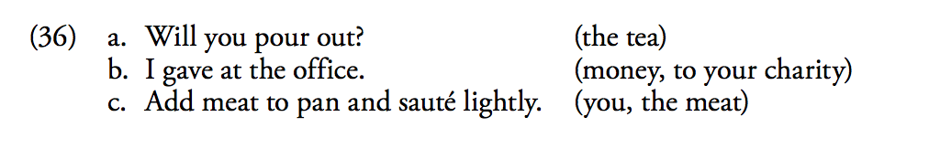
1. Illipsis

Slide 3
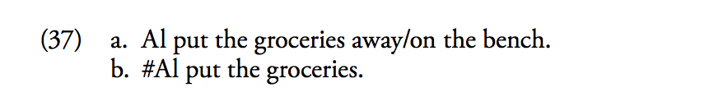
There is a general axiom in syntactic theory that all syntactic arguments of verbs (and possibly of other predicates) are obligatory, and must be expressed in a well-formed sentence. Ellipsis is a special exception to this general rule. This principle may be used to test whether or not a phrase is an argument of the verb

Slide 4
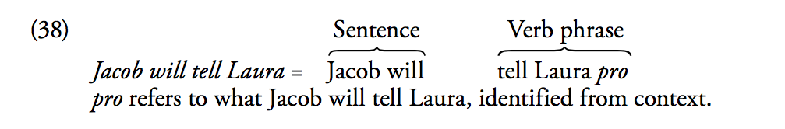
2. Silent Pronouns
This allows the obligatory argument principle to be maintained, as the silent pronoun counts as an expression of the argument in question, even though it is not pronounced. What it refers to is provided by the context, as is commonly the case with pronouns like he, she, they, etc.

Slide 5
Variable Adicity
The adicity of a predicate is the number of arguments it takes.
Types of adicity:
Monadic (= one-place)
Dyadic (= two-place)
Triadic (= three-place), and so on.

Slide 6
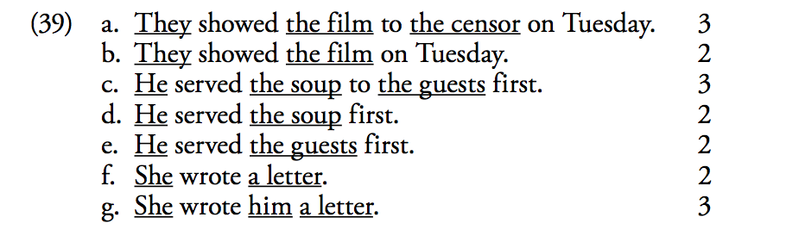
Verbs with Adicity
Verbs with variable adicity seem to have variable numbers of arguments in different sentences.
Discussing data like these, linguists refer informally to optional arguments, although strictly speaking an argument is obligatory by definition. Indispensability is part of what it is to be an argument.

Slide 7

Possible solutions?
An alternative is to maintain that all arguments are indeed obligatory, and that the sentence groups above do not contain the same verb – for example, the verb show in (39a), which has three arguments, is not the same as the two- argument verb show in (39b). In traditional syntactic theory the different vari- ants of verbs like these are represented in the lexicon with different sets of arguments. We will adopt this approach here, so that, for example, (39a) will be represented as (40a), and (39b) as (40b).

Slide 8
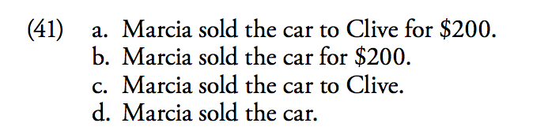
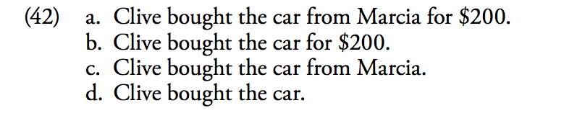
Exchange Verbs: where the semantic and syntactic indications diverge

Slide 9
More problems?
Yes! Problems like these show that the distinction between arguments and non- arguments is not always clear-cut, and in particular, that there are argument-like expressions which nevertheless appear to be syntactically optional.
For our purposes, we will assume that a semantically necessary argument (according to our best intuitions) is an argument. There are unclear cases.

Slide 10
It’s not always that difficult!
there are several types of expression that are easily identified as non-arguments, or adjuncts in syntactic terms. These include all kinds of adverbials, such as expressions of Time, Manner, and Place, and also Reason and Purpose.

Slide 11
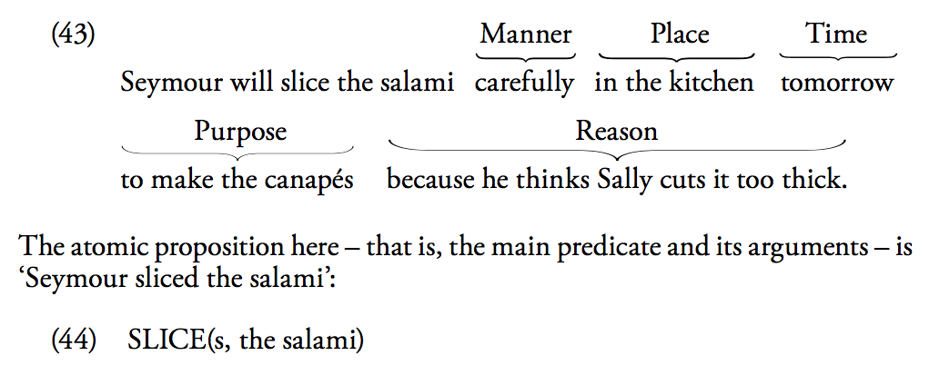
An Example:

