Slide 1
Thermal Fluid Engineering
ENMC4411
Chapter 4 Dimensional Analysis and similitude
Afif Akel Hasan
Mechanical & Mechatronics Engineering Department
Birzeit University

Slide 2
Outline
What and Why dimensional analysis?
Dimensionless groups
Pi- theorem
Formulating dimensionless groups
Similarity and scaling

Slide 3
Dimensional analysis
Dimensional analysis is a method for reducing the number complexity of experimental variables , which affected a given physical phenomenon .
In addition dimensional Analysis can be used to :
  check equation consistently : principle of dimensional homogeneity.
  Changing units .
  Permit limited results to be applied to situation involving different physical dimensions and fluids , providing scaling law from limited model test results to large real situations .

Slide 4
Basic dimensions
In fluid mechanics basic dimensions are ;
  Length L
  Time t
  mass m
  Temperature θ
However force could be used as basic dimension instead of the mass;
force F = ma = MLt⁻²

Slide 5
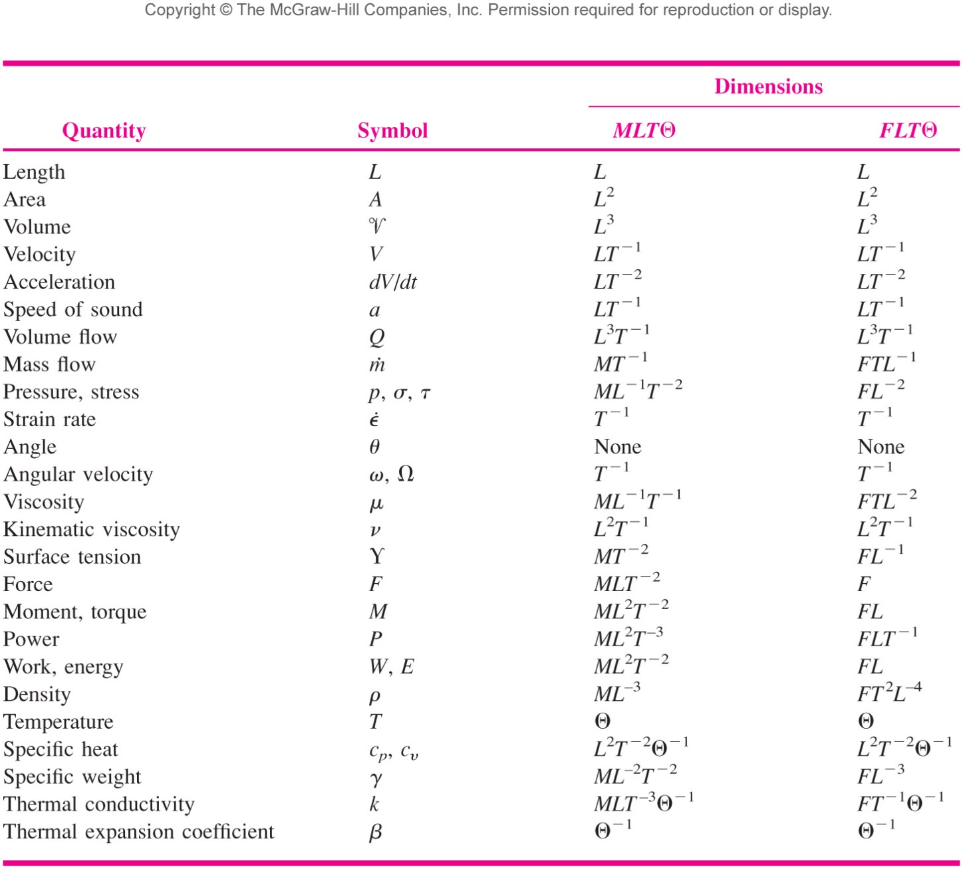
Derived dimensions
Afif Hasan- Birzeit University

Slide 6
Principle of dimensional homogeneity
If an equation truly expresses a proper relationship between variables in a physical process, it will be dimensionally homogeneous; i.e., each of its additive terms will have the same dimensions.
For example :
S = S₀ +V₀ t +0.5gt² for falling body
Bernoulli’s equation :
(P/ρ)+ 0.5V² + gz = constant , all have units of V² or (L² /t² )
Afif Hasan- Birzeit University

Slide 7
Dimensionless groups
A group of variables are dimensionless
Example : (Diameter / length ) = D/L , width/ length
Reynold number R_{e} = (ρVL/ μ ): [(M/L³)(L/t)(L)/(M/Lt)]
R_{e} = (VL/ ν ): (L/t)(L)/(L²/t)
Afif Hasan- Birzeit University

Slide 8
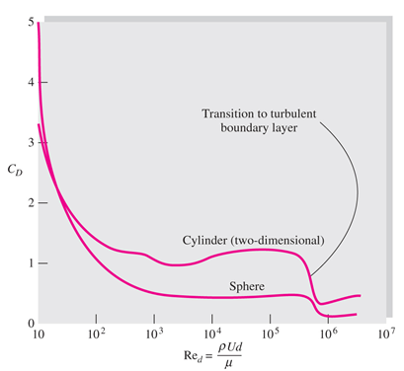
Example
Drag force F of a sphere with diameter D moving with velocity V through a fluid with properties ρ and μ is given as:
F = f(D,V,ρ, μ)
Huge number of experiments is needed to determine this function . You fix all but one variable and assuming each variable requires 10 experiments then you may need 10x10x10x10 = 10⁴ experiments.
Dimensional analysis reduces the above relation to
F/ ρ V² D² = g(ρ V D/μ) or C_{D} = g (R_{e})
Where C_{D} = (F / ρ V² D² ) ; R_{e} = (ρ V D/ μ)
Then analysis can be made by varying Re , and function can be specified.
Afif Hasan- Birzeit University

Slide 9
Pi- theorem
Reducing the number of dimensional variables into a small number of dimensionless groups.
Buckingham Pi theorem : the name Pi comes from the math notation Π meaning a products of variables .
The dimensionless groups are power products donated as Π₁ , Π₂ , ..Π₃ etc.
Pi theorem states that: The number of independent dimensionless groups that may be employed to describe a phenomenon known to involve “ n” variables is equal to n-r where r is the number of basic dimensions needed to express the variables dimensionally .
Afif Hasan- Birzeit University

Slide 10
Pi- theorem
If a physical process satisfies the PDH and involves n dimensional variables, it can be reduced to a relation between only k dimensionless variables or π’s. The reduction j = n- k equals the maximum number of variables which do not form a pi among themselves and is always less than or equal to the number of dimensions describing the variables.
j similar to r in previous equation π=n-r or n-j

Slide 11
Pi- theorem
Example : Drag of flowing sphere F= f (D,V,ρ,μ)
Number of variables n=5
Number of basic dimension r= 3 which are m, L and t
Note ρ : m/L³
V : L/t
D : L
μ : m/L.t
F : mL/t²
Number of dimensionless group π = n-r = 5-3 = 2
In this example π ₁ = ρ VD/ μ , π ₂ = F/ ρ V²D²
Afif Hasan- Birzeit University

Slide 12
Formulating the dimensionless groups
List all variables and write them in terms of the basic dimensions (MLTϴ)
Find number of Pis dimensionless group k=n-r
Choose the repeated variables or scaling variables : some time are specified by the problem . Those usually are equal to the basic dimensions , and will appear in each dimensionless group. Example choose density , velocity or length
Formulate the Pis from those repeated variables by raising each to certain power then multiply by another parameter, see example below.
Substitute the dimensions of each parameter in the Pis and then form the equations; by setting power for each dimension equal to the zero.
Solve the equations to find the power for each parameter.
Afif Hasan- Birzeit University

Slide 13
Formulating the pi’s
Find the reduction j, then select j scaling variables which do not form a pi among themselves. Each desired pi group will be a power product of these j variables plus one additional variable which is assigned any convenient nonzero exponent. Each pi group thus found is independent.
j scaling variables = repeated variables≤ basic dimensions
Pi1= (RV1)^{X1}*(RV2)^{y1}*(RV3)^{z1} …*additional variable
Pi2= (RV1)^{X2}*(RV2)^{y2}*(RV3)^{z2} …*another additional variable

Slide 14
Criteria for choosing the Repeated variables
The following hints help in choosing the repeated variables.
  contain : geometry variable length or diameter etc. ; property of fluid example ρ, μ, and velocity or flow U,Q
  Number of repeated variable equal or less than basic dimensions.
  Repeated variables contain all basic dimension T,L,M
  Repeated variables cannot form Pi group by themselves .
  Do not use output as repeated variable.
  Use more common ones as repeated avoid obscure ones.
Afif Hasan- Birzeit University

Slide 15
EXAMPLE 5.2
Repeat the development of Eq. (5.2) from Eq. (5.1), using the pi theorem.
Suppose one knew that the force F on a particular body immersed in a stream of fluid depended only on the body length L, stream velocity V, fluid density ρ , and fluid viscosity μ, that is,
Using dimensional analysis, we can reduce this to the equivalent form

Slide 16
Example 5.2 p.288
F= f (L,U,ρ,μ)
n=5
r=3
Pis = 5-3 = 2
ρ : mL⁻³ , U : LT⁻¹ , L : L , μ : mL⁻¹ T⁻¹ , F : mLT⁻²
Choose repeated variables L, U, ρ
Π₁ =LªU^{b}ρ^{c} F
Π₂ =LªU^{b}ρ^{c} μ
Form and solve equations
Π₁ = LªU^{b}ρ^{c} F = Lª (LT⁻¹ )^{b}(ML⁻³)^{c} MLT⁻² = M⁰L⁰T⁰
    L : 0 = a+b-3+1= 0
    M : 0 = c+1 ➔ c= -1
    T : 0 = -b-2 ➔ b= -2
    Then a = -2
Hence Π₁ = L⁻²U⁻²ρ⁻¹ F = ( F / LUρ )
Afif Hasan- Birzeit University

Slide 17
Example 5.2 p.288
Π₂ = LªU^{b}ρ^{c} μ : Lª(LT⁻¹)^{b} (ML⁻³)^{c} (ML⁻¹T⁻¹)
  L: a+b-3c-1 =0
  M: c+1 =0 ➔ c= -1 , a= 1-3+1 = -1
  T: -b-1 =0 ➔b= -1
  Π₂ = (μ/ρLU)
Π₂ =LªU^{b}ρ^{c} μ⁻¹ ;
  L: a+b-3c+1 =0
  M: c-1 =0 ➔ c= 1
  T: -b+1 =0 ➔b= 1
  Then a= 1
  Π₂ = (ρLU /μ) = R_{e}
Afif Hasan- Birzeit University

Slide 18
EXAMPLE 5.4
At low velocities (laminar flow), the volume flow Q through a small-bore tube is a function only of the tube radius R, the fluid viscosity , and the pressure drop per unit tube length dp/dx. Using the pi theorem, find an appropriate dimensionless relationship.
There are three primary dimensions (M, L, T), hence j =3. By trial and error we determine that R,μ, and dp/dx cannot be combined into a pi group. Then j = 3, and n - j = 4 – 3= 1. There is only one pi group, which we find by combining Q in a power product with the other three.
Afif Hasan- Birzeit University

Slide 19
EXAMPLE 5.4
Afif Hasan- Birzeit University

Slide 20
Table 5.2 Dimensionless Groups in Fluid Mechanics
Afif Hasan- Birzeit University

Slide 21
Afif Hasan- Birzeit University

Slide 22
Similitude or similarity
Relation between full- scale prototype flow and smaller model but geometrical similar boundaries.
To establish similarity or similitude 3 levels of similarity:
  Geometric similarity
  Kinematics similarity
  Dynamic similarity
Afif Hasan- Birzeit University

Slide 23
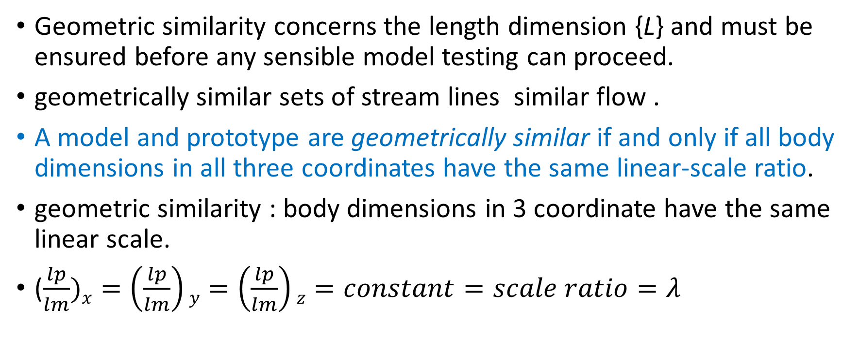
Geometrically similar flows
Geometric similarity concerns the length dimension {L} and must be ensured before any sensible model testing can proceed.
geometrically similar sets of stream lines similar flow .
A model and prototype are geometrically similar if and only if all body dimensions in all three coordinates have the same linear-scale ratio.
geometric similarity : body dimensions in 3 coordinate have the same linear scale.
($\frac{lp}{lm})x=\left(\frac{lp}{lm}\right)y=\left(\frac{lp}{lm}\right)z=constant=scale ratio=λ$
Afif Hasan- Birzeit University

Slide 24
Geometrically similar flows
If the model is to be made one-tenth the prototype size, its length, width, and height must each be one-tenth as large.
Not only that, but also its entire shape must be one-tenth as large, and technically we speak of homologous points, which are points that have the same relative location.
For example, the nose of the prototype is homologous to the nose of the model.
All angles are preserved in geometric similarity. All flow directions are preserved. The orientations of model and prototype with respect to the surroundings must be identical
Fig. 5.4 Geometric similarity in
model testing: (a) prototype;
(b) one-tenth-scale model.
Afif Hasan- Birzeit University

Slide 25
Kinematic Similarity
Kinematic similarity requires that the model and prototype have the same length-scale ratio and the same time-scale ratio.
The result is that the velocity-scale ratio will be the same for both.
The motions of two systems are kinematically similar if homologous particles lie at homologous points at homologous times.
Length-scale equivalence simply implies geometric similarity, but time-scale equivalence may require additional dynamic considerations such as equivalence of the Reynolds and Mach numbers.
Afif Hasan- Birzeit University

Slide 26
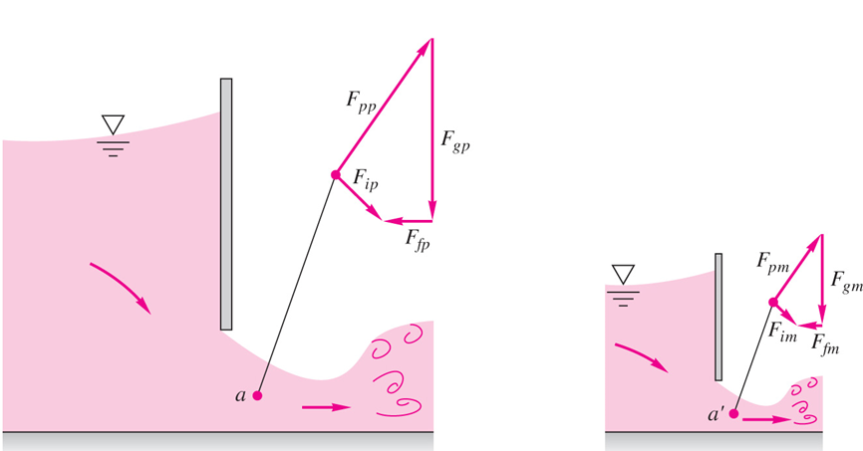
Dynamic Similarity
If viscosity, surface tension, or compressibility is important, kinematic similarity is dependent upon the achievement of dynamic similarity.
Dynamic similarity exists when the model and the prototype have the same length-scale ratio, time-scale ratio, and force-scale (or mass-scale) ratio.
Then dynamic similarity exists, simultaneous with kinematic similarity, if the model and prototype force and pressure coefficients are identical.
In dynamic similarity : at corresponding point of flow identical force are parallel ( pressure ,shear ) same ratio of forces at corresponding points.
Afif Hasan- Birzeit University

Slide 27
Similarity
Drag problem example a sphere drag
F/ρV²D² = C_{d} = g ( R_{e} )
Then ( R_{e} )_{m} = ( R_{e} )_{p}
Open channel flow
Froude number ( F_{r} )_{m} = ( F_{r} )_{p} → ( V²/Lg)_{m} = (V²/Lg)_{p}
Ship testing ( towing tank ) Re , Fr , Eu
Duplicate 2- groups
( R_{e} )_{m} = ( R_{e} )_{p} and ( F_{r} )_{m} = ( F_{r} )_{p}
Afif Hasan- Birzeit University

Slide 28
Example: problem 5.4
When tested in water at 20°C flowing at 2 m/s, an 8-cm-diameter sphere has a measured drag of 5 N. What will be the velocity and drag force on a 1.5-m-diameter weather balloon moored in sea-level standard air under dynamically similar conditions?
For water at 20°C take ρ ≈ 998 kg/m³ and μ ≈ 0.001 kg/m⋅s. For sea-level standard air take ρ ≈ 1.2255 kg/m³ and μ ≈ 1.78E-5 kg/m⋅s.
The balloon velocity follows from dynamic similarity, which requires identical Reynolds numbers
or V_{balloon} ≈ 1.55 m/s.
Afif Hasan- Birzeit University

Slide 29
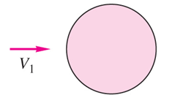

Example: problem 5.4
Then the two spheres will have identical drag coefficients:
Afif Hasan- Birzeit University

Slide 30
End of dimensional analysis

