Slide 1


Slide 2
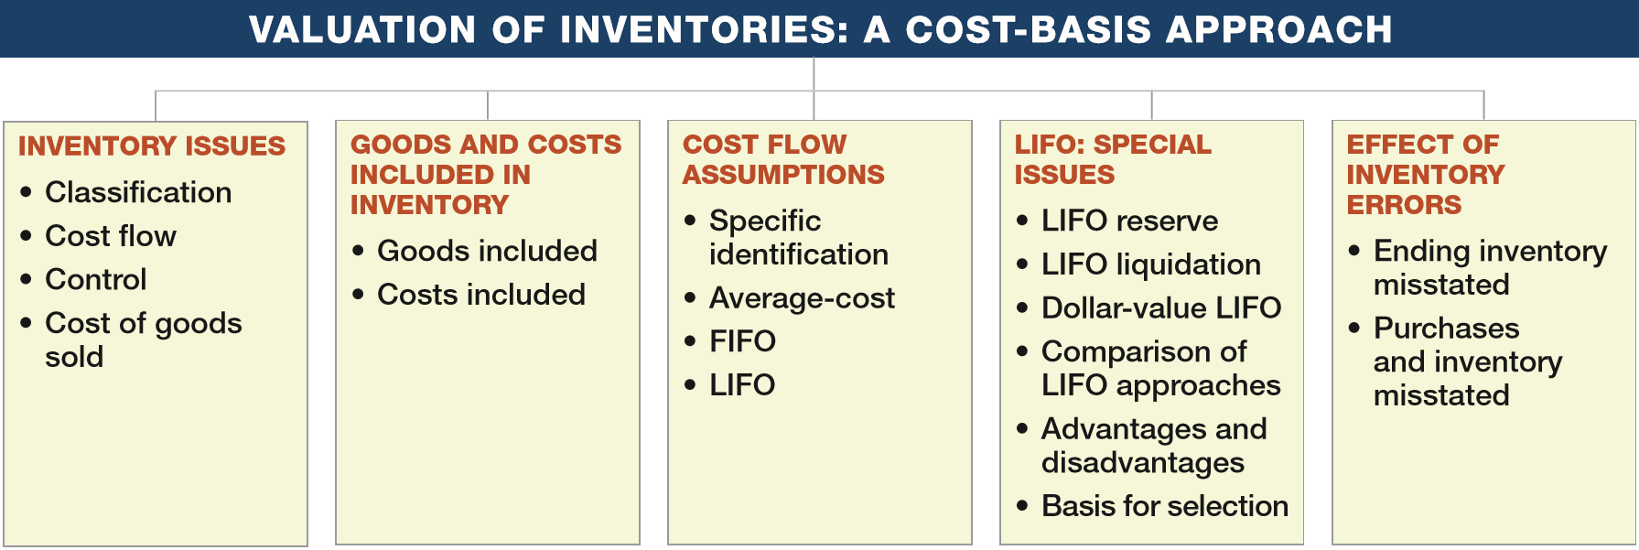
PREVIEW OF CHAPTER 8
Intermediate Accounting
16th Edition
Kieso ● Weygandt ● Warfield

Slide 3
LEARNING OBJECTIVES
8
Valuation of Inventories: A Cost-Basis Approach
After studying this chapter, you should be able to:
Understand inventory classifications and different inventory systems.
Determine the goods and costs included in inventory.
Describe and compare the cost flow assumptions used to account for inventories.
Identify special issues related to LIFO.
Determine the effects of inventory errors on the financial statements.
LO 1

Slide 4
INVENTORY ISSUES
Classification
Inventories are asset:
  items held for sale in the ordinary course of business, or
  goods to be used in the production of goods to be sold.
Businesses with Inventory
Merchandiser
or
Manufacturer
LO 1

Slide 5
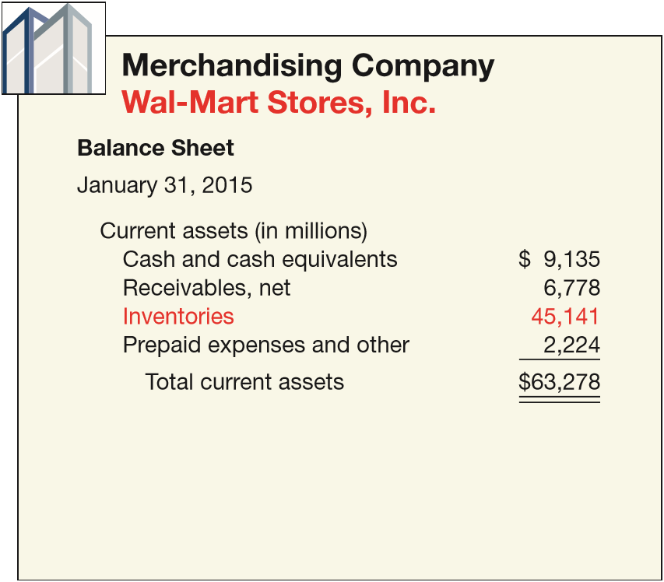
INVENTORY ISSUES
Classification
One inventory account.
Purchase merchandise in a form ready for sale.
ILLUSTRATION 8-1 Comparison of Presentation of Current Assets for Merchandising and Manufacturing Companies
LO 1

Slide 6
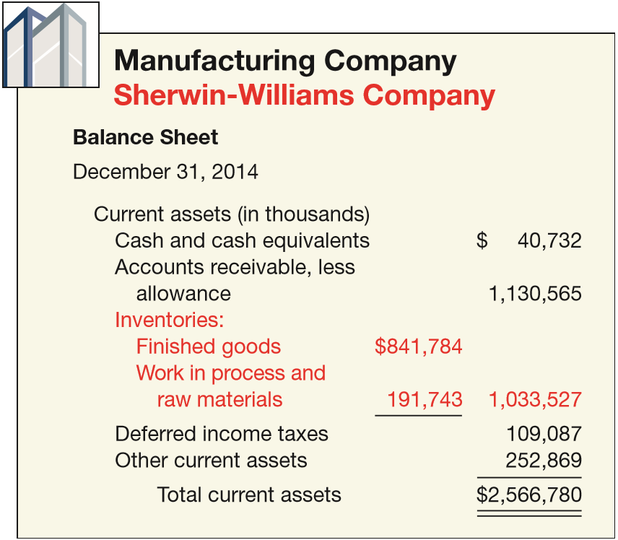
INVENTORY ISSUES
Classification
Three accounts
Raw Materials
Work in Process
Finished Goods
ILLUSTRATION 8-1 Comparison of Presentation of Current Assets for Merchandising and Manufacturing Companies
LO 1

Slide 7
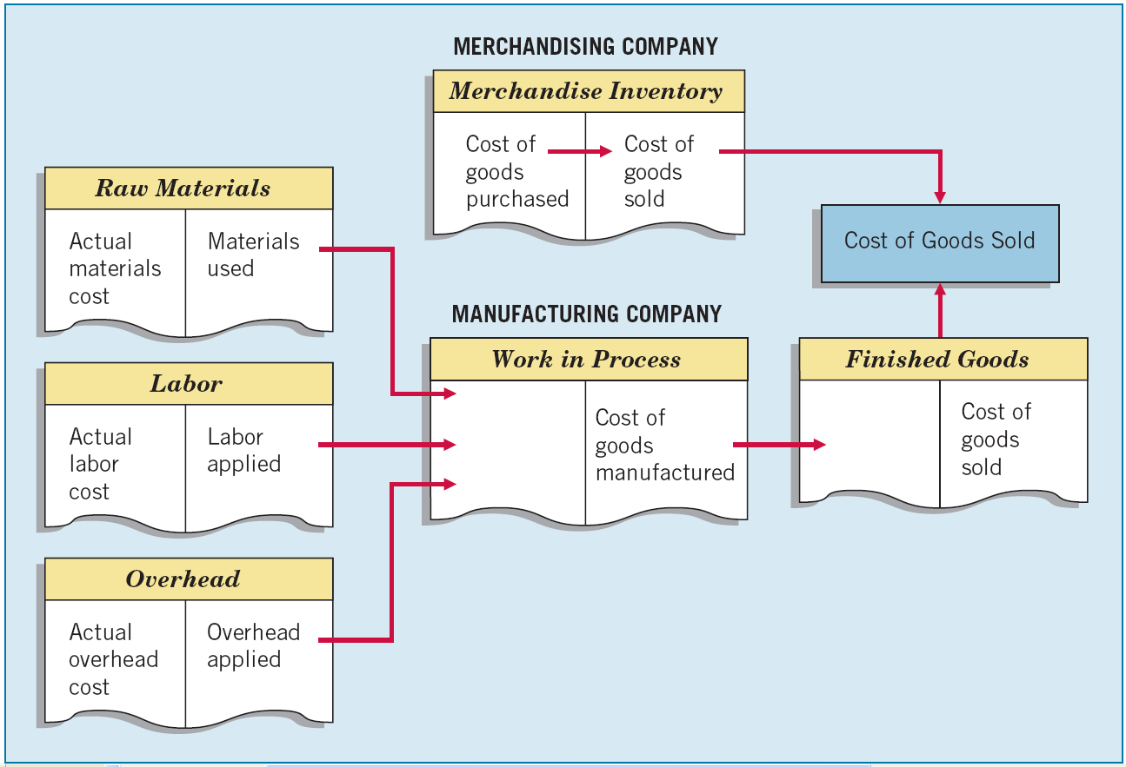
ILLUSTRATION 8-2
Flow of Costs through Manufacturing and Merchandising Companies
LO 1

Slide 8
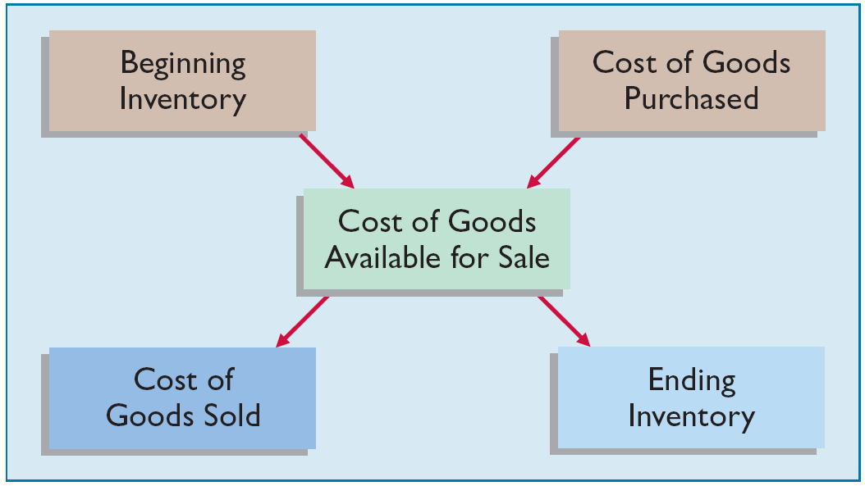
INVENTORY ISSUES
Inventory Cost Flow
ILLUSTRATION 8-3
Inventory Cost Flow
Two types of systems for maintaining inventory records — perpetual system or periodic system.
LO 1

Slide 9
Inventory Cost Flow
Perpetual System
Purchases of merchandise are debited to Inventory.
Freight-in is debited to Inventory. Purchase returns and allowances and purchase discounts are credited to Inventory.
Cost of goods sold is debited and Inventory is credited for each sale.
Subsidiary records show quantity and cost of each type of inventory on hand.
The perpetual inventory system provides a continuous record of Inventory and Cost of Goods Sold.
LO 1

Slide 10
Inventory Cost Flow
Periodic System
Purchases of merchandise are debited to Purchases.
Ending Inventory determined by physical count.
Calculation of Cost of Goods Sold:
Beginning inventory $ 100,000
Purchases, net + 800,000
Goods available for sale 900,000
Ending inventory - 125,000
Cost of goods sold $ 775,000
LO 1

Slide 11
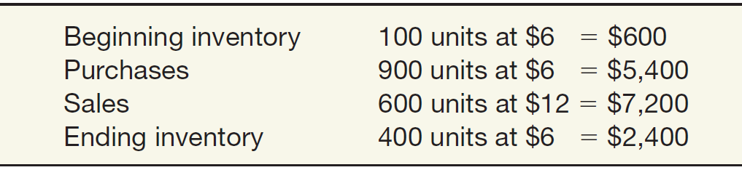
Inventory Cost Flow
Comparing Perpetual and Periodic System
Illustration: Fesmire Company had the following transactions during the current year.
Record these transactions using the Perpetual and Periodic systems.
LO 1

Slide 12
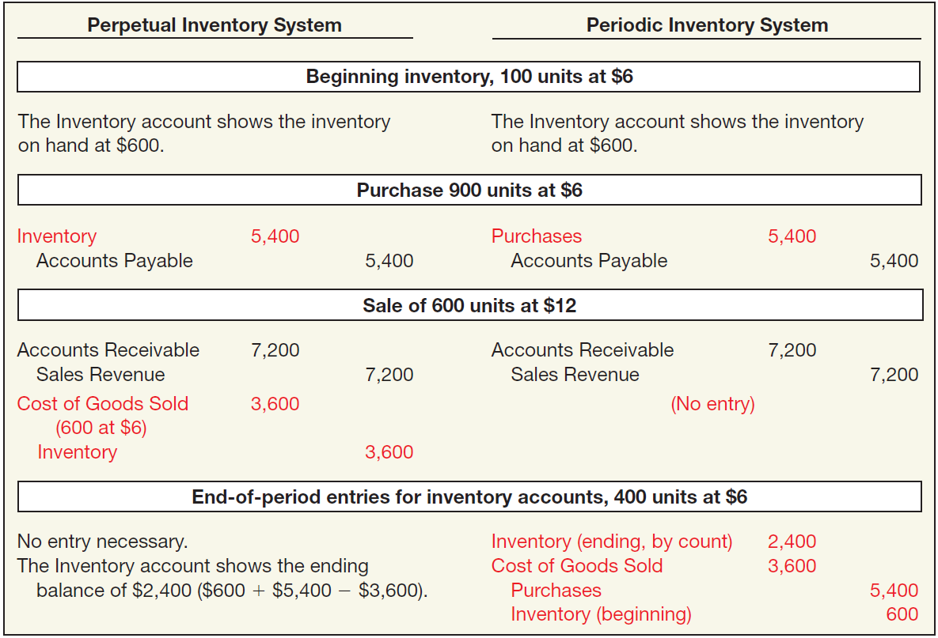

Inventory Cost Flow
ILLUSTRATION 8-4
Comparative Entries— Perpetual vs. Periodic
LO 1

Slide 13
Inventory Cost Flow
Illustration: Assume that at the end of the reporting period, the perpetual inventory account reported an inventory balance of $4,000. However, a physical count indicates inventory of $3,800 is actually on hand. The entry to record the necessary write-down is as follows.
Inventory Over and Short 200
Inventory 200
Note: Inventory Over and Short adjusts Cost of Goods Sold. In practice, companies sometimes report Inventory Over and Short in the “Other revenues and gains” or “Other expenses and losses” section of the income statement.
LO 1

Slide 14
INVENTORY ISSUES
Inventory Control
All companies need periodic verification of the inventory records
by actual count, weight, or measurement,
with counts compared with detailed inventory records.
Companies should take the physical inventory
near the end of their fiscal year,
to properly report inventory quantities in their annual accounting reports.
LO 1

Slide 15
WHAT DO THE NUMBERS MEAN? STAYING LEAN
WHAT’S YOUR PRINCIPLE
When you drop by a Walmart store, you are witnessing one of history’s greatest logistical and operational successes. As one article noted, the retail giant stocks products in more than 70 countries and at any given time operates more than 11,000 stores in 27 countries around the world. It manages an average of $32 billion in inventory.
With these kinds of numbers, having an effective and efﬁcient supply chain management system and a sound internal control system is imperative. For example, Walmart Stores, Inc. uses its buying power in the supply chain to purchase an increasing proportion of its goods directly from manufacturers and on a combined basis across geographic borders. Walmart estimates that it saves 5–15% across its supply chain by implementing direct purchasing on a combined basis for the 15 countries in which it operates. Thus, Wal-Mart has a good handle on what products it needs to stock, and it gets the best prices when it purchases.
Walmart also provides a classic example of the use of tight inventory
(continued)
LO 1

Slide 16
WHAT DO THE NUMBERS MEAN? STAYING LEAN
WHAT’S YOUR PRINCIPLE
controls. Department managers use a scanner that when placed over the bar code corresponding to a particular item, will tell them how many of the items the store sold yesterday, last week, and over the same period last year. It will tell them how many of those items are in stock, how many are on the way, and how many the neighboring Walmart stores are carrying (in case one store runs out). Walmart’s inventory management practices have helped it become one of the top-ranked companies on the Fortune 500 in terms of sales.
Sources: J. Birchall, “Walmart Aims to Cut Supply Chain Cost,” Financial Times (January 4, 2010); and http://www.tradegecko.com/blog/incrediblysuccessful-supply-chain-management-walmart.
LO 1

Slide 17
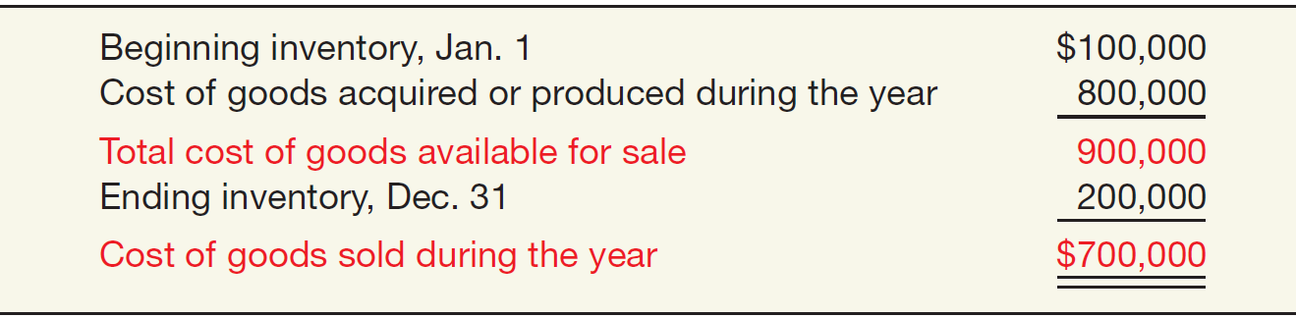
INVENTORY ISSUES
Determining Cost of Goods Sold
Companies must allocate the cost of all the goods available for sale (or use) between the goods that were sold or used and those that are still on hand.
ILLUSTRATION 8-5
Computation of Cost of Goods Sold
LO 1

Slide 18
LEARNING OBJECTIVES
8
Valuation of Inventories: A Cost-Basis Approach
After studying this chapter, you should be able to:
Understand inventory classifications and different inventory systems.
Determine the goods and costs included in inventory.
Describe and compare the cost flow assumptions used to account for inventories.
Identify special issues related to LIFO.
Determine the effects of inventory errors on the financial statements.
LO 2

Slide 19
GOODS AND COSTS INCLUDED IN INVENTORY
Goods Included in Inventory
A company recognizes inventory and accounts payable at the time it controls the asset.
Passage of title is often used to determine control because the rights and obligations are established legally.
LO 2

Slide 20
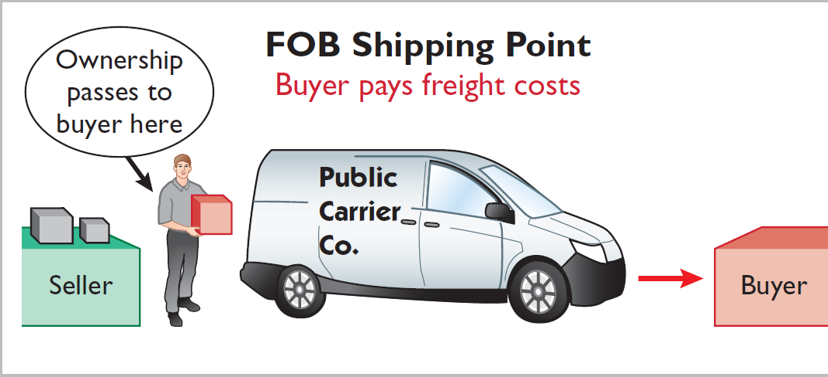
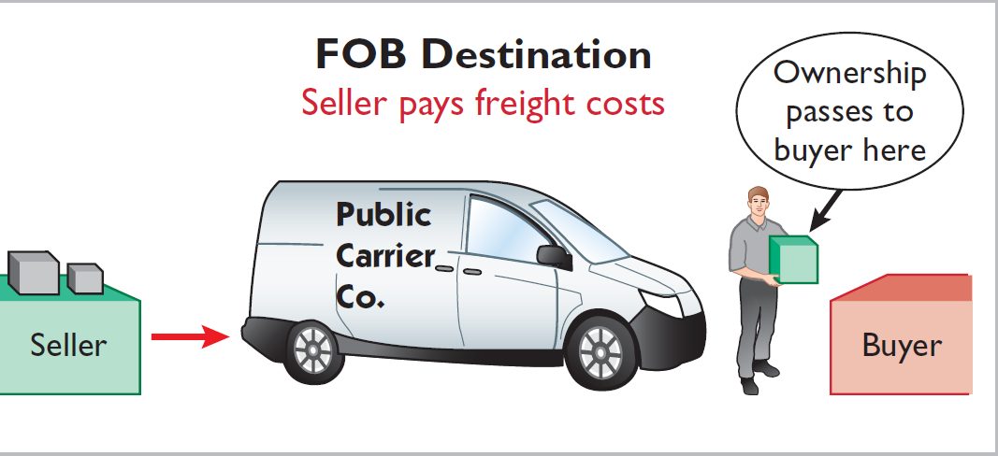
Goods Included in Inventory
Goods in Transit
Ownership of the goods passes to the buyer when the public carrier accepts the goods from the seller.
Ownership of the goods remains with the seller until the goods reach the buyer.
LO 2

Slide 21
Goods Included in Inventory
Consigned Goods
Goods out on consignment remain the property of the consignor.
The consignee makes no entry to the inventory account for goods received.
LO 2

Slide 22
Goods Included in Inventory
Special Sales Agreements
Sales with Repurchase Agreement.
Often referred to as a repurchase (or product financing) agreement, usually involves a transfer (sale) with either an implicit or explicit repurchase agreement.
These arrangements are often described in practice as “parking transactions.”
UNDERLYING CONCEPTS
Recognizing revenue at the time the inventory is “parked” violates the revenue recognition principle. That is, a performance obligation is not met because control has not been transferred to the buyer.
LO 2

Slide 23
Goods Included in Inventory
Special Sales Agreements
Sales with High Rates of Return.
Seller
Record sales revenue at the amount it expects to receive from the transaction.
Establishes an estimated inventory return account at the date of sale to recognize that some of its inventory will be returned.
LO 2

Slide 24
WHAT DO THE NUMBERS MEAN? NO PARKING!
WHAT’S YOUR PRINCIPLE
In one of the more elaborate accounting frauds, employees at Kurzweil Applied Intelligence Inc. booked millions of dollars in phony inventory sales during a two-year period that straddled two audits and an initial public stock offering. They dummied up phony shipping documents and logbooks to support bogus sales transactions. Then they shipped high-tech equipment, not to customers, but to a public warehouse for “temporary” storage, where some of it sat for 17 months. (Kurzweil still had ownership.)
To foil auditors’ attempts to verify the existence of the inventory, Kurzweil employees moved the goods from warehouse to warehouse. To cover the fraudulently recorded sales transactions as auditors closed in, the employees brought back the still-hidden goods, under the pretense that the goods were returned by customers. When auditors uncovered the fraud, the bottom dropped out of Kurzweil’s stock. Similar inventory shenanigans occurred at Delphi, which used side-deals with third parties to get inventory off its books and to record sales. The overstatement in income eventually led to a bankruptcy ﬁling for Delphi. More recently and
(continued)
LO 2

Slide 25
WHAT DO THE NUMBERS MEAN? NO PARKING!
WHAT’S YOUR PRINCIPLE
with an international twist, concerns about inventory shenanigans are surfacing in China. Following years of torrid growth, the global economic slowdown has resulted in a huge buildup of unsold goods that is cluttering shop ﬂoors, clogging car dealerships, and ﬁlling factory warehouses. The large inventory overhang is raising alarms about phantom proﬁts and suspect economic data coming out of China.
Sources: Adapted from “Anatomy of a Fraud,” BusinessWeek (September 16, 1996), pp. 90–94; J. McCracken, “Delphi Executives Named in Suit over Inventory Practices,” Wall Street Journal (May 5, 2005), p. A3; and K. Bradsher, “China Confronts Mounting Piles of Unsold Goods,” The New York Times (August 23, 2012).
LO 2

Slide 26
Costs Included in Inventory
Product Costs
Costs directly connected with bringing the goods to the buyer’s place of business and converting such goods to a salable condition.
Period Costs
Generally selling, general, and administrative expenses.
Treatment of Purchase Discounts
Gross vs. Net Method
LO 2

Slide 27
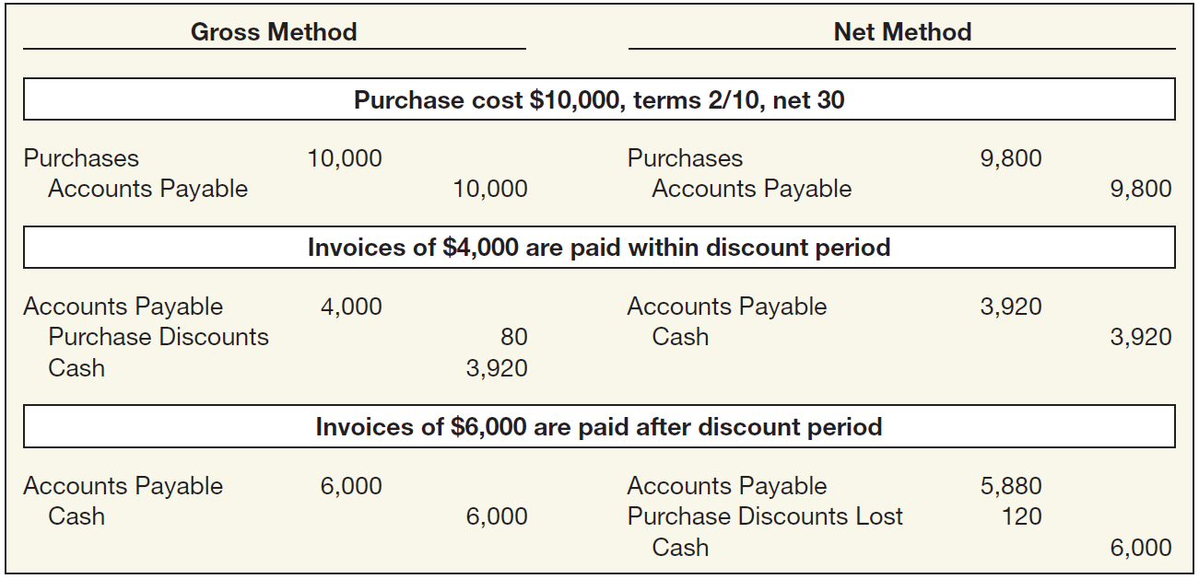
Costs Included in Inventory
Treatment of Purchase Discounts
ILLUSTRATION 8-6 Entries under Gross and Net Methods
**
*
* $4,000 x 2% = $80
** $10,000 x 98% = $9,800
LO 2

Slide 28
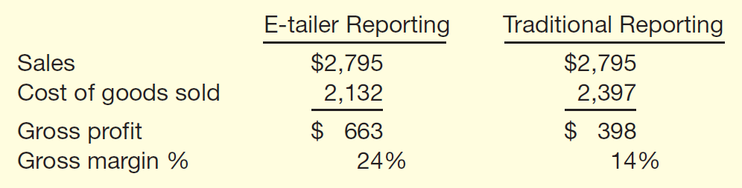
WHAT DO THE NUMBERS MEAN? YOU MAY NEED A MAP
WHAT’S YOUR PRINCIPLE
Does it really matter where a company reports certain costs in its income statement as long as it includes them all as expenses in computing income? For e-tailers, such as Amazon.com or Drugstore.com, where they report certain selling costs does appear to be important. Contrary to well-established retailer practices, these companies insist on reporting some selling costs—fulﬁllment costs related to inventory shipping and warehousing—as part of administrative expenses, instead of as cost of goods sold. This practice is allowable within GAAP, if applied consistently and adequately disclosed. Although the practice doesn’t affect the bottom line, it does make the e-tailers’ gross margins look better. For example, at one time Amazon reported $265 million of these costs in one quarter. Some experts
thought Amazon
should include
those charges in
costs of goods
(continued)
LO 2

Slide 29
WHAT DO THE NUMBERS MEAN? YOU MAY NEED A MAP
WHAT’S YOUR PRINCIPLE
sold, which would substantially lower its gross proﬁt, as shown below (in millions). Similarly, if Drugstore.com and eToys.com made similar adjustments, their gross margins would go from positive to negative. Thus, if you want to be able to compare the operating results of e-tailers to other traditional retailers, it might be a good idea to have a good accounting map in order to navigate their income statements and how they report certain selling costs.
Source: Adapted from P. Elstrom, “The End of Fuzzy Math?” BusinessWeek, e.Biz—Net Worth (December 11, 2000). According to GAAP [5], companies must disclose the accounting policy for classifying these selling costs in income.
LO 2

Slide 30
LEARNING OBJECTIVES
8
Valuation of Inventories: A Cost-Basis Approach
After studying this chapter, you should be able to:
Understand inventory classifications and different inventory systems.
Determine the goods and costs included in inventory.
Describe and compare the cost flow assumptions used to account for inventories.
Identify special issues related to LIFO.
Determine the effects of inventory errors on the financial statements.
LO 3

Slide 31
WHICH COST FLOW ASSUMPTIONS TO ADOPT?
Specific Identification
vs.
FIFO --- LIFO --- Average Cost
Cost Flow Assumption Adopted
does NOT need to be consistent with
Physical Movement of Goods
Method adopted should be one that most clearly reflects periodic income.
LO 3

Slide 32
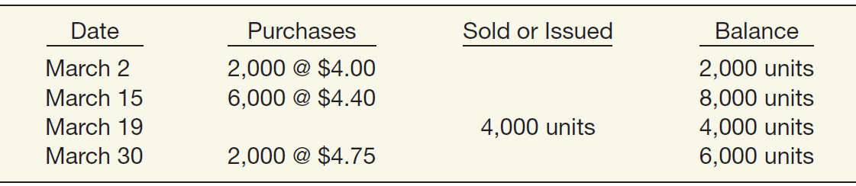
Which Cost Flow Assumptions to Adopt?
Illustration: Call-Mart Inc. had the following transactions in its first month of operations.
Calculate Goods Available for Sale
Beginning inventory (2,000 x $4) $ 8,000
Purchases:
6,000 x $4.40 26,400
2,000 x 4.75 9,500
Goods available for sale $43,900
LO 3

Slide 33
Which Cost Flow Assumptions to Adopt?
Specific Identification
  Includes in cost of goods sold the costs of the specific items sold.
  Used when handling a relatively small number of costly, easily distinguishable items.
  Matches actual costs against actual revenue.
  Cost flow matches the physical flow of the goods.
  May allow a company to manipulate net income.
LO 3

Slide 34
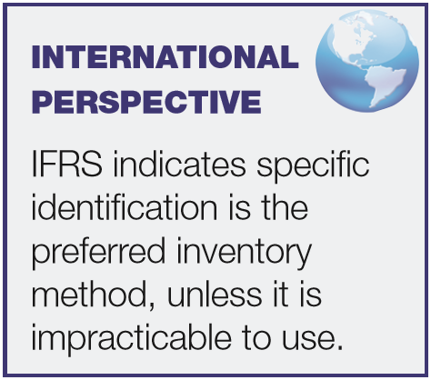
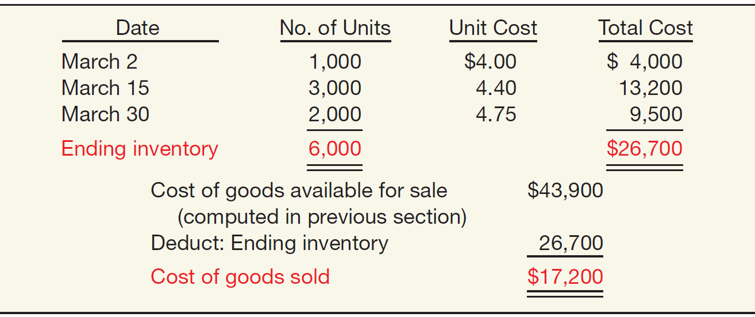
Specific Identification
Illustration: Call-Mart Inc.’s 6,000 units of inventory
consists of 1,000 units from the March 2 purchase, 3,000 from the March 15 purchase, and 2,000 from the March 30 purchase. Compute the amount of ending inventory and cost of goods sold.
ILLUSTRATION 8-7
LO 3

Slide 35
Which Cost Flow Assumptions to Adopt?
Average-Cost
  Prices items in the inventory on the basis of the average cost of all similar goods available during the period.
  Not as subject to income manipulation.
  Measuring a specific physical flow of inventory is often impossible.
LO 3

Slide 36
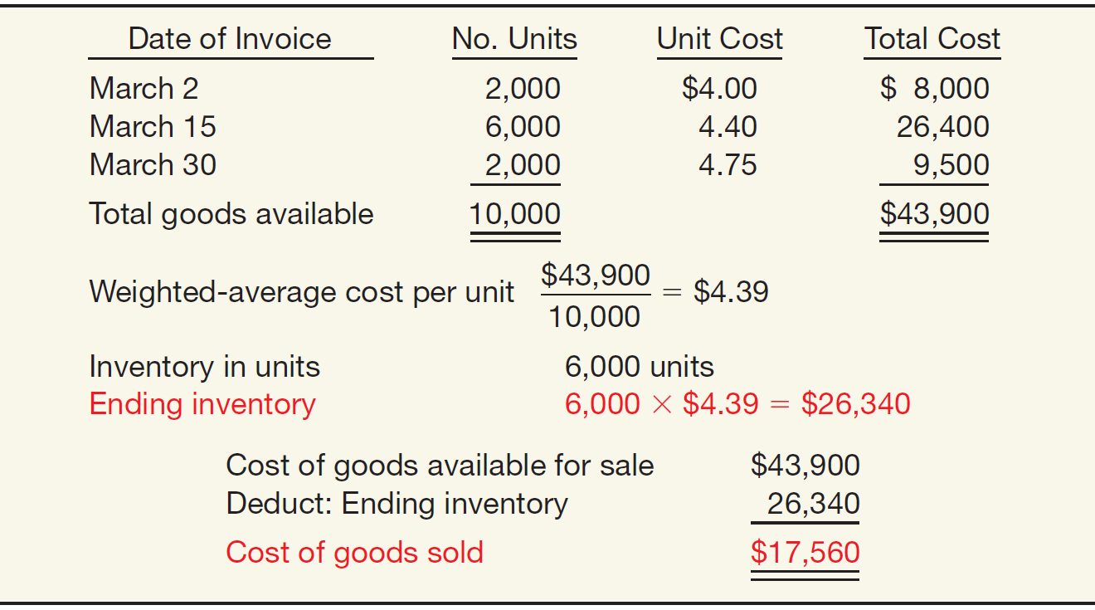
Average-Cost
Weighted-Average Method
ILLUSTRATION 8-8
Weighted-Average Method—Periodic Inventory
Advance slide in presentation mode to reveal answer.
LO 3

Slide 37
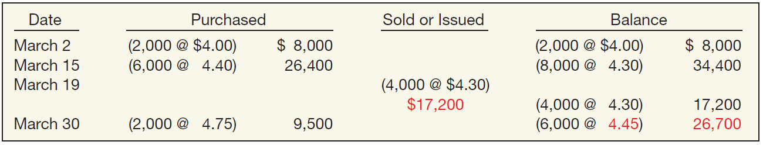
Average-Cost
Moving-Average Method
ILLUSTRATION 8-9
Moving-Average Method—Perpetual Inventory
In this method, Call-Mart computes a new average unit cost each time it makes a purchase.
LO 3

Slide 38
Which Cost Flow Assumptions to Adopt?
First-In, First-Out (FIFO)
  Assumes goods are used in the order in which they are purchased.
  Approximates the physical flow of goods.
  Ending inventory is close to current cost.
  Fails to match current costs against current revenues.
LO 3

Slide 39
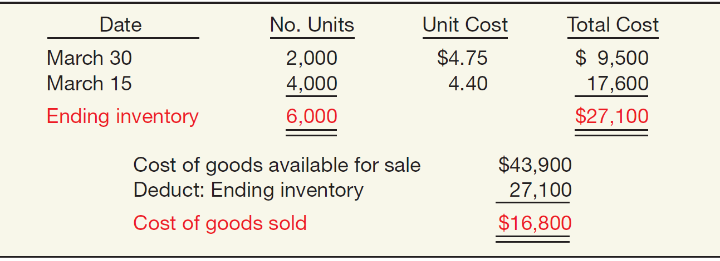
First-In, First-Out (FIFO)
Periodic Inventory System
ILLUSTRATION 8-10
FIFO Method—Periodic Inventory
Determine cost of ending inventory by taking the cost of the most recent purchase and working back until it accounts for all units in the inventory.
LO 3

Slide 40
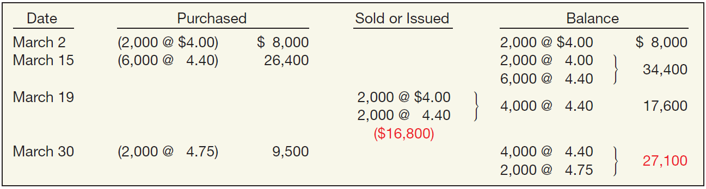
First-In, First-Out (FIFO)
Perpetual Inventory System
ILLUSTRATION 8-11
FIFO Method—Perpetual Inventory
In all cases where FIFO is used, the inventory and cost of goods sold would be the same at the end of the month whether a perpetual or periodic system is used.
LO 3

Slide 41
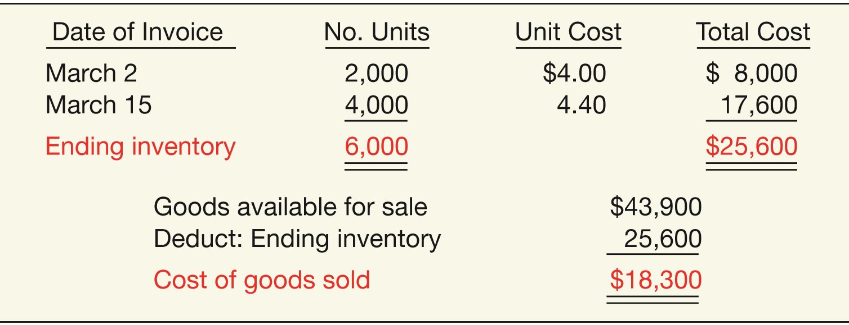

Last-In, First-Out (LIFO)
Periodic Inventory System
ILLUSTRATION 8-12
LIFO Method—Periodic Inventory
The cost of the total quantity sold or issued during the month comes from the most recent purchases.
LO 3

Slide 42
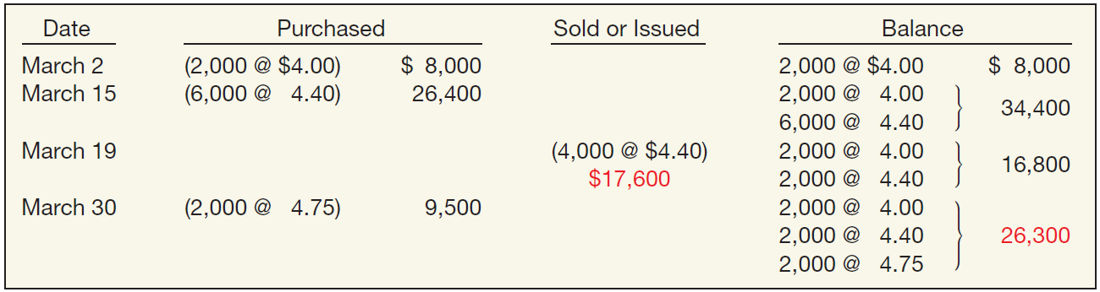
Last-In, First-Out (LIFO)
Perpetual Inventory System
ILLUSTRATION 8-13
LIFO Method—Perpetual Inventory
The LIFO method results in different ending inventory and cost of goods sold amounts than the amounts calculated under the periodic method.
LO 3

Slide 43
LEARNING OBJECTIVES
8
Valuation of Inventories: A Cost-Basis Approach
After studying this chapter, you should be able to:
Understand inventory classifications and different inventory systems.
Determine the goods and costs included in inventory.
Describe and compare the cost flow assumptions used to account for inventories.
Identify special issues related to LIFO.
Determine the effects of inventory errors on the financial statements.
LO 4

Slide 44
SPECIAL ISSUES RELATED TO LIFO
LIFO Reserve
Many companies use
  LIFO for tax and external financial reporting purposes.
  FIFO, average cost, or standard cost system for internal reporting purposes.
Reasons:
Pricing decisions.
Recordkeeping easier.
Profit-sharing or bonus arrangements.
LIFO troublesome for interim periods.
LO 4

Slide 45
SPECIAL ISSUES RELATED TO LIFO
LIFO Reserve is the difference between the inventory method used for internal reporting purposes and LIFO.
Illustration: Acme Boot Company uses the FIFO method for internal
reporting purposes and LIFO for external reporting purposes. At January 1, 2017, the Allowance to Reduce Inventory to LIFO balance is $20,000. At December 31, 2017, the balance should be $50,000. As a result, Acme Boot realizes a LIFO effect and makes the following entry at year-end.
Journal entry to reduce inventory to LIFO:
Cost of Goods Sold 30,000
Allowance to Reduce Inventory to LIFO 30,000
LO 4

Slide 46
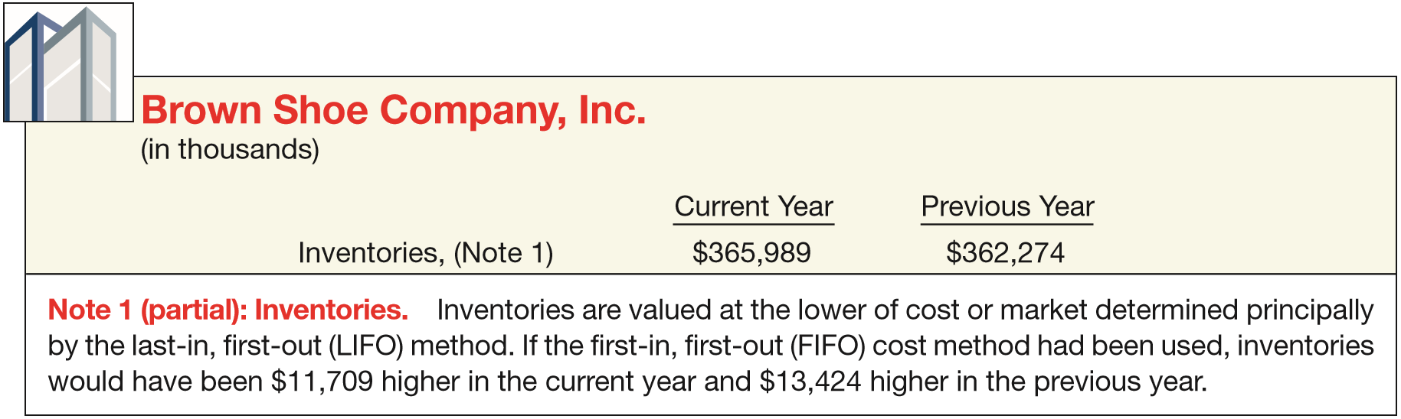
SPECIAL ISSUES RELATED TO LIFO
LIFO Reserve
Companies should disclose either the LIFO reserve or the replacement cost of the inventory
ILLUSTRATION 8-14
Note Disclosure of LIFO Reserve
Illustration 8-19
LO 4

Slide 47
WHAT DO THE NUMBERS MEAN? COMPARING APPLES TO APPLES
WHAT’S YOUR PRINCIPLE
Investors commonly use the current ratio to evaluate a company’s liquidity. They compute the current ratio as current assets divided by current liabilities. A higher current ratio indicates that a company is better able to meet its current obligations when they come due. However, it is not meaningful to compare the current ratio for a company using LIFO to one for a company using FIFO. It would be like comparing apples to oranges since the two companies measure inventory (and cost of goods sold) differently. To make the current ratio comparable on an apples-to-apples basis, analysts use the LIFO reserve. The following adjustments should do the trick:
(For cost of goods sold, deduct the change in the LIFO reserve from LIFO cost of goods sold to yield the comparable FIFO amount.) For Brown Shoe, Inc. (see Illustration 8-14), with current assets of $487.8 million and current liabilities of $217.8 million, the current ratio using LIFO is $487.8 ÷ $217.8 = 2.2. After adjusting for the LIFO effect, Brown Shoe’s current ratio under FIFO would be ($487.8 + $11.7) ÷ $217.8 = 2.3. Thus, without the LIFO adjustment, the Brown Shoe current ratio is understated.
LO 4

Slide 48
SPECIAL ISSUES RELATED TO LIFO
LIFO Liquidation
Older, low cost inventory is sold resulting in a lower cost of goods sold, higher net income, and higher taxes.
The specific-goods approach to costing LIFO inventories is often unrealistic for two reasons:
Accounting cost of tracking each inventory item is expensive.
Erosion of the LIFO inventory can easily occur (LIFO liquidation) which often distorts net income and leads to substantial tax payments.
LO 4

Slide 49
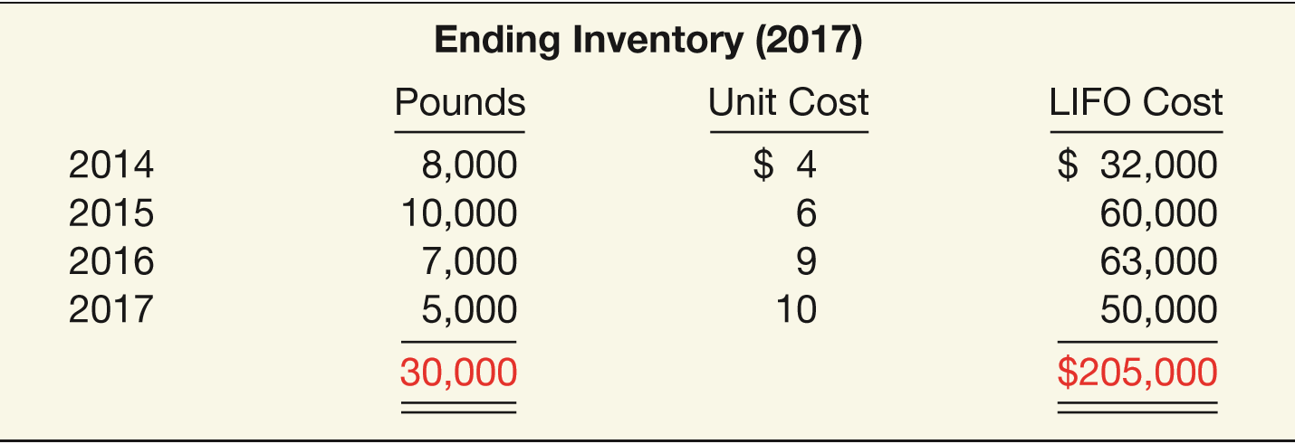
LIFO Liquidation
Illustration: Basler Co. has 30,000 pounds of steel in its inventory on December 31, 2017, with cost determined on a specific-goods LIFO approach.
LO 4

Slide 50
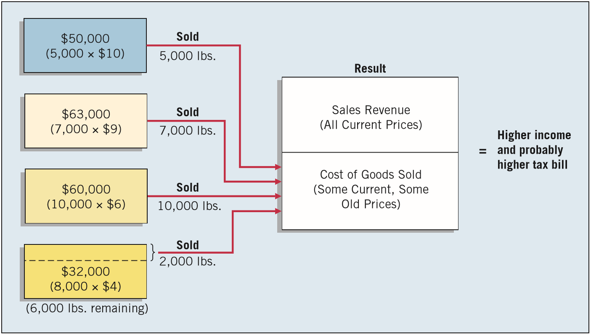
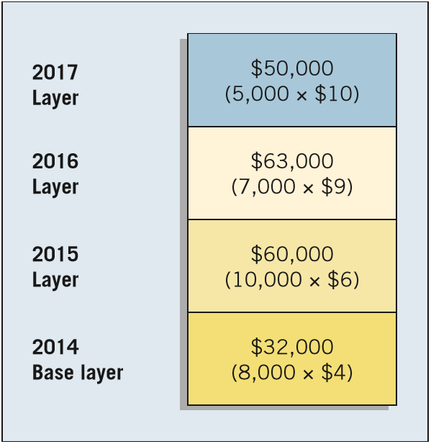
LIFO Liquidation
Illustration: At the end of 2018, only 6,000 pounds of steel remained in inventory.
ILLUSTRATION 8-15
Layers of LIFO Inventory
ILLUSTRATION 8-16
LIFO Liquidation
LO 4

Slide 51
SPECIAL ISSUES RELATED TO LIFO
Dollar-Value LIFO
Increases and decreases in a pool are measured in terms of total dollar value, not physical quantity of goods.
Advantage:
  Broader range of goods in pool.
  Permits replacement of goods that are similar.
  Helps protect LIFO layers from erosion.
LO 4

Slide 52
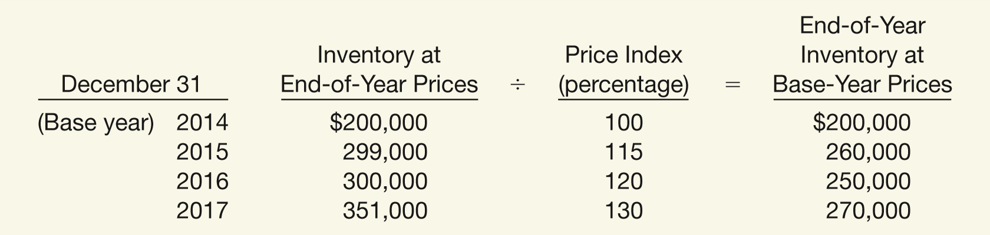
Dollar-Value LIFO
Illustration: Assume that Bismark Company develops the following information.
Use the dollar-value LIFO method to compute the ending inventory for 2014 through 2017.
LO 4

Slide 53
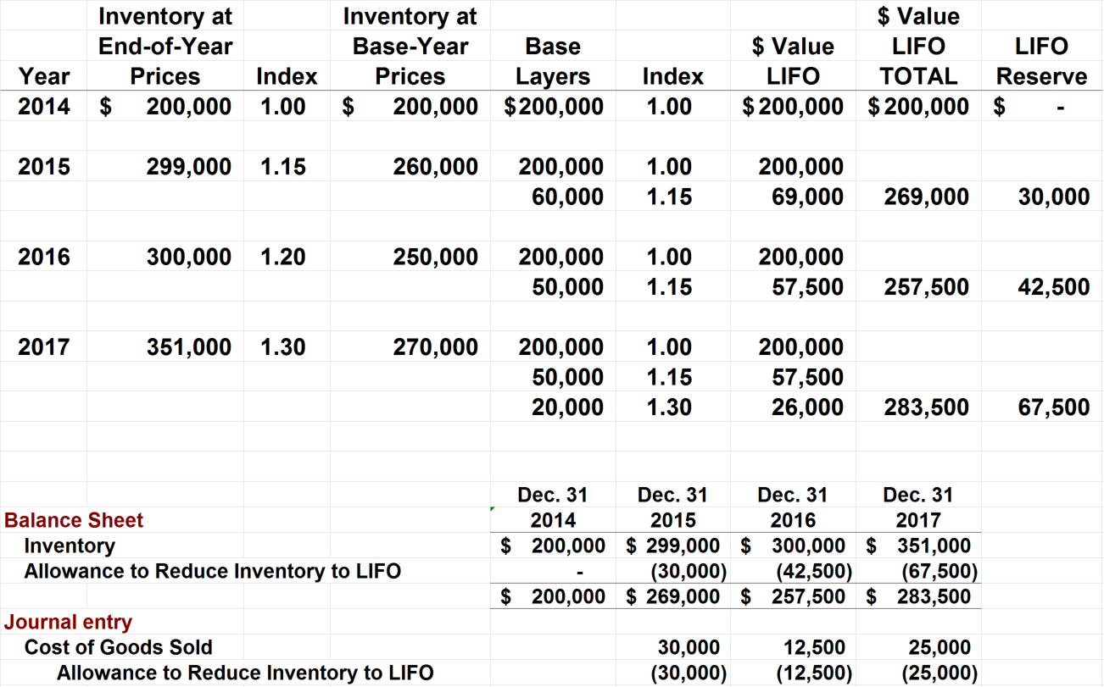
Dollar-Value LIFO
0
LO 4

Slide 54
Dollar-Value LIFO
Selecting a Price Index
  Many companies use the general price-level index that the federal government publishes each month.
  Most popular is the Consumer Price Index for Urban Consumers (CPI-U).
  Companies also use more-specific external price indexes.
  Company may compute its own specific internal price index.
Illustration 8-21
Formula for Computing a Price Index
LO 4

Slide 55
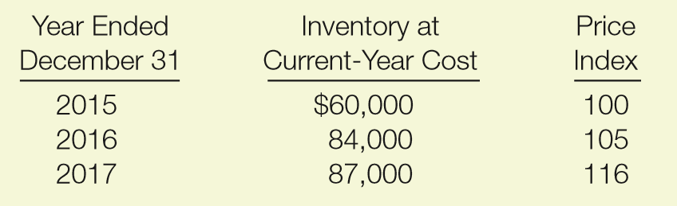
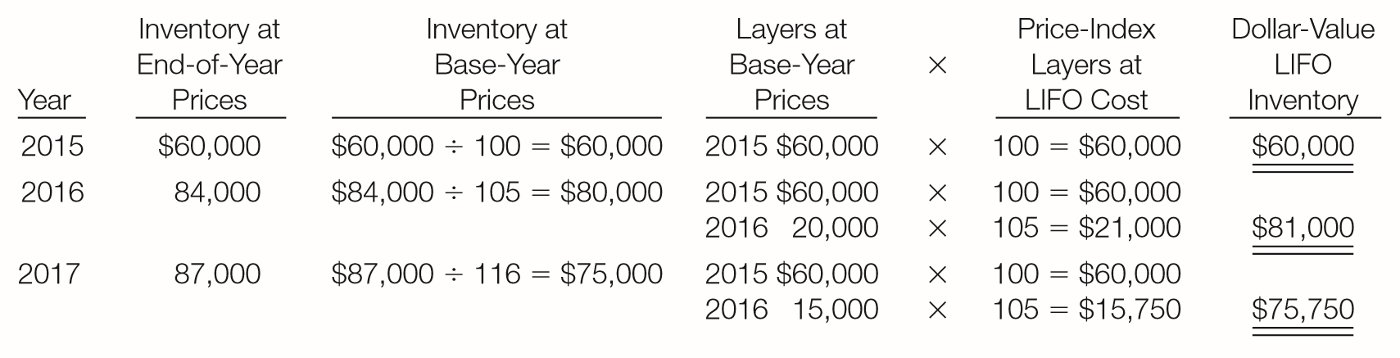
WHAT DO THE NUMBERS MEAN? QUITE A DIFFERENCE
WHAT’S YOUR PRINCIPLE
As indicated, signiﬁcant differences can arise in inventory measured according to current cost and dollar-value LIFO. Let’s look at an additional summary example. Truman Company uses the dollar-value LIFO method of computing its inventory. Inventory for the last three years is as shown below. The values of the 2015, 2016, and 2017 inventories using
the dollar-value LIFO method
are presented in the table
below. As indicated,
consistent with LIFO
costing in times of rising
(continued)
LO 4

Slide 56
WHAT DO THE NUMBERS MEAN? QUITE A DIFFERENCE
WHAT’S YOUR PRINCIPLE
prices, the dollar-value LIFO inventory amount is less than inventory stated at end-of-year prices. The company did not add layers at the 2017 prices. This is because the increase in inventory at end-of-year (current) prices was primarily due to higher prices. Also, establishing the LIFO layers based on price-adjusted dollars relative to base-year layers reduces
the likelihood of a LIFO
liquidation.
LO 4

Slide 57
SPECIAL ISSUES RELATED TO LIFO
Comparison of LIFO Approaches
Specific-goods LIFO - costing goods on a unit basis is expensive and time consuming.
Specific-goods pooled LIFO approach.
  Reduces record keeping and clerical costs.
  More difficult to erode the layers.
  Using quantities as measurement basis can lead to untimely LIFO liquidations.
Dollar-value LIFO is used by most companies.
LO 4

Slide 58
SPECIAL ISSUES RELATED TO LIFO
Advantages
Disadvantages
Matching
Tax Benefits/Improved Cash Flow
Future Earnings Hedge
Reduced Earnings
Inventory Understated
Physical Flow
Involuntary Liquidation / Poor Buying Habits
LO 4

Slide 59
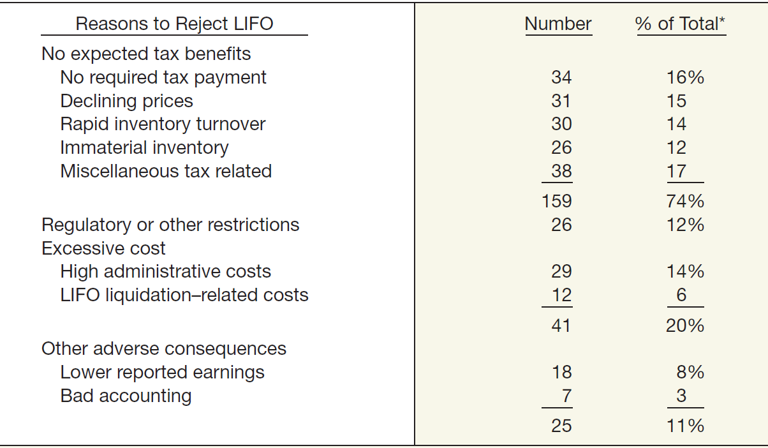
SPECIAL ISSUES RELATED TO LIFO
ILLUSTRATION 8-24
Why Do Companies Reject LIFO? Summary of Responses
LO 4

Slide 60
Basis for Selection of Inventory Method
LIFO is generally preferred:
  If selling prices and revenues are increasing faster than costs and
  If a company has a fairly constant “base stock.”
LIFO is not appropriate:
  Where prices tend to lag behind costs,
  If specific identification traditionally used, and
  Where unit costs tend to decrease as production increases.
LO 4

Slide 61

Basis for Selection of Inventory Method
Tax consequences are another consideration.
Switching from FIFO to LIFO usually results in an immediate tax benefit.
Concern about reduced income resulting from adoption of LIFO has even less substance now because the IRS has also relaxed the LIFO conformity rule.
Companies are able to disclose
FIFO income numbers in the
financial reports if they so desire.
LO 4

Slide 62
EVOLVING ISSUE REPEAL LIFO!
WHAT’S YOUR PRINCIPLE
In some situations, use of LIFO can result in signiﬁcant tax savings for companies. For example, Sherwin-Williams Company estimates its tax bill would increase by $16 million if it were to change from LIFO to FIFO. The option to use LIFO to reduce taxes has become a political issue because of the growing federal deﬁcit. Some are proposing elimination of LIFO (and other tax law changes) to help reduce the 2016 ﬁscal year budget deﬁcit. Why pick on LIFO? Well, one estimate indicates that repeal of LIFO would help plug the budget deﬁcit with over $76 billion in additional tax collections over 10 years. In addition, since IFRS does not permit LIFO, its repeal will contribute to international accounting convergence.
Sources: R. Bloom and W. Cenker, “The Death of LIFO?” Journal of Accountancy (January 2009), pp. 44–49; and A. Lundeen, “Proposed Tax Changes in President Obama’s Fiscal Year 2016 Budget,” http://taxfoundation.org/blog/proposed-tax-changes-president-obama-s-fiscal-year-2016-budget (February 11, 2015).
LO 4

Slide 63
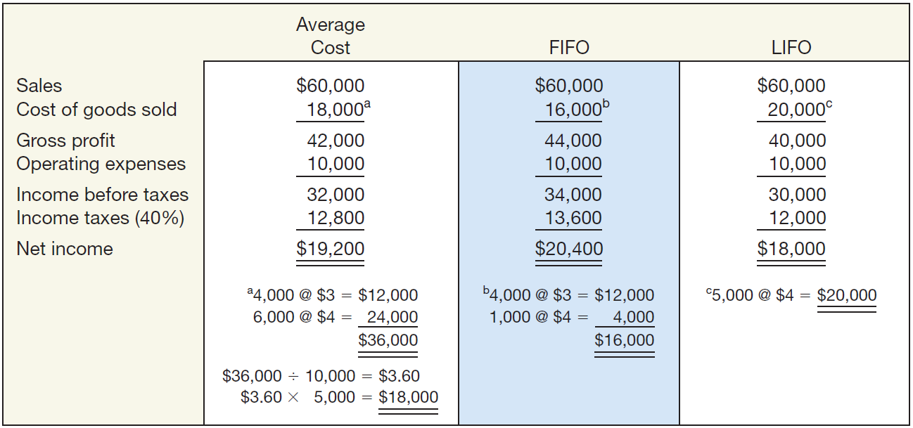
Inventory Valuation Methods - Summary
ILLUSTRATION 8-26
Comparative Results of Average-Cost, FIFO, and LIFO Methods
Notice that gross profit and net income are lowest under LIFO, highest under FIFO, and somewhere in the middle under average-cost.
LO 4

Slide 64
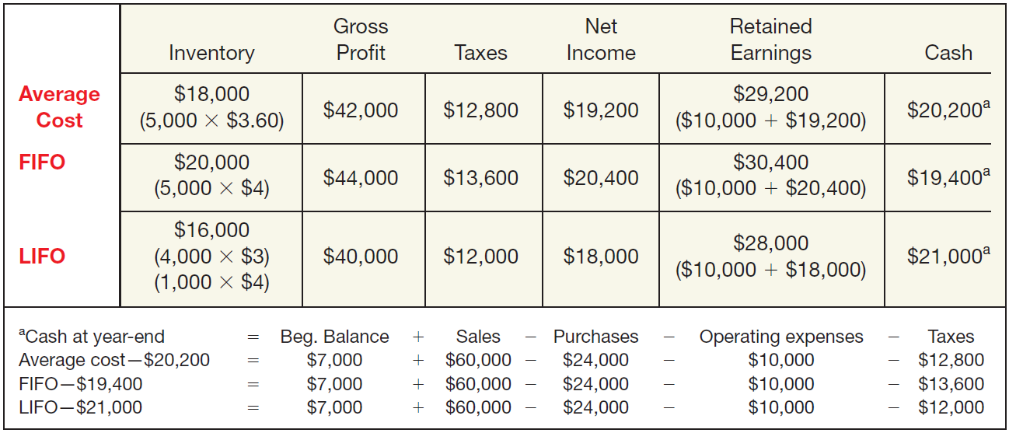
Inventory Valuation Methods - Summary
ILLUSTRATION 8-27
Balances of Selected Items under Alternative Inventory Valuation Methods
LIFO results in the highest cash balance at year-end (because taxes are lower). This example assumes that prices are rising. The opposite result occurs if prices are declining.
LO 4

Slide 65
LEARNING OBJECTIVES
8
Valuation of Inventories: A Cost-Basis Approach
After studying this chapter, you should be able to:
Understand inventory classifications and different inventory systems.
Determine the goods and costs included in inventory.
Describe and compare the cost flow assumptions used to account for inventories.
Identify special issues related to LIFO.
Determine the effects of inventory errors on the financial statements.
LO 5

Slide 66
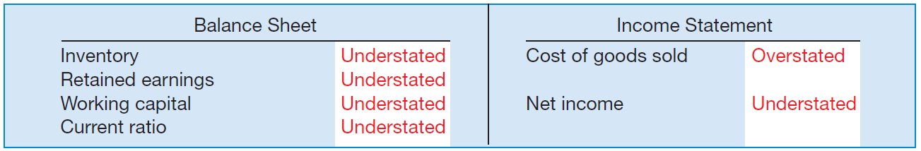
EFFECT OF INVENTORY ERRORS
Ending Inventory Misstated
ILLUSTRATION 8-28
Financial Statement Effects of Misstated Ending Inventory
The effect of an error on net income in one year will be counterbalanced in the next, however the income statement will be misstated for both years.
LO 5

Slide 67
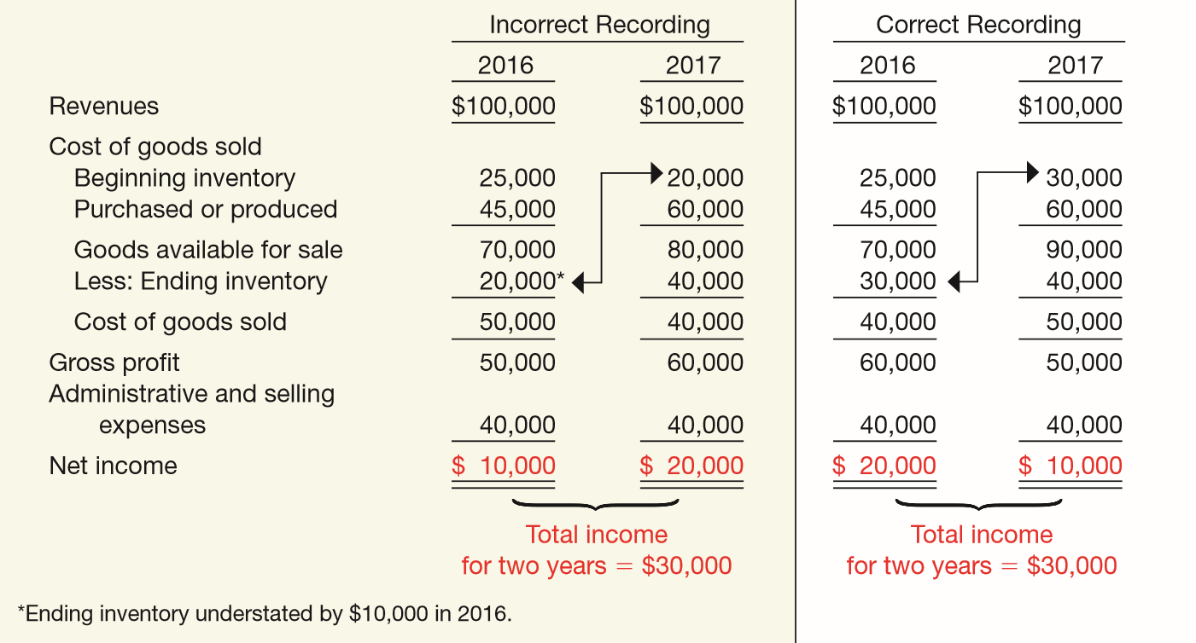
Ending Inventory Misstated
Illustration: Jay Weiseman Corp. understates its ending inventory by $10,000 in 2016; all other items are correctly stated.
ILLUSTRATION 8-29
LO 5

Slide 68
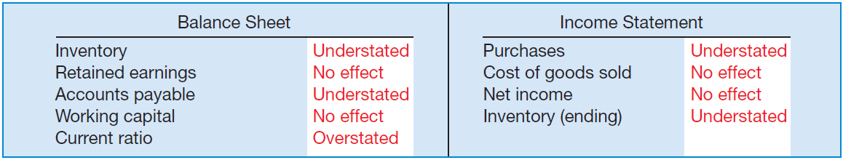
Effect of Inventory Errors
Purchases and Inventory Misstated
ILLUSTRATION 8-30
Financial Statement Effects of Misstated Purchases and Inventory
The understatement does not affect cost of goods sold and net income because the errors offset one another.
LO 5

Slide 69
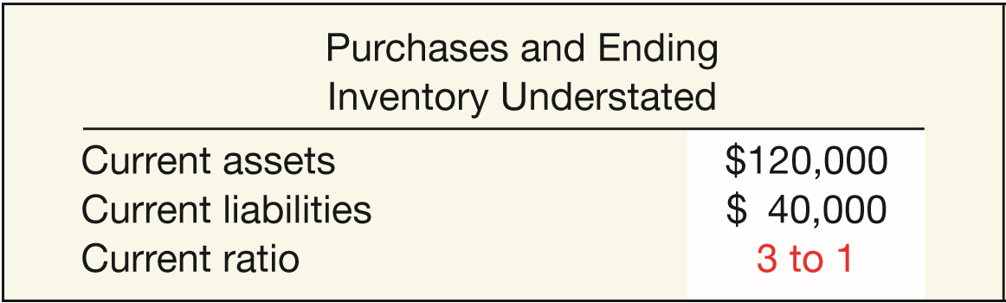
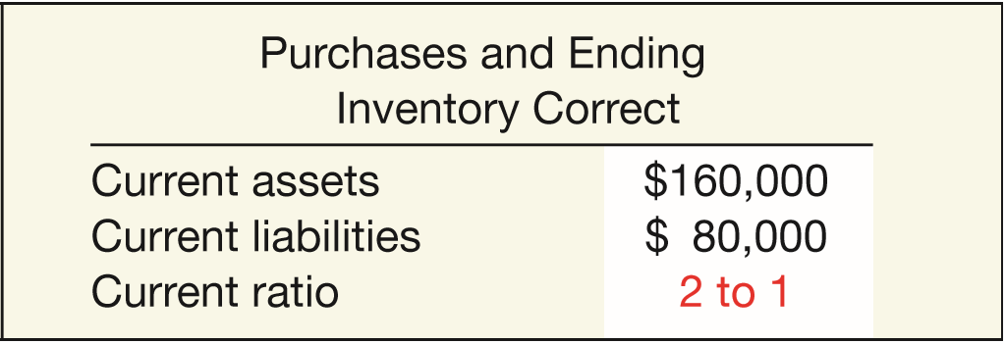
Purchases and Inventory Misstated
Illustration: Assume that Bishop understated accounts payable and ending inventory by $40,000. Illustration 8-31 shows the understated and correct data.
ILLUSTRATION 8-31
Effects of Purchases and Ending Inventory Errors
LO 5

Slide 70
COPYRIGHT
“Copyright © 2016 John Wiley & Sons, Inc. All rights reserved. Reproduction or translation of this work beyond that permitted in Section 117 of the 1976 United States Copyright Act without the express written permission of the copyright owner is unlawful. Request for further information should be addressed to the Permissions Department, John Wiley & Sons, Inc. The purchaser may make back-up copies for his/her own use only and not for distribution or resale. The Publisher assumes no responsibility for errors, omissions, or damages, caused by the use of these programs or from the use of the information contained herein.”

