Slide 1

Mechatronics System Design Chapter 5: Sensors and Transducers.
Instructor: Dr. Ahmad Al-Balasie
First Semester – 2021/2022

Slide 2
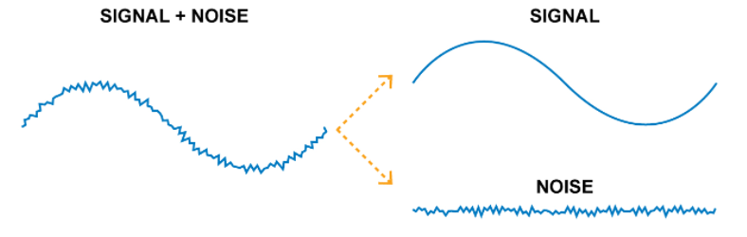
5.1 Signal Conditioning and Processing
The first component of a measurement system is the sensor that converts a physical variable to an electrical quantity.
Any signal is usually in one format that cannot be directly used: it requires conditioning.
Signal conditioning: that converts the electrical signals from an unsuitable format to a suitable format.

Slide 3
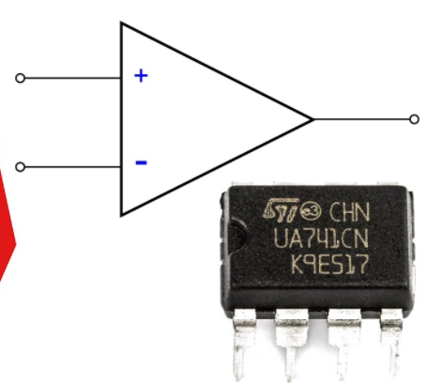

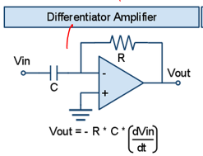
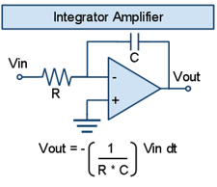
5.1 Signal Conditioning and Processing
Some of the most commonly used signal conditioning circuits are listed below:
Operational Amplifier: It is the most versatile integrated circuit linear building block. It can be designed with a very high gain to obtain a desired gain and bandwidth.
Integrators and Differentiators:
The integral amplifier produces a signal that is directly proportional to the integral of the input signal.
Differentiator amplifier: aims to produces an output signal which is the first derivative of the input signal.

Slide 4
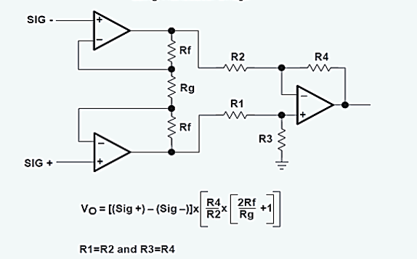
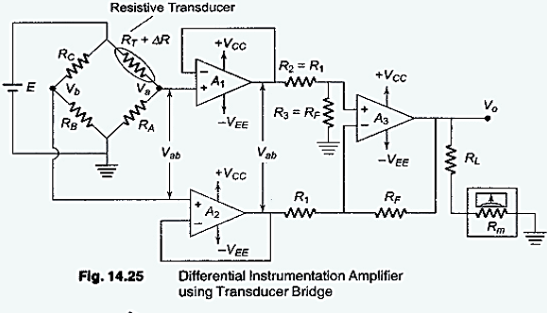
5.1 Signal Conditioning and Processing
Instrumentation Amplifier: it is used to amplify very low-level signals, rejecting noise and interference signals. Examples can be heartbeats, blood pressure, temperature, earthquakes and so on.
The difference amplifier amplifies the difference between two signals that are already amplified in a previous stage.

Slide 5
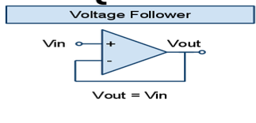
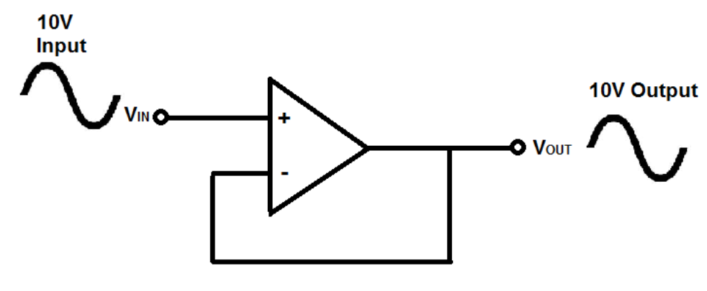

5.1 Signal Conditioning and Processing
Voltage follower (also called a unity-gain amplifier, a buffer amplifier, and an isolation amplifier) is a op-amp circuit which has a voltage gain of 1.
The voltage follower circuit has a very high input impedance. This characteristic makes it a popular choice in many different types of circuits that require isolation between the input and output signal.

Slide 6
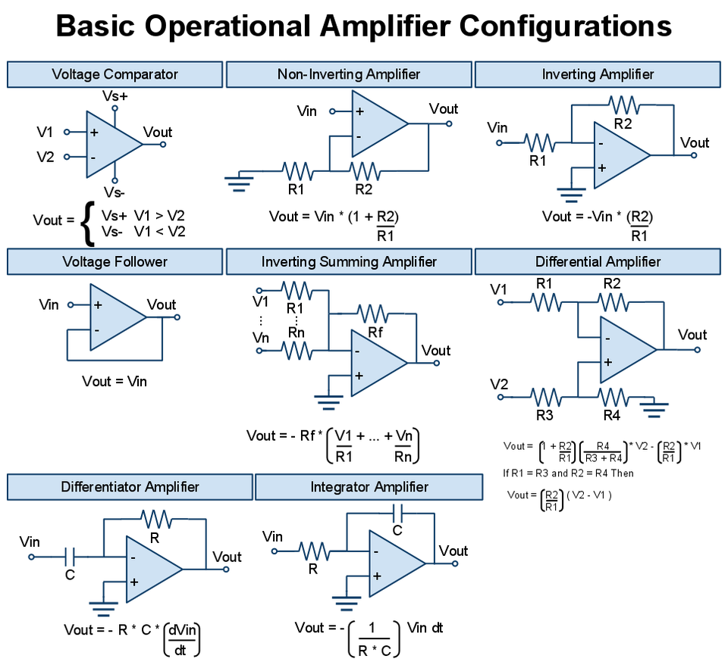

Slide 7
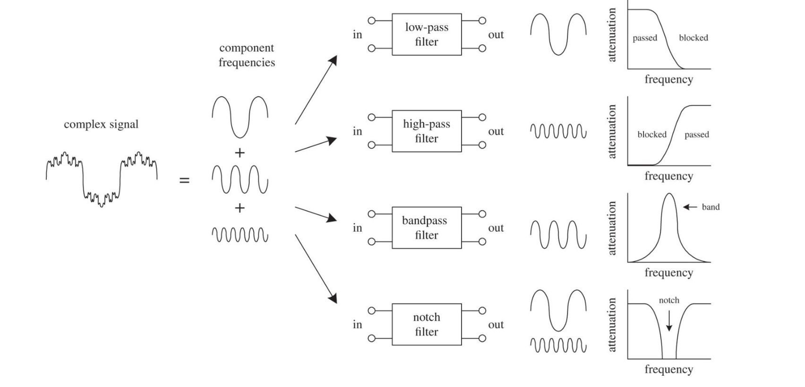
5.1 Signal Conditioning and Processing

Slide 8
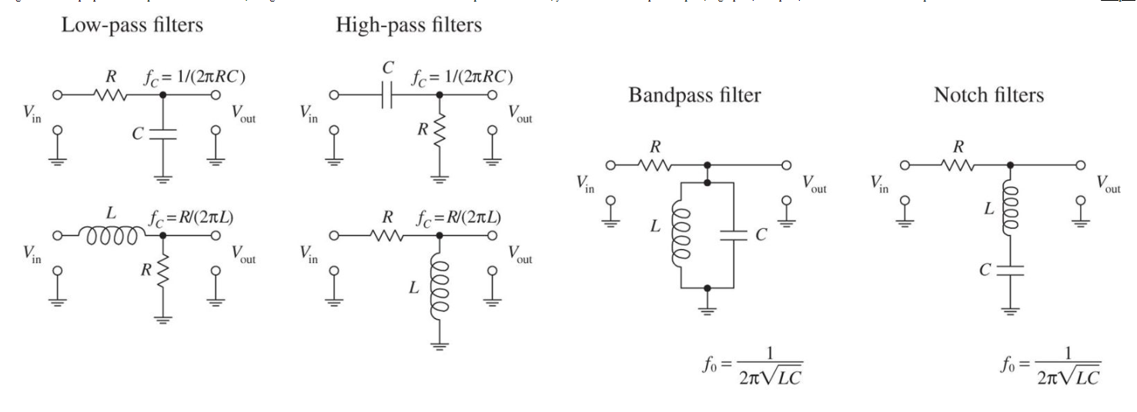
5.1 Signal Conditioning and Processing

Slide 9

5.2 Sensors and Transducers
A sensor is used to detect a physical parameter in one form and report it in another form of energy, often electrical signal.
A transducer is a device that converts a signal in one form of energy to another form of energy (e.g. microphone, speaker).
There are two types of sensors digital or analog i.e. binary or continuous.
The analog sensor produces a continuous output signal that is proportionally varied to the sensed parameter.
Sensors with analog output may also be called transducers, while sensors with discrete (or binary or digital) output are called switches, e.g., “proximity sensor or switch”.

Slide 10
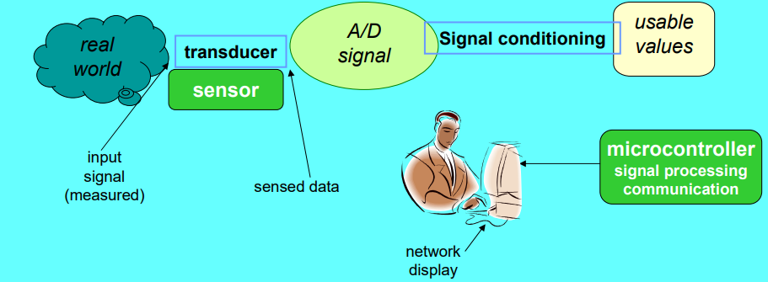
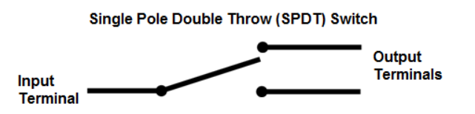
5.2 Sensor and Transducer
When transducers include an analog-to-digital converter (ADC), then they are called digital transducers, since their output can be directly fitted to a digital controller, and should not be confused with the binary or digital sensors of a switch operation type.
The digital sensor produces a discrete output signal in the form of ON or OFF, usually causing a SPDT contact to change state when the physical quantity gets over a predefined value.

Slide 11
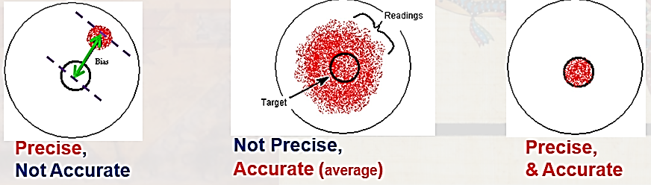
5.2 Sensor and Transducer
Accuracy: error (difference) between the result of a measurement and the true value being measured.
Precision/Repeatability: the ability of the sensor to output the same value for the same input over a number of trials (how close).

Slide 12
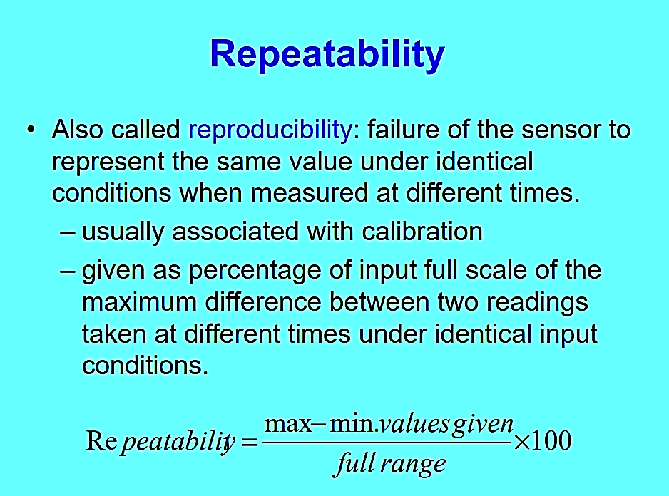


Slide 13
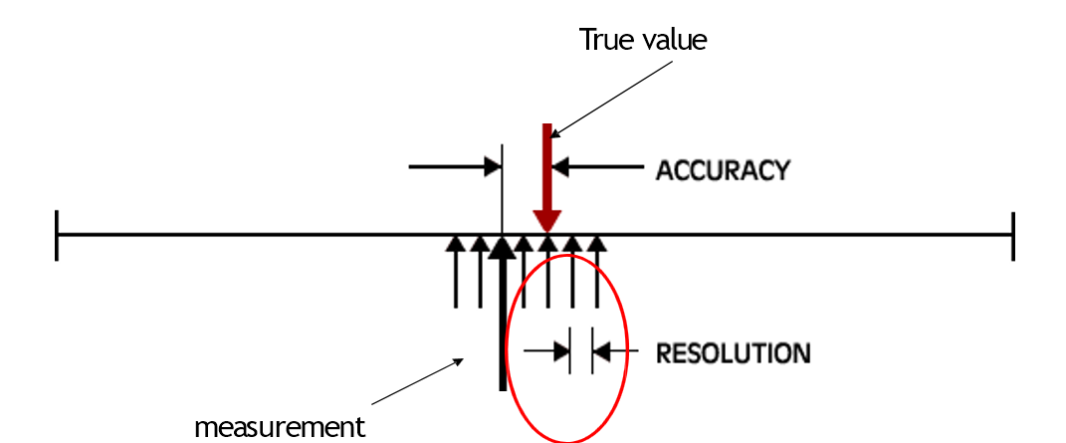
Sensor Characteristics
Resolution (Q): the smallest increment of a measurement that a device can make.

Slide 14
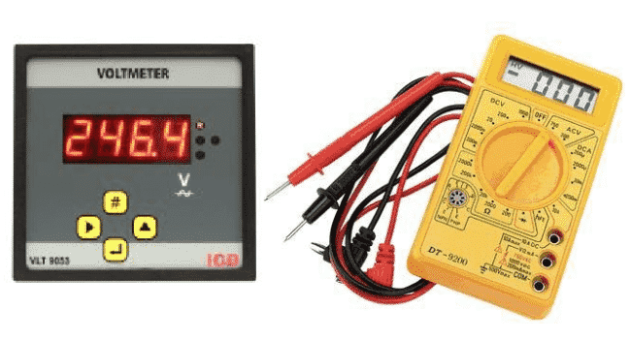
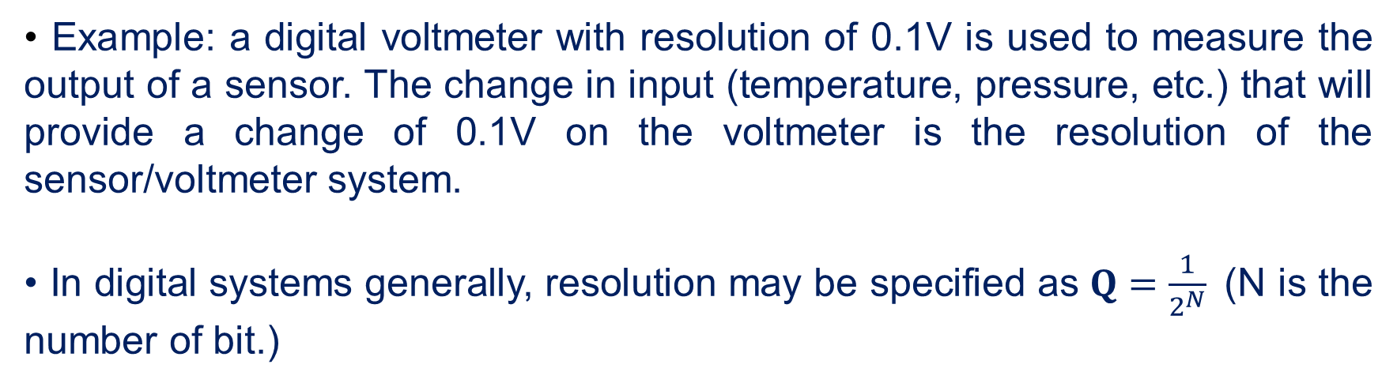
Resolution
• Example: a digital voltmeter with resolution of 0.1V is used to measure the output of a sensor. The change in input (temperature, pressure, etc.) that will provide a change of 0.1V on the voltmeter is the resolution of the sensor/voltmeter system.
• In digital systems generally, resolution may be specified as $Q=\frac{1}{2^{N}}$(N is the number of bit.)

Slide 15
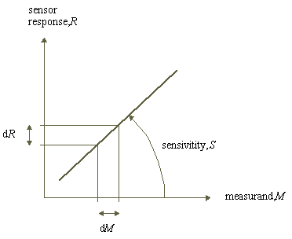

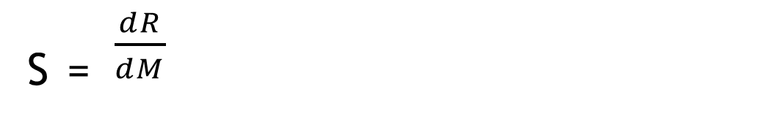
Sensor Characteristics
_{S =} $\frac{dR}{dM}$
Sensitivity:
The ratio between the change in the output signal (Response) to a small change in input physical signal (measurand).

Slide 16
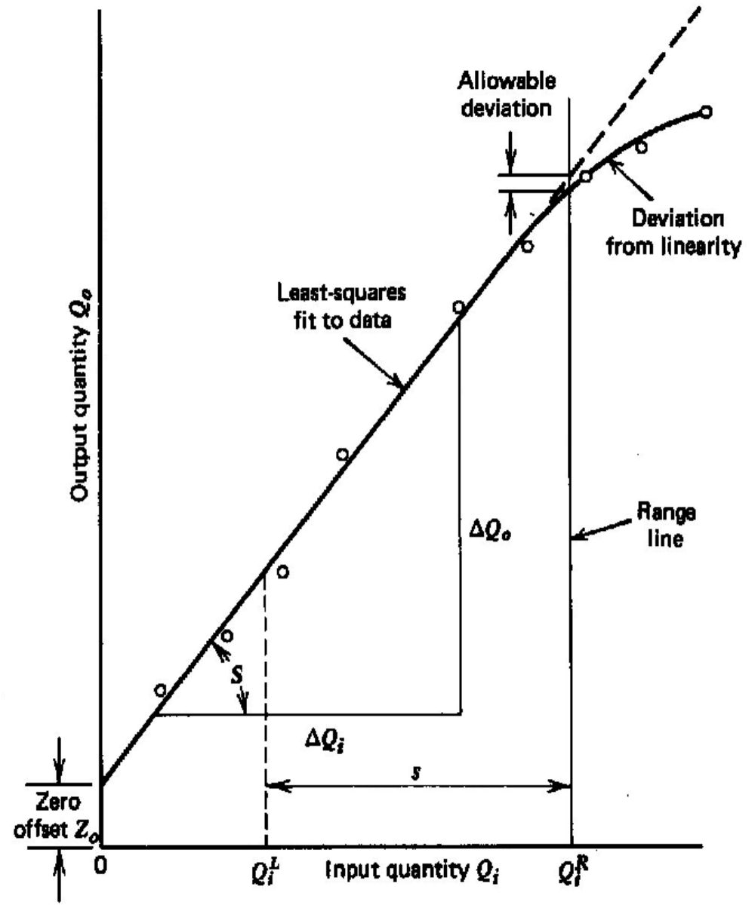
Sensor Characteristics
span = Upper – Lower
Span or range: of the Instrument is the difference between the upper and the lower limits of the input that being sensed.

Slide 17
Sensor Characteristics
Range
lowest and highest values of the stimulus.
Input full scale (IFS)
IFS = Span.
Output full scale (OFS):
It is difference between the upper and lower ranges of the output of the sensor.
Dynamic range:
It is the ratio between the upper and lower limits and is usually expressed in (dB).

Slide 18
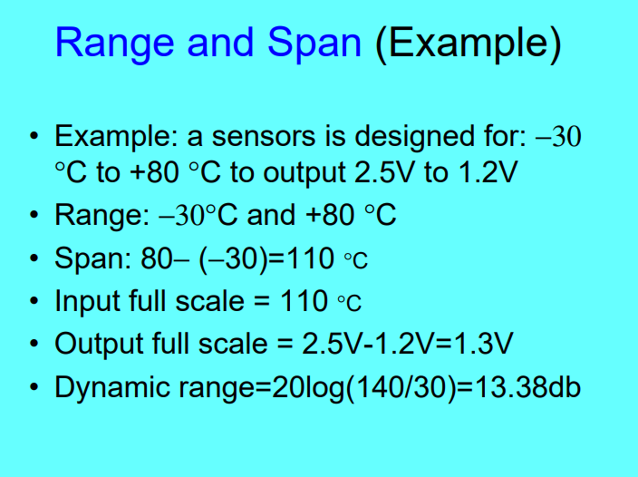

Slide 19
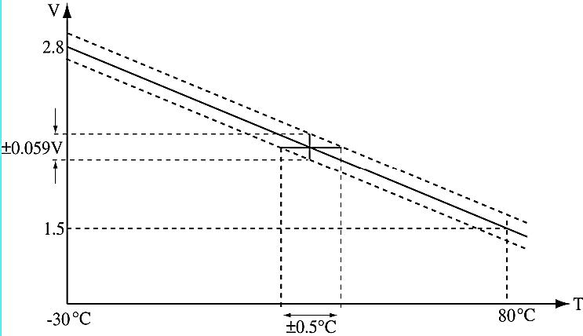
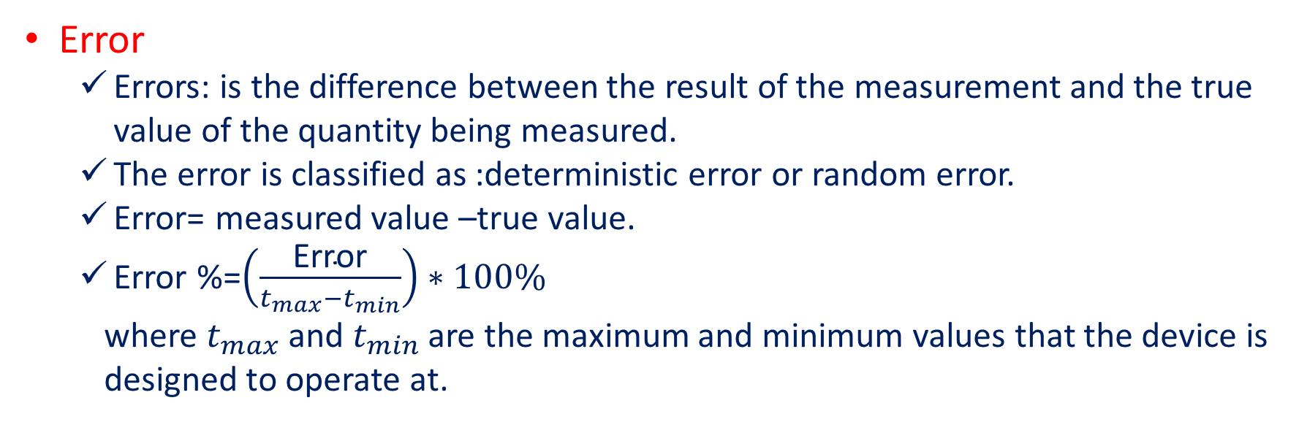
Sensor Characteristics
Error
Errors: is the difference between the result of the measurement and the true value of the quantity being measured.
The error is classified as :deterministic error or random error.
Error= measured value –true value.
Error %=$\left(\frac{\text{Error}}{t_{max}−t_{min}}\right)∗100\%$
where $t_{max}$ and $t_{min}$ are the maximum and minimum values that the device is
designed to operate at.

Slide 20
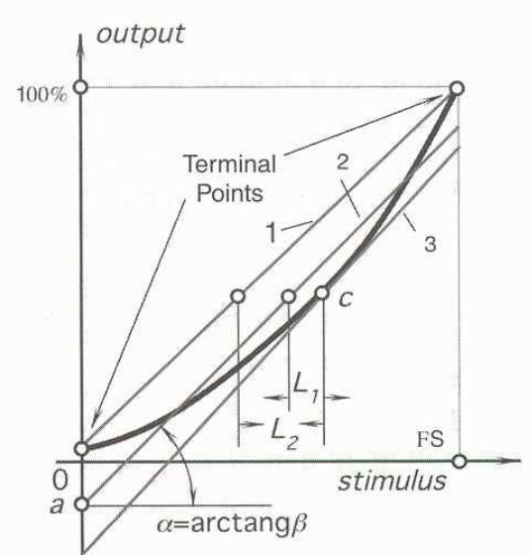
Sensor Characteristics
Nonlinearity is defined as the maximum deviation from the ideal linear transfer function.
Nonlinearity must be deduced from the actual transfer function or from the calibration curve.
A few methods to do so:
by use of the range of the sensor – Pass a straight line between the range points (line 1).
use a linear best fit (least squares) through the points of the curve (line 2).
use the tangent to the curve at some point on the curve. Take a point in the middle of the range of interest -Draw the tangent and extend to the range of the curve (line 3).

Slide 21
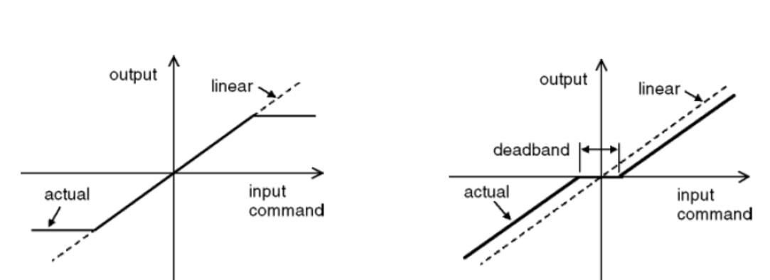
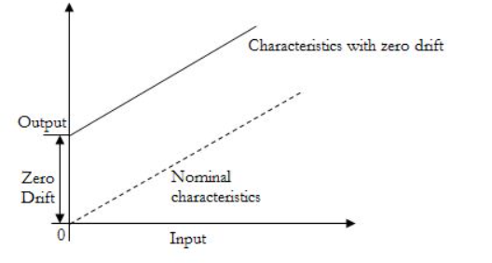
Sensor Characteristics
Saturation
Maximum output capability, regardless of input
Dead band
The range of input for which there is no output
Zero offset
A nonzero value output for no input
Zero Drift
The departure of output from zero value over a period of time for no input

Slide 22
Sensor Characteristics
Response time
The time lag between the input and output
Bandwidth
Frequency at which the output magnitude drops by 3 dB
the frequency range between the lower and upper cutoff frequencies, within which the sensor transfer function is constant gain or linear.
Resonance
The frequency at which the output magnitude peak occurs
Transfer Function:
The relationship between physical input signal and electrical output signal, which may constitute a complete description of the sensor characteristics.

Slide 23
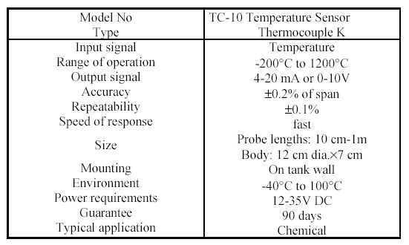
Sensor Characteristics
Operating Range
The range in which the sensor performs as specified

Slide 24
Sensor Selection Criteria
Variables measured and application
Dynamic range
Required resolution and sensitivity
Required accuracy and precision
Environmental conditions
Power available for sensing

Slide 25
Sensor Selection Criteria
Availability
Cost
Size and available space
Ease of use
Ease of maintenance
Required signal processing

Slide 26

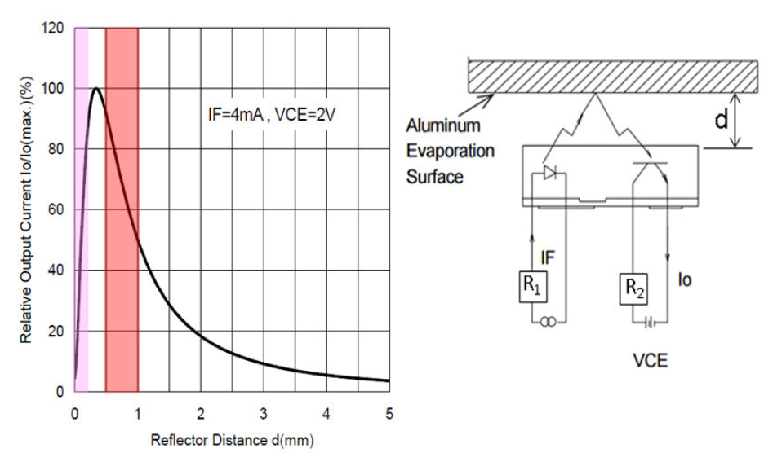
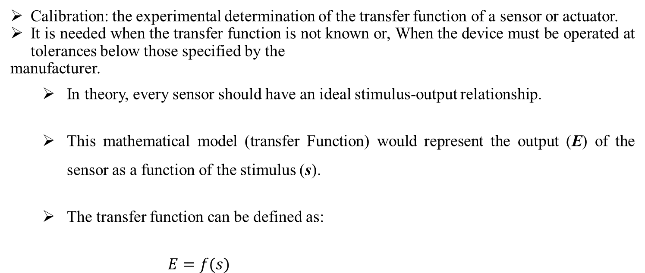
Calibration
Transfer Function:
Calibration: the experimental determination of the transfer function of a sensor or actuator.
It is needed when the transfer function is not known or, When the device must be operated at tolerances below those specified by the
manufacturer.
In theory, every sensor should have an ideal stimulus-output relationship.
This mathematical model (transfer Function) would represent the output (E) of the sensor as a function of the stimulus (s).
The transfer function can be defined as:
$$E=f(s)$$

Slide 27
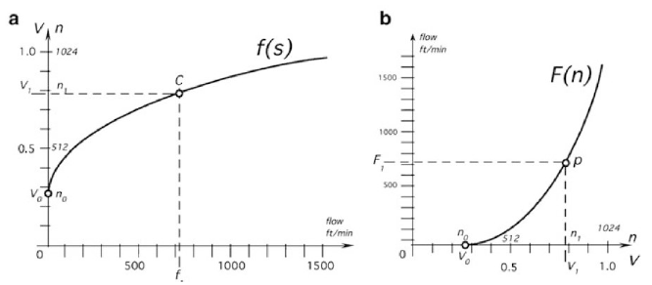

Transfer Function:
Calibration
The more useful model for sensor design, would be the inverse transfer function that would define the true stimulus given the sensor output:
$$s=f^{−1}\left(E\right)$$
$$s=F \left(E\right)$$

Slide 28
Transfer Function:
Calibration
Static VS Dynamic Transfer Function:
The transfer function E = f(s) is a static transfer function as it is time invariant.
A dynamic transfer function will have a more complicated time varying parameters.
For example:
E = f(s, ds/dt, Lt)
Where: ds/dt is the time derivative of the stimulus and Lt is the life of the sensor

Slide 29
Transfer Function:
Calibration
Ideal VS Actual Transfer Function:
The transfer function E = f(s) is an ideal transfer function, BUT
In reality sensors will have drift, random noise, digitization error, etc.
E = f(s)$+μ_{ο}+ε$
Where: $μ_{ο}$is the systematic error and $ε$ is the random noise
Systematic error can be minimized through calibration.
Random noise can be minimized through analog or digital signal processing.

Slide 30
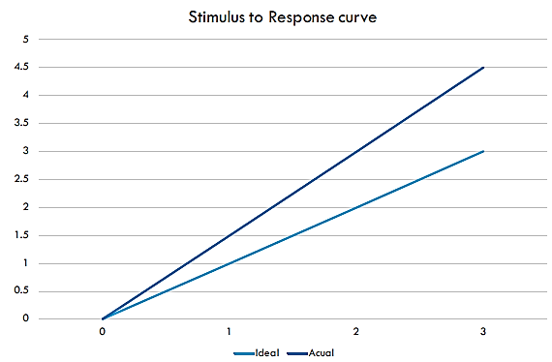
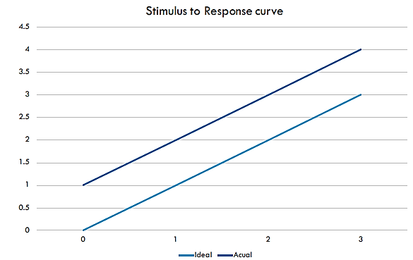
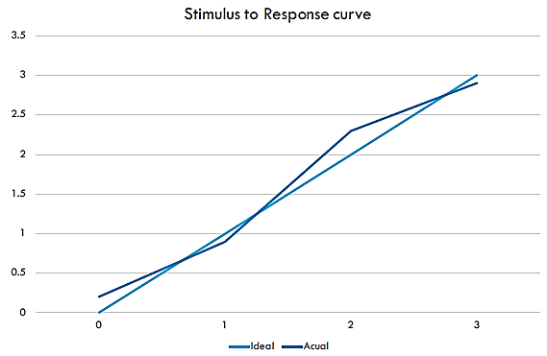
Transfer Function:
Calibration
Ideal VS Actual Transfer Function:

Slide 31
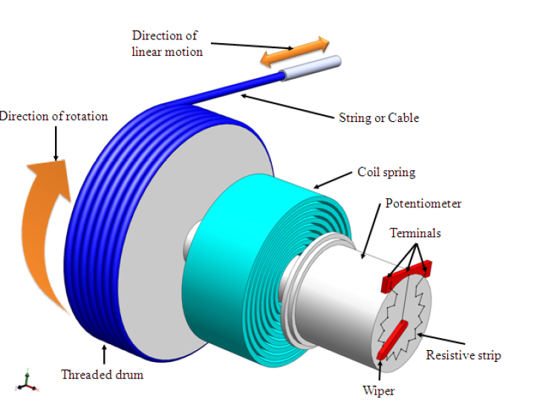
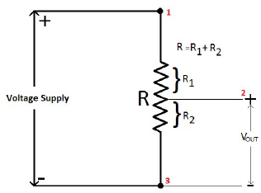
Transfer Function:
Calibration
Functional Approximation:
Ideally the transfer function E = f(s) or the inverse transfer function of s = F(E) can be derived from the physical law transduction effect that forms the basis of the sensors.
For example in a linear potentiometer used to measure distance (d), the ohms law can be applied:
$$V_{out}={V_{s}{ R}_{2}}/R$$
Assuming linear change in resistance with distance traveled.
$$V_{out}={V_{s}d}/D$$
$${d=V}_{out} D/V_{s}$$

Slide 32
Transfer Function:
Calibration
Functional Approximation:
The ideal transfer function may differ from the actual transfer function since:
The potentiometer will likely have a base resistance and will not go from 0 to R in resistance.
The change in resistance will not be exactly linear.
Temperature and relative humidity will affect the resistance of the potentiometer.
Supply voltage can be different than the ideal assumed voltage

Slide 33
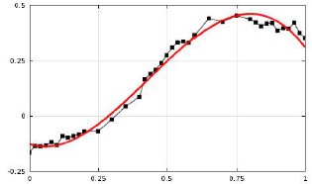
Transfer Function:
Calibration
Functional Approximation:
Instead of determining the ideal transfer function an approximate transfer function can be obtained.
Approximation is a selection of a suitable mathematical expression that can fit the calibration data as close as possible.

Slide 34
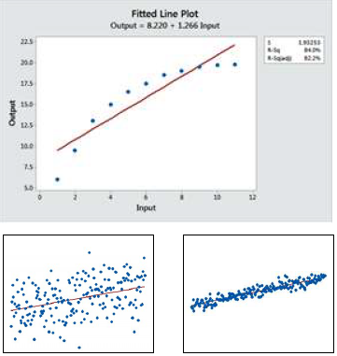
Transfer Function:
Calibration
Functional Approximation:
In general, it is better to start with a model and only use more complex ones if required.
The more complex the model, the larger the data set is required during calibration.
To test the validity of the model, a number of metrics can be calculated:
Standard error of the regression (S).
R².
Adjusted R².

Slide 35
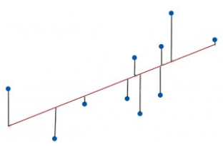

Transfer Function:
Calibration
Functional Approximation:
The standard error of the regression (S):
Represents the average distance that the observed values fall from the transfer function.
Values are in the same unit as the measurand.
Where Y is the actual value, Y’ is the estimated value and N is the number of calibration points.
Lower S values mean a better fit of the transfer function.

Slide 36
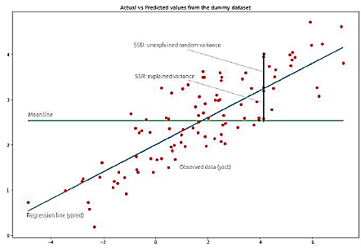
Transfer Function:
Calibration
Functional Approximation:
The R² Error (coefficient of determination):
Represents the error between the observed values and the transfer function as a percentage of the total variance of the measurand.
Values are a percentage of the total.
$$R^{2}=1−\frac{\sum{{(Y_{n}−f_{n})}^{2}}}{\sum{{(Y_{n}−\overline{Y})}^{2}}}$$
Where $Y_{n}$ is the actual value, $f_{n}$ is the estimated value and $\overline{Y}$ is the average of all Y values..
$R^{2}$ = 1 is a perfect fit.

Slide 37
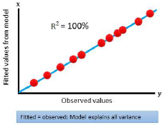
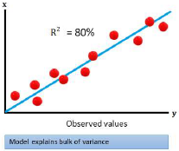
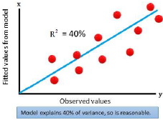
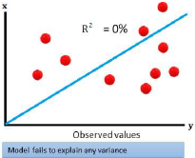
Transfer Function:
Calibration
Functional Approximation:
Comparison of R² for different linear models (same data set)
Great
Good
OK
Inconsistent

Slide 38
Transfer Function:
Calibration
R² vs Standard error:
The standard error (S) of the regression provides the absolute measure of the typical error between the transfer function and the actual observations:
R² provides the relative measure of the percentage of the dependent variable variance that the model explains:
For example: R² =76% means that the model can only explain 76% of the variance in the data. There is 24% of the variance that is either noise or is not modeled correctly.

Slide 39
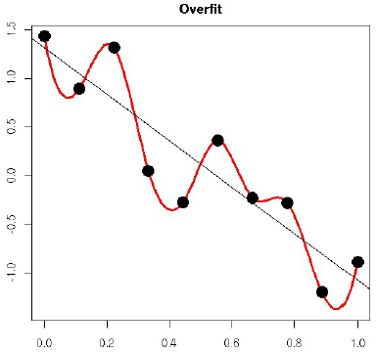
Functional Approximation:
Estimating Transfer Function
Overfitting
Standard R² (coefficient of determination) rewards you with trying to fit a curve to all the data points (noise and signal alike).
The more complex the curve, the higher the R² will be.
R² never decreases by increasing the complexity of the transfer function.
By increasing the complexity you may be “connecting the dots” more than modeling the actual signal.
The model most aim to ignore the noise and only model the signal

Slide 40
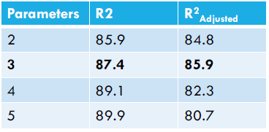
Functional Approximation:
Estimating Transfer Function
Adjusted R²
Adjusted R² penalizes the score for using more complex functions.
$$R_{Adjusted}^{2}=1−\frac{(1−R^{2})(N−1)}{N−p−1}$$
Where:
N is number of samples and P is the number of parameters
P can also be number of input variables

Slide 41
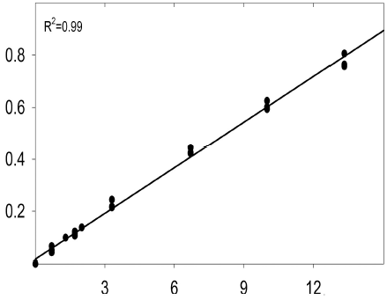
Functional Approximation:
Estimating Transfer Function
How to avoid overfitting?
Take multiple samples per calibration point.
If a large data set is available keep some data for validation.
Compare the S value with data-sheets noise level.
Try using the most basic transfer function that will yield an acceptable R² value.

Slide 42
Calibration Summary:
Estimating Transfer Function
Calibration of a sensor can yield:
Modifying the transfer function or its approximation to fit the experimental data.
Adjustment of the data acquisition system to make the outputs signal fit into a normalized or “ideal” transfer function.
Modification (trimming) the sensor’s properties to fit the predetermined transfer function.
Creating a sensor specific reference device that can be used to compensate for sensor inaccuracies.

Slide 43
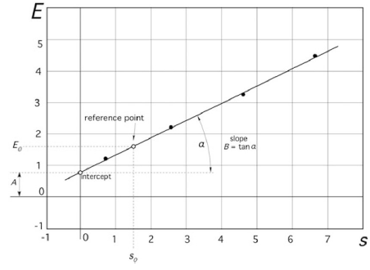
Linear Regression:
Estimating Transfer Function
The simplest and most widely used transfer function is a linear one.
Usually in sensor calibration 3-5 points are tested along the full range of the sensor (10-90%).
The line of best fit is determined to minimize standard error (S)
The slope (sensitivity) and intercept (zero offset) is determined.
Often the intercept (zero offset) must be estimated and can’t be actually measured.

Slide 44
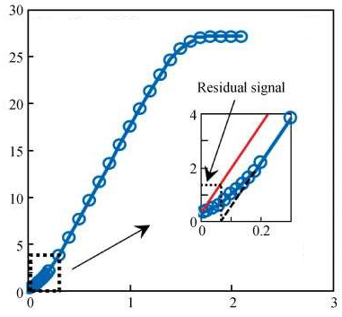
Non-Linear Function:
Estimating Transfer Function
Most sensors are not linear over their entire range.
Usually at the extremes of the detection range the non-linearity is more predominant.
A good strategy is to calibrate the sensor over the range that it will be used rather than its entire sensing range.

Slide 45

Non-Linear Function:
Estimating Transfer Function
More complicated functions can be applied such as:

Slide 46

Non-Linear Function:
Estimating Transfer Function
For each transfer function, The inverse transfer function is also required.
Transfer Function E = A + B ln(X)
Inverse Transfer function X = e^{(E - A) / B}
The three functions provided have only 3 parameters to determine in calibration (A, B).
For these non-linear transfer functions a minimum of 5-8 calibration points are required.

Slide 47

Polynomial Approximation:
Estimating Transfer Function
A sensor may have a more complicated transfer function than these basic ones.
Power series can be used to approximate any transfer function.
The n^{th} order polynomial is:
E = a₀ + a₁ X + a₂ X² + … a_{n} X^{n}
The higher the order the better the fit but the more data points are needed

Slide 48


Instrument calibration
Calibration or gain error. Instrument has to be calibrated vs known standard or at least vs another reasonably good instrument
Offset: This is common cause of errors in DC measurements. One should know what to be called zero. Beware of the drifts!

Slide 54


Slide 55


Slide 56


Slide 57


Slide 58


Slide 59


Slide 64


Slide 65


Slide 66


Slide 67


Slide 68


Slide 69




Slide 70




Slide 73


Slide 74


Slide 75


Slide 76


Slide 77


Slide 79


Slide 85


Slide 93


