Slide 1

MANAGERIAL ECONOMICS 14th Edition
By
Mark Hirschey and Eric Bentzen

Slide 2
Production Analysis and Compensation Policy
Chapter 7

Slide 3
Chapter 7 OVERVIEW
Production Functions
Total, Marginal, and Average Product
Law of Diminishing Returns to a Factor
Input Combination Choice
Marginal Revenue Product and Optimal Employment
Optimal Combination of Multiple Inputs
Optimal Levels of Multiple Inputs
Returns to Scale
Productivity Measurement

Slide 4
Chapter 7 KEY CONCEPTS
ridge lines
marginal revenue product
economic efficiency
net marginal revenue
isocost curve (or budget line)
expansion path
constant returns to scale
increasing returns to scale
decreasing returns to scale
output elasticity
power production function
productivity growth
efficiency gains
capital deepening
production function
discrete production function
continuous production function
returns to scale
returns to a factor
total product
marginal product
average product
law of diminishing returns
isoquant
technical efficiency
input substitution
marginal rate of technical substitution

Slide 5
Production Functions
Properties of Production Functions
Determined by technology, equipment and input prices.
Discrete functions are lumpy.
Continuous functions employ inputs in small increments.
Returns to Scale and Returns to a Factor
Returns to scale measure output effect of increasing all inputs.
Returns to a factor measure output effect of increasing one input.

Slide 6
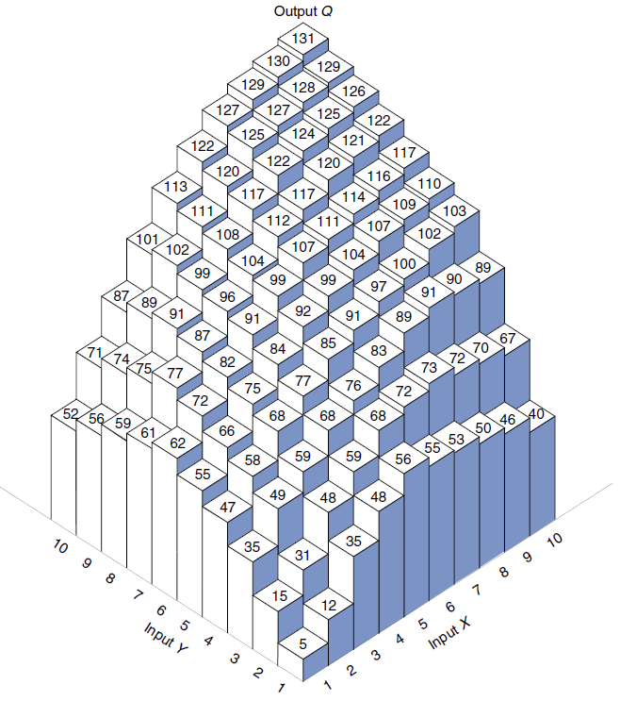

Slide 7
Total, Marginal, and Average Product
Total Product
Total product is whole output.
Marginal product is the change in output caused by increasing any input X.
If MP_{X}=∂Q/∂X> 0, total product is rising.
If MP_{X}=∂Q/∂X< 0, total product is falling (rare).
Average product
AP_{X}=Q/X.

Slide 8
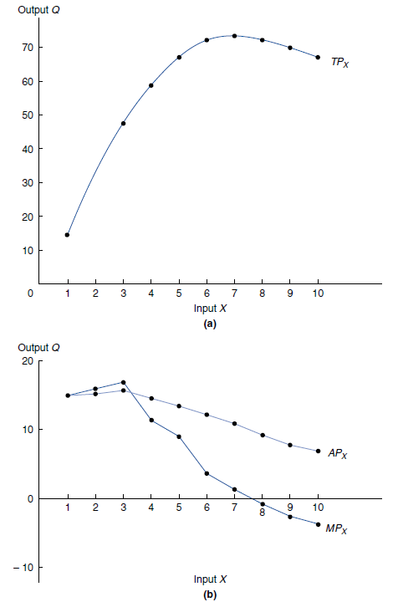

Slide 9

Law of Diminishing Returns to a Factor
Returns to a Factor
Shows what happens to MP_{X} as input X usage grows.
MP_{X}> 0 is common.
MP_{X}< 0 implies irrational input use (rare).
Diminishing Returns to a Factor Concept
MP_{X} shrinks as X usage grows, ∂²Q/∂X²< 0.
If MP_{X} grew with use of X, there would be no limit to input usage.
AP_{L} = Q/L
When MP_{L} > AP_{L}, AP_{L} will increase.
When MP_{L} = AP_{L}, AP_{L} is at its maximum.
When MP_{L} < APL, AP_{L} will decrease.
▶️ Output Elasticity = $∆Q\%/∆L$ = MP_{L}/AP_{L}

Slide 10
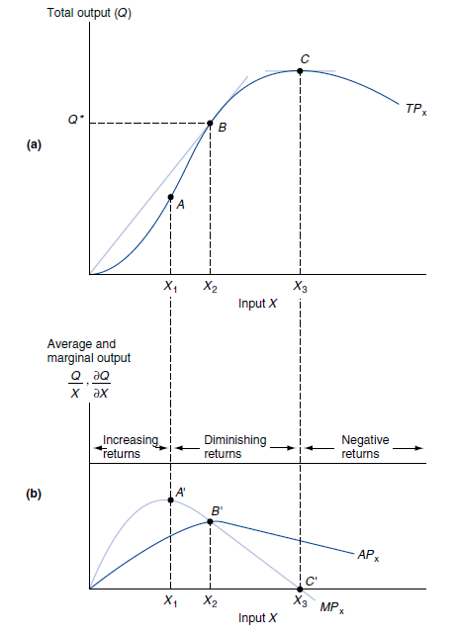

Slide 11
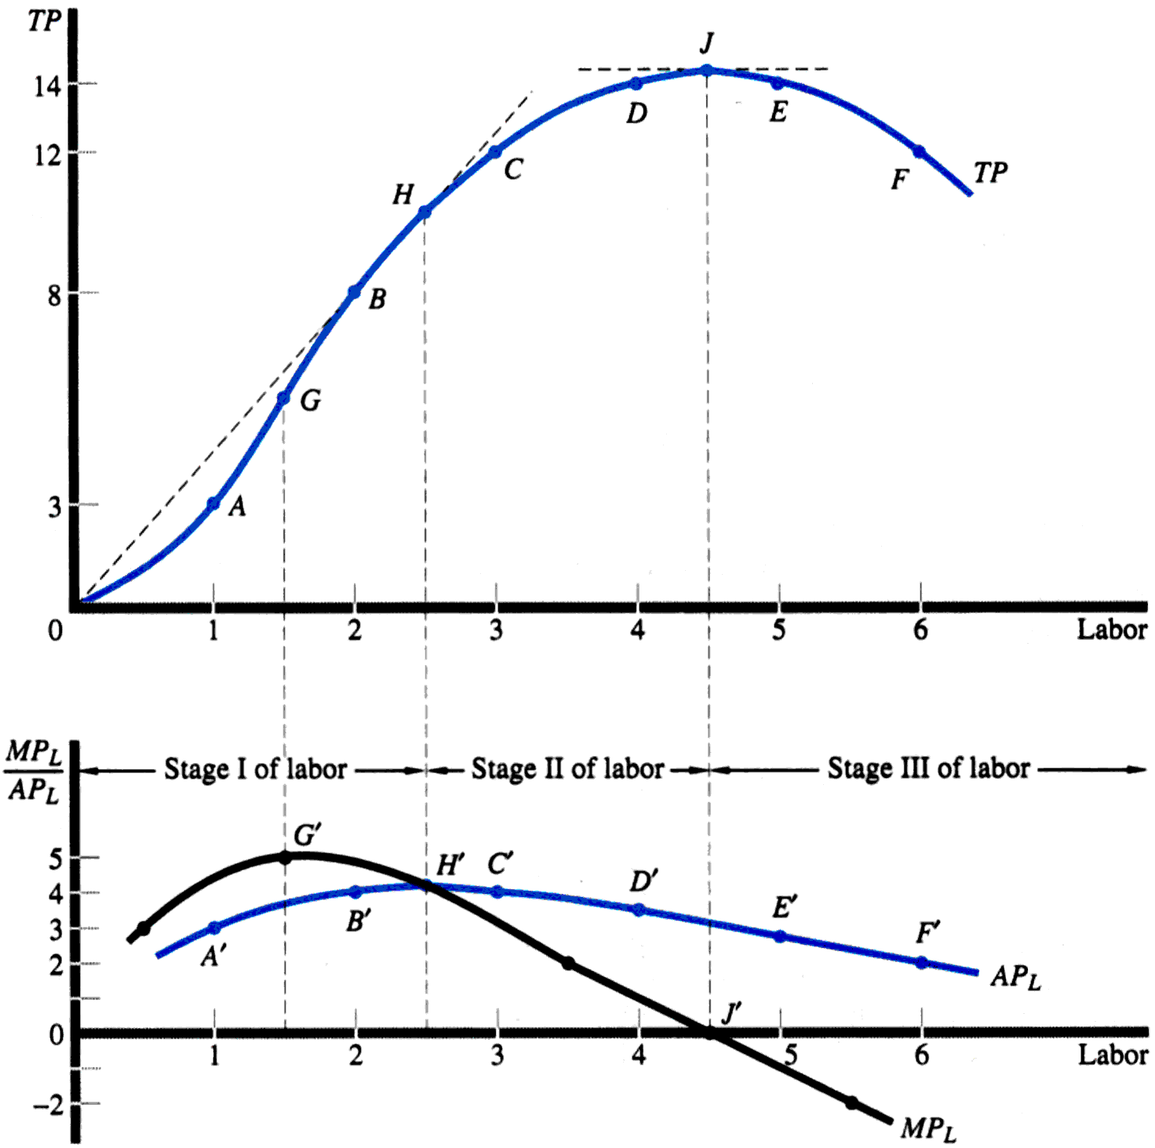
Three Stages of Production but only Stage II is Economical
In stage I, output elasticity, ε > 1.
In stage II, 1 ≥ ε ≥ 0.
In stage III, ε < 0.

Slide 12
Input Combination Choice
Production Isoquants
Show efficient input combinations.
Technical efficiency is least-cost production.
Isoquant shape shows input substitutability.
Straight line isoquants depict perfect substitutes.
C-shaped isoquants depict imperfect substitutes.
L-shaped isoquants imply no substitutability.

Slide 13
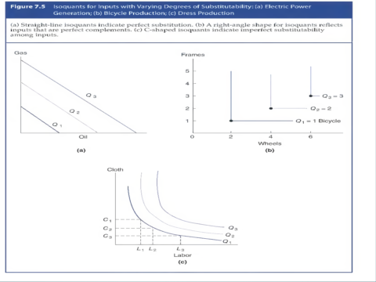

Slide 14

Marginal Rate of Technical Substitution (MRTS)
Marginal Rate of Technical Substitution
Shows amount of one input that must be substituted for another to maintain constant output.
It is the negative of the slope of the isoquant.
For inputs X and Y, MRTS_{XY}= $\frac{∆K}{∆L}=$MP_{X}/MP_{Y}
The MRTS tends to decline as more of X and less of Y are employed.
Rational Limits of Input Substitution
Ridge lines show rational limits of input substitution.
MP_{X}<0 or MP_{Y}<0 are never observed.

Slide 15
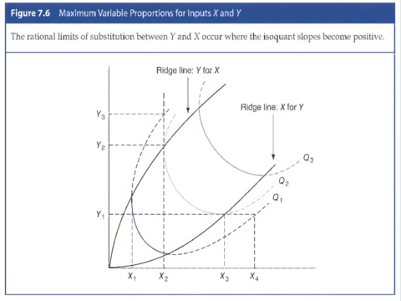


Isoquants
MRTS = $\frac{∆K}{∆L}=MPL/MPK$

Slide 16
Marginal Revenue Product and Optimal Employment
Marginal Revenue Product (of labor)
MRP_{L} = MR . MP_{L}
But MR = ΔTR / ΔQ
And MP_{L} = Δ Q / Δ L
Then MRP_{L} = [ΔTR / ΔQ] x [ΔQ / ΔL] = ΔTR / ΔL = (for infinitely small changes in L) dTR/dL
MRP_{L}= MP_{L} x MR_{Q} = ∂TR/∂L.
MRP_{L} is the net revenue gain after all variable costs except labor costs.
MRP_{L} is the maximum amount that could be paid to increase employment.
Optimal Level of a Single Input
Set MRP_{L}=P_{L} (or wage rate = w) to get optimal employment.
If MRP_{L}= w, then in general input marginal revenue equals input marginal cost.

Slide 17
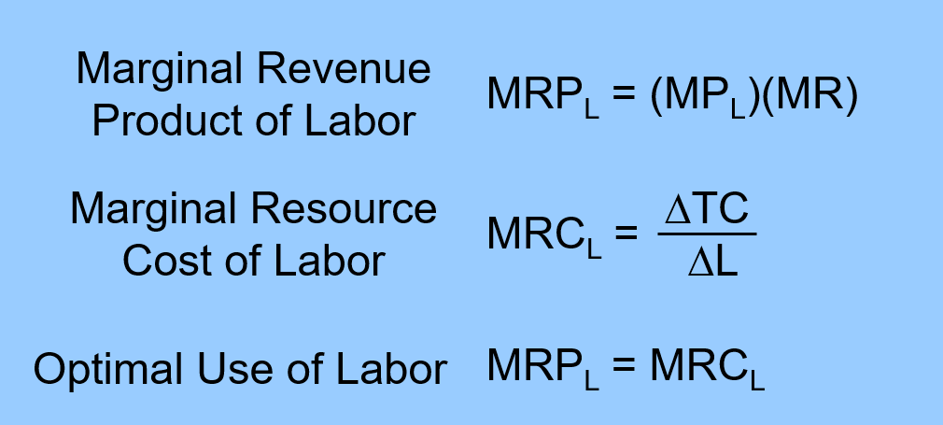
Optimal Use of One Variable Input

Slide 18
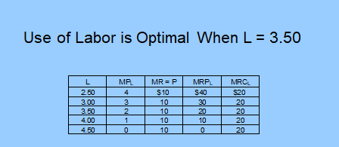
Optimal Use of One Variable Input
Price of the product = $10/unit, and wage rate = $20/unit of labor
Note that the demand for labor is given by the relation between L and MRP_{L}.

Slide 19
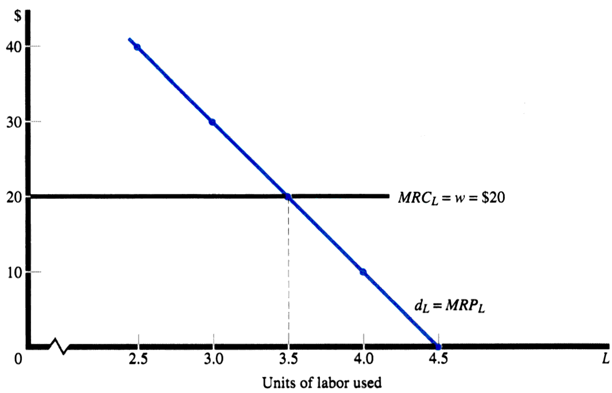
Optimal Use of One Variable Input

Slide 20
Another Example: TP & MP, TR, MRP Function for L for Q = 100K ^{0.5}L^{0.5}, K = 4, and P = $2
L | Q = TP_{L} | MP_{L} | TR | MRP_{L}
0 | 0 | - | $ 0 | -
1 | 200 | 200 | 400 | $ 400
2 | 283 | 83 | 566 | 166
3 | 346 | 63 | 692 | 126
4 | 400 | 54 | 800 | 108
5 | 447 | 47 | 894 | 94
6 | 490 | 43 | 980 | 86
7 | 529 | 39 | 1058 | 78
8 | 565 | 36 | 1130 | 72

Slide 21
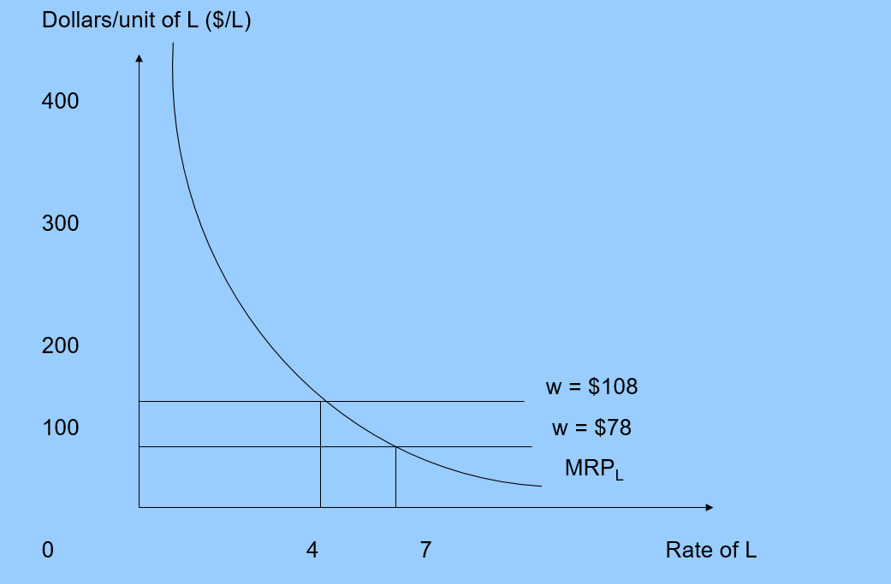

Slide 22
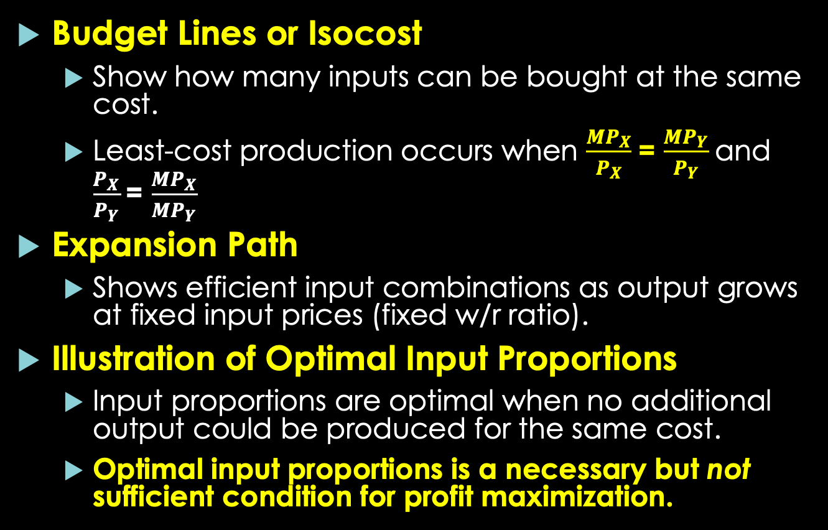
Optimal Combination of Multiple Inputs
Budget Lines or Isocost
Show how many inputs can be bought at the same cost.
Least-cost production occurs when $\frac{{MP}_{X}}{P_{X}}$= $\frac{{MP}_{Y}}{P_{Y}}$and $\frac{P_{X}}{P_{Y}}$= $\frac{{MP}_{X}}{{MP}_{Y}}$
Expansion Path
Shows efficient input combinations as output grows at fixed input prices (fixed w/r ratio).
Illustration of Optimal Input Proportions
Input proportions are optimal when no additional output could be produced for the same cost.
Optimal input proportions is a necessary but not sufficient condition for profit maximization.

Slide 23
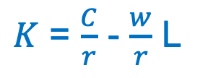

Slope of the isoquant = P_{X}/P_{Y}
Y = $\frac{C}{P_{Y}}$ - $\frac{P_{X}}{P_{Y}}$ X
$K$ = $\frac{C}{r}$ - $\frac{w}{r}$ L

Slide 24





Isocost equation
C = rK + wL
And since K is on the vertical axis, it can be written as
K = $\frac{C}{r}$ - $\frac{w}{r}$ L
K = 100/10 – 5/10L = 10 - 0.5L
K = 100/10 – 10/10 L = 10 - L

Slide 25
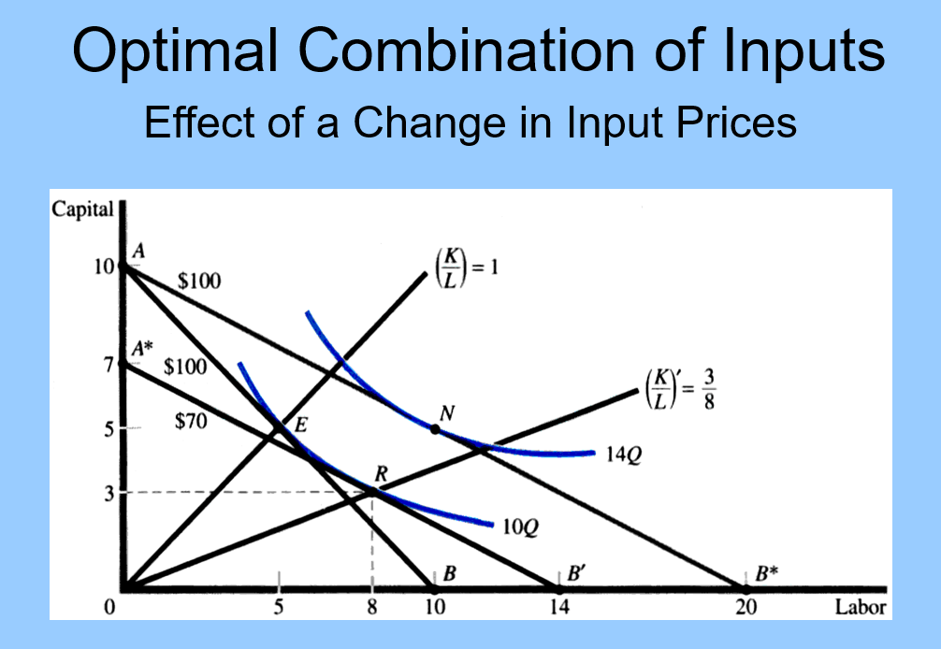

Isoquant 10Q
If the firm wants to produce Q = 10 units
The optimal input combination is at point E
MRTS = w/r = 10/10 = 1
K = 5 units and L = 5 units
Total cost 10x5 + 10x5 = $100
Expansion path, K = L
MRTS = w/r
When w declines to $5/unit of L,
The optimal input combination is at point R
MRTS = w/r = 5/10 = 0.5
K = 3 units and L = 8 units
To produce Q = 10 units (isoquant 10Q)
total cost = 10x3 + 5x8 = $70
Expansion path K’ = $\frac{3}{8}$ L
If the firm wants to produce 14 units
(isoquant 14Q), assuming r = $10 and w = $5
Optimal point is N
MRTS = w/r = 5/10 = 0.5
K = 5 and L = 10,
total cost = 10x5 + 5x10 = $100
Expansion path K’’ = 0.5L

Slide 26
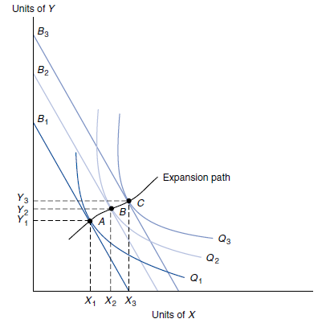

The expansion path traces all optimal input combinations at constant w/r ratio.
At A, B and C: MRTS = constant w/r

Slide 27
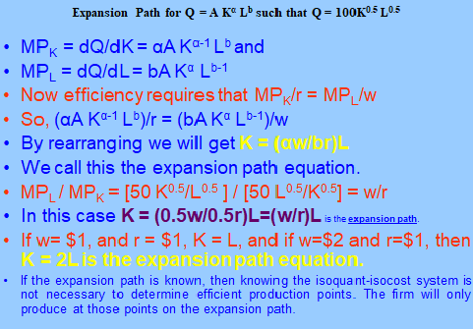






Slide 28



Slide 29



Optimal Levels of Multiple Inputs
Optimal Employment and Profit Maximization
Profits are maximized when MRP_{X} = P_{X} for all inputs.
Profit maximization requires:
(A) optimal input proportions
Plus (B) an optimal level of output.
►Profit maximization means allocative efficiency: efficiently producing what customers want.

Slide 30

Returns to Scale
Returns to scale (RtS) show the output effect of increasing all inputs.
Output elasticity is ε_{Q} = (∂Q/Q)/( ∂X_{i}/X_{i}) where X_{i} is all inputs (labor, capital, etc.)
Output Elasticity and Returns to Scale
ε_{Q} > 1 implies increasing returns (IRS).
ε_{Q} = 1 implies constant returns (CRS).
ε_{Q} < 1 implies decreasing returns (DRS).

Slide 31


Slide 32
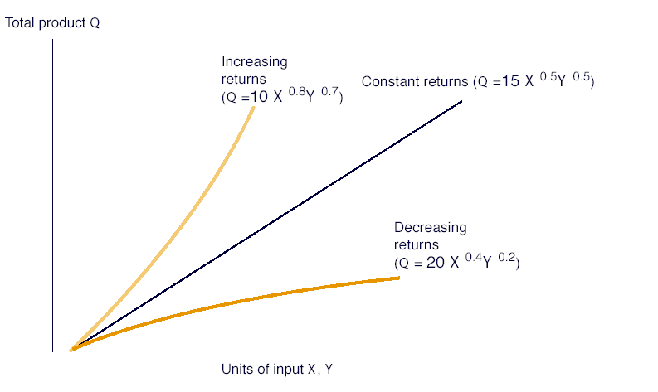
IRS is when a + b > 1
CRS when a + b = 1
DRS when a + b < 1

Slide 33

Productivity Measurement
Economic Productivity
Productivity growth is the rate of change in output per unit of input.
Labor productivity is the change in output per worker hour.
Causes of Productivity Growth
Efficiency gains reflect better input use.
Capital deepening is growth in the amount of capital workers have available for use.

Slide 34
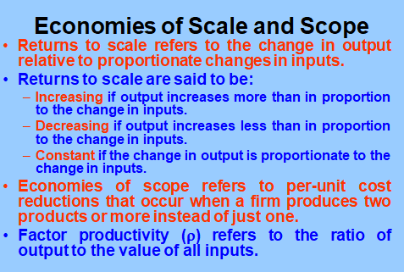

Slide 35
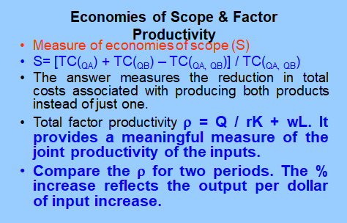



Slide 36
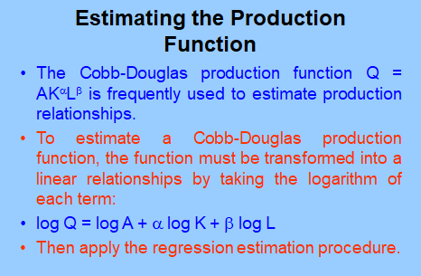


Slide 37
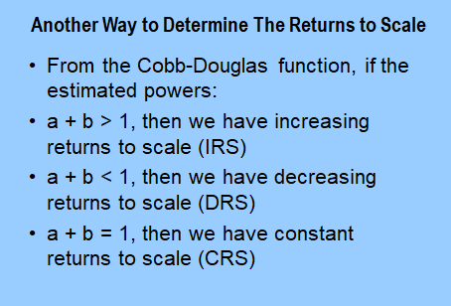

Slide 38
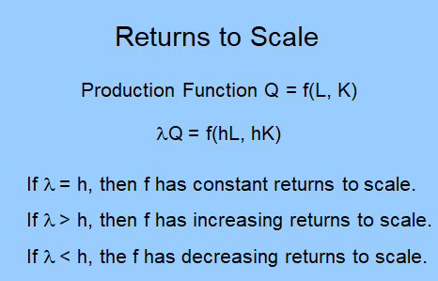

Slide 39
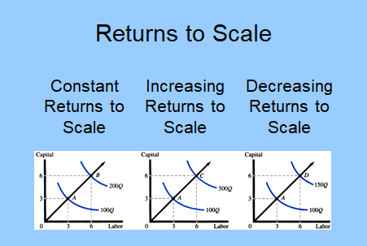




Slide 40
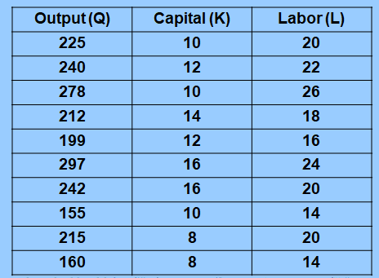
Run the regression to estimate the function of Q = A K^{α} L^{b}

Slide 41


(1)Regression Results: Estimated Coefficients:
Constant term coefficient = antilog of 2.33 = 10.3
t-statistic = 8.56
Capital coefficient ($α$) = 0.193
T-statistic = 3.74
Labor coefficient ($β)=0.88$
T-statistic = 14.2
R² = 0.976, F-statistic = 143
The production equation: Q = 10.3 K ^{0.193} L^{0.88}

Slide 42
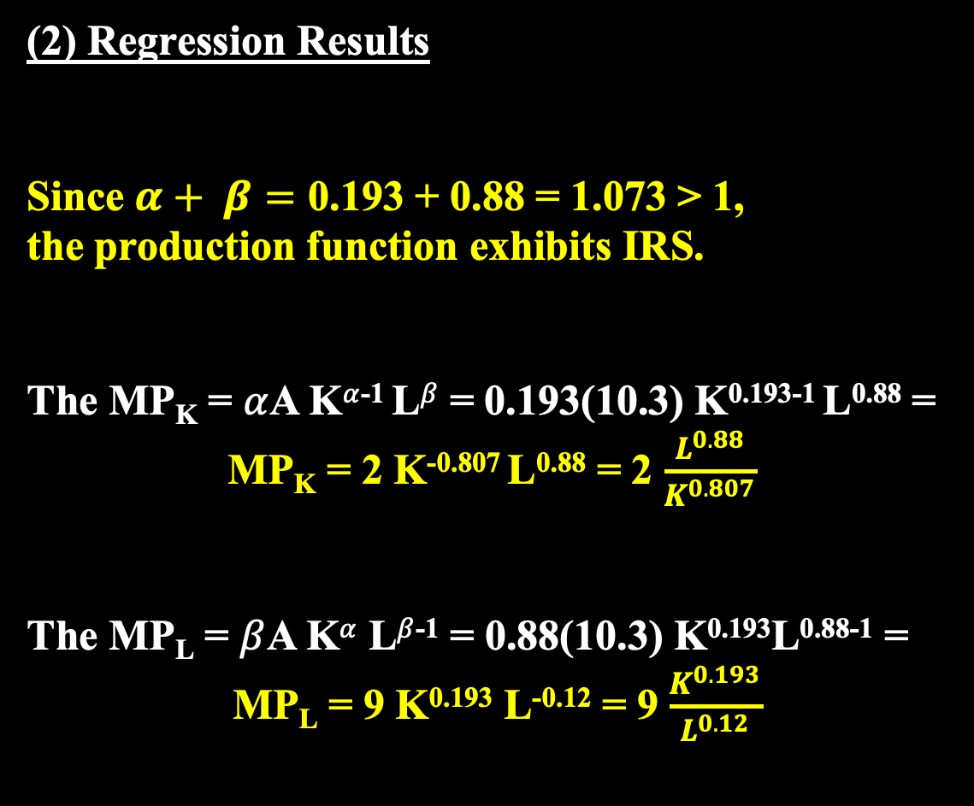
(2) Regression Results
Since $α+ β=\text{0.193}$ + 0.88 = 1.073 > 1,
the production function exhibits IRS.
The MP_{K} = $α$A K$α$⁻¹ L$β$ = 0.193(10.3) K^{0.193-1} L^{0.88} =
MP_{K} = 2 K^{-0.807} L^{0.88} = 2 $\frac{L^{0.88}}{K^{0.807}}$
The MP_{L} = $β$A K$α$ L$β$⁻¹ = 0.88(10.3) K^{0.193}L^{0.88-1} =
MP_{L} = 9 K^{0.193} L^{-0.12} = 9 $\frac{K^{0.193}}{L^{0.12}}$

Slide 43




(3) MP_{K} and MP_{L} for K = 20 units and L = 30 units
MP_{K} = 2 $\frac{L^{0.88}}{K^{0.807}}$ = 2 $\frac{{30}^{0.88}}{{20}^{0.807}}$ = 2 $\frac{19.95}{11.22}$ = 3.6 units of output, meaning that with L held constant at 30 units, a one unit change in K would result in 3.5 unit-change in output.
MP_{L} = 9 $\frac{K^{0.193}}{L^{0.12}}$ = 9 $\frac{{20}^{0.193}}{{30}^{0.12}}$ = 9 $\frac{1.78}{1.5}$ = 10.7 units of output, meaning that with K held constant at 20 units, a one unit change in L would result in 10.7 unit-change in output.

Slide 44

Three Important Relationships
Generally, a specified rate of output can be produced using different combinations of K and L. That is we are assuming some substitutability between labor and capital (or between factors of production).
The concepts of returns to scale (IRS, CRS and DRS) refers to changes in output when all factors of production are varied proportionately.
Returns to a factor of production refers to changes in production associated with changes in that factor only while holding other factors of production constant, usually resulting in diminishing margianl returns or productivity.

