Slide 1
Chapter 7
Financial
Operations of Insurers

Slide 2
Agenda
Property and Casualty Insurers
Life Insurance Companies
Ratemaking in Property and Casualty Insurance
Ratemaking in Life Insurance

Slide 3
“To manage an insurance enterprise successfully, you must understand the volatility inherent in each portfolio of risks and investments. Further, you must understand the impact that unexpected volatility has on the balance sheet, income statement, and cash flows”

Slide 4
Financial Statements of Property and Casualty Insurers
A balance sheet is a summary of what a company owns (assets) and what it owes (liabilities), and the difference between total assets and total liabilities (owners’ equity)
Total Assets = Total Liabilities + Owners’ Equity

Slide 5
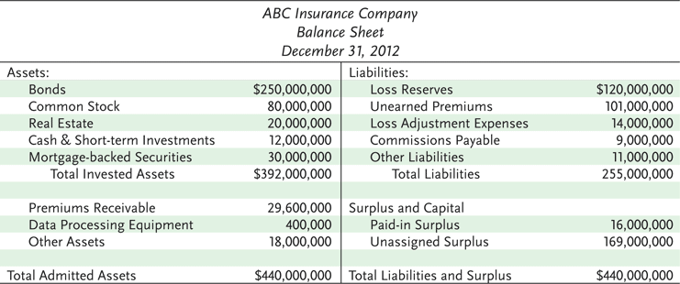
Exhibit 7.1 ABC Insurance Company
Notes:
An insurance company invests premium dollars and retained earnings in financial assets.
These investments also provide an important source of income for an insurer.
As with most insurance companies, ABC’s primary investment holding is bonds.
Other investments are in: preferred and common stocks, real estate, MBS, cash/cash equivalent.

Slide 6
Financial Statements of Property and Casualty Insurers
The primary assets for an insurance company are financial assets
Insurers’ liabilities include required reserves
A loss reserve is an estimated amount for:
  Claims reported and adjusted, but not yet paid
  Claims reported and filed, but not yet adjusted
  Claims incurred but not yet reported to the company
Notes:
Insurance’s company liabilities are more complex than assets,
An insurer is required by law to maintain certain reserves on its balance sheet. Because premiums are paid in advance, and the period of protection extends into the future. An insurer must establish reserves to assure that premiums collected in advance will be available to pay future losses.
There are two principal types of financial reserves (Loss reserves/Unearned premium reserves)
Loss reserve is a large liability item on a property and casualty’s insurance company’s balance sheet.
The loss reserve is especially important to a casualty insurer because bodily injury and property damage are liability claims may take a long time to settle especially if litigation is involved.

Slide 7
Financial Statements of Property and Casualty Insurers
Case reserves are loss reserves that are established for each individual claim
Methods for determining case reserves include:
  The judgment method: a claim reserve is established for each individual claim
  The average value method: an average value is assigned to each claim
  The tabular method: loss reserves are determined for certain claims for which the amounts paid depend on data derived from mortality, morbidity, and remarriage tables
Notes:
Case reserves are assigned when claims are reported for each individual claim.
Judgement method: The amount of the loss reserve can be based on the judgement of someone in the claims department or estimated using a computer program.
Average value method: This method is used when the number of claims is large, and the average claim amount is relatively small. (Auto physical damage)
Tabular method: (Used for life insurance and pension funds)

Slide 8
Financial Statements of Property and Casualty Insurers
The loss ratio method establishes aggregate loss reserves for a specific coverage line
  A formula based on the expected loss ratio is used to estimate the loss reserve
The incurred-but-not-reported (IBNR) reserve is a reserve that must be established for claims that have already occurred but that have not yet been reported
Notes:
The case reserves just discussed establish loss reserves for individual claims. In contrast, the loss ratio method (loss reserves) establishes aggregate loss reserves for a specific coverage line.
The expected loss ratio is multiplied by premiums earned during a specified time period.
The loss ratio method is required for certain lines of insurance, such as workers compensation.
IBNR are not reported until the next accounting period.

Slide 9
Financial Statements of Property and Casualty Insurers
The unearned premium reserve is a liability item that represents the unearned portion of gross premiums on all outstanding policies at the time of valuation
  Its purpose is to pay for losses that occur during the policy period
  It is also needed so that refunds can be paid to policyholders that cancel their coverage
  It also serves as the basis for determining the amount that must be paid to a reinsurer for carrying reinsured polices
  The annual pro rata method is one method of calculating the reserve
Notes:
Unearned premium reserve: is the second type of required loss reserves to be maintained
Unearned premiums are premiums paid in advance for an insuring period, and are converted to earned premiums by the end of that period.
An insurer is required by law to place the entire gross premium in the unearned premium reserve when the policy is first written and to place renewal premiums in the same reserve.

Slide 10
Financial Statements of Property and Casualty Insurers
Policyholders’ surplus is the difference between an insurance company’s assets and liabilities
  The stronger a company’s surplus position, the greater is the security for its policyholders
  The level of surplus is an important determinant of the amount of new business that an insurance company can write
Notes:
Policyholder’s surplus is not calculated directly, it is the balancing item on the balance sheet. If the insurer were to pay all of its liabilities using its assets, the amount remaining would be policyholder’s surplus.
Loss reserves are an estimate of future losses, but the actual losses could easily exceed the estimate,

Slide 11
Financial Statements of Property and Casualty Insurers
The income and expense statement summarizes revenues and expenses paid over a specified period of time
  The two principal sources of revenue for an insurance company are premiums and investment income
  Earned premiums are those premiums for which the service for which the premiums were paid (insurance protection) has been rendered
  Expenses include the cost of adjusting claims, paying the insured losses that occurred, commissions to agents, premium taxes, and general insurance expenses

Slide 12
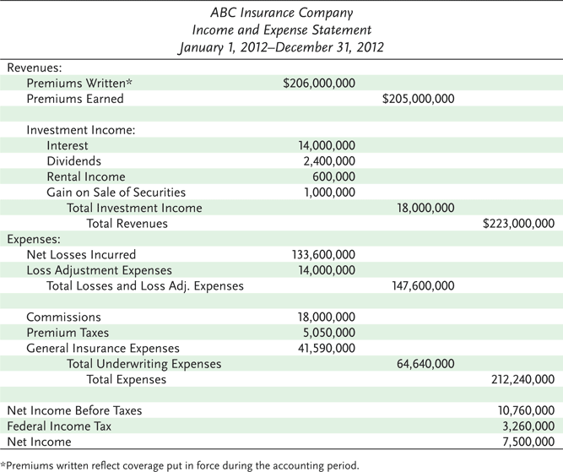
Exhibit 7.2 ABC Insurance Company
Notes:
Given the size of ABC’s bond portfolio, it is not surprising that interest income is the major source of investment income.
The company also received dividend income on stocks owned and rental income on real estate the company owned.
223=205+18

Slide 13
Measuring Profit or Loss
The loss ratio is the ratio of incurred losses and loss adjustment expenses to premiums earned
The expense ratio is equal to the company’s underwriting expenses divided by written premiums
The combined ratio is the sum of the loss ratio and the expense ratio. A positive ratio indicates an underwriting loss
Notes:
In our example: Loss ratio= 147,600/205,000
Expense ratio= 64,640/206,000
Combined ratio= 0.72+0.31= 1.034 which indicates an underwriting loss.

Slide 14
Measuring Profit or Loss
The investment income ratio compares net investment income to earned premiums
The overall operating ratio is equal to the combined ratio minus the investment income ratio
Notes:
A property and casualty insurance company can lose money on its underwriting operations, but still report positive net income if the investment income offsets the underwriting loss.
In our example: 18,000,000/205,000,000=0.088
In our case, overall operating ratio= 1.034-0.088=94.6%
An overall operating ratio of less than 100 indicates that the company, overall, was profitable.
If the operating ratio exceeds 100, it means that investment income was not enough to offset the underwriting loss.

Slide 15


Slide 16
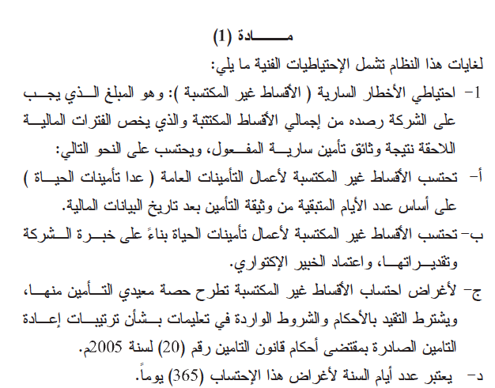

Slide 17
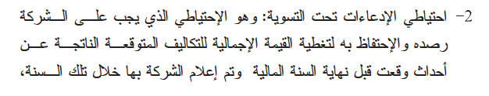


Slide 18


Slide 19


Slide 20



Slide 21
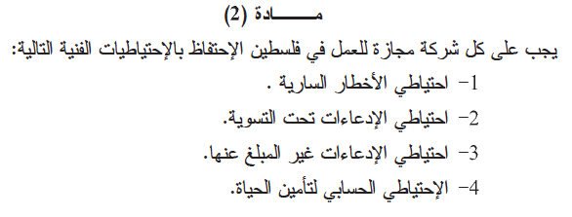
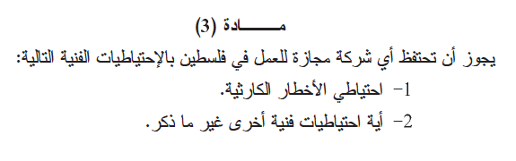

Slide 22
Ratemaking in Property and Casualty Insurance
State Laws Require:
  Rates should be adequate for paying all losses and expenses
  Rates should not be excessive, such that policyholders are paying more than the actual value of their protection
  Rates must not be unfairly discriminatory; exposures that are similar with respect to losses and expenses should not be charged significantly different rates
Notes:
Transparency Master 1.2

Slide 23
Ratemaking in Property and Casualty Insurance
Business Rate-Making Objectives include:
  Rates should be easy to understand
  Rates should be stable over short periods of time
  Rates should be responsive over time to changing loss exposures and changing economic conditions
  The rating system should encourage loss control activities
Notes:
Transparency Master 1.2
Stability: to maintain consumer’s satisfaction
Responsiveness: For example, as a city grows, auto insurance rates should increase to reflect greater traffic and increased frequency of auto accidents. Likewise, rates should reflect changing economic conditions like inflation.
Encouraging loss control activities: to reduce frequency and severity of losses in order to keep insurance affordable.

Slide 24
Basic Ratemaking Definitions
A rate is the price per unit of insurance.
An exposure unit is the unit of measurement used in insurance pricing, e.g., a car-year
The pure premium is the portion of the rate needed to pay losses and loss adjustment expenses
Loading is the amount that must be added to the pure premium for other expenses, profit, and a margin for contingencies
The gross rate consists of the pure premium and a loading element
The gross premium paid by the insured consists of the gross rate multiplied by the number of exposure units

Slide 25
Ratemaking in Property and Casualty Insurance
There are three basic rate making methods in property and casualty insurance
Judgment rating means that each exposure is individually evaluated, and the rate is determined largely by the judgment of the underwriter
Class, or manual rating means that exposures with similar characteristics are placed in the same underwriting class, and each is charged the same rate
Notes:
Judgement rating is used when the loss exposures are so diverse that a class rate can’t be calculated or when credible loss statistics are not available.
Judgement rating is widely used in marine insurance because waters and ports are widely diverse.
Class rating is the most common way
The rate charged reflects the average loss experience for the class as a whole.
Class rating is based on the assumption that future losses to insureds will be determined largely by the same set of factors.
For example: In homeowners insurance, factors are: construction material, age of the home and protective devices.

Slide 26
Ratemaking in Property and Casualty Insurance
Class rates are determined using two basic methods:
  Under the pure premium method, the pure premium can be determined by dividing the dollar amount of incurred losses and loss-adjustment expenses by the number of exposure units
  Under the loss ratio method, the actual loss ratio is compared with the expected loss ratio, and the rate is adjusted accordingly
Notes:
Incurred losses include all losses that occur during the accounting period whether or not they have been paid by the end of the period.
Loss-ratio method: actual loss ratio is the ratio of incurred losses and loss adjustment expenses to earned premiums

Slide 27
Ratemaking in Property and Casualty Insurance
Merit rating is a rating plan by which class rates are adjusted upward or downward based on individual loss experience
  Under a schedule rating plan, each exposure is individually rated
  Under experience rating, the class or manual rate is adjusted upward or downward based on past loss experience
  Under a retrospective rating plan, the insured’s loss experience during the current policy period determines the actual premium paid for that period
Notes:
Merit rating is based on the assumption that the loss experience of a particular insured will differ from the loss experience of another insured.
Schedule rating plan: a basis rate is determined for each exposure. Mainly based on physical differences between insureds. Used in commercial property insurance for large, complex structures such as an industrial plant.

Slide 28
Ratemaking in Life Insurance
Life insurance actuaries use a mortality table or individual company experience to determine the probability of death at each attained age
Expected future payments are discounted back to the start of the coverage period and summed to determine the net single premium or level installment premiums
The annual expected value of death claims equals the probability of death times the amount the insurer must pay if death occurs

