Slide 1
Acoustic Recording and Analysis
Voice 3
provides an imperfect, non-invasive measure of vocal function
can discriminate normal from pathologic voice
is inconsistent agreement between acoustic measures and audio-perceptual ratings of voice quality
can measure change in vocal production across time

Slide 2
Routine Voice Acoustic Measures
fundamental frequency (fo)
  directly reflects the vibration rate of the vocal folds. The acoustic correlate of pitch.
    unit of measure is Hertz (Hz) or cycles per second
    normative data = 100-150 Hz males; 180-250 Hz females
    may be measured from sustained vowels, reading, or conversation
    useful to estimate the appropriateness of fo for sex and age
and for demonstrating pre and post-treatment change

Slide 3
Routine Voice Acoustic Measures cont.
frequency variability
  pitch sigma is the standard deviation of the fundamental frequency
    assesses and documents variation of fo during speech production
phonation range
  range of frequencies from the highest to the lowest that a patient can produce
    may be expressed in Hz or semitones
    normal young adults have about a three octave range; may vary with practice

Slide 4
Routine Voice Acoustic Measures cont.
frequency perturbation
  the change of frequency from one successive period to the next
    unit of measurement is jitter; several algorithms are used to extract jitter; normative data for jitter percent is less than 1.00%
    measures must be made from sustained vowels
    may represent variation of vocal fold mass, tension, muscle activity, or neural activity all of which may effect the periodicity of vocal fold vibration

Slide 5
Routine Voice Acoustic Measures cont.
Intensity (Io)
  directly reflects the sound pressure level (SPL) of voice.
  The direct correlate of loudness.
    unit of measure is the logarithmic decibel (dB) scale
    may be measured from sustained vowels, reading, or conversation
    useful as pre and post-treatment measure

Slide 6
Routine Voice Acoustic Measures cont.
overall SPL
  average SPL in dB
    indication of the strength of vocal fold vibration (Norms: 75-80 dB conversation)
amplitude variability
  standard deviation of the SPL during connected speech
    reflects loudness variability
dynamic range
  range of vocal intensities that a person can produce (Norms: 50-115 dB SPL)

Slide 7
Routine Voice Acoustic Measures cont.
Amplitude perturbation
  small cycle to cycle changes of the amplitude of the vocal fold signal
    unit of measurement is shimmer; several algorithms are used to extract shimmer; normative data for shimmer dB is less than .35 dB
    measures must be made from sustained vowels
    may represent variation of vocal fold mass, tension, muscle activity, or neural activity all of which may effect the amplitude of vocal fold vibration

Slide 8
Routine Voice Acoustic Measures cont.
Harmonics to Noise Ratio
  a ratio measure of the energy in the voice signal over the noise energy in the voice signal
    may be derived from different algorithms and expressed in various units
    greater signal or harmonic energy in the voice reflects better voice quality
    large noise energy represents more abnormal function

Slide 9
Routine Voice Acoustic Measures cont.
Voice Range Profile (Phonetogram)
  plots maximum and minimum intensities for entire frequency range
    resulting plot is ellipsoid-shaped frequency/intensity profile and the dimensions are expressed in semitones
    most useful in pre and post-treatment of professional voice users

Slide 10
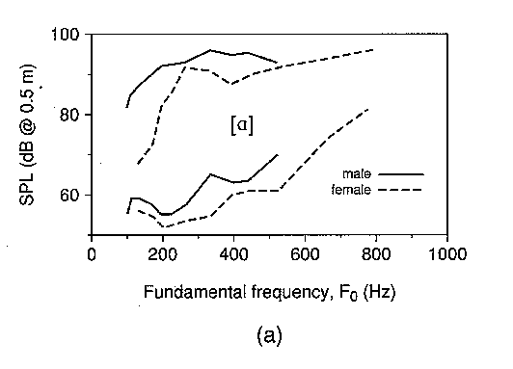
Phonetogram or Voice Range Profile (VRP)

Slide 11
Routine Voice Acoustic Measures cont.
Spectral Analysis
  a sound spectrogram displays the glottal sound source and filtering characteristics across time
    both formant frequency energy (vocal tract resonance) and noise components (aperiodicity are presented in a three-dimensional scale
    horizontal axis = time
    vertical axis = frequency (lowest band = fo; formants are above)
    gray scale (darkness) represents intensity change

Slide 12
Acoustic Recording Considerations
must be a quasi-periodic, stable sound source
most measures are taken from the stable vowel /a/
measures must be at least 1 second in length
the greater the dysphonia, the less confidence in the acoustic measures
variations in fo, Io, and vowel will affect measures
number of trials must be adequate to represent speech behavior
must attend to intrasubject variability by controlling for intensity and frequency in the re-test condition

Slide 13
Aerodynamic Analysis of Voice
Aerodynamic measurement of voice production concerns measurements of air pressures and air flows that are meaningful in clinical diagnosis and treatment.
These measures may help interpret:
  valving activity of the larynx
    vocal fold structure
    vocal fold configuration
    vocal fold movement

Slide 14
Aerodynamic Analysis of Voice cont.
Instruments for measuring pressure and flow:
  U tube manometer
  wet spirometer
  hot wire anemometer
  magnetometers
  pnuemotachograph

Slide 15
Aerodynamic Analysis of Voice cont.
Common aerodynamic measures:
  airflow volume
    volume of air in the lungs available to drive the vocal folds for
voice production
      measured in liters, will vary with age, sex, size, health
  airflow rate
    rate at which air passes between the vocal folds during
phonation
      measured in liters/sec, with normal rate = 50-200 ml/sec
  maximum phonation time (MPT)
    maximum time that a vowel may be sustained while using
maximum airflow volume
      will vary with lung capacity, age, sex, size, health

Slide 16
Aerodynamic Analysis of Voice cont.
Common aerodynamic measures cont.:
  subglottal air pressure (Psub)
    measure of air pressure beneath the vocal folds necessary to overcome the resistance of the approximated folds to initiate and maintain phonation
      direct measure is necessary through needle puncture into
trachea
      measured in cm/H20 with norm for conversational voice being 3-7 cm/H20
      intraoral pressure measures reflective of Psub
      vocal fold stiffness, hypo/hyperfunction, incomplete
glottic closure will influence Psub

Slide 17
Aerodynamic Analysis of Voice cont.
Common aerodynamic measures cont.:
  phonation threshold pressure
    a measure of the effort needed to initiate phonation
      measure is estimated indirectly using intraoral air pressure measured at the exact moment of voice onset for barely audible phonation
      speakers with vocal pathologies often require greater
effort to initiate phonation

Slide 18
Aerodynamic Analysis of Voice cont.
Common aerodynamic measures cont.:
  laryngeal (glottal) resistance
    this is a combination measure that utilizes measures of pressure and flow in a ratio.
    Laryngeal resistance is the quotient of peak intraoral air pressure (from unvoiced plosive) divided by the peak flow rate (measured from a vowel) as measured from a repeated consonant + vowel syllable such as /pi/pi/pi/.
– estimates the overall resistance of the glottis and therefore the valving characteristics, I.e. too tight, too loose, normal

Slide 19
Aerodynamic Analysis of Voice cont.
Aerodynamic Recording Considerations
  requires airtight seals around the lips or mask to face
  as natural speech as possible must be encouraged in this foreign environment
  multiple trials are necessary to ensure a stable baseline
  instrument calibration is required prior to each examination session

Slide 20
Other Physiologic Measures of Vocal
Function
Electroglottography (EGG)
  using an electrical current passing through the neck, EGG measures vocal fold contact across time
Electromyography (EMG)
  the only direct measure of laryngeal function.
  Needle electrodes are inserted into the laryngeal muscles and the pattern of electrical activity is measured

Slide 21
Advantages of Instrumental Voice
Assessment
For the clinician
  extends the ear and eye of the observer
  objectifies the analysis of the observations
  supplements the perceptual judgements
  aids in the appraisal of vocal mechanics
  helps to establish management strategies
  establishes a baseline for measuring treatment effects

Slide 22
Advantages of Instrumental Voice
Assessment cont.
For the patient cont.
provides permanent record and documentation
forces care-givers to be accountable
provides objective documentation for healthcare
companies
facilitates the understanding of the relationship between the voice perception and the underlying physiology of the voice production

Slide 23
Advantages of Instrumental Voice Assessment
For the patient
  tests are generally easy for the patient to perform
  provides immediate results and feedback
  provides visual image of the voice problem
  essentially non-invasive
  management often proves to be more cost-effective
  provides a record against which the patient may measure management progress over time

Slide 24
Pediatric Voice
Special Considerations
The most important consideration in pediatric population is the preservation of airway
The larynx/airway is almost the most important system of the entire infant

Slide 25
Anatomical Differences
Voice pathologists should be aware of the differences between the adult and pediatric laryngeal anatomy and physiology
The differences between adult laryngeal anatomy and pediatric laryngeal anatomy are more significant than mere size of the structures

Slide 26
Position of the Larynx
In an adult the larynx sits opposite approximately the fifth or sixth
cervical vertebral body
In a child the larynx sits opposite approximately the fourth cervical vertebral body
In an infant the larynx can rise as high as first or second cervical body during swallowing

Slide 27
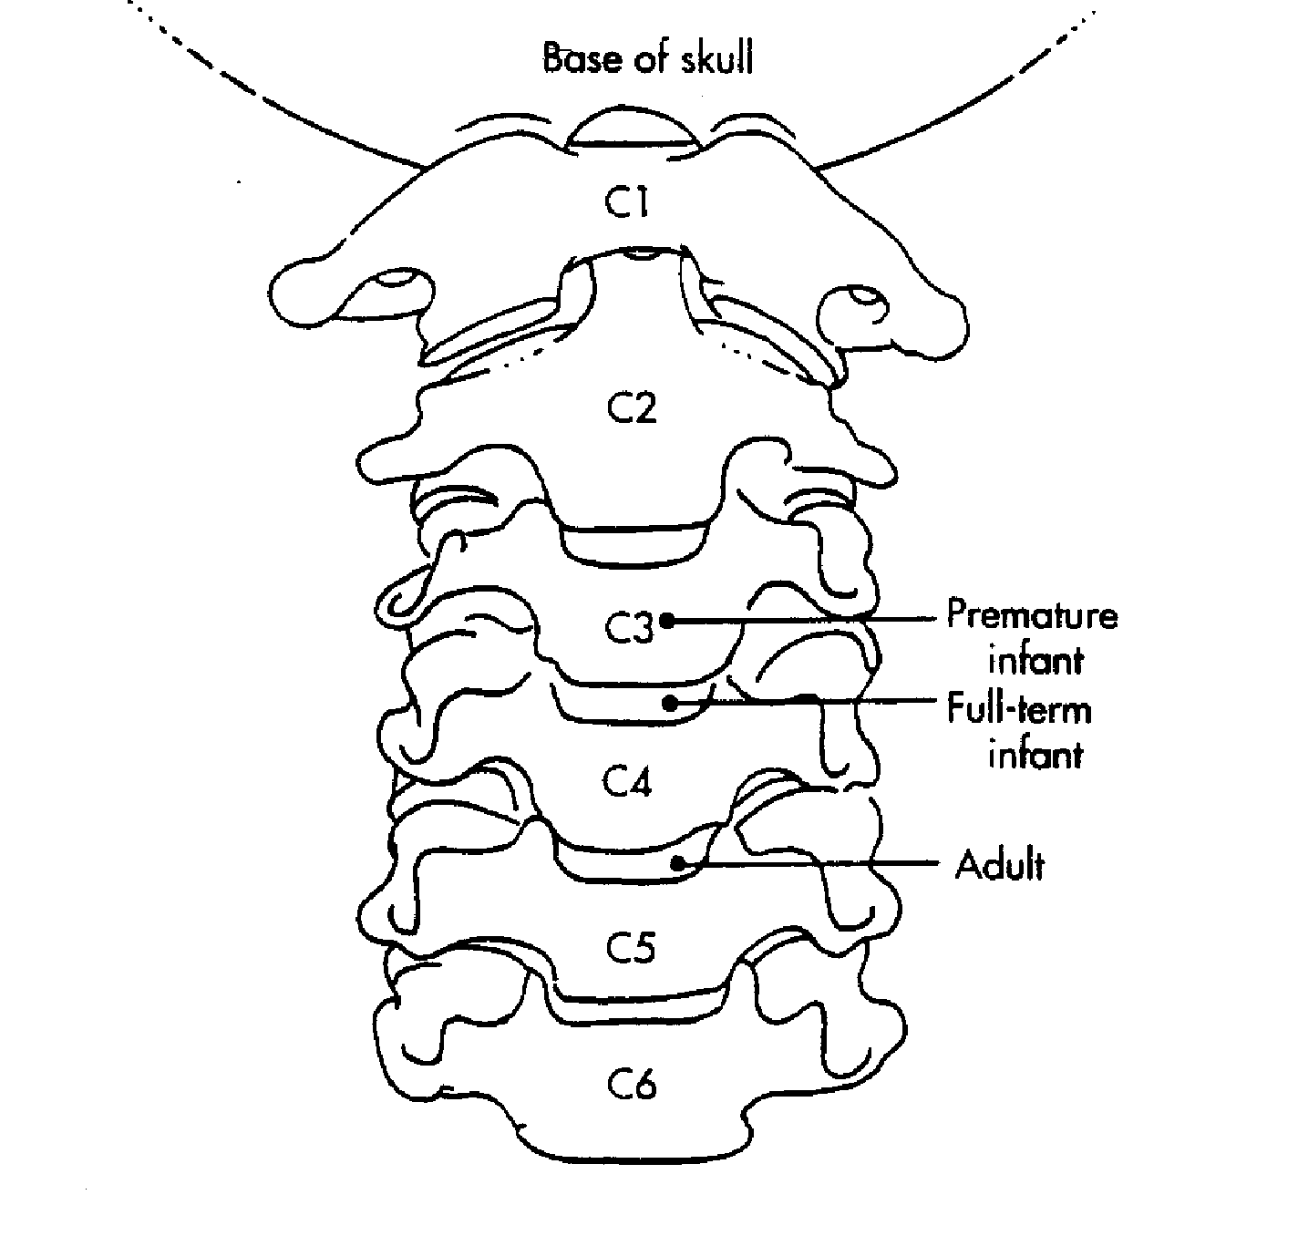

Slide 28
Laryngeal Structures
In the pediatric larynx, the thyroid notch is not prominent as it is in the adult larynx. It is obscured by the overlapping hyoid bone
The thyroid cartilage of the pediatric larynx is not prominent as it is in the adult, but more rounded with no midline vertical ridge

Slide 29
The cricoid cartilage of the pediatric larynx is also not prominent
In the adult larynx, the cricothyroid membrane can be felt as a depression between the thyroid and the cricoid; however, in the pediatric larynx it is just a little slit

Slide 30
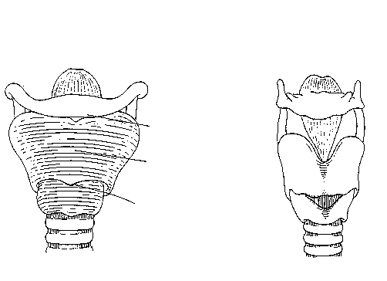
Immature
Mature
Hyoid Cartilage Overlaps Thyroid
No Vertical Prominence in Thyroid
Cricothyroid Membrane is a slit
Anterior View

Slide 31
The pediatric trachea is 4-5 mm in diameter
The aryepiglottic folds and the arytenoid cartilages are large relative to other laryngeal structures
It is estimated that 50% of infant epiglottis are omega shaped

Slide 32
In an adult, starting from the base of the tongue, the airway takes a rather straight vertical shape
In a child, The larynx takes a curved shape

Slide 33
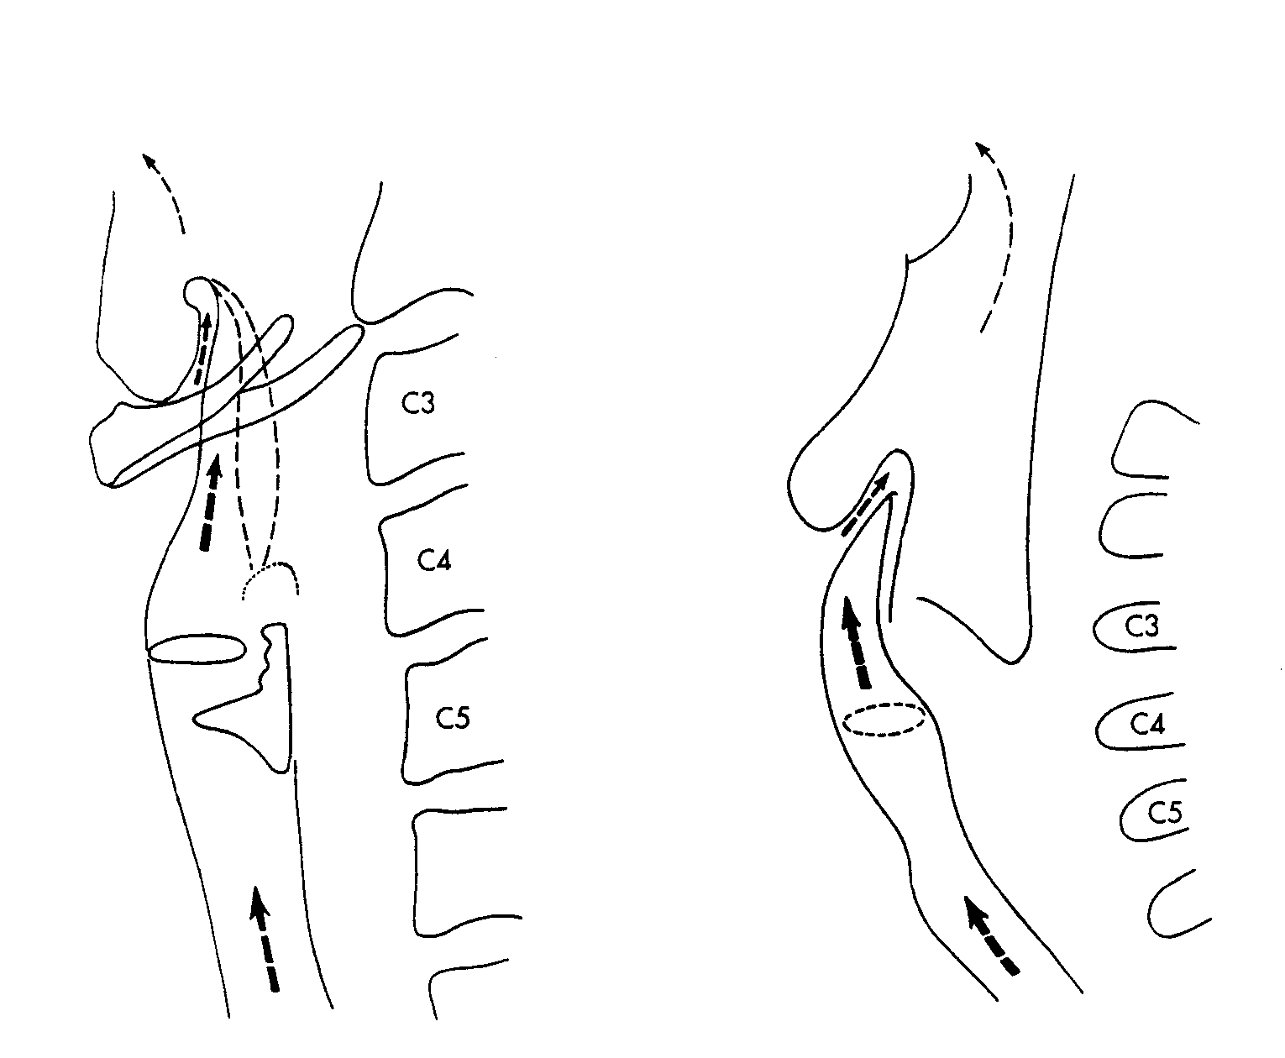
Adult
Child

Slide 34
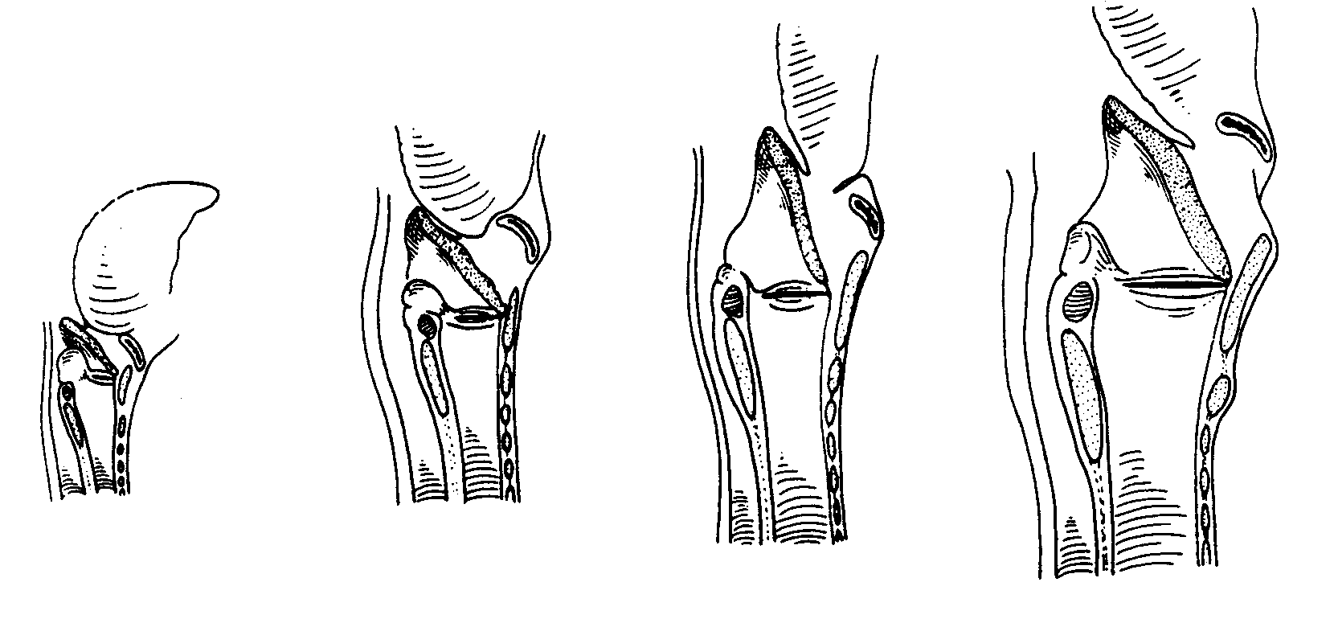
Infant
Child
Adult
Adult

Slide 35
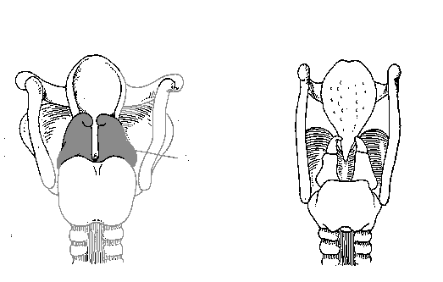
furled epiglottis
large arytenoids
Child
Adult

Slide 36
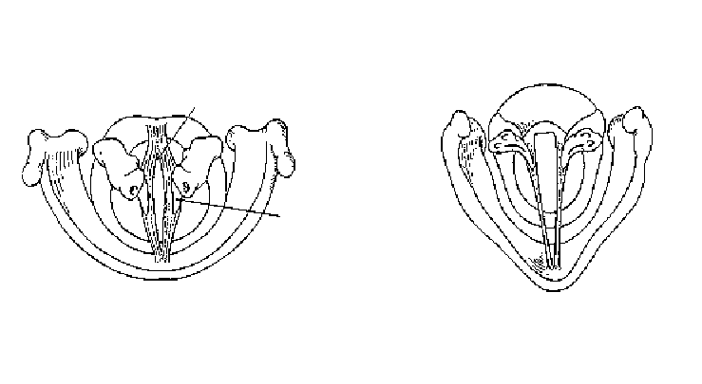
immature
mature
The arytenoid cartilages are large relative to other laryngeal structures in the pediatric larynx.
arytenoids

Slide 37
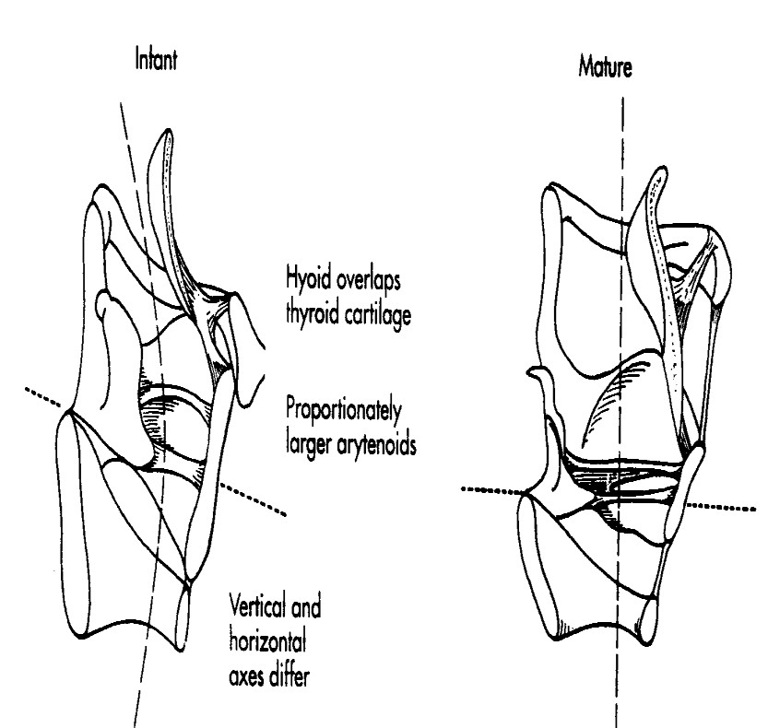
In an adult, the angle of the epiglottis is somewhat vertical and in alignment with the trachea, which is not the case in the pediatric larynx

Slide 38
Vocal Folds
Length of the entire vocal fold
Length of the entire vocal fold in newborns is about 2.5-3.0 mm, with no gender difference up to the age of 10.
In adults, vocal fold length is about 17-21 mm in males and 11-15 mm in females.

Slide 39
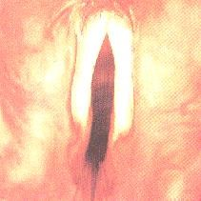
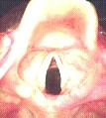
Vocal Folds
Adult vocal folds-normal Pediatric vocal folds-normal

Slide 40
Anatomical – Clinical Indications
Because of the pliable tissue lining the pediatric larynx, normal respiratory pressure may be enough to deform the laryngeal structure (e.g. Laryngomalacia and Tracheomalacia)
The curved shape of the pediatric airway should be considered while conducting laryngoscopy, stroboscope and intubation

Slide 41
The narrowness of the cricothyroid membrane depression in the pediatric larynx should be taken into consideration while considering a cricothyroctomy or a cricothyroid puncture
It is also important if a botox injection is considered.
The large size of arytenoid cartilages obscures much of the vocal folds

