Slide 1
EXP #9
SPRING BOOT PART 1
SLIDES BY: Tarek Zidan and Mohamad Balawi

Slide 2
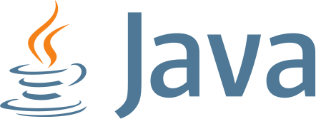


What is Spring and Spring Boot?
Java programming language (1995): the same java we know and love.
Spring (2003): an enterprise java framework which lets you write enterprise java applications, spring framework is widely used due to It’s useful features.
Spring Boot (2014): was introduced to make creating spring applications easier, spring boot was built above Spring MVC.
"Enterprise" in this context refers to large-scale, complex, and mission-critical applications that are typically used by businesses.
“Spring MVC” is a java MVC framework which helps you build MVC architecture using defined features.

Slide 3
What is Spring and Spring Boot?
Spring Boot makes it easy to create stand-alone, production-grade Applications that you can run without even the need for a servlet container, also Spring Boot contains a default configuration which probably will be enough for most cases, which makes it easy to start development without the need to diving into complex configurations ( as in Spring, Spring MVC)
Also, being stand-alone with an embedded servlet container means the server's configuration is embedded with the application configurations, making it easier to deploy in different machines without worrying about configuring the servlet container.
Keep in mind that springboot mainly bootstraps the development of spring MVC projects, so actually, spring MVC will be the one getting the job done.

Slide 4
What is MVC Architecture?
MVC (Model-View-Controller) architecture is a design pattern for organizing code in a way that separates application logic into three interconnected components:
  Model (data and business logic),
  View (user interface),
  Controller (API’s access when requesting a URL).
  Service (business logic)
    Though not explicitly part of MVC, it is a middle layer between Model and Controller.
This separation enhances modularity and maintainability in software development.

Slide 6
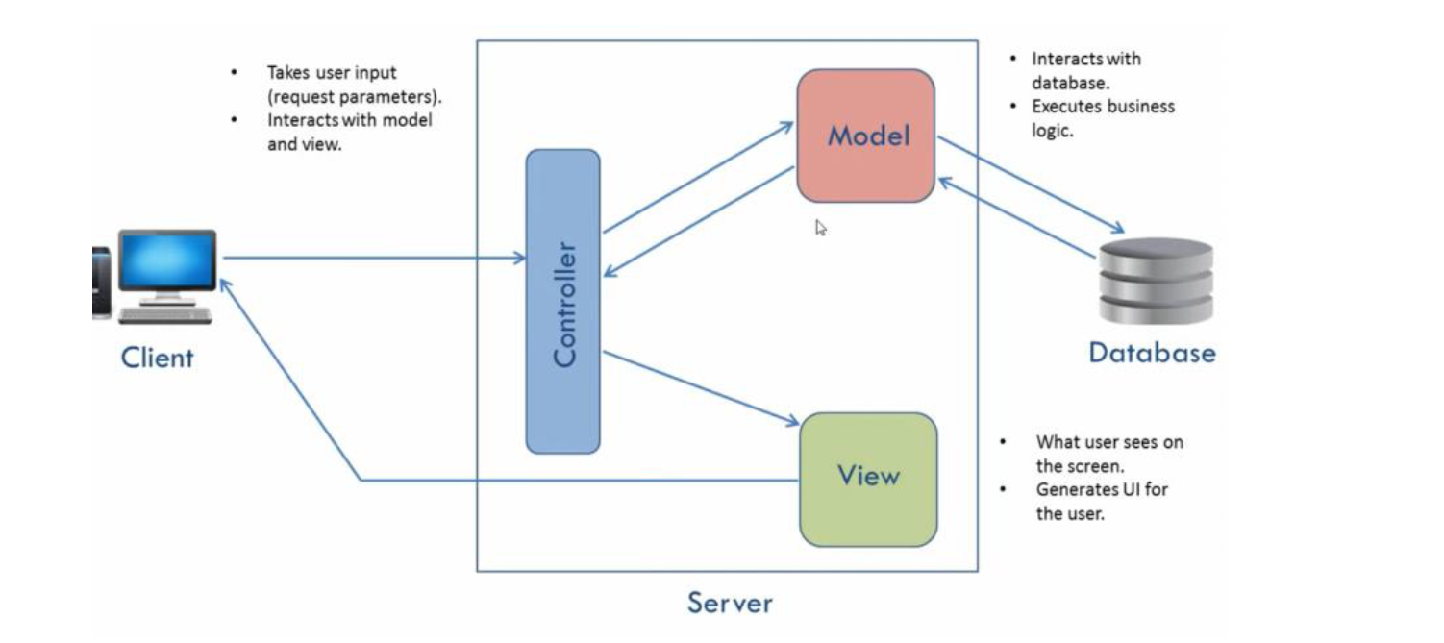
Simplified MVC Architecture

Slide 7
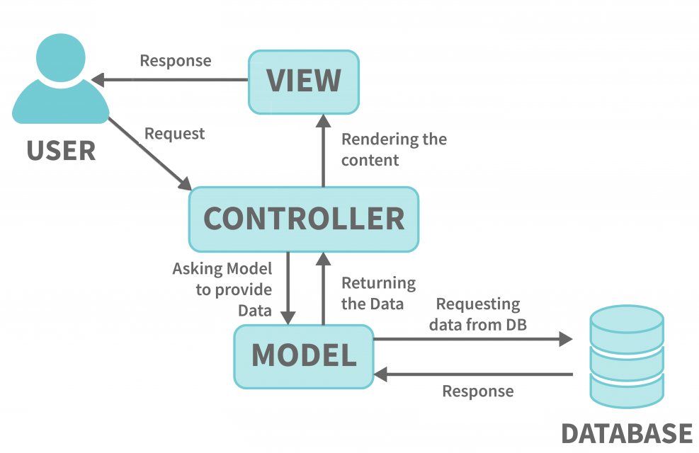
MVC Architecture (general view)

Slide 8
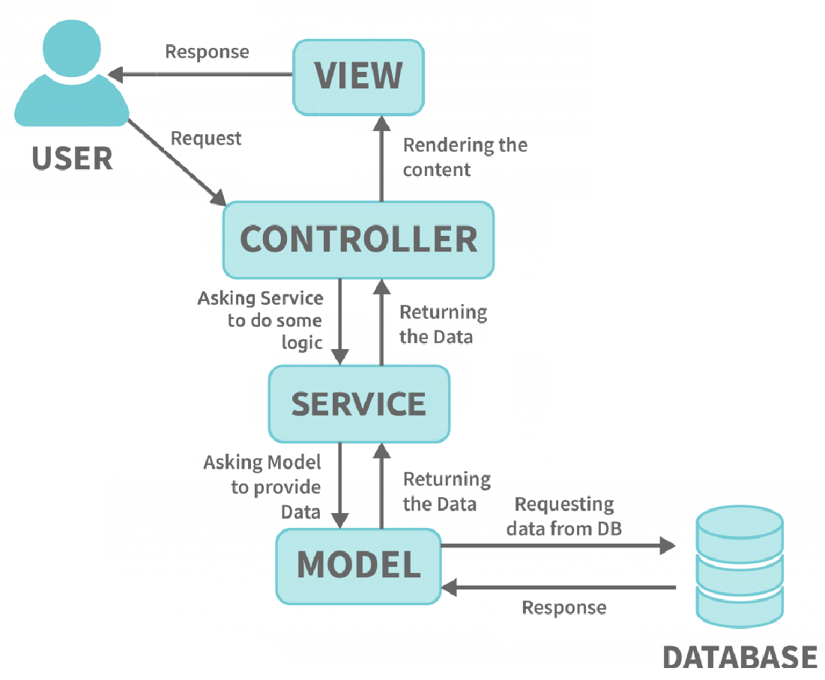
MVC Architecture (with service)

Slide 9
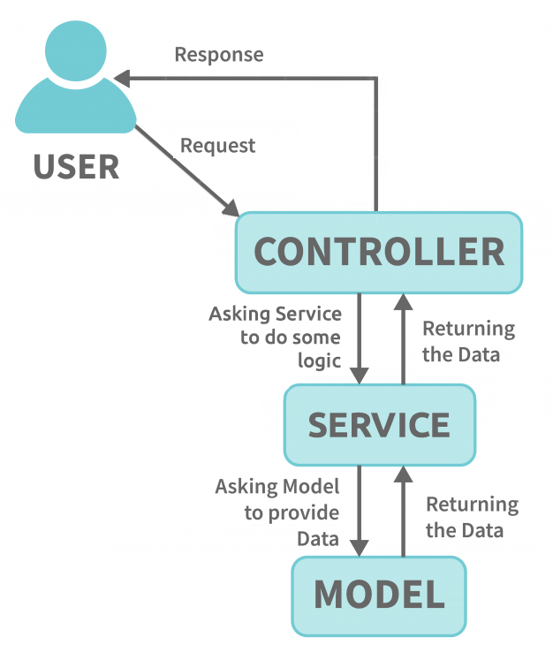
Our MVC Architecture (in this exp.)

Slide 10
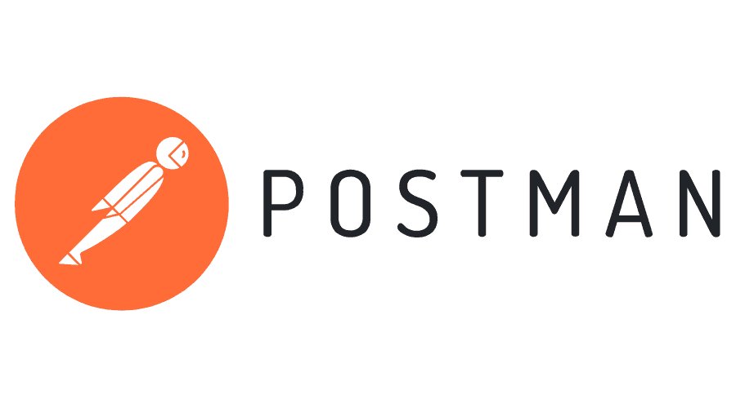
Postman
Postman is a popular tool used by students and developers for testing and managing APIs.
It provides a user-friendly interface to create, send, and analyze HTTP requests.
It acts like a browser but gives you much better control over the request type and body.

Slide 11

IntelliJ IDEA
IntelliJ IDEA is an integrated development environment (IDE) primarily used for Java development but also supports various other languages. It offers advanced features such as code assistance, refactoring tools, and seamless integration with build tools.

Slide 12
Our MVC Architecture (in this exp.)

Slide 13
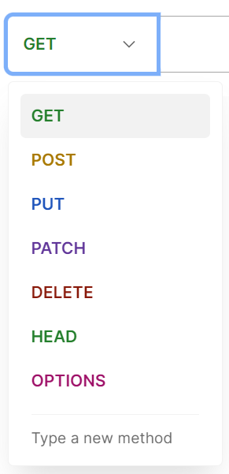
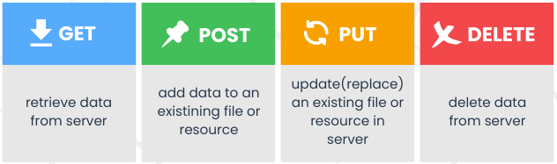
HTTP Methods
There are different HTTP methods, each one has its own purpose.
We can use Postman to specify a method as shown on the right.
A browser uses GET method to retrieve and show web pages.

Slide 14
Common annotations in this experiment
Annotation | Purpose
@Service | Marks the UserService class as a service layer component. It indicates that this class provides business logic and can be auto-detected by Spring's component scanning.
@RestController | Marks the UserController class as a RESTful web controller. It combines @Controller and @ResponseBody, enabling methods to return JSON/XML responses directly.
@RequestMapping | Maps HTTP requests to specific handler methods or classes. It can define the URL path, HTTP method, and other properties. Examples: /users maps to getAllUsers.
@Autowired | Used to enable dependency injection. It automatically injects the UserService bean into the UserController.

Slide 15
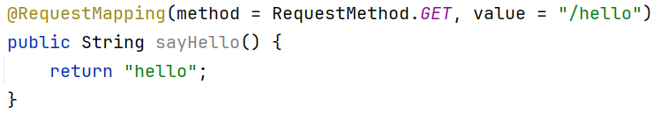

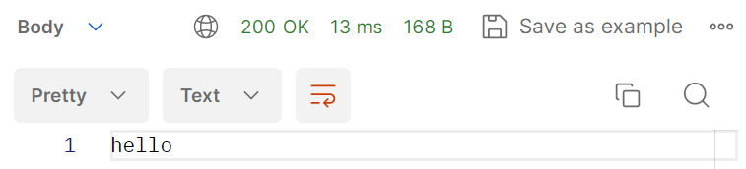
Controller (@RequestMapping)
The annotation @RequestMapping is added before a method to specifiy HTTP Request Method and the URL path.
We can execute a get request in Postman to get data:

Slide 16
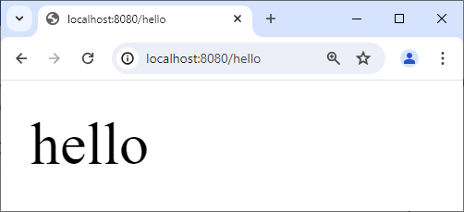
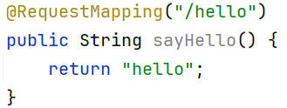
Controller (@RequestMapping)
We can use the browser as well, but the browser only works with GET method.
If we don’t specify the method for @RequestMapping then by default it is considered GET.

Slide 17
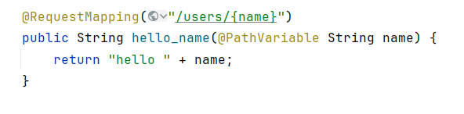
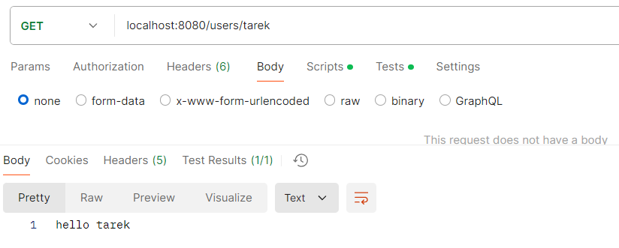
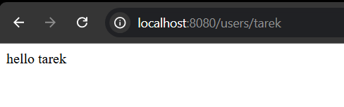
Controller (@PathVariable)
The annotation @PathVariable extracts a variable directly from the URL.
The path variable should be within curley braces {name}.
When we execute a GET request to “/users/tarek” we get “hello tarek” as output:

Slide 18
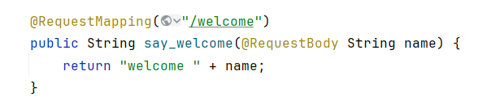
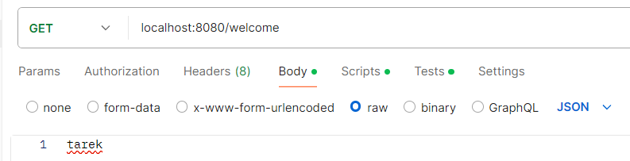
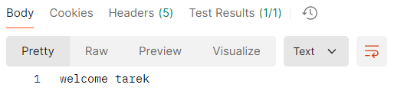
Controller (@RequestBody)
A request has a body of text, we can leave it empty of fill it with text.
We can use Postman to specify a body for our request as shown in the screenshot below.
The annotation @RequestBody creates a variable from the request body.
The response is:

Slide 19
How to Setup Experiment 9 & 10:
Download & install MySQL Server from here.
Download & install IntelliJ Community Edition from here.
Download & install Postman from here.
Open Spring Initializr and create a new application with the following settings and dependencies:

Slide 20
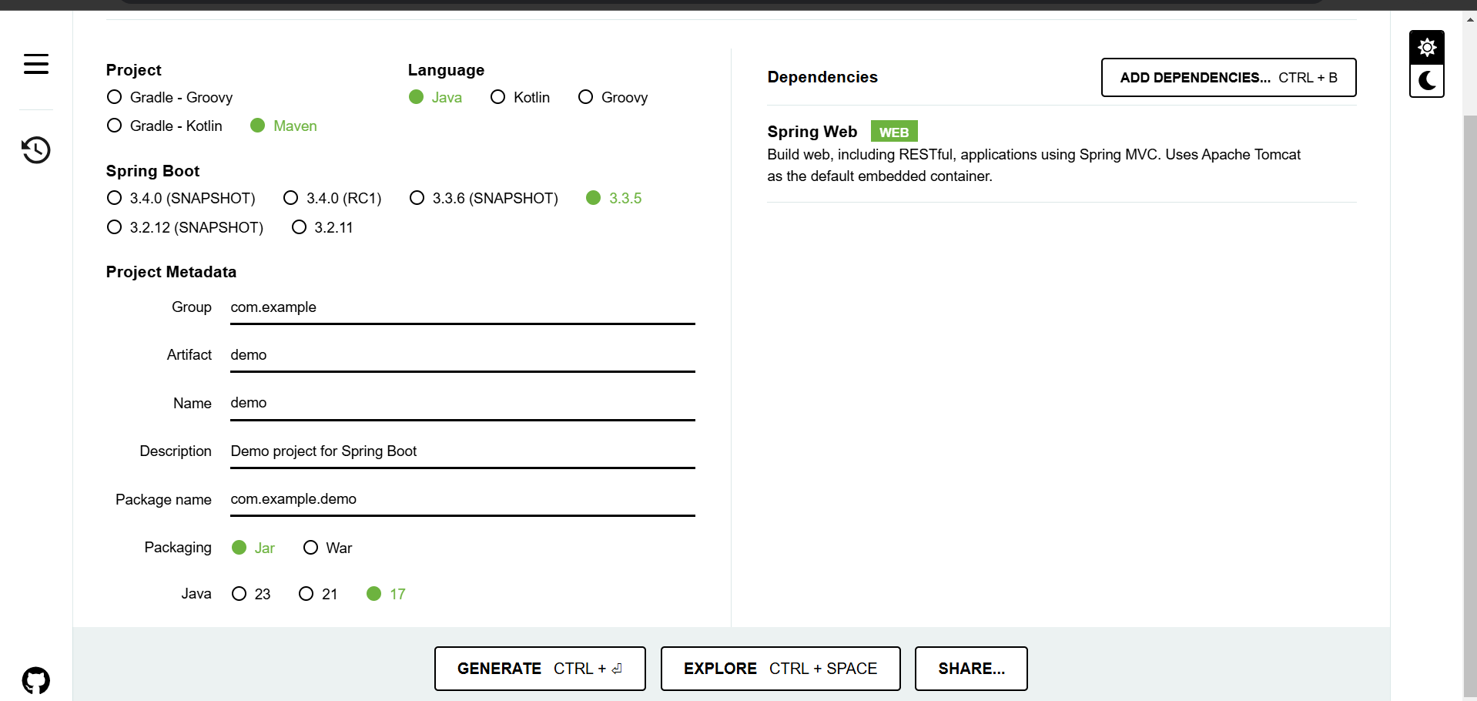

Slide 21
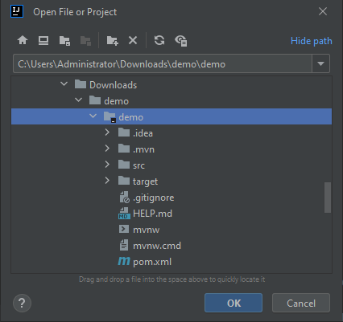

Click "Generate" button and download the ZIP file, then extract it.
Open Intellij, then click File $→$ Open, then choose the unzipped folder, make sure to choose the folder that has pom.xml directly within.

Slide 22
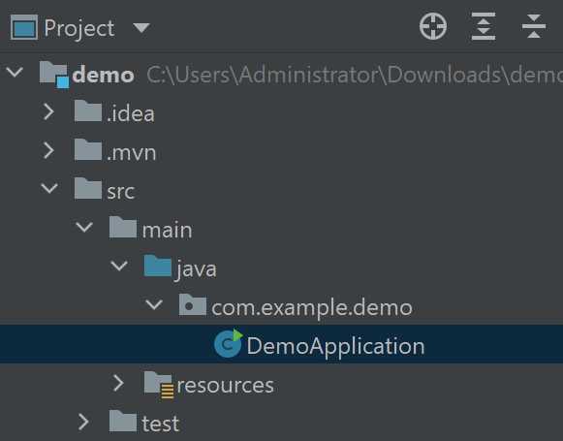
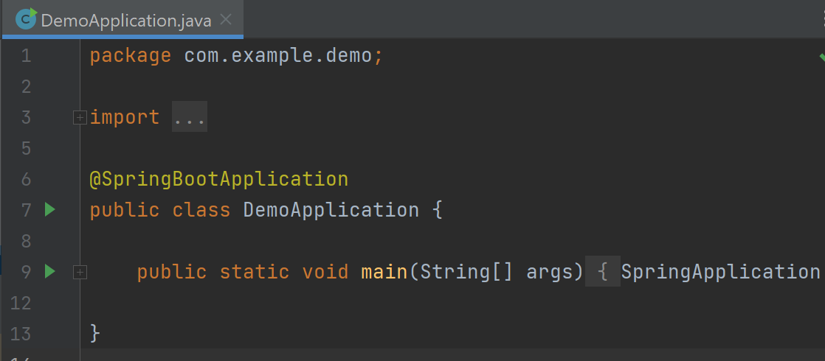
Open src/main/java/com.example.demp/DemoApplication file.
Click on the green arrow which is in the same line as the main method.

Slide 23
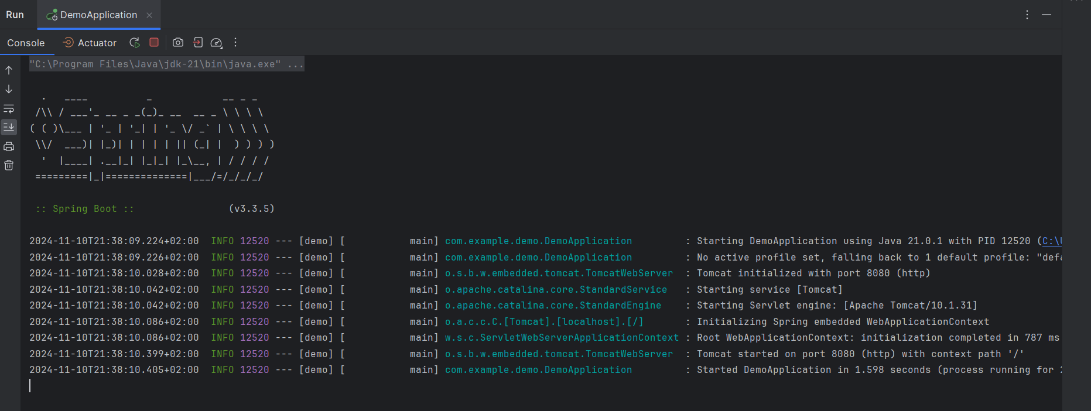
You should get the following text in the terminal:

Slide 24
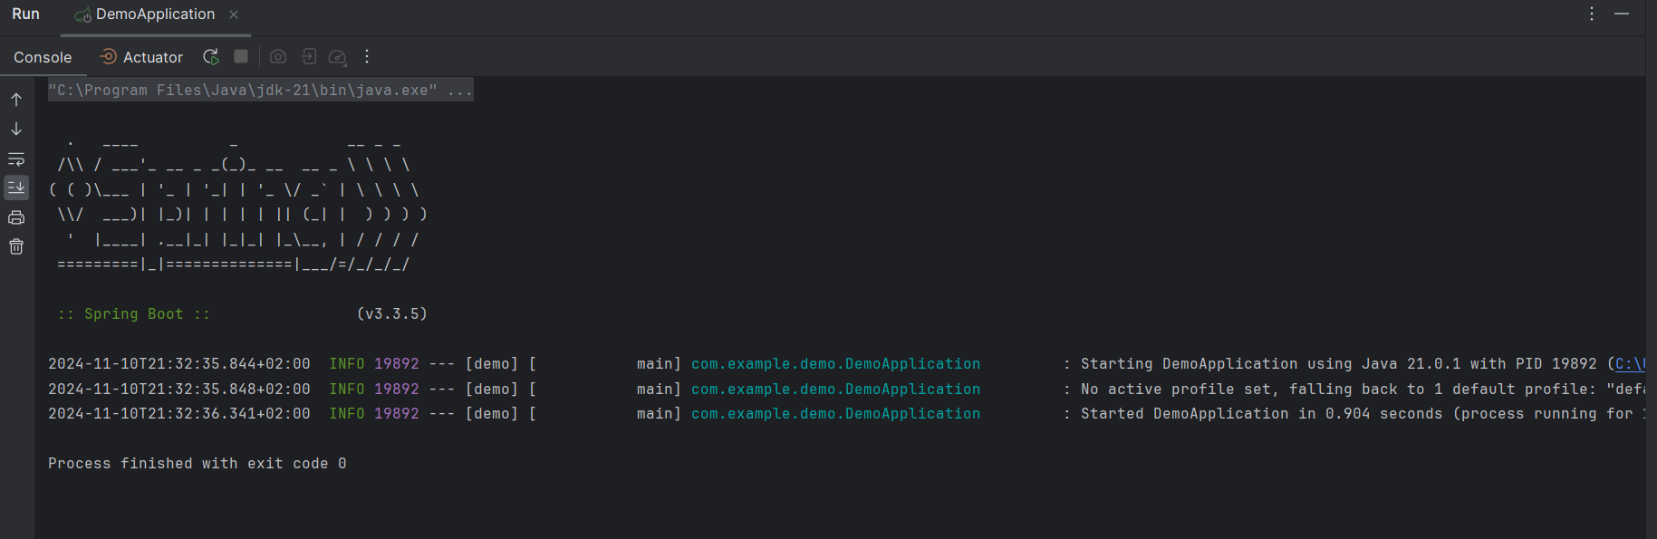
Note: If this appeared, then you did not choose the ‘Spring Web’ dependency in https://start.spring.io/

Slide 25
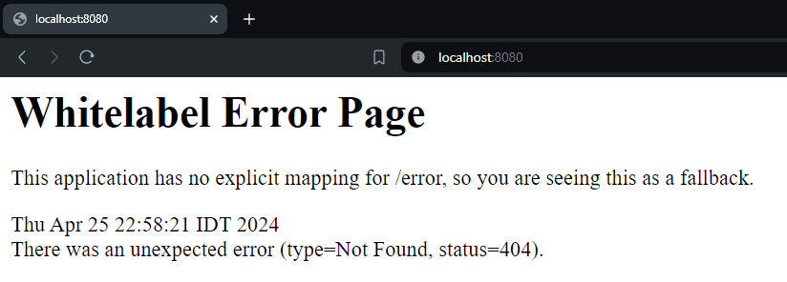
Open the following URL in the browser localhost:8080
If you see the following Whitelabel Error Page, then your setup is correct.
You can begin the experiment on page 105 of the manual.

Slide 26
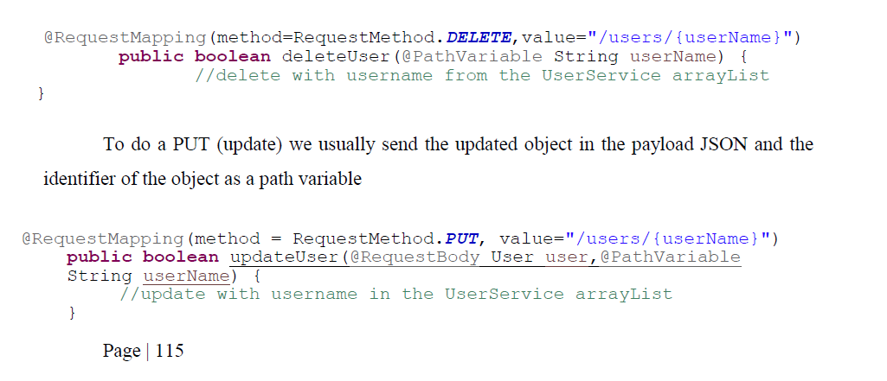
Task
Continue the PUT and DELETE requests as required on page 115

