Slide 1
Amino Acids and Peptides

Slide 2
The word protein that I propose to you . . . I would wish to derive from proteios, because it appears to be the primitive or principal substance of animal nutrition that plants prepare for the herbivores, and which the latter then furnish to the carnivores.
—J. J. Berzelius, letter to G. J. Mulder, 1838

Slide 3
Proteins are the most abundant biological macromolecules, occurring in all cells and all parts of cells. Proteins also occur in great variety; thousands of different kinds may be found in a single cell. Proteins are the molecular instruments through which genetic information is expressed. All proteins, whether from the most ancient lines of bacteria or from the most complex forms of life, are constructed from the same ubiquitous set of 20 amino acids, covalently linked in characteristic linear sequences.

Slide 4
Proteins are found in a wide range of sizes, from relatively small peptides with just a few amino acid residues to huge polymers with molecular weights in the millions. cells can produce proteins with strikingly different properties and activities by joining the same 20 amino acids in many different combinations and sequences.
From these building blocks different organisms can make such widely diverse products as enzymes, hormones, antibodies, transporters, muscle
fibers, the lens protein of the eye, feathers, spider webs, rhinoceros horn, milk proteins, antibiotics, mushroom poisons, and myriad other substances having distinct biological activities

Slide 5
Proteins are polymers of amino acids, with each amino acid residue joined to its neighbor by a specific type of covalent bond. Twenty different amino acids are
commonly found in proteins. The first to be discovered was asparagine, in 1806. The last of the 20 to be found, threonine, was not identified until 1938. All the amino acids have trivial or common names, in some cases derived from the source from which they were first isolated. Asparagine was first found in asparagus, and
glutamate in wheat gluten; tyrosine was first isolated from cheese (its name is derived from the Greek tyros, “cheese”); and glycine (Greek glykos, “sweet”) was so named because of its sweet taste.

Slide 6
All 20 of the common amino acids are α-amino acids. They
have a carboxyl group and an amino group bonded to the
same carbon atom (the carbon) (Fig. 3–2). They differ from each other in their side chains, or R groups, which vary in structure, size, and electric charge, and which influence the solubility of the amino acids in water. In addition to these 20 amino acids there are many less common ones. Some are residues modified after a protein has been synthesized; others are amino acids present in living organisms but not as constituents of proteins. The common amino acids of proteins have been assigned three letter abbreviations and one-letter symbols (Table 3–1), which are used as shorthand to indicate the composition and sequence of amino acids polymerized in proteins.

Slide 7
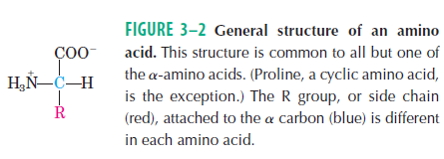

Slide 8
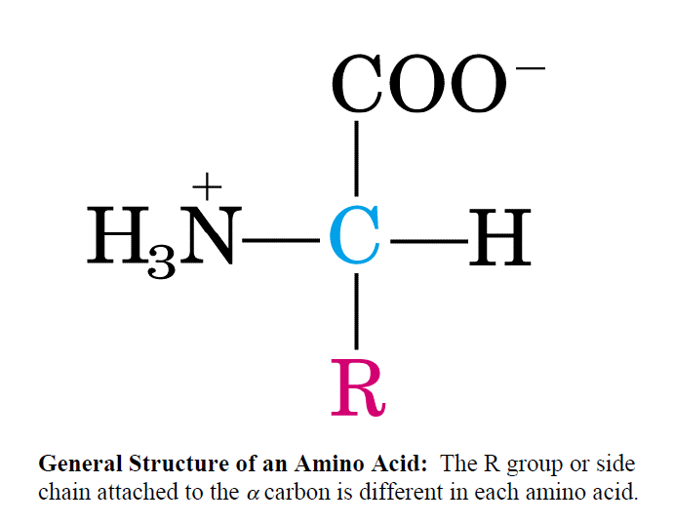

Slide 9
A carbon atom with four different substituents is said to be asymmetric, and asymmetric carbons are called chiral centers (Greek chiros, “hand”; some stereoisomers are related structurally as the right hand is to the left).
A molecule with only one chiral carbon can have two stereoisomers; when two or more (n) chiral carbons are present, there can be 2n stereoisomers. Stereoisomers that are mirror images of each other are called enantiomers (Fig. 1–19). Pairs of stereoisomers that are not mirror images of each other are called diastereomers (Fig. 1–20).

Slide 10
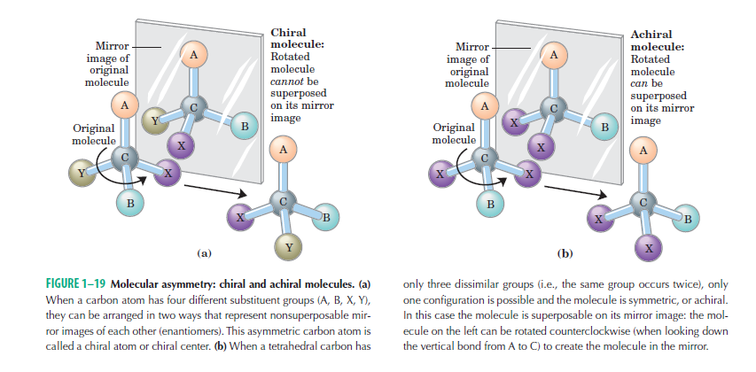

Slide 11
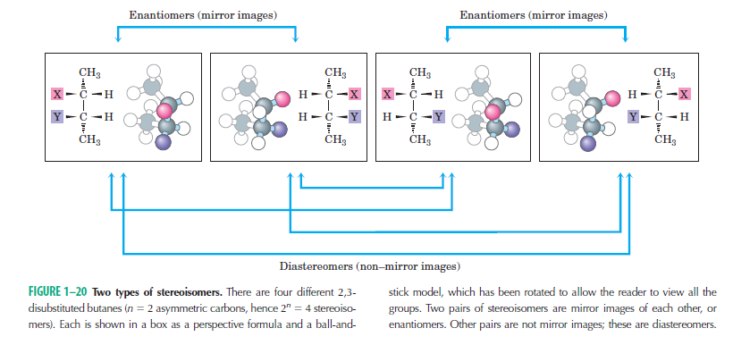

Slide 12
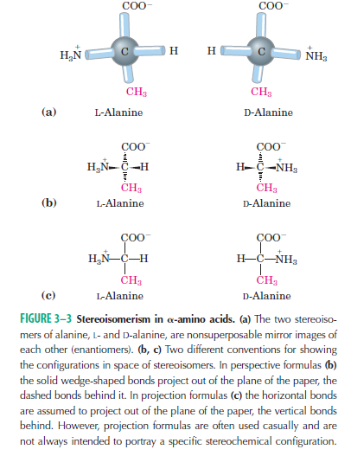

Slide 13

Two conventions are used to identify the carbons in an amino acid—a practice that can be confusing. The additional carbons in an R group are commonly designated β , γ, δ , ε , and so forth, proceeding out from the carbon. For most other organic molecules, carbon atoms are simply numbered from one end, giving highest priority (C-1) to the carbon with the substituent containing the atom of highest atomic number.

Slide 14
Nearly all biological compounds with a chiral center occur
naturally in only one stereoisomeric form, either D or L. The amino acid residues in protein molecules are exclusively L stereoisomers. D-Amino acid residues have been found in only a few, generally small peptides, including some peptides of bacterial cell walls and certain peptide antibiotics. It is remarkable that virtually all amino acid residues in proteins are L stereoisomers.
When chiral compounds are formed by ordinary chemical reactions,
the result is a racemic mixture of D and L isomers, which are difficult for a chemist to distinguish and separate. But to a living system, D and L isomers are as different as the right hand and the left. The formation of stable, repeating substructures in proteins generally requires that their constituent amino acids be of one stereochemical series. Cells are able to specifically synthesize the L isomers of amino acids because the active sites of enzymes are asymmetric, causing the reactions they catalyze to be stereospecific

Slide 15
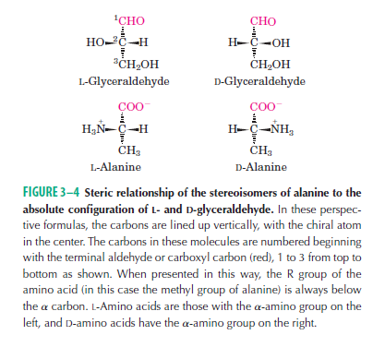

Slide 16

Amino Acids Can Be Classified by R Group
Knowledge of the chemical properties of the common amino acids is central to an understanding of biochemistry. The topic can be simplified by grouping the amino
acids into five main classes based on the properties of their R groups (Table 3–1), in particular, their polarity, or tendency to interact with water at biological pH (near
pH 7.0). The polarity of the R groups varies widely, from nonpolar and hydrophobic (water-insoluble) to highly polar and hydrophilic (water-soluble).
The structures of the 20 common amino acids are shown in Figure 3–5, and some of their properties are listed in Table 3–1.

Slide 17
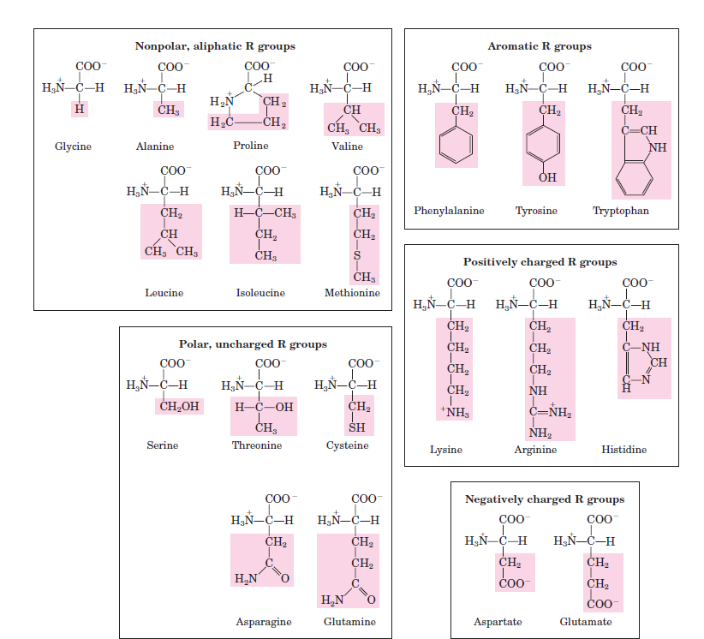

Slide 18
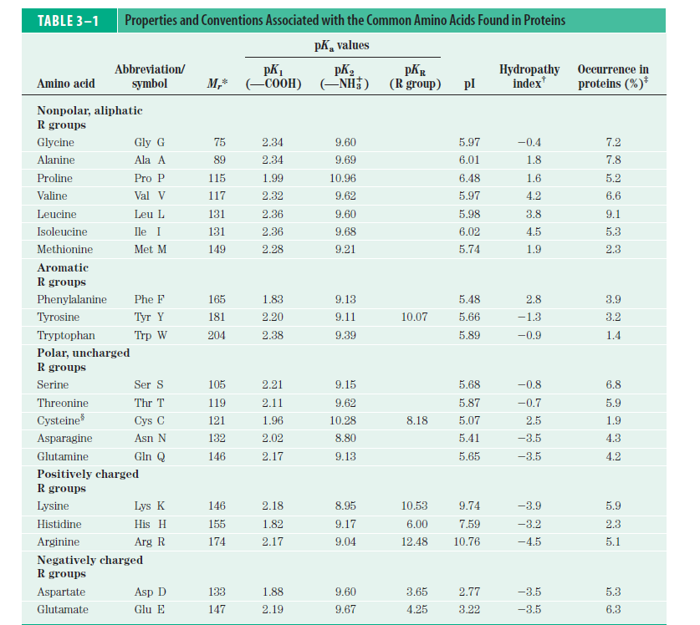

Slide 19
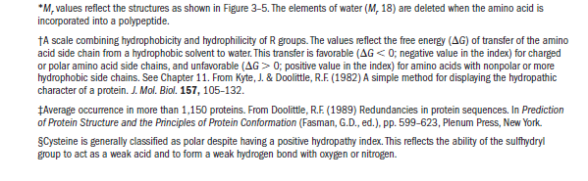

Slide 20
Nonpolar, Aliphatic R Groups The R groups in this class of amino acids are nonpolar and hydrophobic. The side chains of alanine, valine, leucine, and isoleucine tend to cluster together within proteins, stabilizing protein structure by means of hydrophobic interactions. Glycine has the simplest structure. Although it is most easily grouped with the nonpolar amino acids, its very small side chain makes no real contribution to hydrophobic interactions. Methionine, one of the two sulfur-containing amino acids, has a nonpolar thioether group in its side chain. Proline has an aliphatic side chain with a distinctive cyclic structure. The secondary amino (imino) group of proline residues is held in a rigid conformation that reduces the structural flexibility of polypeptide regions containing proline

Slide 21
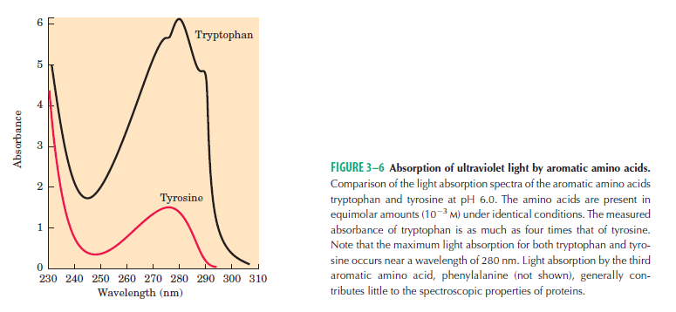
Aromatic R Groups Phenylalanine, tyrosine, and tryptophan, with their aromatic side chains, are relatively nonpolar (hydrophobic). All can participate in hydrophobic interactions. The hydroxyl group of tyrosine
can form hydrogen bonds, and it is an important functional group in some enzymes. Tyrosine and tryptophan are significantly more polar than phenylalanine, because Tryptophan and tyrosine, and to a much lesser extent
phenylalanine, absorb ultraviolet light (Fig. 3–6;. This accounts for the characteristic strong absorbance of light by most proteins at a wavelength
of 280 nm, a property exploited by researchers in the characterization of proteins.

Slide 22
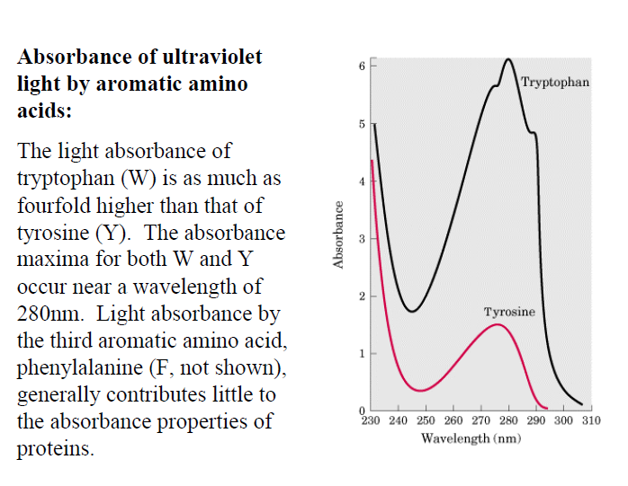

Slide 23
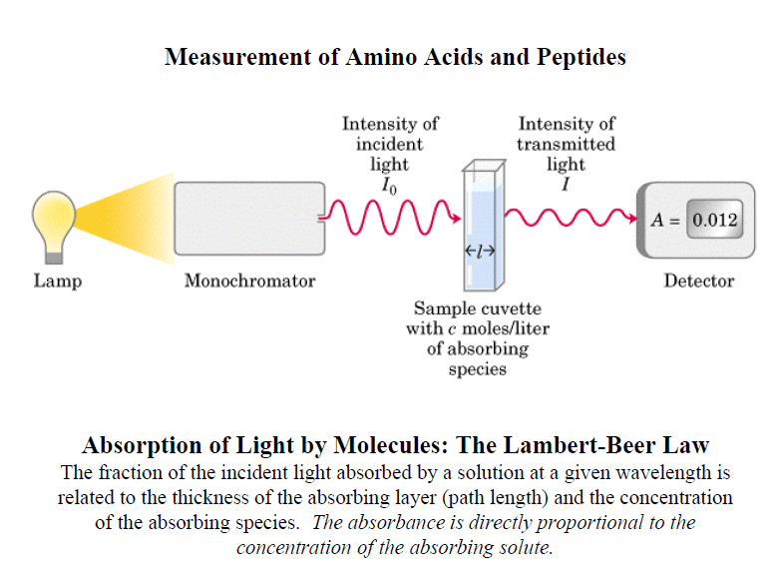

Slide 24
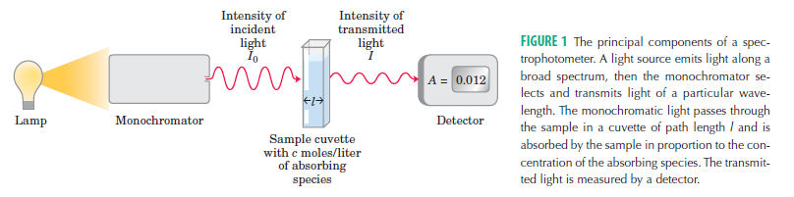

Slide 25
Polar, Uncharged R Groups The R groups of these
amino acids are more soluble in water, or more hydrophilic, than those of the nonpolar amino acids, because they contain functional groups that form
hydrogen bonds with water. This class of amino acids includes serine, threonine, cysteine, asparagine, and glutamine. The polarity of serine and threonine
is contributed by their hydroxyl groups; that of cysteine by its sulfhydryl group, which is a weak acid and can make weak hydrogen bonds with oxygen or nitrogen;
and that of asparagine and glutamine by their amide groups.
Asparagine and glutamine are the amides of two other amino acids also found in proteins, aspartate and glutamate, respectively, to which asparagine and
glutamine are easily hydrolyzed by acid or base. Cysteine is readily oxidized to form a covalently linked dimeric amino acid called cystine, in which two cysteine
molecules or residues are joined by a disulfide bond (Fig. 3–7). The disulfide-linked residues are strongly hydrophobic (nonpolar). Disulfide bonds play a special role in the structures of many proteins by forming covalent links between parts of a polypeptide molecule or between two different polypeptide chains.

Slide 26
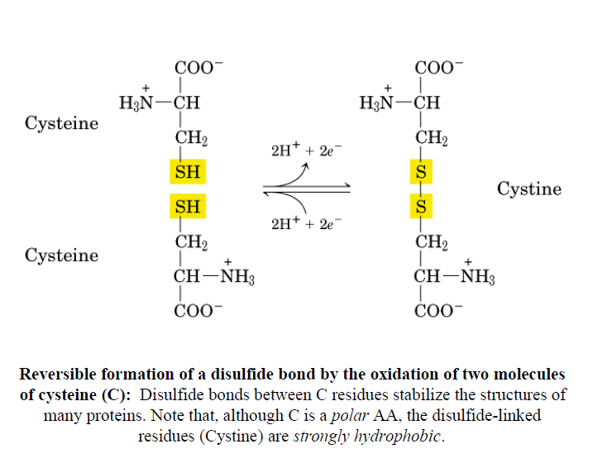
(Fig. 3–7).

Slide 27
Positively Charged (Basic) R Groups The most hydrophilic R groups are those that are either positively or negatively charged. The amino acids in which the R
groups have significant positive charge at pH 7.0 are lysine, which has a second primary amino group at the position on its aliphatic chain; arginine, which has a positively charged guanidinium group; and histidine, which has an aromatic imidazole group. As the only common amino acid having an ionizable side chain with pKa near neutrality, histidine may be positively charged (protonated form) or uncharged at pH 7.0. His residues facilitate many enzyme-catalyzed reactions by serving as proton donors/acceptors.
Negatively Charged (Acidic) R Groups The two
amino acids having R groups with a net negative charge at pH 7.0 are aspartate and glutamate, each of which has a second carboxyl group.

Slide 28
Amino acids to calm down and Pep up
Some people insist that supplements of Tyrosine give them a morning lift and that tryptophan helps them sleep at night .Milk proteins have high levels of tryptophan ; a glass of warm milk before bed is widely believed to be an aid in inducing sleep. Cheese and red wines contain high amounts of tyramine , which mimics epinephrine ; for many people a cheese omelet in the morning is a favorite way to a start the day.

Slide 29
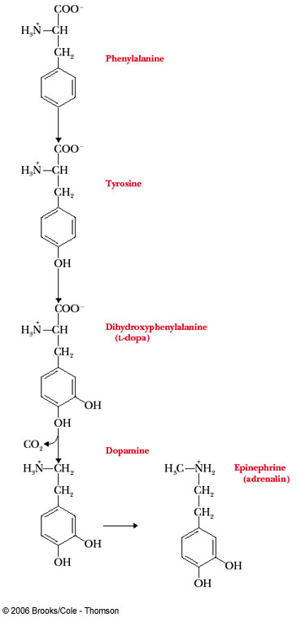
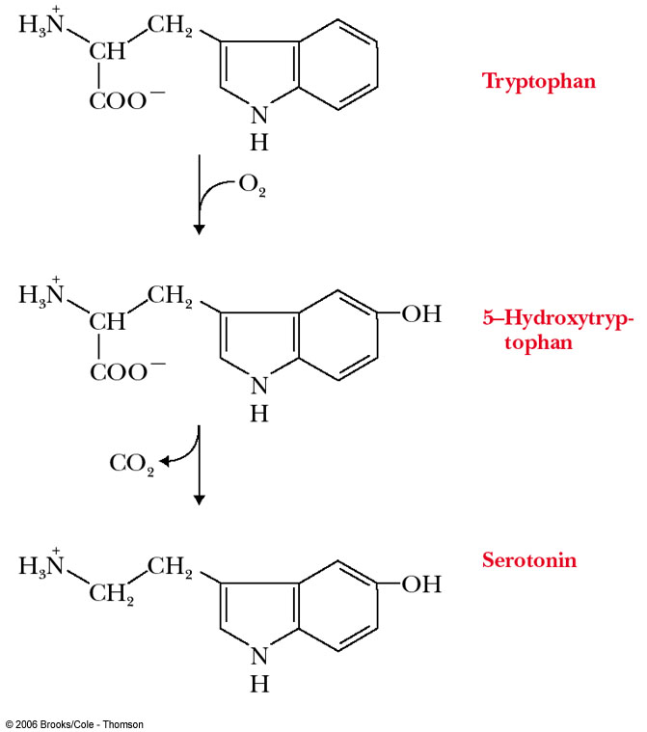

Slide 30
Uncommon Amino Acids Also Have Important Functions
In addition to the 20 common amino acids, proteins may contain residues created by modification of common residues already incorporated into a polypeptide
(Fig. 3–8a). Among these uncommon amino acids are 4-hydroxyproline, a derivative of proline, and 5-hydroxylysine, derived from lysine. The former is found in plant cell wall proteins, and both are found in collagen, a fibrous protein of connective tissues.
6-N-Methyllysine is a constituent of myosin, a contractile protein of muscle. Another important uncommon amino acid is γ-carboxyglutamate, found in the blood clotting
protein prothrombin and in certain other proteins that bind Ca2 as part of their biological function. More complex, a derivative of four Lys residues, which is found in the fibrous proteis desmosine in elastin. Selenocysteine is a special case. This rare amino acid residue is introduced during protein synthesis rather than created through a postsynthetic modification. It contains selenium rather than the sulfur of cysteine. Actually derived from serine, selenocysteine is a constituent of just a few known proteins
Some amino acid residues in a protein may be modified transiently to alter the protein’s function. The addition of phosphoryl, methyl, acetyl, adenylyl, ADPribosyl,
or other groups to particular amino acid residues can increase or decrease a protein’s activity. Some 300 additional amino acids have been found in cells. They have a variety of functions but are not all constituents of proteins. Ornithine and citrulline

Slide 31
FIGURE 3–8 Uncommon amino acids. (a) Some uncommon amino
acids found in proteins. All are derived from common amino acids. Extra functional groups added by modification reactions are shown in red. Desmosine is formed from four Lys residues (the four carbon backbones are shaded in yellow). Note the use of either numbers or Greek letters to identify the carbon atoms in these structures. (b) Reversible amino acid modifications involved in regulation of protein activity. Phosphorylation is the most common type of regulatory modification.
(c) Ornithine and citrulline, which are not found in proteins, are intermediates in the biosynthesis of arginine and in the urea cycle.

Slide 32
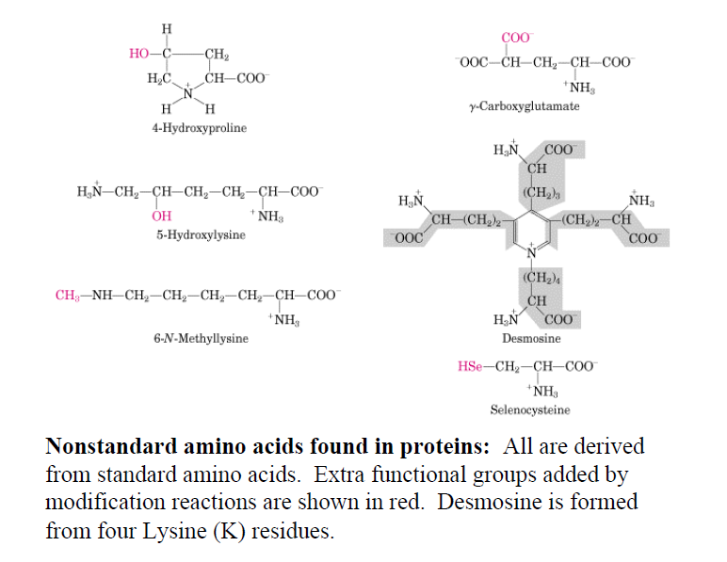

Slide 33
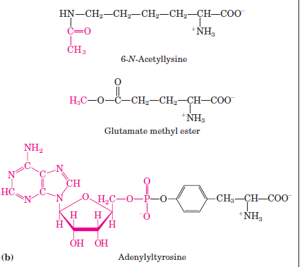
(b) Reversible amino acid modifications involved in regulation of protein activity. Phosphorylation is the most common type of regulatory modification.

Slide 34
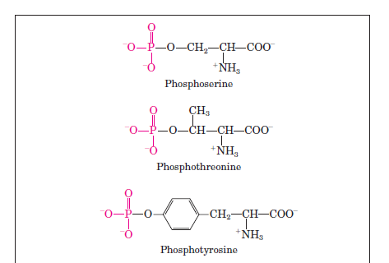
(b) Reversible amino acid modifications involved in regulation of protein activity. Phosphorylation is the most common type of regulatory modification.

Slide 35
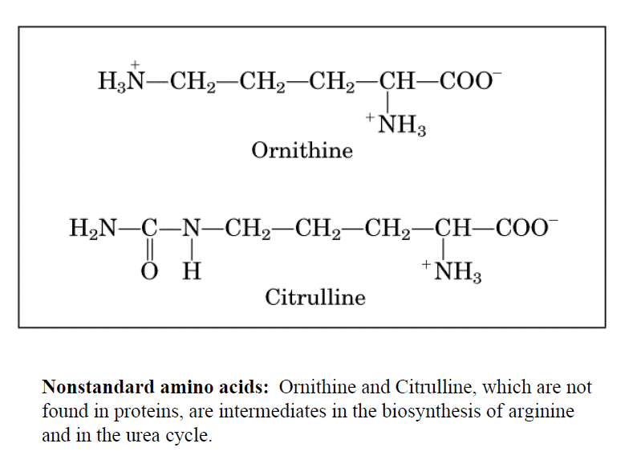

Slide 36
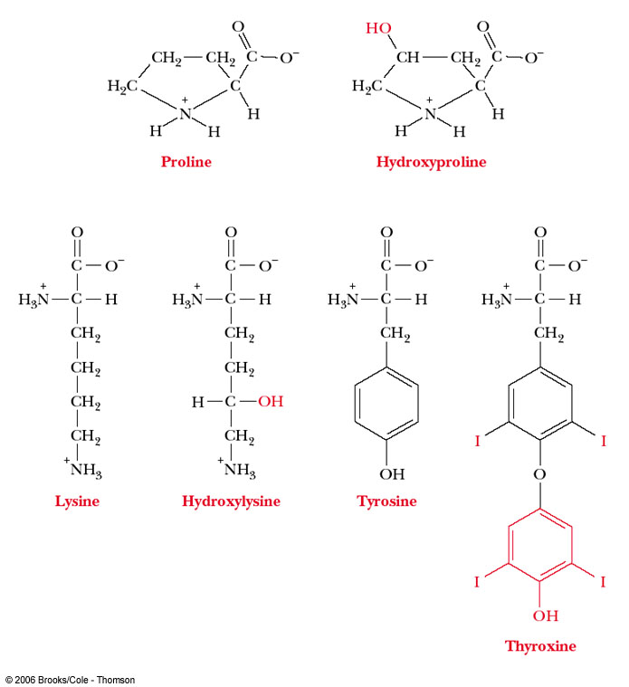
Uncommon amino acids results from posttranslational modification,
Found only in few connective tissue proteins such as collagen.
Thyroxine hormone: is a modification of tyrosine that produced
in thyroid gland.

Slide 37
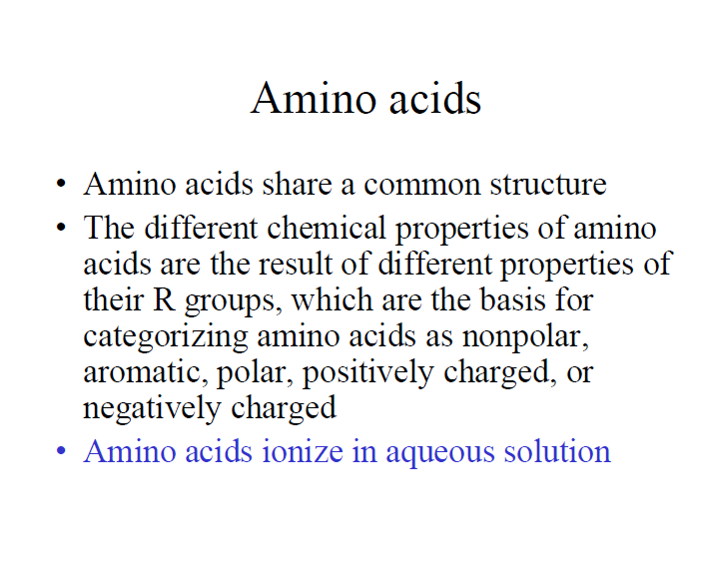

Slide 38
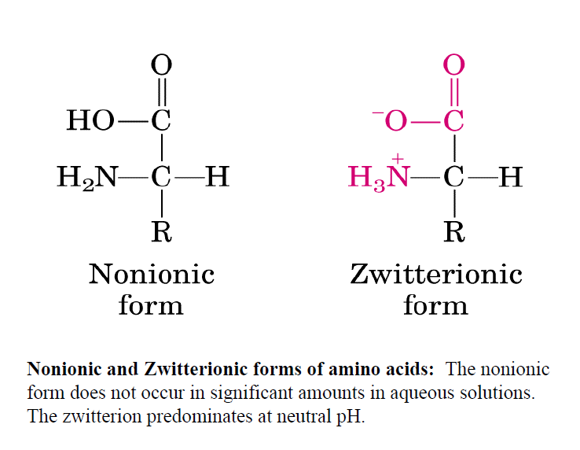

Slide 39
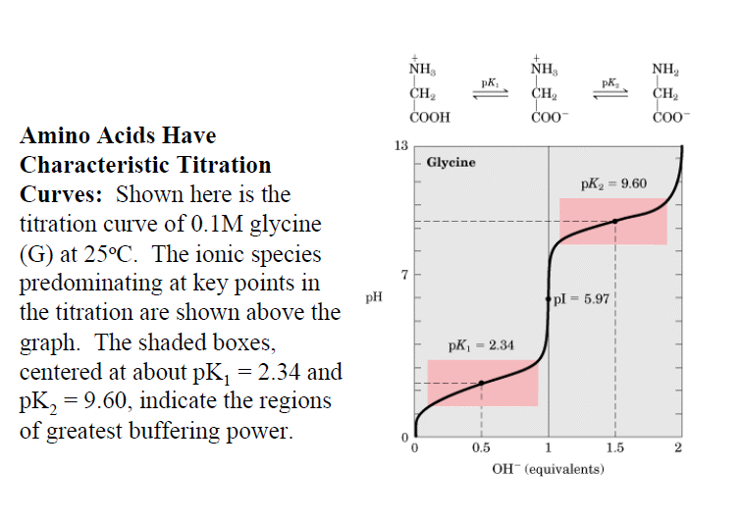

Slide 40
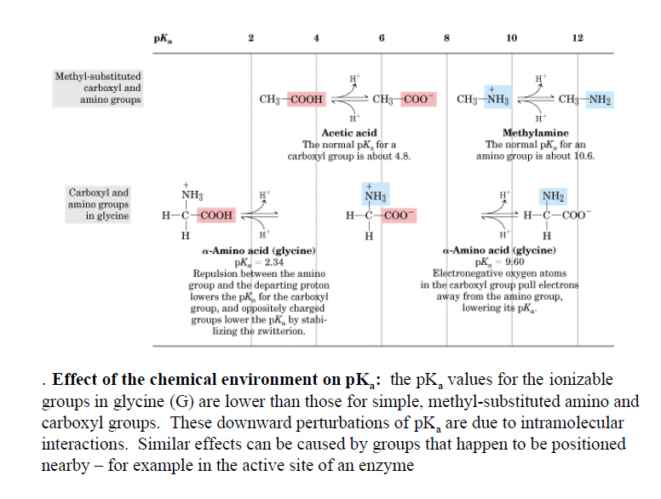

Slide 41
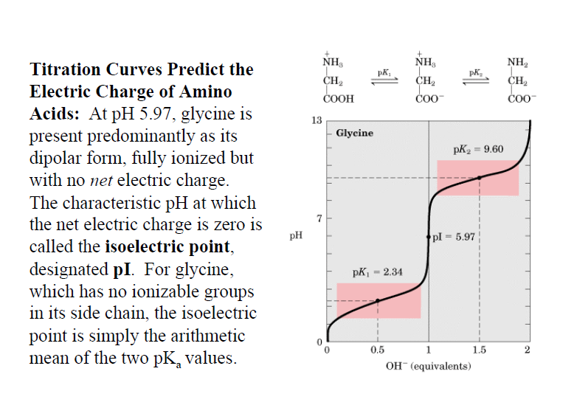

Slide 42
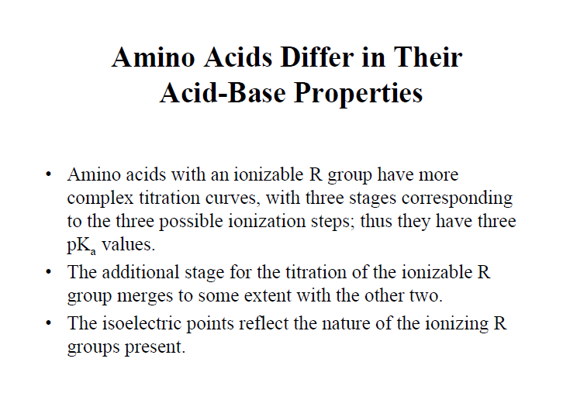

Slide 43
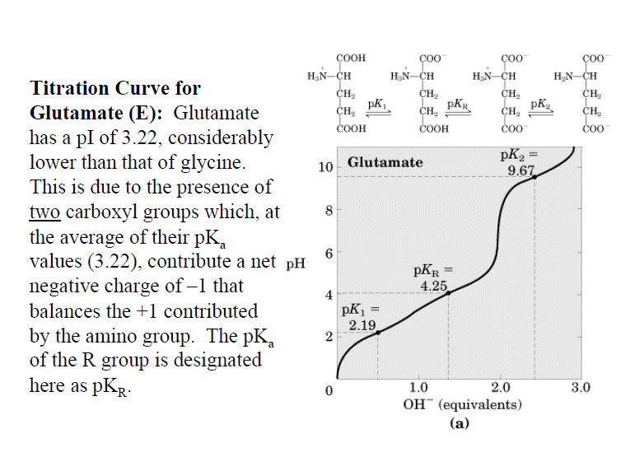

Slide 44
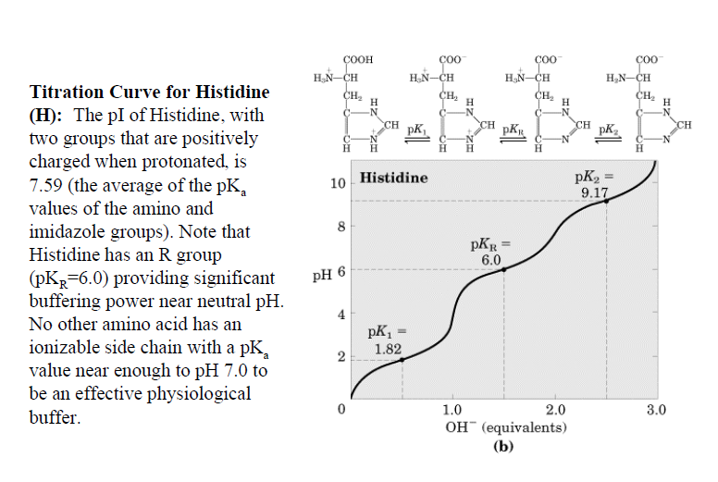

Slide 45
3.3 Amino acids can act as both acids and bases
In free amino acids at neutral pH, the carboxylate group is negatively charged and the amino group is positively charged.
Amino acids without charged groups on their side chains exist in neutral solution as zwitterions, with no net charge.
Titration curves of amino acids indicate the pH ranges in which titratable groups gain or lose a proton.
Side chains of amino acids can also contribute titratable groups; the charge (if any) on the side chain must be taken into consideration in determining the net charge on the amino acid.

Slide 46
Amino acid Charge dependence on pH:
Zwitterions : no net charge on a.a
Isoelectric pH (pI): the pH at which the molecule/a.a has no net charge
Electrophoresis: common method of separating molecule in an electrical field

Slide 47
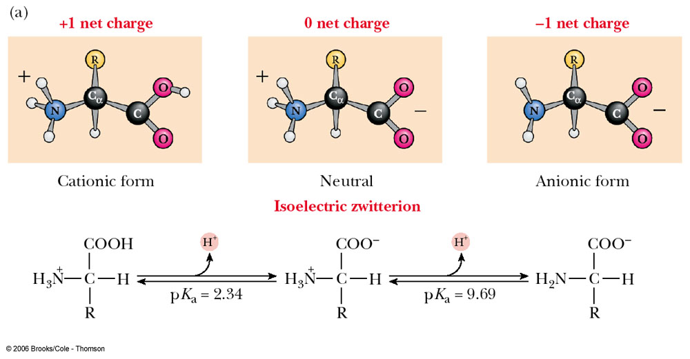
The ionic forms of the amino acids, shown without consideration of any ionizations on the side chain. The cationic form is the low-pH form, and the titration of the cationic species with base yields the zwitterions and finally the anionic form.

Slide 48
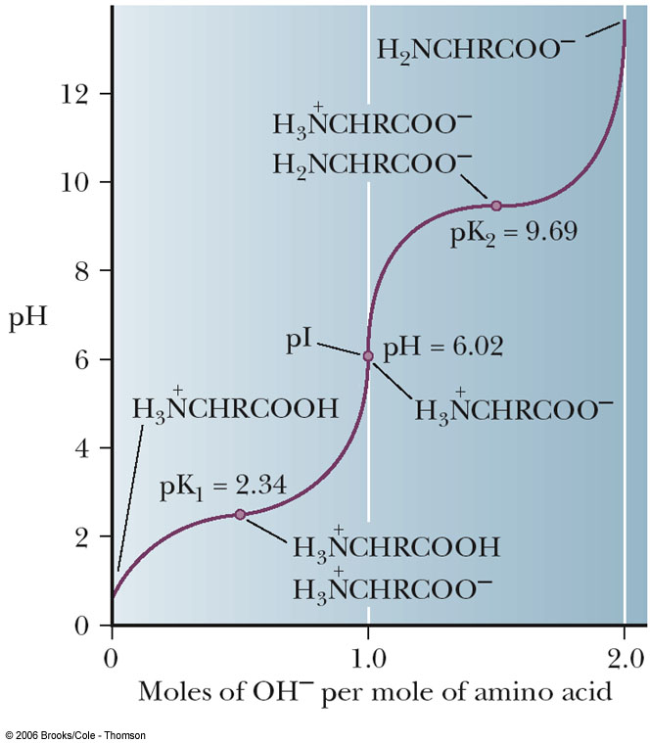
The titration curve of alanine

Slide 49
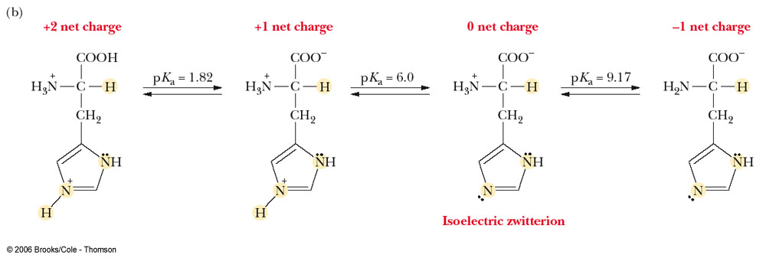
The ionization of histidine (an amino acid with a titratable side chain).

Slide 50
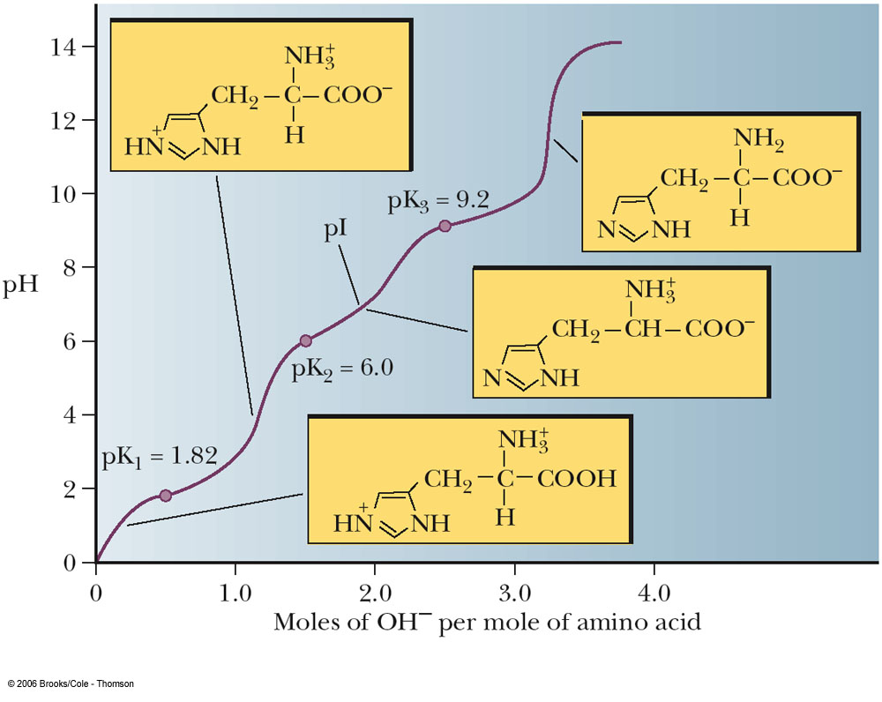
The titration curve of histidine

Slide 51
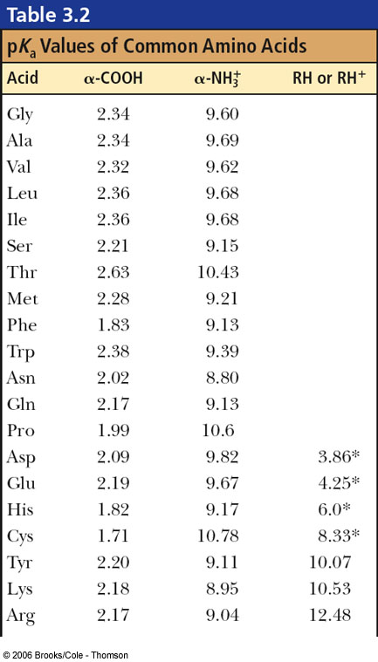

Slide 52
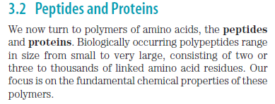

Slide 53
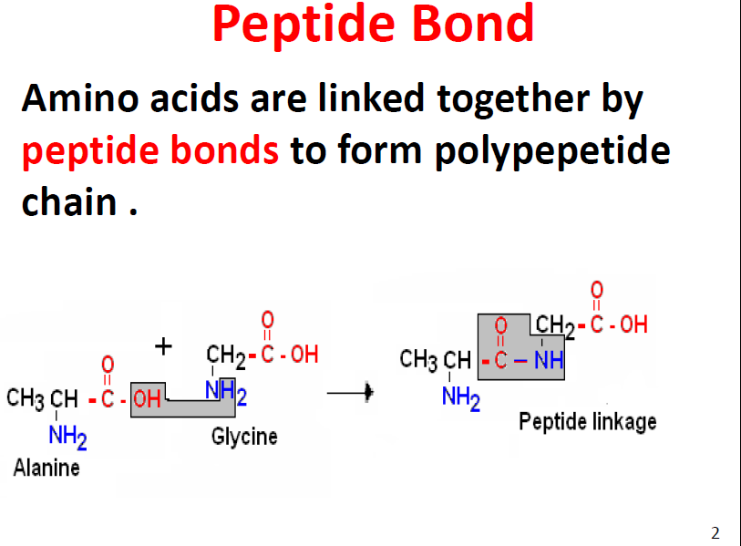

Slide 54
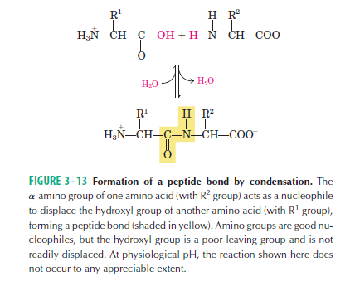

Slide 55
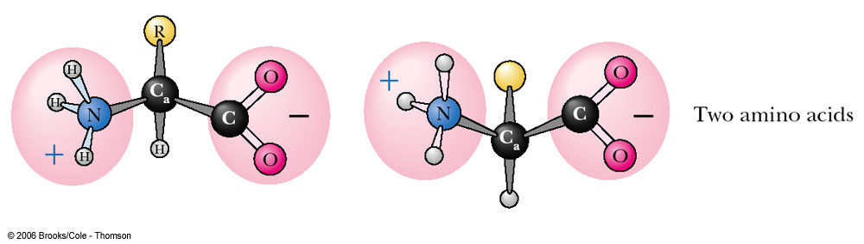
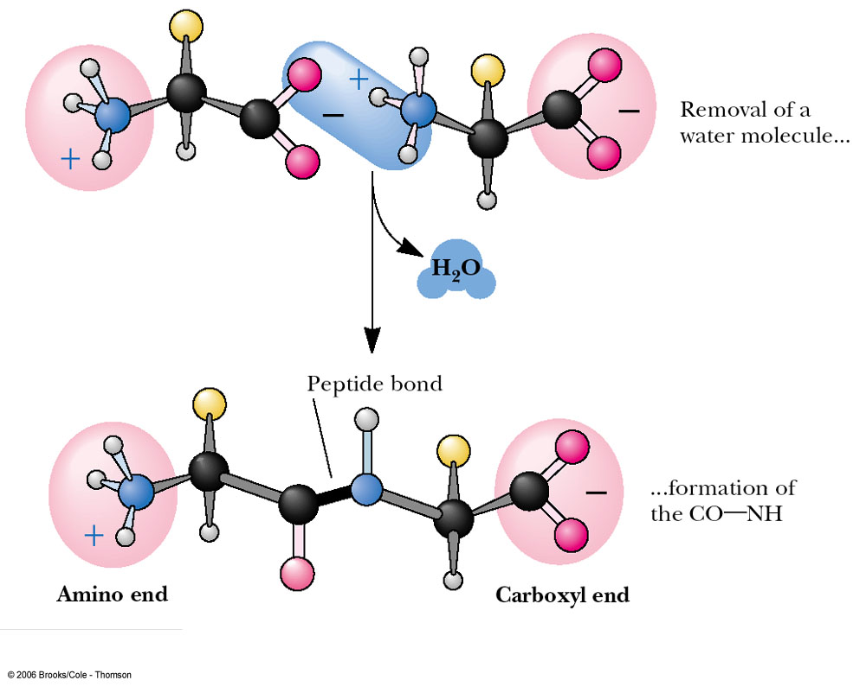

Slide 56
Peptides are formed by linking the carboxyl group of one amino acid to the amino group of another amino acid in a covalent (amide) bond.
Proteins consist of polypeptide chains; the number of amino acids in a protein is usually 100 or more.
The peptide group is planar as a result of resonance stabilization, this stereochemical constraint plays an important role in determining the three-dimensional structures of peptides and proteins.

Slide 57
Three amino acids can be joined by two peptide bonds to form a tripeptide; similarly, four amino acids can be linked to form tetrapeptides, five to form pentapeptides, and so forth. When a few amino acids are joined in this fashion, the structure is called an oligopeptide. When many amino acids are joined, the product is called a polypeptide. Proteins may have thousands of amino acid residues. Although the terms “protein” and “polypeptide” are sometimes used interchangeably, molecules referred to as polypeptides generally have molecular weights below 10,000, and those called proteins have higher molecular weights.

Slide 58
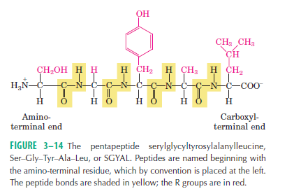

Slide 59
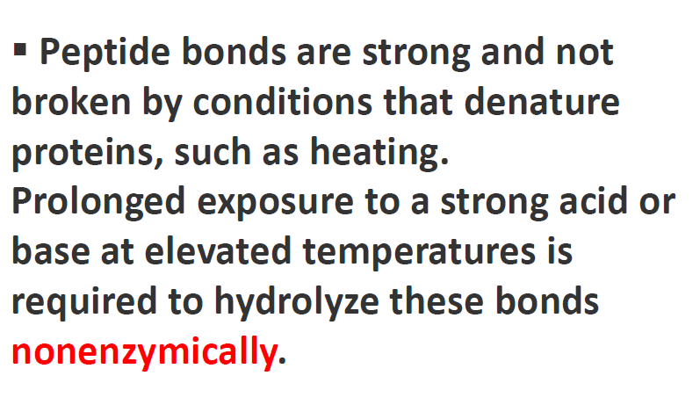

Slide 60
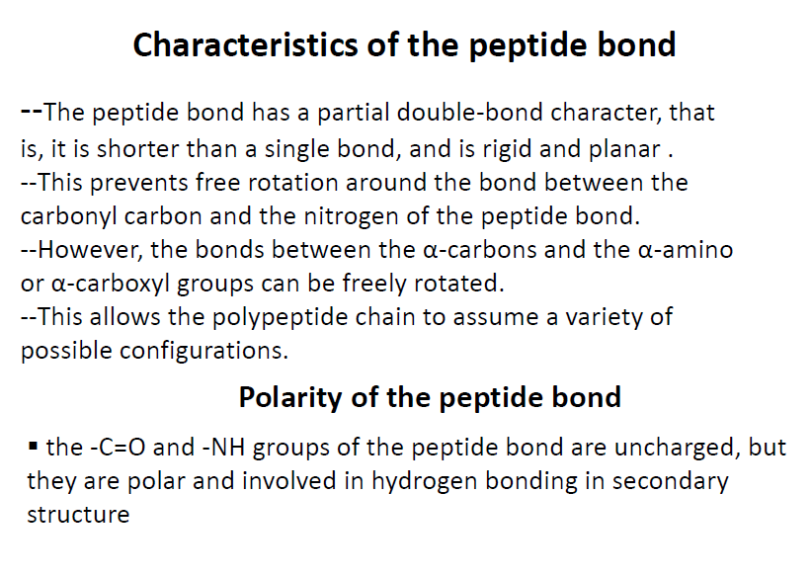

Slide 61
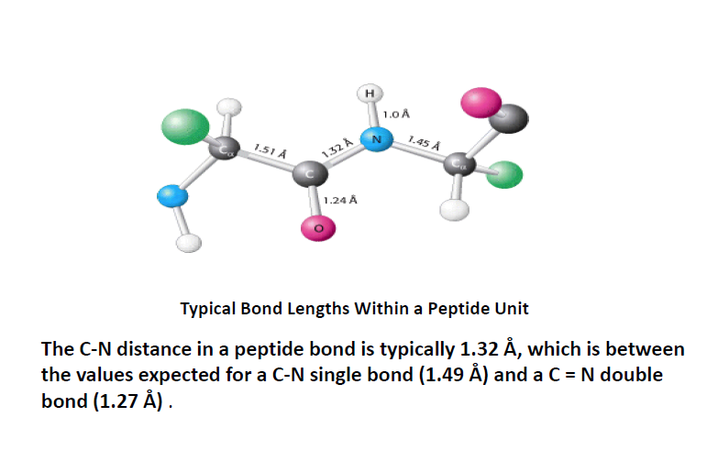

Slide 62
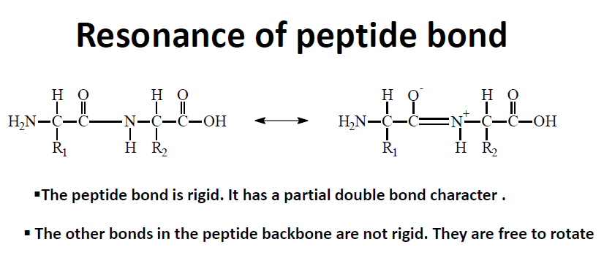

Slide 63
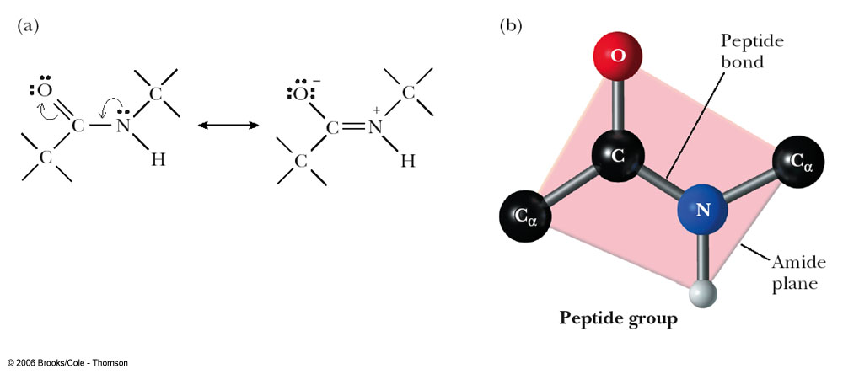
The resonance structures of the peptide bond lead to a planar group.
(a) Resonance structures of the peptide group.
(b) The planar peptide group.

Slide 64
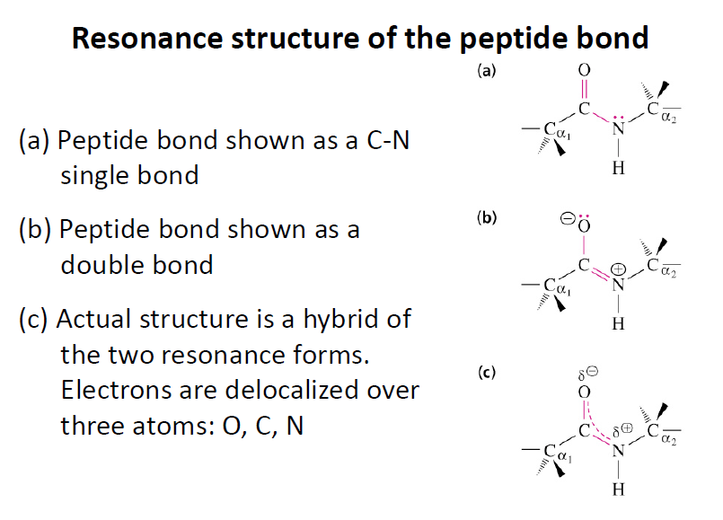

Slide 65
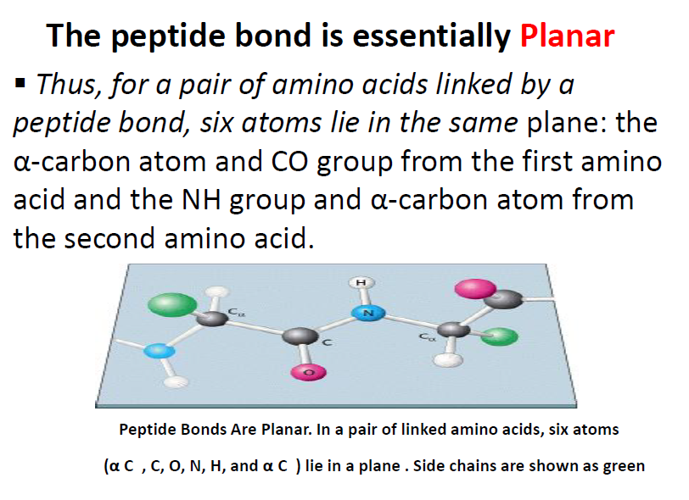

Slide 66
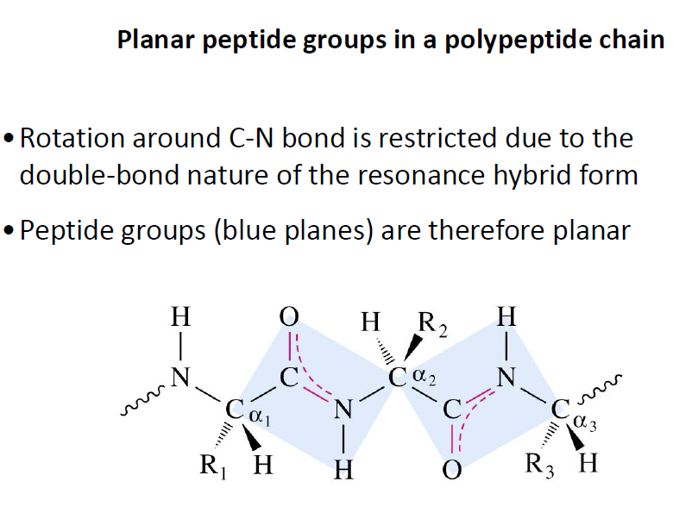

Slide 67
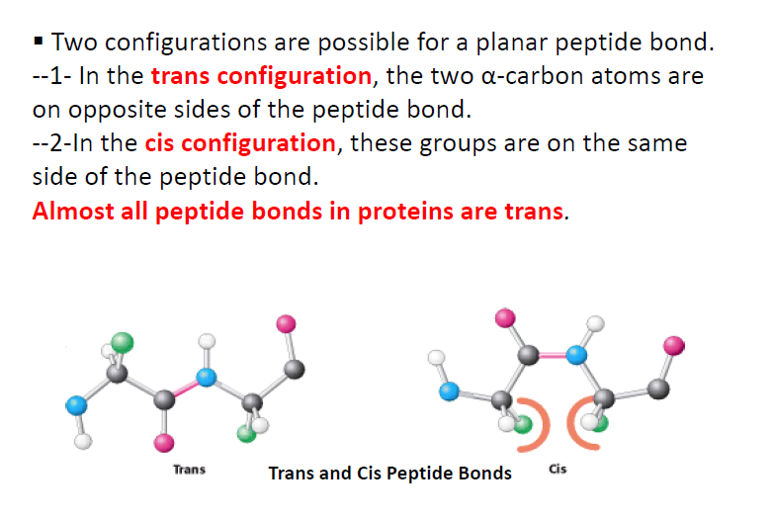

Slide 68
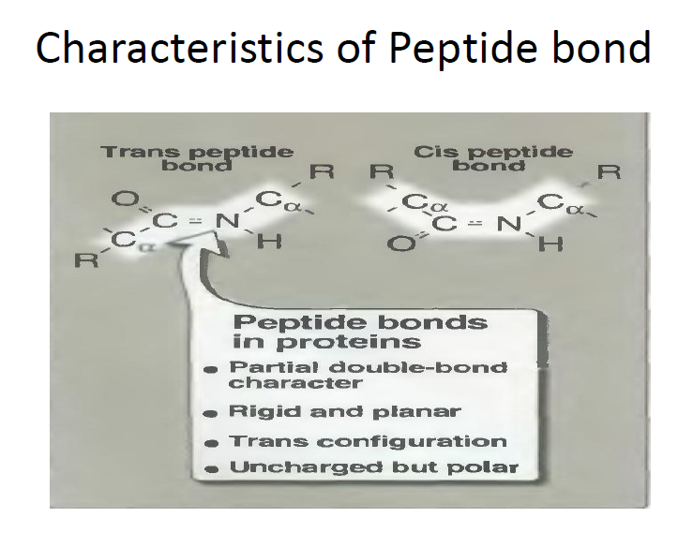

Slide 69


Slide 70


Slide 71

A small peptide showing the direction of the peptide chain (N-terminal to C-terminal)

Slide 72

3.5 Small Peptides with Physiological Activity :
Small peptides, containing two to several dozen amino acid residues, can have marked physiological effects in organisms.
Carnosine is naturally occurring dipeptides (β-alanine and Histidine) in muscle tissue.

Slide 73

Oxytocin has an isoleucine at position 3 and a leucine at position 8; it stimulates smooth muscle contraction in the uterus during labor and in the mammary glands during lactation.
Vasopressin has a phenylalanine at position 3 and an arginine at position 8; it stimulates reabsorption of water by the kidneys, thus raising blood pressure.

Slide 74


Glutathione is a commonly tripeptide that acts as a scavengers of oxidizing agents.
Enkephalins are pentapeptides (Y-G-G-F-L, leucine enkephalin, and Y-G-G-F-M, methionine enkephalin), which are naturally occurring analgesics (Pain relievers).

Slide 75


Slide 76


Slide 77


Slide 78


Slide 79


Slide 80


Slide 81
3.4 The Structure of Proteins: Primary Structure What is it that makes one protein an enzyme, another a hormone, another a structural protein, and still another an antibody? How do they differ chemically?
The most obvious distinctions are structural, and to protein structure we now turn. Four levels of protein structure are commonly defined (Fig. 3–23). A description of all covalent bonds (mainly peptide bonds and disulfide bonds) linking amino acid residues in a polypeptide chain is its primary structure. The most important element of
primary structure is the sequence of amino acid residues.
Secondary structure refers to particularly stable arrangements of amino acid residues giving rise to recurring structural patterns. Tertiary structure describes all aspects of the three-dimensional folding of a polypeptide. When a protein has two or more polypeptide subunits, their arrangement in space is referred to as quaternary
structure.

Slide 82
Levels of Protein Structure Structurally ,proteins can be organized into four levels : 1-Primary .
2-Secondary. 3-Tertiary .
4-Quaternary.

Slide 83


Slide 84


Slide 85
The differences in primary structure can be especially informative. Each protein has a distinctive number and sequence of amino acid residues. The primary structure of a protein determines how it folds up into its unique three-dimensional structure, and this in turn determines the function of the protein.
Each type of protein has a unique three-dimensional structure and this structure confers a unique function.
Each type of protein also has a unique amino acid sequence.
Intuition suggests that the amino acid sequence must play a fundamental role in determining the three-dimensional structure of the protein, and ultimately its function,
Is that correct ????????????????????????????
What do you think?

Slide 86
First, as we have already noted, proteins with different functions always have different amino acid sequences. Second, thousands of human genetic diseases have been traced to the production of defective proteins. The defect can range from a single change in the
amino acid sequence as in sickle cell anemia to deletion of a larger portion of the
polypeptide chain (as in most cases of Duchenne muscular dystrophy: a large deletion in the gene encoding the protein dystrophin leads to production of a shortened,
inactive protein). Thus we know that if the primary structure is altered, the function of the protein may also be changed. Finally, on comparing functionally similar proteins from different species, we find that these proteins often have similar amino acid sequences. An extreme case is ubiquitin, a 76-residue protein involved in regulating the degradation of other proteins. The amino acid sequence of ubiquitin is identical in
species as disparate as fruit flies and humans.
Is the amino acid sequence absolutely fixed, or invariant, for a particular protein? No; some flexibility is possible. An estimated 20% to 30% of the proteins in humans are polymorphic, having amino acid sequence variants in the human population

Slide 87
Furthermore, proteins that carry out a broadly similar function in distantly related species can differ greatly in overall size and amino acid sequence.
The Amino Acid Sequences of Millions of Proteins Have Been Determined
Two major discoveries in 1953 were of crucial importance in the history of biochemistry. In that year, James D. Watson and Francis Crick deduced the double-helical structure of DNA and proposed a structural basis for its precise replication . Their proposal illuminated the molecular reality behind the idea of a gene. In the same year, Frederick Sanger worked out the sequence of amino acid residues in the polypeptide chains of the hormone insulin (Fig. 3–24). a decade after these discoveries, the genetic code relating the nucleotide sequence of DNA to the amino acid sequence of protein molecules was elucidated.

Slide 88


Slide 89



Slide 90
Short Polypeptides Are Sequenced with Automated Procedures
Various procedures are used to analyze protein primary structure. To start, biochemists have several strategies for labeling and identifying the amino-terminal amino acid residue (Fig. 3–25a). Sanger developed the reagent 1-fluoro-2,4-dinitrobenzene (FDNB) for this purpose; other available reagents are dansyl chloride and dabsyl chloride, which yield derivatives that are more easily detectable than the dinitrophenyl derivatives. After the amino-terminal residue is labeled with one of these reagents, the polypeptide is hydrolyzed (in 6 M HCl) to its constituent amino acids and the labeled amino acid is identified. Because the hydrolysis stage destroys the polypeptide, this procedure cannot be used to sequence a polypeptide beyond its amino-terminal residue. However, it can help determine the number of chemically distinct polypeptides in a protein, provided each has a different amino-terminal residue. For example, two residues—Phe and Gly—would be labeled if insulin (Fig. 3–24) were subjected to this procedure.

Slide 91
To sequence an entire polypeptide, a chemical method devised by Pehr Edman is usually employed. The Edman degradation procedure labels and removes only the amino-terminal residue from a peptide, leaving all other peptide bonds intact (Fig. 3–25b). The peptide is reacted with phenylisothiocyanate under mildly alkaline conditions, which converts the aminoterminal amino acid to a phenylthiocarbamoyl (PTC) adduct. The peptide bond next to the PTC adduct is then cleaved in a step carried out in anhydrous trifluoroacetic acid, with removal of the amino-terminal amino acid as an anilinothiazolinone derivative. The derivatized amino acid is extracted with organic solvents, converted to the more stable phenylthiohydantoin derivative by treatment with aqueous acid, and then identified. The use of sequential reactions carried out under first basic and then acidic conditions provides a means of controlling the entire process.

Slide 92
After removal and identification of the aminoterminal
residue, the new amino-terminal residue so exposed can be labeled, removed, and identified through the same series of reactions. This procedure is repeated until the entire sequence is determined. The Edman degradation is carried out in a machine, called a sequenator, that mixes reagents in the proper proportions, separates the products, identifies them, and records the results.

Slide 93


Slide 94


Slide 95


Slide 96



Slide 97



Slide 98


Slide 99


Slide 100


Slide 101


Slide 102
4.2 Protein Secondary Structure
The term secondary structure refers to any chosen segment of a polypeptide chain and describes the local spatial arrangement of its main-chain atoms, without regard to the conformation of its side chains or its relationship to other segments. A regular secondary structure occurs when each dihedral angle, φ and ψ , remains the same or nearly the same throughout the segment. There are a few types of secondary structure that are particularly stable and occur widely in proteins. The most prominent are the α helix and β conformations; another common type is the β turn. Where a regular pattern is not found, the secondary structure is sometimes referred to as undefined or as a random coil. This last designation, however, does not properly describe the structure of these segments. The path of the polypeptide backbone in almost any protein is not random; rather, it is typically unchanging and highly specific to the structure and function of that particular protein. Our discussion here focuses on the regular, common structures.

Slide 103
The Helix Is a Common Protein Secondary Structure
The simplest arrangement the polypeptide chain can assume, given its rigid peptide bonds (but free rotation around its other, single bonds), is a helical structure,
which Pauling and Corey called the α helix (Fig. 4–4). In this structure the polypeptide backbone is tightly wound around an imaginary axis drawn longitudinally
through the middle of the helix, and the R groups of the amino acid residues protrude outward from the helical backbone. The repeating unit is a single turn of the helix,
which extends about 5.4 A along the long axis, slightly greater than the periodicity Astbury observed on x-ray analysis of hair keratin. The amino acid residues in the
prototypical helix have conformations with φ= - 57 and ψ=- 47, and each helical turn includes 3.6 amino acid residues. The -helical segments in proteins often
deviate slightly from these dihedral angles, and even vary somewhat within a single contiguous segment to produce subtle bends or kinks in the helical axis. In all
proteins, the helical twist of the helix is right-handed (Box 4–1). The helix proved to be the predominant structure in -keratins. More generally, about one fourth
of all amino acid residues in proteins are found in helices, the exact fraction varying greatly from one protein to another.

Slide 104
Why does the helix form more readily than many other possible conformations? The answer is, in part, that an helix makes optimal use of internal hydrogen
bonds. The structure is stabilized by a hydrogen bond between the hydrogen atom attached to the electronegative nitrogen atom of a peptide linkage and the electronegative
carbonyl oxygen atom of the fourth amino acid on the amino-terminal side of that peptide bond (Fig. 4–4a). Within the helix, every peptide bond (except those close to each end of the helix) participates in such hydrogen bonding. Each successive turn of the helix is held to adjacent turns by three to four hydrogen bonds, conferring significant stability on the
overall structure. Further model-building experiments have shown that an α helix can form in polypeptides consisting of either L- or D-amino acids. However, all residues must be
of one stereoisomeric series; a D-amino acid will disrupt a regular structure consisting of L-amino acids, and vice versa. In principle, naturally occurring L-amino acids can form either right- or left-handed helices, but extended left-handed helices are theoretically less stable
and have not been observed in proteins.

Slide 105


Slide 106


Slide 107


Slide 108


Slide 109


Slide 110


Slide 111


Slide 112


