Slide 1
8
Fraud, Internal Control, and Cash
Learning Objectives
1
Discuss fraud and the principles of internal control.
2
Apply internal control principles to cash.
3
Identify the control features of a bank account.
4
Explain the reporting of cash.

Slide 2

LEARNING
OBJECTIVE
Discuss fraud and the principles of internal control.
1
Fraud
Dishonest act by an employee that results in personal benefit to the employee at a cost to the employer.
Three factors that contribute to fraudulent activity.
Illustration 8-1
Fraud triangle
LO 1

Slide 3
The Sarbanes-Oxley Act
  Applies to publicly traded U.S. corporations.
  Required to maintain a system of internal control.
  Corporate executives and boards of directors must ensure that these controls are reliable and effective.
  Independent outside auditors must attest to the adequacy of the internal control system.
  SOX created the Public Company Accounting Oversight Board (PCAOB).
LO 1

Slide 4
Internal Control
Methods and measures adopted to:
  Safeguard assets.
  Enhance the reliability of accounting records.
  Increase efficiency of operations.
  Ensure compliance with laws and regulations.
LO 1

Slide 5
Internal Control
Five Primary Components:
  A control environment.
  Risk assessment.
  Control activities.
  Information and communication.
  Monitoring.
LO 1

Slide 6
People, Planet, and Profit Insight
And the Controls Are . . .
Internal controls are important for an effective financial reporting system. The same is true for sustainability reporting. An effective system of internal controls for sustainability reporting will help in the following ways: (1) prevent the unauthorized use of data; (2) provide reasonable assurance that the information is accurate, valid, and complete; and (3) report information that is consistent with overall sustainability accounting policies. With these types of controls, users will have the confidence that they can use the sustainability information effectively. Some regulators are calling for even more assurance through audits of this information. Companies that potentially can cause environmental damage through greenhouse gases, as well as companies in the mining and extractive industries, are subject to reporting requirements. And, as demand for more information in the sustainability area expands, the need for audits of this information will grow.
Why is sustainability information important to investors? (Go to WileyPLUS for this answer and additional questions.)
LO 1

Slide 7

Principles of Internal Control Activities
ESTABLISHMENT OF RESPONSIBILITY
  Control is most effective when only one person is responsible for a given task.
  Establishing responsibility often requires limiting access only to authorized personnel, and then identifying those personnel.
LO 1

Slide 8
ANATOMY OF A FRAUD
Maureen Frugali was a training supervisor for claims processing at Colossal Healthcare. As a standard part of the claims processing training program, Maureen created fictitious claims for use by trainees. These fictitious claims were then sent to the accounts payable department. After the training claims had been processed, she was to notify Accounts Payable of all fictitious claims, so that they would not be paid. However, she did not inform Accounts Payable about every fictitious claim. She created some fictitious claims for entities that she controlled (that is, she would receive the payment), and she let Accounts Payable pay her.
Total take: $11 million
The Missing Control
Establishment of responsibility. The healthcare company did not adequately restrict the responsibility for authoring and approving claims transactions. The training supervisor should not have been authorized to create claims in the company’s “live” system.
LO 1

Slide 9
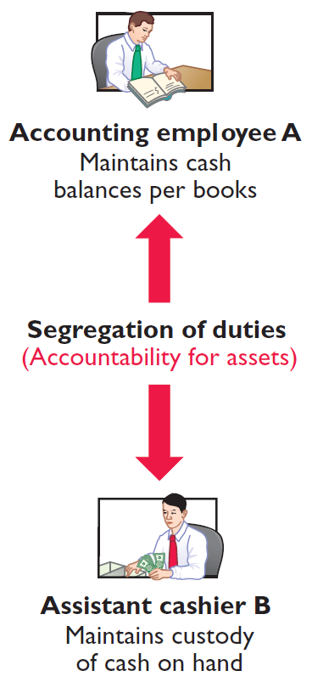
Principles of Internal Control Activities
SEGREGATION OF DUTIES
  Different individuals should be responsible for related activities.
  The responsibility for record-keeping for an asset should be separate from the physical custody of that asset.
LO 1

Slide 10
ANATOMY OF A FRAUD
Lawrence Fairbanks, the assistant vice-chancellor of communications at Aesop University, was allowed to make purchases of under $2,500 for his department without external approval. Unfortunately, he also sometimes bought items for himself, such as expensive antiques and other collectibles. How did he do it? He replaced the vendor invoices he received with fake vendor invoices that he created. The fake invoices had descriptions that were more consistent with the communications department’s purchases. He submitted these fake invoices to the accounting department as the basis for their journal entries and to the accounts payable department as the basis for payment.
Total take: $475,000
The Missing Control
Segregation of duties. The university had not properly segregated related purchasing activities. Lawrence was ordering items, receiving the items, and receiving the invoice. By receiving the invoice, he had control over the documents that were used to account for the purchase and thus was able to substitute a fake invoice.
LO 1

Slide 11
ANATOMY OF A FRAUD
Angela Bauer was an accounts payable clerk for Aggasiz Construction Company. She prepared and issued checks to vendors and reconciled bank statements. She perpetrated a fraud in this way: She wrote checks for costs that the company had not actually incurred (e.g., fake taxes). A supervisor then approved and signed the checks. Before issuing the check, though, she would “white-out” the payee line on the check and change it to personal accounts that she controlled. She was able to conceal the theft because she also reconciled the bank account. That is, nobody else ever saw that the checks had been altered.
Total take: $570,000
The Missing Control
Segregation of duties. Aggasiz Construction Company did not properly segregate record-keeping from physical custody. Angela had physical custody of the checks, which essentially was control of the cash. She also had record-keeping responsibility because she prepared the bank reconciliation.
LO 1

Slide 12
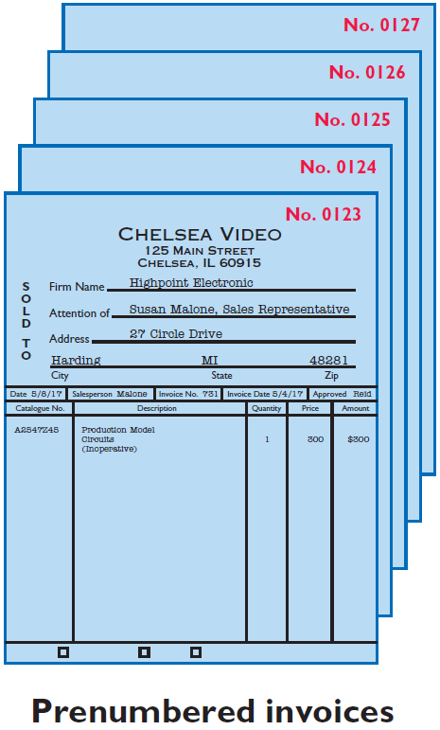
Principles of Internal Control Activities
DOCUMENTATION PROCEDURES
  Companies should use prenumbered documents, and all documents should be accounted for.
  Employees should promptly forward source documents for accounting entries to the accounting department.
LO 1

Slide 13
ANATOMY OF A FRAUD
To support their reimbursement requests for travel costs incurred, employees at Mod Fashions Corporation’s design center were required to submit receipts. The receipts could include the detailed bill provided for a meal, or the credit card receipt provided when the credit card payment is made, or a copy of the employee’s monthly credit card bill that listed the item. A number of the designers who frequently traveled together came up with a fraud scheme: They submitted claims for the same expenses. For example, if they had a meal together that cost $200, one person submitted the detailed meal bill, another submitted the credit card receipt, and a third submitted a monthly credit card bill showing the meal as a line item. Thus, all three received a $200 reimbursement.
Total take: $75,000
The Missing Control
Documentation procedures. Mod Fashions should require the original, detailed receipt. It should not accept photocopies, and it should not accept credit card statements. In addition, documentation procedures could be further improved by requiring the use of a corporate credit card (rather than a personal credit card) for all business expenses.
LO 1

Slide 14
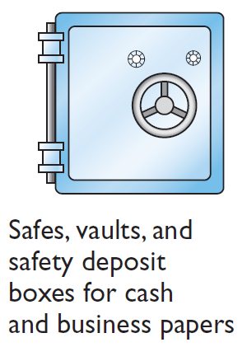


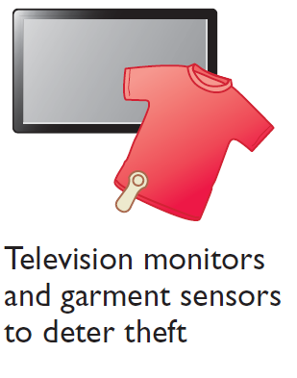
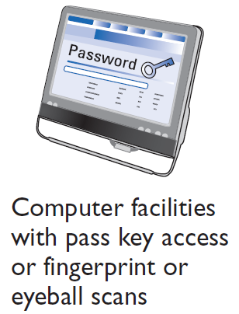

Principles of Internal Control Activities
PHYSICAL CONTROLS
Illustration 8-2
LO 1

Slide 15
ANATOMY OF A FRAUD
At Centerstone Health, a large insurance company, the mailroom each day received insurance applications from prospective customers. Mailroom employees scanned the applications into electronic documents before the applications were processed. Once the applications are scanned they can be accessed online by authorized employees. Insurance agents at Centerstone Health earn commissions based upon successful applications. The sales agent’s name is listed on the application. However, roughly 15% of the applications are from customers who did not work with a sales agent. Two friends—Alex, an employee in record keeping, and Parviz, a sales agent—thought up a way to perpetrate a fraud. Alex identified scanned applications that did not list a sales agent. After business hours, he entered the mailroom and found the hardcopy applications that did not show a sales agent. He wrote in Parviz’s name as the sales agent and then rescanned the application for processing. Parviz received the commission, which the friends then split.
Total take: $240,000
The Missing Control
LO 1

Slide 16
Total take: $240,000
The Missing Control
Physical controls. Centerstone Health lacked two basic physical controls that could have prevented this fraud. First, the mailroom should have been locked during nonbusiness hours, and access during business hours should have been tightly controlled. Second, the scanned applications supposedly could be accessed only by authorized employees using their passwords. However, the password for each employee was the same as the employee’s user ID. Since employee user-ID numbers were available to all other employees, all employees knew all other employees’ passwords. Unauthorized employees could access the scanned applications. Thus, Alex could enter the system using another employee’s password and access the scanned applications.
LO 1

Slide 17
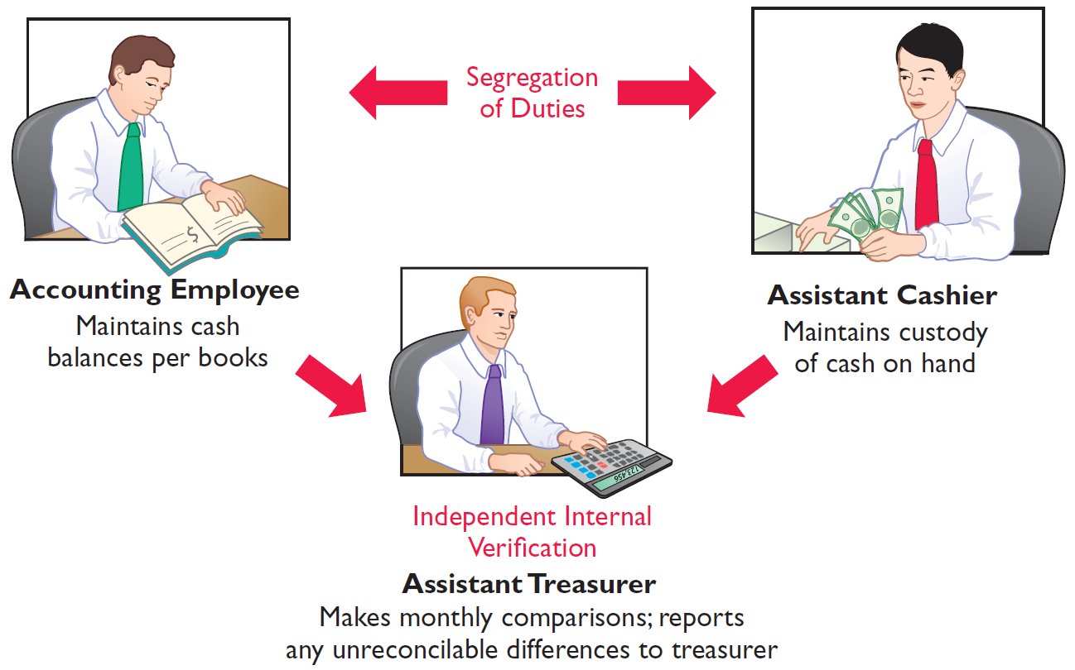
Principles of Internal Control Activities
INDEPENDENT INTERNAL VERIFICATION
  Records periodically verified by an employee who is independent.
  Discrepancies reported to management.
Illustration 8-3
Comparison of segregation of duties principle with independent internal
verification principle
LO 1

Slide 18
ANATOMY OF A FRAUD
Bobbi Jean Donnelly, the office manager for Mod Fashions Corporations design center, was responsible for preparing the design center budget and reviewing expense reports submitted by design center employees. Her desire to upgrade her wardrobe got the better of her, and she enacted a fraud that involved filing expense-reimbursement requests for her own personal clothing purchases. She was able to conceal the fraud because she was responsible for reviewing all expense reports, including her own. In addition, she sometimes was given ultimate responsibility for signing off on the expense reports when her boss was “too busy.” Also, because she controlled the budget, when she submitted her expenses, she coded them to budget items that she knew were running under budget, so that they would not catch anyone’s attention.
Total take: $275,000
The Missing Control
Independent internal verification. Bobbi Jean’s boss should have verified her expense reports. When asked what he thought her expenses were, the boss said about $10,000. At $115,000 per year, her actual expenses were more than ten times what would have been expected. However, because he was “too busy” to verify her expense reports or to review the budget, he never noticed.
LO 1

Slide 19
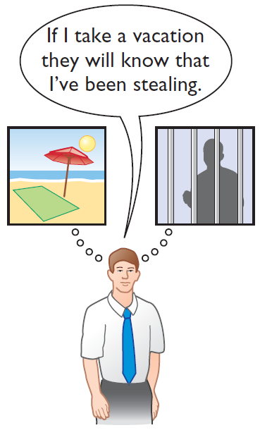
Principles of Internal Control Activities
HUMAN RESOURCE CONTROLS
  Bond employees who handle cash.
  Rotate employees’ duties and require vacations.
  Conduct background checks.
LO 1

Slide 20
ANATOMY OF A FRAUD
Ellen Lowry was the desk manager and Josephine Rodriquez was the head of housekeeping at the Excelsior Inn, a luxury hotel. The two best friends were so dedicated to their jobs that they never took vacations, and they frequently filled in for other employees. In fact, Ms. Rodriquez, whose job as head of housekeeping did not include cleaning rooms, often cleaned rooms herself, “just to help the staff keep up.” Ellen, the desk manager, provided significant discounts to guests who paid with cash. She kept the cash and did not register the guest in the hotel’s computerized system. Instead, she took the room out of circulation “due to routine maintenance.” Because the room did not show up as being used, it did not receive a normal housekeeping assignment. Instead, Josephine, the head of housekeeping, cleaned the rooms during the guests’ stay.
Total take: $95,000
The Missing Control
Human resource controls. Ellen, the desk manager, had been fired by a previous employer. If the Excelsior Inn had conducted a background check, it would not have hired her. The fraud was detected when Ellen missed work due to illness. A system of mandatory vacations and rotating days off would have increased the chances of detecting the fraud before it became so large.
LO 1

Slide 21
Accounting Across the Organization
SOX Boosts the Role of Human Resources
Under SOX, a company needs to keep track of employees’ degrees and certifications to ensure that employees continue to meet the specified requirements of a job. Also, to ensure proper employee supervision and proper separation of duties, companies must develop and monitor an organizational chart. When one corporation went through this exercise, it found that out of 17,000 employees, there were 400 people who did not report to anyone. The corporation also had 35 people who reported to each other. In addition, if an employee complains of an unfair firing and mentions financial issues at the company, HR should refer the case to the company audit committee and possibly to its legal counsel.
Why would unsupervised employees or employees who report to each other represent potential internal control threats? (Go to WileyPLUS for this answer and additional questions.)
LO 1

Slide 22
Limitations of Internal Control
  Costs should not exceed benefit.
  Human element.
  Size of the business.
Helpful Hint
Controls may vary with the risk level of the activity. For example, management may consider cash to be high risk and maintaining inventories in the stockroom as lower risk. Thus, management would have stricter controls for cash.
LO 1

Slide 23
DO IT!
1
Control Activities
Identify which control activity is violated in each of the following situations, and explain how the situation creates an opportunity for a fraud.
The person with primary responsibility for reconciling the bank account and making all bank deposits is also the company’s accountant.
Solution
Violates the control activity of segregation of duties.
Recordkeeping should be separate from physical custody.
Employee could embezzle cash and make journal entries to hide the theft.
LO 1

Slide 24
DO IT!
1
Control Activities
Identify which control activity is violated in each of the following situations, and explain how the situation creates an opportunity for a fraud.
Wellstone Company’s treasurer received an award for distinguished service because he had not taken a vacation in 30 years.
Solution
Violates the control activity of human resource controls.
Key employees must take vacations.
Treasurer, who manages the company’s cash, might embezzle cash and use his position to conceal the theft.
LO 1

Slide 25
DO IT!
1
Control Activities
Identify which control activity is violated in each of the following situations, and explain how the situation creates an opportunity for a fraud.
In order to save money spent on order slips and to reduce time spent keeping track of order slips, a local bar/restaurant does not buy prenumbered order slips.
Solution
Violates the control activity of documentation procedures.
If prenumbered documents are not used, then it is virtually impossible to account for the documents.
An employee could write up a dinner sale, receive cash from the customer, and then throw away the order slip and keep the cash.
LO 1

Slide 26
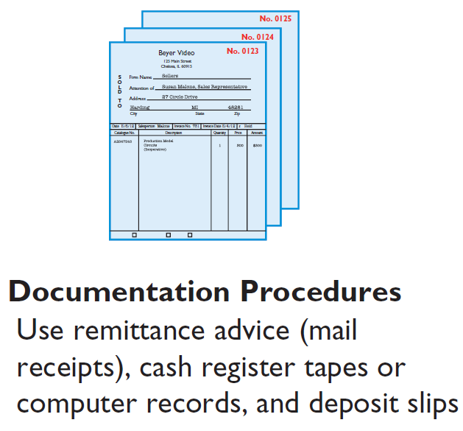
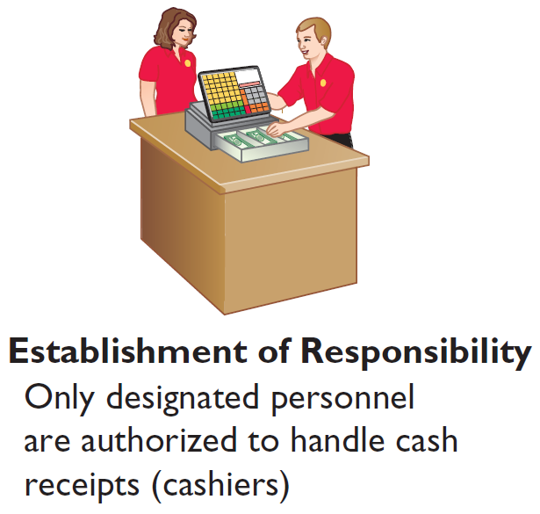
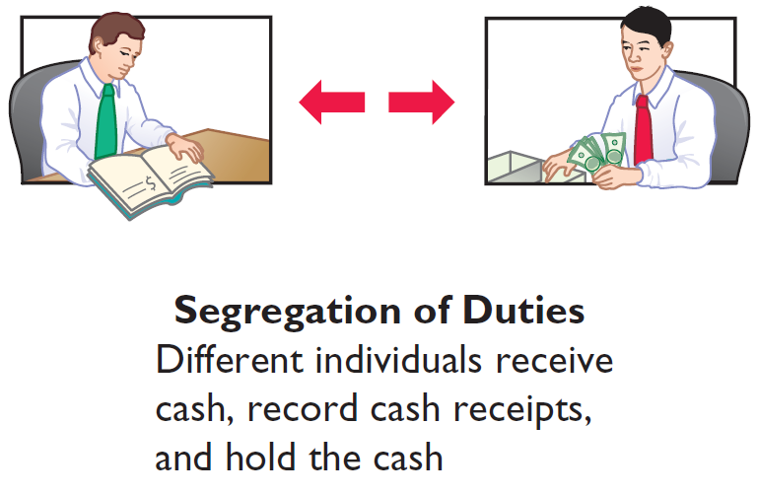
LEARNING
OBJECTIVE
Apply internal control principles to cash.
2
Cash Receipt Controls
Illustration 8-4
Application of internal control principles to cash receipts
LO 2

Slide 27
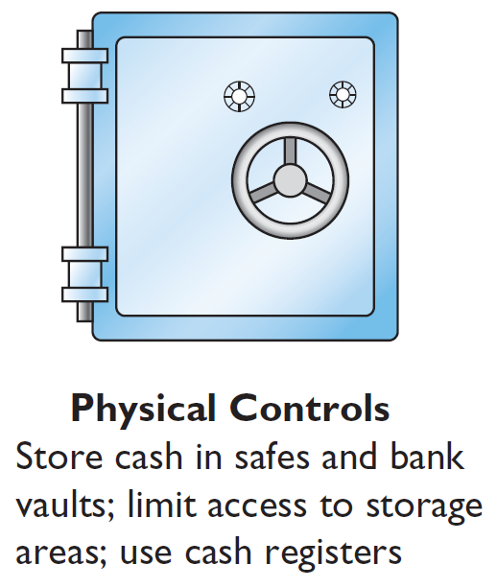
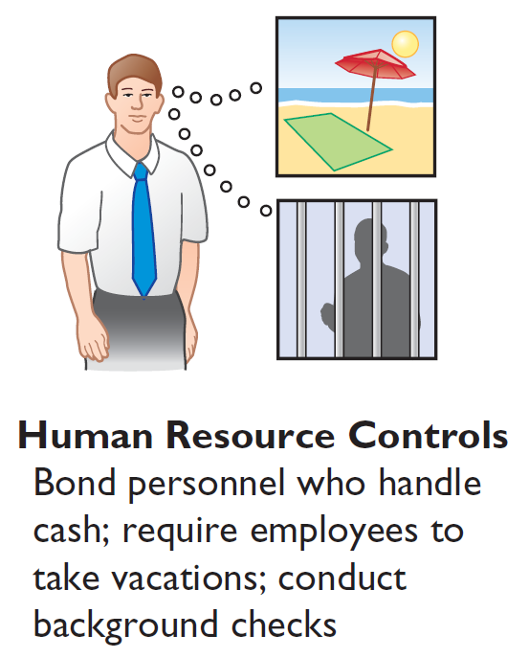

Cash Receipt Controls
Illustration 8-4
Application of internal control principles to cash receipts
LO 2

Slide 28
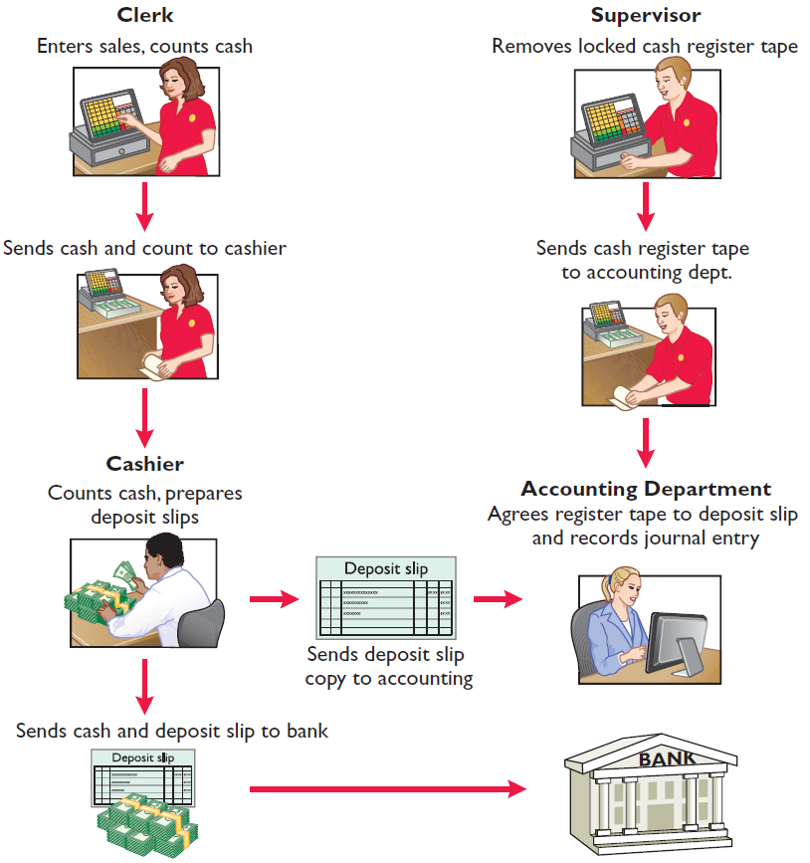
Cash Controls
OVER-THE-COUNTER RECEIPTS
Important internal control principle—segregation of record-keeping from physical custody.
Illustration 8-5
LO 2

Slide 29
Cash Receipt Controls
MAIL RECEIPTS
  Mail receipts should be opened by two mail clerks, a list prepared, and each check endorsed “For Deposit Only.”
  Each mail clerk signs the list to establish responsibility for the data.
  Original copy of the list, along with the checks, is sent to the cashier’s department.
  Copy of the list is sent to the accounting department for recording. Clerks also keep a copy.
LO 2

Slide 30
Cash Receipt Controls
Question
Permitting only designated personnel to handle cash receipts is an application of the principle of:
a. segregation of duties.
b. establishment of responsibility.
c. independent check.
d. other controls.
LO 2

Slide 31
Cash Disbursement Controls
Generally, internal control over cash disbursements is more effective when companies pay by check or electronic funds transfer (EFT) rather than by cash.
One exception is payments for incidental amounts that are paid out of petty cash.
LO 2

Slide 32
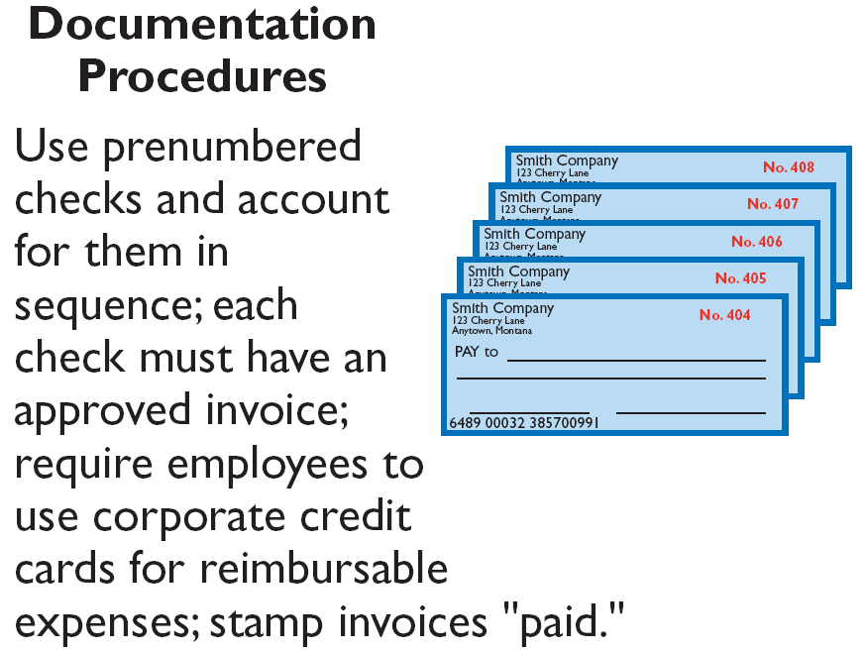
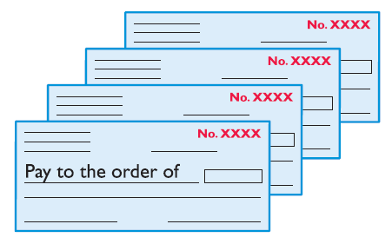
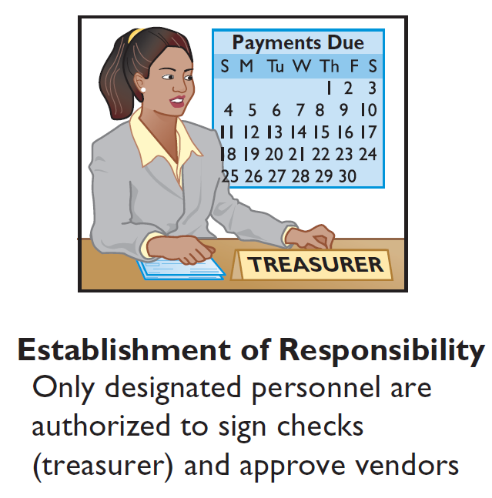
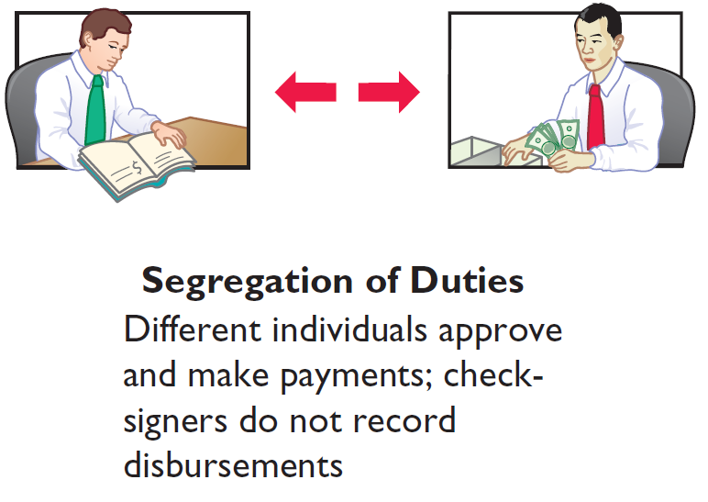
Cash Disbursement
Illustration 8-6
Application of internal
control principles to cash
disbursements
LO 2

Slide 33
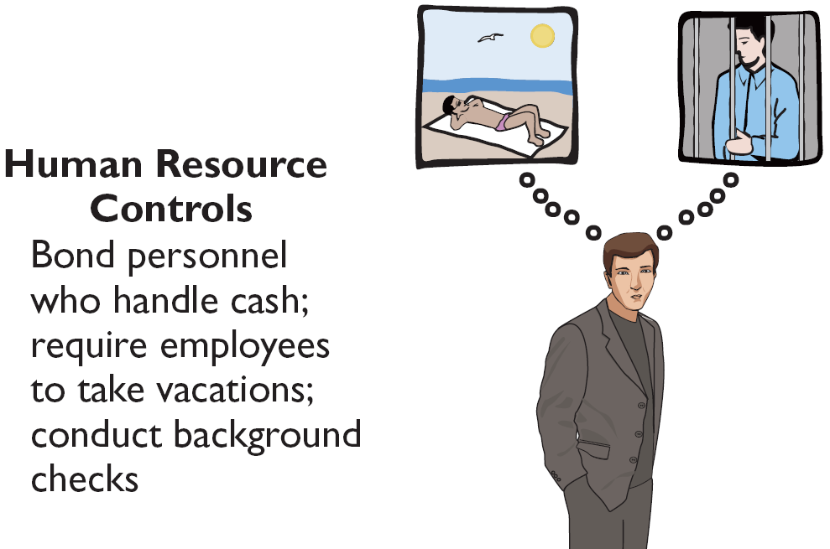
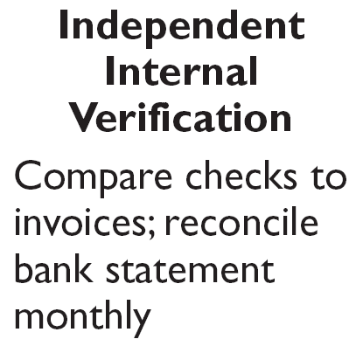


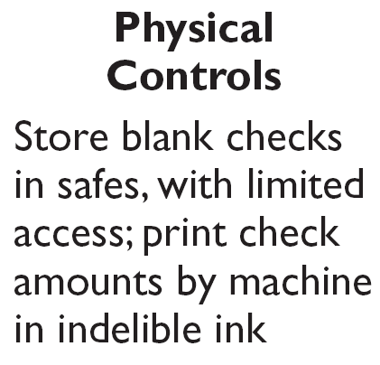


Cash Disbursement Controls
Illustration 8-6
Application of internal
control principles to cash
disbursements
LO 2

Slide 34
Cash Disbursement Controls
Question
The use of prenumbered checks in disbursing cash is an application of the principle of:
a. segregation of duties.
b. establishment of responsibility.
c. physical, mechanical, and electronic controls.
d. documentation procedures.
LO 2

Slide 35
Cash Disbursement Controls
VOUCHER SYSTEM CONTROLS
  A network of approvals by authorized individuals, acting independently, to ensure all disbursements by check are proper.
  A voucher is an authorization form prepared for each expenditure in a voucher system.
LO 2

Slide 36
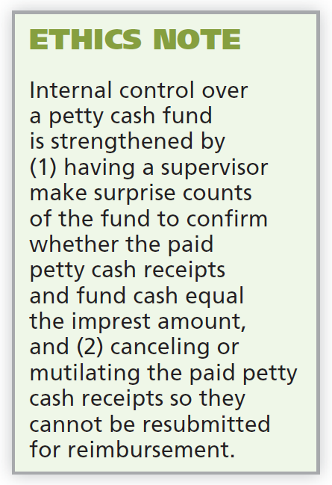
Petty Cash Fund
Petty Cash Fund - Used to pay small amounts.
Involves:
  establishing the fund,
  making payments from the fund, and
  replenishing the fund.
LO 2

Slide 37
Petty Cash Fund
ESTABLISHING THE PETTY CASH FUND
Illustration: If Laird Company decides to establish a $100 fund on March 1, the journal entry is:
March 1
Petty Cash 100
Cash 100
LO 2

Slide 38
Petty Cash Fund
REPLENISHING THE PETTY CASH FUND
Illustration: On March 15 Laird’s petty cash custodian requests a check for $87. The fund contains $13 cash and petty cash receipts for postage $44, freight-out $38, and miscellaneous expenses $5. The journal entry is:
March 15
Postage Expense 44
Freight-Out 38
Miscellaneous Expense 5
Cash 87
LO 2

Slide 39
Petty Cash Fund
Illustration: Assume in the preceding example that the custodian had only $12 in cash in the fund plus the receipts as listed. The request for reimbursement would therefore be for $88, and Laird would make the following entry.
March 15
Postage Expense 44
Freight-Out 38
Miscellaneous Expense 5
Cash Over and Short 1
Cash 88
LO 2

Slide 40
Ethics Insight
How Employees Steal
Occupational fraud is using your own occupation for personal gain through the misuse or misapplication of the company’s resources or assets. This type of fraud is one of three types:
Asset misappropriation, such as theft of cash on hand, fraudulent disbursements, false refunds, ghost employees, personal purchases, and fictitious employees. This fraud is the most common but the least costly.
Corruption, such as bribery, illegal gratuities, and economic extortion. This fraud generally falls in the middle between asset misappropriation and financial statement fraud as regards frequency and cost.
Financial statement fraud, such as fictitious revenues, concealed liabilities and expenses, improper disclosures, and improper asset values. This fraud occurs less frequently than other types of fraud but it is the most costly.
LO 2

Slide 41
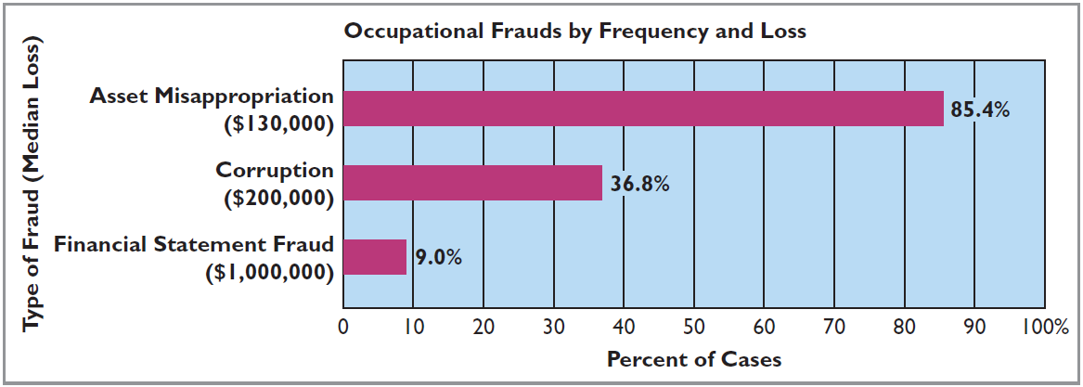
Ethics Insight
How Employees Steal
The graph below shows the frequency and the median loss for each type of occupational fraud.
Source: 2014 Report to the Nations on Occupational Fraud and Abuse, Association of Certified Fraud Examiners, pp. 10–12.
LO 2

Slide 42
DO IT!
2b
Petty Cash Fund
Bateer Company established a $50 petty cash fund on July 1. On July 30, the fund had $12 cash remaining and petty cash receipts for postage $14, office supplies $10, and delivery expense $15. Prepare journal entries to establish the fund on July 1 and to replenish the fund on July 30.
Solution
July 1
Petty Cash 50
Cash 50
Postage Expense 14
Supplies 10
Delivery Expense 15
Cash Over and Short 1
Cash 38
30
LO 2

Slide 43
LEARNING
OBJECTIVE
Identify the control features of a bank account.
3
The use of a bank contributes significantly to good internal control over cash.
  Minimizes the amount of currency on hand.
  Creates a double record of bank transactions.
  Bank reconciliation.
Helpful Hint
Essentially, the bank statement is a copy of the bank’s records sent to the customer (or available online) for review.
LO 3

Slide 44
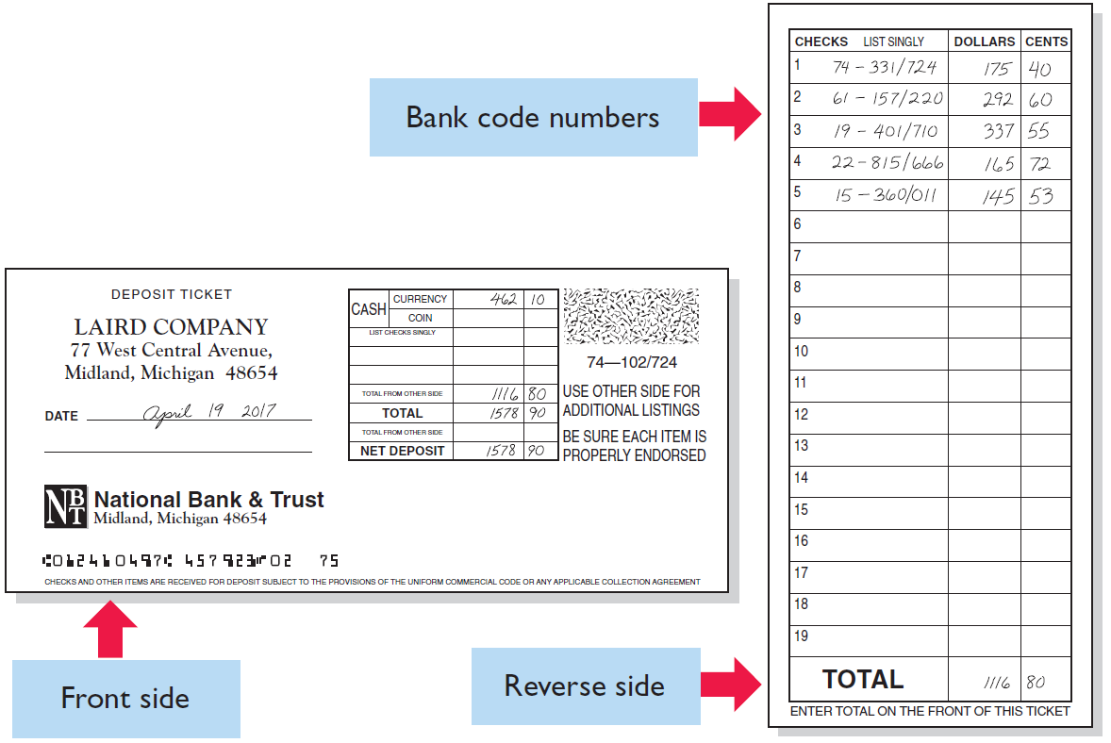
Making Bank Deposits
Authorized employee should make deposit.
Illustration 8-8
LO 3

Slide 45
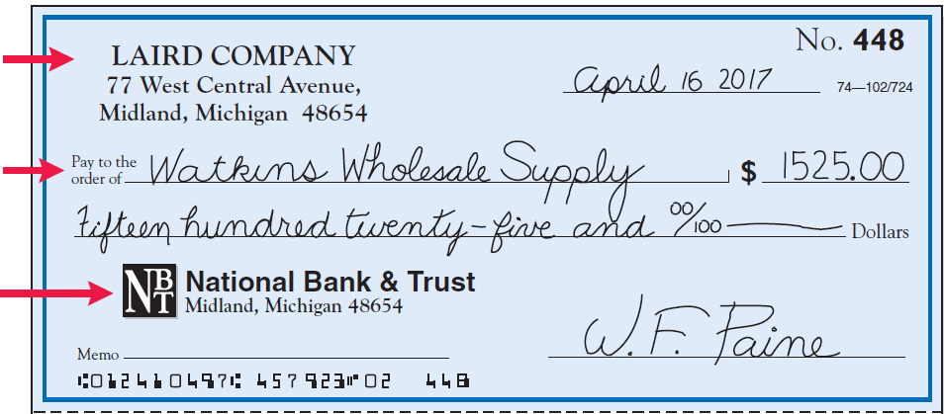
Writing Checks
Written order signed by depositor directing bank to pay a specified sum of money to a designated recipient.
Maker
Payee
Payer
Illustration 8-9
Check
LO 3

Slide 46
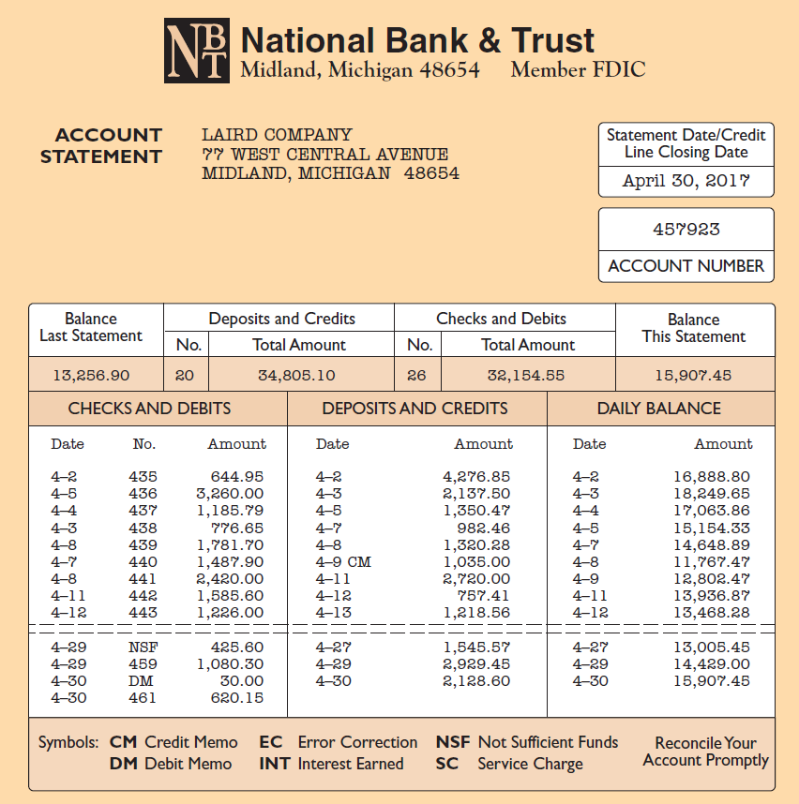
Bank Statements
DEBIT MEMORANDUM
  Bank service charge.
  NSF (not sufficient funds).
CREDIT MEMORANDUM
  Collect notes receivable.
  Interest earned.
Illustration 8-10
LO 3

Slide 47
Bank Statements
Question
The control features of a bank account do not include:
  having bank auditors verify the correctness of the bank balance per books.
  b. minimizing the amount of cash that must be kept on hand.
  providing a double record of all bank transactions.
  d. safeguarding cash by using a bank as a depository.
LO 3

Slide 48
Reconciling the Bank Account
Reconcile balance per books and balance per bank to their “correct” or “true” balance.
Reconciling Items:
  Deposits in transit.
  Outstanding checks.
  Bank memoranda.
  Errors.
Time Lags
LO 3

Slide 49
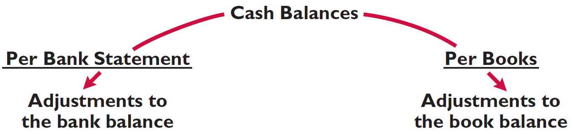
Reconciling the Bank Account
RECONCILIATION PROCEDURES
Illustration 8-11
Bank reconciliation adjustments
+ Deposit in Transit
- Outstanding Checks
+/- Bank Errors
+ Notes collected by bank
- NSF (bounced) checks
- Check printing or other service charges
+/- Company Errors
CORRECT BALANCE
CORRECT BALANCE
LO 3

Slide 50
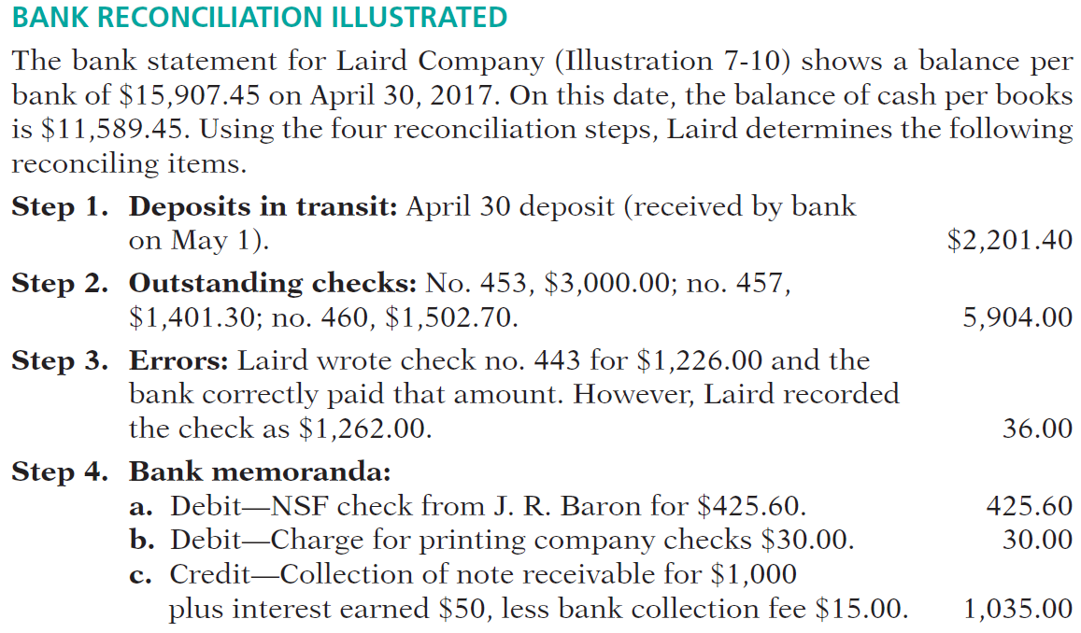
RECONCILIATION PROCEDURES
(Illustration 8-10)
LO 3

Slide 51
RECONCILIATION PROCEDURES
Illustration: Prepare a bank reconciliation at April 30.
Cash balance per bank statement $15,907.45
Deposit in transit 2,201.40
Outstanding checks (5,904.00)
Adjusted cash balance per bank $12,204.85
Cash balance per books $11,589.45
Error in check No. 443 36.00
NSF check (425.60)
Bank service charge (30.00)
Collection of notes receivable 1,035.00
Adjusted cash balance per books $12,204.85
LO 3

Slide 52
Reconciling the Bank Account
ENTRIES FROM BANK RECONCILIATION
COLLECTION OF NOTE RECEIVABLE: Assuming interest of $50 has not been accrued and collection fee is charged to Miscellaneous Expense, the entry is:
Apr. 30
Cash 1,035.00
Miscellaneous Expense 15.00
Notes Receivable 1,000.00
Interest Revenue 50.00
LO 3

Slide 53
ENTRIES FROM BANK RECONCILIATION
BOOK ERROR: The cash disbursements journal shows that check no. 443 was a payment on account to Andrea Company, a supplier. The correcting entry is:
Apr. 30
Cash 36.00
Accounts Payable 36.00
NSF CHECK: As indicated earlier, an NSF check becomes an account receivable to the depositor. The entry is:
Apr. 30
Accounts Receivable 425.60
Cash 425.60
LO 3

Slide 54
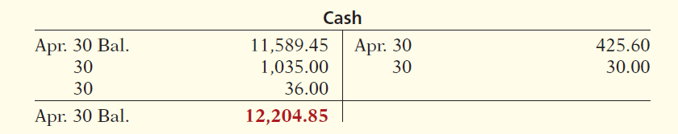
ENTRIES FROM BANK RECONCILIATION
BANK SERVICE CHARGES: Depositors debit check printing charges (DM) and other bank service charges (SC) to Miscellaneous Expense. The entry is:
Apr. 30
Miscellaneous Expense 30.00
Cash 30.00
Illustration 8-13
LO 3

Slide 55
Reconciling the Bank Account
Question
The reconciling item in a bank reconciliation that will result in an adjusting entry by the depositor is:
  outstanding checks.
  b. deposit in transit.
  c. a bank error.
  d. bank service charges.
LO 3

Slide 56
Electronic Funds Transfer (EFT) System
  Disbursement systems that uses wire, telephone, or computers to transfer cash balances between locations.
  EFT transfers normally result in better internal control since no cash or checks are handled by company employees.
LO 3

Slide 57
Investor Insight
Madoff’s Ponzi Scheme
No recent fraud has generated more interest and rage than the one perpetrated by Bernard Madoff. Madoff was an elite New York investment fund manager who was highly regarded by securities regulators. Investors flocked to him because he delivered very steady returns of between 10% and 15%, no matter whether the market was going up or going down. However, for many years, Madoff did not actually invest the cash that people gave to him. Instead, he was running a Ponzi scheme: He paid returns to existing investors using cash received from new investors. As long as the size of his investment fund continued to grow from new investments at a rate that exceeded the amounts that he needed to pay out in returns, Madoff was able to operate his fraud smoothly. To conceal his misdeeds, Madoff fabricated false investment statements that were provided to investors. In addition, Madoff hired an auditor that never verified the accuracy of the investment records but automatically issued unqualified opinions each year. Although a competing fund manager warned the SEC a number of times over a nearly 10-year period that he thought Madoff was engaged in fraud, the SEC never aggressively investigated the allegations. Investors, many of which were charitable organizations, lost more than $18 billion. Madoff was sentenced to a jail term of 150 years.
LO 3

Slide 58
DO IT!
3
Bank Reconciliation
Sally Kist owns Linen Kist Fabrics. Sally asks you to explain how she should treat the following reconciling items when reconciling the company’s bank account: (1) a debit memorandum for an NSF check, (2) a credit memorandum for a note collected by the bank, (3) outstanding checks, and (4) a deposit in transit.
Solution
Sally should treat the reconciling items as follows.
(1) NSF check: Deduct from balance per books.
(2) Collection of note: Add to balance per books.
(3) Outstanding checks: Deduct from balance per bank.
(4) Deposit in transit: Add to balance per bank.
LO 3

Slide 59
LEARNING
OBJECTIVE
Explain the reporting of cash.
4
Cash Equivalents
Cash equivalents are short-term, highly liquid investments that are both:
  Readily convertible to known amounts of cash, and
  So near their maturity that their market value is relatively insensitive to changes in interest rates.
Restricted Cash
Cash that is not available for general use but rather is restricted for a special purpose.
LO 4

Slide 60

Reporting Cash
Illustration 8-14
Balance sheet presentation
of cash
LO 4

Slide 61
Reporting Cash
Question
Which of the following statements correctly describes the reporting of cash?
  Cash cannot be combined with cash equivalents.
  b. Restricted cash fund may be combined with Cash.
  c. Cash is listed first in the current assets section.
  d. Restricted cash funds cannot be reported as a current asset.
LO 4

Slide 62
DO IT!
4
Reporting Cash
Indicate whether each of the following is true or false.
Cash and cash equivalents are comprised of coins, currency (paper money), money orders, and NSF checks.
Restricted cash is classified as either a current asset or noncurrent asset, depending on the circumstances.
A company may have a negative balance in its bank account. In this case, it should offset this negative balance against cash and cash equivalents on the balance sheet.
Because cash and cash equivalents often include short-term investments, accounts receivable should be reported as the first item on the balance sheet.
False
True
False
False
LO 4

Slide 63

A Look at IFRS
LEARNING
OBJECTIVE
Compare the accounting for fraud, internal control, and cash under GAAP and IFRS.
5
Relevant Facts
  Similarities
  The fraud triangle discussed in this chapter is applicable to all international companies. Some of the major frauds on an international basis are Parmalat (Italy), Royal Ahold (the Netherlands), and Satyam Computer Services (India).
  Rising economic crime poses a growing threat to companies, with nearly one-third of all organizations worldwide being victims of fraud in a recent 12-month period.
LO 5

Slide 64
A Look at IFRS
Relevant Facts
  Similarities
  Accounting scandals both in the United States and internationally have re-ignited the debate over the relative merits of GAAP, which takes a “rules-based” approach to accounting, versus IFRS, which takes a “principles-based” approach. The FASB announced that it intends to introduce more principles-based standards.
  The accounting and internal control procedures related to cash are essentially the same under both IFRS and this textbook. In addition, the definition used for cash equivalents is the same.
  Most companies report cash and cash equivalents together under IFRS, as shown in this textbook. In addition, IFRS follows the same accounting policies related to the reporting of restricted cash.
LO 5

Slide 65
A Look at IFRS
Relevant Facts
  Differences
  The SOX internal control standards apply only to companies listed on U.S. exchanges. There is continuing debate over whether foreign issuers should have to comply with this extra layer of regulation.
LO 5

Slide 66
A Look at IFRS
Looking to the Future
Ethics has become a very important aspect of reporting. Different cultures have different perspectives on bribery and other questionable activities, and consequently penalties for engaging in such activities vary considerably across countries.
High-quality international accounting requires both high-quality accounting standards and high-quality auditing. Similar to the convergence of GAAP and IFRS, there is movement to improve international auditing standards. The International Auditing and Assurance Standards Board (IAASB) functions as an independent standard-setting body. It works to establish high-quality auditing and assurance and quality-control standards throughout the world. Whether the IAASB adopts internal control provisions similar to those in SOX remains to be seen. You can follow developments in the international audit arena at http://www.ifac.org/iaasb/.
LO 5

Slide 67
A Look at IFRS
IFRS Self-Test Questions
Non-U.S companies that follow IFRS:
do not normally use the principles of internal control activities described in this textbook.
often offset cash with accounts payable on the balance sheet.
are not required to follow SOX.
None of the above.
LO 5

Slide 68
A Look at IFRS
IFRS Self-Test Questions
The Sarbanes-Oxley Act applies to:
all U.S. companies listed on U.S. exchanges.
all companies that list stock on any stock exchange in any country.
all European companies listed on European exchanges.
Both (a) and (c).
LO 5

Slide 69
A Look at IFRS
IFRS Self-Test Questions
High-quality international accounting requires both high-quality accounting standards and:
a reconsideration of SOX to make it less onerous.
high-quality auditing standards.
government intervention to ensure that the public interest is protected.
the development of new principles of internal control activities.
LO 5

Slide 70
Copyright
“Copyright © 2015 John Wiley & Sons, Inc. All rights reserved. Reproduction or translation of this work beyond that permitted in Section 117 of the 1976 United States Copyright Act without the express written permission of the copyright owner is unlawful. Request for further information should be addressed to the Permissions Department, John Wiley & Sons, Inc. The purchaser may make back-up copies for his/her own use only and not for distribution or resale. The Publisher assumes no responsibility for errors, omissions, or damages, caused by the use of these programs or from the use of the information contained herein.”

