Slide 1
6
Inventories
Learning Objectives
1
Discuss how to classify and determine inventory.
2
Apply inventory cost flow methods and discuss their financial effects.
Indicate the effects of inventory errors on the financial statements.
3
4
Explain the statement presentation and analysis of inventory.

Slide 2
LEARNING
OBJECTIVE
Discuss how to classify and determine inventory.
1
Classifying Inventory
Merchandising Company
Manufacturing Company
One Classification:
  Inventory
Three Classifications:
  Raw Materials
  Work in Process
  Finished Goods
Helpful Hint
Regardless of the
classification, companies report all inventories under Current Assets on the balance sheet.
LO 1

Slide 3
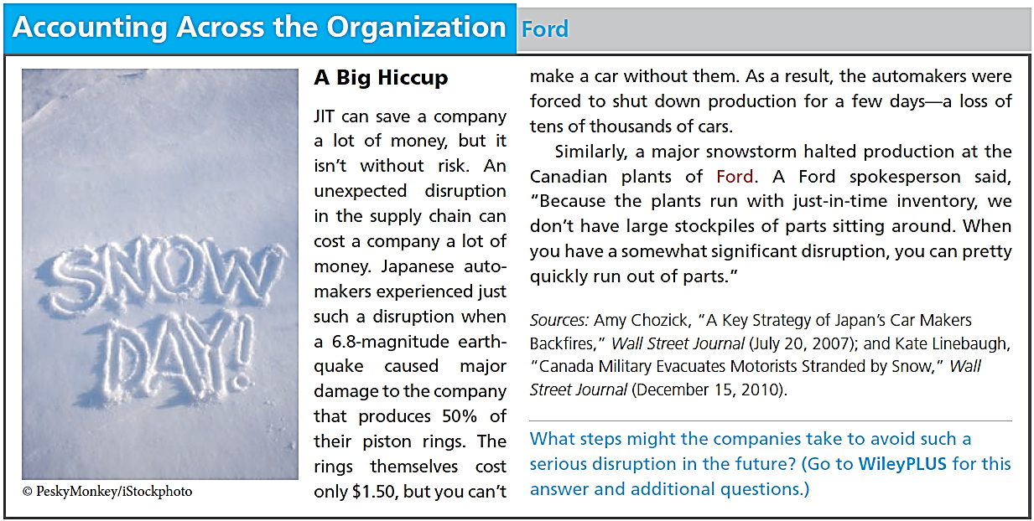
LO 1

Slide 4
Determining Inventory Quantities
Physical Inventory taken for two reasons:
Perpetual System
  Check accuracy of inventory records.
  Determine amount of inventory lost due to wasted raw materials, shoplifting, or employee theft.
Periodic System
  Determine the inventory on hand.
  Determine the cost of goods sold for the period.
LO 1

Slide 5
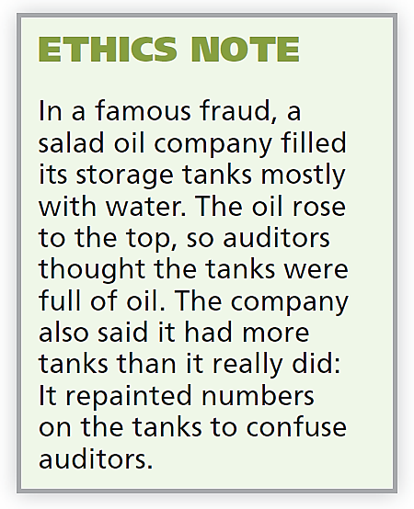
Determining Inventory Quantities
TAKING A PHYSICAL INVENTORY
Involves counting, weighing, or measuring each kind of inventory on hand.
Companies often “take inventory”
  when the business is closed or
  business is slow.
  at the end of the accounting period.
LO 1

Slide 6

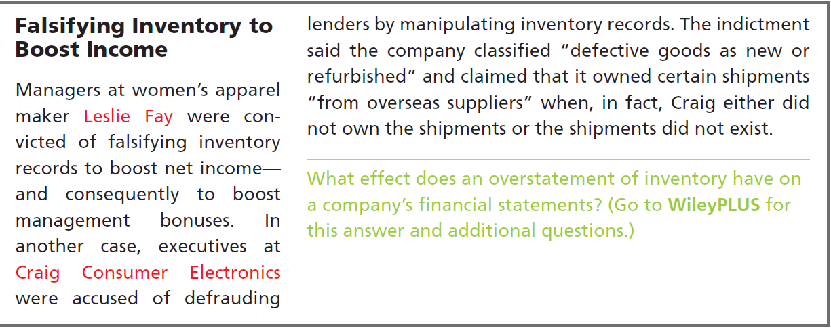

LO 1

Slide 7
Determining Inventory Quantities
DETERMINING OWNERSHIP OF GOODS
GOODS IN TRANSIT
  Purchased goods not yet received.
  Sold goods not yet delivered.
Goods in transit should be included in the inventory of the company that has legal title to the goods. Legal title is determined by the terms of sale.
LO 1

Slide 8
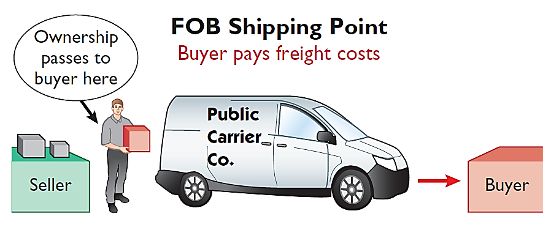
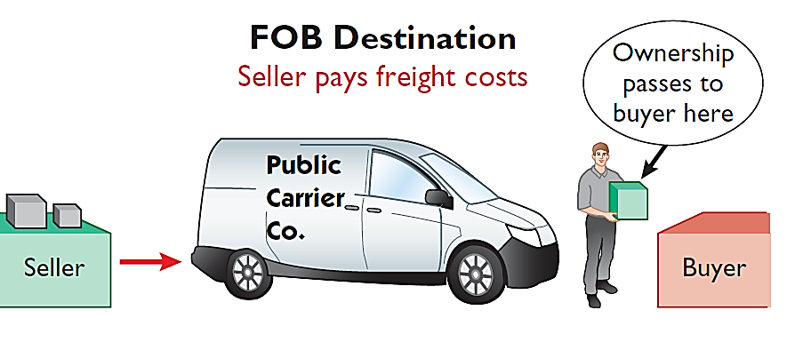
Determining Ownership of Goods
GOODS IN TRANSIT
Illustration 6-2 Terms of sale
Ownership of the goods passes to the buyer when the public carrier accepts the goods from the seller.
Ownership of the goods remains with the seller until the goods reach the buyer.
LO 1

Slide 9
Determining Ownership of Goods
Question
Goods in transit should be included in the inventory of the buyer when the:
  public carrier accepts the goods from the seller.
  goods reach the buyer.
  terms of sale are FOB destination.
  terms of sale are FOB shipping point.
LO 1
Notes:
Answer = A

Slide 10
Determining Ownership of Goods
CONSIGNED GOODS
To hold the goods of other parties and try to sell the goods for them for a fee, but without taking ownership of the goods.
Many car, boat, and antique dealers sell goods on consignment, why?
LO 1

Slide 11
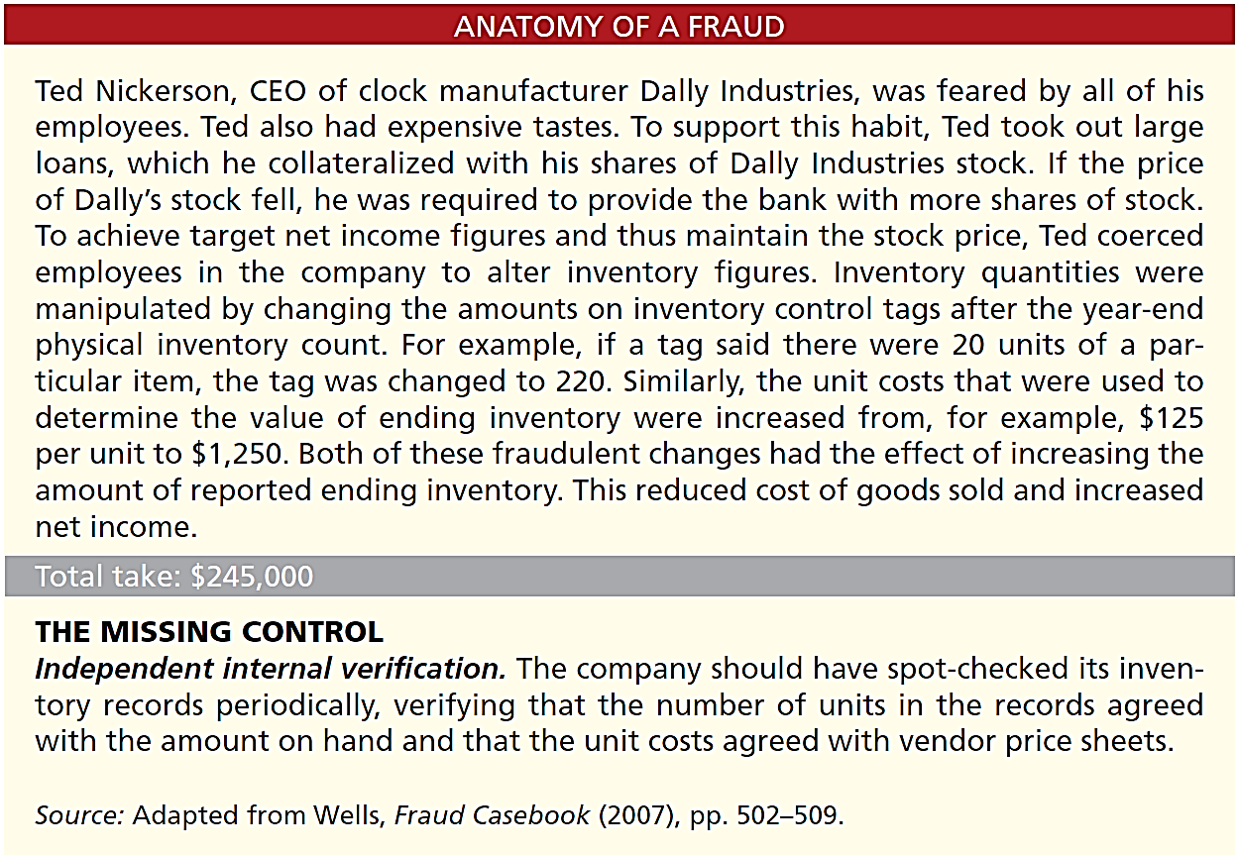
LO 1

Slide 12
DO IT!
1
Rules of Ownership
Hasbeen Company completed its inventory count. It arrived at a total inventory value of $200,000. You have been given the information listed below. Discuss how this information affects the reported cost of inventory.
1. Hasbeen included in the inventory goods held on consignment for Falls Co., costing $15,000.
2. The company did not include in the count purchased goods of $10,000, which were in transit (terms: FOB shipping point).
3. The company did not include in the count inventory that had been sold with a cost of $12,000, which was in transit (terms: FOB shipping point).
Solution
1. Goods of $15,000 held on consignment should be deducted from the inventory count.
2. The goods of $10,000 purchased FOB shipping point should be added to the inventory count.
3. Item 3 was treated correctly.
Inventory should be $195,000 ($200,000 - $15,000 + $10,000).
LO 1

Slide 13
LEARNING
OBJECTIVE
Apply inventory cost flow methods and discuss their financial effects.
2
Inventory is accounted for at cost.
  Cost includes all expenditures necessary to acquire goods and place them in a condition ready for sale.
  Unit costs are applied to quantities to compute the total cost of the inventory and the cost of goods sold using the following costing methods:
    Specific identification
    First-in, first-out (FIFO)
    Last-in, first-out (LIFO)
    Average-cost
Cost Flow Assumptions
LO 2

Slide 14
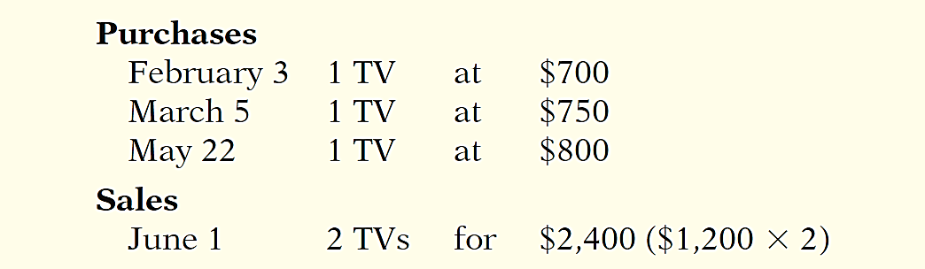
Inventory Costing
Illustration: Crivitz TV Company purchases three identical 50-inch TVs on different dates at costs of $700, $750, and $800. During the year Crivitz sold two sets at $1,200 each. These facts are summarized below.
Illustration 6-3
Data for inventory costing example
LO 2

Slide 15
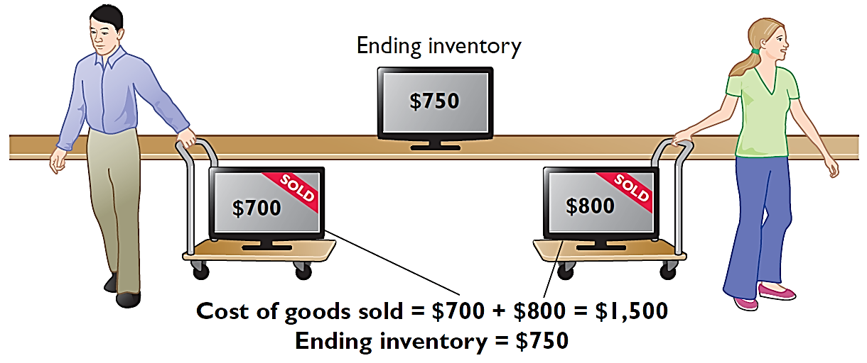
Specific Identification
If Crivitz sold the TVs it purchased on February 3 and May 22, then its cost of goods sold is $1,500 ($700 + $800), and its ending inventory is $750.
Illustration 6-4
LO 2

Slide 16
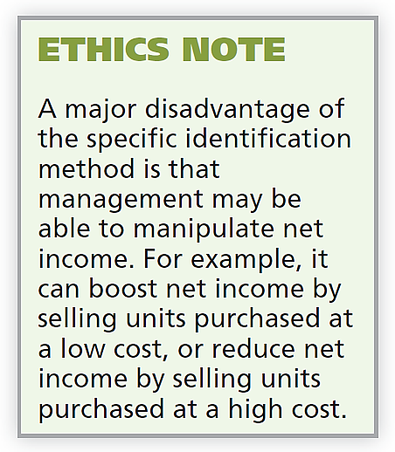
Specific Identification
Actual physical flow costing method in which items still in inventory are specifically costed to arrive at the total cost of the ending inventory.
  Practice is relatively rare.
  Most companies make assumptions (cost flow assumptions) about which units were sold.
LO 2

Slide 17
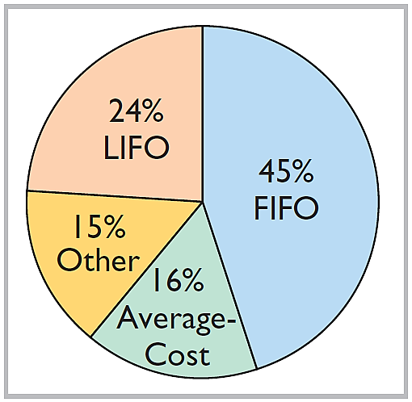
Cost Flow Assumptions
Cost flow assumptions DO NOT need to be consistent with the physical movement of the goods
Illustration 6-12
Use of cost flow methods in major U.S. companies
LO 2

Slide 18
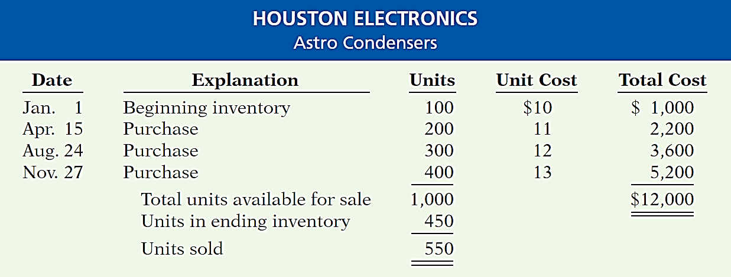
Cost Flow Assumptions
Illustration: Data for Houston Electronics’ Astro condensers.
Illustration 6-5
(Beginning Inventory + Purchases) - Ending Inventory = Cost of Goods Sold
LO 2

Slide 19
Cost Flow Assumptions
FIRST-IN, FIRST-OUT (FIFO)
  Costs of the earliest goods purchased are the first to be recognized in determining cost of goods sold.
  Often parallels actual physical flow of merchandise.
  Companies determine the cost of the ending inventory by taking the unit cost of the most recent purchase and working backward until all units of inventory have been costed.
LO 2

Slide 20
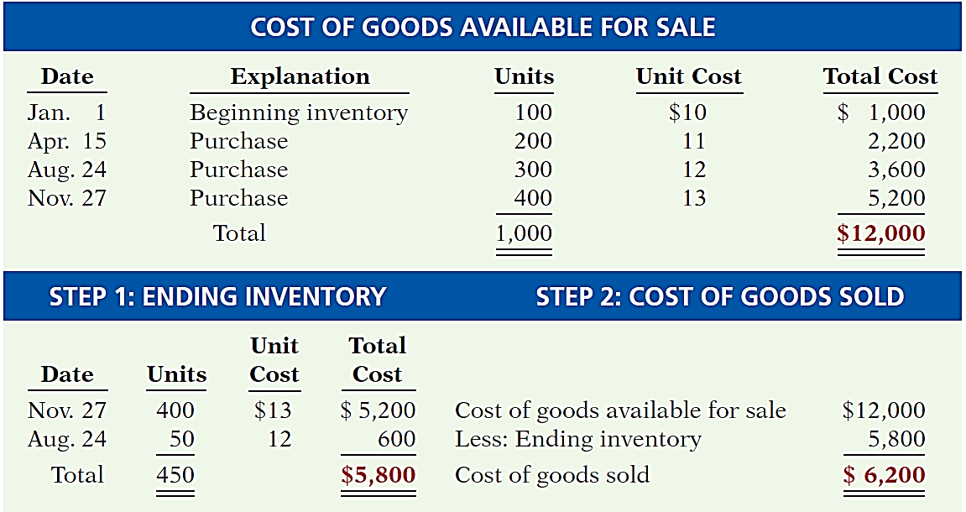
FIRST-IN, FIRST-OUT (FIFO)
Illustration 6-6
LO 2

Slide 21
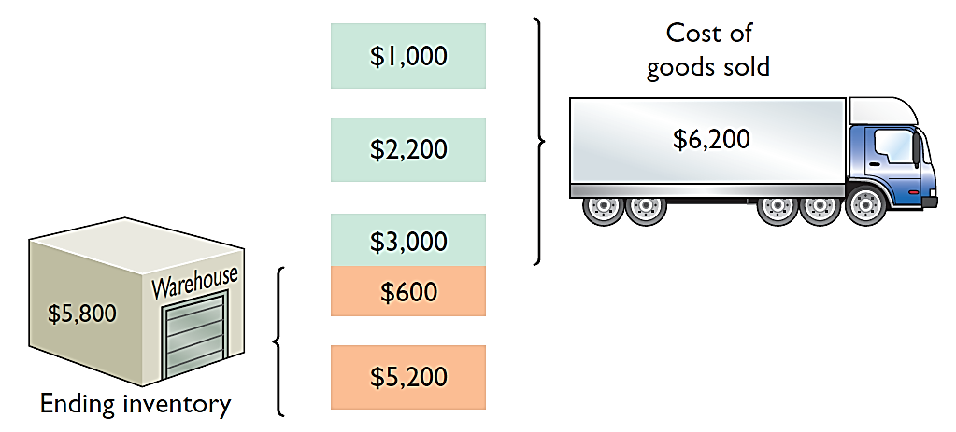
FIRST-IN, FIRST-OUT (FIFO)
Illustration 6-6
Helpful Hint Another way of
thinking about the calculation
of FIFO ending inventory is the
LISH assumption—last in still here.
LO 2

Slide 22
Cost Flow Assumptions
LAST-IN, FIRST-OUT (LIFO)
  Costs of the latest goods purchased are the first to be recognized in determining cost of goods sold.
  Seldom coincides with actual physical flow of merchandise.
  Exceptions include goods stored in piles, such as coal or hay.
LO 2

Slide 23
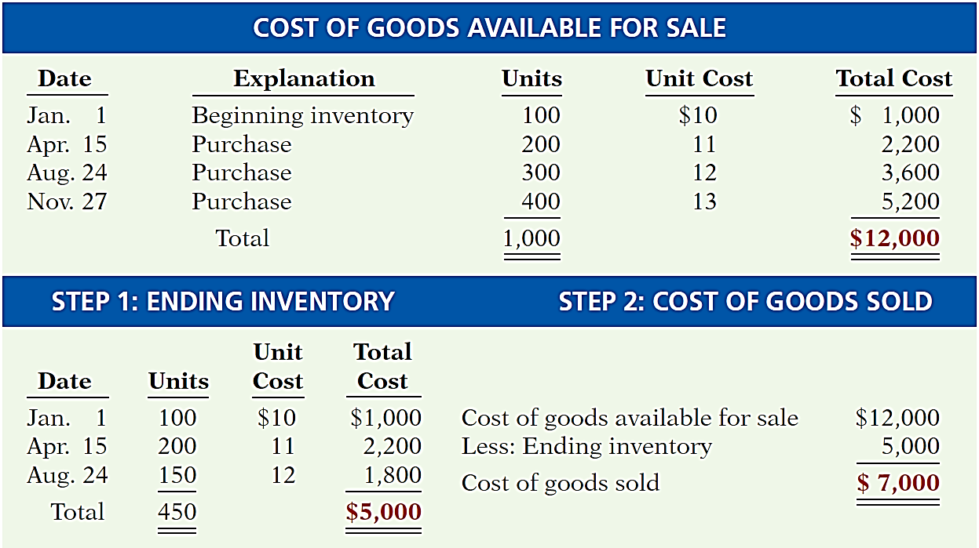
LAST-IN, FIRST-OUT (LIFO)
Illustration 6-8
LO 2

Slide 24
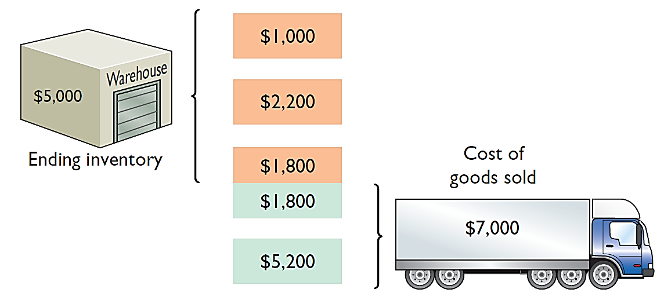
LAST-IN, FIRST-OUT (LIFO)
Illustration 6-8
Helpful Hint Another way of
thinking about the calculation
of LIFO ending inventory is the
FISH assumption—first in still here.
LO 2

Slide 25
Cost Flow Assumptions
AVERAGE-COST
  Allocates cost of goods available for sale on the basis of weighted-average unit cost incurred.
  Applies weighted-average unit cost to the units on hand to determine cost of the ending inventory.
LO 2

Slide 26
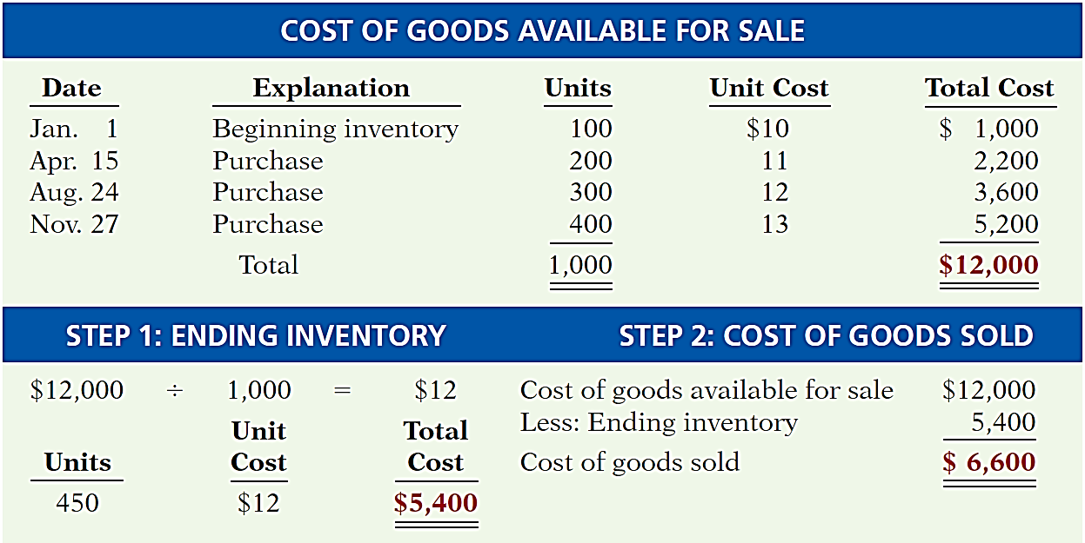
AVERAGE-COST
Illustration 6-11
LO 2

Slide 27
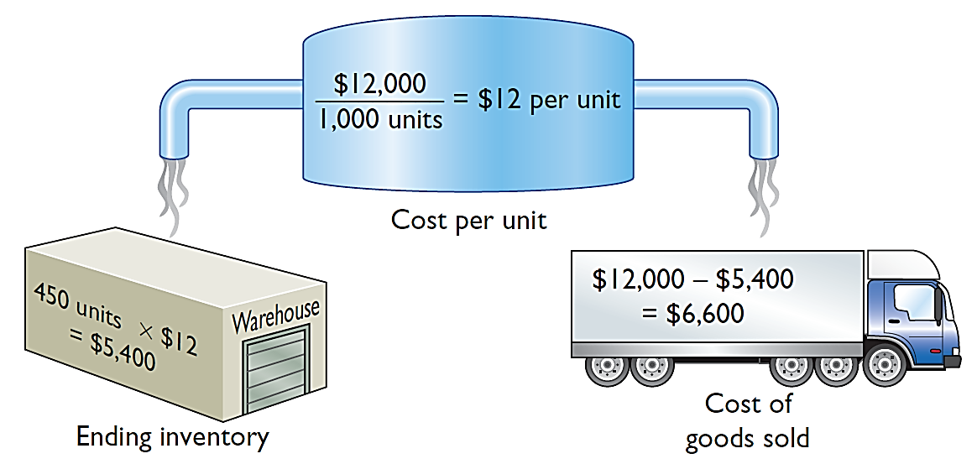
AVERAGE-COST
Illustration 6-11
LO 2

Slide 28
Inventory Costing
Financial Statement and Tax Effects of Cost Flow Methods
  Each of the three cost flow methods is acceptable for use.
  Reebok International Ltd. and Wendy’s International currently use the FIFO method.
  Campbell Soup Company, Krogers, and Walgreen Drugs use LIFO for part or all of their inventory.
  Bristol-Myers Squibb, Starbucks, and Motorola use the average-cost method.
  Stanley Black & Decker Manufacturing Company uses LIFO for domestic inventories and FIFO for foreign inventories.
LO 2

Slide 29
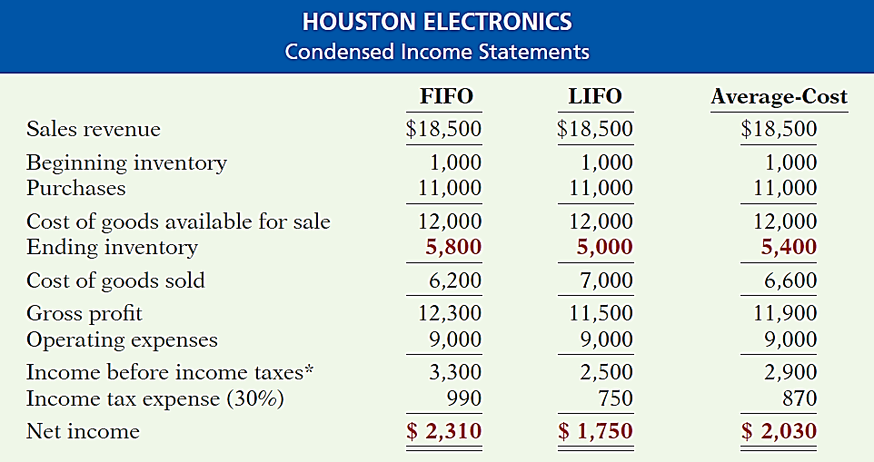

Financial Statement and Tax Effects
INCOME STATEMENT EFFECTS
Illustration 6-13
Comparative effects of cost flow methods
LO 2

Slide 30
Financial Statement and Tax Effects
BALANCE SHEET EFFECTS
  A major advantage of the FIFO method is that in a period of inflation, the costs allocated to ending inventory will approximate their current cost.
  A major shortcoming of the LIFO method is that in a period of inflation, the costs allocated to ending inventory may be significantly understated in terms of current cost.
LO 2

Slide 31
Financial Statement and Tax Effects
TAX EFFECTS
  Both inventory and net income are higher when companies use FIFO in a period of inflation.
  LIFO results in the lowest income taxes (because of lower net income) during times of rising prices.
Helpful Hint
A tax rule, often referred to as the LIFO conformity rule, requires that if companies use LIFO for tax
purposes they must also use
it for financial reporting purposes.
LO 2

Slide 32
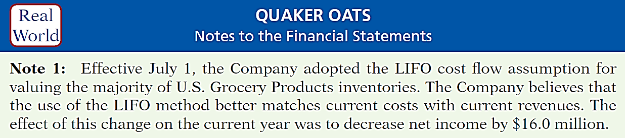
Inventory Costing
Using Cost Flow Methods Consistently
  Method should be used consistently, enhances comparability.
  Although consistency is preferred, a company may change its inventory costing method.
Illustration 6-14
Disclosure of change in cost flow method
LO 2

Slide 33
Cost Flow Assumptions
Question
The cost flow method that often parallels the actual physical flow of merchandise is the:
  FIFO method.
  LIFO method.
  average cost method.
  gross profit method.
LO 2
Notes:
Answer = A

Slide 34
Cost Flow Assumptions
Question
In a period of inflation, the cost flow method that results in the lowest income taxes is the:
  FIFO method.
  LIFO method.
  average cost method.
  gross profit method.
LO 2
Notes:
Answer = B

Slide 35
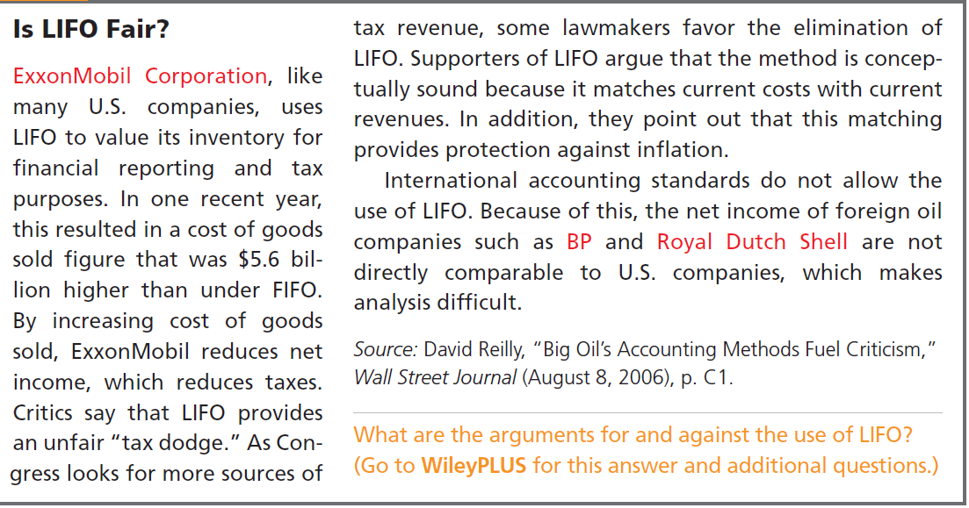
LO 2

Slide 36
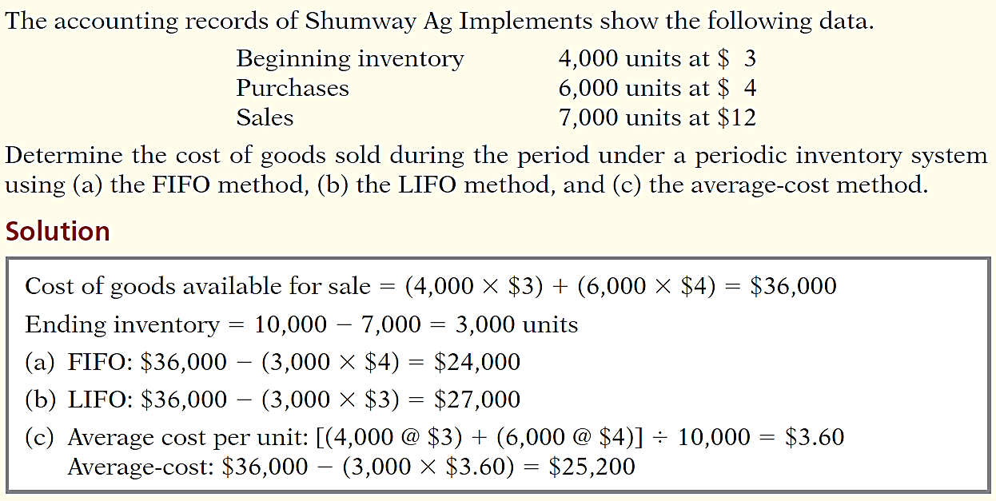
DO IT!
2
Cost Flow Methods
LO 2

Slide 37
LEARNING
OBJECTIVE
Indicate the effects of inventory errors on the financial statements.
3
Common Cause:
  Failure to count or price inventory correctly.
  Not properly recognizing the transfer of legal title to goods in transit.
  Errors affect both the income statement and balance sheet.
LO 3

Slide 38
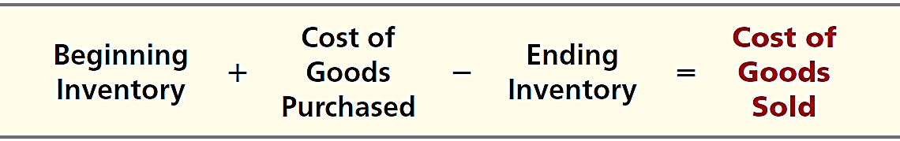
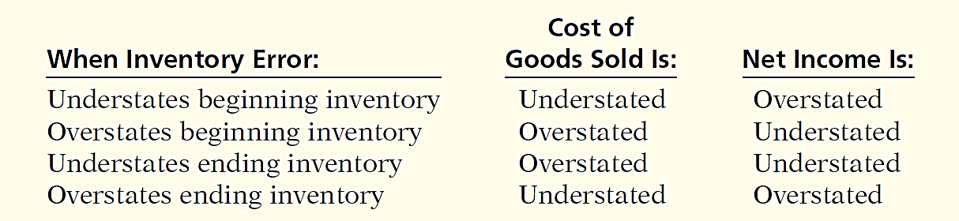
Income Statement Effects
Inventory errors affect the computation of cost of goods sold and net income in two periods.
Illustration 6-15
Illustration 6-16
LO 3

Slide 39
Income Statement Effects
Inventory errors affect the computation of cost of goods sold and net income in two periods.
  An error in ending inventory of the current period will have a reverse effect on net income of the next accounting period.
  Over the two years, the total net income is correct because the errors offset each other.
  Ending inventory depends entirely on the accuracy of taking and costing the inventory.
LO 3

Slide 40
Income Statement Effects
Illustration 6-17
Effects of inventory errors on
two years’ income statements
Combined income for 2-year period is correct.
($3,000)
Net Income understated
$3,000
Net Income overstated
LO 3

Slide 41
Income Statement Effects
Question
Understating ending inventory will overstate:
  assets.
  cost of goods sold.
  net income.
  stockholders’ equity
LO 3

Slide 42
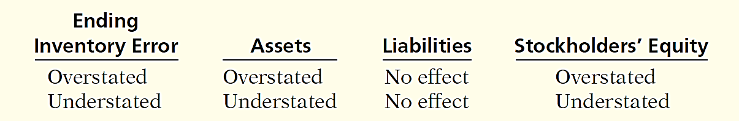
Balance Sheet Effects
Effect of inventory errors on the balance sheet is determined by using the basic accounting equation: Assets = Liabilities + Stockholders’ Equity.
Errors in the ending inventory have the following effects.
Illustration 6-18
Effects of ending inventory
errors on balance sheet
LO 3

Slide 43
DO IT!
3
Inventory Errors
Visual Company overstated its 2016 ending inventory by $22,000. Determine the impact this error has on ending inventory, cost of goods sold, and stockholders’ equity in 2016 and 2017.
Solution
2016
2017
Ending inventory
Cost of goods sold
Stockholders’ equity
Ending inventory $22,000 overstated No effect
Cost of goods sold $22,000 understated $22,000 overstated
Stockholders’ equity $22,000 overstated No effect
LO 3

Slide 44
LEARNING
OBJECTIVE
Explain the statement presentation and analysis of inventory.
4
Presentation
Balance Sheet - Inventory classified as current asset.
Income Statement - Cost of goods sold is subtracted from sales.
There also should be disclosure of the
  major inventory classifications,
  basis of accounting (cost or LCM), and
  costing method (FIFO, LIFO, or average-cost).
LO 4

Slide 45
Lower-of-Cost-or-Net Realizable Value
When the value of inventory is lower than its cost
  Companies must “write down” the inventory to its net realizable value.
  Net realizable value: Amount that a company expects to realize (receive from the sale of inventory).
  Example of conservatism.
LO 4

Slide 46
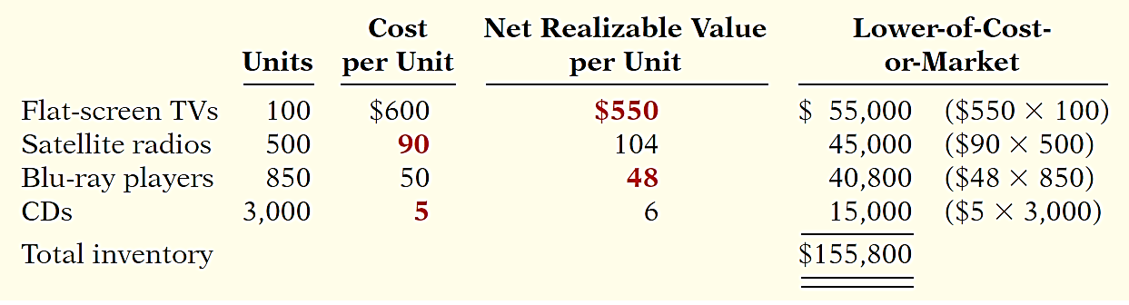
Lower-of-Cost-or-Net Realizable Value
Illustration: Assume that Ken Tuckie TV has the following lines of merchandise with costs and market values as indicated.
Illustration 6-20
Computation of lower-of-cost-or-net realizable value
LO 4

Slide 47
Statement Presentation and Analysis
Analysis
Inventory management is a double-edged sword
  High Inventory Levels - may incur high carrying costs (e.g., investment, storage, insurance, obsolescence, and damage).
  Low Inventory Levels – may lead to stock-outs and lost sales.
LO 4

Slide 48
Analysis
Inventory turnover measures the number of times on average the inventory is sold during the period.
Cost of Goods Sold
Inventory Turnover
=
Average Inventory
Days in inventory measures the average number of days inventory is held.
Days in Year (365)
Days in Inventory
=
Inventory Turnover
LO 4

Slide 49
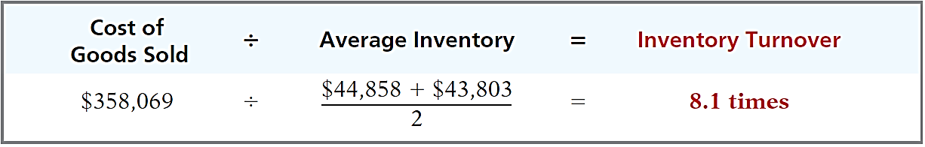
Analysis
Illustration: Wal-Mart reported in its 2014 annual report a beginning inventory of $43,803 million, an ending inventory of $44,858 million, and cost of goods sold for the year ended January 31, 2014, of $358,069 million. The inventory turnover formula and computation for Wal-Mart are shown below.
Illustration 6-21
Days in Inventory: Inventory turnover of 8.1 times divided into 365 is approximately 45.1 days. This is the approximate time that it takes a company to sell the inventory.
LO 4

Slide 50
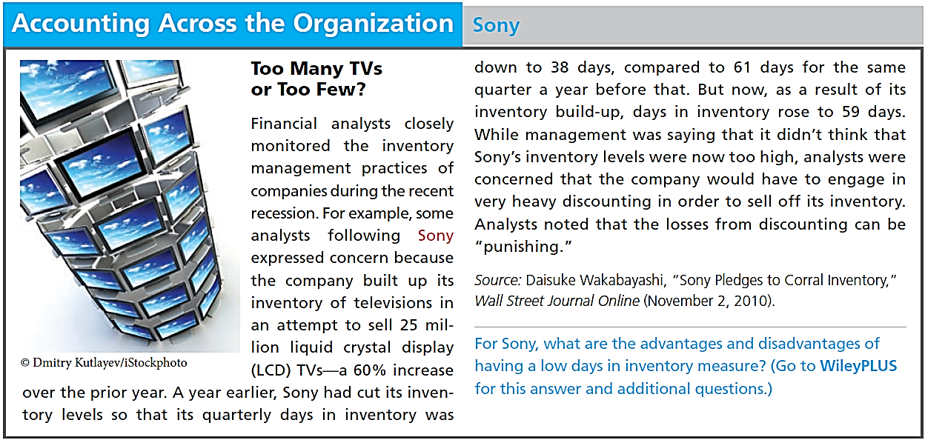
LO 4

Slide 51
DO IT!
4
LCNRV and Inventory Turnover
Tracy Company sells three different types of home heating stoves (gas, wood, and pellet). The cost and net realizable value of its inventory of stoves are as follows.
Cost Net Realizable Value
Gas $ 84,000 $ 79,000
Wood 250,000 280,000
Pellet 112,000 101,000
Determine the value of the company’s inventory under the lower-of-cost-or-net realizable value approach.
Solution
Lowest value for each inventory type is gas $79,000, wood $250,000, and pellet $101,000. The total inventory value is the sum of these amounts, $430,000.
LO 4

Slide 52
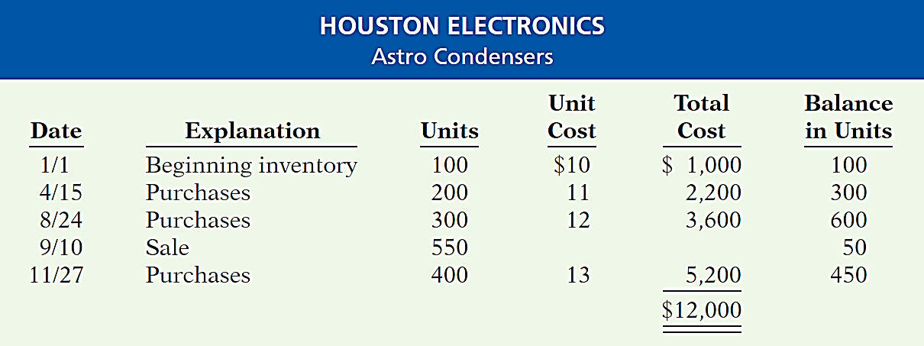
LEARNING
OBJECTIVE
APPENDIX 6A: Apply the inventory cost flow methods to perpetual inventory records.
5
Illustration
Illustration 6A-1
Inventoriable units and costs
Assuming the Perpetual Inventory System, compute Cost of Goods Sold and Ending Inventory under FIFO, LIFO, and average-cost.
LO 5

Slide 53
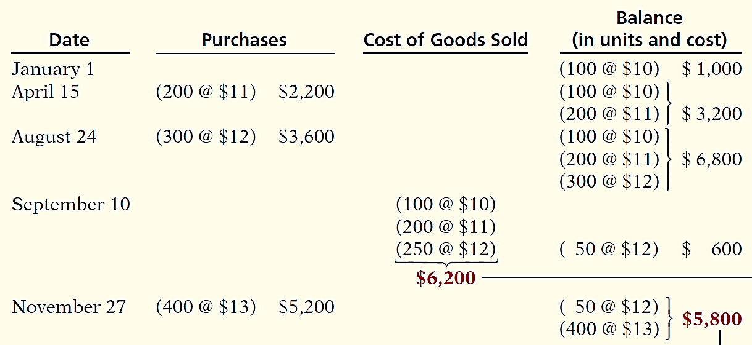

First-In, First-Out (FIFO)
Perpetual Inventory System
Illustration 6A-2
Cost of Goods Sold
Ending Inventory
LO 5

Slide 54
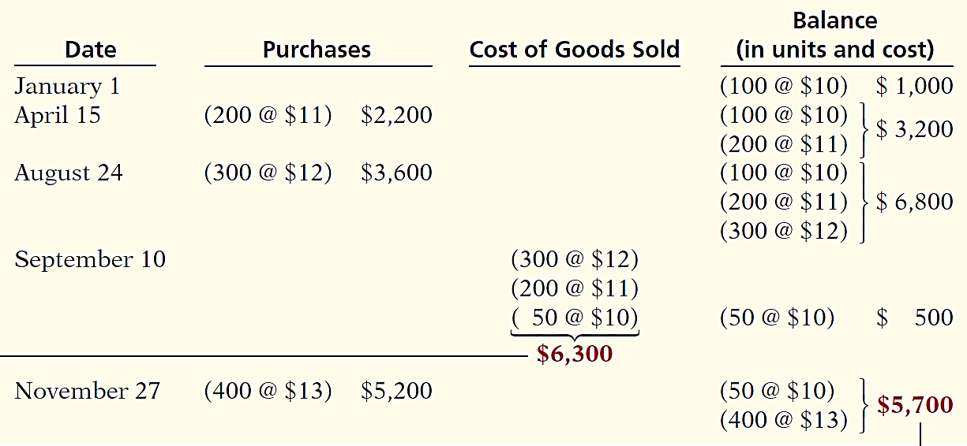
Last-In, First-Out (LIFO)
Perpetual Inventory System
Illustration 6A-3
Cost of Goods Sold
Ending Inventory
LO 5

Slide 55
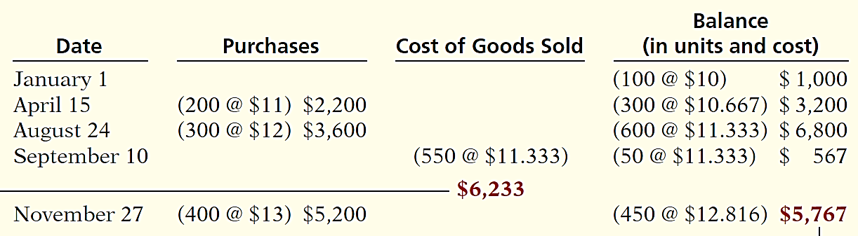
Average-Cost
Moving Average Method
Illustration 6A-4
Cost of Goods Sold
Ending Inventory
LO 5

Slide 56
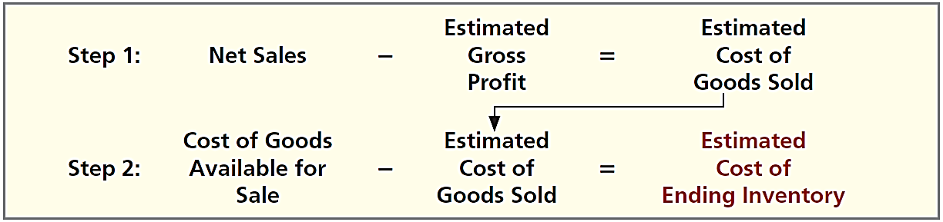
LEARNING
OBJECTIVE
APPENDIX 6B: Describe the two methods of estimating inventories.
6
Gross Profit Method
A method of estimating the cost of ending inventory by applying a gross profit rate to net sales.
A company needs to know its net sales, cost of goods available for sale, and gross profit rate.
Illustration 6B-1
Gross profit method formulas
LO 6

Slide 57
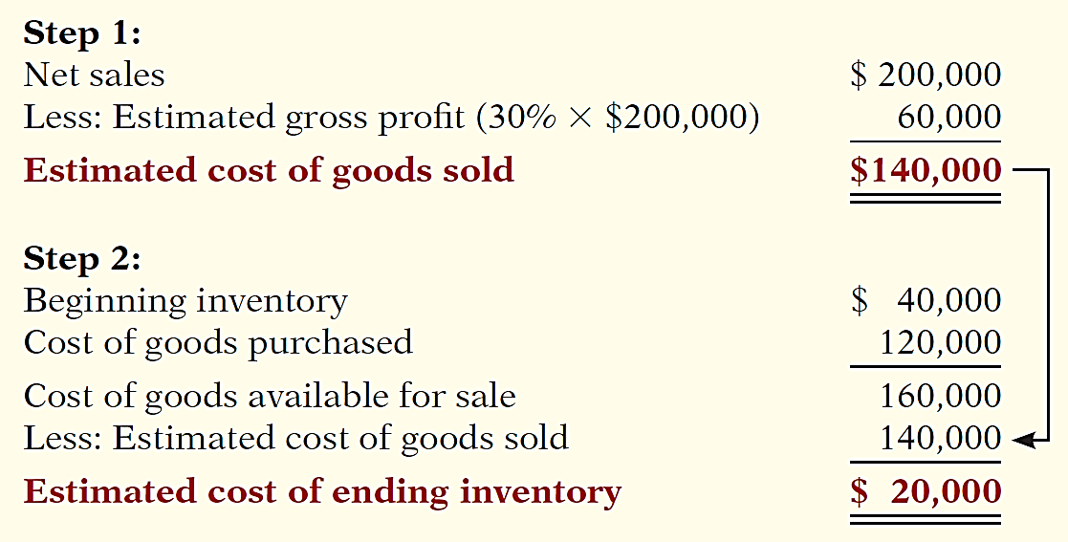
Gross Profit Method
Illustration: Kishwaukee Company records show net sales of $200,000, beginning inventory $40,000, and cost of goods purchased $120,000. In the preceding year, the company realized a 30% gross profit rate. It expects to earn the same rate this year. Compute the estimated cost of the ending inventory at January 31 under the gross profit method.
Illustration 6B-1
Illustration 6B-2
Example of gross profit method

Slide 58
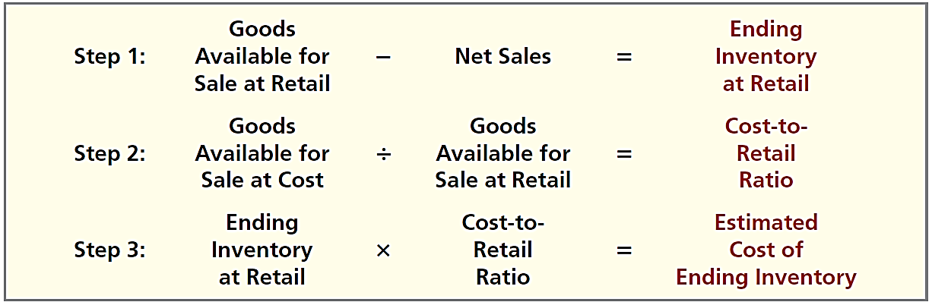
Retail Inventory Method
  Retail companies establish a relationship between cost and sales price.
  Company applies cost-to-retail percentage to ending inventory at retail prices to determine inventory at cost.
Illustration 6B-3
Retail inventory method formulas
LO 6

Slide 59
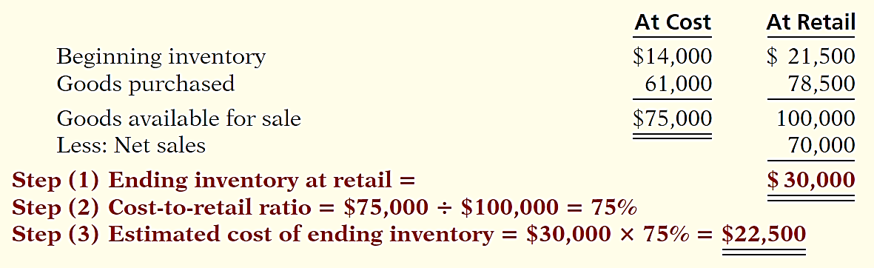
Retail Inventory Method
Illustration: It is not necessary to take a physical inventory to determine the estimated cost of goods on hand at any given time.
Illustration 6B-4
The major disadvantage of the retail method is that it is an averaging technique. It may produce an incorrect inventory valuation if the mix of the ending inventory is not representative of the mix in the goods available for sale.
LO 6

Slide 60

A Look at IFRS
LEARNING
OBJECTIVE
Compare the accounting for inventories under GAAP and IFRS.
7
Relevant Facts
  Similarities
  IFRS and GAAP account for inventory acquisitions at historical cost and value inventory at the lower-of-cost-or-net-realizable value subsequent to acquisition.
  Who owns the goods—goods in transit or consigned goods—as well as the costs to include in inventory are essentially accounted for the same under IFRS and GAAP.
LO 7

Slide 61
A Look at IFRS
Relevant Facts
  Differences
  The requirements for accounting for and reporting inventories are more principles-based under IFRS. That is, GAAP provides more detailed guidelines in inventory accounting.
  A major difference between IFRS and GAAP relates to the LIFO cost flow assumption. GAAP permits the use of LIFO for inventory valuation. IFRS prohibits its use. FIFO and average-cost are the only two acceptable cost flow assumptions permitted under IFRS. Both sets of standards permit specific identification where appropriate.
LO 7

Slide 62
A Look at IFRS
Looking to the Future
One convergence issue that will be difficult to resolve relates to the use of the LIFO cost flow assumption. As indicated, IFRS specifically prohibits its use. Conversely, the LIFO cost flow assumption is widely used in the United States because of its favorable tax advantages. In addition, many argue that LIFO from a financial reporting point of view provides a better matching of current costs against revenue and, therefore, enables companies to compute a more realistic income.
LO 7

Slide 63
A Look at IFRS
IFRS Self-Test Questions
Which of the following should not be included in the inventory of a company using IFRS?
  Goods held on consignment from another company.
  Goods shipped on consignment to another company.
  Goods in transit from another company shipped FOB shipping point.
  None of the above.
LO 7

Slide 64
A Look at IFRS
IFRS Self-Test Questions
Which method of inventory costing is prohibited under IFRS?
  Specific identification.
  FIFO.
  LIFO.
  Average-cost.
LO 7

Slide 65
Copyright
“Copyright © 2015 John Wiley & Sons, Inc. All rights reserved. Reproduction or translation of this work beyond that permitted in Section 117 of the 1976 United States Copyright Act without the express written permission of the copyright owner is unlawful. Request for further information should be addressed to the Permissions Department, John Wiley & Sons, Inc. The purchaser may make back-up copies for his/her own use only and not for distribution or resale. The Publisher assumes no responsibility for errors, omissions, or damages, caused by the use of these programs or from the use of the information contained herein.”

