Slide 1
Chapter 2 Elementary Programming

Slide 2
Trace a Program Execution
animation
public class ComputeArea {
/** Main method */
public static void main(String[] args) {
double radius;
double area;
// Assign a radius
radius = 20;
// Compute area
area = radius * radius * 3.14159;
// Display results
System.out.println("The area for the circle of radius " +
radius + " is " + area);
}
}
memory
radius
20
area
1256.636
print a message to the console

Slide 3
Reading Input from the Console
1. Create a Scanner object
Scanner input = new Scanner(System.in);
2. Use the method nextDouble() to obtain to a double value. For example,
System.out.print("Enter a double value: ");
Scanner input = new Scanner(System.in);
double d = input.nextDouble();
ComputeAreaWithConsoleInput
Run
ComputeAverage
Run

Slide 4
Identifiers
An identifier is a sequence of characters that consist of letters, digits, underscores (_), and dollar signs ($).
An identifier must start with a letter, an underscore (_), or a dollar sign ($). It cannot start with a digit.
An identifier cannot be a reserved word. (See Appendix A, “Java Keywords,” for a list of reserved words).
An identifier cannot be true, false, or null.
An identifier can be of any length.

Slide 5
Variables
int x; // Declare x to be an
// integer variable;
double radius; // Declare radius to
// be a double variable;
char a; // Declare a to be a
// character variable;
x = 1; // Assign 1 to x;
radius = 1.0; // Assign 1.0 to radius;
a = 'A'; // Assign 'A' to a;

Slide 6
Declaring and Initializing in One Step
int x = 1;
double d = 1.4;
Named Constants
final datatype CONSTANTNAME = VALUE;
final double PI = 3.14159;
final int SIZE = 3;

Slide 7
Naming Conventions
Choose meaningful and descriptive names.
Variables and method names:
Use lowercase.
If the name consists of several words, concatenate all in one, use lowercase for the first word, and capitalize the first letter of each subsequent word in the name.
For example, the variables radius and area, and the method computeArea.

Slide 8
Naming Conventions, cont.
Class names:
Capitalize the first letter of each word in the name. For example, the class name ComputeArea.
Constants:
Capitalize all letters in constants, and use underscores to connect words. For example, the constant PI and MAX_VALUE

Slide 9
Character Data Type
char letter = 'A'; (ASCII)
char numChar = '4'; (ASCII)
char letter = '\u0041'; (Unicode)
char numChar = '\u0034'; (Unicode)
NOTE: The increment and decrement operators can also be used on char variables to get the next or preceding Unicode character. For example, the following statements display character b.
char ch = 'a';
System.out.println(++ch);

Slide 10
Numerical Data Types

Slide 11
Reading Numbers from the Keyboard
Scanner input = new Scanner(System.in);
int value = input.nextInt();

Slide 12
Strings
The char type only represents one character. To represent a string of characters, use the data type called String. For example:
String message = "Welcome to Java!";
String is actually a predefined class in the Java library.
The String type is not a primitive type. It is known as a reference type.

Slide 13
More on Strings
// Three strings are concatenated
String message = "Welcome " + "to " + "Java";
// String Chapter is concatenated with number 2
String s = "Chapter" + 2; // s becomes Chapter2
You can use the Scanner class for console input.
Java uses System.in to refer to the standard input device (i.e. Keyboard).
public class Test{
public static void main(String[] s){
Scanner input = new Scanner(System.in);
System.out.println(“Enter text : ”);
int x = input.nextLine();
System.out.println(“You entered: ”+ x);
}
}

Slide 14
Integer Division
+, -, *, /, and %
5 / 2 yields an integer 2.
5.0 / 2 yields a double value 2.5
5 % 2 yields 1 (the remainder of the division)

Slide 15
Remainder Operator
Remainder is very useful in programming. For example, an even number % 2 is always 0 and an odd number % 2 is always 1. So you can use this property to determine whether a number is even or odd. Suppose today is Saturday and you and your friends are going to meet in 10 days. What day is in 10 days? You can find that day is Tuesday using the following expression:

Slide 16
NOTE
Calculations involving floating-point numbers are approximated because these numbers are not stored with complete accuracy. For example,
System.out.println(1.0 - 0.1 - 0.1 - 0.1 - 0.1 - 0.1);
displays 0.5000000000000001, not 0.5, and
System.out.println(1.0 - 0.9);
displays 0.09999999999999998, not 0.1. Integers are stored precisely. Therefore, calculations with integers yield a precise integer result.

Slide 17
Exponent Operations
System.out.println(Math.pow(2, 3));
// Displays 8.0
System.out.println(Math.pow(4, 0.5));
// Displays 2.0
System.out.println(Math.pow(2.5, 2));
// Displays 6.25
System.out.println(Math.pow(2.5, -2));
// Displays 0.16

Slide 18
Integer Literals
An integer literal can be assigned to an integer variable as long as it can fit into the variable. A compilation error would occur if the literal were too large for the variable to hold. For example, the statement byte b = 1000 would cause a compilation error, because 1000 cannot be stored in a variable of the byte type.
An integer literal is assumed to be of the int type, whose value is between -2³¹ (-2147483648) to 2³¹–1 (2147483647). To denote an integer literal of the long type, append it with the letter L or l. L is preferred because l (lowercase L) can easily be confused with 1 (the digit one).

Slide 19
Floating-Point Literals
Floating-point literals are written with a decimal point. By default, a floating-point literal is treated as a double type value. For example, 5.0 is considered a double value, not a float value. You can make a number a float by appending the letter f or F, and make a number a double by appending the letter d or D. For example, you can use 100.2f or 100.2F for a float number, and 100.2d or 100.2D for a double number.

Slide 20
double vs. float
The double type values are more accurate than the float type values. For example,
System.out.println("1.0 / 3.0 is " + 1.0 / 3.0);
System.out.println("1.0F / 3.0F is " + 1.0F / 3.0F);

Slide 21
Arithmetic Expressions
is translated to
(3+4*x)/5 – 10*(y-5)*(a+b+c)/x + 9*(4/x + (9+x)/y)

Slide 22
How to Evaluate an Expression
Though Java has its own way to evaluate an expression behind the scene, the result of a Java expression and its corresponding arithmetic expression are the same. Therefore, you can safely apply the arithmetic rule for evaluating a Java expression.

Slide 23
Problem: Converting Temperatures
Write a program that converts a Fahrenheit degree to Celsius using the formula:
Note: you have to write
celsius = (5.0 / 9) * (fahrenheit – 32)
FahrenheitToCelsius
Run

Slide 24
public class FahrenheitToCelsius {
public static void main(String[] args) {
Scanner input = new Scanner(System.in);
System.out.print("Enter a degree in Fahrenheit: ");
double fahrenheit = input.nextDouble();
// Convert Fahrenheit to Celsius
double celsius = (5.0 / 9) * (fahrenheit - 32);
System.out.println("Fahrenheit " + fahrenheit + " is " +
celsius + " in Celsius");
}
}

Slide 25
Problem: Displaying Current Time
Write a program that displays current time in GMT in the format hour:minute:second such as 1:45:19.
The currentTimeMillis method in the System class returns the current time in milliseconds since the midnight, January 1, 1970 GMT. (1970 was the year when the Unix operating system was formally introduced.) You can use this method to obtain the current time, and then compute the current second, minute, and hour as follows.
ShowCurrentTime
Run

Slide 26
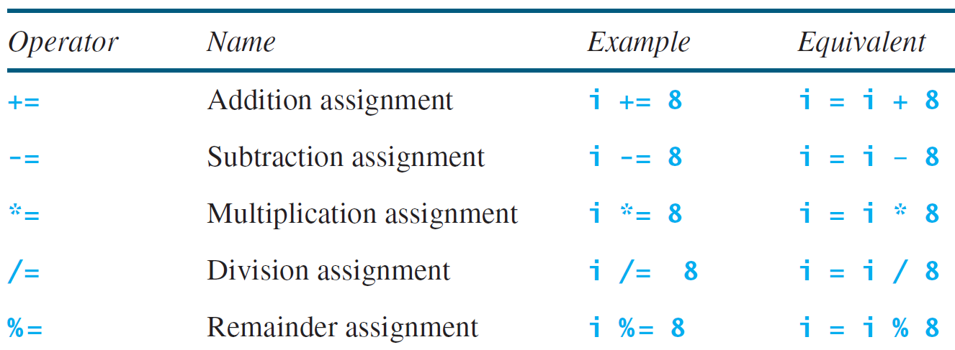
Augmented Assignment Operators

Slide 27
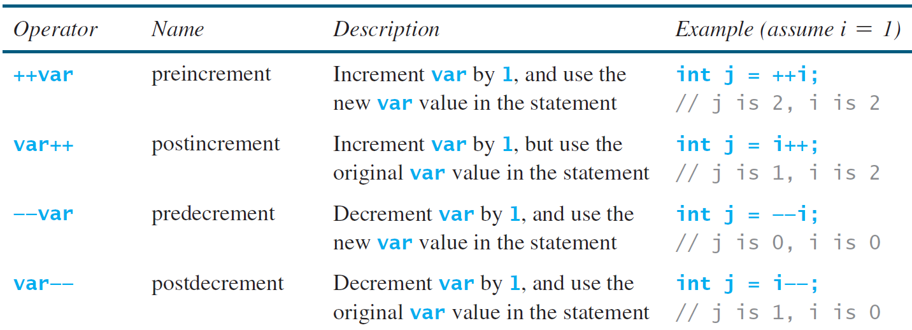
Increment and Decrement Operators

Slide 28
Increment and Decrement Operators, cont.

Slide 29
Increment and Decrement Operators, cont.
Using increment and decrement operators makes expressions short, but it also makes them complex and difficult to read. Avoid using these operators in expressions that modify multiple variables, or the same variable for multiple times such as this: int k = ++i + i.

Slide 30
Assignment Expressions and Assignment Statements
Prior to Java 2, all the expressions can be used as statements. Since Java 2, only the following types of expressions can be statements:
variable op= expression; // Where op is +, -, *, /, or %
++variable;
variable++;
--variable;
variable--;

Slide 31
Numeric Type Conversion
Consider the following statements:
byte i = 100;
long k = i * 3 + 4;
double d = i * 3.1 + k / 2;

Slide 32
Conversion Rules
When performing a binary operation involving two operands of different types, Java automatically converts the operand based on the following rules:
1. If one of the operands is double, the other is converted into double.
2. Otherwise, if one of the operands is float, the other is converted into float.
3. Otherwise, if one of the operands is long, the other is converted into long.
4. Otherwise, both operands are converted into int.

Slide 33
Type Casting
Implicit casting
double d = 3; (type widening)
Explicit casting
int i = (int)3.0; (type narrowing)
int i = (int)3.9; (Fraction part is truncated)
What is wrong? int x = 5 / 2.0;

Slide 34
Problem: Keeping Two Digits After Decimal Points
Write a program that displays the sales tax with two digits after the decimal point.
public class SalesTax {
public static void main(String[] args) {
Scanner input = new Scanner(System.in);
System.out.print("Enter purchase amount: ");
double purchaseAmount = input.nextDouble(); double tax = purchaseAmount * 0.06; System.out.println("Sales tax is " + (int)(tax * 100) / 100.0);
}
}
SalesTax
Run

Slide 35
Casting in an Augmented Expression
In Java, an augmented expression of the form x1 op= x2 is implemented as x1 = (T)(x1 op x2), where T is the type for x1. Therefore, the following code is correct.
int sum = 0;
sum += 4.5; // sum becomes 4 after this statement
sum += 4.5 is equivalent to sum = (int)(sum + 4.5).

Slide 36
Problem: Computing Loan Payments
This program lets the user enter the interest rate, number of years, and loan amount, and computes monthly payment and total payment.
ComputeLoan
Run

Slide 37
public class ComputeLoan {
public static void main(String[] args) {
Scanner input = new Scanner(System.in);
System.out.print("Enter yearly interest rate, for example 8.25: ");
double annualInterestRate = input.nextDouble();
double monthlyInterestRate = annualInterestRate / 1200;
System.out.print( "Enter number of years as an integer, for example 5: ");
int numberOfYears = input.nextInt();
System.out.print("Enter loan amount, for example 120000.95: ");
double loanAmount = input.nextDouble();
double monthlyPayment = loanAmount * monthlyInterestRate / (1
- 1 / Math.pow(1 + monthlyInterestRate, numberOfYears * 12));
double totalPayment = monthlyPayment * numberOfYears * 12;
System.out.println("The monthly payment is $" +
(int)(monthlyPayment * 100) / 100.0);
System.out.println("The total payment is $" +
(int)(totalPayment * 100) / 100.0);
}
}

Slide 38
Common Errors and Pitfalls
Common Error 1: Undeclared/Uninitialized Variables and Unused Variables
Common Error 2: Integer Overflow
Common Error 3: Round-off Errors
Common Error 4: Unintended Integer Division
Common Error 5: Redundant Input Objects
Common Pitfall 1: Redundant Input Objects

Slide 39
Common Error 1: Undeclared/Uninitialized Variables and Unused Variables
double interestRate = 0.05;
double interest = interestrate * 45;

Slide 40
Common Error 2: Integer Overflow
int value = 2147483647 + 1;
// value will actually be -2147483648

Slide 41
Common Error 3: Round-off Errors
System.out.println(1.0 - 0.1 - 0.1 - 0.1 - 0.1 - 0.1);
System.out.println(1.0 - 0.9);

Slide 42
Common Error 4: Unintended Integer Division

Slide 43
Common Pitfall 1: Redundant Input Objects
Scanner input = new Scanner(System.in);
System.out.print("Enter an integer: ");
int v1 = input.nextInt();
Scanner input1 = new Scanner(System.in);
System.out.print("Enter a double value: ");
double v2 = input1.nextDouble();

