Slide 1
Protein

Slide 2
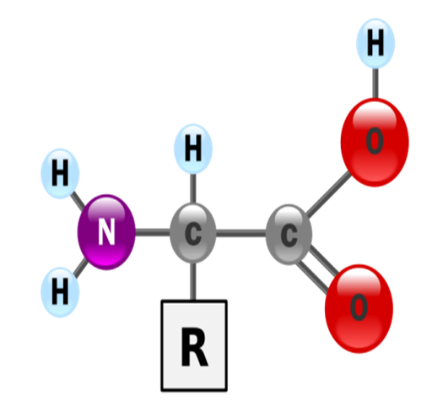
Introduction
Protein is a vital structural and working substance in all cells—not just muscle cells
Following water, protein is the next most abundant chemical compound in the body
Proteins contain Nitrogen (N) atoms
  And carbon (C), hydrogen (H), and oxygen (O) ( Like CHO AND LIPIDS)
Nitrogen atoms give the name amino (nitrogen containing) to the amino acids

Slide 3
Proteins taken in the diet are broken down into amino acids in the processes of digestion and absorption
Absorbed amino acids contribute to the amino acid pool of the body, from which all proteins are synthesized
On average, the rates of protein synthesis = rate of protein degradation in adults
Allowing the amount of protein in the body remains more or less maintaining nitrogen balance

Slide 4
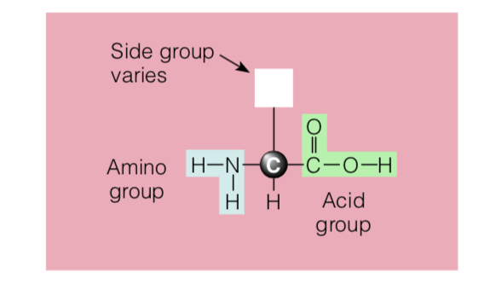
Amino acids
All amino acids have the same basic structure—a central carbon (C) atom with a hydrogen atom (H), an amino group (NH2), and an acid group (COOH) attached to it.
The fourth site distinguishes each amino acid
Attached to the central carbon at the fourth bond is a distinct atom, or group of atoms, known as the side group or side chain

Slide 5
Because the R group can vary-→ we have a variety of amino acids
20 different amino acids, each with a different side group.
Amino Acids differ in size, shape, electrical charge, and other characteristics because of differences in these side groups

Slide 6
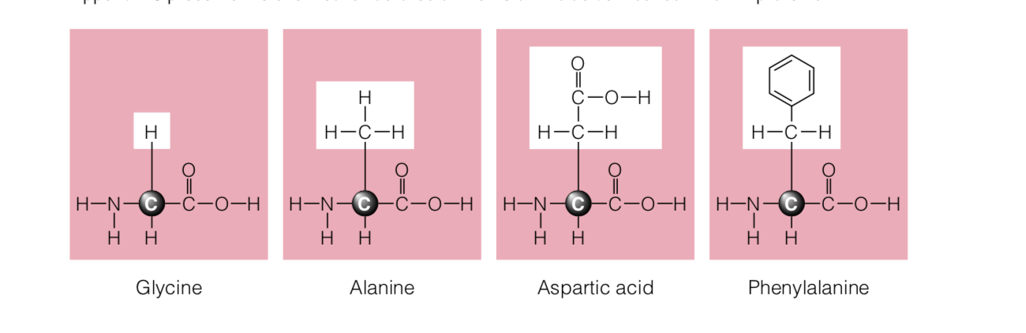
Simplest Amino Acid
Hydrogen atom as the R group

Slide 7
Essential Amino acids
There are 9 essential amino acids that the body has no metabolic pathway to synthesize, the are essential and must be present in the diet

Slide 8
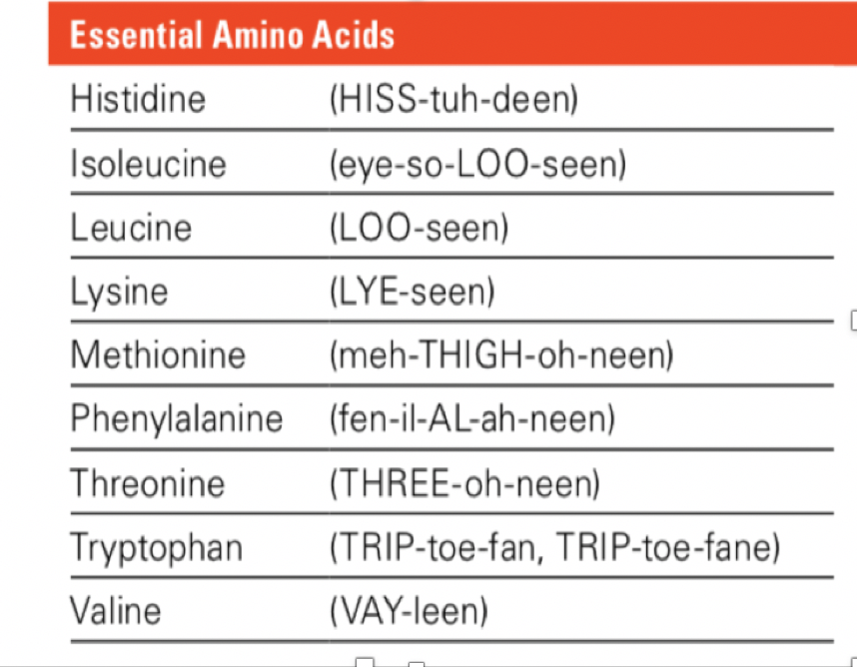
essential amino acids

Slide 9
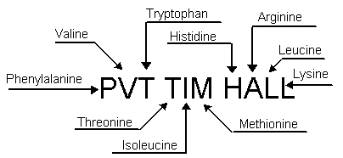
http://aris.gusc.lv/NutritionBioChem/38Olbalt10311Eng.html

Slide 10
NON ESSENTIAL AMINO ACIDS
Can be synthesized by the body from other amino acids or from other precursors. We can obtain them from other metabolic ways besides diet

Slide 11
Conditionally essential
May in principle be synthesized from the essential amino acids;
in nutritional terms, they may be needed in the diet under some circumstances!
metabolic need is great and endogenous synthesis is not adequate.
Arginine essential for children for growth. Not essential for adults
Tyrosine and cysteine can both be synthesized, but from other essential amino acids (phenylalanine and methionine, respectively).

Slide 12
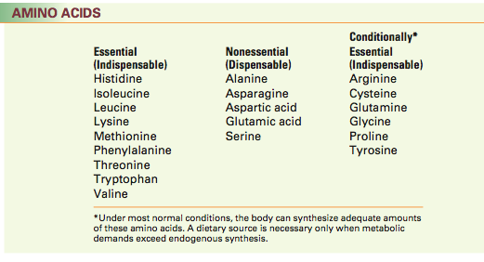

Slide 13
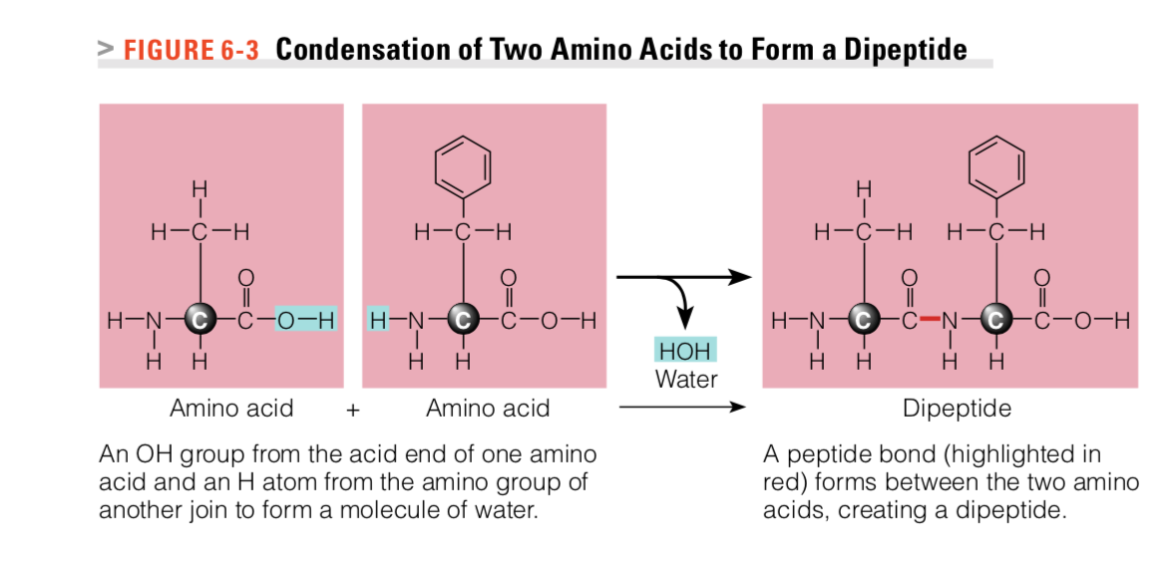
proteins
Proteins are amino acids linked together by peptide bonds
Condensation reactions connect amino acids
R GROUP
R GROUP

Slide 14
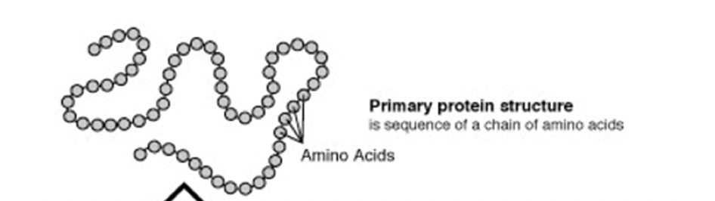
PROTEIN STRUCTURE
A protein’s shape/structure determines its function
Primary Structure—amino acid Sequence
  A linear chain
  The sequence of amino acids in a polypeptide chain

Slide 15
PROTEIN STRUCTURE
2. Secondary Structure
folded structures that form within a polypeptide due to interactions between atoms of the backbone
3. Tertiary Structure 3-D folding that results from interaction between the R groups of amino acid in a polypeptide chain
Interaction include: hydrogen bonding, ionic bonding, hydrophobic interactions and London dispersion forces between the different R groups
4. Quaternary structure of proteins involves the interactions between two or more polypeptides.
Proteins that are made up of multiple polypeptide chains. When these subunits come together, they give the protein its quaternary structure

Slide 16
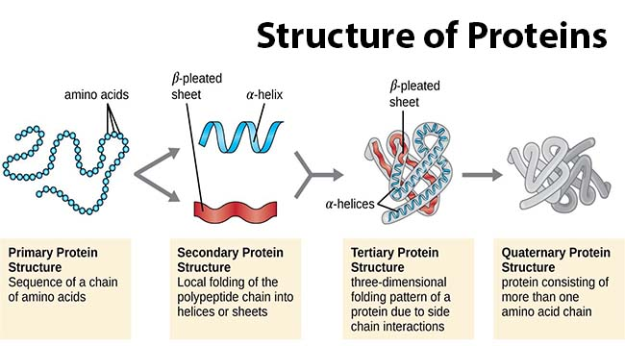

Slide 17
Functions
  Proteins have many function such as
  Body structure : proteins form muscle, skin, some proteins are in blood, are part of membranes, bones etc.
  Enzymes
  Neurotransmitters
  Hormones
  Transport molecules
  Fluid balance

Slide 18
Digestion and absorption of Proteins
Proteins taken in the diet are broken down to the constituent amino acids by digestion
The body then uses these Amino acids to build body proteins such as enzymes, hormones etc..
ALSO Protein provide 4 cal/g
The body does NOT like to use protein for energy
Proteins are only used as energy source in times of starvation. If diet is sufficient, protein stores (muscles) are not broken down to provide energy

Slide 19
Digestion and absorption of Proteins

Slide 20
STOMACH
Partial breakdown (hydrolysis) of proteins
The stomach secretes Hydrochloric acid
HCL has 2 important roles
HCL uncoils (denatures) protein AND EXPOSES proteins for attack by digestive enzymes
  Digestive enzymes break peptide bond between AA
2. Hydrochloric acid converts the inactive form of the enzyme pepsinogen to its active form, pepsin

Slide 21
Small intestines
Pancreatic Proteases break down polypeptides to
  shorter chains
  Tripeptides (3 amino acids chain)
  Dipeptides ( 2 amino acids chain)
  Single amino acids
Next Peptidase Enzymes on the membrane surface of intestinal cells break dipeptides and tripeptides into single amino acids

Slide 22
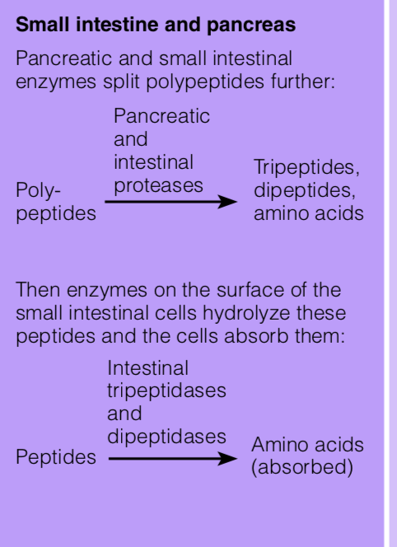
In the small intestine , the enzymes are categorized as either
1. Endopeptidases:
Trypsin and Chymotrypsin break peptide bonds between specific amino acids
cleave peptide bonds in the interior of the polypeptide
2. Exopeptidases
Cleave peptide bonds from the ends of the polypeptide
(aminopeptidase/carboxypeptidase)

Slide 23
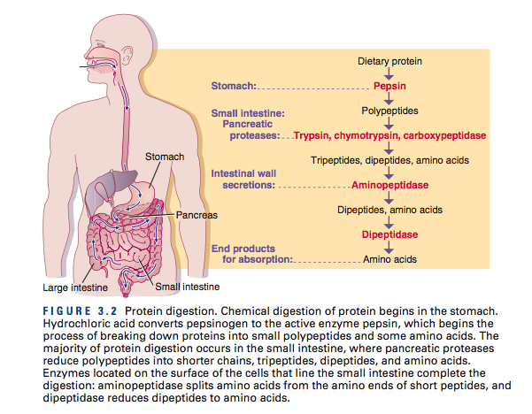
Peptidase Enzymes released by the membrane surfaces of the intestinal cells
Intestinal tripeptidases
Cleave tripeptides to dipeptides and amino acids
Intestinal dipeptidases
Cleave dipeptides to amino acids

Slide 24
Absorption
Amino acids, and sometimes a few dipeptides or larger peptides, are absorbed through the mucosa of the small intestine by active transport with the aid of vitamin B6
Intestinal cells release amino acids into the bloodstream for transport to the liver via the portal vein.

Slide 25

Protein synthesis
The human body has an estimated 20,000 to 25,000 genes that code for hundreds of thousands of proteins
The instructions for making every protein in a person’s body are transmitted by way of the genetic information received at conception
Transforming the information in DNA into the appropriate sequence of amino acids needed to make a specific protein requires two major step

Slide 26
Protein Turnover
Is a continuous process that occurs within each cell as proteins are broken down from normal wear and tear and replenished
Body proteins vary in their rate of turnover
For example: Red blood cells are replaced every 60 to 90 days,
gastrointestinal cells are replaced every 2 to 3 days. and enzymes used in the digestion of food are continuously replenished.

Slide 27
Metabolic Pool
Although protein is not truly stored in the body as are glucose and fat, a supply of each amino acid exists in a metabolic pool of free amino acids within cells and circulating in blood
This pool consists of :
-Recycled amino acids from body proteins that have broken down!
-Amino acids from food.
The pool accepts and donates amino acids as they become available or are needed, it is in a constant state of flux.

Slide 28
Nitrogen Balance.
Reflects the state of balance between protein break- down and protein synthesis!
It is determined by comparing nitrogen intake with nitrogen excretion over a specific period of time, usually 24 hours.
**To calculate nitrogen intake, protein intake is measured (in grams) over a 24-hour period and divided by 6.25
Nitrogen can be lost from the body through a number of routes, but 85–90% is lost in urine and 5–10% in stool, with skin and hair or other losses making up the remainder.

Slide 29
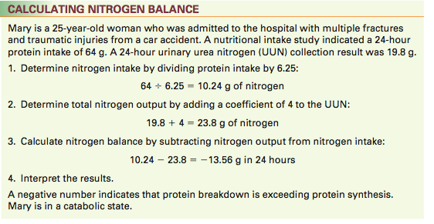
Another equation B = I − (U + F + other) g nitrogen/day
B= nitrogen balance
I=nitrogen intake
U = urinary nitrogen
F = faecal nitrogen

Slide 30
Protein Catabolism for Energy
Using protein for energy is NOT favored because amino acids used for energy are not available to be used for protein synthesis
As long as intake and storage of carbohydrate and fat is adequate, body uses very little amino acids for energy
If insufficient carbohydrate and fat are available for energy use (e.g., when calorie intake is inadequate), dietary and body proteins are sacrificed to provide amino acids that can be burned for energy

Slide 31
A negative nitrogen balance indicates that protein catabolism is occurring at a faster rate than protein synthesis, which occurs during starvation or the catabolic phase after injury
Loss of 30% of body protein causes impaired breathing related to a ----Decrease in muscle strength.
Altered immune function.
Altered organ function
Ultimately death

Slide 32
Protein Quality
High-quality proteins provide enough of all the essential amino acids needed to support the body’s work, and low-quality proteins don’t
Protein Quality
Protein’s digestibility
Amino acid composition

Slide 33
Digestibility
Protein digestibility depends on such factors as the protein’s source and the other foods eaten with it
The digestibility of most animal proteins is high (90 to 99 percent)
Plant proteins are less digestible (70 to 90 percent for most, but more than 90 percent for soy and other legumes).

Slide 34
amino acid Composition
The liver can make any nonessential amino acid
Dietary animal protein sources are considered to be complete proteins.
A protein that contains all of the essential amino acids.
Proteins from vegetable sources are incomplete in that they are generally lacking one or two essential amino acids.
Someone who desires to get their protein from vegetable sources (i.e. vegetarian) will need to consume a variety of vegetables, fruits, grains, and legumes to ensure consumption of all essential amino acids

Slide 35
Reference Protein The quality of a food protein is determined by comparing its amino acid composition with the essential amino acid requirements of preschool-age children
Complete proteins provide all nine essential amino acids in adequate amounts These high-quality proteins are generally from animal sources.
Soy protein is the only plant source of complete protein.
Incomplete proteins also provide all the essential amino acids, but one or more are present in insufficient quantities
  “Limiting proteins”

Slide 36
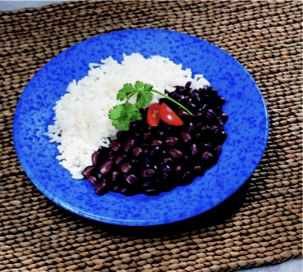
EXAMPLE:
Grains are typically low in lysine and isoleucine and legumes are low in methionine and cysteine.
Eating complementary proteins at the same meal is not necessary as long as a variety of incomplete proteins are consumed over the course of a day

Slide 37
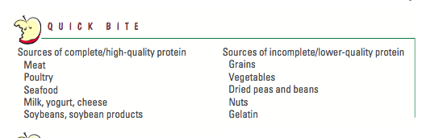

Slide 38
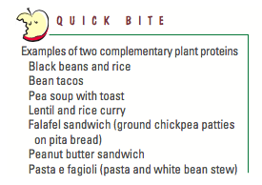

Slide 39
Dietary Reference Intakes
The Recommended Dietary Allowance (RDA) for protein for healthy adults is 0.8 g/kg, derived from the absolute minimum requirement needed to maintain nitrogen balance plus an additional factor to account for individual variations and the mixed quality of proteins typically consumed
The Acceptable Macronutrient Distribution Range (AMDR) for protein for adults is 10% to 35% of total calorie

Slide 40
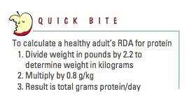

Slide 41
Protein Deficiency
The synthesis of body proteins decreases and degradation increases to provide cells with the amino acids they need. Without proteins to perform their critical roles, many of the body’s activities come to a halt
Protein–energy malnutrition (PEM) occurs when protein, calories, or both are deficient in the diet
Two examples: Kwashiorkor and marasmus are generally viewed as two distinctly different forms of PEM

Slide 42
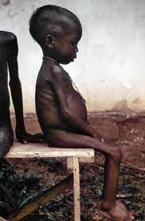
Kwashiorkor
A type of protein–energy malnutrition caused by a deficiency of protein or from infections.
kwashiorkor generally occurs in children less than 2 years of age
sufficient calorie intake, but with insufficient protein consumption
Kwashiorkor results mainly from acute critical illnesses such as trauma, sepsis, and other illnesses seen in intensive care units
Aggressive nutritional support is used to restore metabolic balance as quickly as possible.

Slide 43
Marasmus
A type of protein–energy malnutrition caused from severe deficiency or impaired absorption of calories, protein, vitamins, and minerals.
Marasmus typically affects children between the ages of 1 to 4
Occurs secondary to chronic diseases, such as cancer, AIDS, and chronic pulmonary disease.
It may also be seen among homeless people, elderly people living alone, fad dieters, adults who are addicted to drugs or alcohol, and people with eating disorders.
Nutritional therapy is started slowly and advanced gradually to avoid life- threatening metabolic imbalances

Slide 44
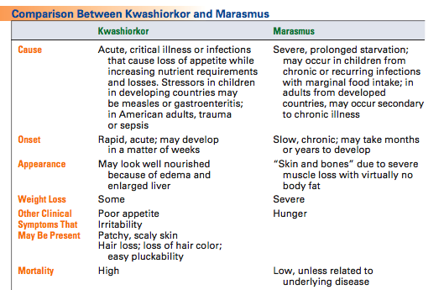

Slide 45
Protein excess
When protein intake is high, calcium excretion increases. Whether excess protein depletes the bones of their chief mineral may depend upon the ratio of calcium intake to protein intake
Excretion of the end products of protein metabolism depends on adequate fluid intake and healthy kidneys. A high protein intake does not cause kidney disease, but it does increase the work of the kidneys
Data are conflicting as to whether high-protein diets increase the risk of osteoporosis or renal stones

Slide 46
Protein excess
A high-protein diet may contribute to the progression of heart disease
foods rich in animal protein also tend to be rich in saturated fats

Slide 47
