Slide 1
Hypertension

Slide 2
Hypertension
High blood pressure.
Defined by the Seventh Report of the Joint National Commission on the Prevention, Detection, Evaluation, and Treatment of High Blood Pressure (JNC 7) as a systolic pressure greater than 140 mm Hg and a diastolic pressure greater than 90 mm Hg.
Based on the average of two or more accurate blood pressure measurements taken during two or more contacts with a health care provider.

Slide 3
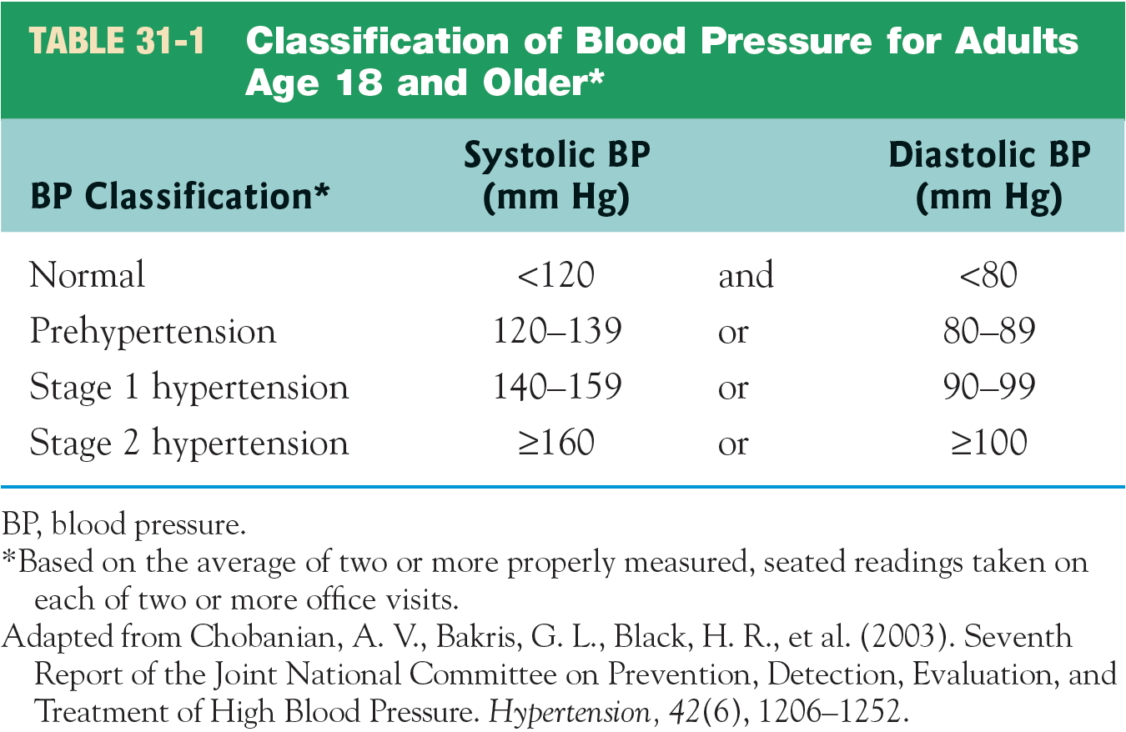
Classification of Blood Pressure for Adults Age 18 Years and Older

Slide 4
Incidence of Hypertension—
“The Silent Killer”
Primary hypertension.
Secondary hypertension.
About 30% of the adult population of the U.S. has hypertension.
About 54% of adults with HTN do not have it under control.
Highest prevalence in African Americans and Hispanics.

Slide 5
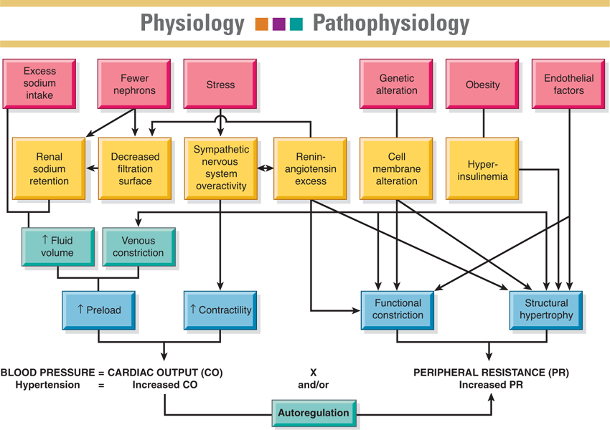
Factors Involved in the Control of Blood Pressure

Slide 6
Manifestations of Hypertension
Usually no symptoms other than elevated blood pressure.
Symptoms seen related to organ damage are seen late and are serious.
  Retinal and other eye changes.
  Renal damage.
  Myocardial infarction.
  Cardiac hypertrophy.
  Stroke.

Slide 7
Major Risk Factors
Hypertension.
Smoking.
Obesity.
Physical inactivity.
Dyslipidemia.
Diabetes mellitus.
Microalbuminuria or GFR <60 mL/min.
Older age.
Family history.

Slide 8
Patient Assessment
History and physical examination.
Laboratory tests.
  Urinalysis.
  Blood chemistry.
  Cholesterol levels.
ECG.

Slide 9
Medical Management
Lifestyle modifications.
  Weight reduction.
  DASH diet, decreased Na intake.
  Physical activity.
  Moderate alcohol consumption.
Medication therapy.
  Diuretics, beta-blockers, alpha₁-blockers, combined alpha- and beta-blockers, vasodilators, ACE inhibitors, ARBs, Ca channel blockers, dihydropyridines (CCB), and direct renin inhibitors.

Slide 10
Medication Treatment
Usually initial medication treatment is a thiazide diuretic.
Low doses are initiated, and the medication dosage is increased gradually if blood pressure does not reach target goal.
Additional medications are added if needed.
Multiple medications may be needed to control blood pressure.
Lifestyle changes initiated to control BP must be maintained.

Slide 11
Nursing History and Assessment
History and risk factors.
Assess potential symptoms of target organ damage.
  Angina, shortness of breath, altered speech, altered vision, nosebleeds, headaches, dizziness, balance problems, nocturia.
  Cardiovascular assessment: apical and peripheral pulses.
Personal, social, and financial factors that will influence the condition or its treatment.

Slide 12
Nursing Diagnoses
Deficient knowledge regarding the relation between the treatment regimen and control of the disease process.
Noncompliance with therapeutic regimen related to side effects of prescribed therapy.

Slide 13
Collaborative Problems and Potential Complications
Left ventricular hypertrophy.
Myocardial infarction.
Heart failure.
Transient ischemic attack (TIA).
Cerebrovascular accident (CVA, stroke, or brain attack).
Renal insufficiency and failure.
Retinal hemorrhage.

Slide 14
Planning and Goals
Understanding of the disease process and its treatment.
Participation in a self-care program.
Absence of complications.

Slide 15
Interventions
Patient education.
Support adherence to the treatment regimen.
Consultation and collaboration.
Follow-up care.
Emphasize control rather than cure.
Reinforce and support lifestyle changes.
A lifelong process.

Slide 16
EVP
Recommendation on blood pressure threshold for initiation of pharmacological treatment:
WHO recommends initiation of pharmacological antihypertensive treatment of individuals with a confirmed diagnosis of hypertension and systolic blood pressure of ≥ 140 mmHg or diastolic blood pressure of ≥ 90 mmHg.
WHO recommends pharmacological antihypertensive treatment of individuals with existing cardiovascular disease and systolic blood pressure of 130–139 mmHg.

Slide 17
EVP
WHO suggests pharmacological antihypertensive treatment of individuals without cardiovascular disease but with high cardiovascular risk, diabetes mellitus, or chronic kidney disease, and systolic blood pressure of 130–139 mmHg.
Initiation of pharmacological hypertension (HTN) treatment should start no later than four weeks following diagnosis of HTN. If blood pressure level is high (e.g. systolic ≥160 mmHg or diastolic ≥100 mmHg) or there is accompanying evidence of end organ damage, initiation of treatment should be started without delay.

Slide 18
Recommendation on Laboratory Testing
When starting pharmacological therapy for hypertension, WHO suggests obtaining tests to screen for comorbidities and secondary hypertension, but only when testing does not delay or impede starting treatment.
Implementation remarks:
Suggested tests include serum electrolytes and creatinine, lipid panel, HbA1C or fasting glucose, urine dipstick, and electrocardiogram (ECG).
In low-resourced areas or non-clinical settings, where testing may not be possible because of additional costs, and lack of access to laboratories and ECG, treatment should not be delayed, and testing can be done subsequently.
Some medicines, such as long-acting dihydropyridine calcium-channel blockers (CCBs) are more suitable for initiation without testing, compared to diuretics or angiotensin-converting enzyme inhibitors (ACEI)/angiotensin-II receptor blockers (ARBs).

Slide 19
Recommendation on Cardiovascular Disease Risk Assessment
WHO suggests cardiovascular risk assessment at or after the initiation of pharmacological treatment for hypertension, but only where this is feasible and does not delay treatment.
Implementation remarks:
Most patients with SBP ≥140 or DBP ≥90 mmHg are high risk and indicated for pharmacological treatment; they do not require cardiovascular (CVD) risk assessment prior to initiating treatment. CVD risk assessment is most important for guiding decisions about initiating pharmacological treatment for hypertension (HTN) in those with lower SBP (130–139 mmHg). It is critical in those with HTN that other risk factors must be identified and treated appropriately to lower total cardiovascular risk.
Whenever risk assessment may threaten timely initiation of HTN treatment and/or patient follow up, it should be postponed and included in the follow-up strategy, rather than taken as a first step to indicate treatment.

Slide 20
Recommendation on Drug Classes to be Used as First-line Agents
For adults with hypertension requiring pharmacological treatment, WHO recommends the use of drugs from any of the following three classes of pharmacological antihypertensive medications as an initial treatment:
thiazide and thiazide-like agents.
angiotensin-converting enzyme inhibitors (ACEIs)/angiotensin-receptor blockers (ARBs).
long-acting dihydropyridine calcium channel blockers (CCBs).
Implementation remarks:
Examples of indications to consider specific agents include diuretics or CCBs in patients over 65 years or those of African descent, beta-blockers in ischemic heart disease, ACEIs/ARBs in patients with severe proteinuria, diabetes mellitus, heart failure or kidney disease.

Slide 21
Recommendation on Combination Therapy
For adults with hypertension requiring pharmacological treatment, WHO suggests combination therapy, preferably with a single-pill combination (to improve adherence and persistence), as an initial treatment. Antihypertensive medications used in combination therapy should be chosen from the following three drug classes: diuretics (thiazide or thiazide-like), angiotensin-converting enzyme inhibitors (ACEIs)/angiotensin-receptor blockers (ARBs), and long-acting dihydropyridine calcium channel blockers (CCBs).
Implementation remarks:
Combination medication therapy may be especially valuable when the baseline BP is ≥20/10 mmHg higher than the target blood pressure.
Single-pill combination therapy improves medication-taking adherence and persistence and BP control.

Slide 22
Recommendation on Target Blood Pressure
WHO recommends a target blood pressure treatment goal of <140/90 mmHg in all patients with hypertension without comorbidities.
WHO recommends a target systolic blood pressure treatment goal of <130 mmHg in patients with hypertension and known cardiovascular disease (CVD).
WHO suggests a target systolic blood pressure treatment goal of <130 mmHg in high-risk patients with hypertension (those with high CVD risk, diabetes mellitus, chronic kidney disease).

Slide 23
Recommendation on Frequency of Assessment
WHO suggests a monthly follow up after initiation or a change in antihypertensive medications until patients reach target.
WHO suggests a follow up every 3–6 months for patients whose blood pressure is under control.

Slide 24
Recommendation on Treatment by Nonphysician Professionals
WHO suggests that pharmacological treatment of hypertension can be provided by nonphysician professionals such as pharmacists and nurses, as long as the following conditions are met: proper training, prescribing authority, specific management protocols and physician oversight.
Implementation remarks:
Community health care workers (HCWs) may assist in tasks such as education, delivery of medications, blood pressure (BP) measurement and monitoring through an established collaborative care model. The scope of hypertension care practised by community HCWs depends on local regulations and currently varies by country.
Telemonitoring and community or home-based self-care are encouraged to enhance the control of BP as a part of an integrated management system, when deemed appropriate by the treating medical team and found feasible and affordable by patients.
Physician oversight can be done through innovative methods such as telemonitoring or similar to ensure access to treatment is not delayed.

Slide 25
Evaluation
Reports knowledge of disease management sufficient to maintain adequate tissue perfusion.
  Maintains blood pressure at less than 140/90 mm Hg with no symptoms of angina, palpitations, or vision changes; stable BUN and serum creatinine levels; and palpable peripheral pulses.
Adheres to the self-care program.
  Reduces calorie, Na, and fat intake; exercises regularly; takes medications as prescribed and reports side effects; measures BP; abstains from tobacco and excessive alcohol intake; keeps appointments.

Slide 26
Evaluation (cont’d)
Has no complications:
  Reports no changes in vision; exhibits no retinal damage on vision testing.
  Maintains pulse rate and rhythm and respiratory rate within normal ranges; reports no dyspnea or edema.
  Maintains urine output consistent with intake; has renal function test results within normal range.
  Demonstrates no motor, speech, or sensory deficits.
  Reports no headaches, dizziness, weakness, changes in gait, or falls.

Slide 27
Gerontologic Considerations
Medication regimen can be difficult to remember.
Expense can be a challenge.
Monotherapy, if appropriate, may simplify the medication regimen and make it less expensive.
Ensure that older adult patients understand the regimen and can see and read instructions, open medication containers, and get prescriptions refilled.
Include family and caregivers in educational program.

Slide 28
Hypertensive Crises
Hypertensive emergency:
  Blood pressure >180/120 mm Hg and must be lowered immediately to prevent damage to target organs.
Hypertensive urgency:
  Blood pressure is very high but no evidence of immediate or progressive target organ damage.

Slide 29
Hypertensive Emergency
Reduce blood pressure 25% in first hour.
Reduce to 160/100 over 6 hours.
Then gradual reduction to normal over a period of days.
Exceptions are ischemic stroke and aortic dissection.
Medications:
  IV vasodilators: sodium nitroprusside, nicardipine, fenoldopam mesylate, enalaprilat, nitroglycerin.
Need very frequent monitoring of BP and cardiovascular status.

Slide 30
Hypertensive Urgency
Patient requires close monitoring of blood pressure and cardiovascular status.
Assess for potential evidence of target organ damage.
Medications:
  Fast-acting oral agents: beta-adrenergic blocker— labetalol; angiotensin-converting enzyme inhibitor— captopril; or alpha₂-agonist—clonidine.

Slide 31
Case Study
62 yo M with a history of hypertension, normally on Lisinopril, presents to PCP for routine check-up. Patient with no complaints.
BP found to be 224/130 on check in clinic.
PE normal.
Referred to ED for “hypertensive crisis”.

Slide 32
Case Study
Dx: Severe BP elevation in otherwise stable patients without acute or impending change in target organ damage or dysfunction.
Rx options:
Confirm that patient has no end-organ damage (i.e. this is urgency, not emergency).
History with focused review of systems and PE sufficient.

Slide 33
Case Study
Monitoring and Follow-up:
Allow period of rest (30min) and recheck blood pressure. This will fix up to a third of patients.
If bp remains elevated, consider augmenting or beginning home anti-hypertensive regimen.
Typically felt that outpatient follow-up within 1 week is sufficient.

Slide 34
Case Study
Patient had run out of Lisinopril and been off it for more than a week.
In ED, remained asymptomatic. Repeat BP 210/120.
PE normal.
Restarted on Lisinopril, referred back to PCP in a week for bp check.
In clinic later that week, BP 150/92.
Started on second anti-hypertensive.

