Slide 1
Organizational Behavior 15th Ed
Chapter 3
Robbins and Judge
Attitudes and Job Satisfaction

Slide 2
Chapter 3 Learning Objectives
After studying this chapter you should be able to:
Contrast the three components of an attitude.
Summarize the relationship between attitudes and behavior.
Compare and contrast the major job attitudes.
Define job satisfaction and show how it can be measured.
Summarize the main causes of job satisfaction.
Identify four employee responses to dissatisfaction.

Slide 3
Contrast the Three Components of an Attitude
LO 1
Evaluative statements or judgments concerning objects, people, or events
Three components of an attitude:
Affective
Cognitive
Behavioral
Attitude
The emotional or feeling segment of an attitude
The opinion or belief segment of an attitude
An intention to behave in a certain way toward someone or something

Slide 4
Summarize the Relationship Between Attitudes and Behavior
LO 2
The attitudes people hold determine what they do.
Festinger proposed that cases of attitude following behavior illustrate the effects of cognitive dissonance.
Cognitive Dissonance is incompatibility an individual might perceive between two or more attitudes or between behavior and attitudes.
Research has generally concluded that people seek consistency among their attitudes and between their attitudes and their behavior.

Slide 5
Summarize the Relationship Between Attitudes and Behavior
LO 2
Importance of the attitude
Its correspondence to behavior
Its accessibility
The presence of social pressure
Whether or not a person has had direct experience with the behavior
The attitude/behavior relationship is stronger if it refers to something in our direct personal experience
Attitude
Predicts
Mitigating Variables
Behavior

Slide 6
Compare and Contrast the Major Job Attitudes
LO 3
Job Satisfaction
A positive feeling about the job resulting from an evaluation of its characteristics
Job Involvement
Degree of psychological identification with the job where perceived performance is important to self-worth
Psychological Empowerment
Belief in the degree of influence over the job, competence, job meaningfulness, and autonomy

Slide 7
Compare and Contrast the Major Job Attitudes
LO 3
Organizational Commitment
Identifying with a particular organization and its goals, while wishing to maintain membership in the organization.
Three dimensions:
Affective – emotional attachment to organization
Continuance – economic value of staying
Normative – moral or ethical obligations

Slide 8
Compare and Contrast the Major Job Attitudes
LO 3
Organizational Commitment (cont)
Has some relation to performance, especially for new employees.
Theoretical models propose that employees who are committed will be less likely to engage in work withdrawal even if they are dissatisfied, because they have a sense of organizational loyalty.

Slide 9
Compare and Contrast the Major Job Attitudes
LO 3
Perceived Organizational Support (POS)
Degree to which employees believe the organization values their contribution and cares about their well-being.
Higher when rewards are fair, employees are involved in decision making, and supervisors are seen as supportive.
High POS is related to higher OCBs and performance.

Slide 10
Compare and Contrast the Major Job Attitudes
LO 3
Employee Engagement
The degree of involvement with, satisfaction with, and enthusiasm for the job.
Engaged employees are passionate about their work and company.

Slide 11
Compare and Contrast the Major Job Attitudes
LO 3
Are These Job Attitudes Really Distinct?
No: these attitudes are highly related
Variables may be redundant (measuring the same thing under a different name)
While there is some distinction, there is also a lot of overlap
Overlap may cause confusion

Slide 12
Define Job Satisfaction and Show How It Can Be Measured
LO 4
Job satisfaction
A positive feeling about a job resulting from an evaluation of its characteristics
Two approaches for measuring Job Satisfaction are popular:
The single global rating
The summation of job facets

Slide 13
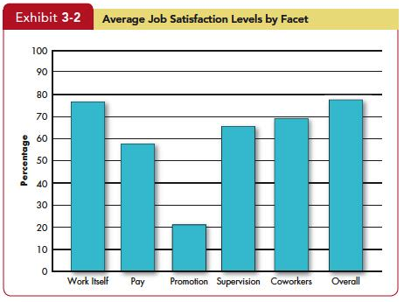
Define Job Satisfaction and Show How It Can Be Measured
LO 4
Insert Exhibit 3.2

Slide 14
Summarize the Main Causes of Job Satisfaction
LO 5
Pay influences job satisfaction only to a point.
After about $40,000 per year (in the U.S.), there is no relationship between amount of pay and job satisfaction.
Money may bring happiness, but not necessarily job satisfaction.

Slide 15
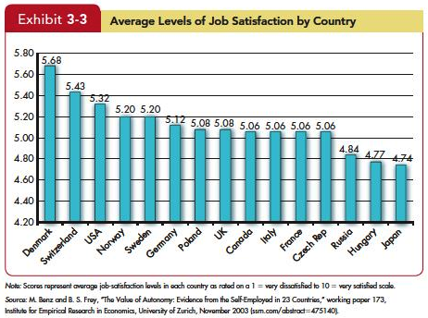
Summarize the Main Causes of Job Satisfaction
LO 5
Insert Exhibit 3-3
Insert Exhibit 3-22

Slide 16
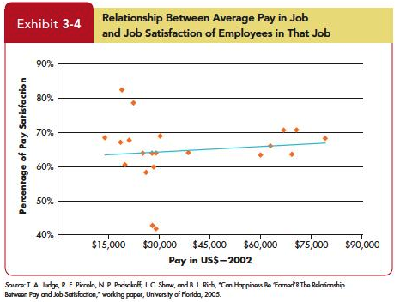
Summarize the Main Causes of Job Satisfaction
LO 5
Insert Exhibit 3-4
Insert Exhibit 3-22

Slide 17
Summarize the Main Causes of Job Satisfaction
LO 5
Personality also plays a role in Job Satisfaction.
People who have positive core self-evaluations, who believe in their inner worth and basic competence are more satisfied with their jobs than those with negative core self-evaluations.
Those with negative core self-evaluations set less ambitious goals and are more likely to give up when confronting difficulties.
Insert Exhibit 3-22

Slide 18
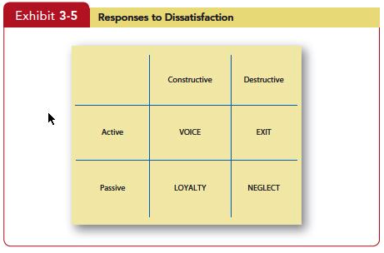
Identify Four Employee Responses to Dissatisfaction
LO 6
Insert Exhibit 3-5
Insert Exhibit 3-22

Slide 19
Summary and Implications for Managers
Satisfied and committed employees have lower rates of turnover, absenteeism, and withdrawal behaviors.
Managers will also want to measure job attitudes effectively so they can tell how employees are reacting to their work.
The most important thing managers can do to raise employee satisfaction is focus on the intrinsic parts of the job, such as making the work challenging and interesting.
Although paying employees poorly will likely not attract high-quality employees to the organization or keep high performers, managers should realize that high pay alone is unlikely to create a satisfying work environment.
Insert Exhibit 3-22

Slide 20
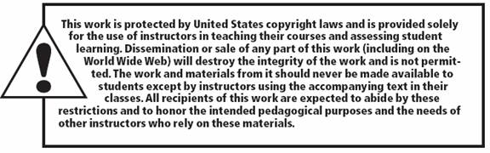
All rights reserved. No part of this publication may be reproduced, stored in a retrieval system, or transmitted, in any form or by any means, electronic, mechanical, photocopying, recording, or otherwise, without the prior written permission of the publisher. Printed in the United States of America.
Copyright © 2013 Pearson Education, Inc. publishing as Prentice Hall
Notes:
All rights reserved. No part of this publication may be reproduced, stored in a retrieval system, or transmitted, in any form or by any means, electronic, mechanical, photocopying, recording, or otherwise, without the prior written permission of the publisher. Printed in the United States of America.

