Slide 1

Search
We will consider the problem of designing goal-based agents in fully observable, deterministic, discrete, known environments
Example:
Start state
Goal state

Slide 2
Search
We will consider the problem of designing goal-based agents in fully observable, deterministic, discrete, known environments
The solution is a fixed sequence of actions
Search is the process of looking for the sequence of actions that reaches the goal
Once the agent begins executing the search solution, it can ignore its percepts (open-loop system)

Slide 3
Search problem components
Initial state
Actions
Transition model
What is the result of performing a given action in a given state?
Goal state
Path cost
Assume that it is a sum of nonnegative step costs
The optimal solution is the sequence of actions that gives the lowest path cost for reaching the goal
Initial
state
Goal state

Slide 4
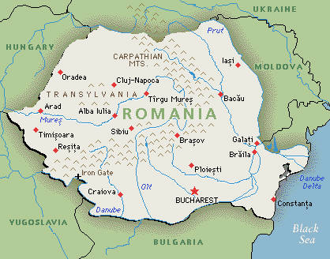
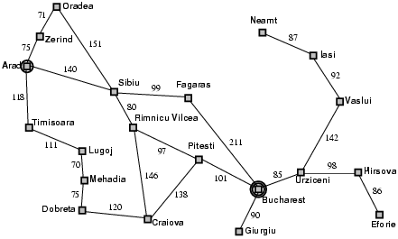
Example: Romania
On vacation in Romania; currently in Arad
Flight leaves tomorrow from Bucharest
Initial state
Arad
Actions
Go from one city to another
Transition model
If you go from city A to city B, you end up in city B
Goal state
Bucharest
Path cost
Sum of edge costs

Slide 5
State space
The initial state, actions, and transition model define the state space of the problem
The set of all states reachable from initial state by any sequence of actions
Can be represented as a directed graph where the nodes are states and links between nodes are actions
What is the state space for the Romania problem?

Slide 6
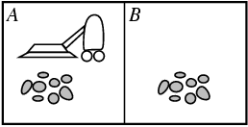
Example: Vacuum world
States
Agent location and dirt location
How many possible states?
What if there are n possible locations?
Actions
Left, right, suck
Transition model

Slide 7
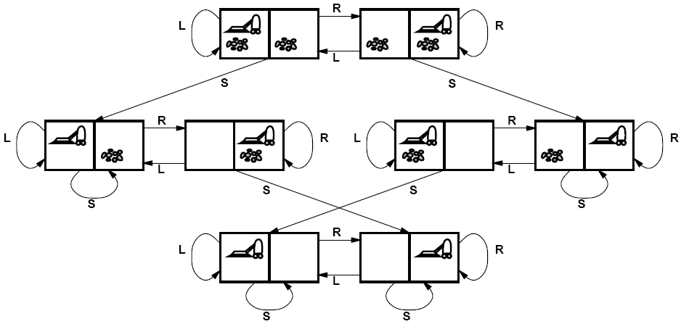
Vacuum world state space graph

Slide 8
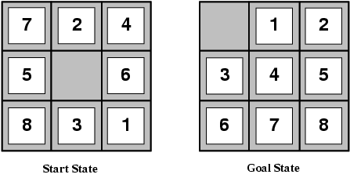
Example: The 8-puzzle
States
Locations of tiles
8-puzzle: 181,440 states
15-puzzle: 1.3 trillion states
24-puzzle: 10²⁵ states
Actions
Move blank left, right, up, down
Path cost
1 per move
Finding the optimal solution of n-Puzzle is NP-hard

Slide 9
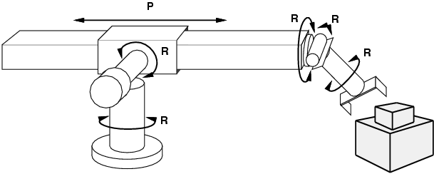
Example: Robot motion planning
States
Real-valued coordinates of robot joint angles
Actions
Continuous motions of robot joints
Goal state
Desired final configuration (e.g., object is grasped)
Path cost
Time to execute, smoothness of path, etc.

Slide 10
Search
Given:
Initial state
Actions
Transition model
Goal state
Path cost
How do we find the optimal solution?
How about building the state space and then using Dijkstra’s shortest path algorithm?
The state space may be huge!
Complexity of Dijkstra’s is O(E + V log V), where V is the size of the state space

Slide 11
Tree Search
Let’s begin at the start node and expand it by making a list of all possible successor states
Maintain a fringe or a list of unexpanded states
At each step, pick a state from the fringe to expand
Keep going until you reach the goal state
Try to expand as few states as possible

Slide 12
Search tree
Starting state
“What if” tree of possible actions and outcomes
The root node corresponds to the starting state
The children of a node correspond to the successor states of that node’s state
A path through the tree corresponds to a sequence of actions
A solution is a path ending in the goal state
Nodes vs. states
A state is a representation of a physical configuration, while a node is a data structure that is part of the search tree
Action
Successor state
…
…
…
…
Goal state

Slide 13
Tree Search Algorithm Outline
Initialize the fringe using the starting state
While the fringe is not empty
Choose a fringe node to expand according to search strategy
If the node contains the goal state, return solution
Else expand the node and add its children to the fringe

Slide 14
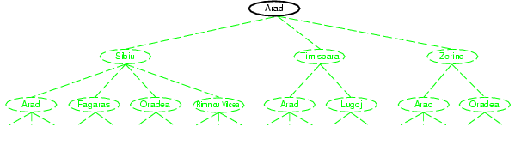
Tree search example

Slide 15
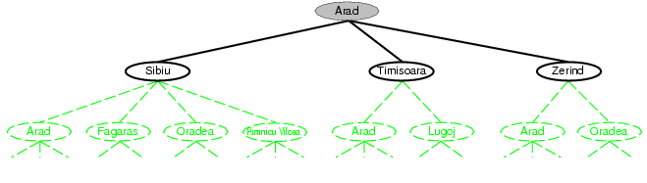
Tree search example

Slide 16
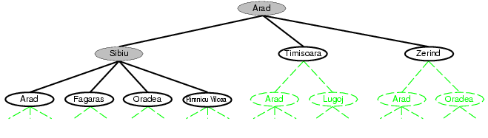
Tree search example
Fringe

Slide 17
Search strategies
A search strategy is defined by picking the order of node expansion
Strategies are evaluated along the following dimensions:
Completeness: does it always find a solution if one exists?
Optimality: does it always find a least-cost solution?
Time complexity: number of nodes generated
Space complexity: maximum number of nodes in memory
Time and space complexity are measured in terms of
b: maximum branching factor of the search tree
d: depth of the least-cost solution
m: maximum length of any path in the state space (may be infinite)

Slide 18
Uninformed search strategies
Uninformed search strategies use only the information available in the problem definition
Breadth-first search
Depth-first search
Iterative deepening search
Uniform-cost search

Slide 19
Breadth-first search
Expand shallowest unexpanded node
Implementation:
fringe is a FIFO queue, i.e., new successors go at end
A
B
C
D
E
F
G

Slide 20
Breadth-first search
Expand shallowest unexpanded node
Implementation:
fringe is a FIFO queue, i.e., new successors go at end
A
B
C
D
E
F
G

Slide 21
Breadth-first search
Expand shallowest unexpanded node
Implementation:
fringe is a FIFO queue, i.e., new successors go at end
A
B
C
D
E
F
G

Slide 22
Breadth-first search
Expand shallowest unexpanded node
Implementation:
fringe is a FIFO queue, i.e., new successors go at end
A
B
C
D
E
F
G

Slide 23
Breadth-first search
Expand shallowest unexpanded node
Implementation:
fringe is a FIFO queue, i.e., new successors go at end
Fringe: [A] -> [B,C]-> [C,D,E]->[D,E,F,G]
So , the order is A,B,C,D,E,F,G OR: A,C,B,G,F,E,D OR:….
A
B
C
D
E
F
G

Slide 24
Properties of breadth-first search
Complete?
Yes (if branching factor b is finite)
Optimal?
Yes – if cost = 1 per step
Time?
Number of nodes in a b-ary tree of depth d: O(b^{d})
(d is the depth of the optimal solution)
Space?
O(b^{d})
Space is the bigger problem (more than time)

Slide 25
Depth-first search
Expand deepest unexpanded node
Implementation:
fringe = LIFO queue, i.e., put successors at front
A
B
C
D
E
F
G

Slide 26
Depth-first search
Expand deepest unexpanded node
Implementation:
fringe = LIFO queue, i.e., put successors at front
A
B
C
D
E
F
G

Slide 27
Depth-first search
Expand deepest unexpanded node
Implementation:
fringe = LIFO queue, i.e., put successors at front
A
B
C
D
E
F
G

Slide 28
Depth-first search
Expand deepest unexpanded node
Implementation:
fringe = LIFO queue, i.e., put successors at front
A
B
C
D
E
F
G

Slide 29
Depth-first search
Expand deepest unexpanded node
Implementation:
fringe = LIFO queue, i.e., put successors at front
A
B
C
D
E
F
G

Slide 30
Depth-first search
Expand deepest unexpanded node
Implementation:
fringe = LIFO queue, i.e., put successors at front
A
B
C
D
E
F
G

Slide 31
Depth-first search
Expand deepest unexpanded node
Implementation:
fringe = LIFO queue, i.e., put successors at front
A
B
C
D
E
F
G

Slide 32
Depth-first search
Expand deepest unexpanded node
Implementation:
fringe = LIFO queue, i.e., put successors at front
A
B
C
D
E
F
G

Slide 33
Depth-first search
Expand deepest unexpanded node
Implementation:
fringe = LIFO queue, i.e., put successors at front
Fringe: [A] -> [B,C]-> [D,E,C]->[E,C]->[C]->[F,G]->[G],[]
So , the order is A,B,D,E,C,F,G] OR: A,C,G,F,B,E,D OR:….
[visit all subtree once its root is visited]
A
B
C
D
E
F
G

Slide 34
Properties of depth-first search
Complete?
Fails in infinite-depth spaces, spaces with loops
Modify to avoid repeated states along path
→ complete in finite spaces
Optimal?
No – returns the first solution it finds
Time?
Could be the time to reach a solution at maximum depth m: O(b^{m})
Terrible if m is much larger than d
But if there are lots of solutions, may be much faster than BFS
Space?
O(bm), i.e., linear space!

Slide 35
Iterative deepening search
Use DFS as a subroutine
Check the root
Do a DFS searching for a path of length 1
If there is no path of length 1, do a DFS searching for a path of length 2
If there is no path of length 2, do a DFS searching for a path of length 3…

Slide 36
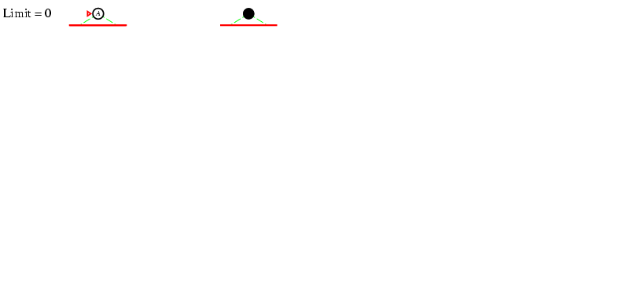
Iterative deepening search

Slide 37
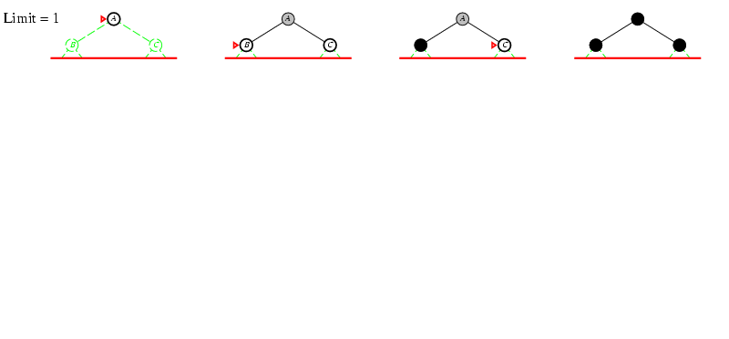
Iterative deepening search

Slide 38
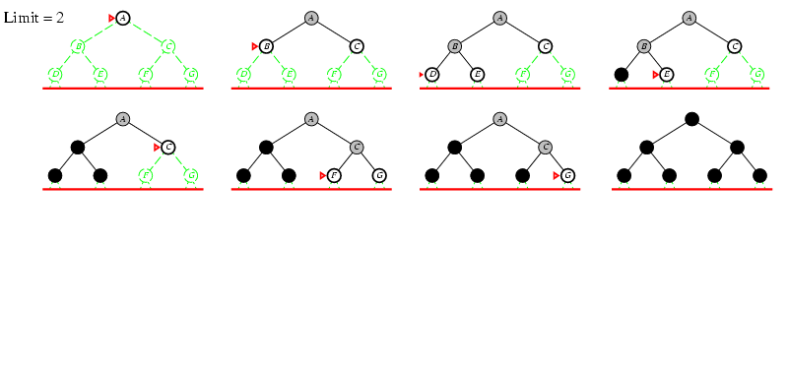
Iterative deepening search

Slide 39
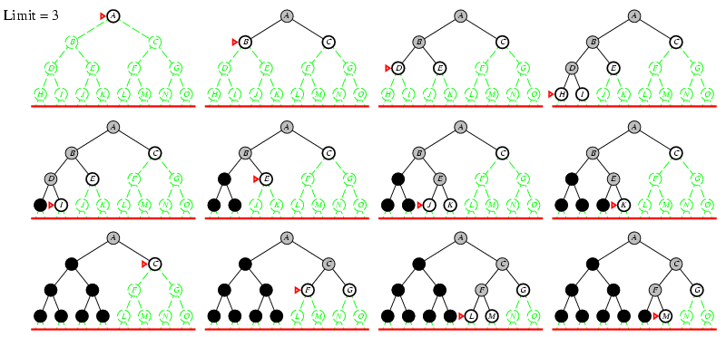
Iterative deepening search

Slide 40
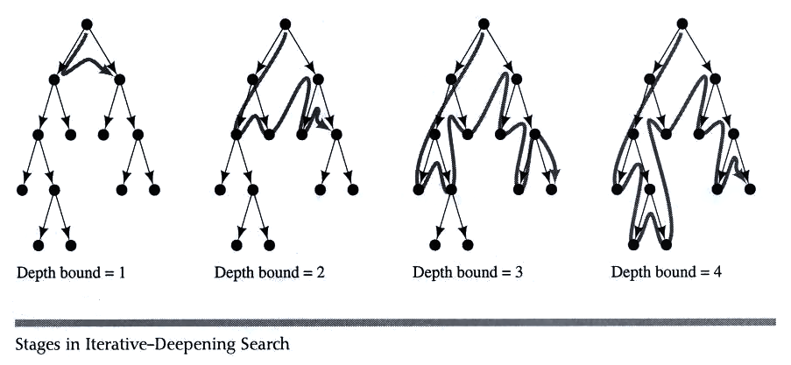
Example IDS

Slide 41
Bidirectional Search
Idea
simultaneously search forward from S and backwards from G
stop when both “meet in the middle”
need to keep track of the intersection of 2 open sets of nodes
What does searching backwards from G mean
need a way to specify the predecessors of G (may be missing)
this can be difficult,
e.g., predecessors of checkmate in chess?
what if there are multiple goal states?
what if there is only a goal test, no explicit list?
Conclusion: be careful!

Slide 42
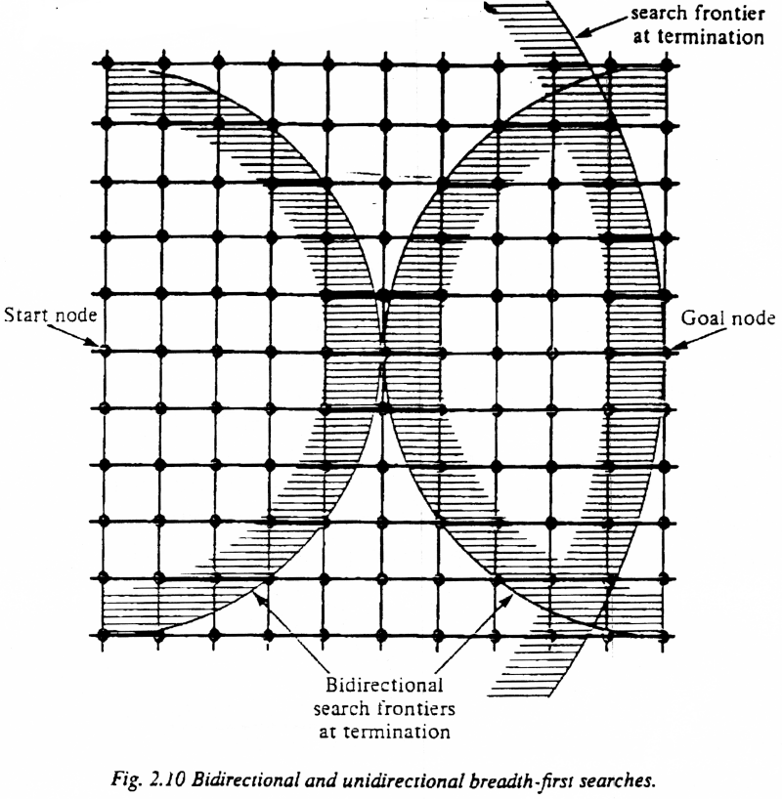
Bi-Directional Search
Complexity: time and space complexity are:

Slide 43
Properties of iterative deepening search
Complete?
Yes
Optimal?
Yes, if step cost = 1
Time?
(d+1)b⁰ + d b¹ + (d-1)b² + … + b^{d} = O(b^{d})
Space?
O(bd)

Slide 44
Uniform-cost search
Expand least-cost unexpanded node
Implementation: fringe is a queue ordered by path cost (priority queue)
Equivalent to breadth-first if step costs all equal
Complete?
Yes, if step cost is greater than some positive constant ε (we don’t want infinite sequences of steps that have a finite total cost)
Optimal?
Yes – nodes expanded in increasing order of path cost
Time?
Number of nodes with path cost ≤ cost of optimal solution (C*), O(b^{C*/ ε})
This can be greater than O(b^{d}): the search can explore long paths consisting of small steps before exploring shorter paths consisting of larger steps
Space?
O(b^{C*/ ε})

Slide 45
Uniform-Cost -First
the nodes with the lowest cost are explored first
similar to BREADTH-FIRST, but with an evaluation of the cost for each reachable node
g(n) = path cost(n) = sum of individual edge costs to reach the current node
function UNIFORM-COST-SEARCH(problem) returns solution
return TREE-SEARCH(problem, COST-FN, FIFO-QUEUE())
Time Complexity | b^{C*/e}
Space Complexity | b^{C*/e}
Completeness | yes (finite b, step costs >= e)
Optimality | yes
b | branching factor
C* | cost of the optimal solution
e | minimum cost per action

Slide 46
Uniform-Cost Snapshot
Initial
1
Visited
4
3
Fringe
2
3
Current
Visible
7
2
2
4
Goal
4
5
6
7
Edge Cost
9
2
5
4
4
4
3
6
9
8
9
10
11
12
13
14
15
3
4
7
2
4
8
6
5
4
3
4
2
8
3
9
2
16
17
18
19
20
21
22
23
24
25
26
27
28
29
30
31
Fringe: [27(10), 4(11), 25(12), 26(12), 14(13), 24(13), 20(14), 15(16), 21(18)]
+ [22(16), 23(15)]

Slide 47
Uniform Cost Fringe Trace
[1(0)]
[3(3), 2(4)]
[2(4), 6(5), 7(7)]
[6(5), 5(6), 7(7), 4(11)]
[5(6), 7(7), 13(8), 12(9), 4(11)]
[7(7), 13(8), 12(9), 10(10), 11(10), 4(11)]
[13(8), 12(9), 10(10), 11(10), 4(11), 14(13), 15(16)]
[12(9), 10(10), 11(10), 27(10), 4(11), 26(12), 14(13), 15(16)]
[10(10), 11(10), 27(10), 4(11), 26(12), 25(12), 14(13), 24(13), 15(16)]
[11(10), 27(10), 4(11), 25(12), 26(12), 14(13), 24(13), 20(14), 15(16), 21(18)]
[27(10), 4(11), 25(12), 26(12), 14(13), 24(13), 20(14), 23(15), 15(16), 22(16), 21(18)]
[4(11), 25(12), 26(12), 14(13), 24(13), 20(14), 23(15), 15(16), 23(16), 21(18)]
[25(12), 26(12), 14(13), 24(13),8(13), 20(14), 23(15), 15(16), 23(16), 9(16), 21(18)]
[26(12), 14(13), 24(13),8(13), 20(14), 23(15), 15(16), 23(16), 9(16), 21(18)]
[14(13), 24(13),8(13), 20(14), 23(15), 15(16), 23(16), 9(16), 21(18)]
[24(13),8(13), 20(14), 23(15), 15(16), 23(16), 9(16), 29(16),21(18), 28(21)]
Goal reached!
Notation: [Bold+Yellow: Current Node; White: Old Fringe Node; Green+Italics: New Fringe Node].
Assumption: New nodes with the same cost as existing nodes are added after the existing node.

Slide 48
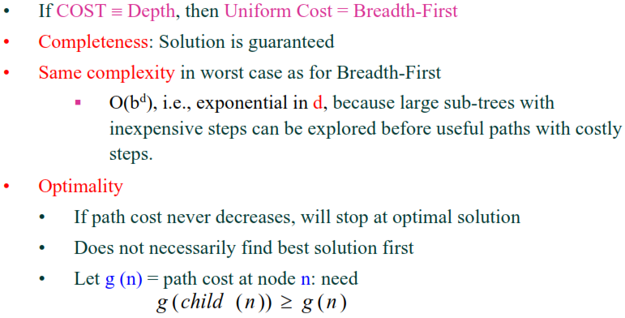
Uniform Cost Search: Evaluation

Slide 49
Breadth-First vs. Uniform-Cost
breadth-first always expands the shallowest node
only optimal if all step costs are equal
uniform-cost considers the overall path cost
optimal for any (reasonable) cost function
non-zero, positive
gets bogged down in trees with many fruitless, short branches
low path cost, but no goal node
both are complete for non-extreme problems
finite number of branches
strictly positive search function

Slide 50
Informed search
Idea: give the algorithm “hints” about the desirability of different states
Use an evaluation function to rank nodes and select the most promising one for expansion
Greedy best-first search
A* search

Slide 51
Heuristic function
Heuristic function h(n) estimates the cost of reaching goal from node n
Example:
2 components start to goal
through n:
From start to n (real) f
From n to goal (estimate) h
Start state
Goal state

Slide 52
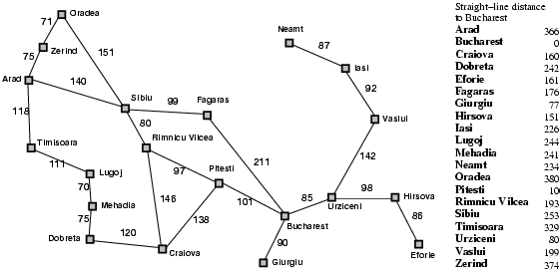
Heuristic for the Romania problem

Slide 53
Greedy best-first search
Expand the node that has the lowest value of the heuristic function h(n)

Slide 54
Greedy Search
Start
State | Heuristic: h(n)
A | 366
B | 374
C | 329
D | 244
E | 253
F | 178
G | 193
H | 98
I | 0
A
75
118
140
B
C
111
E
D
80
99
G
F
97
H
211
101
I
Goal
f(n) = h (n) = straight-line distance heuristic

Slide 55
Greedy Search: Tree Search
Start
A

Slide 56
Greedy Search: Tree Search
Start
A
75
118
[329]
140
[374]
B
C
[253]
E

Slide 57
Greedy Search: Tree Search
Start
A
75
118
[329]
140
[374]
B
C
[253]
E
80
99
[193]
[178]
G
F
[366]
A

Slide 58
Greedy Search: Tree Search
Start
A
75
118
[329]
140
[374]
B
C
[253]
E
80
99
[193]
[178]
G
F
[366]
A
211
[253]
I
[0]
E
Goal

Slide 59
Greedy Search: Tree Search
Start
A
75
118
[329]
140
[374]
B
C
[253]
E
80
99
[193]
[178]
G
F
[366]
A
211
[253]
I
[0]
E
Path cost(A-E-F-I) = 253 + 178 + 0 = 431
dist(A-E-F-I) = 140 + 99 + 211 = 450
Goal

Slide 60
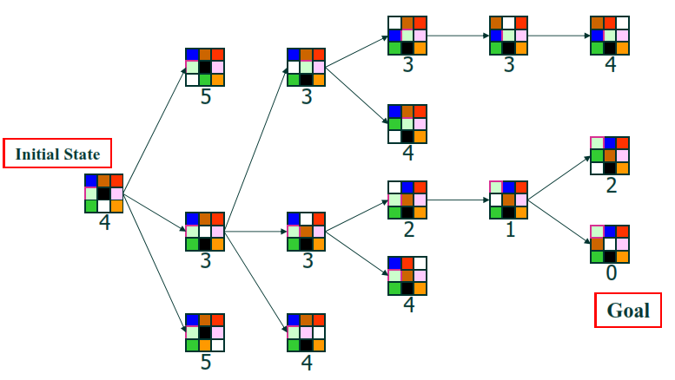
Greedy Best-First Search: 8-Puzzle Example

Slide 61

Greedy best-first search example

Slide 62
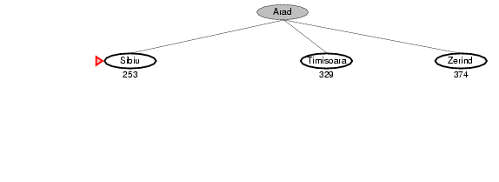
Greedy best-first search example

Slide 63
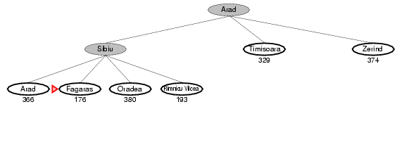
Greedy best-first search example

Slide 64
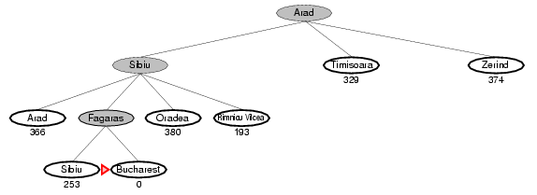
Greedy best-first search example

Slide 65
Properties of greedy best-first search
Complete?
No – can get stuck in loops
start
goal

Slide 66
Properties of greedy best-first search
Complete?
No – can get stuck in loops
Optimal?
No

Slide 67
Properties of greedy best-first search
Complete?
No – can get stuck in loops
Optimal?
No
Time?
Worst case: O(b^{m})
Best case: O(bd) – If h(n) is 100% accurate
Space?
Worst case: O(b^{m})

Slide 68
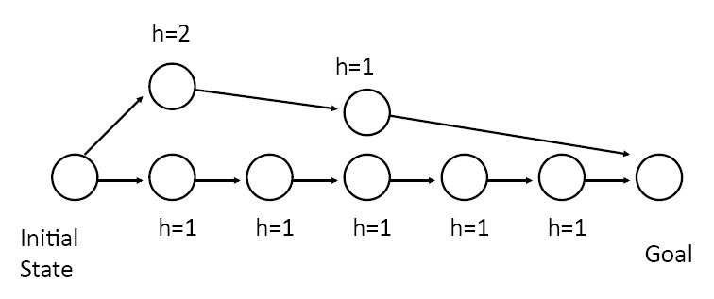
How can we fix the greedy problem?

Slide 69
A* search
Idea: avoid expanding paths that are already expensive
The evaluation function f(n) is the estimated total cost of the path through node n to the goal:
f(n) = g(n) + h(n)
g(n): cost so far to reach n (path cost)
h(n): estimated cost from n to goal (heuristic)
Notes:
Dates back to 1968

Slide 70

A* search example

Slide 71
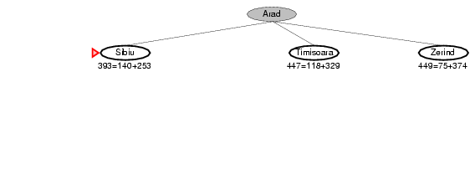
A* search example

Slide 72
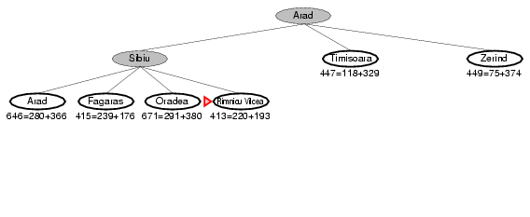
A* search example

Slide 73
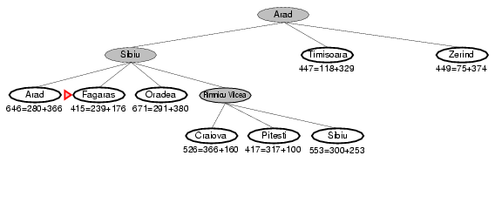
A* search example

Slide 74
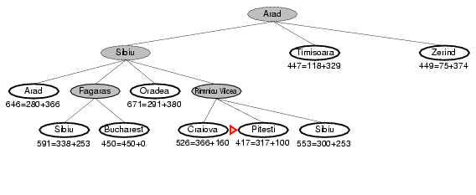
A* search example

Slide 75
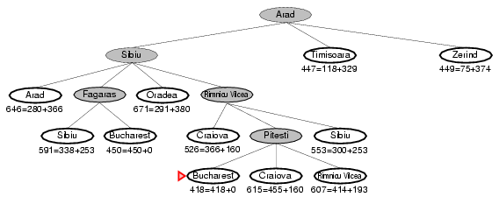
A* search example

Slide 76
A* Search: Another example
Start
State | Heuristic: h(n)
A | 366
B | 374
C | 329
D | 244
E | 253
F | 178
G | 193
H | 98
I | 0
A
75
118
140
B
C
111
E
D
80
99
G
F
97
H
211
101
I
f(n) = g(n) + h (n)
g(n): is the exact cost to reach node n from the initial state.
Goal

Slide 77
A* Search: Tree Search
A
Start

Slide 78
A* Search: Tree Search
A
Start
118
75
140
E
[393]
B
[449]
[447]
C
State | Heuristic: h(n)
A | 366
B | 374
C | 329
D | 244
E | 253
F | 178
G | 193
H | 98
I | 0

Slide 79
A* Search: Tree Search
A
Start
118
75
140
E
[393]
B
[449]
[447]
C
80
99
State | Heuristic: h(n)
A | 366
B | 374
C | 329
D | 244
E | 253
F | 178
G | 193
H | 98
I | 0
[413]
G
F
[417]

Slide 80
A* Search: Tree Search
A
Start
118
75
140
E
[393]
B
[449]
[447]
C
80
99
State | Heuristic: h(n)
A | 366
B | 374
C | 329
D | 244
E | 253
F | 178
G | 193
H | 98
I | 0
[413]
G
F
[417]
97
[415]
H

Slide 81
A* Search: Tree Search
A
Start
118
75
140
E
[393]
B
[449]
[447]
C
80
99
[413]
G
F
[417]
97
[415]
H
101
I
[418]
Goal

Slide 82
A* Search: Tree Search
A
Start
118
75
140
E
[393]
B
[449]
[447]
C
80
99
[413]
G
F
[417]
97
[415]
H
I
[450]
101
I
[418]
Goal

Slide 83
A* Search: Tree Search
A
Start
118
75
140
E
[393]
B
[449]
[447]
C
80
99
[413]
G
F
[417]
97
[415]
H
I
[450]
101
I
[418]
Goal

Slide 84
A* Search: Tree Search
A
Start
118
75
140
E
[393]
B
[449]
[447]
C
80
99
[413]
G
F
[417]
97
[415]
H
I
[450]
101
I
[418]
Goal

Slide 85
A* Search: h not admissible !
h() overestimates the cost to reach the goal state
Start
State | Heuristic: h(n)
A | 366
B | 374
C | 329
D | 244
E | 253
F | 178
G | 193
H | 138>101
I | 0
A
75
118
140
B
C
111
E
D
80
99
G
F
97
H
211
101
I
f(n) = g(n) + h (n) – (H-I) Overestimated
g(n): is the exact cost to reach node n from the initial state.
Goal

Slide 86
A* Search: Tree Search
A
Start

Slide 87
A* Search: Tree Search
A
Start
118
75
140
E
[393]
B
[449]
[447]
C

Slide 88
A* Search: Tree Search
A
Start
118
75
140
E
[393]
B
[449]
[447]
C
80
99
[413]
G
F
[417]

Slide 89
A* Search: Tree Search
A
Start
118
75
140
E
[393]
B
[449]
[447]
C
80
99
[413]
G
F
[417]
97
[455]
H

Slide 90
A* Search: Tree Search
A
Start
118
75
140
E
[393]
B
[449]
[447]
C
80
99
[413]
G
F
[417]
97
[455]
Goal
H
I
[450]

Slide 91
A* Search: Tree Search
A
Start
118
75
140
E
[393]
B
[449]
[447]
C
80
99
[473]
[413]
G
F
[417]
D
97
[455]
Goal
H
I
[450]

Slide 92
A* Search: Tree Search
A
Start
118
75
140
E
[393]
B
[449]
[447]
C
80
99
[473]
[413]
G
F
[417]
D
97
[455]
Goal
H
I
[450]

Slide 93
A* Search: Tree Search
A
Start
118
75
140
E
[393]
B
[449]
[447]
C
80
99
[473]
[413]
G
F
[417]
D
97
[455]
Goal
H
I
[450]

Slide 94
A* Search: Tree Search
A
Start
118
75
140
E
[393]
B
[449]
[447]
C
80
99
[473]
[413]
G
F
[417]
D
97
[455]
Goal
H
I
[450]
A* not optimal !!!, h not admissible

Slide 95
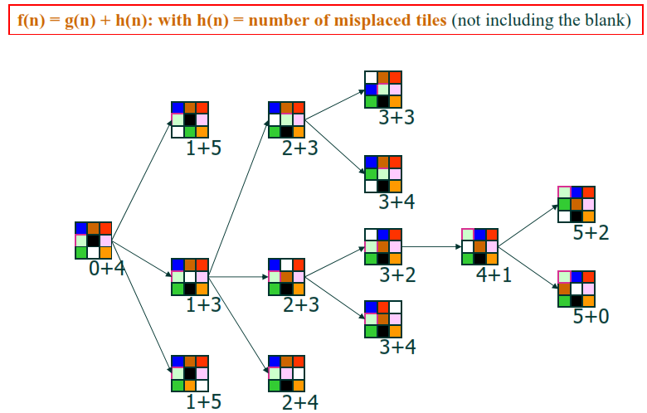
8-Puzzle Example: A* Search

Slide 96
A* Search: Analysis
A* is complete except if there is an infinity of nodes with f < f(G).
A* is optimal if heuristic h is admissible.
Time complexity depends on the quality of heuristic but is still exponential.
For space complexity, A* keeps all nodes in memory. A* has worst case O(b^{d}) space complexity, but an iterative deepening version is possible (IDA*).
Start
A
75
118
140
B
C
111
E
D
80
99
G
F
97
H
211
101
I
Goal

Slide 97
A* Properties
the value of f never decreases along any path starting from the initial node
also known as monotonicity of the function
almost all admissible heuristics show monotonicity
those that don’t can be modified through minor changes
This property can be used to draw contours
regions where the f-cost is below a certain threshold
with uniform cost search (h = 0), the contours are circular
the better the heuristics h, the narrower the contour around the optimal path

Slide 98
A* Snapshot with Contour f=11
Initial
1
9
Visited
4
3
Fringe
11
10
2
7
3
7
Current
Visible
7
2
2
4
Goal
17
11
10
13
4
6
5
5
6
5
7
6
Edge Cost
9
2
5
4
4
4
3
6
9
Heuristics
20
21
14
13
11
12
18
22
7
8
7
9
5
10
4
11
3
12
2
13
4
14
5
15
6
f-cost
10
3
4
7
2
4
8
6
5
4
3
4
2
8
3
9
2
24
24
29
23
18
19
18
16
13
13
14
13
25
21
31
25
Contour
8
7
6
5
4
3
2
1
0
1
2
3
4
5
6
7
16
17
18
19
20
21
22
23
24
25
26
27
28
29
30
31

Slide 99
A* Snapshot with Contour f=13
Initial
1
9
Visited
4
3
Fringe
11
10
2
7
3
7
Current
Visible
7
2
2
4
Goal
17
11
10
13
4
6
5
5
6
5
7
6
Edge Cost
9
2
5
4
4
4
3
6
9
Heuristics
20
21
14
13
11
12
18
22
7
8
7
9
5
10
4
11
3
12
2
13
4
14
5
15
6
f-cost
10
3
4
7
2
4
8
6
5
4
3
4
2
8
3
9
2
24
24
29
23
18
19
18
16
13
13
13
25
21
31
25
Contour
8
7
6
5
4
3
2
1
0
1
3
4
5
6
7
16
17
18
19
20
21
22
23
24
25
14
27
28
29
30
31
2
26

Slide 100
Admissible heuristics
A heuristic h(n) is admissible if for every node n, h(n) ≤ h*(n), where h*(n) is the true cost to reach the goal state from n
An admissible heuristic never overestimates the cost to reach the goal, i.e., it is optimistic
Example: straight line distance never overestimates the actual road distance
Theorem: If h(n) is admissible, A* is optimal

Slide 101
Optimality of A*
f(n*) = C*
n*
n
f(n) > C*
n'
g(n') ≥ f(n) > C*
Suppose A* terminates its search at n* (cost C*)
It has found a path to the goal whose actual cost f(n*) = g(n*), since h(n*)=0, is lower than the estimated cost f(n) of any path going through any fringe node
Since f(n) is an optimistic estimate, there is no way n can have a successor goal state n’ with g(n’) < C*

Slide 102
Optimality of A*
A* is optimally efficient – no other tree-based algorithm that uses the same heuristic can expand fewer nodes and still be guaranteed to find the optimal solution
Any algorithm that does not expand all nodes with f(n) < C* risks missing the optimal solution

Slide 103
Properties of A*
Complete?
Yes – unless there are infinitely many nodes with f(n) ≤ C*
Optimal?
Yes
Time?
Number of nodes for which f(n) ≤ C* (exponential)
Space?
Exponential

Slide 104
Designing heuristic functions
Heuristics for the 8-puzzle
h₁(n) = number of misplaced tiles
h₂(n) = total Manhattan distance (number of squares from desired location of each tile)
h₁(start) = 8
h₂(start) = 3+1+2+2+2+3+3+2 = 18
Are h₁ and h₂ admissible?

Slide 105
Heuristics from relaxed problems
A problem with fewer restrictions on the actions is called a relaxed problem
The cost of an optimal solution to a relaxed problem is an admissible heuristic for the original problem
If the rules of the 8-puzzle are relaxed so that a tile can move anywhere, then h₁(n) gives the shortest solution
If the rules are relaxed so that a tile can move to any adjacent square, then h₂(n) gives the shortest solution

Slide 106
Heuristics from subproblems
Let h₃(n) be the cost of getting a subset of tiles (say, 1,2,3,4) into their correct positions
Can precompute and save the exact solution cost for every possible subproblem instance – pattern database

Slide 107
Dominance
If h₁ and h₂ are both admissible heuristics and h₂(n) ≥ h₁(n) for all n, then h₂ dominates h₁
Which one is better for search?
A* search expands every node with f(n) < C* or h(n) < C* – g(n)
Therefore, A* search with h₁ will expand more nodes

Slide 108
Dominance
Typical search costs for the 8-puzzle (average number of nodes expanded for different solution depths): d:depth
d=12 IDS = 3,644,035 nodes A*(h₁) = 227 nodes A*(h₂) = 73 nodes
d=24 IDS ≈ 54,000,000,000 nodes A*(h₁) = 39,135 nodes A*(h₂) = 1,641 nodes

Slide 109
Combining heuristics
Suppose we have a collection of admissible heuristics h₁(n), h₂(n), …, h_{m}(n), but none of them dominates the others
How can we combine them?
h(n) = max{h₁(n), h₂(n), …, h_{m}(n)} ???

Slide 110
Weighted A* search
Idea: speed up search at the expense of optimality
Take an admissible heuristic, “inflate” it by a multiple α > 1, and then perform A* search as usual
Fewer nodes tend to get expanded, but the resulting solution may be suboptimal (its cost will be at most α times the cost of the optimal solution)

Slide 111
Memory-bounded search
The memory usage of A* can still be large
How to make A* more memory-efficient while maintaining completeness and optimality?
Iterative deepening A* search
Recursive best-first search, SMA*
Forget some subtrees but remember the best f-value in these subtrees and regenerate them later if necessary
Problems: memory-bounded strategies can be complicated to implement, suffer from “thrashing”: keep needing things thought irrelevant!

Slide 112
Uninformed search strategies
Algorithm | Complete? | Optimal? | Time complexity | Space complexity
BFS
UCS
DFS
IDS
Yes
If all step costs are equal
O(b^{d})
O(b^{d})
Yes
Yes
Number of nodes with g(n) ≤ C*
No
No
O(b^{m})
O(bm)
Yes
If all step costs are equal
O(b^{d})
O(bd)
b: maximum branching factor of the search tree
d: depth of the optimal solution
m: maximum length of any path in the state space
C*: cost of optimal solution
Notes:
When is UCS equivalent to BFS?
Can the complexity of UCS exceed the complexity of BFS?
How to make DFS complete?
When is DFS better than BFS?

Slide 113
All search strategies
Algorithm | Complete? | Optimal? | Time complexity | Space complexity
BFS
UCS
DFS
IDS
Greedy
A*
Yes
If all step costs are equal
O(b^{d})
O(b^{d})
Yes
Yes
Number of nodes with g(n) ≤ C*
No
No
O(b^{m})
O(bm)
Yes
If all step costs are equal
O(b^{d})
O(bd)
Worst case: O(b^{m})
No
No
Best case: O(bd)
Yes
Yes
Number of nodes with g(n)+h(n) ≤ C*

Slide 114
So far: Global Search
→ methods that systematically explore the search space, possibly using principled pruning (e.g., A*)
Current best such algorithm can handle search spaces of up to 10¹⁰⁰ states / around 500 binary variables
What if we have much larger search spaces?
Search spaces for some real-world problems might be much larger - e.g. 10^{30,000} states. Also some spaces are continuous!
→ A completely different kind of method is called for:
Local search methods or Iterative Improvement Methods (or Metaheuristics, OR)

Slide 115
Local Search
Approach quite general used in:
planning, scheduling [e.g. class scheduling], routing, configuration, protein folding, etc.
In fact, many (most?) large Operations Research problems are solved using local search methods (e.g., airline scheduling).

Slide 116
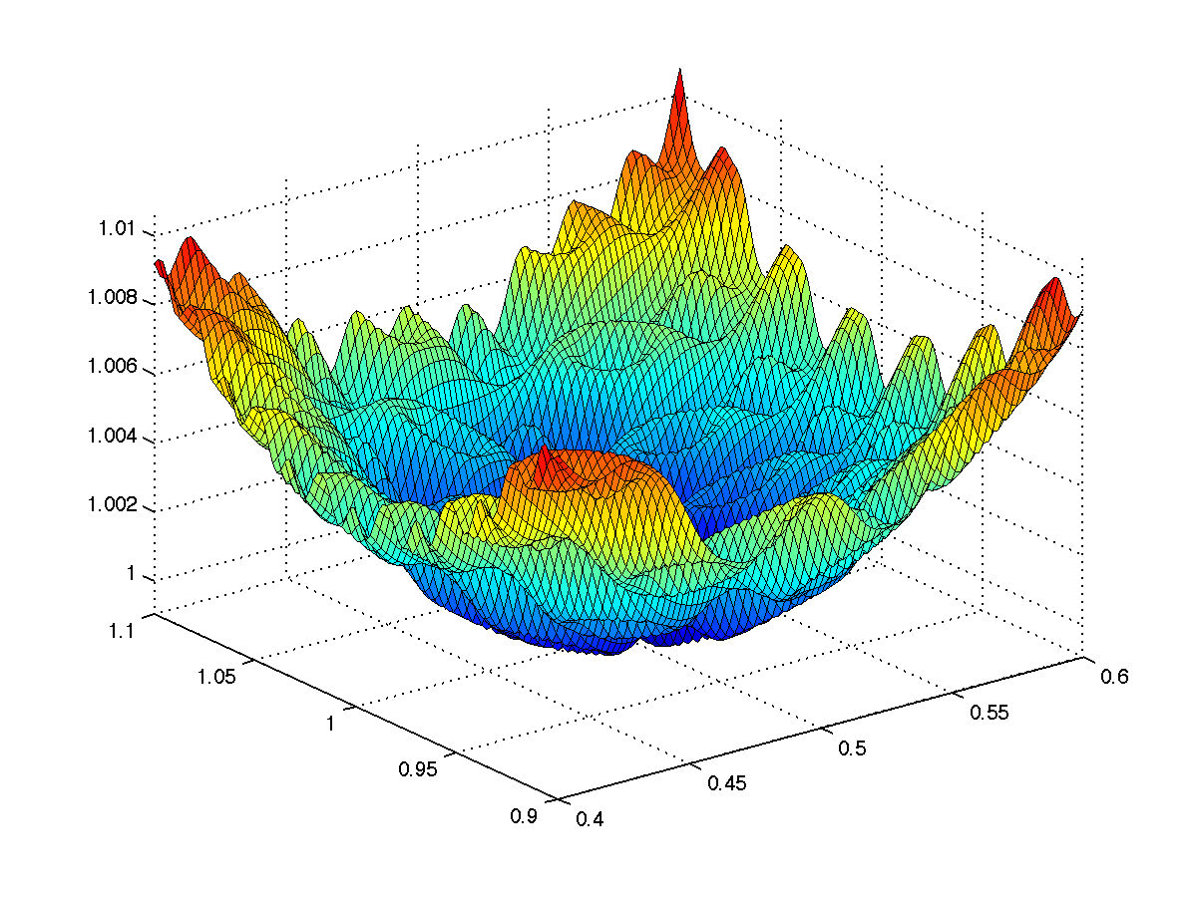
Local search algorithms
Some types of search problems can be formulated in terms of optimization
We don’t have a start state, don’t care about the path to a solution
We have an objective function that tells us about the quality of a possible solution, and we want to find a good solution by minimizing or maximizing the value of this function

Slide 117
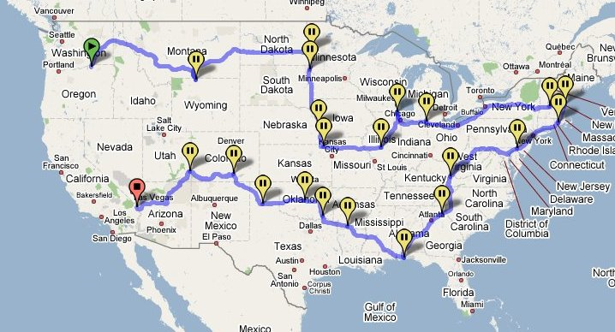
Example: Traveling salesman problem
Find the shortest tour connecting a given set of cities
State space: all possible tours
Objective function: length of tour

Slide 118
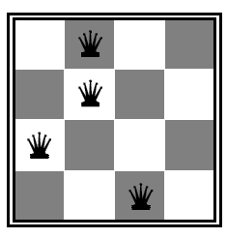
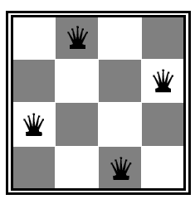
Example: n-queens problem
Put n queens on an n × n board with no two queens on the same row, column, or diagonal
State space: all possible n-queen configurations
What’s the objective function?
Number of pairwise conflicts

Slide 119
Local Search
Key idea (surprisingly simple):
Select (random) initial state (initial guess at solution)
Make local modification to improve current state
Repeat Step 2 until goal state found (or out of time) (or close enough to an optimal state).
Requirements:
generate an initial (often random; probably-not-optimal or even valid) guess
evaluate quality of guess
move to other states (well-defined neighborhood function) choosing better states
. . . and do these operations quickly
. . . and don't save paths followed

Slide 120
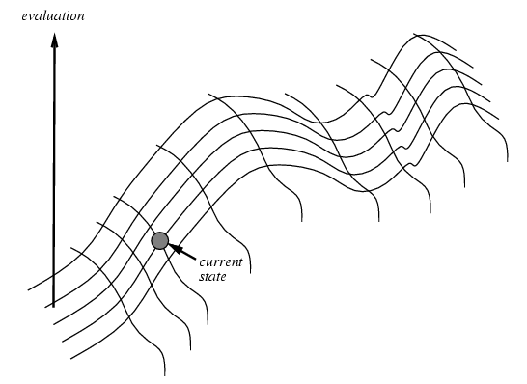
Hill-climbing (greedy) search
Idea: keep a single “current” state and try to locally improve it
“Like climbing mount Everest in thick fog with amnesia”

Slide 121
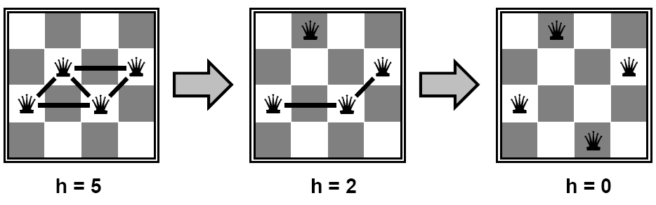
Example: n-queens problem
Put n queens on an n × n board with no two queens on the same row, column, or diagonal State space: all possible n-queen configurations
Objective function: number of pairwise conflicts
What’s a possible local improvement strategy?
Move one queen within its column to reduce conflicts
start intermediate Goal

Slide 122
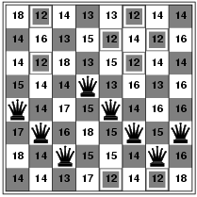
Example: n-queens problem
Put n queens on an n × n board with no two queens on the same row, column, or diagonal State space: all possible n-queen configurations
Objective function: number of pairwise conflicts
What’s a possible local improvement strategy?
Move one queen within its column to reduce conflicts
h = 17

Slide 123
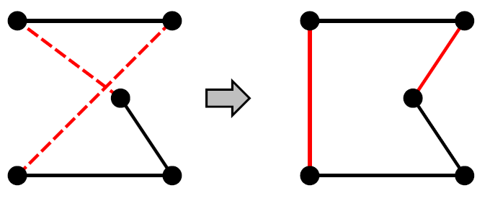
Example: Traveling Salesman Problem
Find the shortest tour connecting n cities
State space: all possible tours
Objective function: length of tour
What’s a possible local improvement strategy?
Start with any complete tour, perform pairwise exchanges
A
B
A
B
C
C
D
E
D
E
ABDEC
ABCED

Slide 124
Hill-climbing (greedy) search
Initialize current to starting state
Loop:
Let next = highest-valued successor of current
If value(next) < value(current) return current
Else let current = next
Variants: choose first better successor, randomly choose among better successors

Slide 125
8 Queens Min-Conflicts Heuristic
1
2
2
0
3
2
3
2
2
2
2
2
3
2
Pick initial complete assignment (at random)
Repeat
Pick a conflicted variable var (at random)
Set the new value of var to minimize the number of conflicts
If the new assignment is not conflicting then return it
(Min-conflicts heuristics)

Slide 126
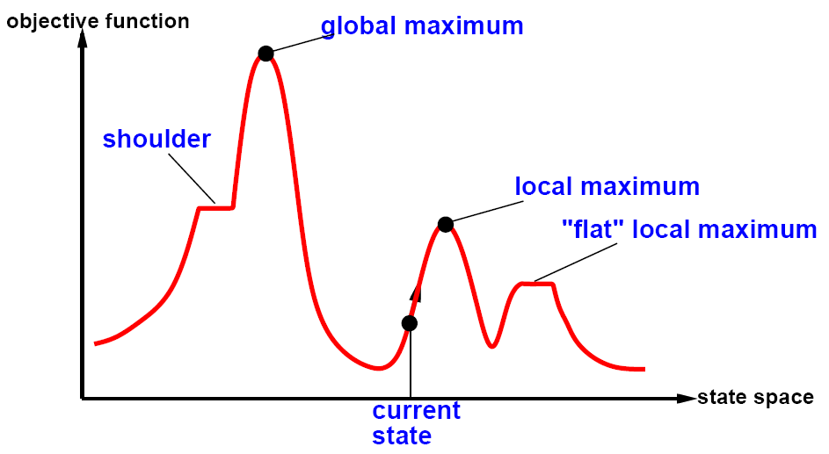
The state space “landscape”
How to escape local maxima?
Random restart hill-climbing
What about “shoulders”?
What about “plateaux”?

Slide 127
Hill-climbing search
Is it complete/optimal?
No – can get stuck in local optima

Slide 128
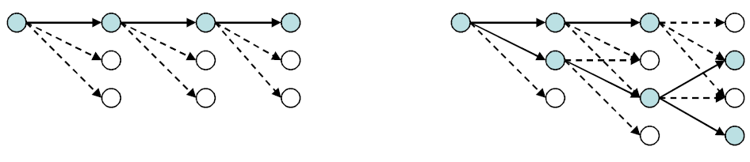
Local beam search
Start with k randomly generated states
At each iteration, all the successors of all k states are generated
If any one is a goal state, stop; else select the k best successors from the complete list and repeat
Is this the same as running k greedy searches in parallel?
Greedy search
Beam search

Slide 129
Simulated Annealing
Idea:
Use conventional hill-climbing style techniques, but
occasionally take a step in a direction other than that in which there is improvement (downhill moves).
As time passes, the probability that a down-hill step is taken is gradually reduced and the size of any down-hill step taken is decreased.
Notes:
Purpose of SA is to avoid local maxima. (Most frequently encountered difficulty with hill climbing.) Idea... [allows downhill steps occasionally].
The undirected steps won't in general reduce the ability of the procedure to find a global maximum (although they might increase the running time). But they may dislodge the problem solver from a foothill, i.e., a local maximum.
Q: Why large steps at first?
A: To avoid local maxima that extend over a wide area of the search space. Like doing a lot of exploring of the whole search space early. Subsequent undirected steps are smaller because we expect to only have to avoid more restricted local maxima.
Name came from an analogy with metal-casting.

Slide 130
Simulated annealing search
One can prove: If temperature decreases slowly enough, then simulated annealing search will find a global optimum with probability approaching one
However:
This usually takes impractically long
The more downhill steps you need to escape a local optimum, the less likely you are to make all of them in a row

Slide 131
Local search for CSPs/Coming Soon!

Slide 132

Genetic Algorithms
Another class of iterative improvement algorithms
A genetic algorithm maintains a population of candidate solutions for the problem at hand, and makes it evolve by iteratively applying a set of stochastic operators
Inspired by the biological evolution process
Uses concepts of “Natural Selection” and “Genetic Inheritance” (Darwin 1859)
Originally developed by John Holland (1975)

Slide 133
High-level Algorithm
Randomly generate an initial population[chromosomes]
Evaluate the fitness of population [evaluation Function: e.g. # of 1s for each chromosome]
Select parents and “reproduce” the next generation [crossover]
Replace the old generation with the new generation: may keep some of the old (say by keeping based on Evaluation Function]
Repeat step 2 though 4 till iteration N
Notes:
T is predefined by the user.

Slide 134
Stochastic Operators
Cross-over
decomposes two distinct solutions and then
randomly mixes their parts to form novel solutions
Mutation
randomly perturbs [changes] a candidate solution
Flip a 1 to 0 or exchange cities in TSP

Slide 135
Flow Diagram of the Genetic Algorithm Process
Describe
Problem
Generate
Initial
Solutions
Step 1
Test: is initial
solution good enough?
Yes
Stop
No
Step 2
Select parents
to reproduce
Step 3
Apply crossover process
and create a set of offspring
Apply random mutation
Step 4
Step 5

Slide 136
Genetic Algorithm Operators:
Mutation and Crossover
Parent 1
1 0 1 0 1 1 1
Parent 2
1 1 0 0 0 1 1
How are the
children produced?
Child 1
1 0 1 0 0 1 1
Child 2
1 1 0 0 1 1 1
Mutation
1 1 0 0 1 1 1
0

Slide 137
Genetic algorithms
A successor [child] state is generated by combining two parent states
Start with k randomly generated states (population)
A state is represented as a string over a finite alphabet (often a string of 0s and 1s)
Evaluation function (fitness function). Higher values for better states.[e.g. number of 1’s if that is positive]
Produce the next generation of states by selection, crossover, and mutation

Slide 138
Example: The Knapsack Problem
You are going on an overnight hike and have a number of items that you could take along.
Each item has a weight (in pounds) and a benefit or value to you on the hike(for measurements sake let’s say, in US dollars), and you can take one of each item at most.
There is a capacity limit on the weight you can carry (constraint).
This problem only illustrates one constraint, but in reality there could be many constraints including volume, time, etc.

Slide 139
GA Example: The Knapsack Problem
Item: 1 2 3 4 5 6 7
Benefit: 5 8 3 2 7 9 4
Weight: 7 8 4 10 4 6 4
Knapsack holds a maximum of 22 pounds
Fill it to get the maximum benefit
Solutions take the form of a string of 1’s and 0’s. Also known as strings of genes called Chromosomes
0101010
1101100
0100111

Slide 140
Example: The Knapsack Problem
We represent a solution as a string of seven 1s and 0s and the fitness function as the total benefit, which is the sum of the gene values in a string solution times their representative benefit coefficient.
The method generates a set of random solutions (initial parents), uses total benefit as the fitness function and selects the parents randomly to create generations of offspring by crossover and mutation.
Possible solutions generated by the system using Reproduction, Crossover, or Mutations
0101010
1101100
0100110

Slide 141
Knapsack Example Solution 1
Item | 1 | 2 | 3 | 4 | 5 | 6 | 7
Solution | 0 | 1 | 0 | 1 | 0 | 1 | 0
Benefit | 5 | 8 | 3 | 2 | 7 | 9 | 4
Weight | 7 | 8 | 4 | 10 | 4 | 6 | 4
Benefit 8 + 2 + 9 = 19
Weight 8 + 10 + 6 = 24

Slide 142
Knapsack Example Solution 2
Item | 1 | 2 | 3 | 4 | 5 | 6 | 7
Solution | 1 | 1 | 0 | 0 | 1 | 0 | 0
Benefit | 5 | 8 | 3 | 2 | 7 | 9 | 4
Weight | 7 | 8 | 4 | 10 | 4 | 6 | 4
Benefit 5 + 8 + 7 = 20
Weight 7 + 8 + 4 = 19

Slide 143
Knapsack Example Solution 3
Item | 1 | 2 | 3 | 4 | 5 | 6 | 7
Solution | 0 | 1 | 0 | 0 | 1 | 1 | 1
Benefit | 5 | 8 | 3 | 2 | 7 | 9 | 4
Weight | 7 | 8 | 4 | 10 | 4 | 6 | 4
Benefit 8 + 7 + 9 + 4 = 28
Weight 8 + 4 + 6 + 4 = 22

Slide 144
Knapsack Example
Solution 3 is clearly the best solution and has met our conditions, therefore, item number 2, 5, 6, and 7 will be taken on the hiking trip. We will be able to get the most benefit out of these items while still having weight equal to 22 pounds.
This is a simple example illustrating a genetic algorithm approach.

Slide 145
Knapsack Example
1101100 + 0100110 (crossover)= 1100110 + 0101100
0101010➔ mutation: 0100110
Evaluate: 1100110, 0101100 and 0100110 .
Benefit 5 + 8 + 7 + 9 = 29
Weight 7 + 8 + 4+6 = 25
Item | 1 | 2 | 3 | 4 | 5 | 6 | 7
Solution | 1 | 1 | 0 | 0 | 1 | 1 | 0
Benefit | 5 | 8 | 3 | 2 | 7 | 9 | 4
Weight | 7 | 8 | 4 | 10 | 4 | 6 | 4

Slide 146
Knapsack Example
1101100 + 0100110 (crossover)= 1100110 + 0101100
0101010➔ mutation: 0100110
Evaluate: 1100110, 0101100 and 0100110.
Benefit 5 + 3 + 2 + 7 = 17
Weight 7 + 4 + 10+4 = 25
Item | 1 | 2 | 3 | 4 | 5 | 6 | 7
Solution | 1 | 0 | 1 | 1 | 1 | 0 | 0
Benefit | 5 | 8 | 3 | 2 | 7 | 9 | 4
Weight | 7 | 8 | 4 | 10 | 4 | 6 | 4

Slide 147
Knapsack Example
1101100 + 0100110 (crossover)= 1100110 + 0101100
0101010➔ mutation: 0100110
Evaluate: 1100110, 0101100 and 0100110.
Benefit 8 + 7 + 9 = 24
Weight 8 + 4+6 = 18
Item | 1 | 2 | 3 | 4 | 5 | 6 | 7
Solution | 0 | 1 | 0 | 0 | 1 | 1 | 0
Benefit | 5 | 8 | 3 | 2 | 7 | 9 | 4
Weight | 7 | 8 | 4 | 10 | 4 | 6 | 4

Slide 148
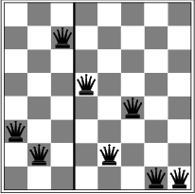
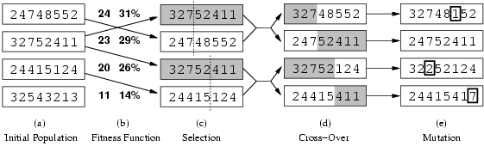
Genetic algorithms
production of next generation
Fitness function: number of non-attacking pairs of queens (min = 0, max = 8 × 7/2 = 28 → the higher the better) 24/(24+23+20+11) = 31% 23/(24+23+20+11) = 29% etc
random mutation
crossover point randomly generated
probability of a given pair selection
proportional to the fitness (b)

Slide 149
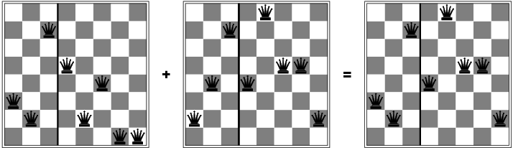
Genetic algorithms

Slide 150
Genetic algorithms
Travelling Salesman Problem: TSP
Chromosome: list of cities ordered by visit order
Goodness function: Inverse of the distance covered to visit in that order (or max_distance –distance)
Selection, crossover, mutation as usual.
Note problem with repetition.

Slide 151
Lots of variants of genetic algorithms with different selection, crossover, and mutation rules.
GA have a wide application in optimization – e.g., circuit layout and job shop scheduling
Much wirk remains to be done to formally understand GA’s and to identify the conditions under which they perform well.

Slide 152
Summary
Local search algorithms
Hill-climbing search
Local beam search
Simulated annealing search
Genetic algorithms

Slide 153
Local Search Summary
Surprisingly efficient search technique
Wide range of applications
Formal properties elusive
Intuitive explanation:
Search spaces are too large for systematic search anyway. . .
Area will most likely continue to thrive

