Slide 1
Upper Gastrointestinal disorders

Slide 2
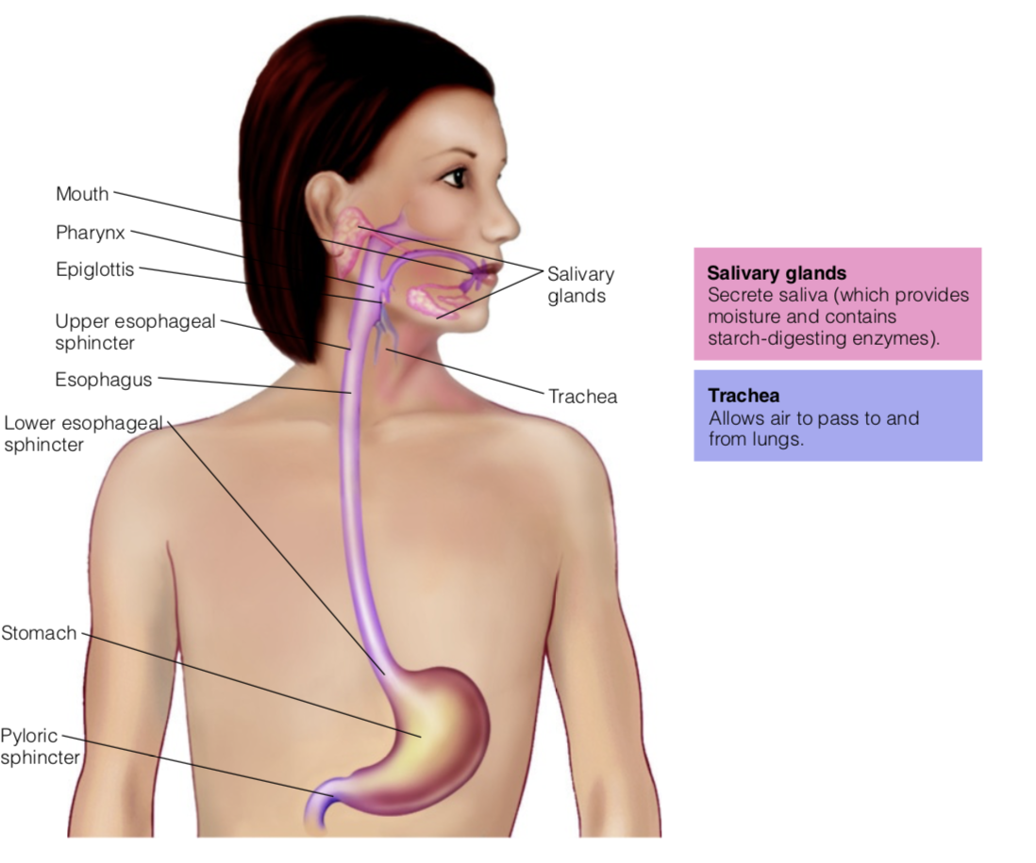
LES:
Allows passage from esophagus to stomach. Prevents backflow from stomach
UES:
Allows passage from mouth to esophagus. Prevents backflow from esophagus
Pyloric sphincter
Allows passage from stomach to small intestine. Prevents backflow from small intestine.

Slide 3
The GI tract is often described as a long tube approximately 15 feet in length (450 cm)
The upper GI tract is composed of the mouth, pharynx, esophagus, and stomach
Motility is the movement of the food consumed along the GI tract. contractions and mixing movements serve to move foodstuffs toward sites of digestion and absorption, but to mix foods with digestive secretions and maximize potential absorption.
Secretions of the GI tract include water, electrolytes, enzymes, bile salts, and mucus.
Epithelial cells in the gut (enterocytes) lined with mucus layer, have tight junctions to protect antigens, bacteria, toxins from entering

Slide 4
In the mouth, the teeth and jaw muscles work together to break down food to a consistency that is easily swallowed.
Upon swallowing, a bolus of food passes through the pharynx to the esophagus, where peristaltic contractions move the bolus toward the stomach.
The lower esophageal sphincter relaxes to allow the bolus to enter the stomach and then closes to prevent reflux (backward flow) of stomach contents

Slide 5
Objectives
Understand how the process of nutrient digestion & absorption is impaired in specific GI diseases
Understand the causes of nutritional risk and/or under-nutrition in various GI conditions and diseases
Know the appropriate dietary recommendations in various GI conditions and diseases

Slide 6
Conditions Affecting the Esophagus
Dysphagia (difficulty swallowing)
Gastroesophageal reflux disease (GERD) : “symptoms or complications resulting from the reflux of gastric contents into the esophagus or beyond, into the oral cavity (including larynx) or lung.”
Physiology:
Upper esophageal sphincter (UES):
remains closed except during swallowing
prevents flow of air into esophagus & stomach
Lower esophageal sphincter (LES)
remains contracted (closed)
closes off stomach entrance
prevents stomach contents from refluxing into esophagus
opens once swallowed material gets to bottom of esophagus

Slide 7
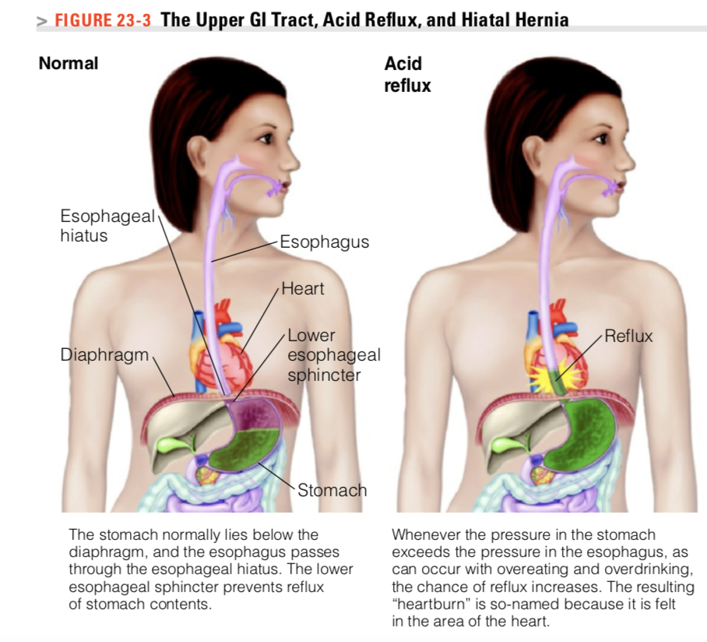
GERD
lower esophageal sphincter (LES) normally serves as a barrier between the esophagus and stomach. Under normal conditions, atmospheric pressure is greater in the esophagus than in the stomach, and this pressure differential typically prevents reflux of gastric contents.

Slide 8
The signs and symptoms experienced with GERD are attributed to a reflux of both gastric acid and pepsin ( heart burn burning sensation starting from behind the breast bone that moves toward neck and throat)/ irritation of esophagus mucosa
Etiology ?
Physical and lifestyle factors
Acute Esophagitis
  Viral or bacterial infection Ingestion of corrosive agents
Chronic Esophagitis
  Low LES pressure
  Delayed gastric emptying
  Hiatal hernia
  Recurrent vomiting
  Increased intra-abdominal pressure
    obesity, pregnancy

Slide 9
Lifestyle factors aggravating GERD
Sleep--body position
Pregnancy
Some drugs, smoking (Nicotine tends to relax smooth muscle Relaxing LES)
Coffee ( Caffeine relaxes LES)
Spicy food, acidic food (irritate)
Fat, chocolate, alcohol (more time in stomach, more acid production, ↓ LES, also alcohol stimulates acid

Slide 10
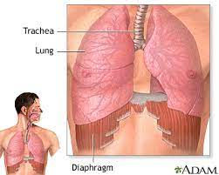
Hiatal Hernia
The esophagus connects the throat to the stomach. It passes through the middle of the chest and enters the abdomen through a hole in the diaphragm called the esophageal hiatus.
The diaphragm is the thin muscle wall that separates the chest cavity from the abdomen. When part of the stomach is herniated or pushes through the abdomen into that opening in the diaphragm, this is what is known as a Hiatal Hernia. This hernia forces food, liquids, and oftentimes stomach acid back up through the esophagus causing the burning, pain, and other symptoms listed above.
https://www.coffeeregional.org/could-a-hiatal-hernia-be-causing-your-reflux/

Slide 11
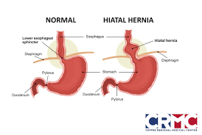
Hiatal Hernia
A portion of the stomach extends above the diaphragm
Pressure forces stomach acid into esophagus – results in GERD & Esophagitis (inflammation (swelling) of the lining of the esophagus
https://www.coffeeregional.org/could-a-hiatal-hernia-be-causing-your-reflux/

Slide 12
Consequences of GERD
Heart burn after meals
Esophagitis
  Severe and chronic inflammation may lead to esophageal ulcers, with consequent bleeding. After healing begins, the scar tissue may narrow the inner diameter of the esophagus, causing esophageal stricture. A slowly progressive dysphagia for solid foods sometimes results, and swallowing occasionally becomes painful
Pulmonary disease may develop if gastric contents are aspirated into the lungs
Damage to

Slide 13
Treatment of GERD
Goal:
Prevent pain & irritation of the inflamed esophageal mucosa
Increasing LES competence
Decreasing gastric acidity, and thus decreasing the severity of symptoms
  Medications that suppress gastric acid secretion help the healing process by reducing the damaging effects of acid on esophageal tissue
3. improving clearance of contents from the esophagus.

Slide 14
Medications
Antacids, which neutralize stomach acid
Histamine-2 receptor blockers :Blocks the action of histamine on the parietal cell and therefore decreases the secretion of acid
Proton Pump Inhibitors
  Irreversible inhibitor of proton pump (H/K ATP’ase) of parietal cell, therefore decreases the secretion of acid
Foaming agent
  Creates barrier on top of stomach that prevents acid reflux from occurring

Slide 15
Lifestyle factors that compromise LES competence such as cigarette smoking, use of medications, obesity, and nutritional history should be addressed. Patient education can focus on ways to improve clearance in the esophagus; for example, patients may be instructed to remain upright after eating, to lose weight, and to raise the head of their bed for sleeping.

Slide 16
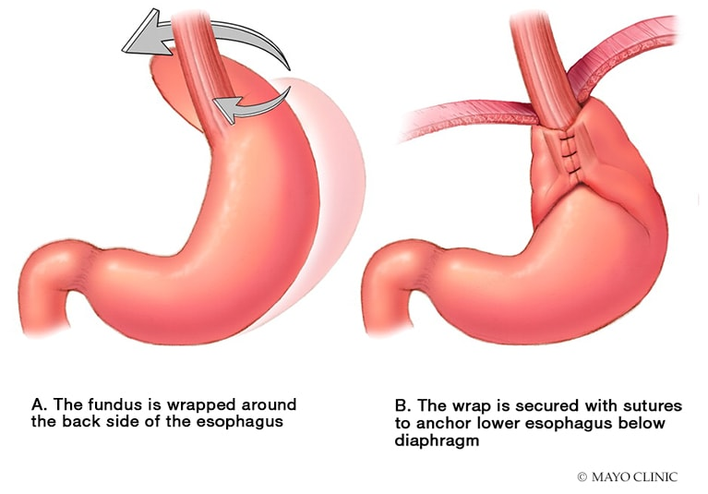
Surgery may be required in severe cases of GERD that are unresponsive to medications and lifestyle changes
fundoplication
  Lower esophagus and sphincter surrounded by stomach muscle
inflatable balloon-like device to dilate esophagus strictures
https://www.mayoclinic.org/medical-professionals/digestive-diseases/news/endoscopic-fundoplication-bridges-gap-in-gerd-management/MAC-20429858

Slide 17
Nutrition Therapy for GERD
Nutrition Diagnosis????
Dietary Management
  Avoid acidic/irritating foods- citrus juice or fruits, tomatoes, soda, spices
  Avoid foods that may increase gastric acid secretion: coffee , alcohol
  Avoid foods that relax (i.e.. lower) LES pressure : fat, chocolate, coffee , alcohol
  Eat Small Frequent meals
  Avoid lying down for 3 hr after meals; elevate head of bed
  Lose weight if obese

Slide 18
Oral Cavity
General problems associated with mouth, teeth, and gums
Dental caries: Tooth decay is destruction of tooth structure through the development of small pits or cavities
The use of liquids with eating helps clear the mouth of food debris and can reduce the potential for caries. Crunchy, high-fiber foods also help clear the mouth of food debris and assist with cleaning the teeth.
Prevention of Dental Disease

Slide 19
Inflammatory Conditions of the oral Cavity
Gingivitis is an inflammation of the gingiva (gums)
The gums appear red and swollen and often bleed; the tissue is very tender and painful. Other symptoms include fever, loss of appetite, foul breath, and a bad taste in the mouth.
Deficiency
Disease progression is associated with Ascorbic acid ( vitamin C) deficiency

Slide 20
Stomatitis is inflammation of the oral mucosa and is often associated with fungal infections OR viruses. It is common in stomatitis to have open ulcerations on the oral mucosa
Common causes include infections, nutritional deficiencies, allergic reactions, radiotherapy
Glossitis: tongue is swollen and inflamed/involves increased redness, swelling, and pain of the tongue and lips
Nutritional deficiencies that can lead to Stomatitis and Glossitis:
B2, B6, B12, folic, niacin, iron

Slide 21
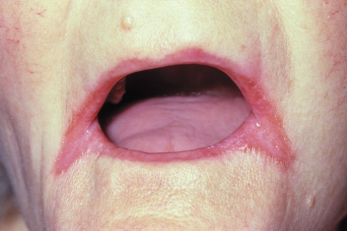
Cheilosis : swelling and fissuring of the lips. It is painful and results in bleeding/ fissuring (splits/lesions) on corner of mouth. associated with infectious organisms including candidiasis or bacteria
Nutritional deficiencies: a sign/symptom of riboflavin, folate, niacin, deficiency

Slide 22
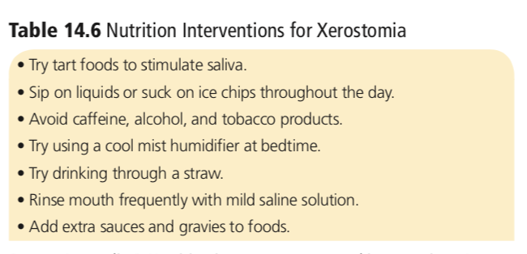
Side effects of chemo- or radiation therapy for oral/esophogeal cancers
Xerostomia: may result from either a disease process or a medical treatment ( lack of saliva)
Salivary glands produce lubrication and amylase
Dry mouth can result in the under consumption of foods due to reduced oral function/ Hard to swallow, lack of taste, more infections and dental caries

Slide 23
Masticatory Insufficiency:
No teeth, or inadequate number and location of teeth, often poorly-fitting dentures
Chewing difficulties
Nutritional Implications:
May choose soft, low-fiber foods (↓ meat & veg)
At risk of nutrient deficiencies, weight loss
**Need to teach acceptable food prep methods; instruct on good nutrient dense foods
Dysgeusia is the condition of altered or impaired sense of taste.
Ageusia is the inability to taste or “mouth blindness.”
Epithelial cells of the oral mucosa have a high turnover rate and can be affected by either chemotherapy or radiation therapy
Certain medications can alter taste

Slide 24
The primary nutrition problem for diseases involving the oral cavity is the inability to maintain adequate oral intake
Foods may be difficult to swallow due to lack of saliva, or the pain of an inflammatory condition or dental disease. When saliva production or quality is impaired, there is an additional risk of infection and dental caries.

Slide 25
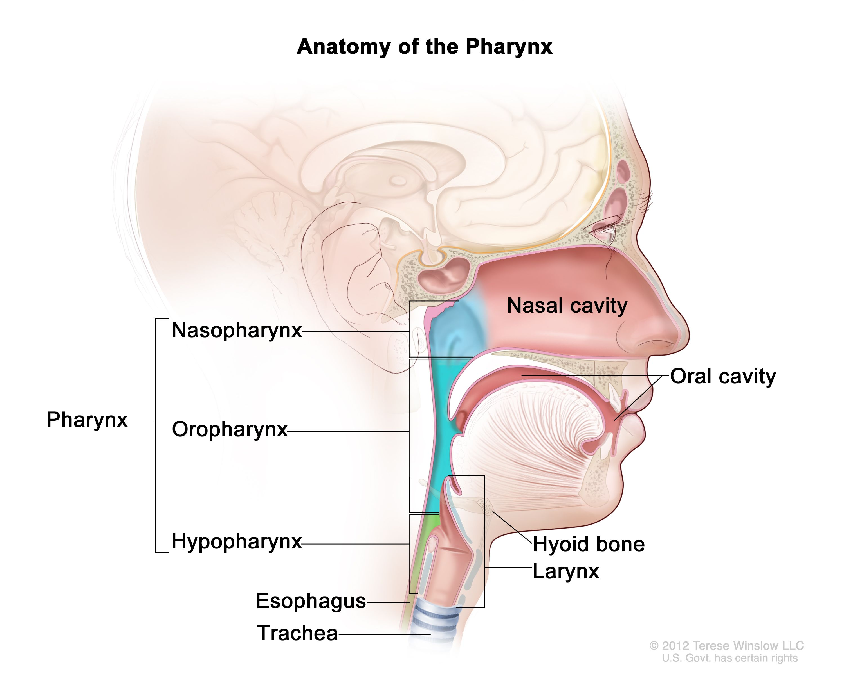
Dysphagia- Issues with swallowing
Swallowing is divided into stages:
Oral phase – voluntary, movement of the bolus from the oral cavity into the oropharynx- involves action of tongue and muscles in the mouth . Epiglottis blocks the opening to the trachea to prevent aspiration of food substances or saliva into the lungs.
Esophageal phase: peristalsis forces the bolus through the esophagus, and the lower esophageal sphincter relaxes to allow passage of the bolus into the stomach

Slide 26
Oropharyngeal Dysphagia: issues moving food from mouth→ pharynx→ esophagus (neuromuscular or structural disorder )
  Can be due to stroke, brain injury, Parkinson’s disease etc.
Esophageal Dysphagia: difficulty passing materials through the esophageal lumen and into the stomach, usually due to an obstruction in the esophagus or a motility disorder ( due to stricture, tumor
  Achalasia: the most common motility disorder, is a degenerative nerve condition affecting the esophagus; it is characterized by the absence of peristalsis and impaired relaxation of the lower esophageal sphincter.

Slide 27
Nutrition Intervention for Dysphagia
Consume foods and beverages that have been physically modified so that they are easier to swallow.
Avoid dehydration and undernutrition
Dietary treatment : Several stages of food modifications
Dysphagia Pureed
Dysphagia Mechanically Altered
Dysphagia Advanced
Appropriate diet consistency -- Individualize
Purees/ Spoon thick
Honey thick
Nectar thick
Thin liquids

Slide 28
The National Dysphagia Diet, developed in 2002 by a panel of dietitians, speech and language therapists, and a food scientist, has helped to standardize the nutrition care of dysphagia patients
The appropriate dietary level is selected
The diet must be adjusted to suit the person’s swallowing abilities and tolerances.
Notes:
The primary nutritional implications are weight loss and subsequent development of nutrient deficiencies that can result from an inadequate dietary intake.

Slide 29
Symptoms
Drooling
Food retention
Choking, coughing
Muscle weakness & motor defects
Diagnosis
Team: Speech Pathologist, RD, Occupational Therapist, Physician
Liquids
A person with dysphagia may aspirate thin liquids more easily
Some are thin and flow quickly. Others are thicker and flow more slowly. Thicker liquids that flow slowly are easier to swallow.

Slide 30
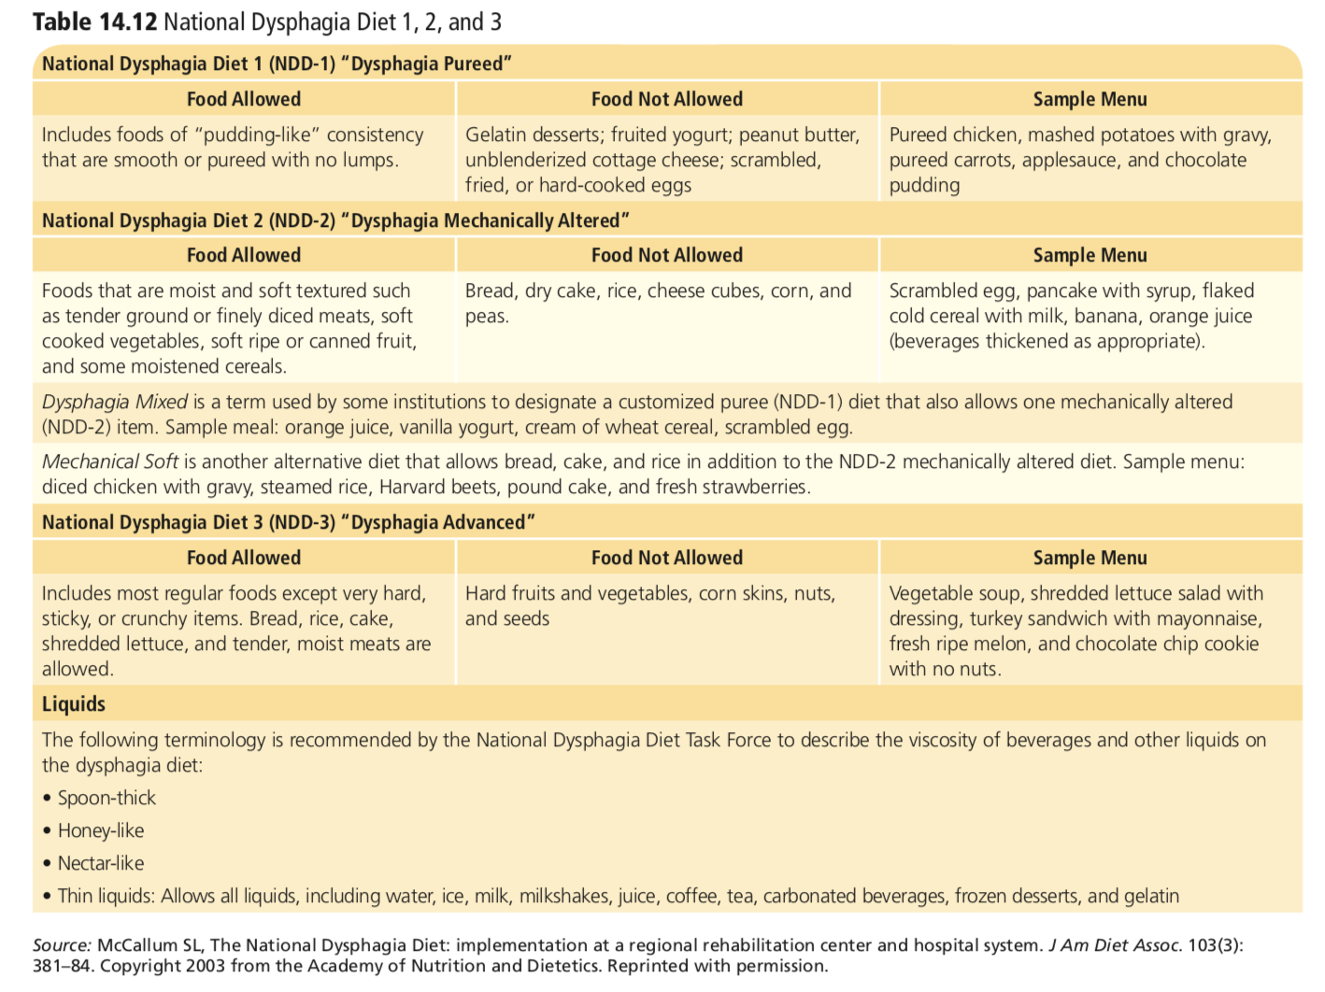

Slide 31
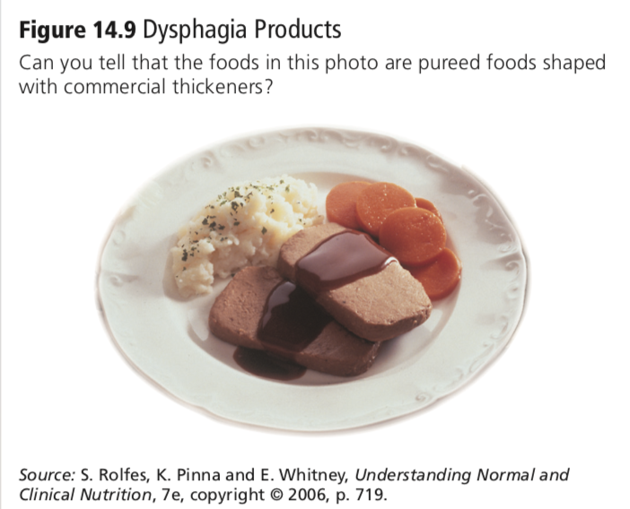
A variety of thickening agents and texture-modified products
Thickening agents are primarily made from carbohydrates, and many foods included in the dysphagia diets are also high in simple sugars--> managing blood glucose for individuals with diabetes may be challenging in this context.

Slide 32
Nausea and Vomiting
Nausea :the unpleasant sensation that there is a need to vomit
Vomiting is the expulsion of gastric contents
Nausea and vomiting occur with many different medical conditions. Such as :Infection, pain, pregnancy, headache, metabolic disorders, motion sickness, kidney failure, myocardial infarction and many more…
Severe vomiting also causes loss of potassium (hypokalemia) and sodium (hyponatremia). The kidneys compensate for these losses by retaining sodium in the collecting ducts at the expense of hydrogen ions
Additionally vomiting results in the loss of hydrochloric acid
Increase in blood pH to >7.45→ metabolic alkalosis

Slide 33
Prolonged nausea and vomiting can have significant clinical consequences.
Forceful vomiting →rupture the esophagus (Boerhaave’s syndrome) tear the lower esophageal sphincter (Mallory-Weiss tear)
  Injury can cause bleeding or hematemesis (Vomiting blood)
Continued vomiting
  Dehydration
  Acid-base imbalances
  Malnutrition can be a long-term consequence for the patient if he or she is not able to ingest an adequate diet for a prolonged amount of time.
If gastric contents are aspirated into the lungs→ aspiration pneumonia
Dental caries

Slide 34
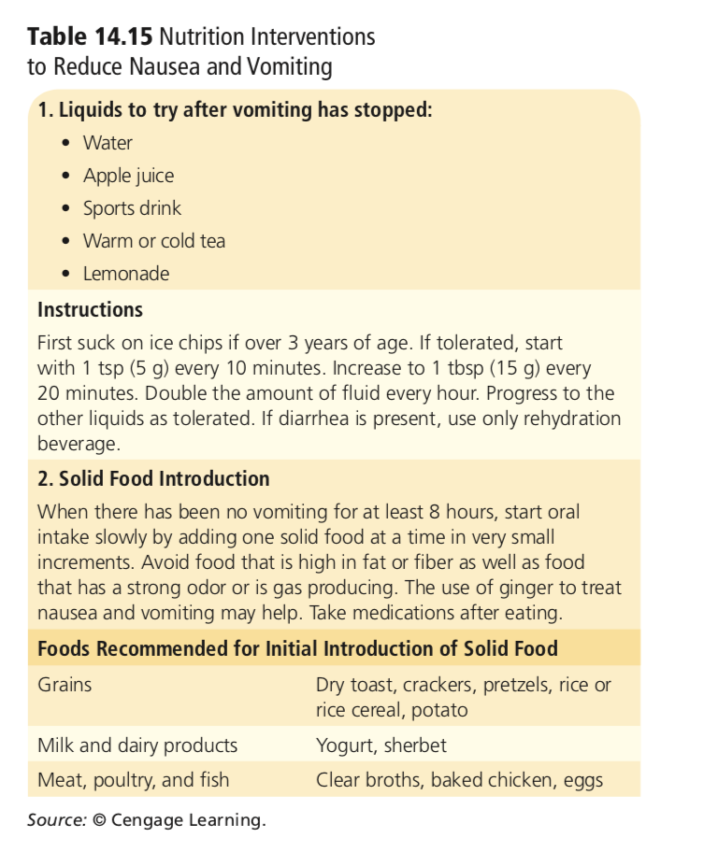
Nutrition Intervention
Nutrition therapy does not necessarily treat nausea and vomiting but can minimize symptoms and discomfort.
maintaining nutritional status and monitor hydration status
To minimize stomach distention, patients should consume small meals and drink beverages between meals rather than during a meal
Notes:
Dry, starchy foods such as toast, crackers, and pretzels may help to reduce nausea, whereas fatty or spicy foods and foods with strong odors may worsen symptoms

Slide 35
Conditions Affecting the Stomach
Diseases and clinical disorders that affect and can influence nutritional status.
Some disorders, such as indigestion, are mild and temporary conditions that resolve easily. Others are chronic and require aggressive medical intervention.

Slide 36
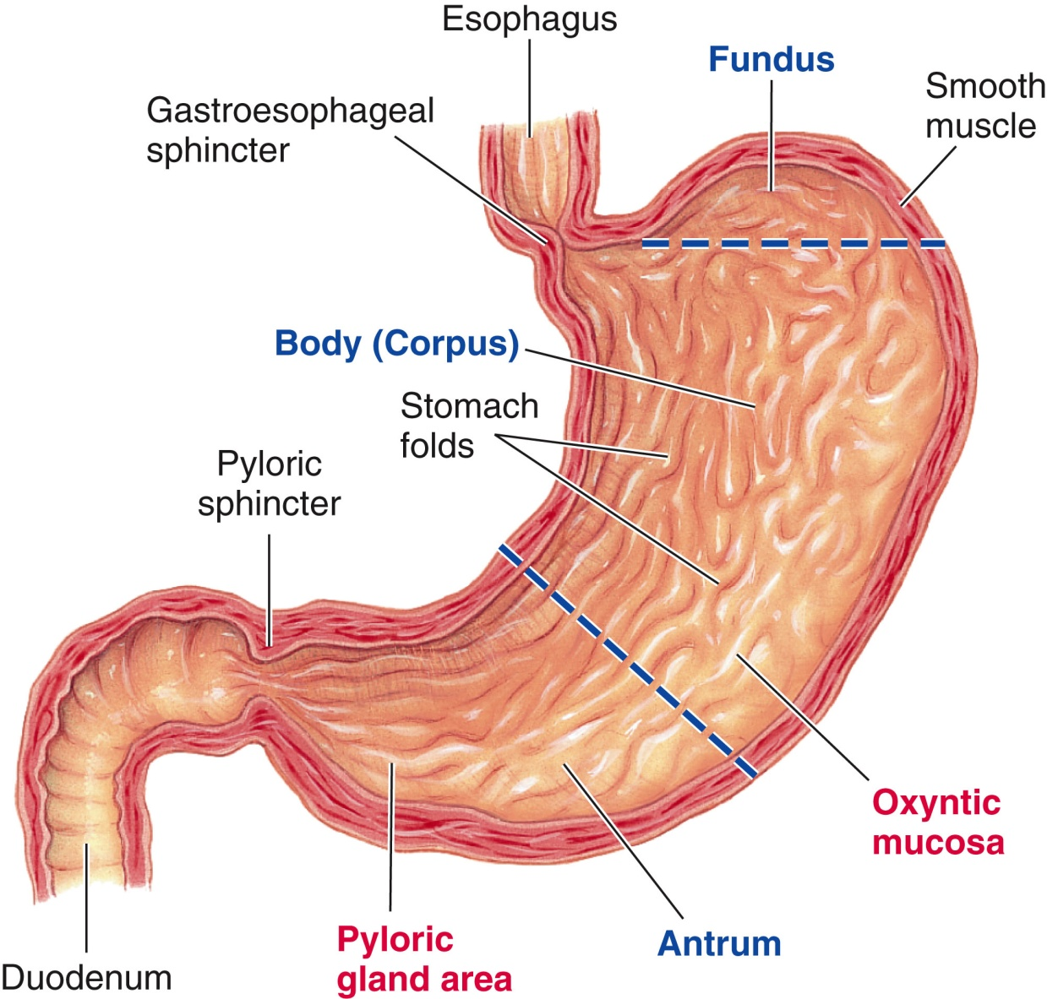
Gastric Mucosa ( inner layer)
Contains gastric gland with specialized cells that pump protons into the gastric lumen in an effort to acidify the contents of the stomach. These cells are known as parietal cells
Parietal Cells
  HCl production
  Activates pepsinogen
  Denatures proteins
  Releases B-12 from food
  Kills bacteria
  IF
Chief Cells
  Pepsinogen
G cells
  Gastrin
Mucus neck cells
  Production of Mucus

Slide 37
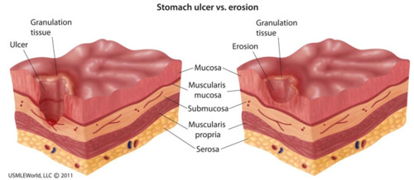
Gastritis
Inflammation of the gastric mucosa
Inflammation & tissue damage
Results from erosion of mucosal layer
Underlying cells are exposed to gastric secretions
Microbes can access exposed cells
May result from numerous conditions
Acute vs. Chronic

Slide 38
Acute Gastritis
Acute onset = rapid onset of inflammation
Cause:
Corrosive chemical ingestion
Food poisoning
Stress ulcers due to trauma & injury (burns, head trauma, decreased blood flow to gastric area)
Treat underlying cause
Antacids & other medications
NPO 1-2 days, or longer as needed
Progress to regular diet
No coffee or smoking

Slide 39
Chronic Gastritis
Chronic onset = over months to decades
Autoimmune disease and may progress to atrophic gastritis (widespread gastric inflammation and tissue atrophy- loss of gastric cells) atrophy of parietal cells = decrease in HCl (achlorhydria)
  Most cases of gastritis result from Helicobacter pylori (H. pylori) infection
  Gram-negative bacteria that produces urease
  or the use of nonsteroidal anti-inflammatory drugs (NSAIDs)
  Pernicious anemia. Pernicious anemia has an autoimmune component whereby antibodies are formed against parietal cells and achlorhydria results. This may lead to vitamin B12-deficiency anemia because intrinsic factor, which is produced in the parietal cells, is necessary for absorption of vitamin B12.
Notes:
Under normal conditions, the gastric mucosa is well protected against injury. The production of mucus provides a barrier that prevents damage to the cells, and their high turnover rate allows for efficient recovery from injury.

Slide 40
Chronic Gastritis
Effects:
Gastric and esophogeal ulcers & Increased risk of cancer
Treatment:
Medications: Antibiotics if H. pylori is present; change to less irritating medication if that is a cause of gastritis
Small, Frequent Meals (SFM)
Avoid irritating foods (Symptoms of gastritis can include belching, anorexia, abdominal pain, vomiting, and, in the more severe cases, bleeding)
Nutritional Management for B-12 deficiency
Take high doses of oral B-12 or monthly intramuscular injections
Use fortified cereals if some IF still produced

Slide 41
Gastroparesis
Motility disorder → delayed stomach emptying
often a consequence of diabetes (high glucose damage nerves extending to stomach) or gastric surgery, but may also be caused by various stomach disorders, neuromuscular diseases, spinal cord injuries
Symptoms nausea, vomiting, early satiety, stomach pain or discomfort, and acid reflux, weight loss , nutrient deficiencies
Treatments
Medical:
  Drug therapies, which improve stomach motility or reduce nausea and vomiting, and electrical stimulation of stomach tissue, which promotes muscle contractions
Dietary
  SFM
  Use practices to improve stomach emptying: drinking fluids with meals, chewing foods well, and remaining upright or walking after meals are consumed
  high in fat or soluble fibers are discouraged

Slide 42
Peptic Ulcer Disease
Peptic ulcer is an open sore that develops in the GI mucosa when gastric acid and pepsin overwhelm mucosal defenses and destroy mucosal tissue→ penetrate the submucosa
usually occur in the antrum of the stomach or in the first few centimeters of the duodenum.
Mucosa tissue break down →attack by the highly acidic environment of the stomach as well as damage from other secretions of the stomach, such as pepsin

Slide 43
Peptic Ulcers
Under normal conditions...
Mucosa of stomach and duodenum is protected from digestive actions of acid and pepsin via Mucus production
Bicarbonate production
Adequate blood flow to maintain tissue barrier functions
Rapid renewal & repair of epithelial cell injury
When these functions are interrupted, injury can occur. Various causes & pathologies can result in ulcers...
Causes of Peptic Ulcers:
H. pylori infection
use of NSAIDs ( cause damage to mucosa and mucus producing glands)
excessive acid secretion
Smoking/stress

Slide 44
Symptoms of Peptic Ulcers
Epigastric pain
  Hunger pain, a sensation of gnawing, or a burning pain in the stomach region. The pain or discomfort of ulcers may be relieved by food (food can ability to dilute any irritants but partial neutralization of gastric acid is followed by a rebound of gastrin release, causing additional stimulation of HCl and probably more pain)
  Pain recur after a meal, especially if the ulcer is duodenal
  Gastric ulcers may be aggravated by food and can cause loss of appetite and eventual weight loss.
Blood in stool or vomit
Changes in white blood cell counts

Slide 45
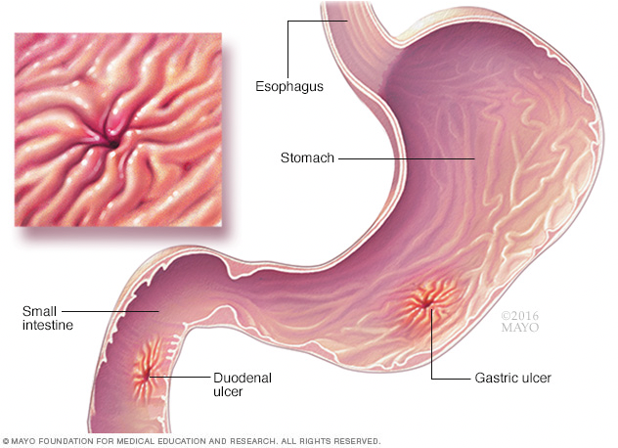
Treatment
The goals of ulcer treatment are to relieve pain, promote healing, and prevent recurrence
Antibiotics used to eradicate H. pylori infection
Discontinuing the use of aspirin and other NSAIDs
Antacids
Proton pump inhibitors
  inhibits last step of acid production
Histamine receptor antagonists (Decrease acid production)
Suppression of acid secretion will ultimately promote healing of the ulceration

Slide 46
MNT
Current nutrition therapy for PUD includes recommending a trial of restriction of foods that may increase acid secretion or cause direct irritation to gastric mucosa.
Examples: black and red pepper, caffeine, coffee (including decaffeinated), and alcohol.
Historically, milk and cream were used to treat PUD, but it is now known that their consumption increases both gastrin and pepsin secretion.
lie down after eating and avoid eating large meals
Small frequent meals
Micronutrients of concern may include iron, calcium, and B12

Slide 47
Gastric Surgery
Gastrectomy: Surgery that removes diseased areas of the stomach
Necessary for treating stomach cancer, some ulcer complications, and ulcers that are resistant to drug therapy.
Bariatric surgery: Surgery that treats severe obesity
Gastric surgeries can interfere with stomach function either temporarily or permanently, patients generally need to make significant dietary adjustments afterward

Slide 48
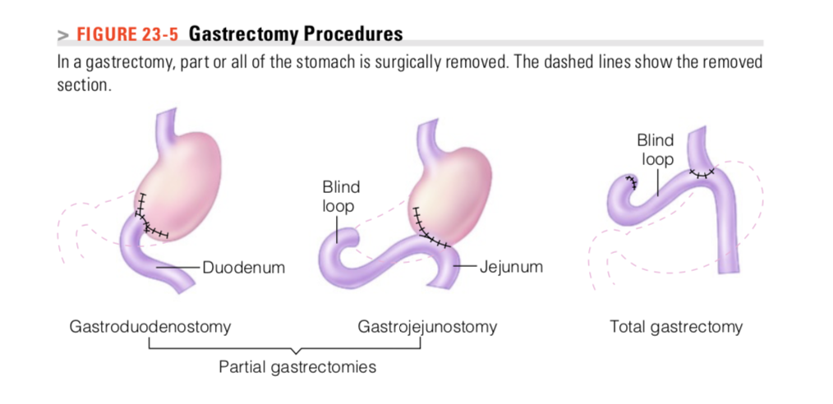
Gastrectomy
Partial gastrectomy: Only part of the stomach is removed, and the remaining portion is connected to the duodenum or jejunum
Total gastrectomy: The surgeon removes the entire stomach and connects the esophagus directly to the small intestine.

Slide 49
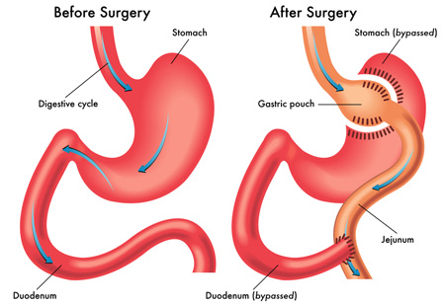
Gastric bypass surgery is a type of bariatric, or weight loss, surgery
  Restricting the amount of food that your stomach holds
  Makes a small stomach pouch
  Surgeon cuts the small intestine and sews part of it directly onto the pouch. Food then goes into this small pouch of stomach and then directly into the small intestine sewn to it
Possible complication: iron, and B12 malabsorption
May also play a role in reduced calcium absorption→ if reduced gastric secretion
Notes:
Fe+3 becomes Fe+2 by acid /Fe+2 more readily absorbed

Slide 50
Nutritional risk is due to reduced capacity of the stomach and potential changes in gastric emptying
Decreased oral intake, maldigestion, and/or malabsorption.
Common complication: iron, B12 malabsorption
May also play a role in reduced calcium absorption→ if reduced gastric secretion
Bone loss due to lower acid and Ca absorption
Weight loss in 60%
B vitamin deficiencies have been reported

Slide 51
Dumping Syndrome
One of the most common complications after gastric surgery
Dumping syndrome occurs when an increased osmolar load enters the small intestine too quickly from the stomach
In a healthy person food may remain in the stomach anywhere from 1- 3 hours as it becomes liquefied and partially digested then enters the duodenum via the pyloric sphincter slowly, so the acidic chyme is neutralized by pancreatic bicarbonate. When the pyloric portion of the stomach is removed, bypassed, or destroyed, the rate of gastric emptying is increased.
When duodenum is bypassed, feedback inhibition is lost

Slide 52
Food “dumps” into the small intestine
Chyme is hyperosmolar, fluid is drawn into the small intestine from blood in an attempt to dilute intestinal contents. These processes result in cramping, abdominal pain, hypermotility, and diarrhea.
Late” dumping syndrome can occur anywhere from 1 to 3 hours after eating, and is especially common after consuming simple carbohydrates. In this situation, rapid absorption in the small intestine stimulates insulin release. After quick movement and absorption of food through the small intestine, blood glucose levels drop rapidly as insulin promotes glucose uptake into the cells. This results in hypoglycemia

Slide 53
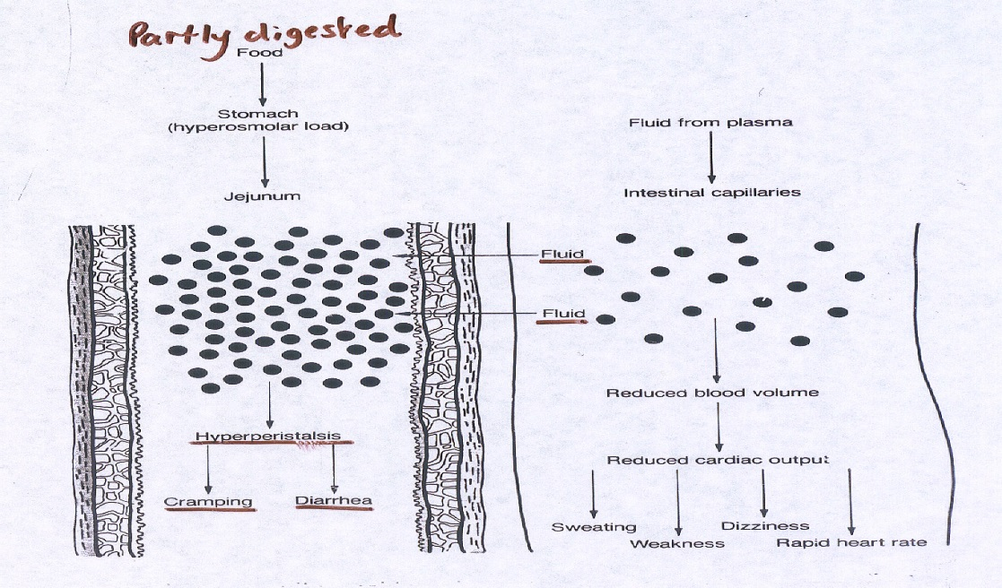
Dietary Management of Dumping Syndrome
Small frequent meals (SFM)
Liquids between (instead of during meals) }
Emphasize high-protein foods (helps with hypoglycemia)
Limit simple sugars
Eat slowly
In some cases, octreotide—a medication that inhibits GI motility and insulin release—may be prescribed to lessen symptoms.

Slide 54
Additional complications related to Gastrectomy ?
After a gastrectomy, it may take time for the patient to learn the amount of food that can be consumed without experiencing discomfort
Fat malabsorption. Fat digestion and absorption may become impaired (accelerated transit of food material may prevent the normal mixing of fat with lipase and bile )
Bypassed duodenum
Bacterial overgrowth, a common consequence of gastric surgeries can lead to changes in bile acids that upset bile function
Supplemental pancreatic enzymes are sometimes provided to improve fat digestion
Medium-chain triglycerides, which are more easily digested and absorbed, can be used to supply additional fat kcalories.

Slide 55
Nutrition Care after Gastrectomy
Meet the nutritional needs of the postsurgical patient
promote the healing of stomach tissue
prevent discomfort or nutrient deficiencies that may arise due to reduced stomach capacity or altered stomach function.
Following a gastrectomy, the oral ingestion of fluids and foods is suspended until some healing has occurred, fluids are supplied intravenously. Oral in- takes may begin with small sips of water, ice chips
Dietary measures after a gastrectomy are determined by the size of the remaining stomach, which influences meal size, and the stomach emptying rate, which affects food tolerances
the patient may require as many as five to eight small meals and snacks per day

Slide 56
Application of the Nutrition Care process
Sara Flores is a 45-year-old Hispanic female who has a 5-year history of gastroesophageal reflux disease. Mrs. Flores presented to her physician with complaints of chronic indigestion and increased abdominal pain. She is now status post endoscopy, which revealed a 2 cm duodenal ulcer and generalized gastritis. Biopsy positive for Helicobacter pylori.
Mrs. Flores’s endoscopy indicated that her biopsy was positive for Helicobacter pylori. What is this and how is it related to her duodenal ulcer?

Slide 57
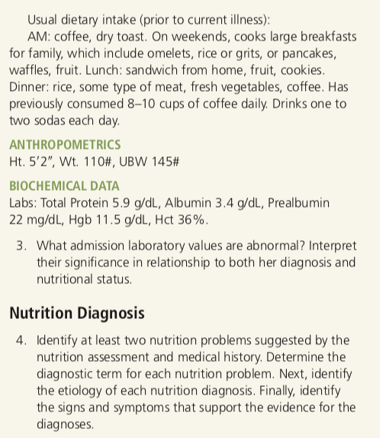
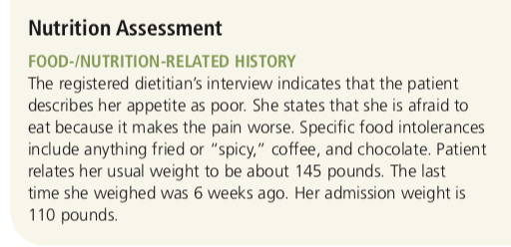
Hgb: 11.5 g/dL (normal 12–15 g/dL)
Hct: 36% (normal 37%–47%)
Protein: 5.9 g/dL (normal 6–8 g/dL)
albumin: 3.4 g/dL (normal 3.5–5 g/dL)
Notes:
Low protein and albumin may be reduced as a response to an active inflammatory process. During inflammation, the synthesis rate of albumin is reduced. Long-term inad- equate oral intake (as evidenced by her history, weight loss, and pain associated with her diagnosis) may have also impacted her albumin levels.
Hgb: 11.5 g/dL (normal 12–15 g/dL); Hct: 36% (normal 37%–47%)
Hgb and Hct are both below the normal range. Both would seem to indicate blood loss and/or anemia.

