Slide 1

Instructor
Dr. Wasel Ghanem
Email:ghanem@birzeit.edu
The content of these slides is a collection of different resources

Slide 2
 Introduce the fundamentals of intelligent sensor systems:
sensors, instrumentation, interfacing techniques and pattern analysis
 Provide the students with an integrative and multidisciplinary experience by building a complete multi-sensor intelligent system
 Allow the students to develop data acquisition and software using modern interfacing techniques and software tools required

Slide 3
 System
A combination of two or more elements, subsystems and parts necessary to carry out one or more functions
To interact with the real world, a system requires
  Sensors: inputs devices
  Actuators: output devices
  Processing: signals, information and knowledge
 Sensor
A device that receives and responds to a stimulus
  Stimulus: mechanical, thermal, magnetic, electric, optical, chemical…
  Response: an electrical signal (in most cases)
 Intelligence
The ability to combine
  A priori knowledge (available before experience) and
  Adaptive learning (from experience

Slide 4
 Several definitions are available
A sensor that is capable of modifying its internal behavior to optimize the collection of data from the external world
  The concepts of adaptation and compensation are central to the Intelligent Sensor philosophy
A device that combines a sensing element and a signal processor on a single integrated circuit
  The minimum requirements of the signal processor are not clear
    Basic integrated electronics (signal conditioning, ADC)
    A micro-processor
    Logic functions and decision making
A smart sensor is a sensor that provides functions beyond those necessary for generating a correct representation of a sensed or controlled quantity (IEEE 1451.2)
  This function typically simplifies the integration of the transducer into applications in a networked environment
“Intelligent” or “Smart” Sensors?

Slide 6

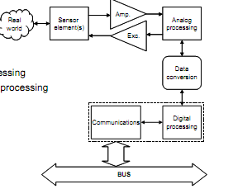
 The principal sub-systems within an ISS are
Primary sensing element(s)
Excitation control
Amplification
Analogue filtering
Data conversion
Compensation
Digital information processing
Digital communications processing

Slide 7
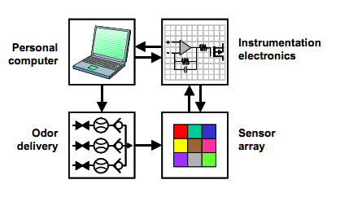
An electronic nose (e-nose) is a device that identifies the specific components of an odor and analyzes its chemical makeup to identify it. An electronic nose consists of a mechanism for chemical detection, such as an array of electronic sensors, and a mechanism for pattern recognition, such as a neural network

Slide 8

Need to diagnose an illness in a hurry? Scientists are developing an 'electronic nose' app for smart phones
Researchers are working to manufacture a smart phone attachment that works when used in conjunction with what they call sensory vapour technology

Slide 9
 Track Everything- the Internet of Things
 The Internet of Things
 System of Systems

Slide 10


Slide 11
 Transducers, sensors and measurements
 Calibration, interfering and modifying inputs
 Static sensor characteristics
 Dynamic sensor characteristics

Slide 12


 Transducer
A device that converts a signal from one physical form to a corresponding signal having a different physical form
  Physical form: mechanical, thermal, magnetic, electric, optical, chemical…
Transducers are ENERGY CONVERTERS or MODIFIERS
 Sensor
A device that receives and responds to a signal or stimulus
  This is a broader concept that includes the extension of our perception capabilities to acquire information about physical quantities
 Transducers: sensors and actuators
Sensor: an input transducer (i.e., a microphone)
Actuator: an output transducer (i.e., a loudspeaker)

Slide 13


 A simple instrument model
A observable variable X is obtained from the measurand
  X is related to the measurand in some KNOWN way (i.e., measuring mass)
 The sensor generates a signal variable that can be manipulated:
Processed, transmitted or displayed
 In the example above the signal is passed to a display, where a measurement can be taken
 Measurement
The process of comparing an unknown quantity with a standard of the same quantity (measuring length) or standards of two or more related quantities (measuring velocity)

Slide 14

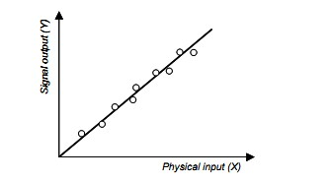
 The relationship between the physical measurement variable (X) and the signal variable (S)
A sensor or instrument is calibrated by applying a number of KNOWN physical inputs and recording the response of the system

Slide 15

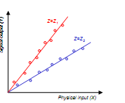

 Interfering inputs (Y)
Those that the sensor to respond as the linear superposition with the measurand variable X
  Linear superposition assumption: S(aX+bY)=aS(X)+bS(Y)
 Modifying inputs (Z)
Those that change the behavior of the sensor and, hence, the calibration curve
  Temperature is a typical modifying input

Slide 16
 Static characteristics
The properties of the system after all transient effects have settled to their final or steady state
  Accuracy
  Discrimination
  Precision
  Errors
  Drift
  Sensitivity
  Linearity
  Hystheresis (backslash)
 Dynamic characteristics
The properties of the system transient response to an input
  Zero order systems
  First order systems
  Second order systems

Slide 17
 Accuracy is the capacity of a measuring instrument to give RESULTS close to the TRUE VALUE of the measured quantity
Accuracy is related to the bias of a set of measurements
(IN)Accuracy is measured by the absolute and relative errors
 Discrimination is the minimal change of the input necessary to produce a detectable change at the output
Discrimination is also known as RESOLUTION
When the increment is from zero, it is called THRESHOLD

Slide 18

 The capacity of a measuring instrument to give the
same reading when repetitively measuring the same quantity under the same prescribed conditions
Precision implies agreement between successive readings, NOT closeness to the true value
  Precision is related to the variance of a set of measurements
Precision is a necessary but not sufficient condition for accuracy
 Two terms closely related to precision
Repeatability
  The precision of a set of measurements taken over a short time interval
Reproducibility
  The precision of a set of measurements BUT
    taken over a long time interval or
    Performed by different operators or
    with different instruments or
    in different laboratories

Slide 19
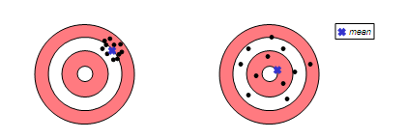
 Shooting darts
Discrimination
  The size of the hole produced by a dart
Which shooter is more accurate?
Which shooter is more precise?

Slide 20

 Systematic errors
Result from a variety of factors
  Interfering or modifying variables (i.e., temperature)
  Drift (i.e., changes in chemical structure or mechanical stresses)
  The measurement process changes the measurand (i.e., loading errors)
  The transmission process changes the signal (i.e., attenuation)
  Human observers (i.e., parallax errors)
Systematic errors can be corrected with COMPENSATION methods (i.e.,
  feedback, filtering)
 Random errors
Also called NOISE: a signal that carries no information
True random errors (white noise) follow a Gaussian distribution
Sources of randomness:
  Repeatability of the measurand itself (i.e., height of a rough surface)
  Environmental noise (i.e., background noise picked by a microphone)
  Transmission noise (i.e., 60Hz hum)
Signal to noise ratio (SNR) should be >>1
  With knowledge of the signal characteristics it may be possible to interpret a signal with a low SNR (i.e., understanding speech in a loud environment)

Slide 21

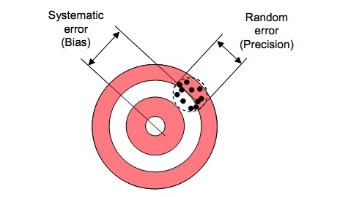
https://uncertainty.nist.gov/

Slide 22
Suppose a reading of 27.5 mV results from the sensor used. Find the temperature that could provide this reading.

Slide 23
System Accuracy
Often, one must consider the overall accuracy of many elements
in a process-control loop to represent a process variable. Generally, the best way to do this is to express the accuracy of each element in terms of the transfer functions.

Slide 24
A control system was installed to regulate the weight of potato chips dumped into bags in a packaging operation. Given samples of 15 bags drawn from the operation before and after the control system was installed, evaluate the success of the system. Do this by comparing the arithmetic mean and standard deviations before and after. The bags should be 200 g.
Samples before: 201, 205, 197, 185, 202, 207, 215, 220, 179, 201, 197, 221, 202,
200, 195
Samples after: 197, 202, 193, 210, 207, 195, 199, 202, 193, 195, 201, 201, 200, 189, 197

Slide 26
 Input range
The maximum and minimum value of the physical variable that can be measured (i.e., -40F/100F in a thermometer)
Output range can be defined similarly
 Sensitivity
The slope of the calibration curve y=f(x)
  An ideal sensor will have a large and constant sensitivity
Sensitivity-related errors: saturation and “dead-bands”
 Linearity
The closeness of the calibration curve to a specified straight line
(i.e., theoretical behavior, least-squares fit)
 Monotonicity
  A monotonic curve is one in which the dependent variable always increases or decreases as the independent variable increases
 Hystheresis
The difference between two output values that correspond to the same input depending on the trajectory followed by the sensor (i.e., magnetization in ferromagnetic materials)
  Backslash: hystheresis caused by looseness in a mechanical joint

Slide 28

 The sensor response to a variable input is different from that
exhibited when the input signals are constant (the latter is described by the static characteristics)
 The reason for dynamic characteristics is the presence of energy-storing elements
Inertial: masses, inductances
Capacitances: electrical, thermal
 Dynamic characteristics are determined by analyzing the response of the sensor to a family of variable input waveforms:
Impulse, step, ramp, sinusoidal, white noise…

Slide 29


 The dynamic response of the sensor is (typically) assumed to
 be linear
Therefore, it can be modeled by a constant-coefficient linear differential equation
In practice, these models are confined to zero, first and second order. Higher order models are rarely applied
 These dynamic models are typically analyzed with the Laplace transform, which converts the differential equation into a
polynomial expression
Think of the Laplace domain as an extension of the Fourier transform
  Fourier analysis is restricted to sinusoidal signals
    x(t) = sin(ωt) = e-jωt
  Laplace analysis can also handle exponential behavior
    x(t) = e-σtSin(ωt) = e-(σ +jω)

Slide 30
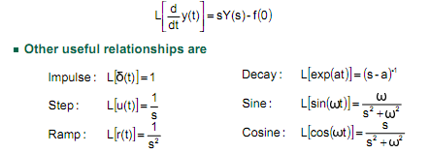
 The Laplace transform of a time signal y(t) is denoted by
L[y(t)] = Y(s)
  The s variable is a complex number s=σ+jω
  The real component σ defines the real exponential behavior
  The imaginary component defines the frequency of oscillatory behavior
 The fundamental relationship is the one that concerns the transformation of differentiation

Slide 31
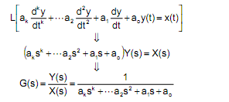
 Applying the Laplace transform to the sensor model yields
G(s) is called the transfer function of the sensor
➢The position of the poles of G(s) -zeros of the denominator- in the s-plane determines the dynamic behavior of the sensor
such as
•Oscillating components
•Exponential decays
•Instability

Slide 32

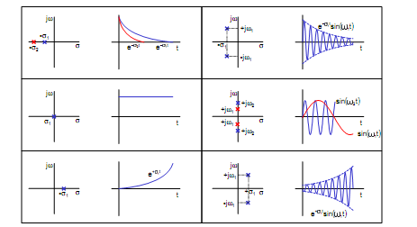

Slide 33


 Input and output are related by an equation of the type
Zero-order is the desirable response of a sensor
  No delays
  Infinite bandwidth
  The sensor only changes the amplitude of the input signal
Zero-order systems do not include energy-storing elements
Example of a zero-order sensor
  A potentiometer used to measure linear and rotary displacements
    This model would not work for fast-varying displacements

Slide 34

 Inputs and outputs related by a first-order
differential equation
First-order sensors have one element that stores energy and one that dissipates it
Step response
  y(t) = Ak(1-exp(-t/τ))
    A is the amplitude of the step
    k (=1/a0) is the static gain, which determines the static response
    τ (=a1/a0) is the time constant, which determines the dynamic response
Ramp response
  y(t) = Akt - Akτu(t) + Akτ exp(-t/τ)
Frequency response
  Better described by the amplitude and phase shift plots

Slide 35
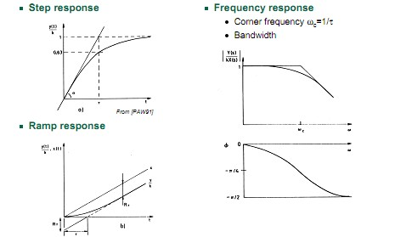

Slide 37
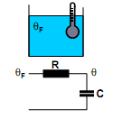


 A mercury thermometer immersed into a fluid
What type of input was applied to the sensor?
Parameters
  C: thermal capacitance of the mercury
  R: thermal resistance of the glass to heat transfer
  θF: temperature of the fluid
  θ(t): temperature of the thermometer
The equivalent circuit is an RC network
 Derivation
Heat flow through the glass
Temperature of the thermometer rises as
Taking the Laplace transform

Slide 38


 Inputs and outputs are related by a second-order
differential equation
We can express this second-order transfer function as
Where
  k is the static gain
  ζ is known as the damping coefficient
  ωn is known as the natural frequency

Slide 39
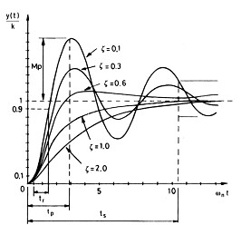
 Response types
Underdamped (ζ<1)
Critically damped (ζ=1)
Overdamped (ζ>1)
 Response parameters
Rise time (tr)
Peak overshoot (Mp)
Time to peak (tp)
Settling time (ts)

Slide 40
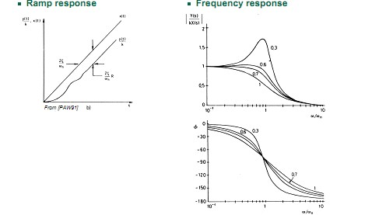

Slide 41
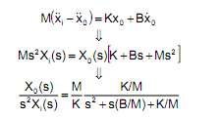
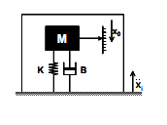
 A thermometer covered for protection
Adding the heat capacity and thermal resistance of the protection yields a second-order system with two real poles (overdamped)
 Spring-mass-dampen accelerometer
The armature suffers an acceleration
  We will assume that this acceleration is orthogonal to the direction of gravity
x0 is the displacement of the mass M with respect to the armature
The equilibrium equation is:
HOMEWORK: Using Matlab, develop an accelerometer

Slide 63
cv

Slide 73
Systems Suited for Analysis with Laplace Transform
Linear Time-Invariant (LTI) Systems: The Laplace transform is particularly well-suited for analyzing systems that are linear and whose parameters do not change over time. An example is an electrical RLC circuit (consisting of resistors, inductors, and capacitors). The Laplace transform simplifies the analysis of such circuits by converting differential equations that describe the circuit behavior into algebraic equations in the s-domain.
System Stability and Control Analysis: For designing controllers for LTI systems or assessing their stability, the Laplace transform provides valuable tools like the Bode plot, Nyquist plot, and Root Locus. For instance, analyzing the stability of an automatic voltage regulator system in a power generation plant can be effectively done using these tools.
Signal Processing: In signal processing, the Laplace transform is used to analyze and design filters (such as low-pass, high-pass, band-pass, and band-stop filters). These systems are typically LTI, and their behavior can be easily manipulated and understood in the s-domain. For example, designing a low-pass filter to remove high-frequency noise from a signal is a classic application of the Laplace transform.

Slide 74
State Space Method
Systems Suited for State Space Representation
Non-linear Systems: Many real-world systems exhibit non-linear behavior that cannot be accurately modeled or analyzed using linear techniques like the Laplace transform. An example is a robotic arm with multiple joints and actuators. The dynamics of such a system, including the non-linearities introduced by the actuators and the kinematics of the arm, can be effectively modeled using state space methods.
Multi-input Multi-output (MIMO) Systems: Complex systems that have multiple inputs and outputs are often more naturally and effectively modeled using state space representation. For example, modern aircraft control systems, which need to manage inputs like throttle, ailerons, elevators, and rudders to control outputs such as pitch, roll, yaw, and velocity, are typically designed using state space methods.
Time-varying Systems: Systems whose parameters change with time can be challenging to analyze with the Laplace transform. An example of a time-varying system could be a satellite control system where the dynamics change significantly depending on the satellite's orientation and position relative to Earth. State space models can accommodate these variations explicitly in their representation.
Notes:
State Space

