Slide 1
The effect of heat on performance-beating the heat
NUTD 337

Slide 2
Topic covered
Thermoregulation
Effect of heat on performance
Dehydration
Drinking
Measuring Sweat Rate & Acclimation

Slide 3
Thermoregulation
Training in hot temperature
Training in cold temperature
Muscle contraction
Core Temperature
Heat dissipation
Muscle contraction
Core Temperature
Minimize heat loss
To prevent a dangerous rise in core temperature the body dissipates heat
To prevent a dangerous fall in core temperature the body minimize heat loss

Slide 4
Mechanism Of Heat Dissipation
Conduction
Direct transmission of heat (only 3% of heat loss)
Convection
Solid medium(human body) and a moving medium (water or air); If temperature is high heat is gained
Radiation
Emission of heat waves from one object and absorption by another (60% of heat loss)
Sweating
Evaporation of sweat
Cooling effect
Through sweat glands
2-4 million sweat glands
Sweat is hypotonic
Similar to plasma with no proteins
Consists of Electrolytes and sodium
Sweat rate
0.5-2 Liter/hour (L/h)

Slide 5
Factors That Affect Sweat Loss
Heat capacity
Lean tissue 0.83 Kcal/kg/ºC
Fat tissue 0.41 Kcal/kg/ºC
Humidity reduces evaporative cooling of sweat!!
Factors that determine sweat losses
Number of sweat glands
acclimation
Exercise duration
Exercise intensity
Clothing
Weather conditions

Slide 6
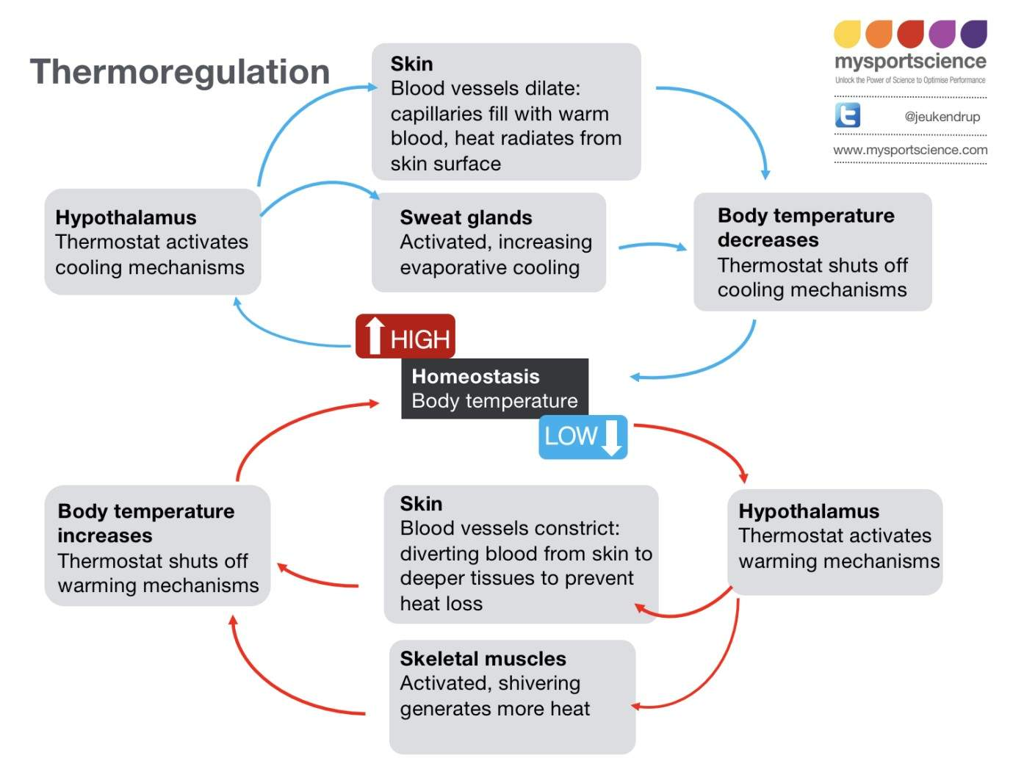
Hypothalamus Thermoregulation
The hypothalamus when detecting a rise in body temperature increases blood flow to skin
through vasodilatation to direct more blood to skin surface and increase heat loss from skin, it also activates sweat glands
To increase evaporative cooling of sweat. When body temperature falls the hypothalamus shuts off warming mechanism s causing
vasoconstriction increasing blood flow to inner tissue instead and activating muscle shivering to generate heat.
Source: Jeukendrup. www.mysportscience.com

Slide 7
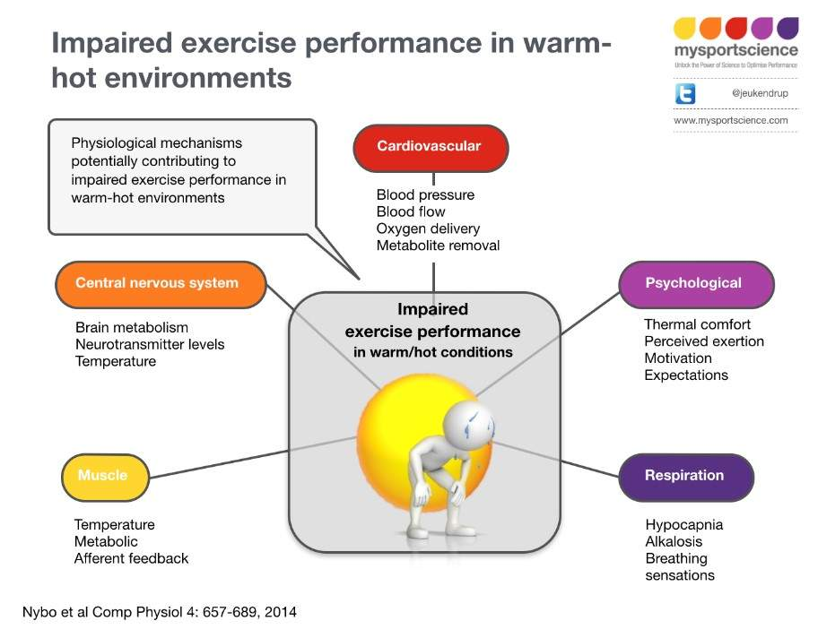
Heat Stress & Performance
Air Temperature and heat stress risk
<22ºC no risk
22ºC-28ºC low risk
> 28ºC high risk
For every 1ºC rise in skin temperature performance is reduced by 1.3%
Best marathon times
achieved at 10-11 ºC

Slide 8
Heat Stress Types & Their Management
1- Heat cramps
2- Heat Syncope Management
Remove from training or competition
Allow player to rest in shade, fan and spray water
Loosen or remove clothing
Provide sips of water
Monitor temperature and check for mental confusion
3- Heat exhaustion and 4- heat stroke management
Immediately call for an ambulance or emergency services
Lay the player down in the shade with legs elevated
Undress the player as much as possible
Poor water over the player and fan
Cool by best means possible, water immersion, ice packs
If patient is conscious give sips of water
Monitor airways and breathing

Slide 9
Effect Of Dehydration
At 2% body weight loss performance not affected
At >2% body weight loss performance aspects are affected
Dehydration: normal body water content
Dehydration : dynamic loss of body water
Effect of dehydration on performance
Reduction in blood volume
Decreased skin blood flow
Decreased heat dissipation
Decreased sweat rate
Increased rate of muscle glycogen use
Increased core temperature

Slide 10
Avoiding performance decrement in Heat- Avoid Dehydration…Drink!
Measure sweat rates of players?
Allow a maximum of 2% weight loss
Consider if extra time is an option
Calculate drink volume to prevent 2% weight loss
Prepare drink with
- carbohydrate, sodium, water
Consider different forms of drink delivery (gel plus water for example).

Slide 11
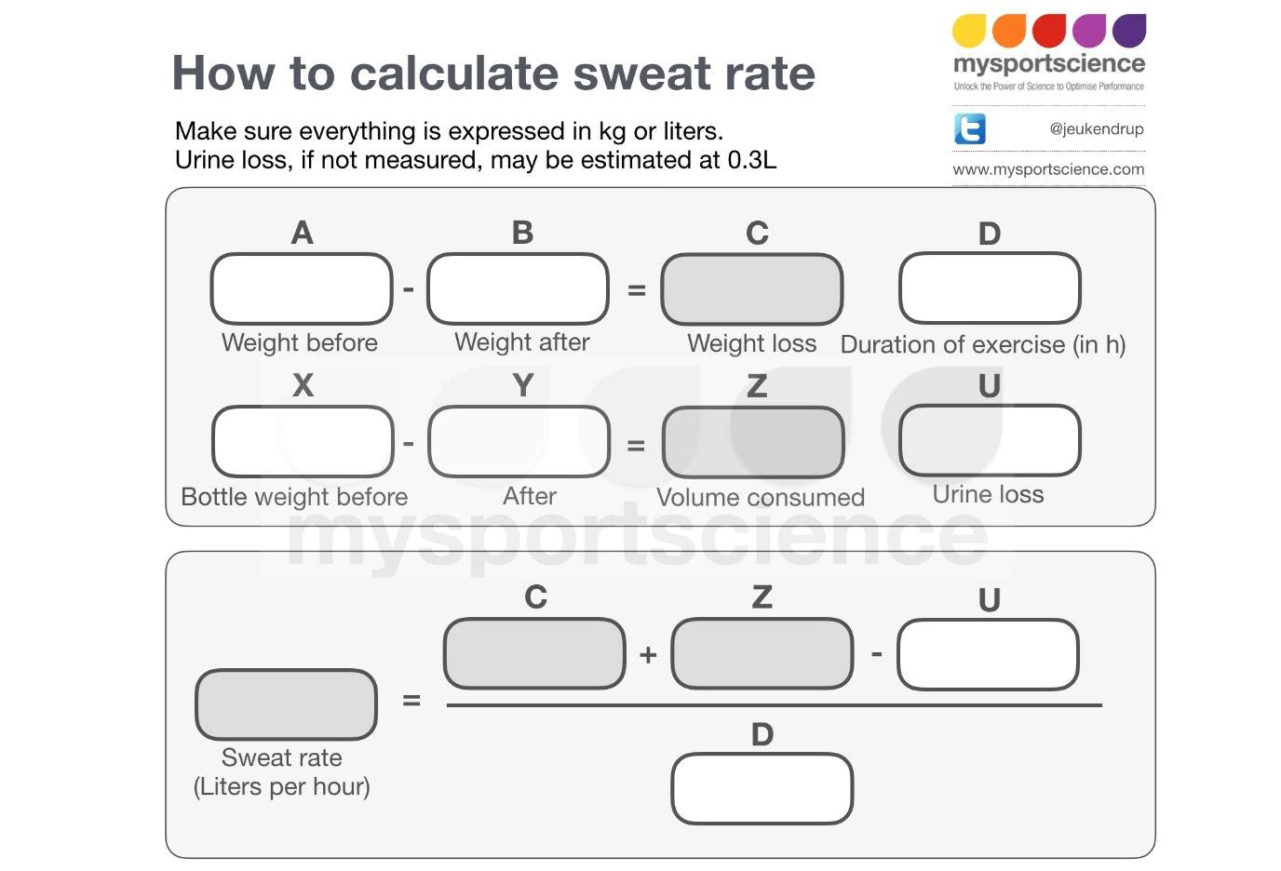
How to measure sweat rate
Source: Jeukendrup. www.mysportscience.com

Slide 12
Acclimation
Train in similar condition- least 60 min/day for 2 weeks (optimal)
Measure sweat rates under similar conditions
Develop hydration strategies based on sweat rates
Pre-cool (avoid major core temperature reduction)
Avoid glycogen depletion

