Slide 1
ADC and DAC
Summery

Slide 2
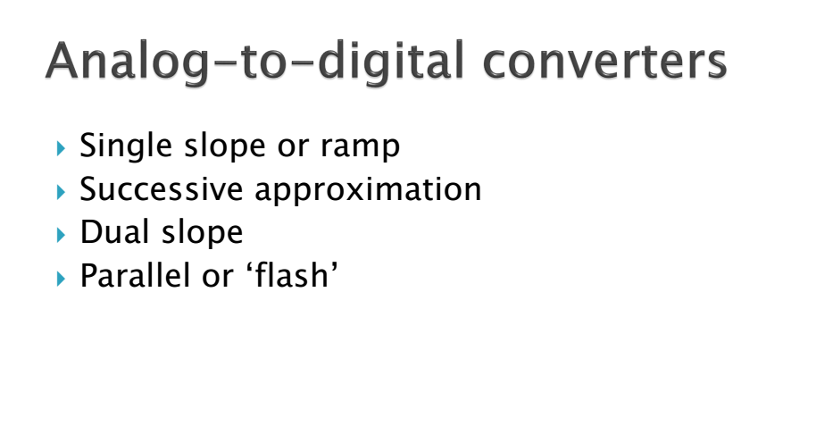

Slide 3
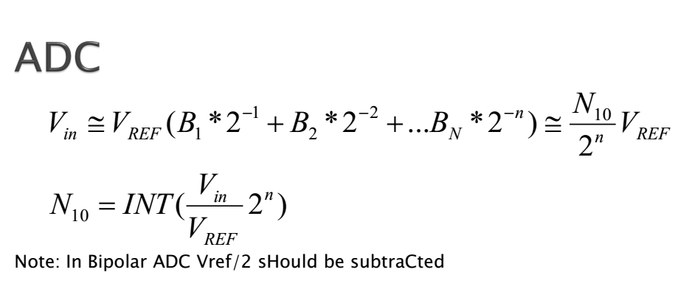
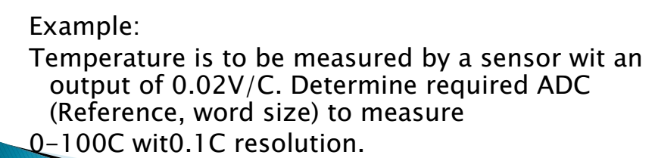

Slide 4
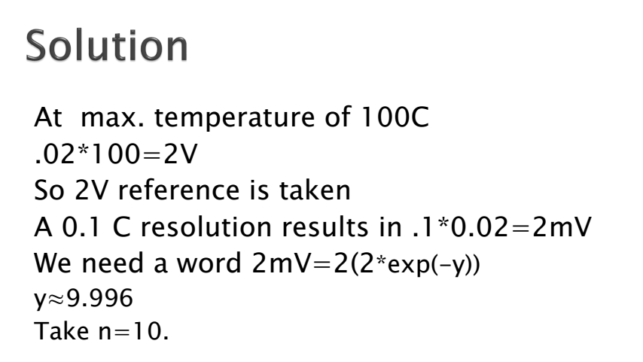

Slide 5
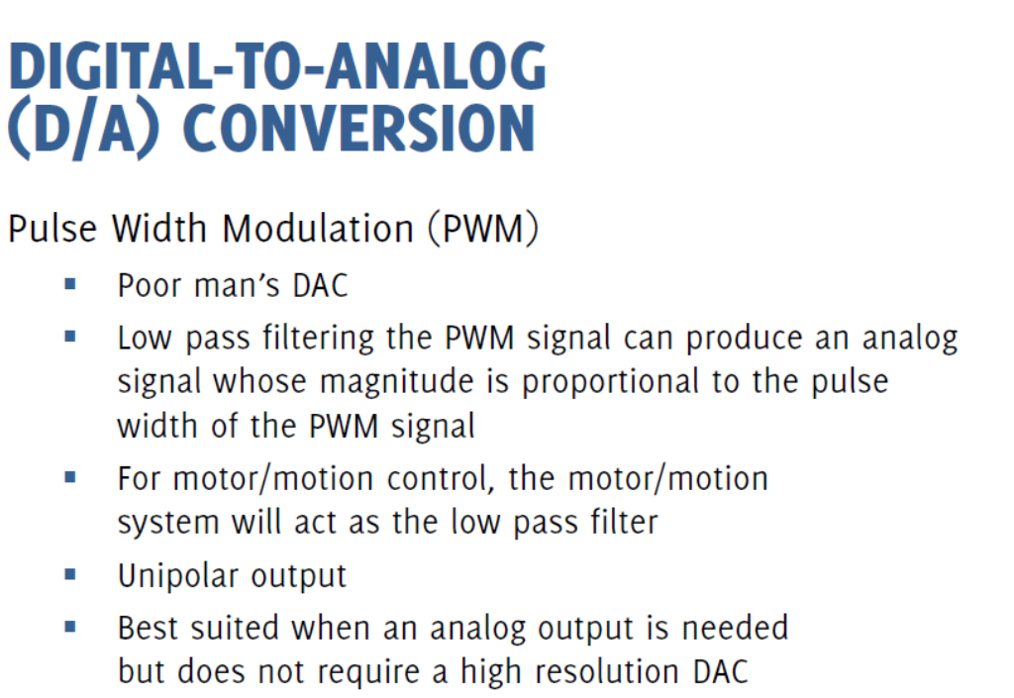

Slide 6
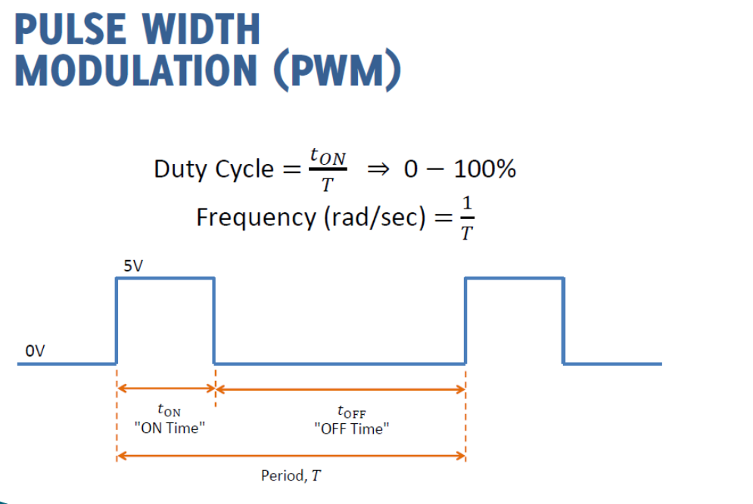

Slide 7
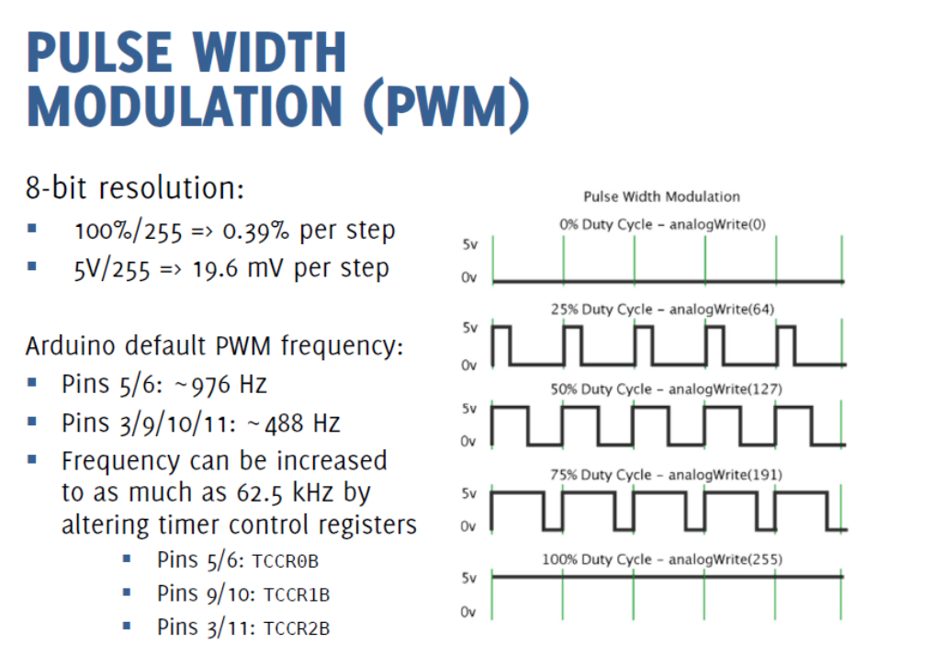
https://circuitdigest.com/microcontroller-projects/arduino-timer-tutorial
https://prototyperobotics.com/steps/2

Slide 8
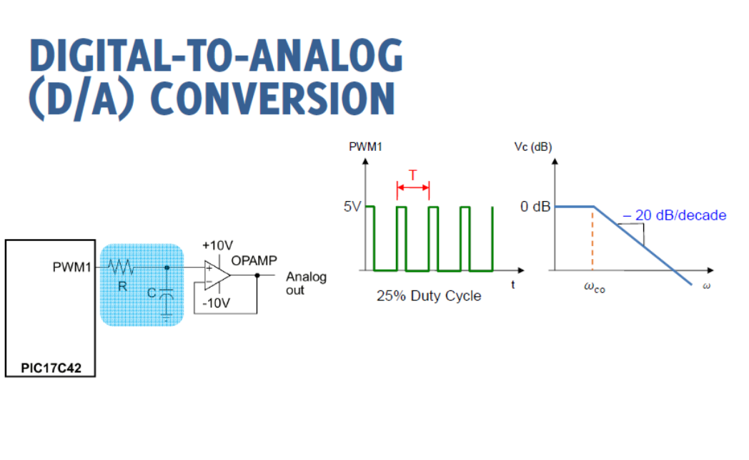

Slide 9
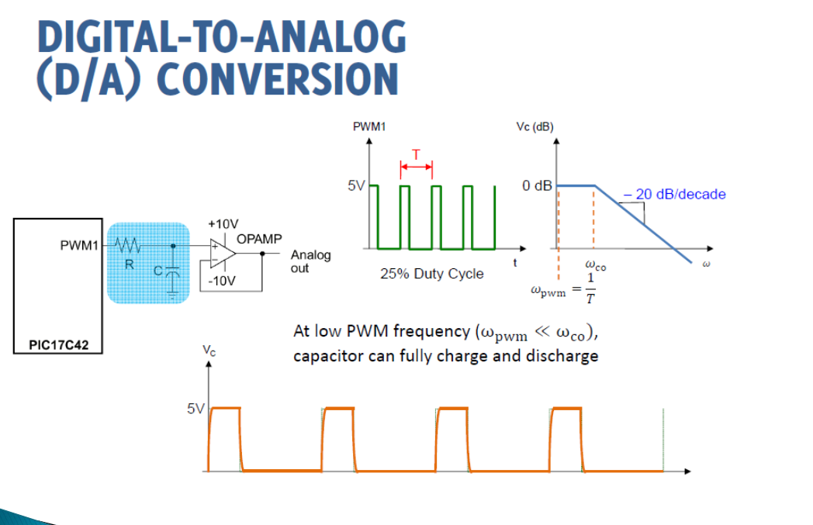

Slide 10
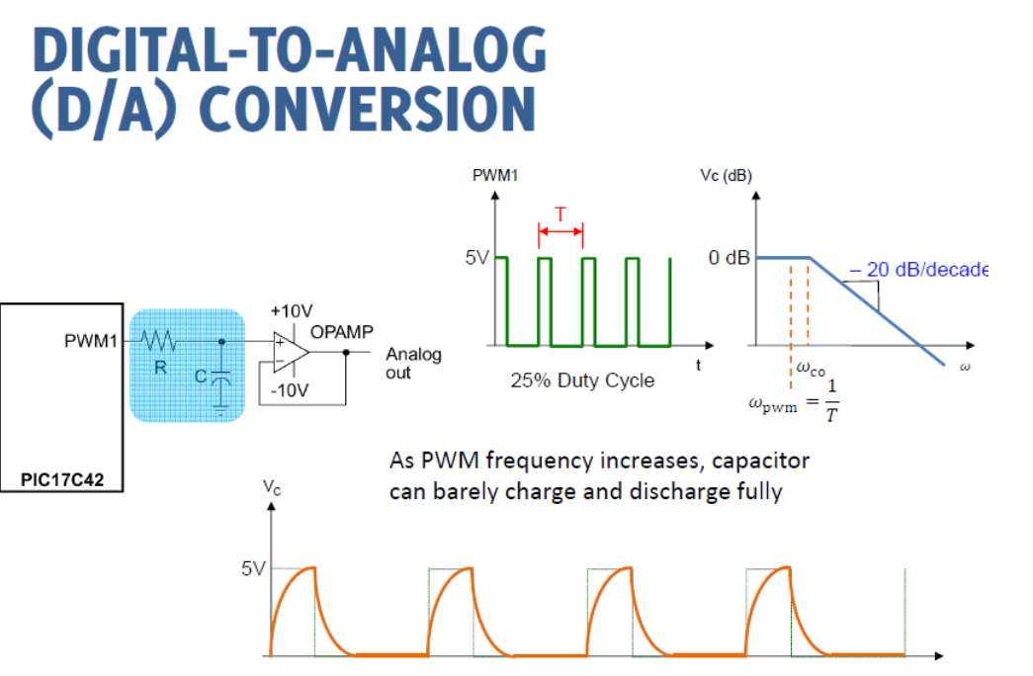

Slide 11
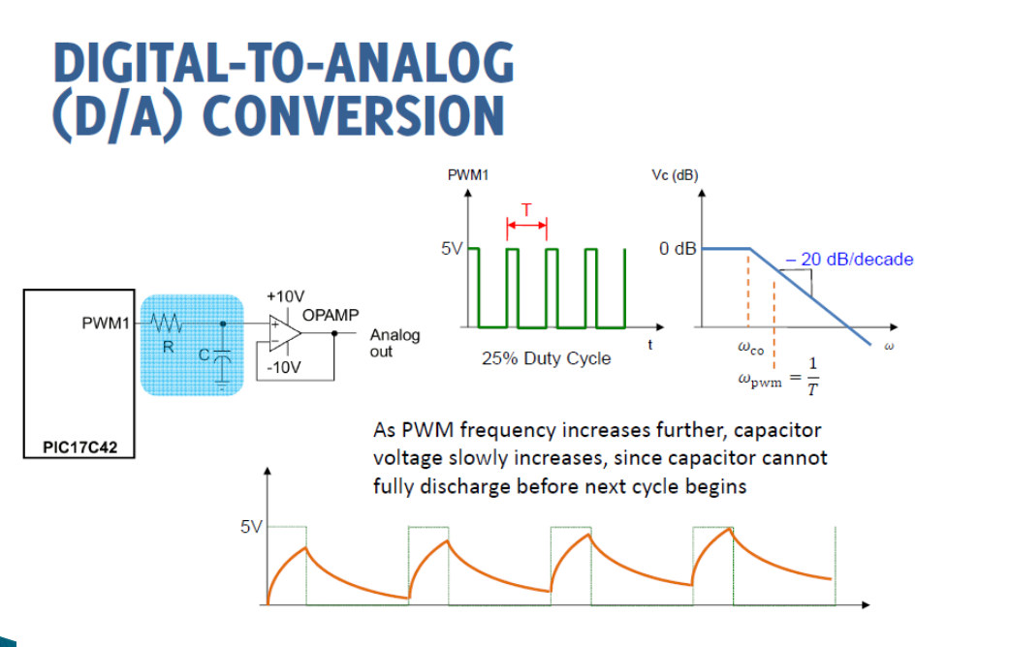

Slide 12
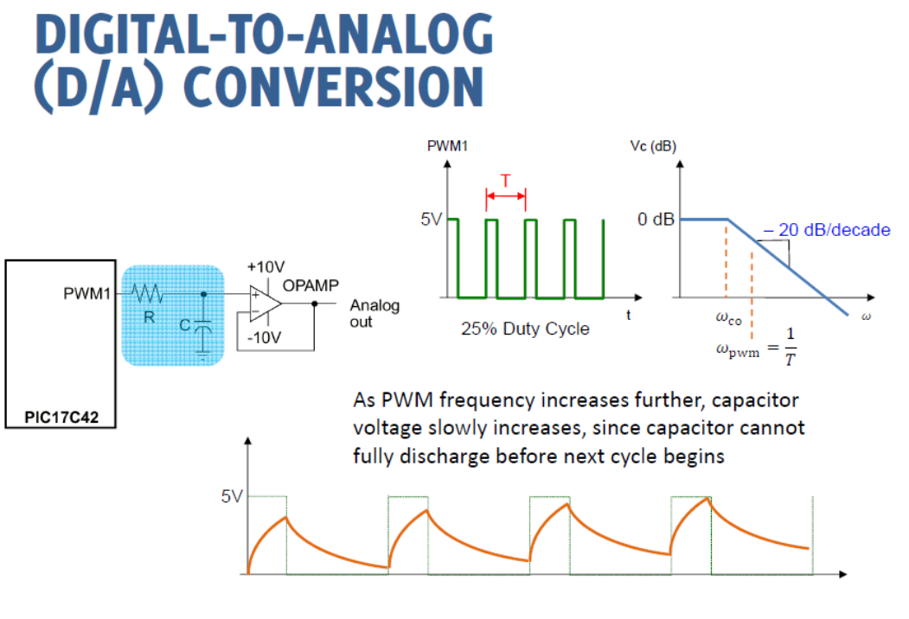

Slide 13
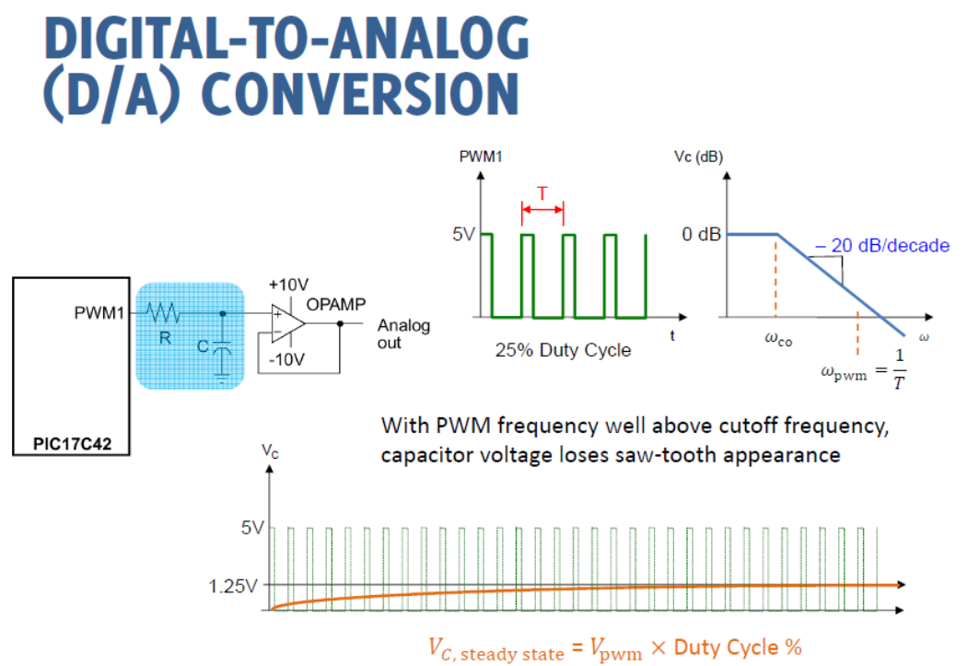

Slide 14
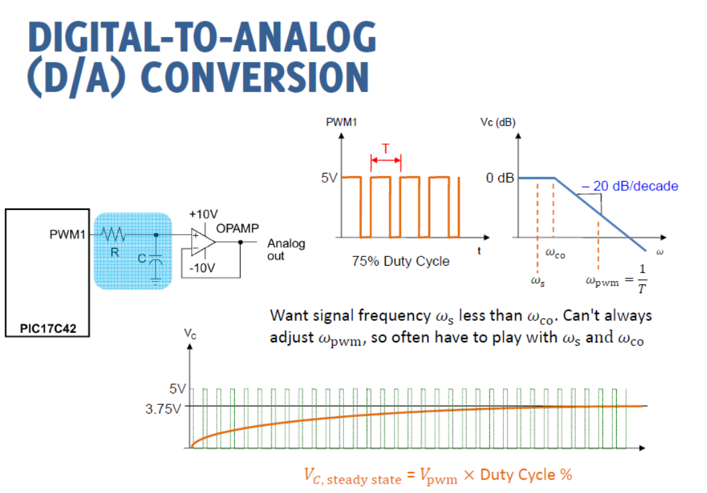

Slide 15
RC Low-pass Filter Design for PWM
Calculated peak-to-peak ripple voltage and settling time at a given PWM frequency and cut-off frequency or values of R and C.
http://sim.okawa-denshi.jp/en/PWMtool.php
https://www.allaboutcircuits.com/technical-articles/low-pass-filter-a-pwm-signal-into-an-analog-voltage/

Slide 16
How to adjust Arduino PWM frequencies
Pins 5 and 6: controlled by Timer 0 in fast PWM mode (cycle length = 256)
Setting Divisor Frequency
0x01 1 62500
0x02 8 7812.5
0x03 64 976.5625 <--DEFAULT
0x04 256 244.140625
0x05 1024 61.03515625
TCCR0B = (TCCR0B & 0b11111000) | <setting>;

Slide 17
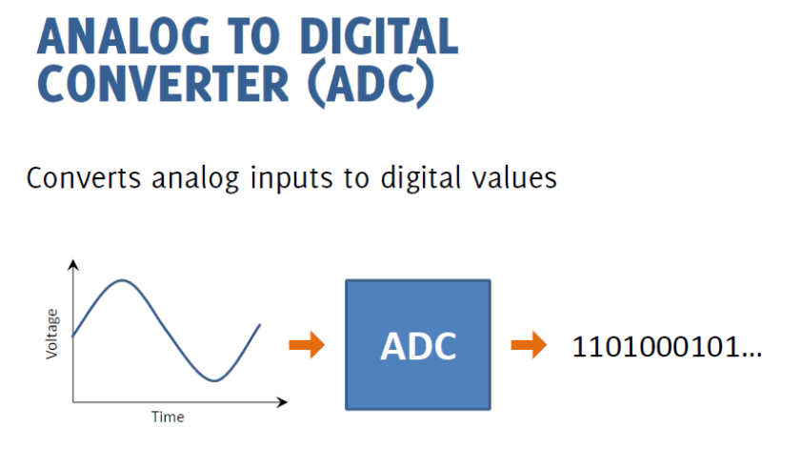

Slide 18
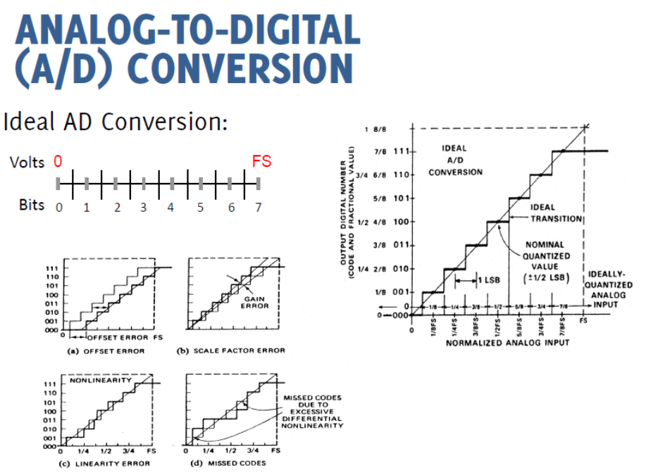

Slide 19
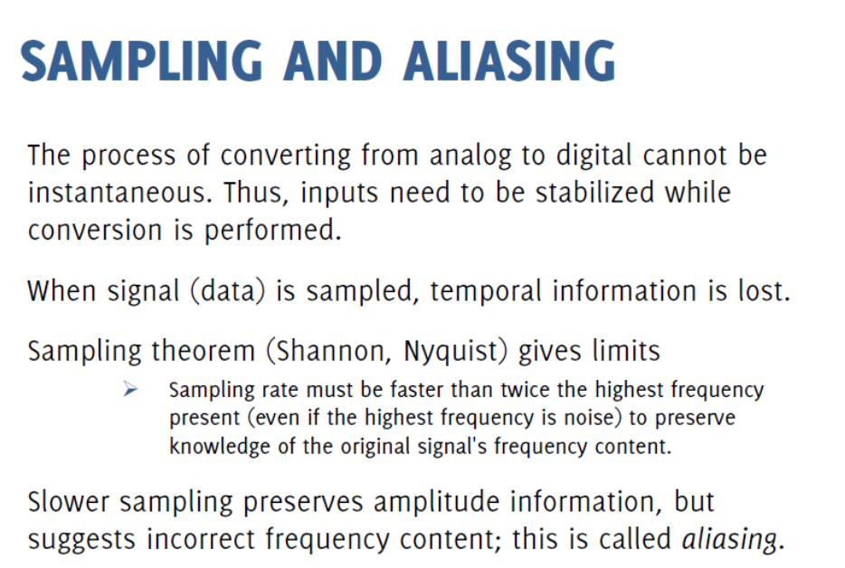

Slide 20
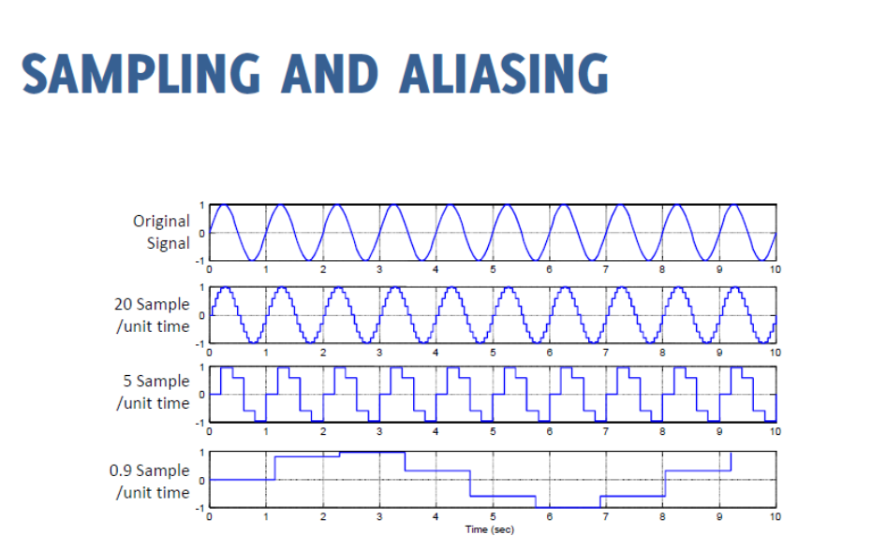

Slide 21
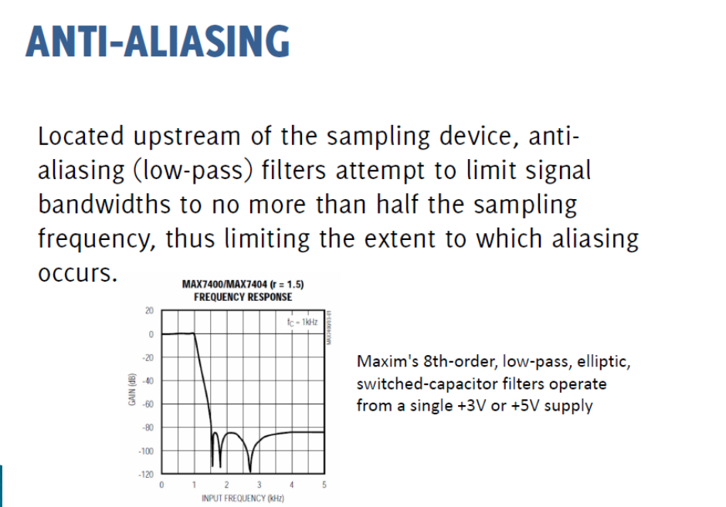

Slide 22
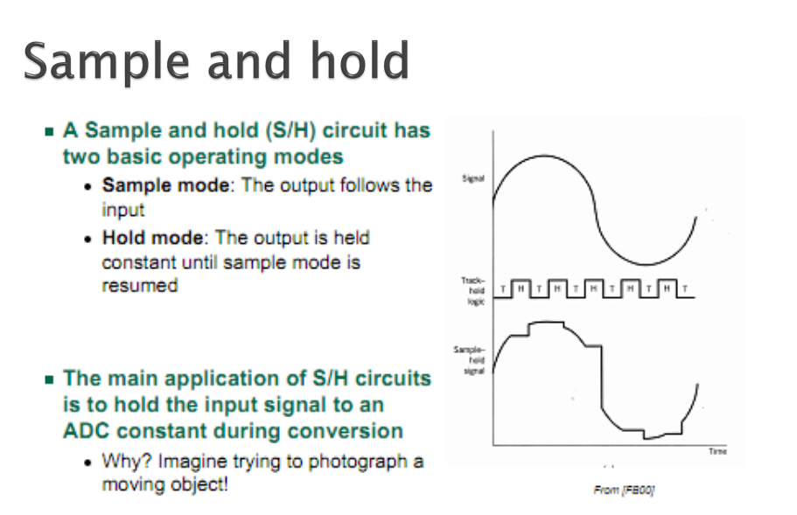

Slide 23
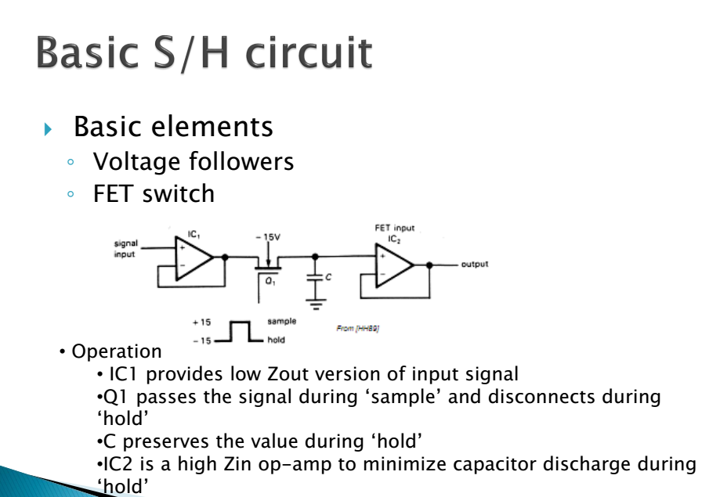

Slide 30
Example on Bipolar ADC

Slide 32
Conversion Time Consequences, Why S/H?
τc is conversion time
Notes:
τχ is conversion time

