Slide 1
Assessment of Language in children II

Slide 2
Formal language testsing
Things to consider when choosing a formal language test :
How old is the client?
What are the specific language concerns that need to be evaluated
What is the client’s ethnic background?
How much time is available to administer the test?
How well will the client be able to participate in testing?
Is an insurance company, employer, or other agency requiring a certain test?

Slide 3
Informal language assessment
Informal testing allows the clinician to assess certain aspects of language more deeply than formal tests, and it provides the opportunity to view a client’s functional use of language in natural context.
Informal tasks can be receptively or expressively based

Slide 4
Example informal tasks
Ask the child to follow verbal commands.
Naming and identifying objects
Naming items from a category, or identify a category when provided
examples.
Ask the child to describe similarities and differences of objects.
Ask the child to describe a picture, recount an event, or tell a short story.
Engage in role-playing activities. For example, pretend to serve food at a restaurant; then reverse roles.

Slide 5
LANGUAGE SAMPLING AND ANALYSIS
A good language sample may provide the most useful information about :
Form of language:
Understanding of semantic intent
Language use
Rate of speaking
Sequencing

Slide 6
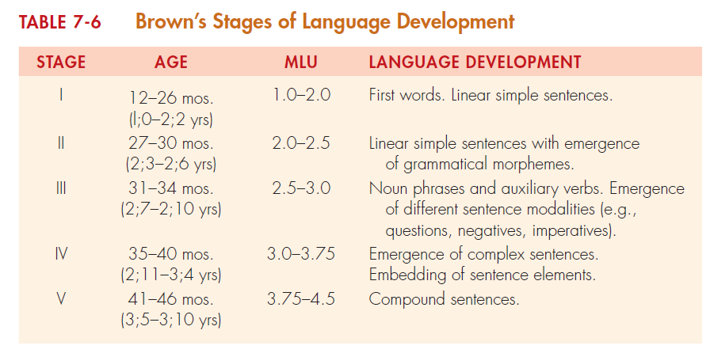
ASSESSMENT OF MORPHOLOGIC SKILLS
Give examples activities to of morphology both expressively and receptively?

Slide 7
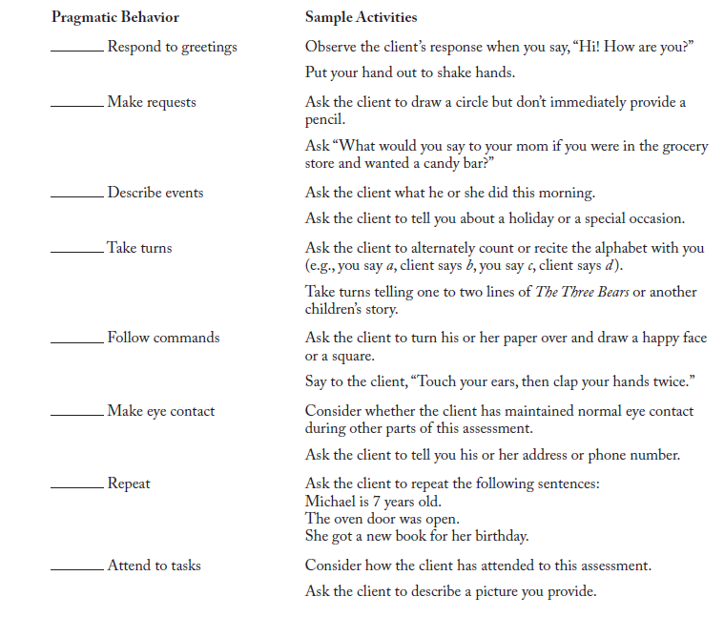
Assessment of pragmatics
Example behaviors to examine

Slide 8
ASSESSMENT OF SEMANTIC SKILLS
When assessing semantic skills, note the following:
Number of different words
Unusual use of words
Overgeneralizations
Undergeneralizations
Frequent use of empty words such as thing or that
Word-finding problems, such as circumlocutions, repetitions, and frequent pauses
Types of words (e.g., function, prepositions, negatives, descriptive)
Difficulty with word comprehension
Difficulty with sentence comprehension
Poor understanding of nonliteral forms (e.g., jokes)

Slide 9
ASSESSMENT OF SYNTACTIC SKILLS
We should examine the class of words, type of phrases, and complexity of sentence structures the child is using. Children with language impairments are likely to demonstrate:
Simple, less elaborate noun phrases
Shorter utterances
Limited range of sentence types
Overreliance on the S-V-O sentence structure
Lack of sentence complexity
Confusion with pronoun references
Misinterpretations of passive sentences

Slide 10
Making a diagnosis
A child with language disorder will show
Delayed onset of language
Limited amount of language
Deficiencies in syntactic, semantic, and morphologic components
Deficient cognitive skills
Academic problems
Limited language comprehension
Poor listening skills
Limited conversational skills
Limited ability to narrate experiences
A general inappropriate use of language

