Slide 1
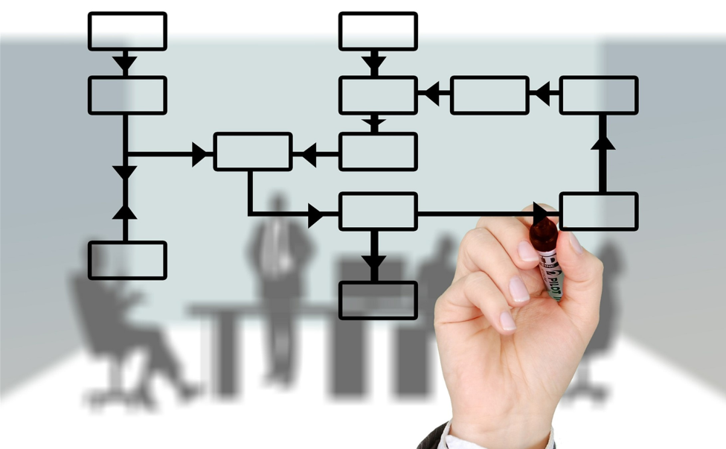
Chapter 6
Internal Control
Internal Audit (ACCT 337)
Internal Audit & Risk Management
ACCT 337

Slide 2
What is Internal Control?
Internal control is a process designed to provide reasonable assurance regarding the achievement of objectives in the following categories:
Effectiveness and Efficiency of Operations
Reliability of Financial Reporting
Compliance with Applicable Laws and Regulations
It is a continuous process that is affected by people at all levels within an organization and is designed to prevent or detect errors, fraud, and inefficiencies.

Slide 3
Internal Control Limitations
Internal control only provides reasonable assurance of achieving objectives.
It cannot provide absolute assurance because any system of internal control has the following inherent limitations:
Human judgment is faulty, and controls may fail because of simple errors or mistakes.
Management may inappropriately override internal controls, e.g., to fraudulently achieve revenue projections or hide liabilities.
Manual or automated controls can be circumvented by collusion.
The cost of internal control must not be greater than its benefits

Slide 4
Internal Control as defined by IIA
The following are control-related definitions from The IIA Glossary:
Control is “any action taken by management, the board, and other parties to manage risk and increase the likelihood that established objectives and goals will be achieved. Management plans, organizes, and directs the performance of sufficient actions to provide reasonable assurance that objectives and goals will be achieved.”
Control processes are “the policies, procedures (both manual and automated), and activities that are part of a control framework, designed and operated to ensure that risks are contained within the level that an organization is willing to accept.”
Control environment is “the attitude and actions of the board and management regarding the importance of control within the organization. The control environment provides the discipline and structure for the achievement of the primary objectives of the system of internal control.
The control environment includes the following elements: 1) Integrity and ethical values 2) Management’s philosophy and operating style 3) Organizational structure 4) Assignment of authority and responsibility 5) Human resource policies and practices 6) Competence of personnel

Slide 5
The COSO Internal Control- Integrated Framework
Developed in 1992 by the Committee of Sponsoring Organizations of the Treadway Commission (COSO) and updated in 2013.
This model has been adopted as the generally accepted framework for internal control and is widely recognized as the definitive standard against which organizations measure the effectiveness of their systems of internal control.

Slide 6
COSO Definition of Internal Control
The COSO model defines internal control as “a process effected by an entity’s board of directors, management and other personnel designed to provide reasonable assurance of the achievement of objectives in the following categories:
Operational Effectiveness and Efficiency
Financial Reporting Reliability
Applicable Laws and Regulations Compliance

Slide 7
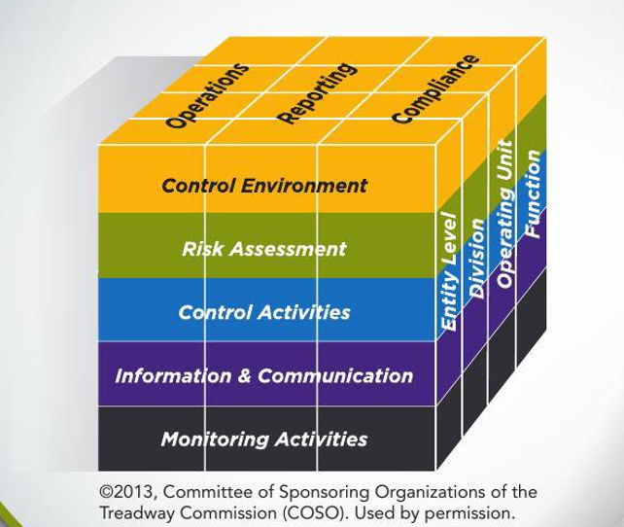
COSO Internal Control Framework- Cube
COSO explains, “A direct relationship exists between objectives, which are what an entity strives to achieve, components [and principles], which represent what is required to achieve the objectives, and entity structure (the operating units, legal entities, and other structures). The relationship can be depicted in the form of a cube.”
The rows are the 5 components.
The slices are the 3 objectives.
The columns are the entity’s structure.

Slide 8
COSO Internal Control Framework- 5 Components
In an effective internal control system, the following five components work to support the achievement of an entity’s mission, strategies and related business objectives:
1- Control Environment: Sets the tone of an organization (senior management & the BOD), influencing the control consciousness of its people. (integrity, ethics, organizational structure, authority and responsibility etc..)
2- Risk Assessment: The process of identifying and analyzing risks relevant to financial reporting objectives.
3- Control Activities: are the actions taken by management, the board, and other parties to mitigate risk and increase the likelihood that established objectives and goals will be achieved.
4- Information and Communication: The process of obtaining, generating, and communicating information in support of the other components of internal control. Relevant, accurate, and timely information must be available to individuals at all levels of an organization who need such information to run the business effectively.
5-Monitoring Activities: To remain reliable, internal control systems must be monitored. As COSO indicates, monitoring activities consist of “ongoing evaluations built into business processes at different levels of the entity [that] provide timely information. Ongoing evaluations, separate evaluations, or some combination of the two, to ascertain whether each of the five components of internal control are present and functioning.

Slide 9
COSO Internal Control Framework- 5 Components summarized
The control environment provides an atmosphere in which people conduct their activities and carry out their control responsibilities. It serves as the foundation for the other components. Within this environment, management assesses risks to the achievement of specified objectives. Control activities are implemented to help ensure that management directives to address the risks are carried out. Meanwhile, relevant information is captured and communicated throughout the organization. The entire process is monitored and modified as conditions warrant.

Slide 10
Control Activities
As indicated by COSO, “Control activities are performed at all levels of the [organization], at various stages within business processes, and over the technology environment. They may be preventative or detective in nature and may encompass a range of manual and automated activities, such as authorizations and approvals, verifications, reconciliations, and business performance reviews.”
One critical concept common to all control activities is the concept that COSO defines as segregation of duties.
Segregation of duties is the concept of dividing, or segregating, control activities related to the authorization of transactions from the processing of those transactions from physical access to the assets related to those underlying transactions. The primary purpose of segregating duties (dividing control activities) among different people is to reduce the risk of error or inappropriate actions taken by any single individual.
For any given transaction, the following three functions preferably should be performed by separate individuals in different parts of the organization:
Authorization of the transaction
Recording of the transaction
Custody of the assets associated with the transaction

Slide 11
Segregation of Duties-Example
Scenario: Inventory Management Process
1. Authorization:
Role: Purchasing Manager
Duty: The purchasing manager is responsible for approving the purchase of inventory items. For example, before any items are ordered, the purchasing manager must approve the order based on the business's needs.
2. Recording:
Role: Inventory Clerk
Duty: The inventory clerk is responsible for updating the inventory records once the goods are received. They enter the quantities, item details, and prices into the inventory system to ensure accurate records.
3. Custody:
Role: Warehouse Staff
Duty: The warehouse staff is responsible for physically storing and safeguarding the inventory items once they are received. They ensure the items are stored properly and are kept secure.
By separating these duties, you ensure that no one person has control over the entire process, reducing the risk of fraud or errors.

Slide 12
Objectives
The COSO framework sets forth three categories of objectives, which allow organizations to focus on differing aspects of internal control:
Operations Objectives—These pertain to effectiveness and efficiency of the entity’s operations, including operational and financial performance goals, and safeguarding assets against loss.
Reporting Objectives—These pertain to internal and external financial and non-financial reporting and may encompass reliability, timeliness, transparency, or other terms as set forth by regulators, standard setters, or the entity’s policies.
Compliance Objectives—These pertain to adherence to laws and regulations to which the entity is subject.

Slide 13
Internal Control Roles and Responsibilities
Everyone in an organization has responsibility for internal control:
Management: The CEO assumes primary responsibility for the system of internal controls. The “tone at the top” (how ethical or how much integrity an organization has) is set by the CEO and rolls down from there to senior management, line management, and ultimately to all of the individuals in an organization.
Board of Directors: The board of directors oversees management, provides direction regarding internal control, and ultimately has responsibility for overseeing the system of internal controls. the board of directors has ultimate responsibility for ensuring management has established an effective system of internal controls.
Internal Auditors: The internal audit function provides reasonable assurance that the system of internal controls is designed adequately and operating effectively, increasing the likelihood that the organization’s business objectives and goals will be met.
Other Personnel: COSO clearly indicates that everyone in an organization has responsibility for internal control: “Internal control is the responsibility of everyone in an entity and therefore constitutes an explicit or implicit part of everyone’s job description. Front-line personnel constitute the first line of defense in the performance of internal control responsibilities.”

Slide 14
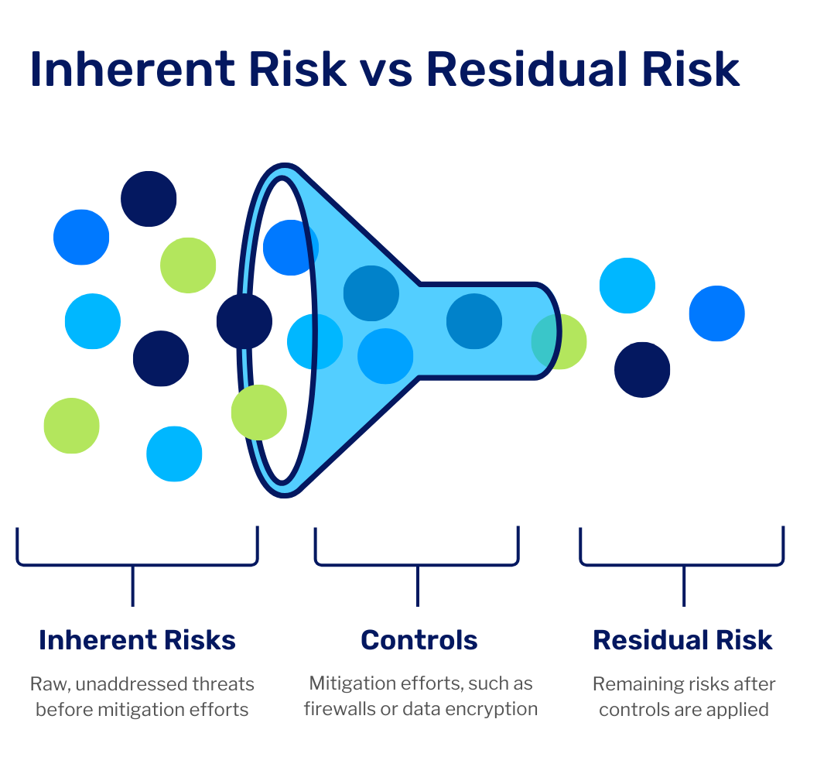
Risks & Controls
An organization’s ability to achieve established entity objectives is affected by both internal and external risks.
The combination of internal and external risks in their pure, uncontrolled state is referred to as inherent risk. Said another way, inherent risk is the gross risk that exists assuming there are no internal controls in place. Acknowledgement of the existence of inherent risk and that certain events or conditions are simply outside of management’s control (external risks) is critical to recognizing the inherent limitations of internal control.
Controllable risk is that portion of inherent risk that management can directly influence and reduce through day-to-day business activities. Once management has implemented cost-effective controls to address controllable risks, then and only then can they determine if the organization is operating within the overall risk appetite established by senior management and the board of directors.
The portion of inherent risk that remains after mitigating all controllable risks is defined as residual risk.
If the remaining uncontrolled risk (residual risk) is less than the established risk appetite, then the system of internal controls is operating at an acceptable level and within an organization’s defined risk appetite.
If, however, residual risk exceeds the organization’s established risk appetite, it is necessary to reevaluate the system of internal controls to determine if additional cost-effective controls can be implemented to further reduce residual risk to a level within management’s risk appetite.

Slide 15
Inherent, Controllable & Residual Risk-Example
Scenario: Driving a Car
Inherent Risk: Inherent risk is the natural risk present in a situation before any precautions are taken.
For example, driving a car inherently involves risks like accidents, bad weather, or mechanical failure. These are natural risks that come with operating a vehicle, regardless of how careful the driver is.
Controllable Risk: Controllable risk is the part of the inherent risk that can be managed or reduced by taking precautions or actions.
For instance, a driver can reduce the risk of an accident by following traffic laws, wearing a seatbelt, driving at a safe speed, and keeping the car well-maintained. These actions control the risk and make driving safer.
Residual Risk: Residual risk is the risk that remains after taking precautions.
Even after driving carefully, wearing a seatbelt, and ensuring the car is in good condition, there may still be risks—like another driver making a mistake, poor road conditions, or an unexpected hazard. These risks remain despite the efforts to control them, and they are the residual risks that the driver must accept while still being vigilant.

Slide 16
TYPES OF CONTROLS
Entity-Level, Process-Level, and Transaction-Level Controls
Key Controls and Secondary Controls (according to their importance)
Preventive, Detective, Corrective & Directive Controls
Information Systems (Technology) Controls

Slide 17
Entity-Level, Process-Level, and Transaction-Level Controls
Entity-Level Control: A control that operates across an entire entity and, as such, is not bound by, or associated with, individual processes. are designed to achieve organizational objectives and to address entity-wide risks. They include governance controls and management oversight controls.
Entity-level governance controls are established by the board of directors at the highest level (governance level). They include organizational policies and procedures that define the entity’s culture and communicate its expectations. Examples include IT policies, the code of conduct, oversight of controls, and setting the risk appetite.
Entity-level management oversight controls are implemented by management at the business unit level to achieve business unit objectives and address business unit risks. Examples include IT general controls and period-end controls.
Process-Level Control: are designed to achieve process objectives and to address process risks. Examples of process-level controls include:
■ Reconciliations of key accounts.
■ Physical verifications of assets (such as inventory counts).
■ Process employee supervision and performance evaluations.
Transaction-Level Control: An activity that reduces risk relative to a group or variety of operational-level tasks or transactions within an organization. They are designed to achieve transaction objectives and to address risks specific to transactions. Examples include:
■ Authorizations: ensuring that a transaction is approved by an authorized individual.
■ Documentation: keeping proper records of transactions, like invoices or contracts (such as source documents).
■ Segregation of duties: ensuring that no one person is responsible for approving and processing a transaction.
■ IT application controls: ensuring that data input, processing, output are accurate & secure.

Slide 18
Key Controls and Secondary Controls
Key (Primary) Control: the most important controls in an organization, designed to reduce risk associated with a critical business objective.
Failure to implement adequately designed and effectively operating key controls can result in the failure of the organization not only to achieve critical business objectives but to survive.
Example: A key control in a company’s financial process could be the approval of large transactions by senior management before they’re processed. If this control fails, it could lead to significant financial loss or fraud, risking the organization’s financial health.
A secondary control is one that is designed to either 1) mitigate risks that are not key to business objectives, or 2) partially reduce the level of risk and provide additional protection when a key control does not operate effectively. Example: Regular reviews of reports or financial statements by department heads, which provide additional oversight but do not directly mitigate a critical risk.
Compensating Controls are designed to supplement key controls (replace or back up) that are either ineffective or cannot fully mitigate a risk or group of risks by themselves to an acceptable level within the risk appetite established by management and the board.
For example, close supervision in instances when adequate segregation of duties cannot be achieved may be a compensating control. Such controls also can back up or duplicate multiple controls and may operate across multiple processes and risks.
Complementary controls that work alongside other controls (often key controls) to enhance or strengthen the overall risk mitigation process to an acceptable level. In other words, their synergy is more effective than either control by itself.
For example, separating the functions of accounting for and custody of cash receipts is complemented by obtaining deposit slips validated by the bank.

Slide 19
Preventive, Detective, Corrective & Directive Controls (1/2)
Preventive controls: are designed to prevent undesirable events from occurring in the first place. Their goal is to deter risks before they happen.
Examples of preventive controls include physical and logical access controls, such as locked doors, gates, safes and user IDs with unique passwords and multi-factor authentication (2 or more verification factors e.g., password and a fingerprint scan), Firewalls and Antivirus Software, and segregation of duties.
Detective control is designed to discover undesirable events that have already occurred and alert the appropriate individuals after an unwanted event. Detective controls identify issues in a timely manner to mitigate further damage.
A detective control must occur timely (before the undesirable event has had an unacceptably negative impact on the organization) to be considered effective.
Examples of detective controls include burglar alarms, security cameras to identify unauthorized physical access and review of computer logs listing unauthorized access attempts, inventory audit and Intrusion Detection Systems (IDS) which are software or hardware systems designed to detect unauthorized access or malicious activity in a network.

Slide 20
Preventive, Detective, Corrective & Directive Controls (2/2)
Corrective controls correct or remediate the negative effects of unwanted events once it has occurred. Corrective controls help to bring the situation back to the desired state.
Examples: a requirement that all cost variances over a certain amount be justified. Disciplinary Action of employees, restoring data from backup after a system failure or data breach.
Directive controls cause or encourage the occurrence of a desirable event. They set expectations and guide employees toward the correct actions, behaviors, and decisions.
These include the following: 1) Policy and procedure manuals 2) Employee training 3) Job descriptions 4) Performance goals

Slide 21
Information Systems (Technology) Controls
Sometimes generally referred to as “technology” controls, there are two types of information systems controls that can be used to mitigate these risks:
1. IT General controls. These “apply to many if not all application systems and help ensure their continued, proper operation.”
2. Application controls. These “include computerized steps within the application software and related manual procedures to control the processing of various types of transactions.”
These two types of controls work together “to ensure completeness, accuracy, and validity of the financial and other information in the system.”
IT General controls are considered entity-level controls because they apply across the organization and its many computer applications. Application controls, on the other hand, are most often considered process-level or transaction-level controls.

Slide 22
IT General Controls
The objectives of IT general controls are to ensure the appropriate development and implementation of applications, as well as the integrity of program and data files and of computer operations.
The most common IT general controls are:
Logical Access Controls (e.g., passwords):
These controls ensure that only authorized people can access the systems, applications, and data. For example, using passwords or multi-factor authentication prevents unauthorized users from getting into sensitive information.
System Development Life Cycle (SDLC) Controls:
SDLC controls are steps taken to ensure that new software or systems are developed in a structured and secure way. This includes planning, testing, and reviewing the software before it’s fully implemented to prevent errors or security vulnerabilities.
Program Change Management Controls:
These controls ensure that changes to software or systems (like updates or bug fixes) are done correctly and securely. Before any change is made, it needs to be approved and tested, so that nothing breaks or creates security risks.
Physical Security Controls over the Data Center:
These are measures to protect the physical infrastructure where data is stored, such as locking server rooms, using security cameras, and restricting access to authorized personnel. This prevents theft or damage to the hardware and data.
System and Data Backup and Recovery Controls:
These controls ensure that data is regularly backed up and can be recovered in case of a disaster, such as a system crash or data loss. This includes regular backups and having a plan to restore data to minimize downtime.

Slide 23
Application Controls
Application controls are those that pertain to the scope of individual business processes or application systems.
The objective of application controls is to ensure that:
Input data is accurate, complete, authorized, and correct.
Examples:
Data Validation Checks: In an online order system, when a customer enters their personal information (e.g., name, address, payment details), the system verifies that the data entered meets certain criteria (e.g., valid email format, postal code length, and credit card number format). This ensures that the input data is accurate and complete.
Field Completeness Checks: A banking system requires that all fields (such as account number, name, amount) in a deposit form are filled before submitting the transaction to prevent incomplete input.
Data is processed as intended in an acceptable time period.
Example:
Transaction Sequencing: In an inventory management system, transactions (like purchases and sales) are processed sequentially to ensure no steps are skipped, and that they occur in the proper order (e.g., sales orders are processed after inventory is updated).
Data stored is accurate and complete.
Example:
Backup and Redundancy: A healthcare application automatically backs up patient records daily to prevent data loss and ensure that stored information is complete and secure.
Outputs are accurate and complete.
Examples:
Report Review and Approval:: In a financial reporting system, reports such as income statements or balance sheets must be reviewed and approved by a manager before being finalized. This ensures the accuracy and completeness of the output.
Automated Output Checks:: A sales order processing system automatically checks that all required fields (product details, quantities, pricing) are present in the output invoices. If any data is missing, the system flags the issue before the invoice is sent out.
A record is maintained to track the process of data from input to storage and to the eventual output.
Examples:
Audit Trails: In an accounting system, an audit trail records every action taken on a transaction (e.g., data input, modification, or deletion). This helps trace the path of data from entry to output, ensuring accountability.
Log Files: In a healthcare system, all changes to patient records are logged with timestamps, user IDs, and the nature of the change. This allows tracking of the data from entry to modification to output (e.g., reports generated for patient care).

Slide 24
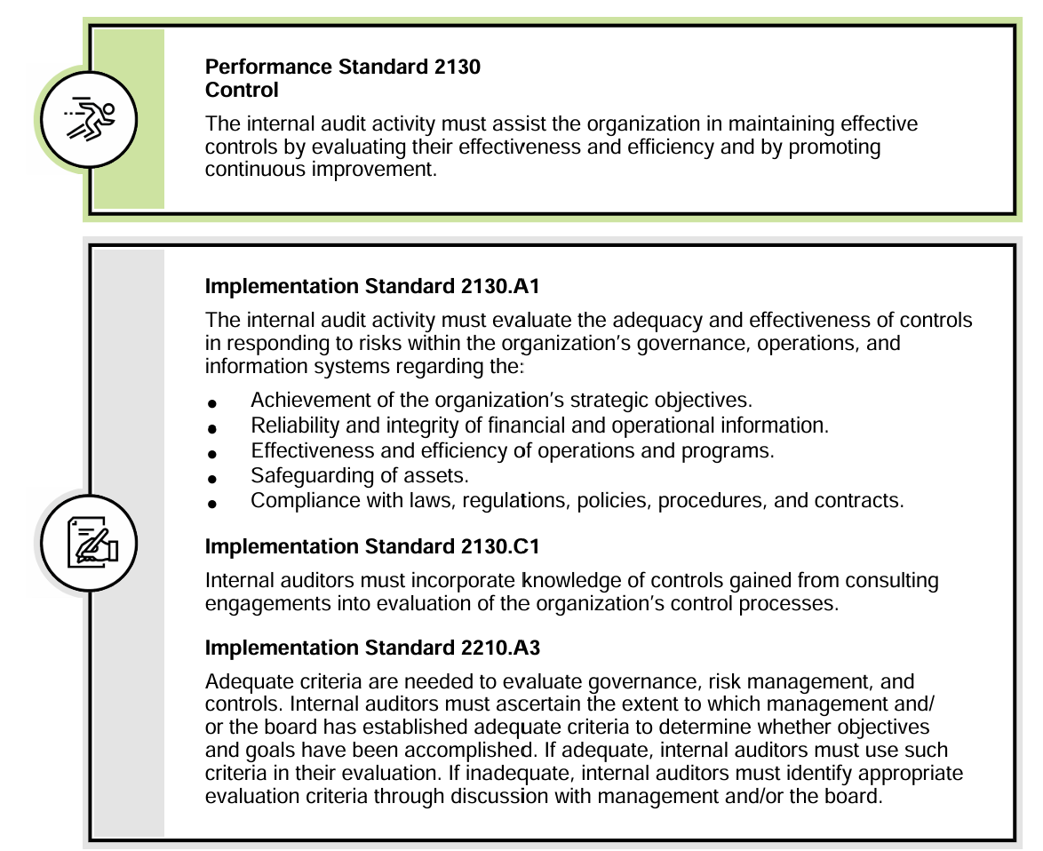
Internal Auditor’s Role in Control
As indicated in The IIA’s International Standards for the Professional Practice of Internal Auditing, the internal audit function is responsible for assessing an organization’s controls (either elements of, or the entirety of, the system of internal controls).
The IPPF provides guidance on the internal audit function’s responsibility for assessing the adequacy of an organization’s control processes by indicating that the CAE must consider whether significant discrepancies (weaknesses) were identified (and by whom), if corrections or improvements were made after the discovery of discrepancies, and if the discoveries and their potential consequences indicate that a pervasive condition exists, resulting in an unacceptable level of risk or operating ineffectiveness.

Slide 25
End of Chapter Questions

Slide 26
Which of the following best describes an internal auditor’s purpose in reviewing the organization’s existing governance, risk management, and control processes?
To help determine the nature, timing, and extent of tests necessary to achieve engagement objectives.
To ensure that weaknesses in the internal control system are corrected.
To provide reasonable assurance that the processes will enable the organization’s objectives and goals to be met efficiently and economically.
To determine whether the processes ensure that the accounting records are correct and that financial statements are fairly stated.
Answer: C
2. What is residual risk?
Impact of risk.
Risk that is under control.
Risk that is not managed.
Underlying risk in the environment.
Answer: C

Slide 27
3. The requirement that purchases be made from suppliers on an approved vendor list is an example of a:
Preventive control.
Detective control.
Compensating control.
Monitoring control.
Answer: A
4. An effective system of internal controls is most likely to detect a fraud perpetrated by a:
Group of employees in collusion.
Single employee.
Group of managers in collusion.
Single manager.
Answer: B
5. The control that would most likely ensure that payroll checks are written only for authorized amounts is to:
Conduct periodic floor verification of employees on the payroll.
Require the return of undelivered checks to the cashier.
Require supervisory approval of employee time cards.
Periodically witness the distribution of payroll checks.
Answer: C

Slide 28
6. Appropriate internal control for a multinational corporation’s branch office that has a department responsible for the transfer of money requires that:
The individual who initiates wire transfers does not reconcile the bank statement.
The branch manager must receive all wire transfers.
Foreign currency rates must be computed separately by two different employees.
Corporate management approves the hiring of employees in this department.
Answer: A
Who has primary responsibility for the monitoring component of internal control?
The organization’s independent outside auditor.
The organization’s internal audit function.
The organization’s management.
The organization’s board of directors.
Answer: C

Slide 29
8. Reasonable assurance, as it pertains to internal control, means that:
The objectives of internal control vary depending on the method of data processing used.
A well-designed system of internal controls will prevent or detect all errors and fraud.
Inherent limitations of internal control preclude a system of internal control from providing absolute assurance that objectives will be achieved.
Management cannot override controls, and employees cannot circumvent controls through collusion.
Answer: C
9. Which of the following best exemplifies a control activity referred to as independent verification?
Reconciliation of bank accounts by someone who does not handle cash or record cash transactions.
Identification badges and security codes used to restrict entry to the production facility.
Accounting records and documents that provide a trail of sales and cash receipt transactions.
Separating the physical custody of inventory from inventory accounting.
Answer: A

Slide 30
10. The risk assessment component of internal control involves the:
Independent outside auditor’s assessment of residual risk.
Internal audit function’s assessment of control deficiencies.
Organization’s identification and analysis of the risks that threaten the achievement of its objectives.
Organization’s monitoring of financial information for potential material misstatements.
Answer: C

