Slide 1
Acceleration Sensors
Modeling

Slide 2
The piezoresistive effect is a change in the electrical resistivity of a semiconductor or metal when mechanical strain is applied. In contrast to the piezoelectric effect, the piezoresistive effect causes a change only in electrical resistance, not in electric potential.
Piezoelectricity is the electric charge that accumulates in certain solid materials—such as crystals, certain ceramics, in response to applied mechanical stress

Slide 7
Piezoelectric Design

Slide 8
Capacitive Accelerometer Design
Capacitive accelerometers are microelectromechanical systems (MEMS) utilizing a displacement
of the proof-mass due to acceleration that is converted to a proportional capacitive change and
subsequently converted to an amplified voltage. The “gap” approach along
with its circuit equivalent and detailed structure. Here the concept is based on a change in the gap
distance (d) between two plates that creates a large change in capacitance ( DC ). The change is
inversely proportional to the gap causing a large change with acceleration.

Slide 9
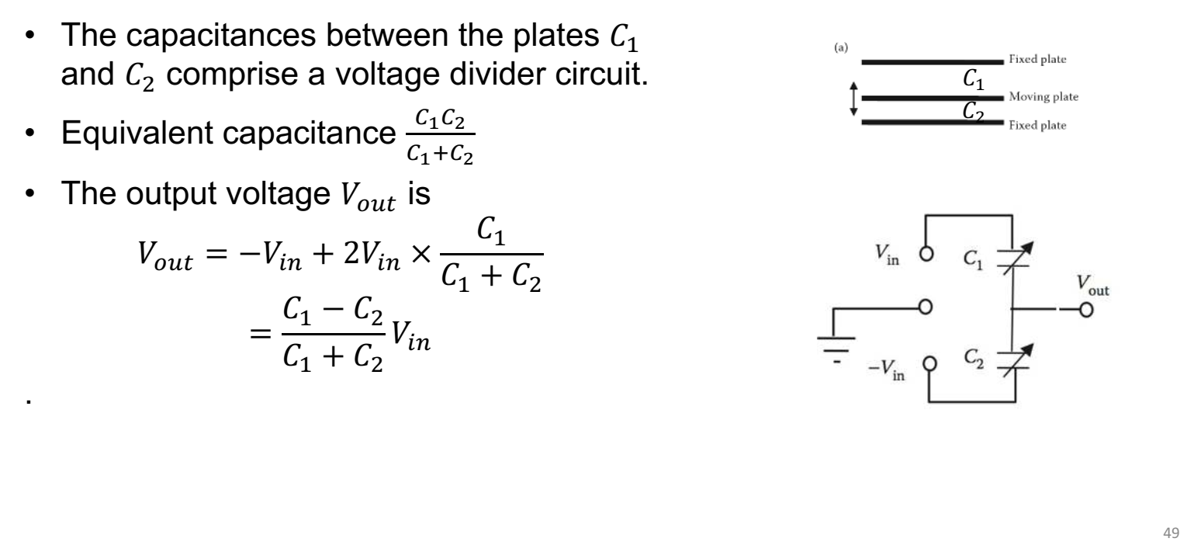

Slide 10
Why State Space?
State space is important in modeling for sensors because it provides a structured and systematic framework for representing and understanding the behavior of dynamic systems. Sensors are devices that measure and monitor physical quantities in the environment, and they are often used in various applications, including robotics, control systems, navigation, and many others. State space models help in accurately describing and predicting the behavior of these systems for several reasons:
Modeling Complex Systems: Many real-world systems are complex and dynamic, with multiple interacting components and variables. State space models allow us to capture this complexity by representing the system's state (a set of variables that describe the system) and its evolution over time through a set of equations. This enables us to model a wide range of sensor-equipped systems, from simple ones to highly complex ones.
Flexibility: State space models are flexible and adaptable, making them suitable for various sensor applications. They can handle linear and nonlinear systems, time-varying and time-invariant systems, and continuous or discrete-time systems. This flexibility is essential because sensors are used in diverse environments and contexts.
System Identification: State space models can be used to identify the underlying dynamics of a system based on sensor data. By comparing the observed data with the predictions of the model, it is possible to estimate the system's parameters and states, which is crucial for system control and optimization.
Estimation and Prediction: Sensors often provide measurements that are noisy or incomplete. State space models can incorporate stochastic components to account for measurement uncertainties and make probabilistic predictions about the system's future behavior. This is valuable for filtering and smoothing sensor data and making reliable predictions.
Control and Decision-Making: In many applications, sensors are integrated into control systems or autonomous decision-making processes. State space models serve as a foundation for designing controllers and decision-making algorithms that rely on sensor information to achieve desired objectives.

Slide 11
State space is important in modeling for sensors because it provides a structured and systematic framework for representing and understanding the behavior of dynamic systems. Sensors are devices that measure and monitor physical quantities in the environment, and they are often used in various applications, including robotics, control systems, navigation, and many others. State space models help in accurately describing and predicting the behavior of these systems for several reasons:
Modeling Complex Systems: Many real-world systems are complex and dynamic, with multiple interacting components and variables. State space models allow us to capture this complexity by representing the system's state (a set of variables that describe the system) and its evolution over time through a set of equations. This enables us to model a wide range of sensor-equipped systems, from simple ones to highly complex ones.
Flexibility: State space models are flexible and adaptable, making them suitable for various sensor applications. They can handle linear and nonlinear systems, time-varying and time-invariant systems, and continuous or discrete-time systems. This flexibility is essential because sensors are used in diverse environments and contexts.
Simulation and Analysis: State space models enable the simulation of system behavior under different conditions and scenarios. This is useful for testing and validating sensor-equipped systems in a virtual environment before deploying them in the real world.
State Estimation: State space models are central to state estimation techniques like the Kalman filter and the Extended Kalman filter, which are widely used in sensor data processing. These techniques help in accurately estimating the true state of a system based on sensor measurements.
Modeling Nonlinearity: In many cases, sensor-equipped systems exhibit nonlinear behavior. State space models can handle nonlinearities by using techniques like the Unscented Kalman filter or particle filters, allowing accurate modeling and estimation in such scenarios.
In summary, state space modeling is a powerful tool for understanding, analyzing, and controlling systems that involve sensors. It provides a structured framework that can handle complex and dynamic systems, making it a fundamental concept in the field of sensor-based modeling and control.

Slide 12
STATE-SPACE ACCELEROMETER MODELS
The state-space provides a natural mechanism to incorporate measurements of a physical
system together in a meaningful relationship
It is a natural characterization of many systems incorporating the underlying phenomenology (physics), measurement system (measurements) and noise (uncertainties) by combining their interrelationships, mathematically, into a well-defined representation or model with inherent properties that can easily be analyzed to ensure a viable system.

Slide 13
Next an accelerometer measurement system model can be incorporated into the overall
system model. If a sensor is developed to measure the acceleration directly, it can be modeled by
including a scale factor conversion, say Ca , to give

Slide 14
Piezoelectric Accelerometer State-Space Model

Slide 16
Capacitance Accelerometer State-Space Model

