Slide 1
DC and Stepper Motors, and RC Servos

Slide 2
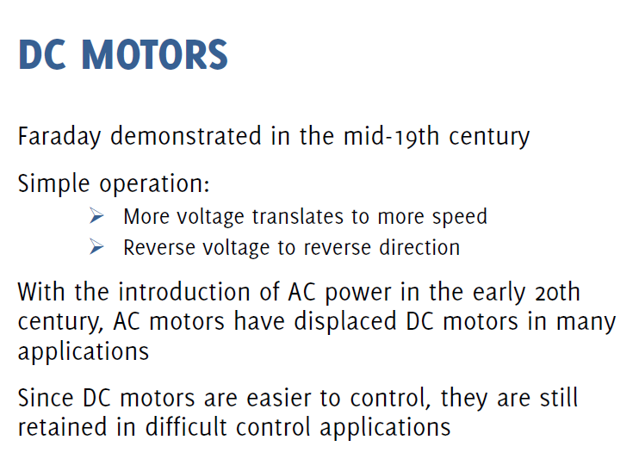

Slide 3
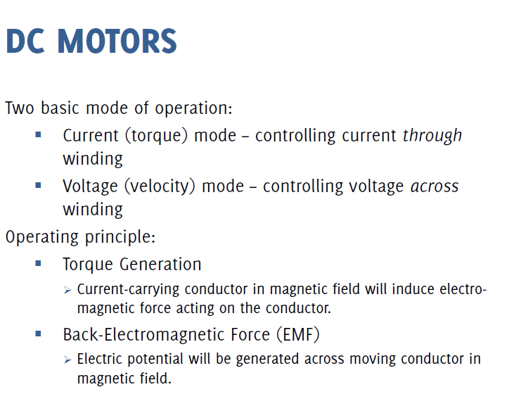

Slide 4
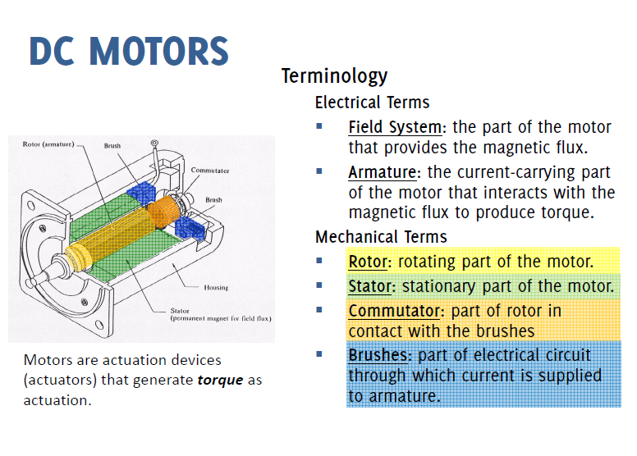

Slide 5
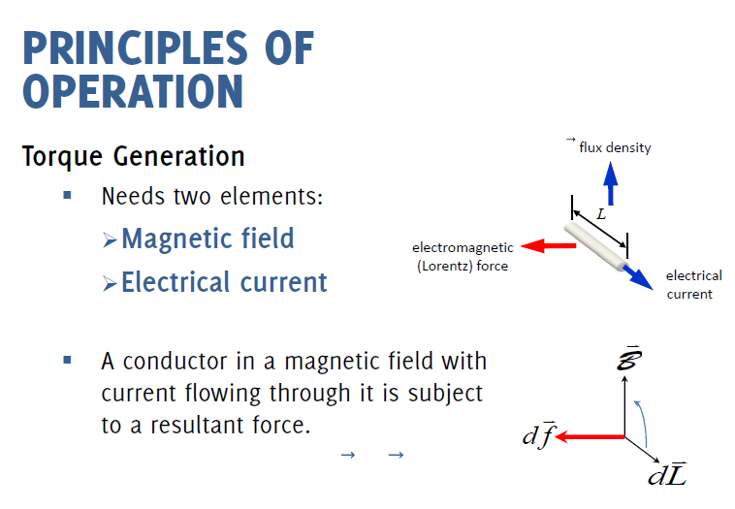
1https://www.youtube.com/watch?v=CWulQ1ZSE3c&ab_channel=JaredOwen

Slide 6
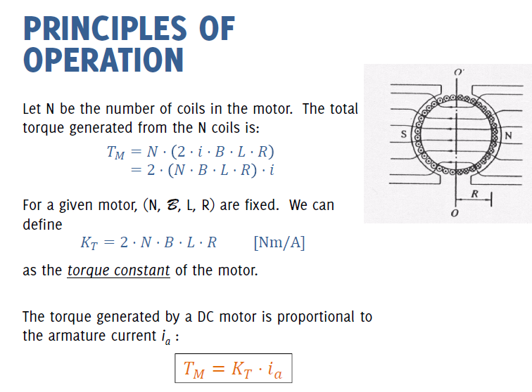

Slide 7
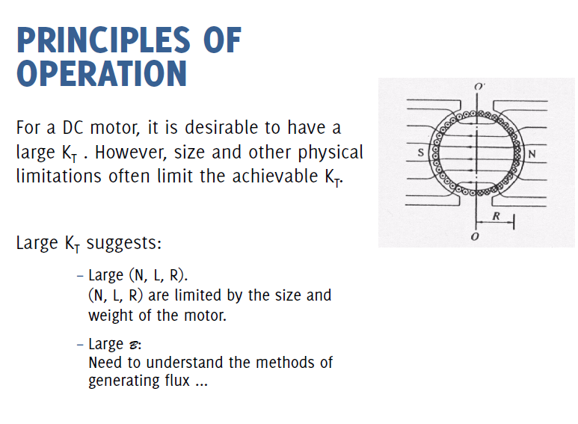

Slide 8
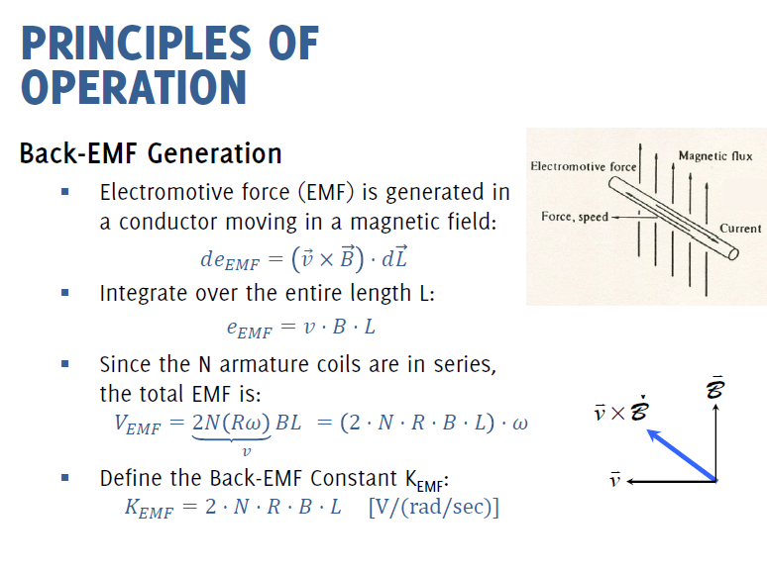

Slide 9
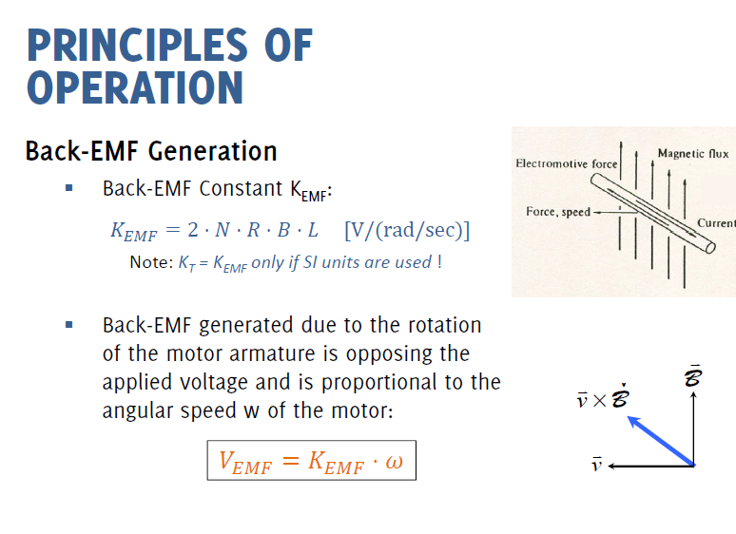

Slide 10
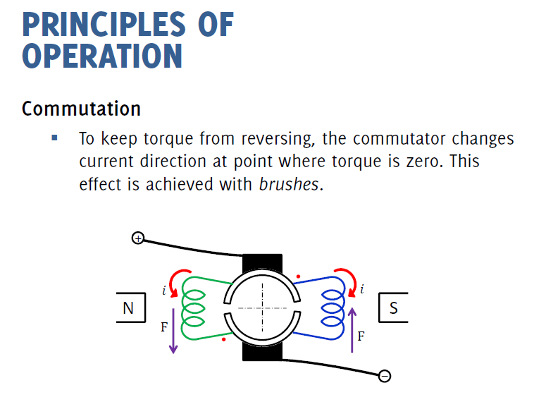
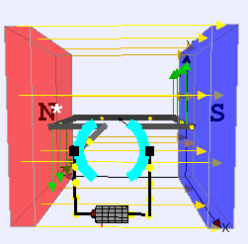

Slide 11
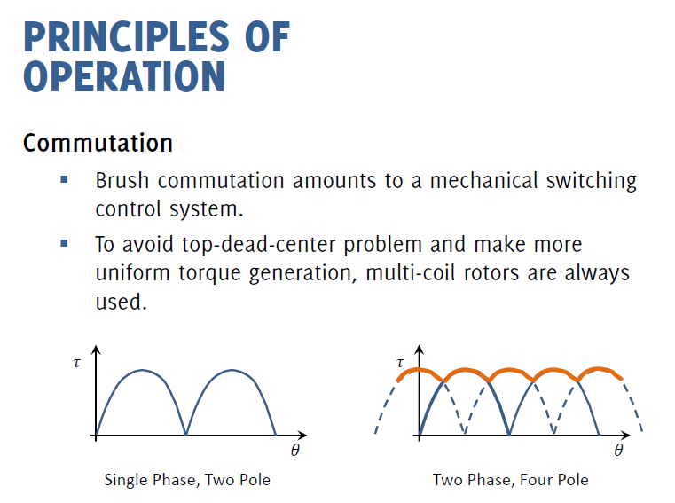

Slide 12
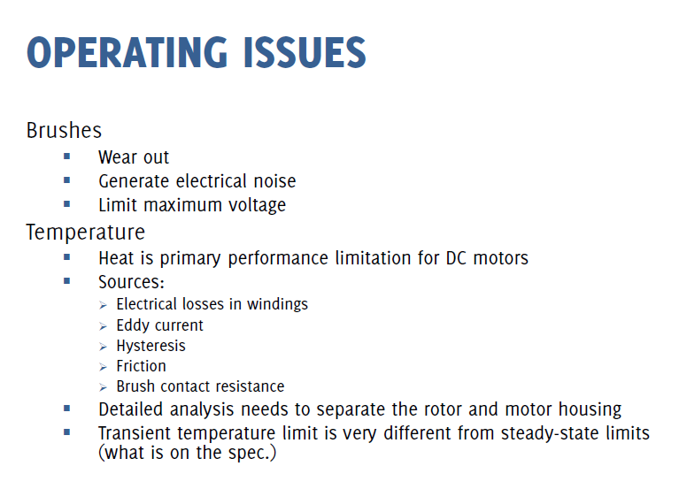

Slide 13
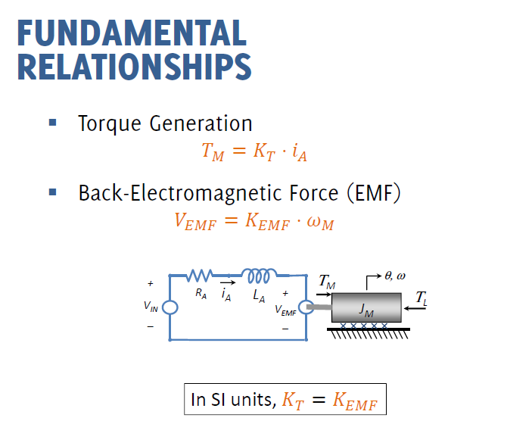
`

Slide 14
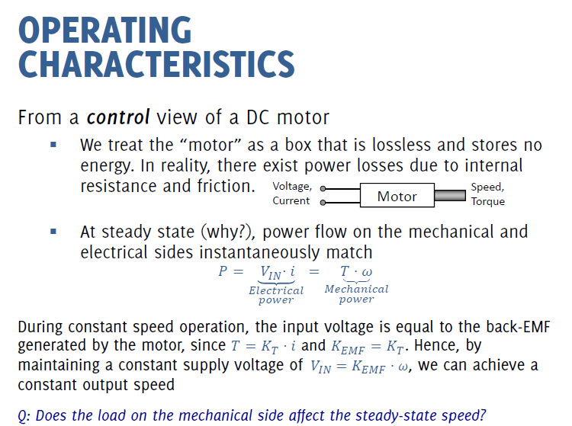

Slide 15
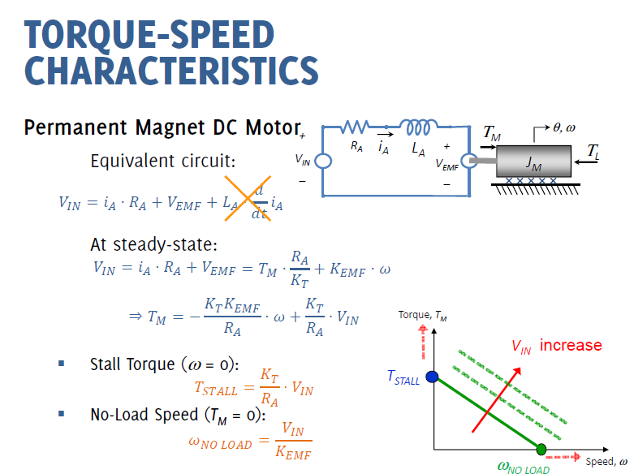

Slide 16
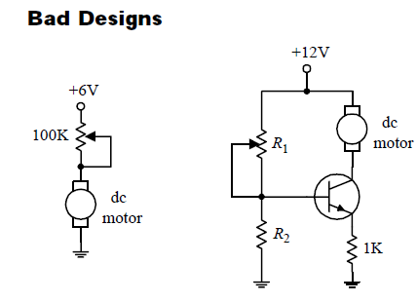
Speed Control DC Motor
Pot. Resistance increases, the amount of energy that must be converted to heat increases –it consumes supply power and may lead to pot. meltdown
Collector emitter resistance increases, transistor must dissipate considerable amount of heat. This can lead to trans. meltdown
Notes:
Pot. Resistance increases, the amount of energy that must be converted to heat increases –it consumes supply power and may lead to pot. meltdown

Slide 17
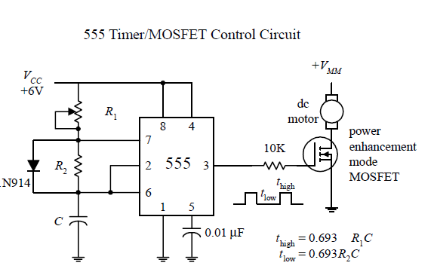
Better Designs…..
To prevent component melt-down, solution is sending the motor short pulses of current by varying the width and frequency
https://www.electronics-tutorials.ws/blog/pulse-width-modulation.html
Notes:
To prevent component melt-down, approach is sending the motor short pulses of current by varying the width and frequncy

Slide 18
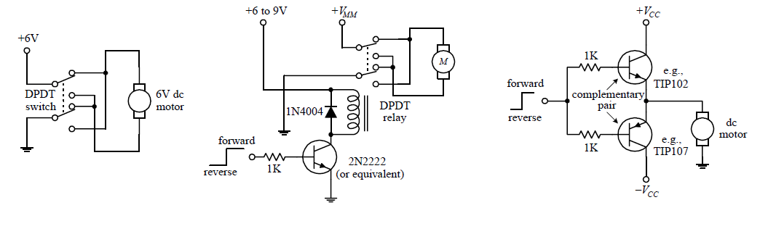
Directional control of DC Motors
Double Pole Double Throw switch
Notes:
Double Pole Double Throw switch

Slide 19
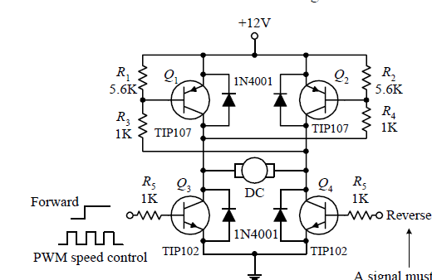


H-Bridge
LMD18200 National Semiconductor H-Bridge

Slide 20
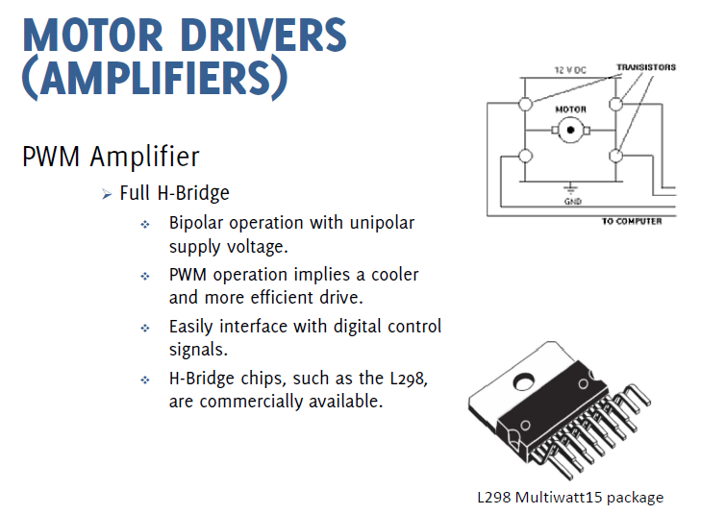

Slide 21
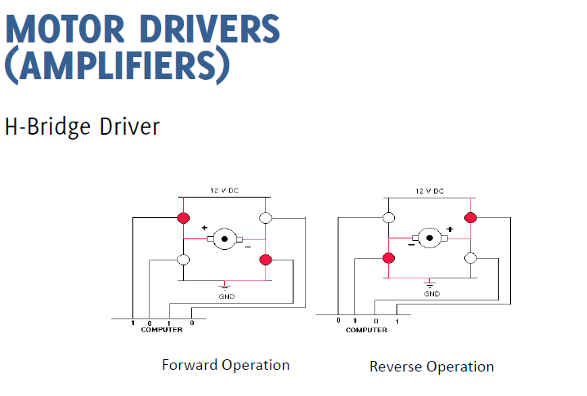

Slide 22
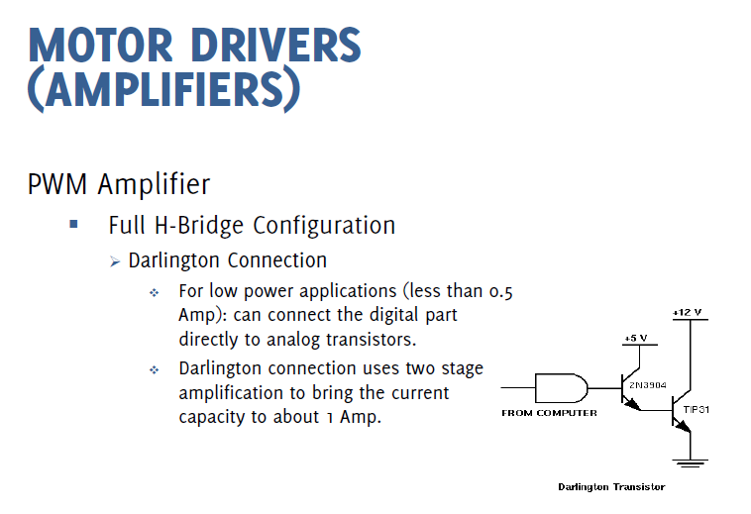

Slide 23
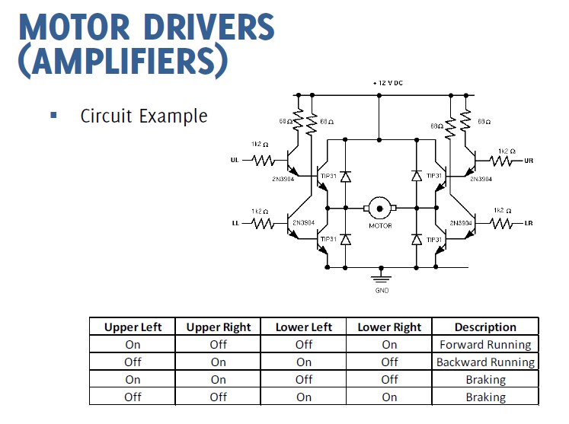

Slide 24
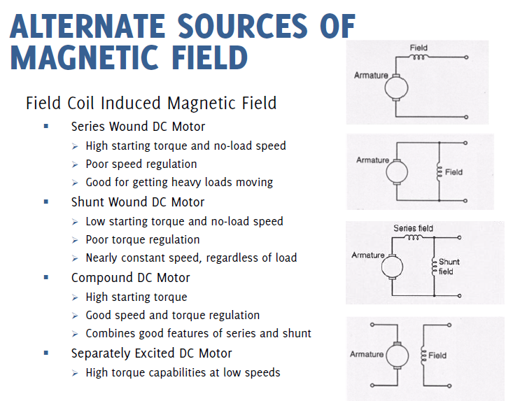

Slide 25
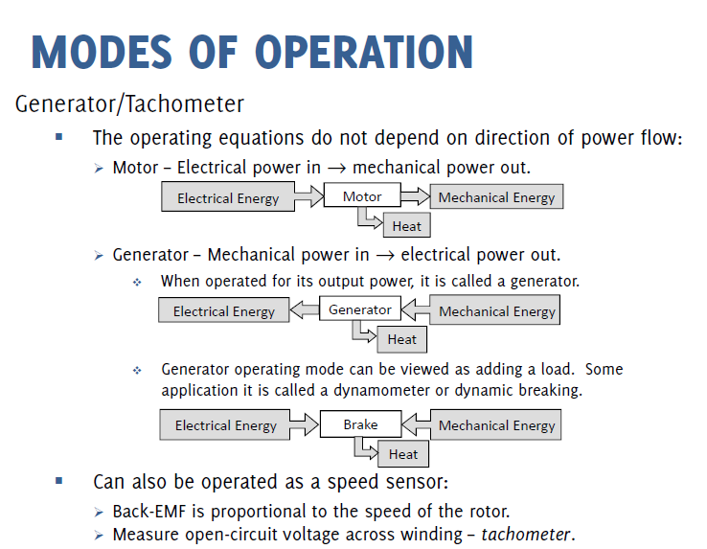

Slide 26
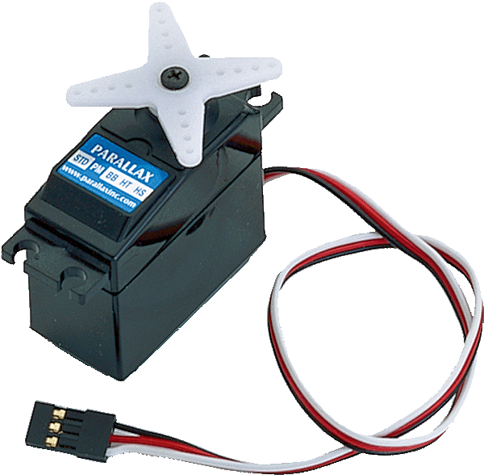
Servo Motor

Slide 27
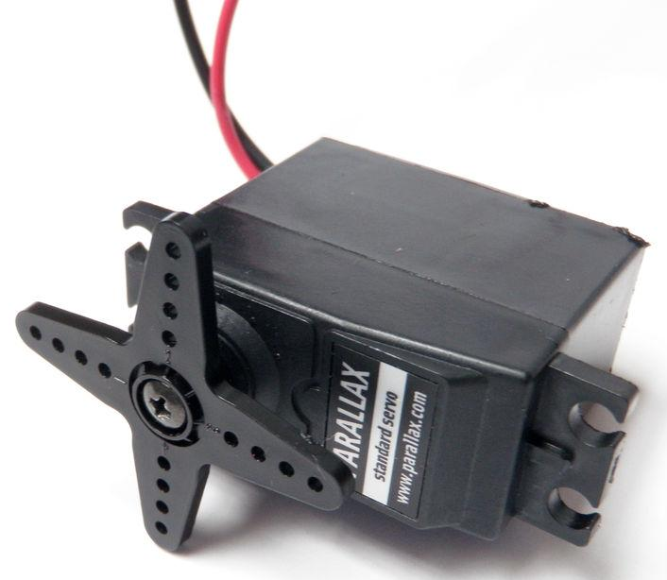
Overview
A servo motor is only capable of rotating 180 degrees
It is given an angle to proceed to, as opposed to a speed or direction

Slide 28
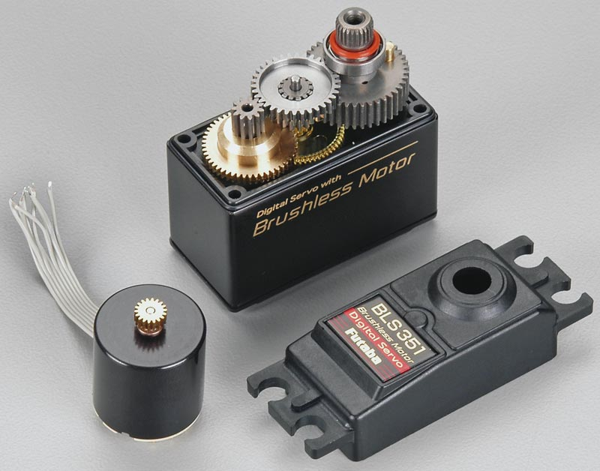
What is a servo motor
Servo motors consist of:
Gear reduction (slow but strong)
Position sensor
Electronic circuitry

Slide 29
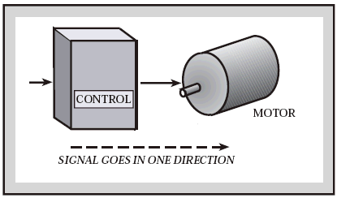
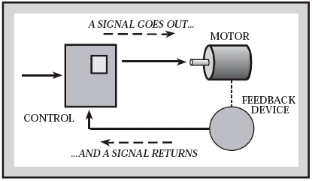
Feed-back loop
A servo motor is a closed-loop system
The motor is constantly taking note of its location, and sending that information to the motor to determine if it should keep spinning
Open-
loop
Closed-
loop

Slide 30
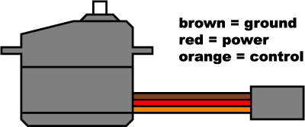
Wiring
A servo connects to a microcontroller using three wires
  Power
  Ground (black or brown)
  Control

Slide 31
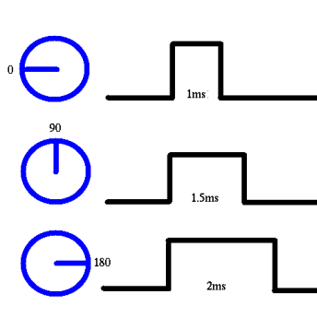
Control
The control wire sends a 5v pulse to the motor
The angle is determined by the duration of the pulse
A 1.5 millisecond pulse means 90 degree position
Shorter than 1.5 ms means closer to 0°. Longer means closer to 180°

Slide 32
Coding
The servo can be controlled with only four lines of code
Line 1- includes the servo library into the code
Line 2- name the servo (you might have multiple)
Line 3- indicates the pin the control wire is connected to
Line 4- used to move the servo
1-
#include <Servo.h>
Servo myservo;
void setup()
  {
  myservo.attach('pin');
  }
void loop()
  {
  myservo.write('angle');
  }
2-
3-
4-

Slide 33
Servo Summary
Control angle, NOT speed
High torque, i.e. strong
Only 180 degrees of rotation

Slide 34
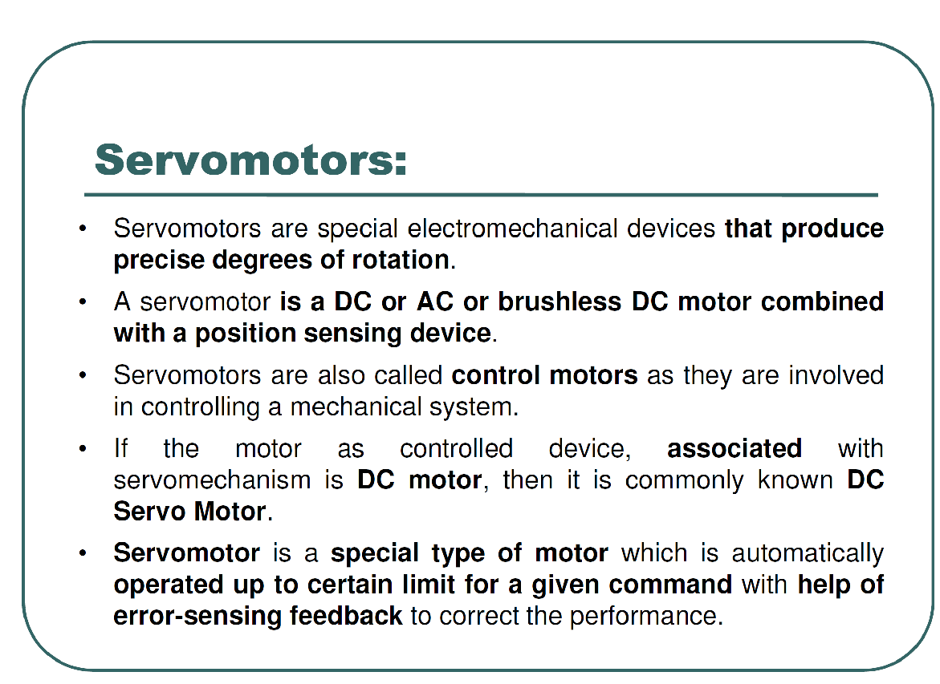

Slide 35
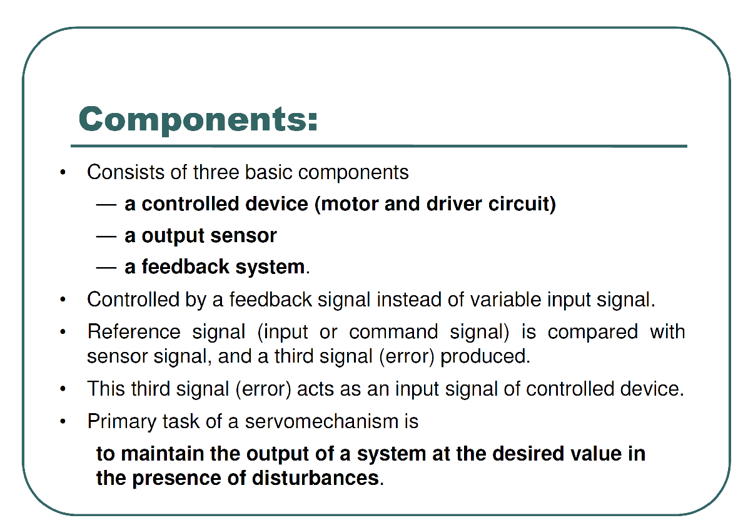

Slide 36
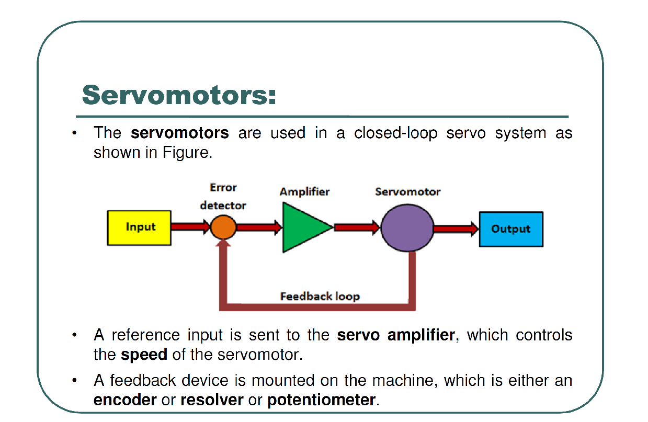

Slide 37
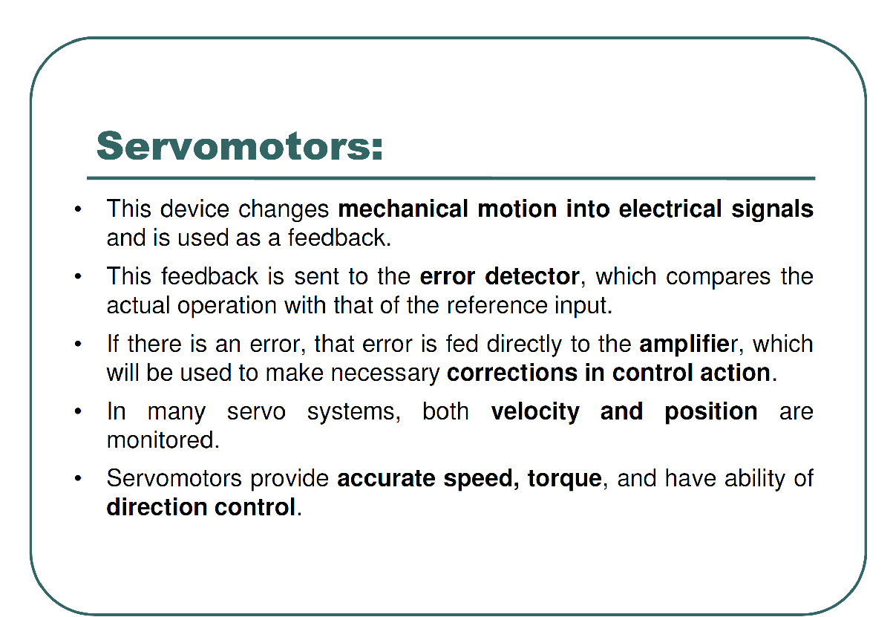

Slide 38
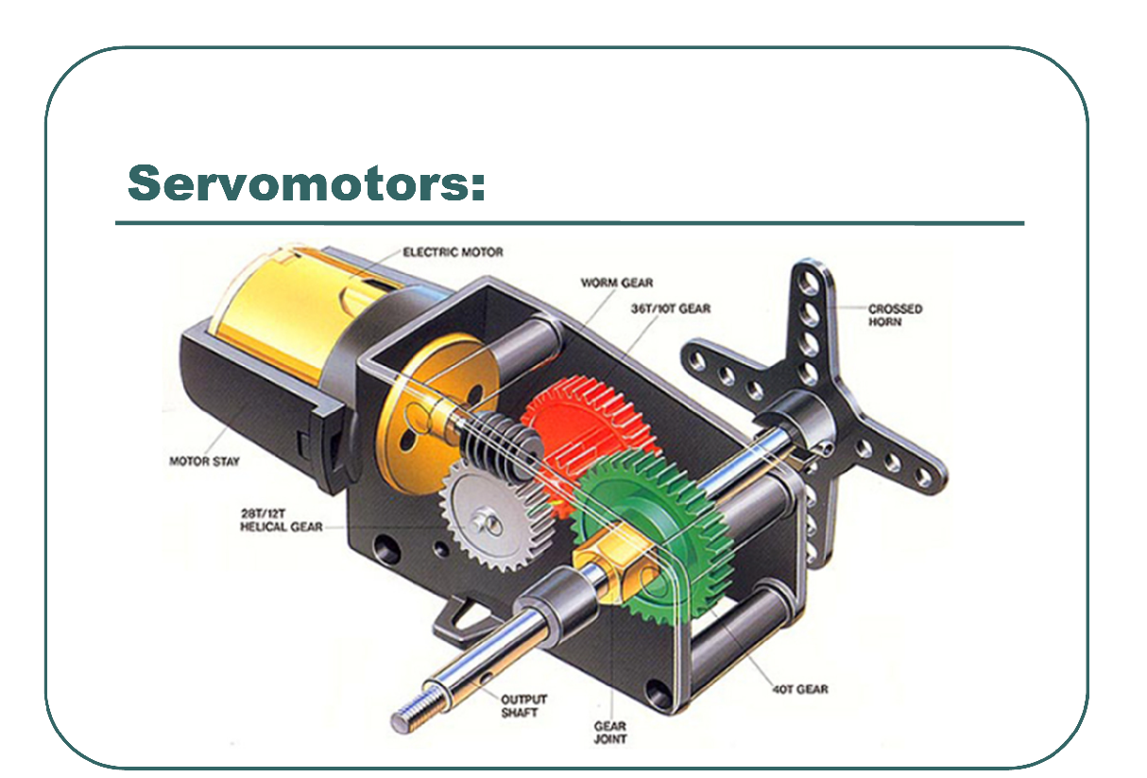

Slide 39
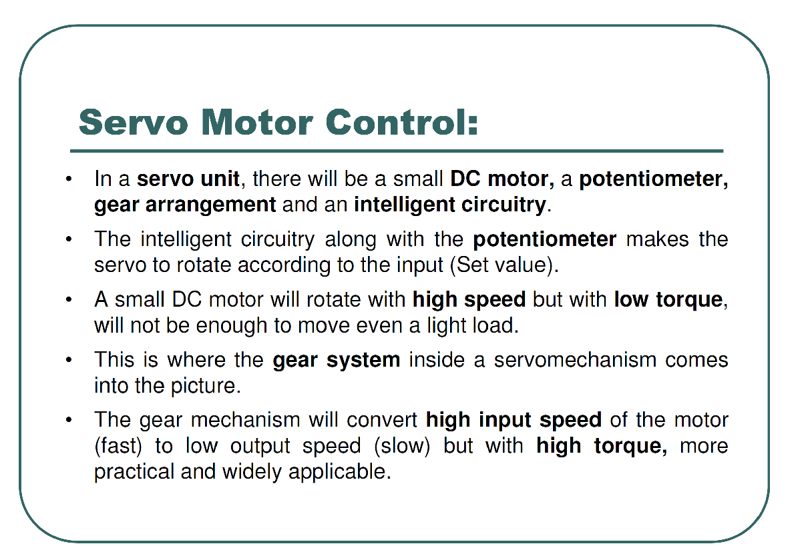

Slide 40
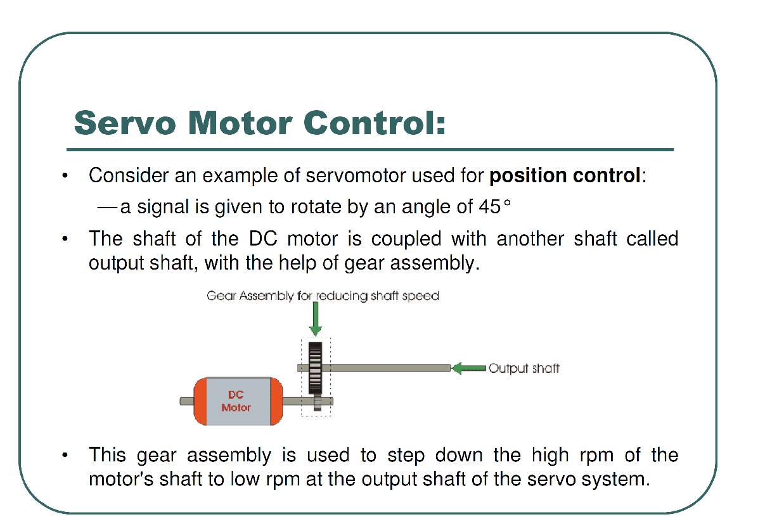

Slide 41
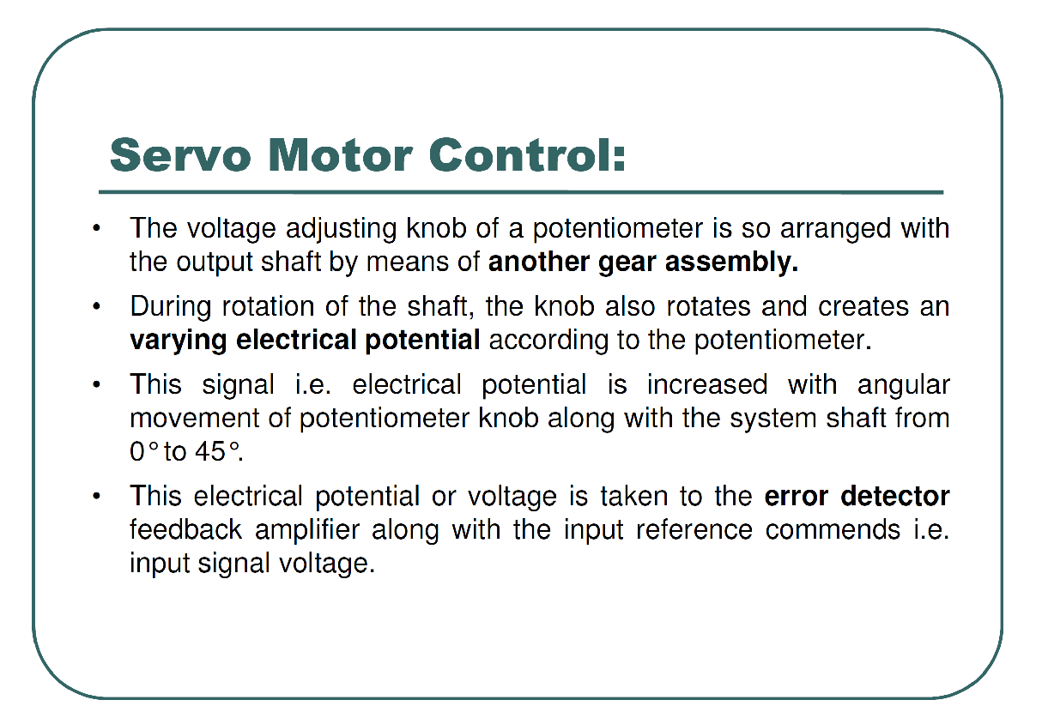

Slide 42
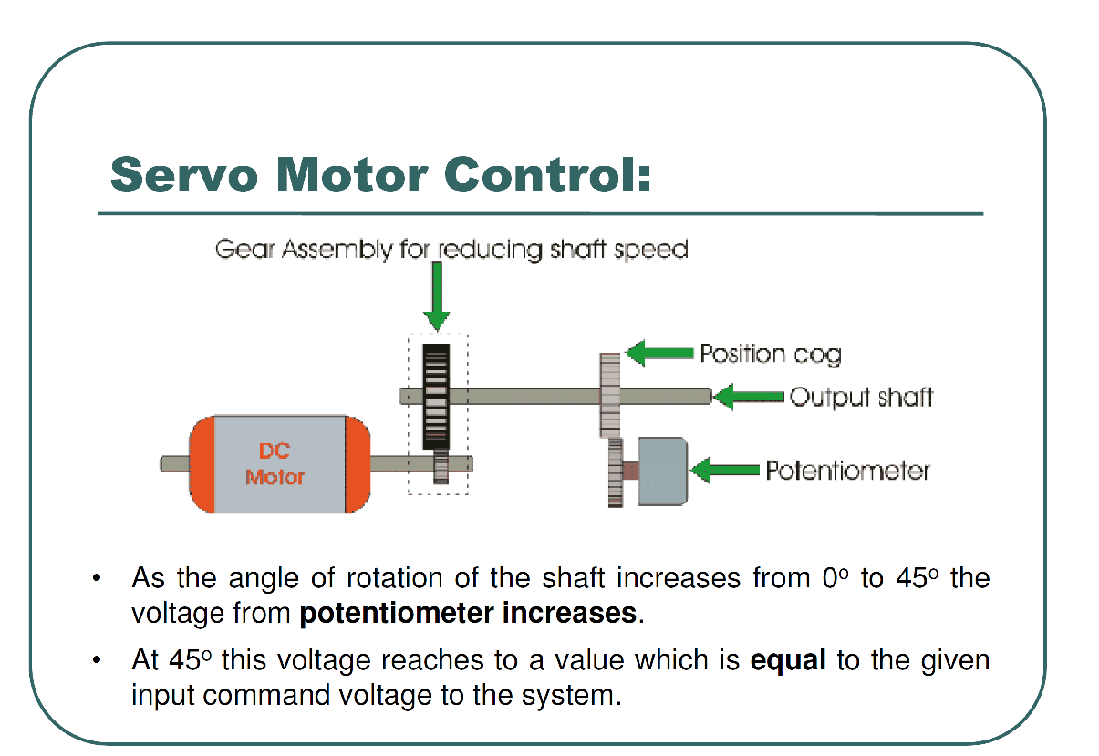

Slide 43
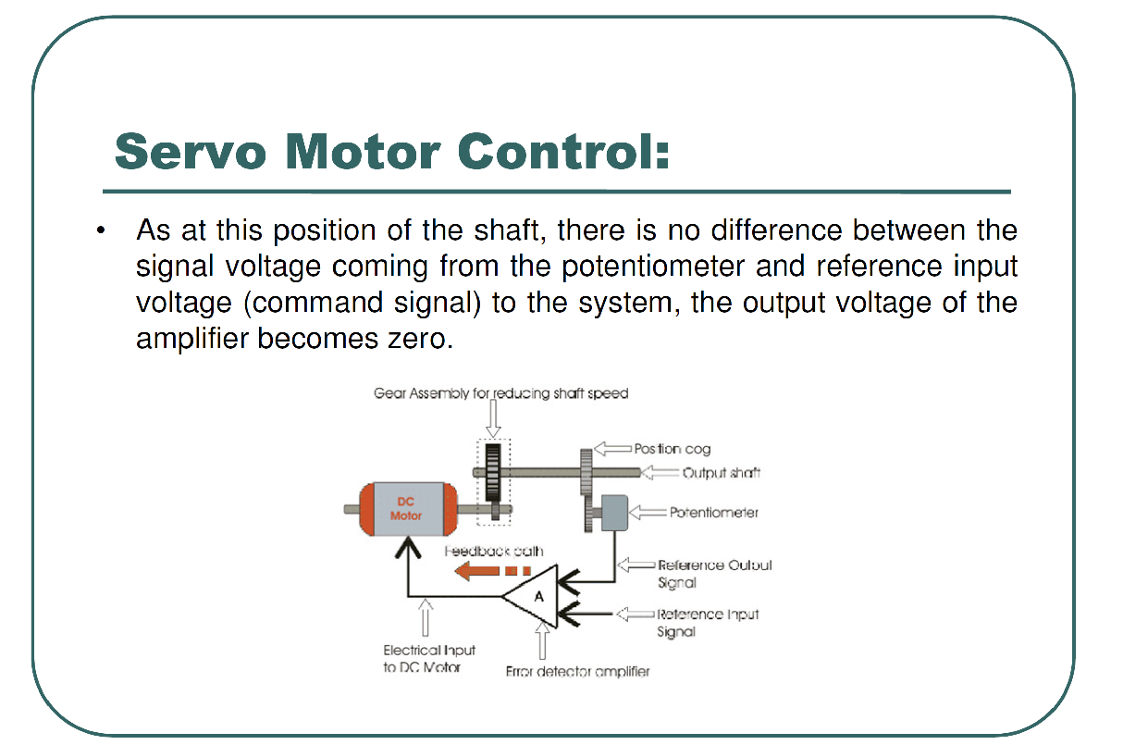

Slide 44
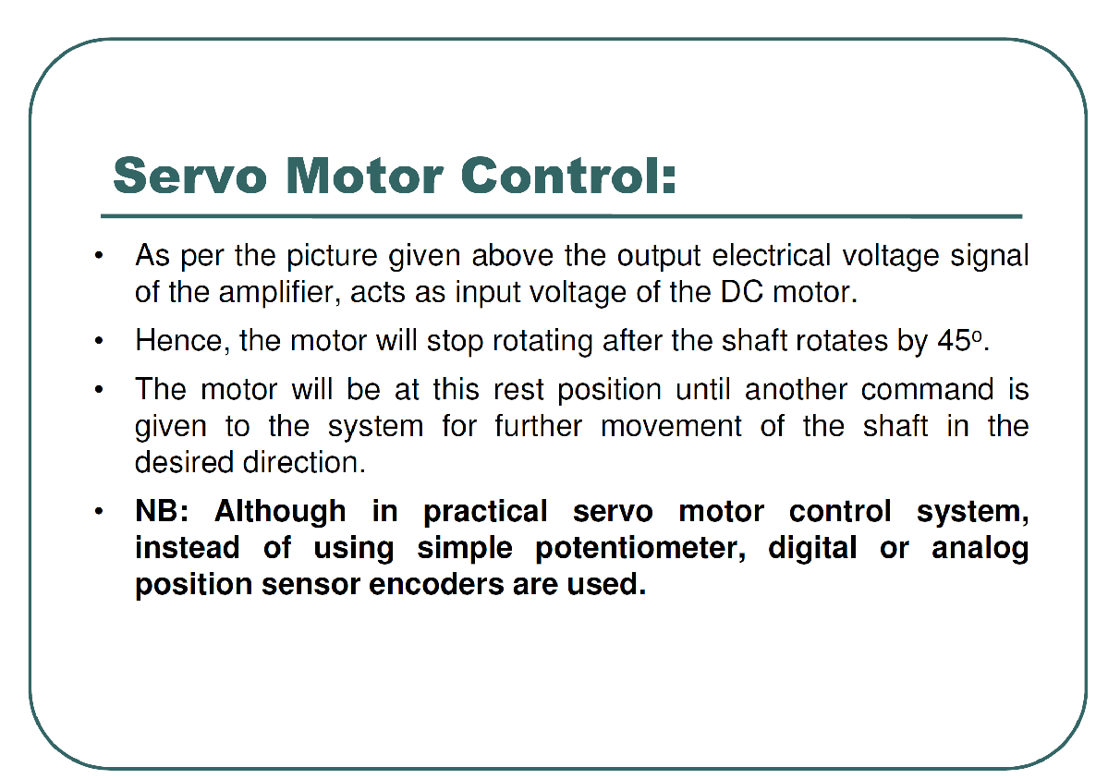

Slide 45
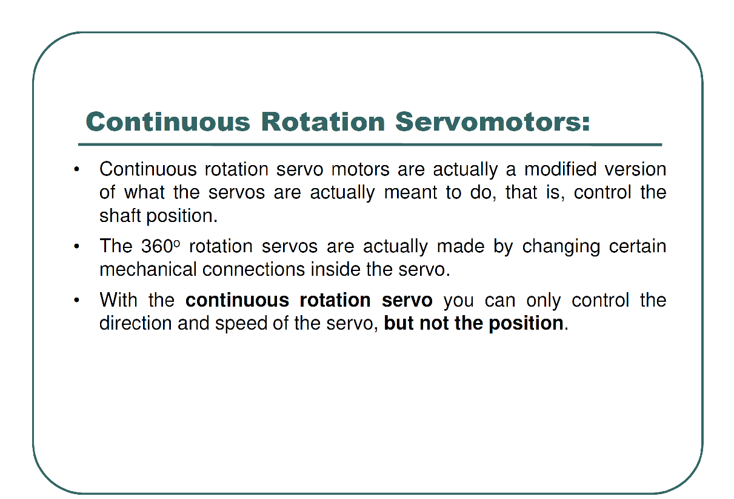

Slide 46
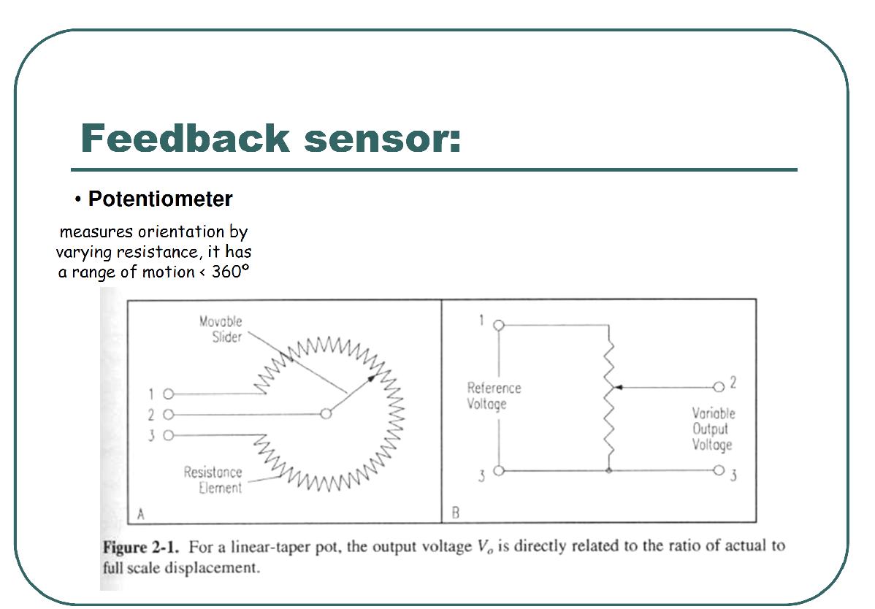

Slide 47
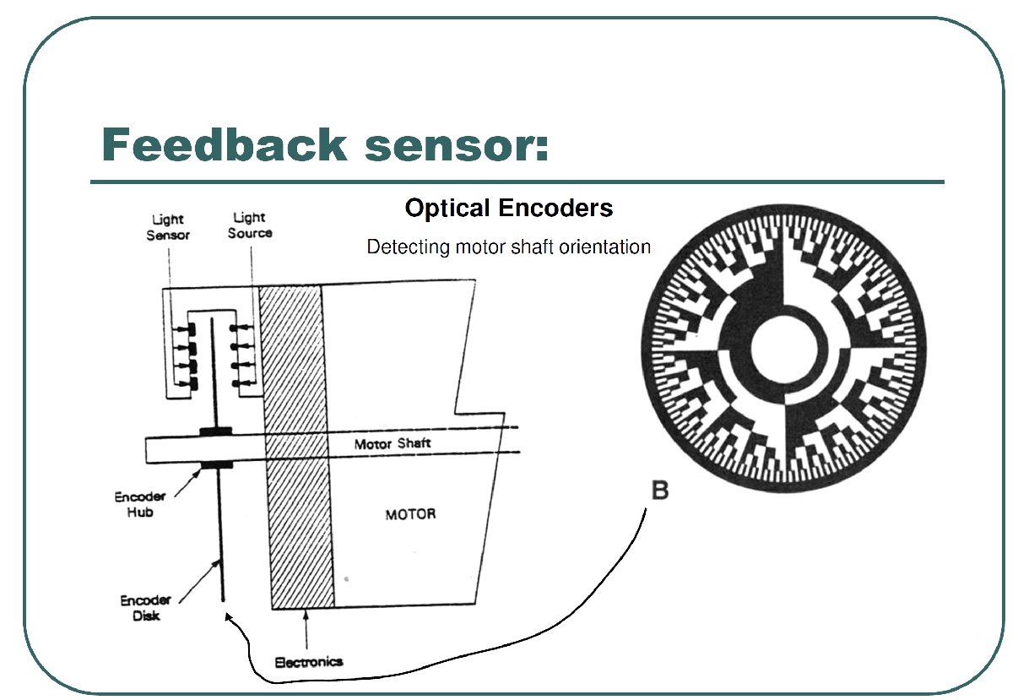

Slide 48
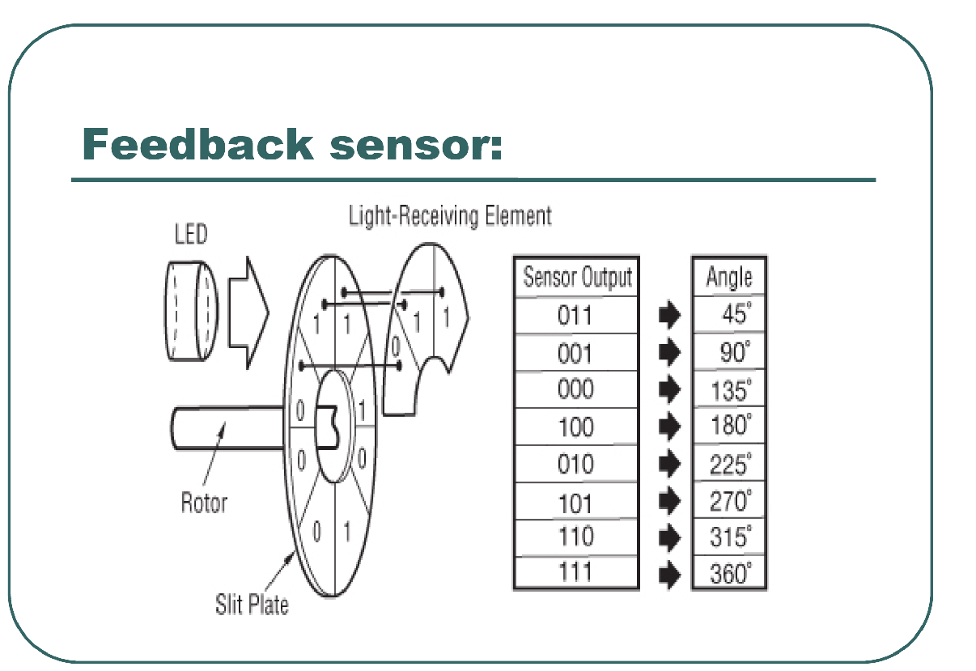

Slide 49
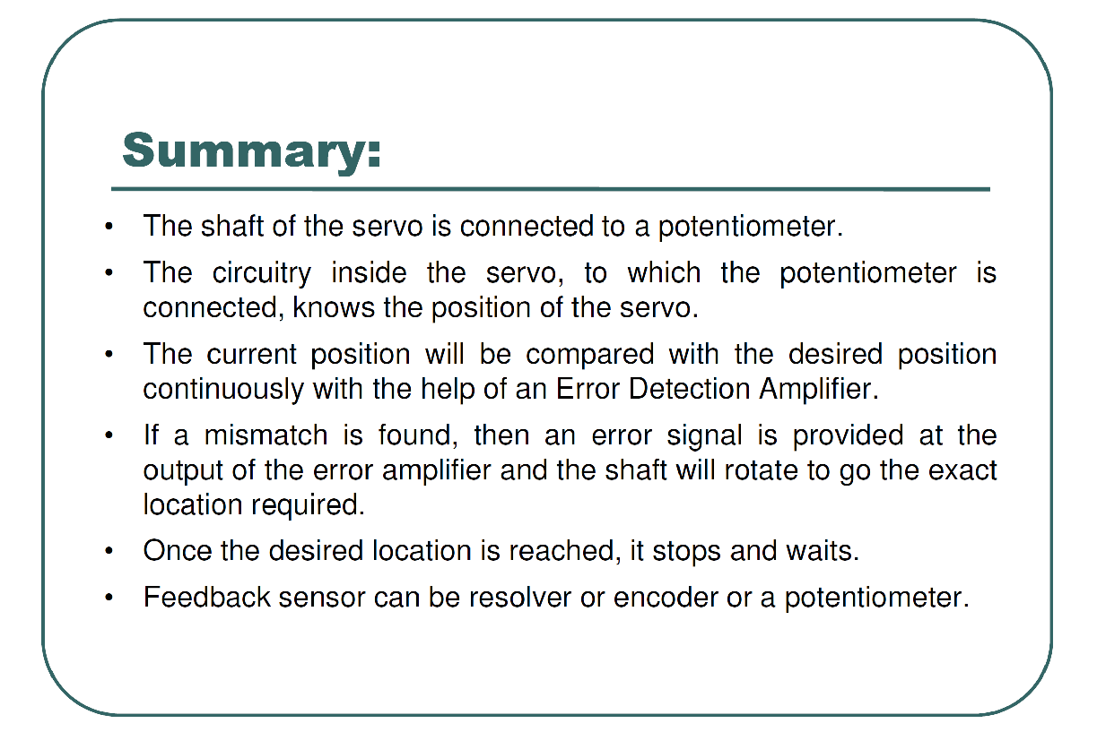

Slide 50
Stepper Motor

Slide 51
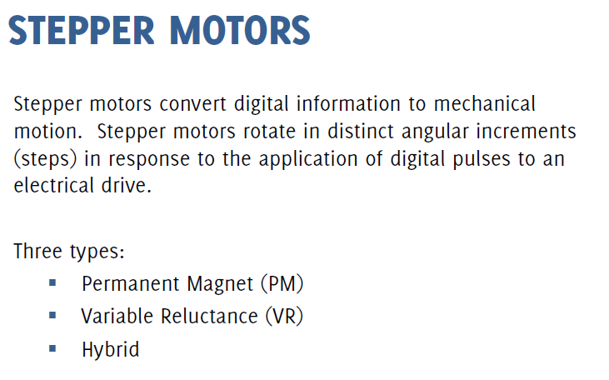

Slide 52
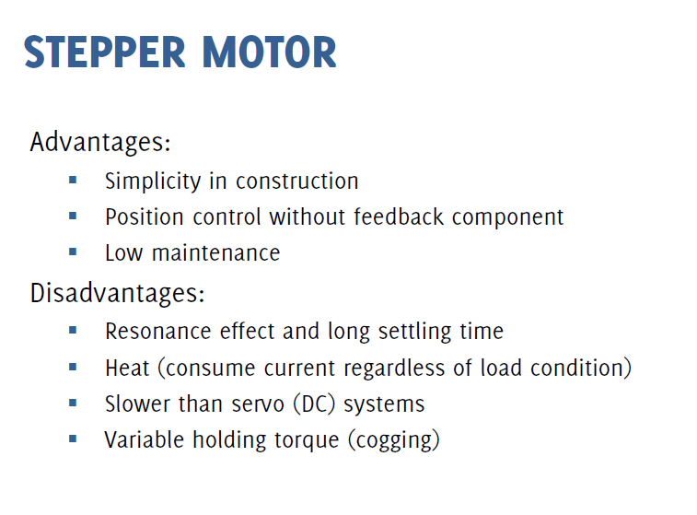

Slide 53

Stepper Motor
As all motors, the stepper motors consists of a stator an a rotor. The rotor carries a set of permanent magnets, and the stator has the coils. The very basic design of a stepper motor would be as follows:

Slide 54


Concept of Operation –Single Coil Excitation
The coils are energized in series, with about 1sec interval. The shaft rotates 90º each time the next coil is activated:

Slide 55

Full-Step Drive
According to this method, the coils are energized in pairs. According to the connection of the coils (series or parallel) the motor will require double the voltage or double the current to operate that needs when driving with Single-Coil Excitation. Yet, it produces 100% the nominal torque of the motor.

Slide 56



Half-Stepping
This is a very interesting way to achieve double the accuracy of a positioning system, without changing anything from the hardware
Two-Coil excitation
Single-Coil excitation

Slide 57


Step Angle

Slide 58


Slide 59


Slide 60

Simplified unipolar Stepper Motor
Frame 1: The top electromagnet (1) is turned on, attracting the nearest teeth of the gear-shaped iron rotor. With the teeth aligned to electromagnet 1, they will be slightly offset from right electromagnet (2). Frame 2: The top electromagnet (1) is turned off, and the right electromagnet (2) is energized, pulling the teeth into alignment with it. This results in a rotation of 3.6° in this example. Frame 3: The bottom electromagnet (3) is energized; another 3.6° rotation occurs. Frame 4: The left electromagnet (4) is energized, rotating again by 3.6°. When the top electromagnet (1) is again enabled, the rotor will have rotated by one tooth position; since there are 25 teeth, it will take 100 steps to make a full rotation in this example.
RPM = a/360 * fz * 60
RPM = Revolutions per minute.
“a” = step angle
“fz” = pulse frequency in hertz

Slide 61


Slide 62


Slide 63


Slide 64



Slide 65



Slide 66


Slide 67

Driving Stepper Motor

Slide 68

ULN2003a for Arduino

Slide 69




Connecting to Arduino

Slide 70
#define delaytime 80 //delay time in ms to control the stepper motor delaytime.
//Our tests showed that 8 is about the fastest that can yield reliable operation w/o missing steps
void setup() {
// initialize the 8 pin as an output:
pinMode(pin1, OUTPUT);
pinMode(pin2, OUTPUT);
pinMode(pin3, OUTPUT);
pinMode(pin4, OUTPUT);
}
void loop(){
int numberOfSteps = 48;
step_OFF(); //turning all coils off
while(numberOfSteps>0){
forward(); //going forward
numberOfSteps -- ;//counting down the number of steps
}
delay(2000);
step_OFF(); //turning all coils off
numberOfSteps = 48;
while(numberOfSteps>0){
backward(); //going backward
numberOfSteps -- ;//counting down the number of steps
}
delay(2000);
}

Slide 71

Driving Stepper Motor

Slide 72

Drive Bipolar
To prevent two 1’s at the same time, XOR circuit is added to the input otherwise output is shorted to ground
Notes:
To prevent two 1’s at the same time, XOR circuit is added to the input otherwise output is shorted to ground

Slide 73

Controlling the Driver with Translator
To generate four phase drive pattern :
-Using computer (microcontroller)
-Use simple circuits like CMOS 4017 decade counter (or 74194 TTL version)
-Use CMOS 4027 dual JK flip flops. The CMOS 4070 XOR is used to step directional control
Notes:
-Using computer (microcontroller)
-Use simple circuits like CMOS 4017 decade counter (or 74194 TTL version)
-Use CMOS 4027 dual JK flip flops. The CMOS 4070 XOR is used to step directional control

Slide 74

Complete Circuit
Translator and driver could be in one IC. Classic stepper controller is Philips SAA1027 bipolar IC to drive four-phase steppers
Notes:
Translator and driver could be in one IC. Classic stepper controller is Philips SAA1027 bipolar IC to drive four-phase steppers

Slide 75


Slide 76

Identifying Stepper Motor

Slide 77
Applications
Electric Cars
https://ocw.tudelft.nl/course-lectures/2-0-2-mr-smith-animation/
https://ocw.tudelft.nl/course-readings/2-1-2-lecture-notes-parts-of-an-ev-recap/
https://ocw.tudelft.nl/course-lectures/2-1-3-how-does-an-ev-work/

